Slide 1
Dentist Office Database Project
Dustin Chilson Justin Keenan Brian Rakestraw Omar Alanazi

Slide 2
Table of Contents
ERD
Table Creation
Index Creation
Insert Script
Update Table
Drop Script
Grant Access
Two Table Join
Three Table Join
Row Deletion
Row Update
Row Addition
Numeric Recalculation

Slide 3
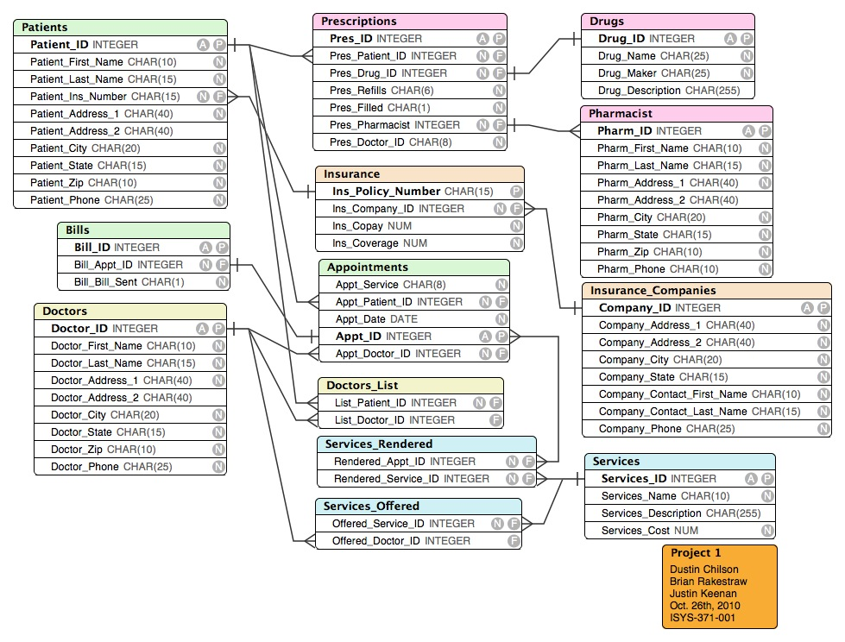
ERD
Dustin Chilson

Slide 4
Table Creation
CREATE TABLE Pharmacist ( Pharm_ID INTEGER GENERATED ALWAYS AS IDENTITY (START WITH 10000000, INCREMENT BY 1), Pharm_First_Name CHAR(10) NOT NULL, Pharm_Last_Name CHAR(15) NOT NULL, Pharm_Address_1 CHAR(40) NOT NULL, Pharm_Address_2 CHAR(40), Pharm_City CHAR(20) NOT NULL, Pharm_State CHAR(15) NOT NULL, Pharm_Zip CHAR(10) NOT NULL, Pharm_Phone CHAR(10) NOT NULL, PRIMARY KEY (Pharm_ID) );
CREATE TABLE Drugs ( Drug_ID INTEGER GENERATED ALWAYS AS IDENTITY (START WITH 10000000, INCREMENT BY 1), Drug_Name CHAR(25) NOT NULL, Drug_Maker CHAR(25) NOT NULL, Drug_Description CHAR(255), PRIMARY KEY (Drug_ID) );
Dustin Chilson

Slide 5
Index Creation
CREATE INDEX phIndex ON Pharmacist (Pharm_Last_Name, Pharm_First_Name);
CREATE INDEX drugIndex ON Drugs (Drug_Name)
Omar Alanazi

Slide 6
Insert Script
Insert Into Pharmacist (Pharm_First_Name,Pharm_Last_Name,Pharm_Address_1,Pharm_Address_2,Pharm_City,Pharm_State,Pharm_Zip,Pharm_Phone) Values ('Antonio','Gomez','1234 Durden','F321','Big Rapids','Michigan','49307','2315784891');
Insert Into Drugs (Drug_Name,Drug_Maker,Drug_Description) Values ('Nexium','AstraZeneca','Heartburn');
Brian Rakestraw

Slide 7
Update Table
UPDATE Pharmacist SET Pharm_Last_Name='Jonathan’ WHERE Pharm_Address_1='1234 Durden' AND Pharm_Address_2='F321’
UPDATE Patients SET Patient_Last_Name='Jonathan’ WHERE Patient_Ins_Number='10000004' AND Patient_Address_1='5678 Hendrick'
Omar Alanazi

Slide 8
Drop Script
DROP TABLE Prescriptions;
DROP TABLE Pharmacist;
DROP TABLE Drugs;
DROP TABLE Bills;
DROP TABLE Services_Rendered;
DROP TABLE Appointments;
DROP TABLE Services_Offered;
DROP TABLE Doctors_List;
DROP TABLE Doctors;
DROP TABLE Patients;
DROP TABLE Insurance;
DROP TABLE Insurance_Companies;
DROP TABLE Services;
Dustin Chilson

Slide 9
Grant Access
GRANT SELECT, INSERT, UPDATE, DELETE ON Patients, Pharmacist, Doctors, Services_Offered TO f0balao, f0bchid, f0brakb, f0bkeej;
Omar Alanazi

Slide 10
Two Table Join
SELECT Patients.Patient_First_Name, Patients.Patient_Last_Name, Prescriptions.Pres_Drug_ID FROM Patients JOIN Prescriptions ON Patients.Patient_ID = Prescriptions.Pres_Patient_ID;
Justin Keenan

Slide 11
Three Table Join
SELECT Patients.Patient_Last_Name, Prescriptions.Pres_Filled, Drugs.Drug_Name FROM Patients JOIN Prescriptions ON Patients.Patient_ID = Prescriptions.Pres_Patient_ID JOIN Drugs ON Prescriptions.Pres_Drug_ID = Drugs.Drug_ID
Justin Keenan

Slide 12
Row Deletion Procedure
Delete From Patients Where Patient_ID = '10000001'
Justin Keenan

Slide 13
Row Update Procedure
UPDATE Pharmacist SET Pharm_Last_Name='Jonathan’ WHERE Pharm_Address_1='1234 Durden' AND Pharm_Address_2='F321’;
Omar Alanazi

Slide 14
Row addition
Insert into Bills (Bill_Appt_ID,Bill_Bill_Sent) Values (10000001,1);
Insert into Bills (Bill_Appt_ID,Bill_Bill_Sent) Values (10000002,1);
Insert into Bills (Bill_Appt_ID,Bill_Bill_Sent) Values (10000003,1);
Insert into Bills (Bill_Appt_ID,Bill_Bill_Sent) Values (10000004,1);
Insert into Bills (Bill_Appt_ID,Bill_Bill_Sent) Values (10000005,0);
Brian Rakestraw

Slide 15
Numeric Recalculation Procedure
UPDATE Services SET Services_Cost = Services_Cost + 100 WHERE Services_ID = 10000000;
Brian Rakestraw

Slide 16
Populate Script Files
Appointments
Bills
Doctors
Drugs
Ins Companies
Insurance
Patients
Pharmacists
Prescriptions
Services Offered
Services Rendered
Services

Slide 17
Procedures
Grant Access
Index Creation
Row Deletion
3 table Join
2 Table Join
Table Creation
ERD

