Slide 1
Telling Stories with Data
Interactive Data Visualizations with D3.js and ASP.Net
Dustin Ewers
Twitter: @DustinJEwers
Website: www.dustinewers.com
LinkedIn: www.linkedin.com/in/dustinewers/

Slide 2
Roadmap
Why Data Visualization?
What is D3.js?
Why D3.js?
Why not D3.js?
Just enough SVG
Demos
Using D3.js with ASP.NET
Building Charts in D3.js
Building Different Types of Visualizations
Resources

Slide 3
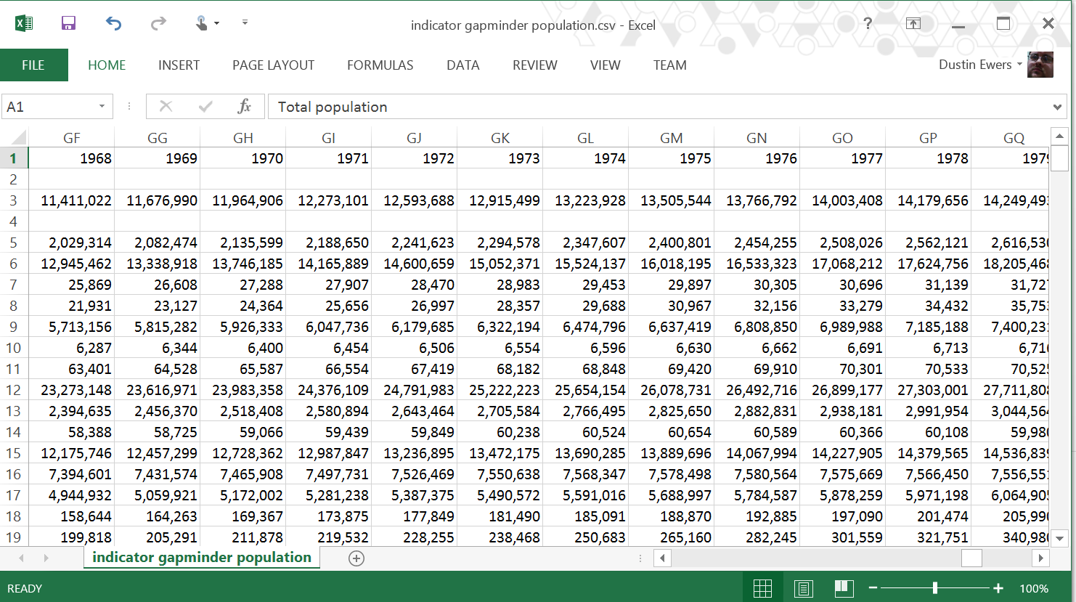
Why Data Visualization?

Slide 4
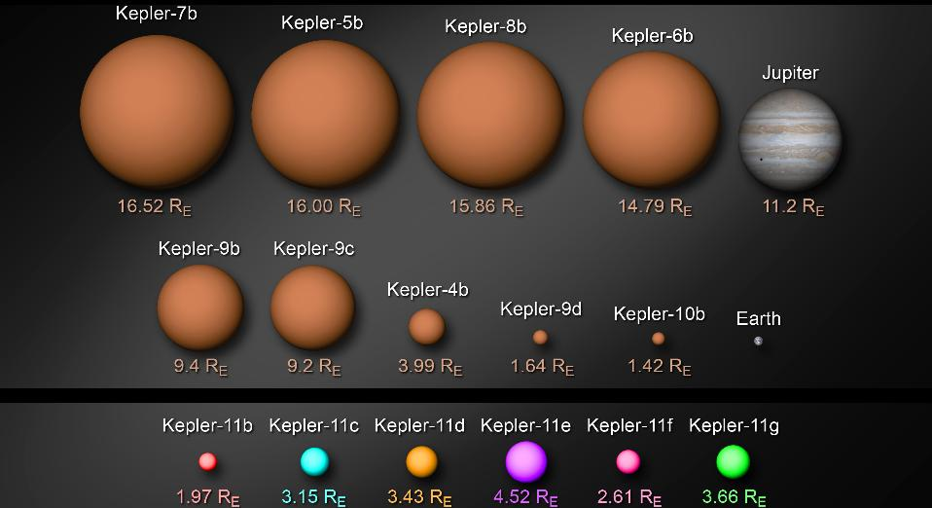
Data Visualization Adds Meaning
Source: http://kepler.nasa.gov/multimedia/artwork/diagrams/?ImageID=123
Notes:
Two ways:
Increased conceptualization of large numbers
National Budgets
Planet Sizes
http://xkcd.com/980/huge
http://www.nytimes.com/interactive/2012/02/13/us/politics/2013-budget-proposal-graphic.html?_r=0

Slide 5
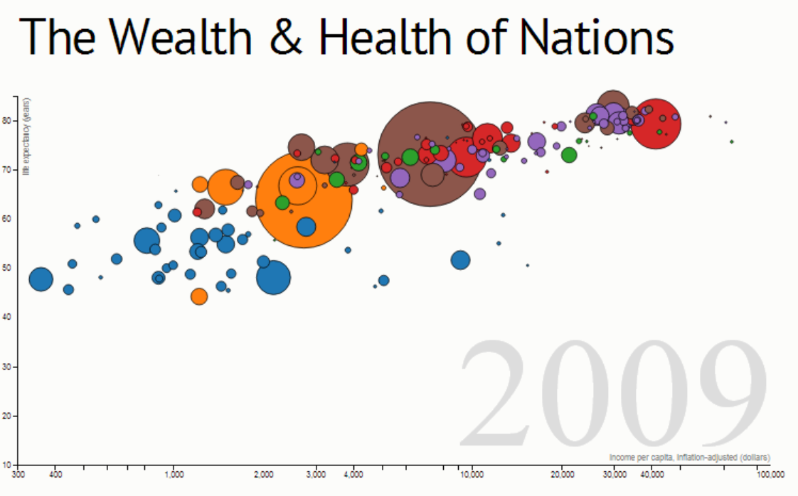
Data Visualization can Tell Stories
http://bost.ocks.org/mike/nations/
Notes:
Allows for meaning to be attached to large datasets
Gapminder data
http://bost.ocks.org/mike/nations/
We can use visuals to give meaning to data that’s too abstract to understand. This understanding creates perspective.
Examples:
Federal budget numbers
Planet Sized
Examples:
http://xkcd.com/980/huge
- Money from 1$ to National Budget
http://bost.ocks.org/mike/nations/
D3 representation of Gapminder data
200 years that changed the world (Gapminder)
www.bit.ly/c6ItL7
Additional Representations
- https://github.com/mbostock/d3/wiki/Gallery

Slide 6
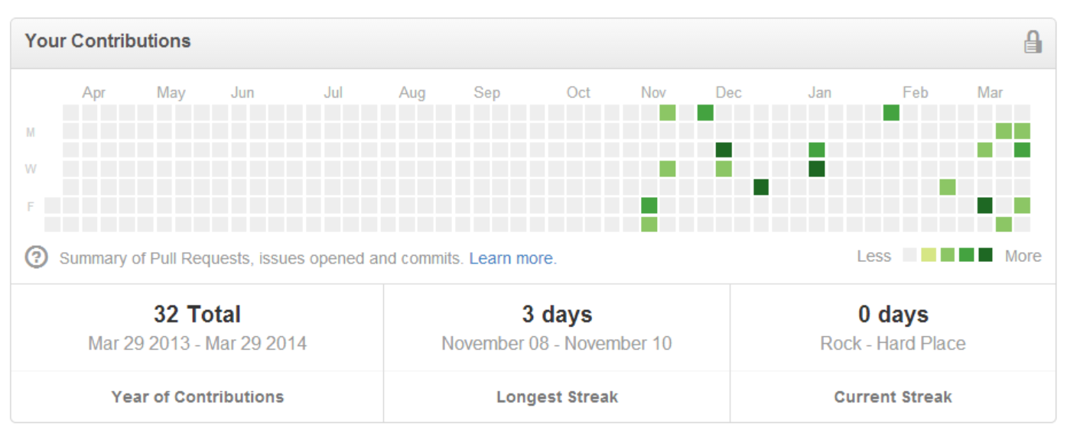
Data Visualization Increases Customer Engagement
Notes:
Mint
Khan Academy
Github

Slide 7
We’ve Never Had More Available Data
Governments
Research organizations
NGOs
The Internet of Things
Logging & Usage Data
Financial Data
Notes:
The amount of data available to humanity is huge.
Eric Schmidt claims that we are creating as much data in two days as humanity has created up until 2003
IBM claims that we create 2.5 Quintillion Bytes of data every day
SINTEF claims that 90% of the our current data was created in the last two years
Governments and research organizations are opening up their data sets
http://www.data.gov/education/
http://www.census.gov/
http://www.bls.gov/
http://www.gapminder.org/data/
https://data.cityofmadison.com/
Data from Social Media sites
Marketing and Tracking Data
The Internet of Things
Logging Data
A/B Tests and Usage Data
Sources:
http://www.storagenewsletter.com/rubriques/market-reportsresearch/ibm-cmo-study/
http://www.sciencedaily.com/releases/2013/05/130522085217.htm

Slide 8
What is D3.js?
Notes:
Stands for Data Driven Documents
Invented by Mike Bostock in 2011
- NY Times -> Where you’ll find some nice Data Vis
A toolbox for creating data visualizations on the web using JavaScript (usually in SVG)
Doesn’t render canned visuals
Uses web standards like SVG, JavaScript, etc…
Comes from a history of plugin based tools like prefuse and Flare
Supports a large number of types of visuals, including maps and animations

Slide 9
Why D3.js?
Examples:
http://www.nytimes.com/interactive/2013/05/25/sunday-review/corporate-taxes.html
http://www.koalastothemax.com/
http://www.jasondavies.com/maps/countries-by-area/
Notes:
D3 excels at creating interactive web visualizations in SVG
Includes tools for creating lots of common data vizualizations, including Geo Maps
It’s web based so it’s easy to embed in web apps
There’s no stupid plugins
It’s free and Open Source

Slide 10
Why Not D3.js?
Notes:
D3 has a steep learning curve
Doesn’t include any pre-canned visuals
Doesn’t support older browsers (no IE 8)
Best for SVG, not bitmaps or canvas
Doesn’t hide root data (because JavaScript)

Slide 11
Just Enough SVG
Notes:
SVG = Scalable Vector Graphics
Vector, math based as opposed to bitmap based like JPEG or PNG
HTML Based
There are several basic SVG shapes, including circles, ellipses, rectangles, and lines

Slide 12
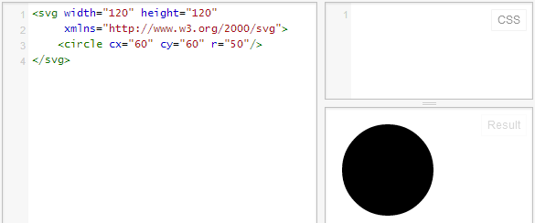
SVG Circle
Notes:
Circles have a center x, y and a radius

Slide 13
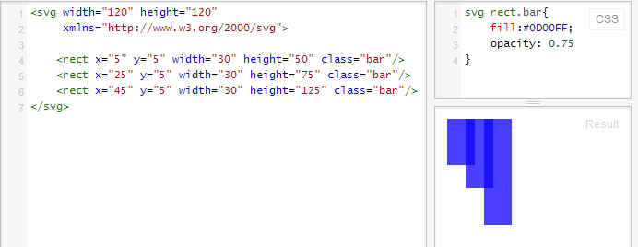
SVG Rectangle
Notes:
Rect – x, y, width, height
SVG concepts
Can apply classes
Layering -> no z-index

Slide 14
Demo Time!
https://github.com/DustinEwers/D3-DotNetMVC-Demos
Notes:
Demo

Slide 15
Resources
Info About D3.js:
http://d3js.org/
http://bost.ocks.org/mike/
Interactive Data Visualization for the Web
http://alignedleft.com/tutorials/d3/
Datasets:
http://www.gapminder.org/data/
http://www.data.gov/
http://www.bls.gov/
https://data.cityofmadison.com/

