Slide 1


Telling Campfire Stories with Data
Interactive Data Visualizations with D3.js
Dustin Ewers
Twitter: @DustinJEwers
Website: http://dustinewers.com
LinkedIn: www.linkedin.com/in/dustinewers/
Code Examples:
https://github.com/DustinEwers/D3-js-Demos

Slide 2











Notes:
Please take a moment and thank our Principal, Platinum and Gold Sponsors.

Slide 3
Roadmap
Why Data Visualization?
What is D3.js?
Why D3.js?
Why not D3.js?
How do I use D3.js? (Demos)
Notes:
Goal: To show you how to add data visualizations to .net applications.
Why?
What?
How?

Slide 4
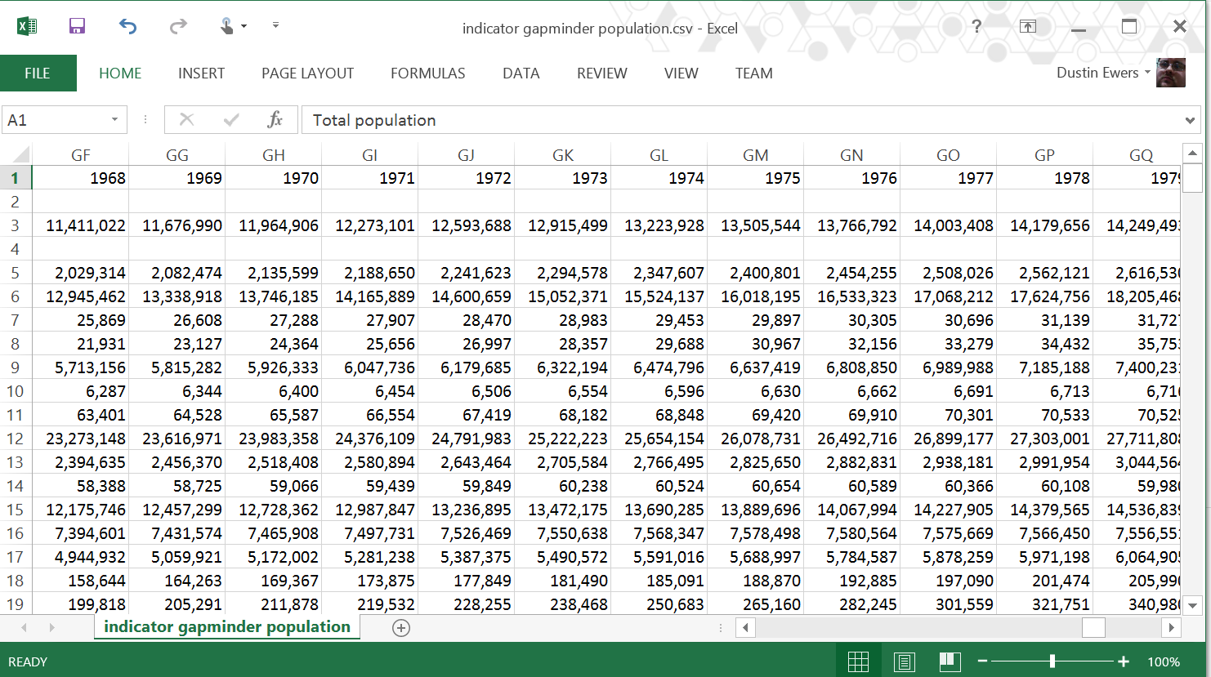
Why Data Visualization?
Notes:
Why not just use Excel?
…or stats?
…numbers?
- Numbers are more precise
- Numbers are less prone to manipulation
Data viz gives you three things:
Understanding
– Data viz adds meaning
- Data viz can tell stories
Persuasion
- People respond persuasively to two things: stories and images. Data viz gives you both.
Efficiency
There’s more data than ever before and the trend is only going up. Data viz makes it easier to understand.

Slide 5
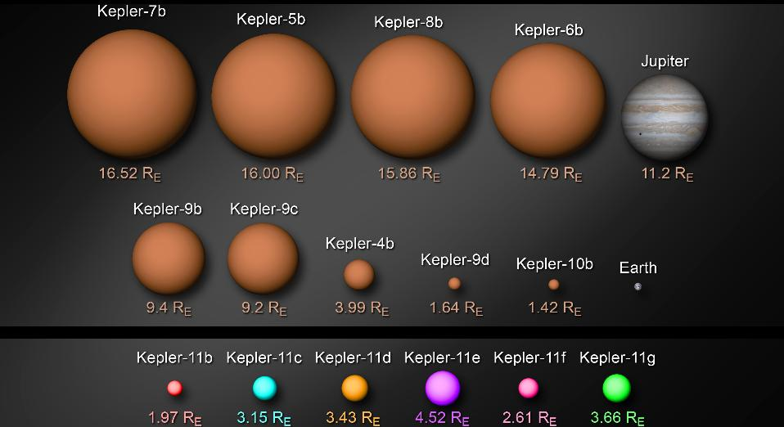
Data Visualization Adds Meaning
Source: http://kepler.nasa.gov/multimedia/artwork/diagrams/?ImageID=123
Notes:
We can use visualization to provide context to otherwise hard to understand numbers.
Increased conceptualization of large numbers
Increased ability to digest large sets of data quickly
Examples:
National Budgets
Planet Sizes
http://xkcd.com/980/huge
http://www.nytimes.com/interactive/2012/02/13/us/politics/2013-budget-proposal-graphic.html?_r=0

Slide 6
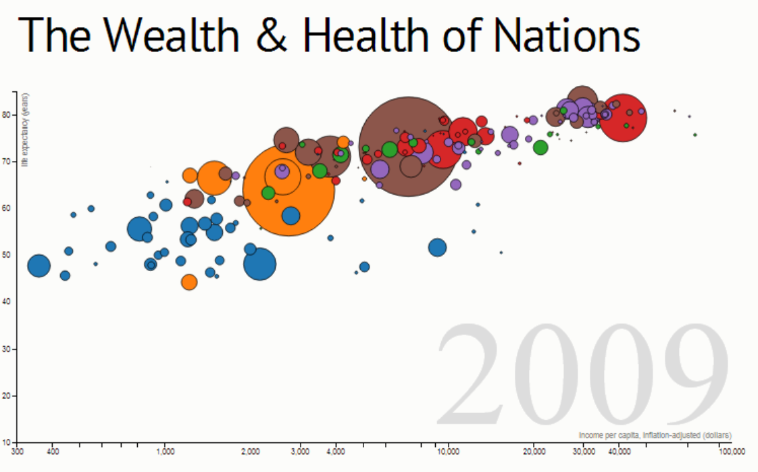
Data Visualization can Tell Stories
Source: http://bost.ocks.org/mike/nations/
200 Years That Changed the World: www.bit.ly/c6ItL7
Notes:
Gapminder Data stories:
200 years ago, everyone was poor, most people lived very short lives
1800 – 1900 Major industrial powers like US, UK, Germany and France started gaining wealth, but most people were still poor and lived short lives
1900-1950 Industrial nations (Japan, US, Western Europe) had massive increases in both wealth and life expectancy
1950-1980 Even though many countries were still poor, they had massive gains in life expectancy (the opposite of the industrialized nations, who got rich and then got healthy)
1980-Present India, China, and the rest of the world starts to gain wealth
http://bost.ocks.org/mike/nations/
Examples:
http://xkcd.com/980/huge
- Money from 1$ to National Budget
http://bost.ocks.org/mike/nations/
D3 representation of Gapminder data
200 years that changed the world (Gapminder)
www.bit.ly/c6ItL7
Additional Representations
- https://github.com/mbostock/d3/wiki/Gallery

Slide 7
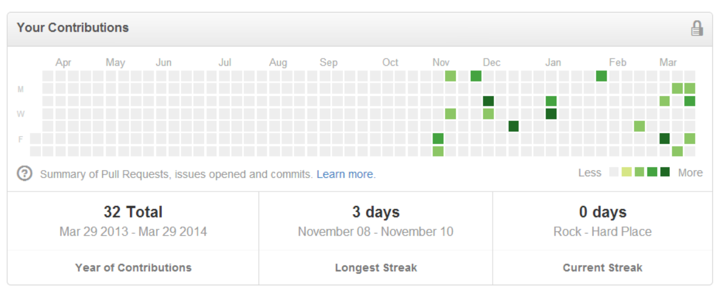
Data Visualization Increases Customer Engagement
Notes:
Github
Khan Academy
Mint
https://www.mint.com/how-it-works/graphs/

Slide 8
We’ve Never Had More Available Data
Governments
Research organizations
NGOs
The Internet of Things
Logging & Usage Data
Financial Data
Notes:
The amount of data available to humanity is huge.
Eric Schmidt claims that we are creating as much data in two days as humanity has created up until 2003
IBM claims that we create 2.5 Quintillion Bytes of data every day
SINTEF claims that 90% of the our current data was created in the last two years
Governments and research organizations are opening up their data sets
http://www.data.gov/education/
http://www.census.gov/
http://www.bls.gov/
http://www.gapminder.org/data/
https://data.cityofmadison.com/
Data from Social Media sites
Marketing and Tracking Data
The Internet of Things
Logging Data
A/B Tests and Usage Data
Sources:
http://www.storagenewsletter.com/rubriques/market-reportsresearch/ibm-cmo-study/
http://www.sciencedaily.com/releases/2013/05/130522085217.htm

Slide 9
Demo Time!
Notes:
Demo

Slide 10
Resources
Info About D3.js:
http://d3js.org/
http://bost.ocks.org/mike/
Interactive Data Visualization for the Web
http://alignedleft.com/tutorials/d3/
Datasets:
http://www.gapminder.org/data/
http://www.data.gov/
http://www.bls.gov/
https://data.cityofmadison.com/

Slide 11

See you next year…
Notes:
Next year’s date.

