Slide 1

Climbing Data Mountain Web Based Data Visualizations in NVD3.js and D3.js
Dustin Ewers
Consultant @ Centare
Demos & Slides: https://github.com/DustinEwers/shiny-angular-demos
Website: www.dustinewers.com
Twitter: @dustinjewers
Notes:
Slide background from: www.subtlepatterns.com

Slide 2
Roadmap
Why Bother?
Charting Best Practices
Web Based Charting
Intro to D3.js
Demos

Slide 3
What’s so great about data visualization anyway?

Slide 4
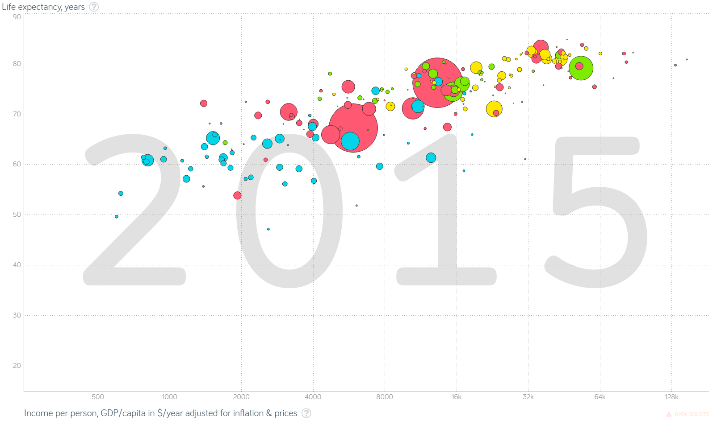
Notes:
Actually shell out to the website if I can.
Major points:
1. There’s a ton of data here. Each data dimension is an excel spreadsheet.
2. The animation tells a very interesting story
3. Easily accessible by nearly anyone
4. People can actually handle the data (it’s interactive)
http://www.gapminder.org/tools/#_locale_id=en;&chart-type=bubbles

Slide 5
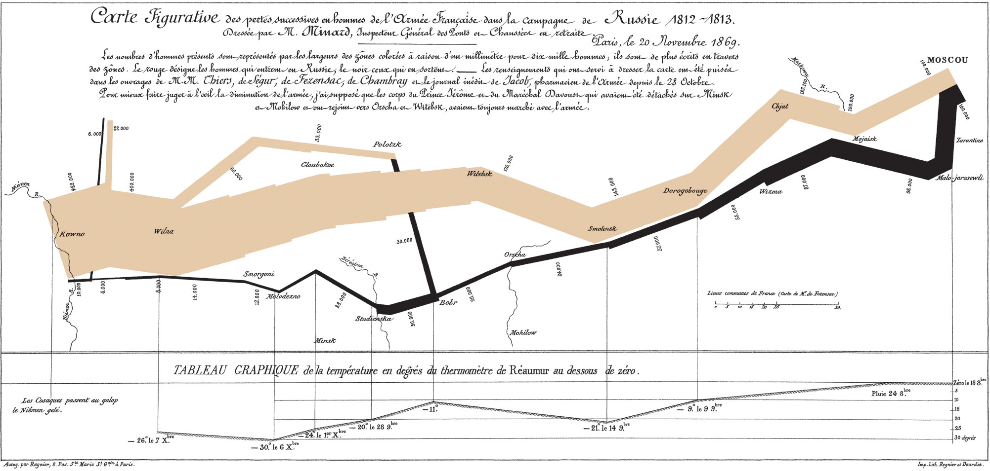
Notes:
https://en.wikipedia.org/wiki/Charles_Joseph_Minard
This data viz tells a story about Napoleon and his followers.
Doesn’t even need to be high tech… This is from 1869

Slide 6
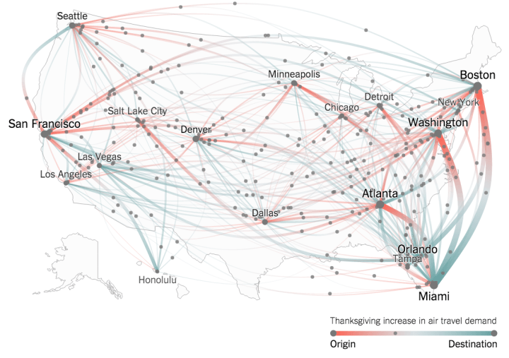
Notes:
https://www.nytimes.com/interactive/2015/11/24/upshot/thanksgiving-flight-patterns.html
Data viz gives you a better overview of the data than statistics would.

Slide 7
How do we make it not suck?

Slide 8
Bad
Notes:
This chart is loaded with extra details that don’t communicate information.
Also known as “chart junk”
Gradient, stupid 3d effects, etc...

Slide 9
Also Bad
Notes:
This chart lacks axes and explanations.

Slide 10
Better
Notes:
Avoid “chart junk”
Use visual ques to denote information, but don’t over embellish

Slide 11
Notes:
Scales should start at zero
Avoid any trickery with scaling too

Slide 12
Web Based Charting Tools
Kendo UI
Chart.js
Google Charts
High Charts
Notes:
Dime a dozen…
Usually reasonably easy to use…
http://www.chartjs.org/
https://www.highcharts.com/products/highcharts
http://docs.telerik.com/kendo-ui/controls/charts/overview
https://developers.google.com/chart/

Slide 13
D3.js
Notes:
Mike Bostock | 2011
D3 = Data Driven Documents
Data Visualization Toolbox
Uses Web Standards to make charts

Slide 14

Notes:
D3 is the laser chain saw of visualization tools
It’s a powerful library and has lots of features:
Scroll through the API documentation:
https://github.com/d3/d3/blob/master/API.md

Slide 15
When to Use D3.js
DIY Charting Library
Unique Visualizations
Need Low Level Control
Notes:
DIY Charting Library
- Build the basis for a company wide charting library
Unique Visualizations
- Need something that the standard charts can’t handle
Need Low Level Control
- Lots of people come to D3 after their regular charting stuff doesn’t work out

Slide 16
NVD3.js
Notes:
D3.js charts
Easier to use than D3.js
Uses the older version of D3, which is annoying.
D3 v3 vs. D3 v4

Slide 17
SVG

Slide 18
Data Loading

Slide 19
Data Binding

Slide 20
Transformations

Slide 21
Extras

Slide 22
Demos

Slide 23
Takeaways
Data Can Be Beautiful
D3 is Hard
D3 is Powerful

