Slide 1

R: It's Not Just For Pirates Anymore
Dustin Ewers
Consultant @ Centare
Code: https://github.com/DustinEwers/d3-demos-data-mountain
Website: www.dustinewers.com
Notes:
Slide background from: www.subtlepatterns.com

Slide 2
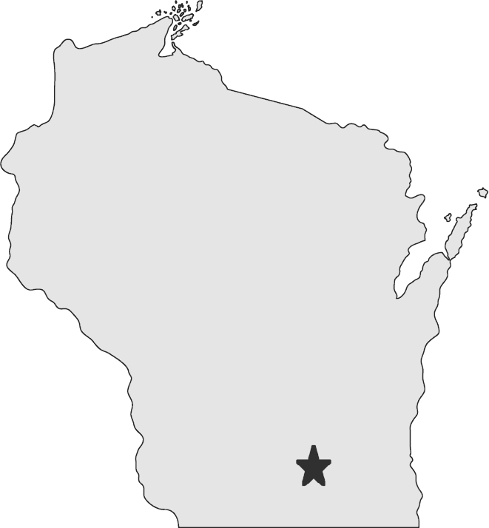

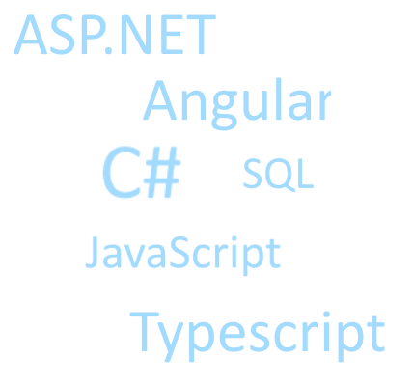
My Perspective
Notes:
10 years of Web Dev on the Microsoft stack
Hail from the Hipster Capital of the Midwest, Madison
We are awash in data, so I’m trying to learn different tactics to deal with it
IOT | Behavioral tracking | the cloud
My math skills could use some work, but web based data viz seems like a good entry point

Slide 3
“In God we trust, all others must bring data”
- W. Edwards Deming
Notes:
With data visualization, you can use your datasets to change mindsets.
https://www.ted.com/talks/hans_rosling_at_state
https://www.ted.com/talks/hans_rosling_shows_the_best_stats_you_ve_ever_seen

Slide 4
Data Stories – Target
Notes:
Target
Tons of analytics being collected
Ability to tell stories

Slide 5
“Let the dataset change your mindset.”
- Hans Rosling
Notes:
With data visualization, you can use your datasets to change mindsets.
https://www.ted.com/talks/hans_rosling_at_state
https://www.ted.com/talks/hans_rosling_shows_the_best_stats_you_ve_ever_seen

Slide 6
Data Stories – Gapminder

Slide 7
“Data is a precious thing and will last longer than the systems themselves.”
- Tim Berners-Lee
Notes:
With data visualization, you can use your datasets to change mindsets.
https://www.ted.com/talks/hans_rosling_at_state
https://www.ted.com/talks/hans_rosling_shows_the_best_stats_you_ve_ever_seen

Slide 8
Data Stories – Volume of Data

Slide 9
Roadmap
Demystifying Data Analysis
Why R?
Navigating the R ecosystem
A Brief Tour of R
R Recipes (Demos)

Slide 10
R: A Brief History

Slide 11
Popular Data Science Languages
Scala
R
Python
Notes:
Scala -

Slide 12
Why R?

Slide 13
Why R? – Free & OSS

Slide 14
Why R? - Specifically Made for Data Analysis

Slide 15
Learning New Languages is Good for You
Notes:
Find the chapter in Pragmatic Programmer
Find that Ron Swanson fishing meme
R is especially cool because it’s a statistical language

Slide 16
Lots of places where you can use it. Low Ceremony
Notes:
Visual Studio
SQL Server
Jupyter Notebooks

Slide 17
When to use it?

Slide 18
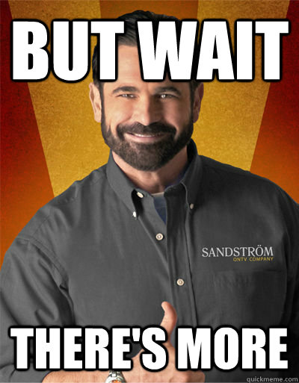
Notes:
D3.js has lots of other things to help with chart generation. We can’t cover them all here.

Slide 19
“If the statistics are boring, you’ve got the wrong numbers.”
- Edward Tufte
Notes:
With data visualization, you can use your datasets to change mindsets.
https://www.ted.com/talks/hans_rosling_at_state
https://www.ted.com/talks/hans_rosling_shows_the_best_stats_you_ve_ever_seen

Slide 20
“If we have data, let’s look at data. If all we have are opinions, let’s go with mine.”
- Jim Barksdale
Notes:
With data visualization, you can use your datasets to change mindsets.
https://www.ted.com/talks/hans_rosling_at_state
https://www.ted.com/talks/hans_rosling_shows_the_best_stats_you_ve_ever_seen

Slide 21
Demos

Slide 22
Takeaways
Data Can Be Beautiful
D3.js is a data viz toolbox
D3.js is high effort, high control

