Slide 1
Winning With Web Components
Dustin Ewers
Consultant @ Centare
www.dustinewers.com
https://www.linkedin.com/in/dustinewers/
https://github.com/DustinEwers/winning-with-web-components

Slide 2
________.js
Notes:
How many people have played _________.js?
Framework churn is real
JavaScript evolves at a rapid pace
It seems to be slowing down, we still have lots of options
--
This churn really sucks if you’re trying to build a component library.
Ionic, Telerik, Bootstrap, Material UI, etc…
Or a corporation that wants to build an internal framework
Personal libraries:
I’ve been down this road, building my own components for every new library I see.
-- an approach that uses new web standards to break free of framework churn
-- Web components | new standards

Slide 3
Roadmap
A Brief History
What are Web Components?
Why Should I Care?
How can I use them?
Notes:
By the end, you’ll be able to deploy your own fleet of web components

Slide 4
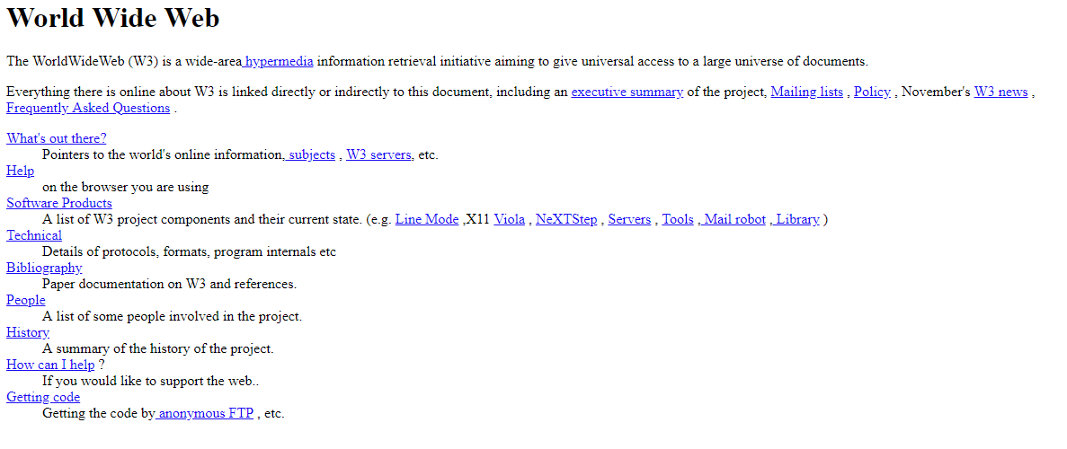
In The Beginning
Notes:
WWW wasn’t meant for web applications
… but we did it anyway

Slide 5
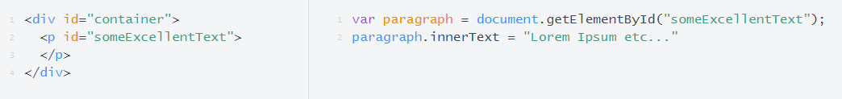
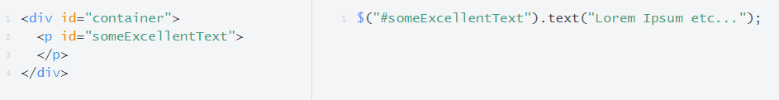
DOM Manipulation
Notes:
DHTML to jQuery

Slide 6
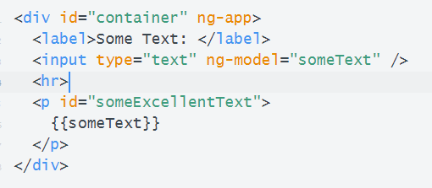
Data Binding
Notes:
Angular.js, Knockout, etc…
Also known as MVVM frameworks

Slide 7
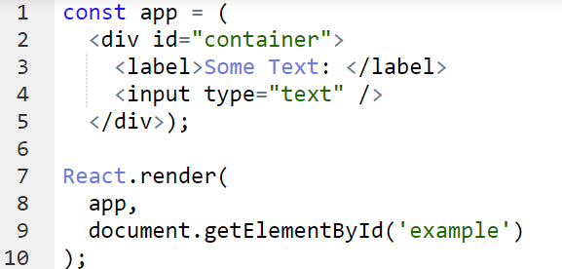
Component Based Frameworks
Notes:
React and Angular (new Angular)
This has become the dominant paradigm
Wouldn’t it be nice if you didn’t need a framework?

Slide 8
React
Web Components
Angular
Vanilla JS
Notes:
Now you can.. With Web Components
Living the Dream –
Native Components you can use in any app
Set of W3 based standards that allow you to create reusable components that work anywhere
#usetheplatform

Slide 9
Custom Elements
Notes:
Extend existing elements
Custom elements from htmlelement

Slide 10
Shadow DOM
Notes:
Shadow Dom Encapsulates the DOM
Unlike the shadow dom in React or Angular
--
Allow you to simplify HTML. Just like in React and Angular components.

Slide 11
HTML Templates
Notes:
Templates and Slots – allow for the creation of HTML templates

Slide 12
Demo!

Slide 13
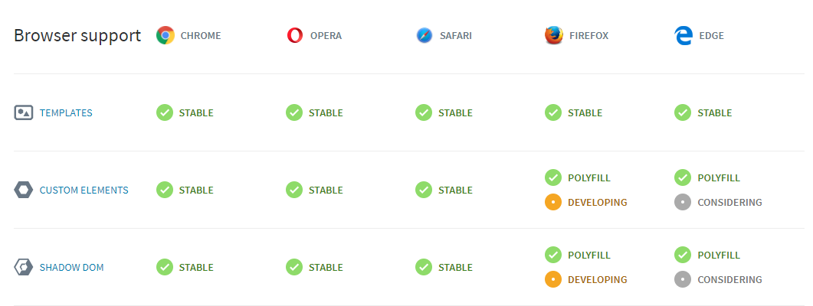
Browser Support
Notes:
From https://www.webcomponents.org/

Slide 14
How do I Use Them Today?
Notes:
Native , or use a library
Polymer
Stencil

Slide 15
Demos

Slide 16
Why bother?
Notes:
Three reasons

Slide 17
Reusability
Notes:
Reusability
- Can use your components across libraries

Slide 18
Simplicity
Notes:
Simplicity
Through encapsulation of components
This is why component model frameworks are dominant

Slide 19
Speed
Notes:
Speed
Because you don’t need a framework
Components are native browser elements
Don’t need to parse a whole framework to get stuff on the page

Slide 20

Where They Really Shine
Notes:
- Library Makers | Bootstrap, Ionic, Material UI etc…
- Corporate Internal Frameworks

Slide 21
Libraries

Slide 22
Progressive Web Applications
Notes:
Why:
Speed.
Time to paint on web components is much faster than with something where you have to parse a big library

Slide 23
#UseThePlatform
Notes:
Conclusion –
The web has come a long way
DHTML -> Binding -> Components
Standards have come a long way too
Web components is the newest evolution of those standards
Use them vanilla or with a library like Polymer or Stencil
We don’t need fancy frameworks, we can leverage the platform of the web itself
-- get out there and use the platform

Slide 24
Winning With Web Components
Thanks!
Dustin Ewers
Consultant @ Centare
www.dustinewers.com
https://www.linkedin.com/in/dustinewers/
https://github.com/DustinEwers/winning-with-web-components

