Slide 1
CSC I367 Computer Networking Internetworking Concept and Architectural Model

Slide 2
Overview - Internetworking & Architectural Model
Application-Level Interconnection Network-Level Interconnection Properties of the Internet Internet Architecture Interconnection of Multiple Networks with IP Routers The User’s View All Networks are Equal

Slide 3
Application-Level Interconnection
When faced with heterogeneous systems, early designers relied on special application programs, called application gateways, to hide differences and provide the appearance of uniformity. Application gateways provides to be cumbersome and reduce reliability communication.

Slide 4
Network-Level Interconnection
Relying on network-level communications (instead of application-level) is aligned with the “end-to-end” argument. 1. More efficient 2. Standardization of packets means intermediate computers can handle traffic without knowledge of the application 3. Greater flexibility, not limited to single use 4. The network technologies can change without changing applications

Slide 5
Network-Level Interconnection
The key to designing universal network-level interconnection is found in the concept of internetworking. For economic and technical reasons, no single network hardware technology can satisfy all constraints. (heterogeneous quality of WAN, LAN, etc)
Users desire universal interconnection

Slide 6
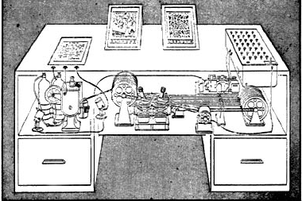
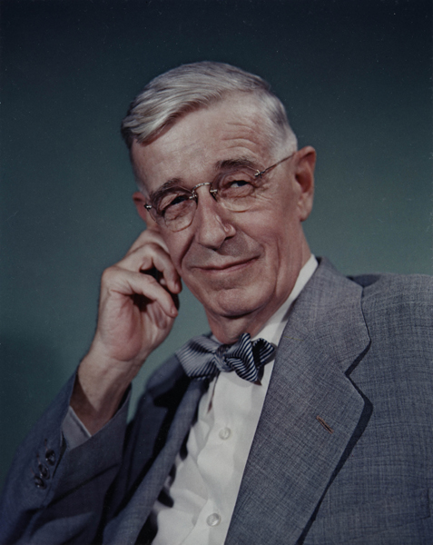
Visionaries - Vannevar Bush
“Memex” machine
“Consider a future device … in which an individual stores all his books, records, and communications, and which is mechanized so that it may be consulted with exceeding speed and flexibility. It is an enlarged intimate supplement to his memory.”
During World War II Bush headed the U.S. Office of Scientific Research and Development (OSRD)
Bush, Vannevar. "As we may think." The atlantic monthly 176.1 (1945): 101-108.

Slide 7
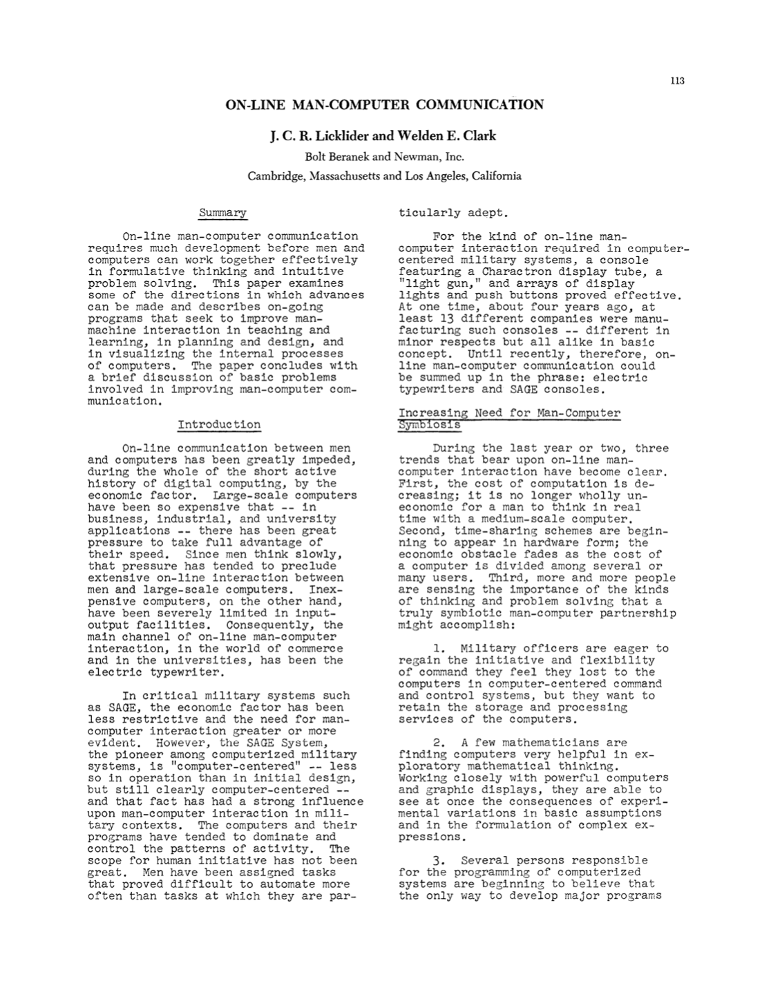
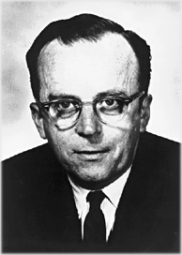
Visionaries - J. C. R. Licklider aka “Lick”
“On-line man-computer communication requires much development before men and computers can work together effectively informulative thinking and intuitive problem solving. This paper examines some of the directions in which advances can be made and describes ongoing programs that seek to improve man-machine interaction in teaching and learning, in planning and design, and in visualizing the internal processes of computers. The paper concludes with a brief discussion of basic problems involved in improving man-computer communication.”
1962 Licklider became head of the Information Processing Techniques Office (IPTO) at DARPA, the United States Department of Defense Advanced Research Projects Agency.
Licklider, Joseph Carl Robnett, and Welden E. Clark. "On-line man-computer communication." Proceedings of the May 1-3, 1962, spring joint computer conference. 1962.

Slide 8
Properties of the Internet
Internetworking involves… Encapsulation - hiding internet architecture from applications and users, The ‘open’ quality of the IP network provides flexible, not only to new technologies, but to new networks. Being able to communicate across intermediate networks. Universal set of names and addresses.

Slide 9
Internet Architecture
Internetworking is achieved through the use of internet or IP routers
Net 1
Net 2
R
Router R captures & transfers packets between networks based on packet’s destination network.

Slide 10
Interconnection of Multiple Networks w/ IP Routers
Routers need to know about the networks that they are not directly connected to. Routers use the destination network, not the destination computer, when forwarding a packet.
Net 1
Net 2
Net 3
R1
R2

Slide 11

The User / Application View
The success of internetworking means users and applications can operate with little or no awareness of the constituent parts that facilitate online communication. This contributes to a view of the internet as a unified whole.

Slide 12
All Networks are Equal
The TCP/IP Internet treats all networks equally. A Local Area Network such an Ethernet, a Wide Area Network used as a backbone, a Wi-Fi hotspot, and a point-to-point link between two computers, they are all treated the same. TCP/IP Defines an abstraction of “network” that conceals details and differences.

Slide 13
Summary / Key Concepts
Application Gateways Benefits of Network-level communication Concept of “Internetworking” Encapsulation ‘Open’ quality of the IP internet IP Routers Communication across intermediate networks Universal set of names and addresses

