Slide 1
CSC I367 Computer Networking Protocol Layering

Slide 2
Overview - Protocol Layering
The Need for Multiple Protocols The Conceptual Layers of Protocol Software Functionality of the Layers ISO 7-Layer Reference Model X.25 and Its Relation to the ISO Model The TCP/IP 5-Layer Reference Model Locus of Intelligence The Protocol Layering Principle Two Important Boundaries in the TCP/IP Model The Basic Idea Behind Multiplexing and Demultiplexing

Slide 3
The Need for Multiple Protocols
Network communication is a complex problem with many aspects. Consider the many problems that can arise… Hardware Failure Network Congestion Packet Delay or Packet Loss Data Corruption Data Duplication or Inverted Arrivals It is impossible to write a single protocol that can handle every problem.

Slide 4
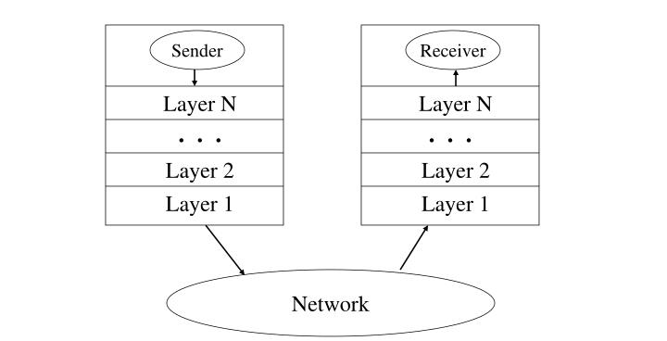
The Conceptual Layers of Protocol Software
Each layer takes responsibility for handling a particular problem.

Slide 5
Functionality of the Layers
If you’re going to divide the functionality of the network into layers… How many layers should there be? What functionality should they have?

Slide 6
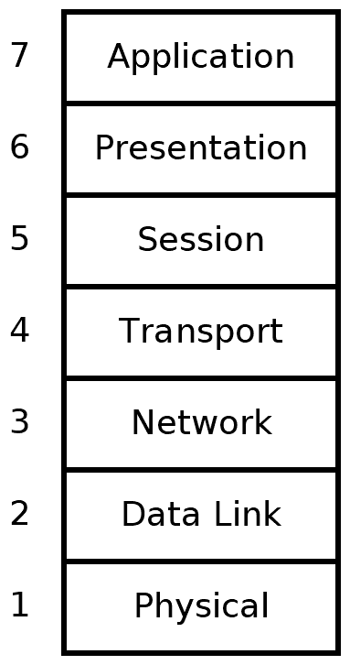
ISO 7-Layer Reference Model
International Organization for Standardization (ISO) The ISO Model predates the design of IP internet. It contains layers not used by TCP/IP. Rather than internetworking, the ISO Model centered on the idea of single network. ISO model informed the early internet protocol implementations.

Slide 7
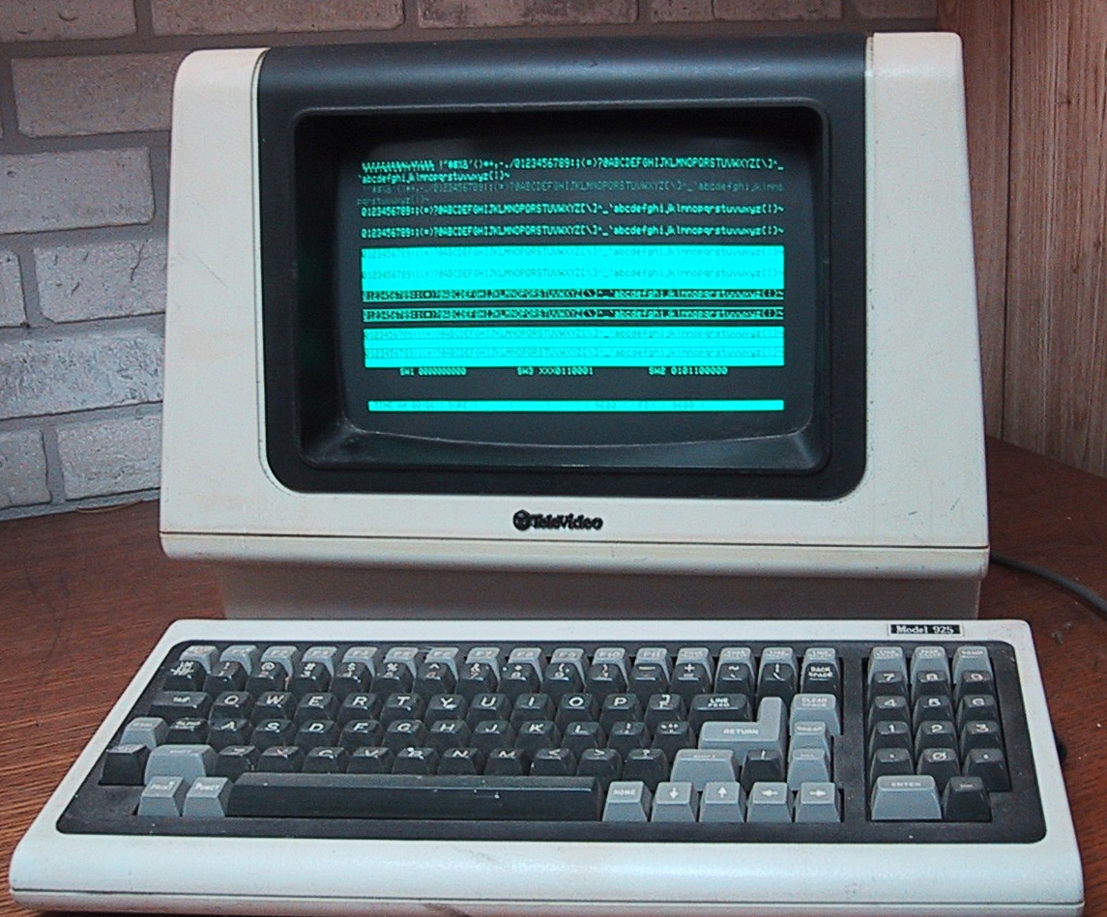
X.25 and Its Relation to the ISO Model
International Telecommunications Union (ITU) X.25 protocols were developed by ITU in 1976, several years before IPv4. The X.25 protocols a data network that operated much like a telephone system. Popular in the 1980s, it continued to be used by financial services well into the 2010s.
A Televideo terminal model 925 made around 1982

Slide 8
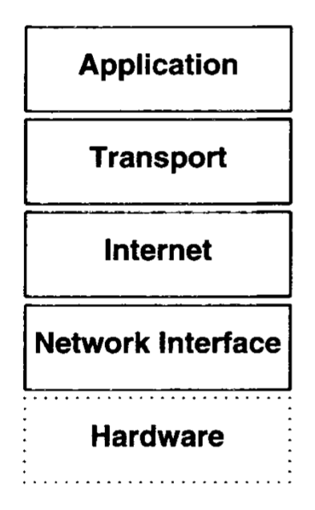
The TCP/IP 5-Layer Reference Model
IP were not designed by a standards body, instead they arose from a network of research teams. The ISO model was prescriptive, by contrast, the IP Internet Model is descriptive. Unlike the ISO model, which was defined by committees before protocols were implemented, the Internet 5-layer reference model was formalized after the protocols had been designed and tested.

Slide 9
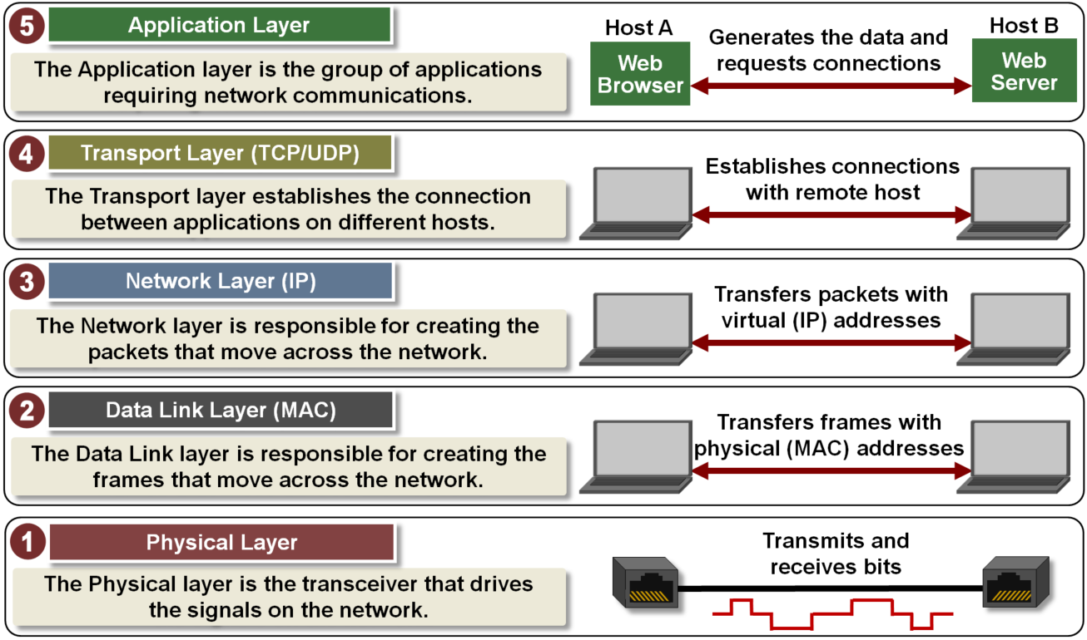

Slide 10
Software outside the operating system
Software inside the operating system
only IP addresses used
Physical addressing used

Slide 11
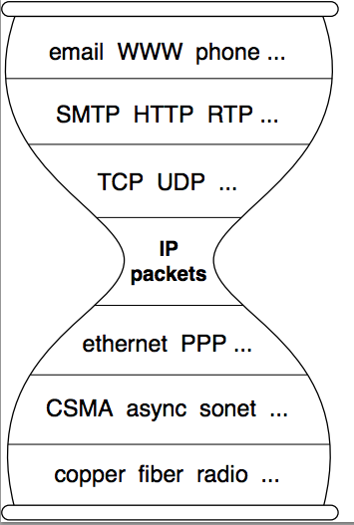
“Hour glass” or “narrow waist”
Are phrases used in the networking community to describe the role of the TCP/IP protocols. While all network traffic passes through the TCP/IP protocols, what is ‘above’ or ‘below’ the protocols is heterogeneous. Numerous applications run on the network, and there are many different hardware systems and transmission mediums that constitute the physical network.

Slide 12
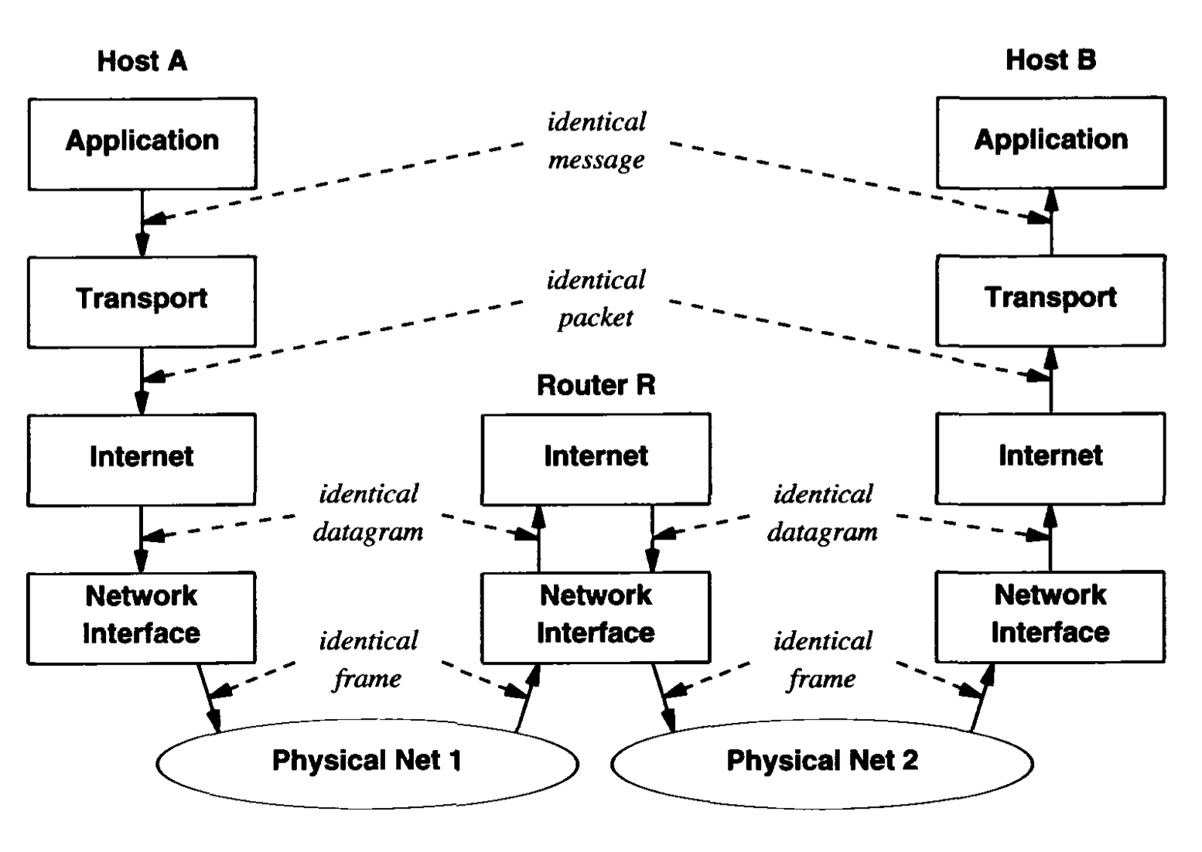
In this diagram we see the difference between ‘end users’ (host A & B) and intermediate systems (Router R).

Slide 13
Locus of Intelligence
The internet presents a significant departure from earlier network designs, because ‘intelligence’ is placed outside of the network in the end systems. TCP/IP Protocols place much of the intelligence in hosts. Routers in the Internet forward Internet packets, but do not participate in the higher layer services.

Slide 14
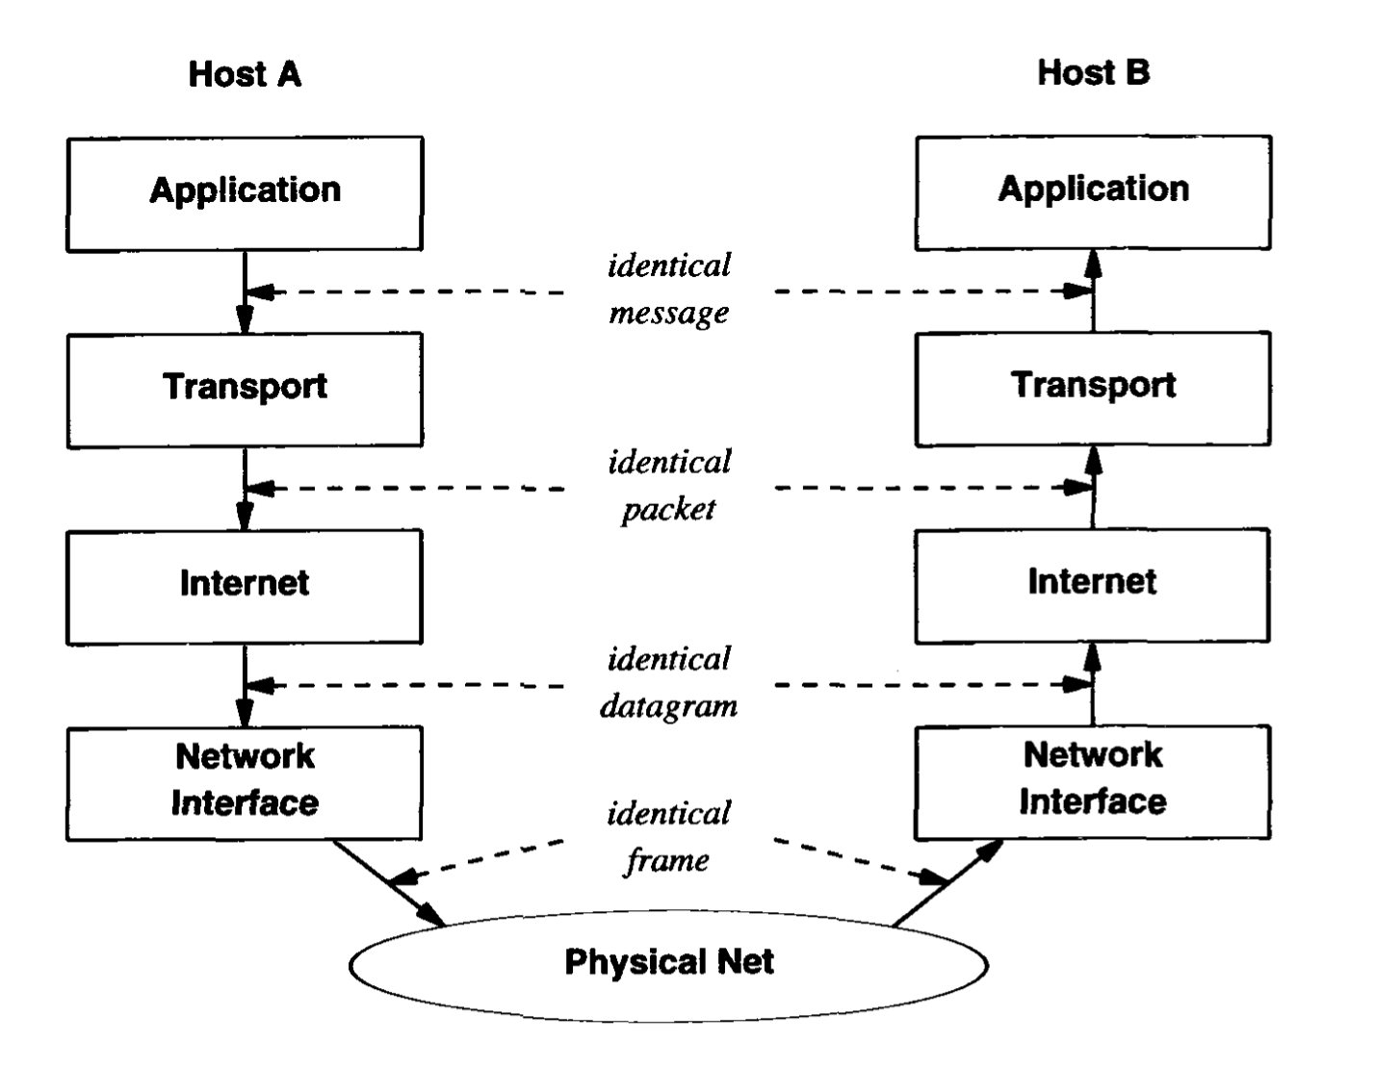
The Protocol Layering Principle
Layered protocols are designed so that layer n at the destination receives exactly the same object sent by layer n at the source. The layering concept offers: Protocol design independence Divide & contain problems within modularized systems. Definition of the end-to-end property Protocol is considered end-to-end when the layering principle applies between the both original source and the ultimate destination.

Slide 15
The Basic Idea Behind Multiplexing & Demultiplexing
Layered protocols use a pair of techniques known as multiplexing and demultiplexing throughout the layering hierarchy. When sending a message the source computer includes extra bits that store meta-data, such as message type, the identity of the application program that sent the data, and the protocols used. On the receiving end, a destination computer uses the meta-data to guide processing Multiplexing & Demultiplexing occurs at each layer.

Slide 16
The Basic Idea Behind Multiplexing & Demultiplexing
Layered protocols use a pair of techniques known as multiplexing and demultiplexing throughout the layering hierarchy. When sending a message the source computer includes extra bits that store meta-data, such as message type, the identity of the application program that sent the data, and the protocols used. On the receiving end, a destination computer uses the meta-data to guide processing Multiplexing & Demultiplexing occurs at each layer.

Slide 17
Summary / Key Concepts
Layering of protocols ISO 7-Layer Reference Model & the X.25 Protocols The TCP/IP 5-Layer Reference Model “Hour glass” or “narrow waist” Multiplexing and Demultiplexing

