Slide 1
CSC I367 Computer Networking Internet Addressing (IPv4)

Slide 2
Overview - Internet Addressing (IPv4)
Universal Host Identifiers Original IPv4 Classful Addressing Scheme Dotted Decimal Notation Used with IPv4 IPv4 Subnet Addressing Fixed & Variable Length IPv4 Subnets IPv4 Subnet Mask Representation & Slash Notation The Current Classless IPv4 Addressing Scheme IPv4 Address Blocks and CIDR Slash Notation IPv4 CIDR Blocks Reserved for Private Networks

Slide 3

Universal Host Identifiers
Host - any ‘end system’ that attaches to the Internet Within the TCP/IP internet, machines fall within two categories: hosts or routers. Universal Communication Service means any host can communication with any other hosts. Identifiers include: names (what it is), addresses (where it is), or routes (and how to get there).

Slide 4
IPv4 Addresses - Prefix & Suffix
Internet Protocol Address or IP Address is divided into two parts (prefix & suffix) to increase efficiency. Prefix - identifies the network to which the host is attached - (netid) Suffix - identifies a specific host on the network - (hostid) IPv4 Address size is 32 bits IPv6 Address size is 128 bits

Slide 5
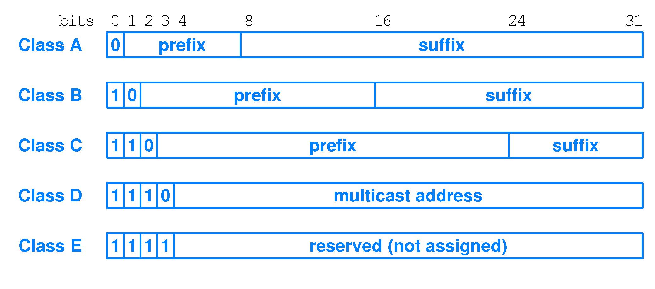
Original IPv4 Classful Addressing Scheme
While IPv4 classful addressing is no longer widely used, it is worth understanding. The classful address scheme was designed to reflect large, medium, and small networks. Starting with class A for large networks, and class C for small networks. Classes are self-identifying, through the prefix - suffix boundary.
The five forms of IP addresses using IPv4 classful addressing scheme.

Slide 6
Original IPv4 Classful Addressing Scheme
While IPv4 classful addressing is no longer widely used, it is worth understanding. The classful address scheme was designed to reflect large, medium, and small networks. Starting with class A for large networks, and class C for small networks. Classes are self-identifying, through the prefix - suffix boundary.
The five forms of IP addresses using IPv4 classful addressing scheme.

Slide 7
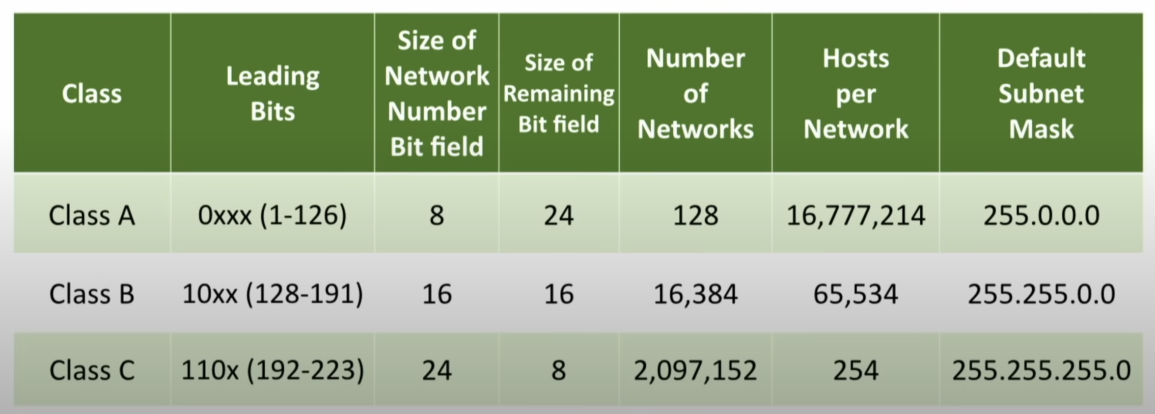
Original IPv4 Classful Addressing Scheme
While IPv4 classful addressing is no longer widely used, it is worth understanding. The classful address scheme was designed to reflect large, medium, and small networks. Starting with class A for large networks, and class C for small networks. Classes are self-identifying, through the prefix - suffix boundary.
Total Number of IPv4 Address - 4,294,967,296

Slide 8
Dotted Decimal Notation Used with IPv4
IPv4 Address size is 32 bits, or 4 octets IPv4 addresses are written as four decimal integers separated by decimals points, where each integer gives the value of one octet of the address. Most software uses dotted decimal notation Example: 10000000 00001010 00000010 00011110 128.10.2.30

Slide 9
Dotted Decimal Notation Used with IPv4
IPv4 Address size is 32 bits, or 4 octets IPv4 addresses are written as four decimal integers separated by decimals points, where each integer gives the value of one octet of the address. Most software uses dotted decimal notation Example: 10000000 00001010 00000010 00011110 128.10.2.30

Slide 10
Dotted Decimal Notation Used with IPv4
IPv4 Address size is 32 bits, or 4 octets IPv4 addresses are written as four decimal integers separated by decimals points, where each integer gives the value of one octet of the address. Most software uses dotted decimal notation Example: 10000000 00001010 00000010 00011110 128.10.2.30

Slide 11
IPv4 Subnet Addressing
In the early 1980s with the growth of Local Area Networks, it became apparent that the classful addressing scheme would have insufficient addresses (especially class B prefixes). Subnet addressing or subnetting was developed as a solution for accommodating growth, while maintaining the classful addressing scheme.
Network 128.10.1.0
Rest of the internet
H1
128.10.1.1
H2
128.10.1.2
All traffic to 128.10.0.0
R
Network 128.10.2.0
H3
128.10.2.1
H4
128.10.2.2

Slide 12
IPv4 Subnet Addressing
16 bits
16 bits
Internet portion
Local portion
With subnetting the IPv4 address is divided between an internet portion and a local portion. The interpretation of the internet portion remains the same, while the local portion identifies a physical network and host.
Internet portion
physical network
host
Network 128.10.1.0
Rest of the internet
H1
128.10.1.1
H2
128.10.1.2
All traffic to 128.10.0.0
R
Network 128.10.2.0
H3
128.10.2.1
H4
128.10.2.2

Slide 13
IPv4 Subnet Addressing
16 bits
16 bits
Internet portion
Local portion
In this example, when reading the address for H2 (“128.10.1.2”), the last octet (“2”) refers to the specific host, while the second to last octet (“1”) refers to the physical network. Subnetting imposes a hierarchical addressing and hierarchical routing.
Internet portion
physical network
host
Network 128.10.1.0
Rest of the internet
H1
128.10.1.1
H2
128.10.1.2
All traffic to 128.10.0.0
R
Network 128.10.2.0
H3
128.10.2.1
H4
128.10.2.2

Slide 14
Fixed & Variable Length IPv4 Subnets
Within the local portion, the use of bits for networks and hosts is flexible. The idea that a manager can choose a division for the local portion of its address and then use the division throughout the site is known as fixed-length subnetting
Internet portion
physical network
host
8 bits
8 bits

Slide 15
Fixed & Variable Length IPv4 Subnets
Within the local portion, the use of bits for networks and hosts is flexible. The idea that a manager can choose a division for the local portion of its address and then use the division throughout the site is known as fixed-length subnetting
Internet portion
physical network
host
8 bits
8 bits

Slide 16
Fixed & Variable Length IPv4 Subnets
Within the local portion, the use of bits for networks and hosts is flexible. The idea that a manager can choose a division for the local portion of its address and then use the division throughout the site is known as fixed-length subnetting As the number of physical networks goes up, the number of hosts that can connect to a network goes down.
Internet portion
physical network
host
8 bits
8 bits
10 bits
6 bits

Slide 17
Fixed & Variable Length IPv4 Subnets
Within the local portion, the use of bits for networks and hosts is flexible. The idea that a manager can choose a division for the local portion of its address and then use the division throughout the site is known as fixed-length subnetting As the number of physical networks goes up, the number of hosts that can connect to a network goes down.
With fixed-length subnets the ratio between networks and hosts is consistent across the subnet. With variable-length subnetting a manager can create partitions within subnet. Once defined, variable-length subnet partitions do not change over time, but they enable a mix of large and small networks within a subnet.
Internet portion
physical network
host
8 bits
8 bits
10 bits
6 bits

Slide 18
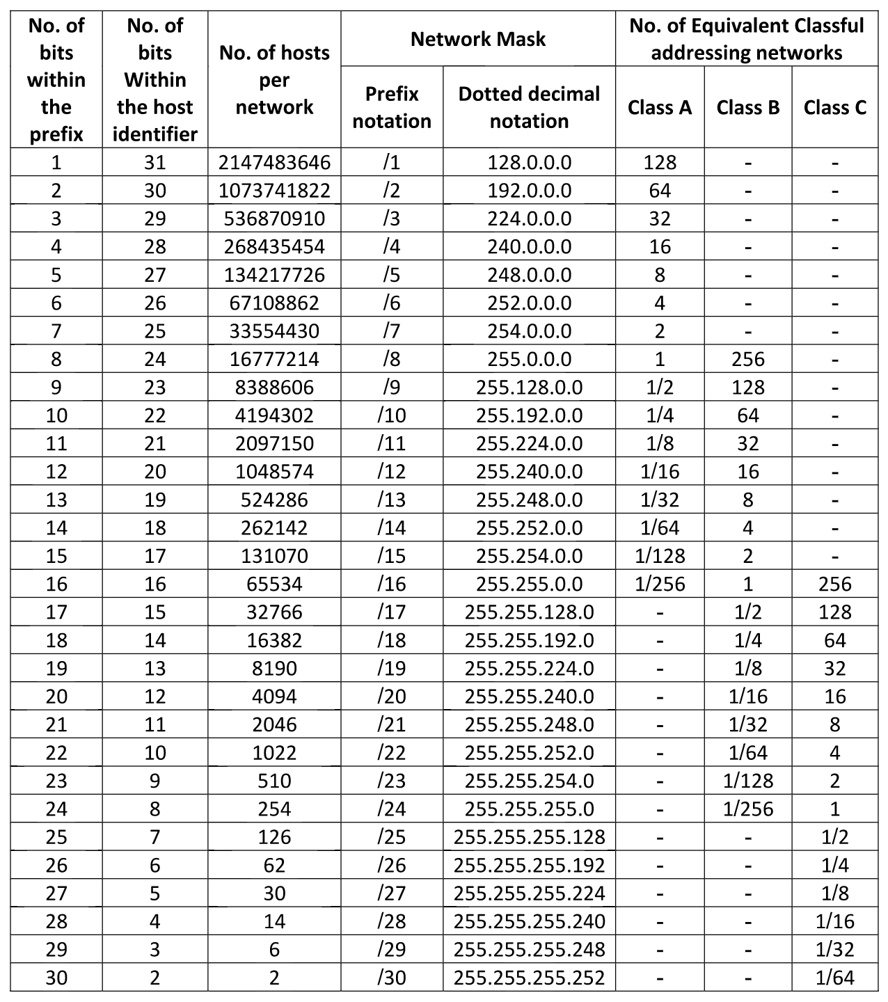
IPv4 Subnet Mask Representation & Slash Notation
Specifying subnet masks in binary is awkward. So most systems allow alternative representations. Dotted decimal representation is common and easier to use, as long as the subnet boundaries align with the octet boundaries. To make it easier to understand and represent address masks, the IETF developed syntactic form that is informally known as Slash notation. For example, Dotted decimal: 255.255.255.0 Slash notation: /24

Slide 19
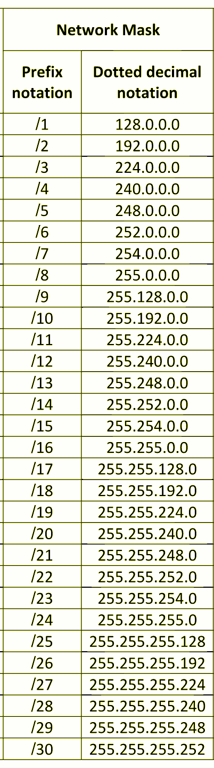
IPv4 Subnet Mask Representation & Slash Notation
Specifying subnet masks in binary is awkward. So most systems allow alternative representations. Dotted decimal representation is common and easier to use, as long as the subnet boundaries align with the octet boundaries. To make it easier to understand and represent address masks, the IETF developed syntactic form that is informally known as Slash notation. For example, Dotted decimal: 255.255.255.0 Slash notation: /24

Slide 20
The Current Classless IPv4 Addressing Scheme
When subnetting was first developed as a way of accommodating growth, it was understood that additional measures would need to be taken to sustain internet growth. While IPv6 would eventually address such issues, by 1993 a temporary measure known as classless addressing was embraced. Classless addressing does away with the class A, B, and C addresses. In place of the three classes, the new scheme extends the ideas used in subnetting. The technology became known as Classless Inter-Domain Routing (CIDR).
Class A, B, and C, did not divide network addresses into equal size classes. While there were fewer than seventeen thousand B class numbers created, there were more than two million C class network numbers created.
Because C prefixes only suffice for small networks and are not amenable to subnetting, demand for C prefixes was lower
Demand for class B prefixes address would exhaust supply
So one of the first uses of classless addressing was known as supernetting, and would enable an organization to receive a contiguous set of class C addresses instead of a class B address.

Slide 21
IPv4 Address Blocks and CIDR Slash Notation
Dotted decimal 32-bit Binary Equivalent
Lowest 128.211.168.0 10000000 11010011 10101000 00000000 Highest 128.211.175.255 10000000 11010011 10101111 11111111
Slash Notation or CIDR Notation
128.211.168.0/21
the /21 defines a network with 2046 hosts.

Slide 22
A Classless IPv4 Addressing
Classless addressing enables greater flexibility in allocating various sized blocks of addresses. With CIDR an ISP can partition addresses into contiguous subblocks, and assign customers address blocks that are an appropriate size to their needs.
Dotted decimal 32-bit Binary Equivalent
Lowest 128.211.176.212 10000000 11010011 10110000 11010100 Highest 128.211.176.215 10000000 11010011 10110000 11010111
Slash Notation or CIDR Notation
128.211.176.212/30
The /30 defines a network with two hosts

Slide 23
IPv4 CIDR Blocks Reserved for Private Networks
In the context of a private intranet, that does not connect with the larger internet, arbitrary addresses could be used. To avoid conflict between private and public addresses, the IETF reserved several address prefixes for private intranets. Private addresses or non-routable address If packets containing one of the private addresses is forwarded to the global internet, a router will detect the problem and discard the packet.
Prefix Lowest Address Highest Address
10.0.0.0/8 10.0.0.0 10.255.255.255 172.16.0.0/12 172.16.0.0 172.31.255.255 192.168.0.0/16 192.168.0.0 192.168.255.255 169.254.0.0/16 169.254.0.0 169.254.255.255

Slide 24
IPv4 CIDR Blocks Reserved for Private Networks
In the context of a private intranet, that does not connect with the larger internet, arbitrary addresses could be used. To avoid conflict between private and public addresses, the IETF reserved several address prefixes for private intranets. Private addresses or non-routable address If packets containing one of the private addresses is forwarded to the global internet, a router will detect the problem and discard the packet.
Prefix Lowest Address Highest Address
10.0.0.0/8 10.0.0.0 10.255.255.255 172.16.0.0/12 172.16.0.0 172.31.255.255 192.168.0.0/16 192.168.0.0 192.168.255.255 169.254.0.0/16 169.254.0.0 169.254.255.255

Slide 25
IPv4 Special Addresses
IPv4 Network Address - an address that has a Host ID of 0, is used to refer to the network itself. IPv4 Direct Broadcast Address or Network Broadcast Address - When there are all 1s in the Host ID of a destination address, it refers to all computers on a specific network. IPv4 Limited (Local Network) Broadcast Address - consists of thirty-two 1 bits, and is used to broadcast across local network, and used at startup before a computer learns its IP address. IPv4 Subnet Broadcast Address - using a subnet prefix of all 1s, the subnet broadcast address is used on a single network within a site that used subnetting. IPv4 All-0s Source Address - when a host need to communicate, but does not know its address yet. IPv4 Multicast Addresses - In addition to unicast and broadcast delivery, IPv4 support multicasting (a topic we will examine in more detail later). IPv4 Loopback Address - using the network prefix 127.0.0.0/8 (a value originally from class A range) is reserved for loopback and intended for use in testing TCP/IP and for inter-process communication on the local computer.

Slide 26
Summary / Key Concepts
Addresses Prefix & Suffix IPv4 Classes (ABC) Binary Dotted Decimal Slash notation Fixed & Variable Subnetting Classless Inter-Domain Routing (CIDR) Private addresses IPv4 Special Addresses

