Slide 1
CSC I367 Computer Networking Mapping Internet Addresses to Physical Addresses (ARP)

Slide 2
Overview - Mapping Physical Addresses (ARP)
The Addressing Resolution Problem Two Types of Hardware Addresses Resolution Through Direct Mapping Resolution in a Direct-Mapped Network IPv4 Address Resolution Through Dynamic Binding The ARP Cache ARP Cache Timeout ARP Implementation ARP Encapsulation and Identification ARP Message Format Automatic ARP Cache Revalidation Reverse Address Resolution ARP Caches in Layers 3 Switches Proxy ARP IPv6 Neighbor Discovery

Slide 3
The Addressing Resolution Problem
The problem of mapping high-level addresses to physical addresses is known as the address resolution problem. Solutions fall into two categories - Dynamic Binding: tables that pair high-level and physical addresses (common with IPv4) - Direct Mapping: embedding a hardware address in highlevel addresses (common with IPv6) Two Types of Hardware Addresses - larger than the host portion of an IP address (requires dynamic binding) - smaller than the host portion of an IP address (direct mapping is possible) Because IPv6 dedicates 64 bits to the host portion of an address, it accommodates all types of hardware addresses. Therefore, the smaller/larger distinction is only important for IPv4.

Slide 4
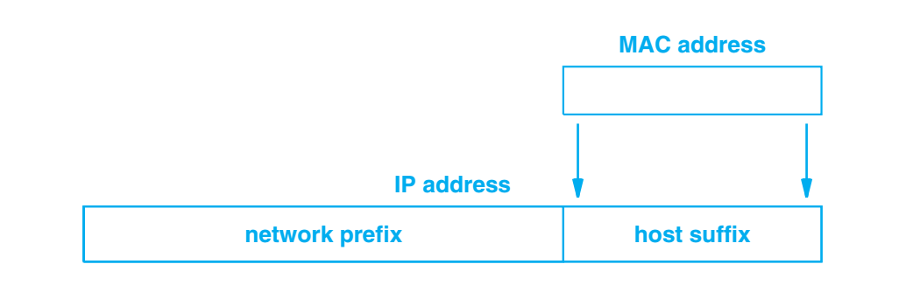
Resolution Through Direct Mapping
IPv6 uses a technique known as direct mapping. Direct mapping - a computer’s hardware address is used as the host portion of the computer’s Internet address.
IPv4 can use direct mapping when addresses are sufficiently small.

Slide 5
Resolution Through Direct Mapping
IPv4 example: 192.5.48.0 / 24
The network prefix occupies the first three octets, leaving one octet for the host ID.
The first computer on the network is assigned hardware address 1 and IP address 192.5.48.1
The second computer is assigned hardware address 2 and IP address 192.5.48.2 and so on.
That is, the network is configured such that the low-order octet of each IP address is the same as the computer’s hardware address. Of course, the example only works if the hardware addresses are between 1 and 254. The advantage of direct mapping is that new computers can be added to a network without changing existing assignments and without propagating new information to existing computers.

Slide 6
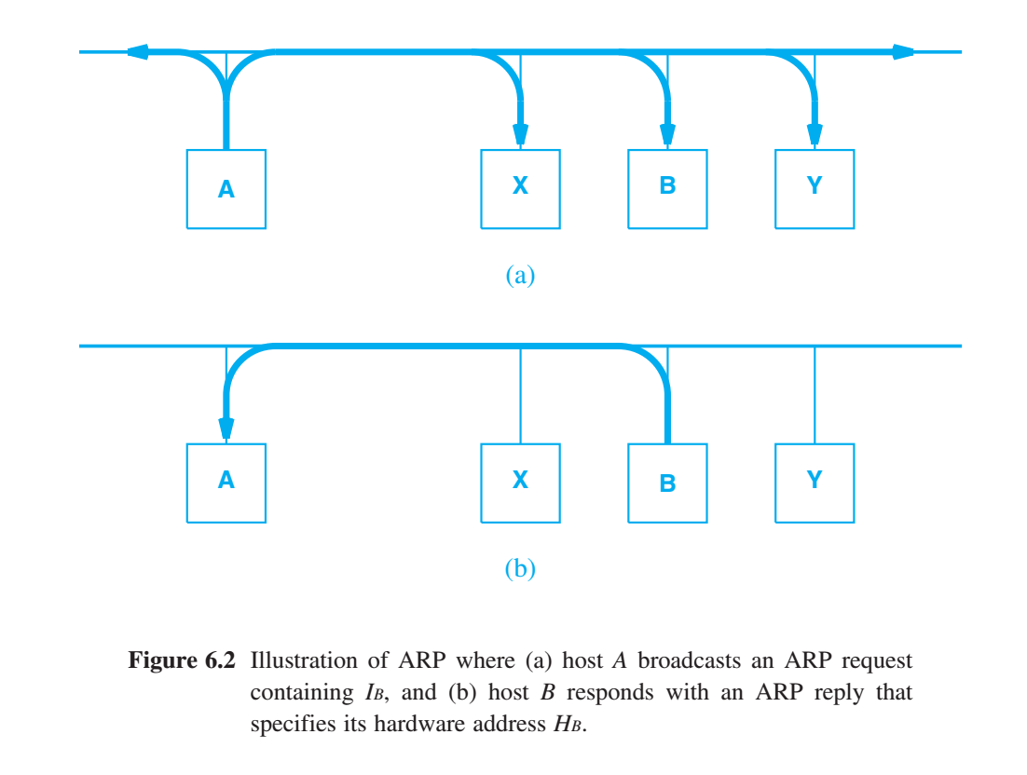
IPv4 Address Resolution Through Dynamic Binding
Unfortunately direct mapping cannot be used with IPv4 if a hardware addresses is larger than an IPv4 address. For instance, an Ethernet MAC address cannot be directly mapped into an IPv4 address because a MAC address is 48 bits long and an IPv4 address is only 32 bits long. Solution Address Resolution Protocol (ARP) allows a host to find the physical address of a target host on the same physical network, given only the target’s IP address.

Slide 7
IPv4 Address Resolution Through Dynamic Binding
Unfortunately direct mapping cannot be used with IPv4 if a hardware addresses is larger than an IPv4 address. For instance, an Ethernet MAC address cannot be directly mapped into an IPv4 address because a MAC address is 48 bits long and an IPv4 address is only 32 bits long. Solution Address Resolution Protocol (ARP) allows a host to find the physical address of a target host on the same physical network, given only the target’s IP address.

Slide 8
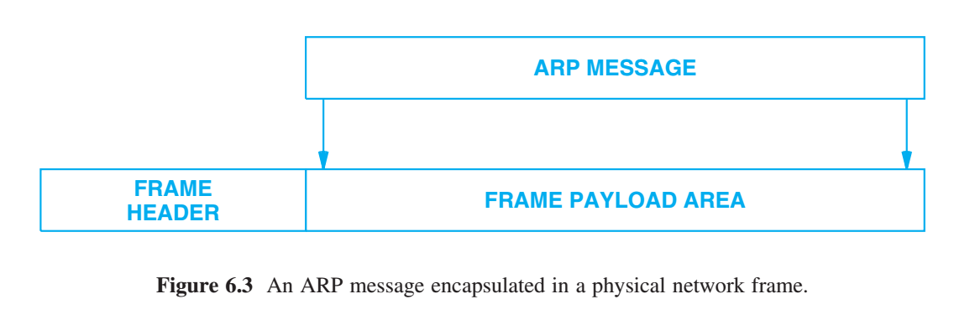
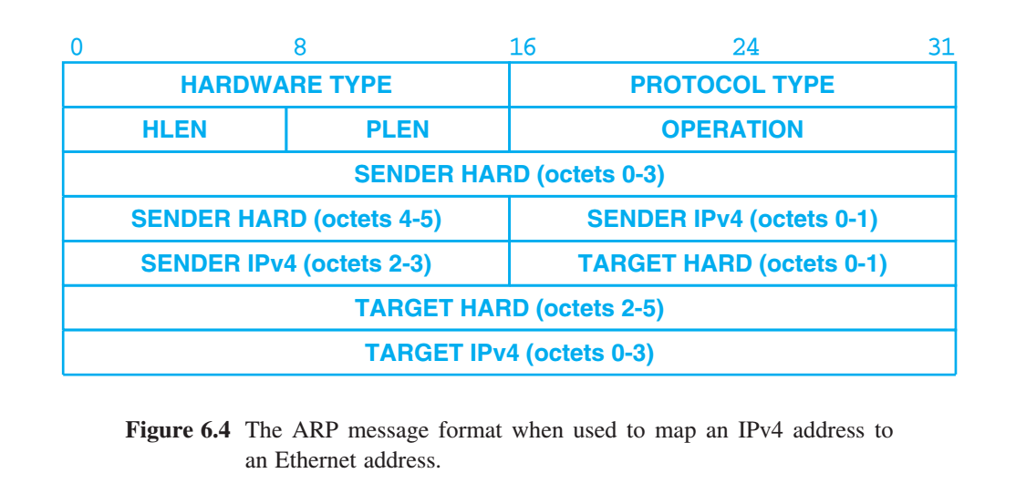
IPv4 Address Resolution Through Dynamic Binding
Address Resolution Protocol (ARP) is used to map 32-bit IPv4 addresses to 48-bit Ethernet addresses. ARP software maintains a cache of recently acquired IP-to-hardware address bindings. When transmitting a packet, a computer always looks in its cache before sending an ARP request. ARP is an example of soft state, where information can become stale without warning. Thus, a timer is used to remove information. Common ARP timer is 20 minutes. The chief disadvantage of soft state arises from delay — if the timer interval is N minutes, a sender may not detect that a receiver has crashed until N minutes elapse.
28-octet ARP message: including the 32 bits (4 octets) protocol address, and the 48-bits (6 octets) hardware address.

Slide 9
IPv4 Address Resolution Through Dynamic Binding
Functionally, ARP software is divided into two parts: The first part provides address resolution for outgoing packets: given the IP address of a computer on the network, it finds the hardware address of the computer. If an address is not in the cache, it sends a request. The second part handles incoming ARP packets. It updates the cache, answers requests from other computers on the network, and checks whether a reply matches an outstanding request.
28-octet ARP message: including the 32 bits (4 octets) protocol address, and the 48-bits (6 octets) hardware address.

Slide 10
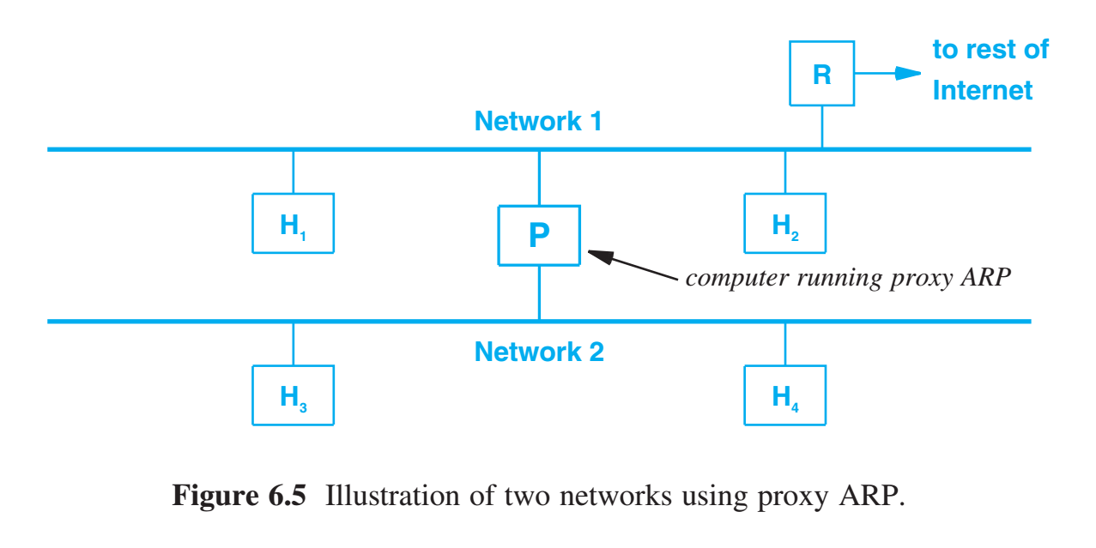
Proxy ARP
While the Address Resolution Protocol (ARP) was designed to map 32-bit IPv4 addresses to 48-bit Ethernet addresses within a single network. Proxy ARP bridges multiple networks, relying on a computer that has two network connections and runs special-purpose ARP software.
Computer P has a database that contains the IPv4 address and the Ethernet MAC address of each other machine on network 1 & 2. The router and all the other hosts run standard ARP; they are unaware that proxy ARP is being used. More important, all the other hosts and the router are configured as if they are on a single network.

Slide 11
IPv6 Neighbor Discovery
IPv6 uses the term neighbor to describe another computer on the same network.
IPv6’s Neighbor Discovery Protocol (NDP) replaces ARP and allows a host to map between an IPv6 address and a hardware address. NDP uses early binding and takes a proactive approach to state maintenance.
Instead of waiting until a datagram must be sent, an IPv6 node uses NDP to discover neighbors at startup. Furthermore, an IPv6 node continually checks the status of neighbors. Thus, transmission of an IPv6 datagram to a neighbor can proceed without delay and does not involve broadcast.

Slide 12
Summary / Key Concepts
The Addressing Resolution Problem Two Types of Hardware Addresses Resolution Through Direct Mapping Resolution in a Direct-Mapped Network IPv4 Address Resolution Through Dynamic Binding The ARP Cache ARP Cache Timeout ARP Implementation - outgoing / incoming functionality ARP Encapsulation & Message Format Proxy ARP IPv6 Neighbor Discovery

