Slide 1
CSC I367 Computer Networking Internet Protocol: Connectionless Datagram Delivery

Slide 2
Overview - IP Connectionless Datagram Delivery
A Virtual Network Internet Architecture & Philosophy Principles Behind the Structure Connectionless Delivery System Characteristics Purpose and Importance of the Internet Protocol The IP Datagram Datagram Type of Service and Differentiated Services Datagram Encapsulation Datagram Size, Network MTU, and Fragmentation Datagram Reassembly Header Fields Used for Datagram Reassembly Time to Live (IPv4) and Hop Limit (IPv6) Optional IP Items Optional Processing During Fragmentation Network Byte Order

Slide 3

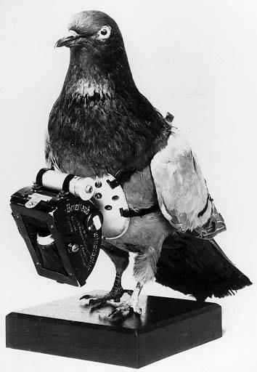
A Virtual Network
Internet technology presents the abstraction of a single virtual network that interconnects all hosts, and through which communication is possible. The underlying architecture is both hidden and irrelevant. In a sense, an internet is an abstraction of a large physical network. At the lowest level, internet technology provides the same basic functionality as a physical network: it accepts packets and delivers them. Higher levels of internet software and network applications add most of the rich functionality that users perceive.
Homing Pigeon & “Pigeon-Gram” stamp circa 1940s https://en.wikipedia.org/wiki/Homing_pigeon

Slide 4
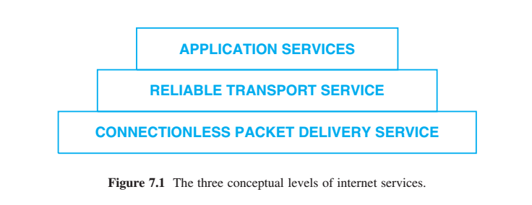
Principles Behind the Structure
Internet protocols are designed around three conceptual levels of service. A connectionless service at the lowest level matches underlying hardware well, a reliable transport service provides service to applications, and a variety of applications provide the services users expect.
The three-level concept accounts for much of the Internet’s success; as a consequence of the basic design, the Internet technology has been surprisingly robust and adaptable.
It represents a dramatic departure from previous thinking about data communication. Early networks followed the approach of building reliability at each level.
Advantage of conceptual separation: one service can be enhanced or replaced without disturbing others

Slide 5
Connectionless Delivery System Characteristics
Technically, the service is defined as an unreliable, best-effort, connectionless packet delivery system.
unreliable delivery is not guaranteed
A packet may be lost, duplicated, delayed, or delivered out of order.
the connectionless service will not detect such conditions, nor will it inform the sender or receiver
connectionless each packet is treated independently from all others
A sequence of packets sent from one computer to another may travel over different paths, or some may be lost while others are delivered.
best-effort delivery the Internet software makes an earnest attempt to deliver packets
The Internet does not discard packets capriciously; unreliability arises only when resources are exhausted or underlying networks fail.

Slide 6
Purpose and Importance of the Internet Protocol
Internet Protocol (IP) = the protocol that defines the unreliable, connectionless delivery mechanism
The Internet Protocol is such a fundamental part of the design that the Internet is sometimes called an IP-based technology.
IP provides three important specifications:
defines the basic unit of data transfer used throughout a TCP/IP internet
performs the forwarding function, choosing a path over which a packet will be sent
IP includes a set of rules that embody the basis of unreliable delivery: how hosts and routers should process packets, how and when error messages should be generated, and the conditions under which packets can be discarded

Slide 7
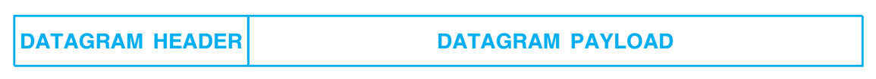
IP Datagram
IP Datagram - or data packet is the basic transfer unit of transferring information across the internet Maximum size of IP datagram is 65,535 octets
Similarities between datagrams and network frames:
Divided into a header and payload
Header contains metadata
Difference between datagrams and network frames
the datagram header contains IP addresses, whereas the frame header contains hardware addresses.

Slide 8
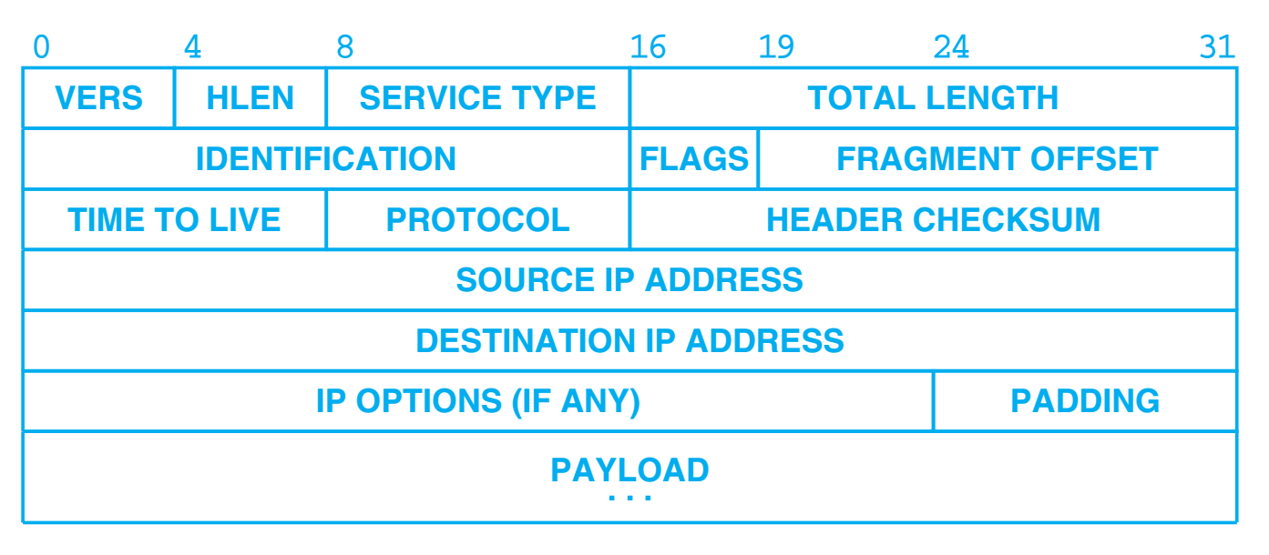
IPv4 Datagram Format
VERS - version IP protocol (value: 4, for IPv4) HLEN - gives the datagram header length. To indicate if optional header fields are included. Service Type - Differentiated services, such as low-latency voice or streaming media, or best-effort service for web etc. Total Length - gives the length of the IP datagram measured in octets, including the header and payload.

Slide 9
IPv4 Datagram Format
Identification - unique number assigned to a datagram to help in the reassembly (Flags & Fragments Offset fields also involved with fragmentation and reassembly) Time to Live - Time that the datagram is allowed to exist on the network. A router that processes the packet decrements this by one. Once the value reaches 0, the packet is discarded. Protocol - specifies which high-level protocol was used to create the message carried in the PAYLOAD, specifying the format of the PAYLOAD area. Header Checksum - used to detect corruption in the header. Source & Destination IP Addresses - original sender and ultimate destination.

Slide 10
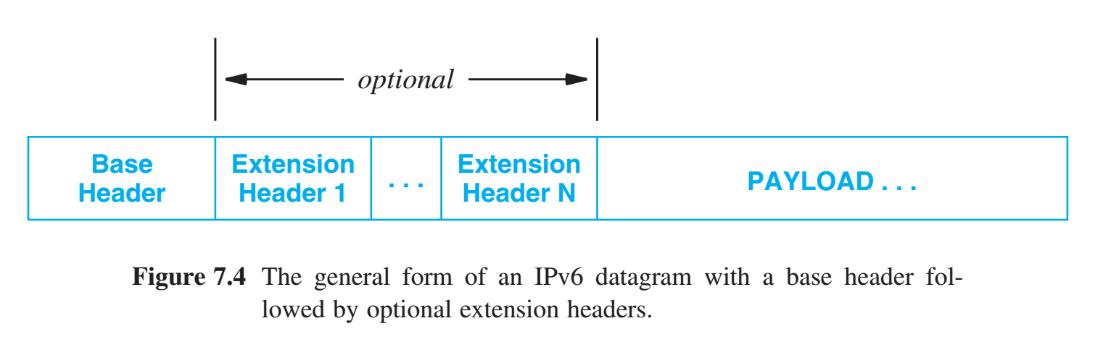
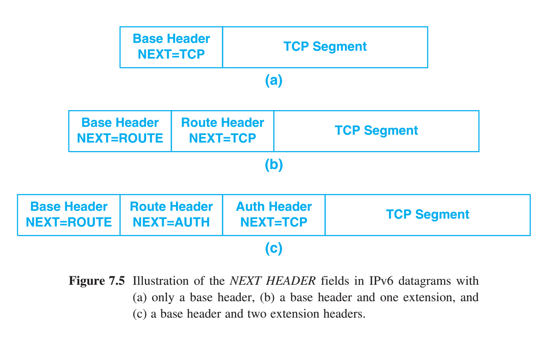
IPv6 Datagram Format
Instead of trying to specify all details in a single header, IPv6 uses an extension capability that allows the IETF to adapt the protocol. NEXT HEADER field that specifies the type of the header that follows. The final header uses the NEXT HEADER field to specify the type of the payload.
The IPv6 address size increases inefficiency. But having fewer fixed fields, helps increase efficiency, since most datagrams do not use all mechanisms.

Slide 11
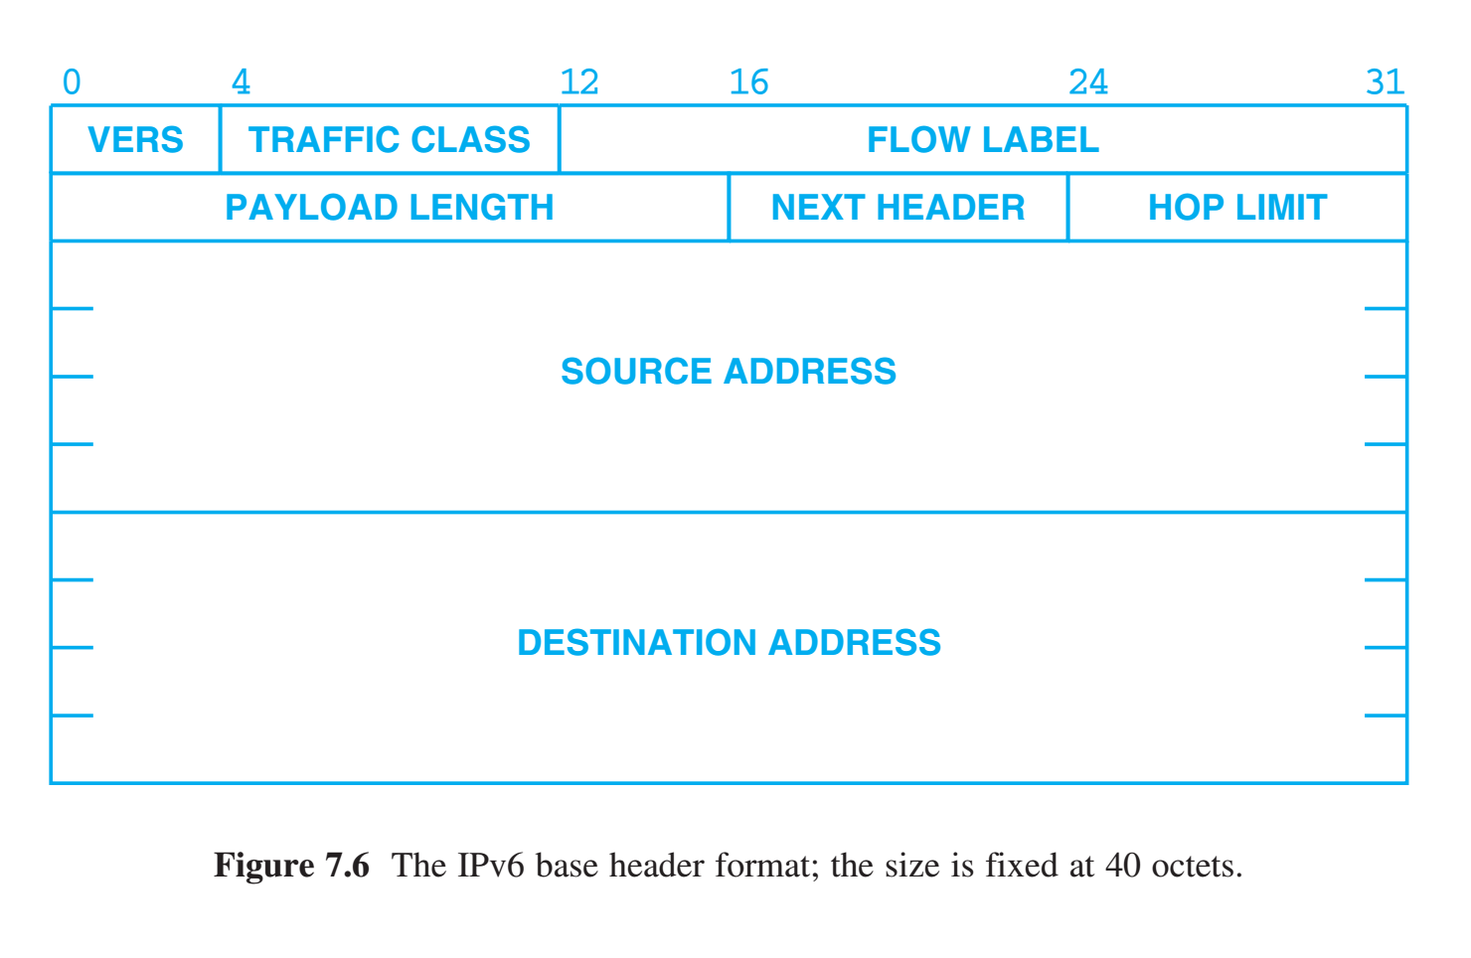
IPv6 Datagram Format
40 octet base header VERS - version IP protocol (value: 6, for IPv6) Traffic Class similar to IPv4 Service Type Flow Label - Flow consists of a path through an internet. Intermediate routers along the path guarantee a specific quality of service for packets on the flow. The FLOW LABEL holds an ID that allows a router to identify the flow, which is used instead of the destination address when forwarding a datagram.

Slide 12
IPv6 Datagram Format
Payload Length - the size of data being carried, but does not include the header. IPv6 includes an extension header that specifies a larger datagram known as a jumbogram.
Next Header - appears in all base header and enables the extension, and in the final header, gives the type of the payload. Hop Limit - specifies the maximum number of networks the datagram can traverse before being discarded.
Source and Destination Address - original sender and ultimate destination.

Slide 13
Datagram Type of Service & Differentiated Services
Informally called Type Of Service (TOS), the 8-bit SERVICE TYPE field in an IPv4 header and the TRAFFIC CLASS field in an IPv6 header specify how the datagram should be handled. In IPv4, the field was originally divided into subfields that specified the datagram’s precedence and desired path characteristics (low delay or high throughput). In the late 1990s, the IETF redefined the meaning of the field to accommodate a set of differentiated services (DiffServ). Most networks use the following commonly defined per-hop behaviors:
Default Forwarding (DF) PHB — which is typically best-effort traffic Expedited Forwarding (EF) PHB — dedicated to low-loss, low-latency traffic: suitable for voice, video, realtime services. Assured Forwarding (AF) PHB — gives assurance of delivery under prescribed conditions Class Selector PHBs — which maintain backward compatibility with the IP precedence field that predates DiffServ

Slide 14
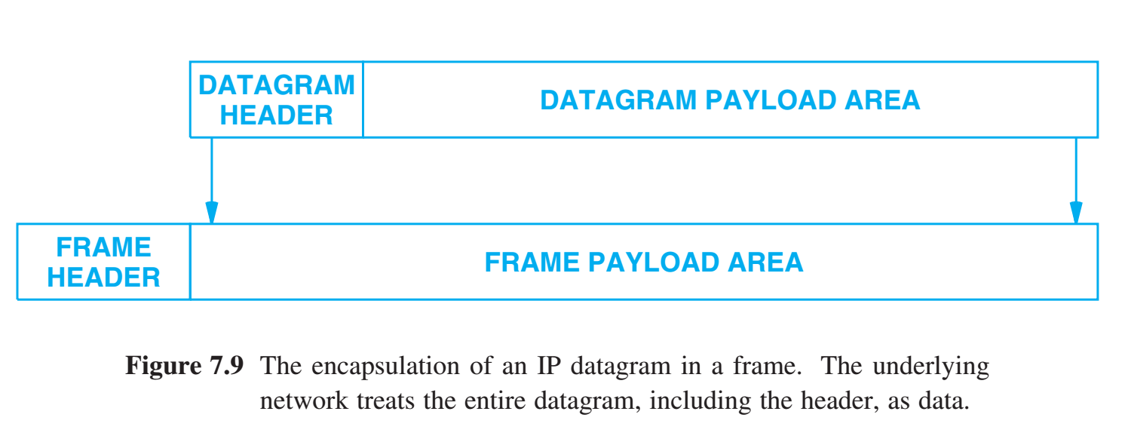
Datagram Encapsulation
Encapsulation - carrying one datagram in one network frame (IPv4 & IPv6) To the underlying network, a datagram is like any other message sent from one machine to another — the network hardware does not recognize the datagram format, nor does it understand the IP destination address.

Slide 15
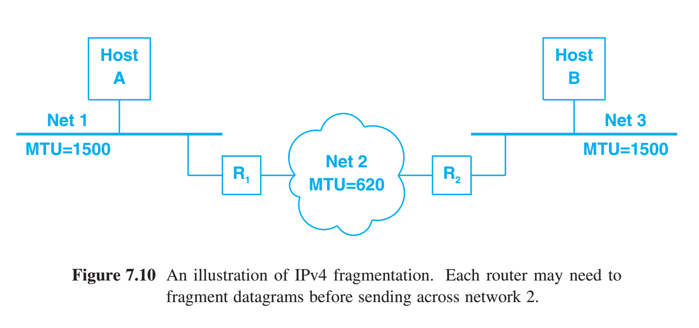
Datagram Size, Network MTU, and Fragmentation
Each packet switching technology places a fixed upper bound on the amount of data that can be transferred in one frame. We refer to the size limit as the network’s maximum transfer unit or maximum transmission unit (MTU) Potential conflict between an app’s datagram size versus a network’s MTU. Design Principles The internet technology should accommodate the greatest possible variety of network hardware. The internet technology should accommodate the greatest possible variety of network applications.
The path MTU from host A to host B is 620. When Host A sends a datagram to Host B Host A insures the datagram fits the MTU of network 1 Using fragmentation Router 1 insures the datagram fits the MTU of network 2

Slide 16
Datagram Size, Network MTU, and Fragmentation
Each packet switching technology places a fixed upper bound on the amount of data that can be transferred in one frame. We refer to the size limit as the network’s maximum transfer unit or maximum transmission unit (MTU) Potential conflict between an app’s datagram size versus a network’s MTU. Solution The solution is known as fragmentation. TCP/IP protocols allow each application to choose a datagram size that is best suited to the application. Then when transferring a datagram, routers check the size to see if the datagram is less than the MTU of the network the packet is being forwarded onto. If the datagram does not fit into a frame, the datagram is divided into smaller pieces called fragments. The process of dividing a datagram is known as fragmentation.
The path MTU from host A to host B is 620. When Host A sends a datagram to Host B Host A insures the datagram fits the MTU of network 1 Using fragmentation Router 1 insures the datagram fits the MTU of network 2

Slide 17
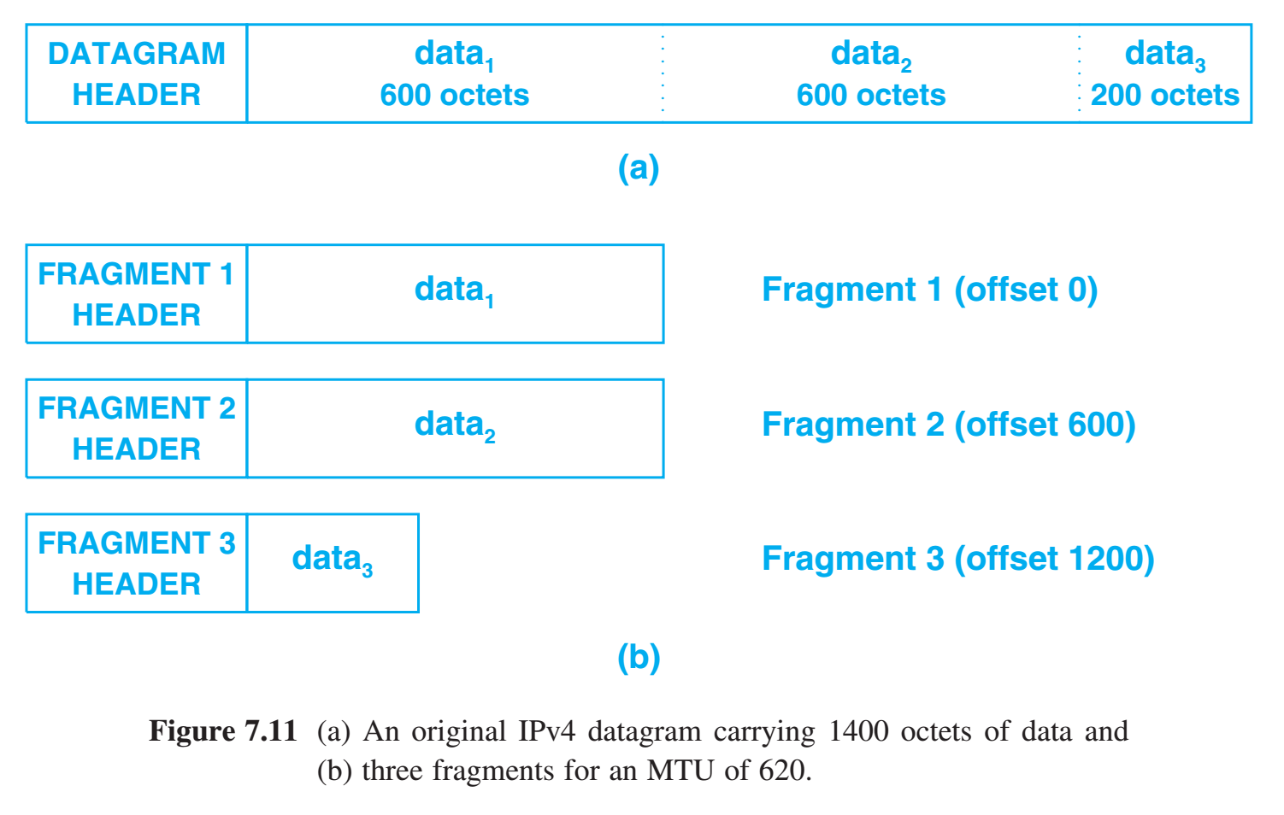
Datagram Size, Network MTU, and Fragmentation
Each packet switching technology places a fixed upper bound on the amount of data that can be transferred in one frame. We refer to the size limit as the network’s maximum transfer unit or maximum transmission unit (MTU) Potential conflict between an app’s datagram size versus a network’s MTU. Solution IPv4 fragmentation occurs automatically at any point along the path when a datagram is too large for a network over which it must pass; the source only needs to insure that datagrams can travel over the first hop. Each fragment contains a datagram header that duplicates most of the original datagram header (except for bits in the FLAGS field that specify fragmentation),

Slide 18
IPv6 Fragmentation & Path MTU Discovery
Instead of delayed fragmentation, IPv6 uses a form of early binding: the original source host is required to find the minimum MTU along the path to the destination and fragment each datagram according to the path it will take. IP routers along the path are not permitted to fragment IPv6 datagrams; if a datagram does not fit into the MTU of a network, the router sends an error message to the original source and drops the datagram.
Because networking technologies used in the Internet do not inform a host about the path MTU, a host must engage in a trial-and-error mechanism to determine the path MTU. Known as Path MTU Discovery (PMTUD), the mechanism consists of sending an IPv6 datagram that fits in the MTU of the directly-connected network. If a network along the path has a smaller MTU, a router will send an ICMP error message to the original source that specifies the smaller MTU.

Slide 19
Datagram Reassembly
In the Internet, the ultimate destination reassembles fragments. The design means that routers do not need to store fragments or keep other information about packets. Header Fields Used for Datagram Reassemble Three fields in an IPv4 datagram header or an IPv6 Fragment Extension Header control reassembly: IDENTIFICATION, FLAGS (M in IPv6), and FRAGMENT OFFSET.

Slide 20
Time to Live (IPv4) and Hop Limit (IPv6)
IP software in each machine along a path from source to destination decrements the field known as TIME-TO-LIVE (IPv4) or HOP LIMIT (IPv6). When the field reaches zero the datagram is discarded. A router does more than merely discard a datagram when the TTL reaches zero. A router does more than merely discard a datagram when the TTL reaches zero — the router sends an error message back to the source.

Slide 21
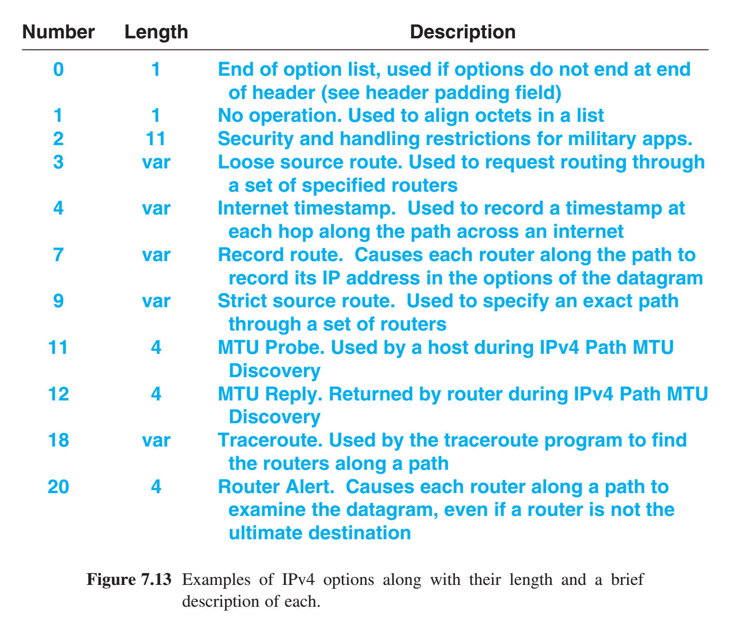
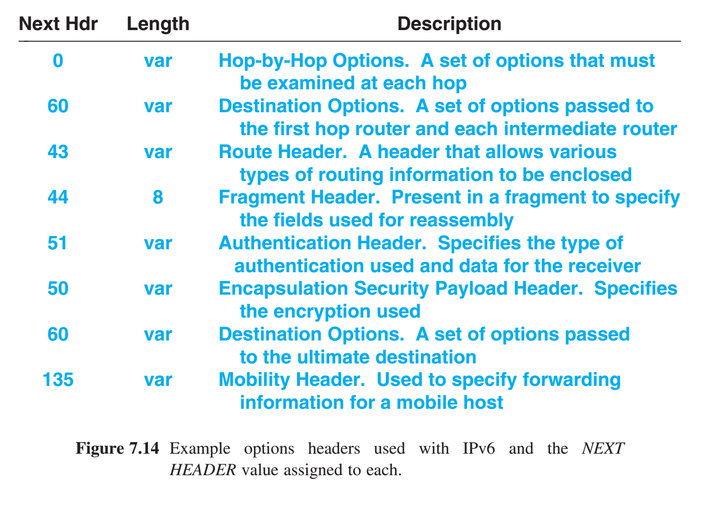
Optional IP Items
Both IPv4 and IPv6 define optional items that can be included in a datagram. In IPv4, the IP OPTIONS field that follows the destination address is used to send optional items. In IPv6, each of the extension headers is optional, and a given datagram may include multiple extensions. Optional IP items provide greater control.

Slide 22
Network Byte Order… Big or Little Endian? Big
The Internet protocols define network byte order to be big endian. A sender must convert all integer fields in packet headers to network byte order before sending a packet, and a receiver must convert all integer fields in packet headers to local byte order before processing a packet.

Slide 23
Summary / Key Concepts
A Virtual Network Internet Architecture & Philosophy Principles Behind the Structure Connectionless Delivery System Characteristics Purpose and Importance of the Internet Protocol The IP Datagram Datagram Type of Service and Differentiated Services Datagram Encapsulation Datagram Size, Network MTU, and Fragmentation Datagram Reassembly Header Fields Used for Datagram Reassembly Time to Live (IPv4) and Hop Limit (IPv6) Optional IP Items Optional Processing During Fragmentation Network Byte Order

Slide 24
Quiz Graphic
R1
MTU 1200
MTU 700
MTU 500
H.Z
H.A
R2

