Slide 1
CSC I367 Computer Networking Internet Protocol: Forwarding IP Datagrams

Slide 2
Overview - Forwarding IP Datagrams
Forwarding in an Internet Direct and Indirect Delivery Transmission Across a Single Network Indirect Delivery Table-Driven IP Forwarding Next-Hop Forwarding Default Routes and a Host Example Host-Specific Routes The IP Forwarding Algorithm Longest-Prefix Match Paradigm Forwarding Tables and IP Addresses Handling Incoming Datagrams

Slide 3
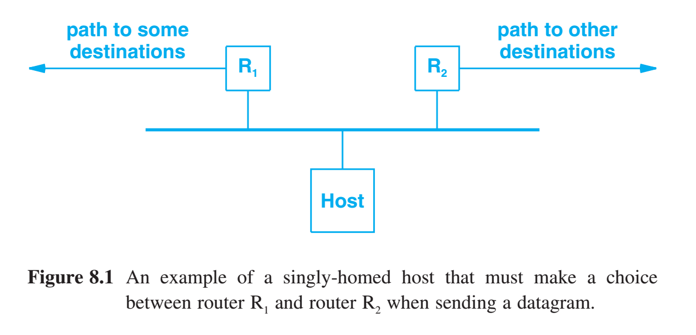
Forwarding in an Internet
A router performs transit forwarding, which means the router will accept incoming datagrams from any of the networks to which the router attaches, and will forward each datagram on toward its destination. Forwarding Direct delivery, the transmission of a datagram from one machine across a single physical network directly to another. Indirect delivery occurs when the destination of a datagram is not on a directly attached network.

Slide 4
Direct Delivery - Transmission on a Single Network
Sender encapsulates the datagram in a physical frame - maps the next-hop IP address to a hardware address - places the hardware address in the frame - and uses the network hardware to transfer the frame IPv4 typically uses ARP IPv6 uses Neighbor Discovery
Transmission of an IP datagram between two machines on a single physical network does not involve intermediary routers. The sender encapsulates the datagram in a physical frame, binds the next-hop address to a physical hardware address, and sends the resulting frame directly to the destination.

Slide 5
Indirect Delivery
Routers form a cooperative, interconnected structure. Datagrams pass from router to router until they reach a router that can deliver the datagram directly.
host only knows about directly-connected networks
host relies on routers to transfer datagrams to remote destinations.
Routers know how to reach all possible destinations in the internet
given a datagram, a router can forward it correctly.

Slide 6
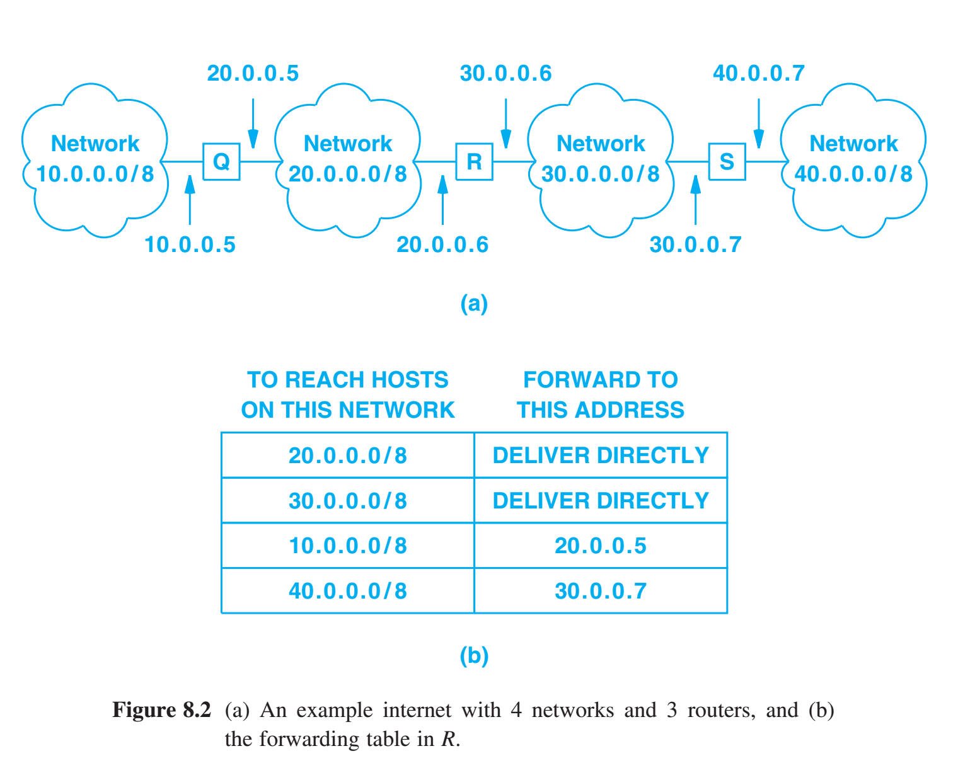
Table-Driven IP Forwarding
The IP forwarding algorithm employs a data structure that stores information about possible destinations and how to reach them. The data structure is known formally as an Internet Protocol forwarding table or IP forwarding table. - both hosts and routers have a forwarding table - forwarding tables use network prefixes. Their design is based on the principle of information hiding, enabling machines to make forwarding decisions with minimal information

Slide 7
Next-Hop Forwarding
Forwarding tables contain a set of pairs (N & R) - N: network prefix for a network in the internet - R: IP address for the “next” router on the path to N Router R is called the next hop, and the idea of using a forwarding table to store a next hop for each destination is called next-hop forwarding.
The forwarding table specifies one step along the path towards the destination network — the router does not know the complete path to a destination.
Each entry in a forwarding table points to a router that can be reached across a single network.

Slide 8
Because R is connected to network 20.0.0.0 and network 30.0.0.0, it can use direct delivery when sending a datagram to a host on either network.

Slide 9
When router R sends a datagram with a destination on network 40.0.0.0 indirect delivery is needed. R forwards the datagram to router S interface address 30.0.0.7, and then S forward the datagram using direct delivery.

Slide 10
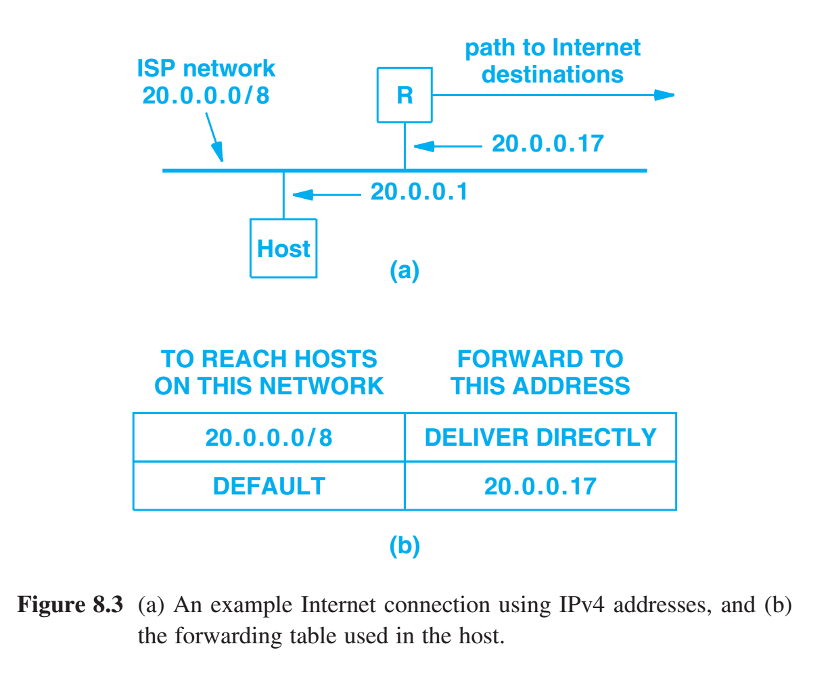
Default Routes and a Host Example
A default route is especially useful when many destinations lie beyond a single router. The IP design includes an interesting optimization that further hides information and reduces the size of forwarding tables: consolidation of multiple entries into a single default case.

Slide 11
Host-Specific Routes
Although forwarding is based on networks and not on individual hosts, most IP forwarding software allows a host-specific route to be specified as a special case. Having host-specific routes gives a network administrator more control, that is useful in the following cases: Control over network use. An administrator can send traffic for certain hosts along one path and traffic for remaining hosts along another path. For example, an administrator can separate traffic destined to the company’s web server from other traffic. Testing a new network. A new, parallel network can be installed and tested by sending traffic for specific hosts over the new network while leaving all other traffic on the old network. Security. An administrator can use host-specific routes to direct traffic through security systems. For example, traffic destined to the company’s financial department may need to traverse a secure network that has special filters in place.

Slide 12
The IP Forwarding Algorithm
Given everything we’ve discussed thus far, it may seem that IP software should take the following steps when deciding how to forward a datagram: 1. Extract the destination IP address (D) from the datagram 2. If the forwarding table contains a host-specific entry for D, forward the datagram to the next hop specified in the entry 3. If D prefix matches any directly connected network, direct delivery over the network to D 4. If the forwarding table contains an entry that matches the network prefix of D, forward the datagram to the next hop 5. If the forwarding table contains a default route, forward the datagram to the next hop specified in the default route
6. If none of the above cases has forwarded the datagram, declare a forwarding error

Slide 13
The IP Forwarding Algorithm
The unified lookup scheme requires four items to be specified for each entry in the forwarding table: 1. The IP address (A) that gives the destination for the entry 2. An address mask (M) that specifies how many bits of A to examine 3. The IP address of a next-hop router (R), or “deliver direct” 4. A network interface (I) to use when sending

Slide 14
The IP Forwarding Algorithm
The unified lookup scheme requires four items to be specified for each entry in the forwarding table: 1. The IP address (A) that gives the destination for the entry 2. An address mask (M) that specifies how many bits of A to examine 3. The IP address of a next-hop router (R), or “deliver direct” 4. A network interface (I) to use when sending
A & M define a network prefix — the mask specifies which bits of the destination address to use during comparison. The IP address A, gives a value against which to compare. In slash notation, the length of a mask is given explicitly (e.g., / 28 denotes a mask with length 28 bits). For IPv6: / 64 mask will compare the first 64 bits of the address = network prefix / 128 mask compare all 128 bits of address = a host-specific route 0 value compares none = a default route

Slide 15
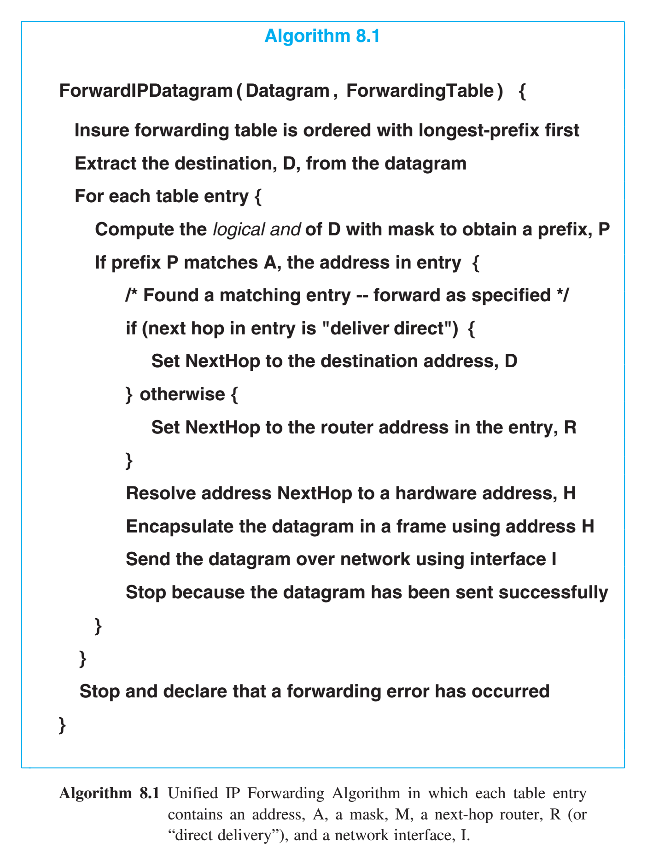
Longest-Prefix Match Paradigm
We use the term longest-prefix match to describe the idea of examining the most specific routes first. If we imagine the forwarding table to be an array, the longest prefix match rule means entries in the array must be sorted in descending order according to the length of their mask. To make the algorithm work correctly, entries in the table must be examined in an order that guarantees entries with a longer mask are checked before entries with a shorter mask. For example, suppose the table contains a host-specific route for a host X and also contains a network-specific route for the network portion of X. Both entries will match X, but forwarding should choose the most specific match (i.e., the host-specific route).

Slide 16
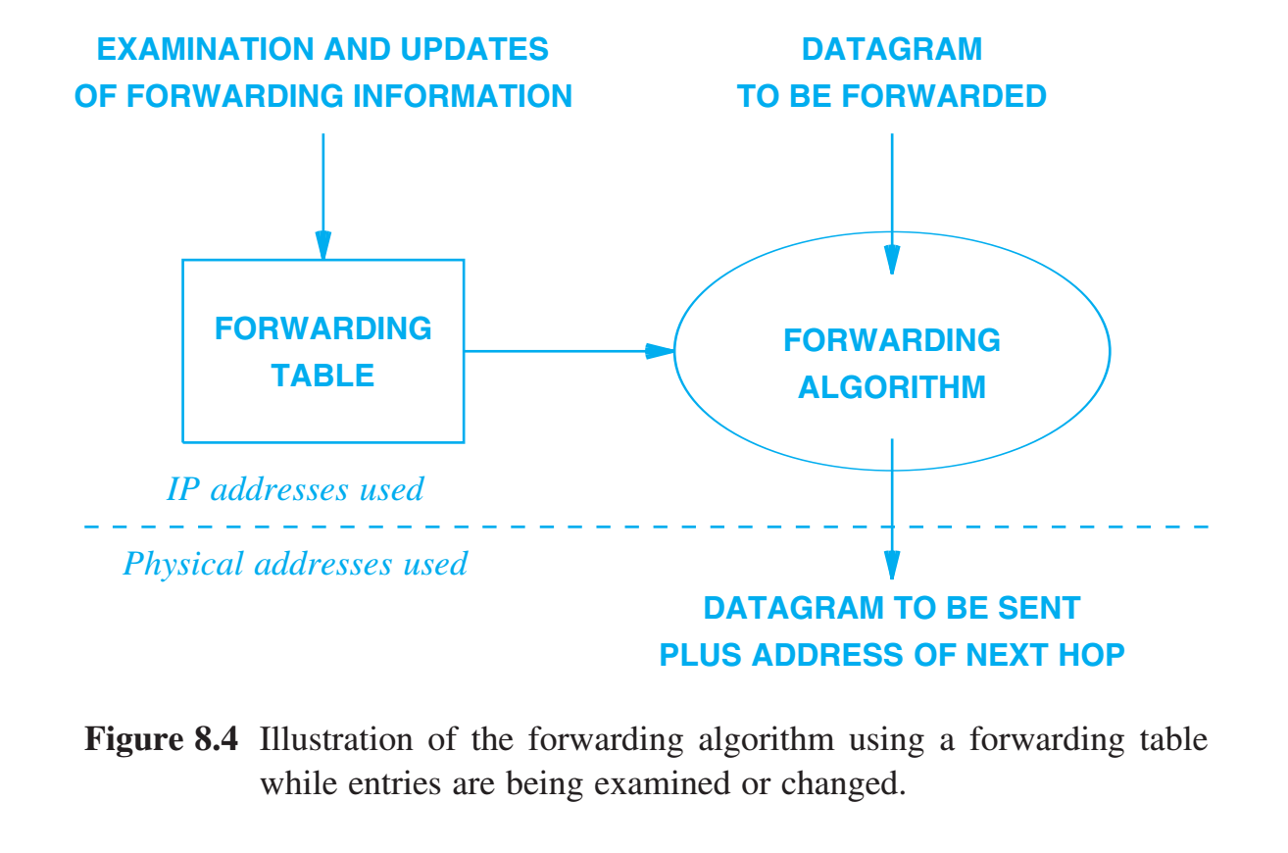
Forwarding Tables & IP Addresses
Except for decrementing the hop limit (TTL in IPv4) and recomputing the checksum, IP forwarding does not alter the original datagram. The datagram’s source and destination addresses remain unaltered, but when executing the forwarding algorithm, IP computes a new address -- the IP address of the machine to which the datagram should be sent next, most likely a router. This is called the next-hop address. If the datagram can be delivered directly, the new address is the same as the address of the ultimate destination. Once the next-hop address is determined, the network interface must map the next-hop address to a hardware address, create a frame, place the hardware address in the destination address field of the frame, encapsulate the datagram in the payload area of the frame, and transmit the result. Once it has obtained a hardware address, the network interface software discards the next-hop address.

Slide 17
Handling Incoming Datagrams
IP software must process incoming datagrams in addition to forwarding datagrams. When an IP datagram arrives at a host: - the network interface delivers the datagram to the IP module for processing - If the datagram and host’s IP addresses match - IP software on the host accepts & passes it to the appropriate higher-level protocol software - If the destination IP address does not match host, the host is required to discard the datagram

Slide 18
Handling Incoming Datagrams
IP software must process incoming datagrams in addition to forwarding datagrams. When an IP datagram arrives at a router, two cases arise: - the datagram must be forwarded - uses standard algorithm, destination IP address, and local forwarding table. - the datagram has reached its final destination intended for an app on the router (such as a network management application) - IP software on the router accepts & passes it to the appropriate higher-level protocol software

Slide 19
Summary / Key Concepts
Forwarding in an Internet Direct and Indirect Delivery Transmission Across a Single Network Indirect Delivery Table-Driven IP Forwarding Next-Hop Forwarding Default Routes and a Host Example Host-Specific Routes The IP Forwarding Algorithm Longest-Prefix Match Paradigm Forwarding Tables and IP Addresses Handling Incoming Datagrams

