Slide 1
CSC I367 Computer Networking Internet Protocol: Error & Control messages (ICMP)

Slide 2
Overview - IP: Error & Control messages (ICMP)
The Internet Control Message Protocol Error Reporting vs Error Correction ICMP Message Delivery Conceptual Layering ICMP Message Format Example ICMP Message Types Used with IPv4 & IPv6 Testing Destination Reachability and Status Echo Request and Reply Message Format Checksum Computation and the IPv6 Pseudo-Header Reports of Unreachable Destinations ICMP Error Reports Regarding Fragmentation Route Change Requests from Routers Detecting Circular or Excessively Long Routes Reporting other Problems Older ICMP Messages used at Startup

Slide 3
The Internet Control Message Protocol
Internet Control Message Protocol (ICMP) enables routers to send error or control messages back to the source of a datagram that caused a problem. ICMP is: - required part of IP - error reporting mechanism: enables routers that encounter an error to communicate that error with the source - communication between ICMP modules on different machines, not applications. Limitations - If the problem comes from a router the original source has no ability control the misbehaving router.

Slide 4
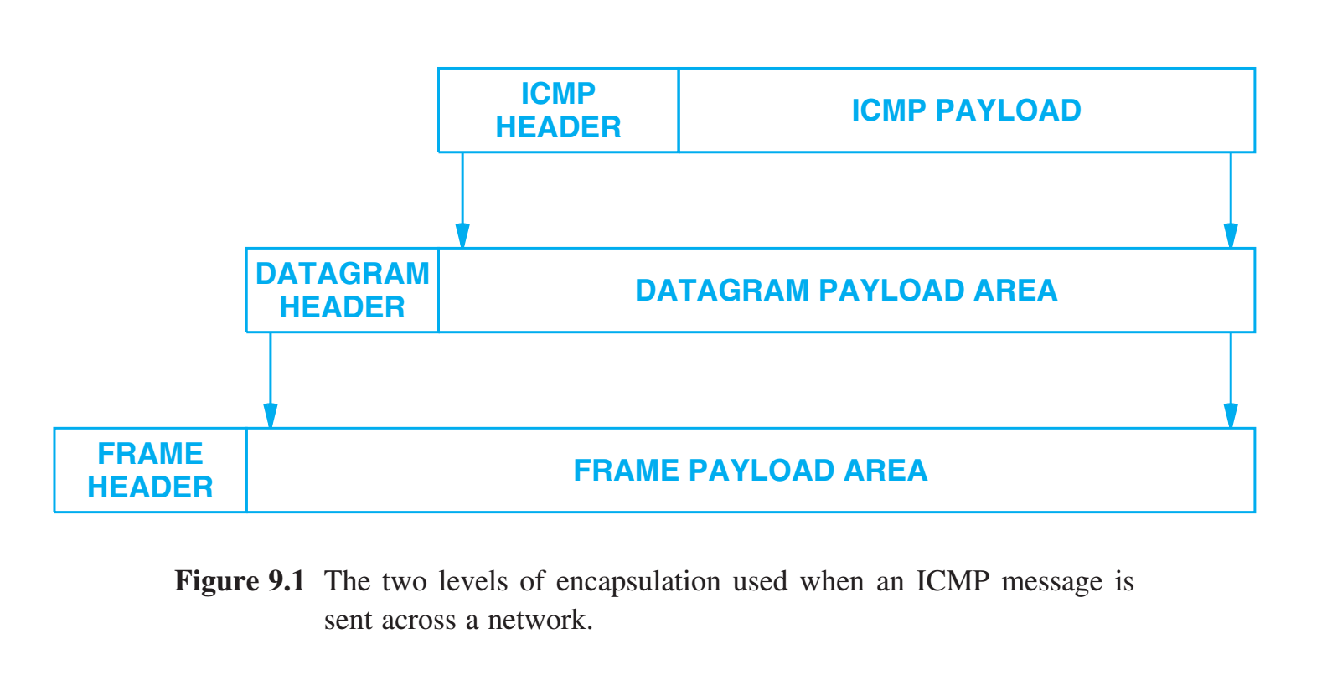
ICMP Message Delivery
ICMP messages travel in the payload area of IP datagrams. Two levels of encapsulation are required.
Assumption Errors are rare, and datagrams with ICMP messages will be delivered. Errors are indeed rare.

Slide 5
ICMP Message Delivery
IPv4 PROTOCOL field in the datagram header as a type field. PROTOCOL field is set to 1. IPv6 NEXT HEADER field in the datagram header to specify ICMP NEXT HEADER field before the ICMP message contains 58.

Slide 6
ICMP Message Delivery
Encapsulation typically involves diff conceptual layers, but ICMP represents an exception. ICMP is not considered a higher-level protocol. Instead, ICMP is a required part of IP, which means ICMP is classified as a Layer 3 protocol.

Slide 7
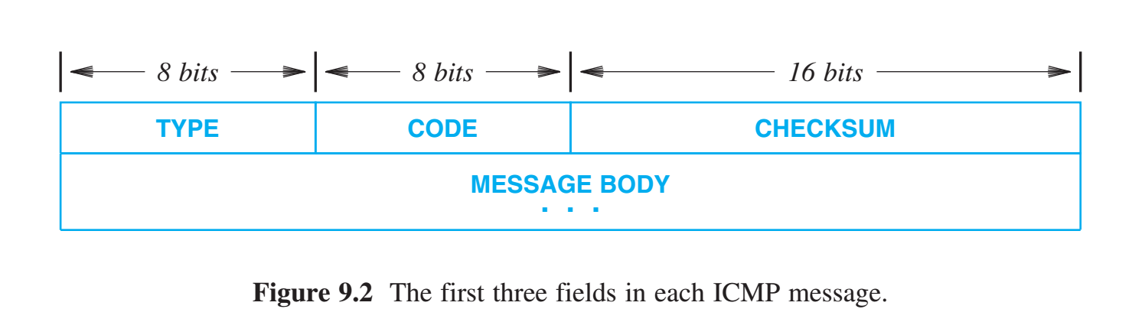
ICMP Message Format
Two ICMP formats, one for IPv4 and another for IPv6. ICMP IPv4 & IPv6 messages begin with the same three fields: TYPE field identifies the specific ICMP message that follows, and used by the receiver to know how to parse rest of the message. CODE field provides further information about the message type. For example, ICMP TIME EXCEEDED message can have a code value to indicate that the hop count (TTL) of the datagram reached zero or that reassembly timed out before all fragments arrived. CHECKSUM checking for errors.

Slide 8
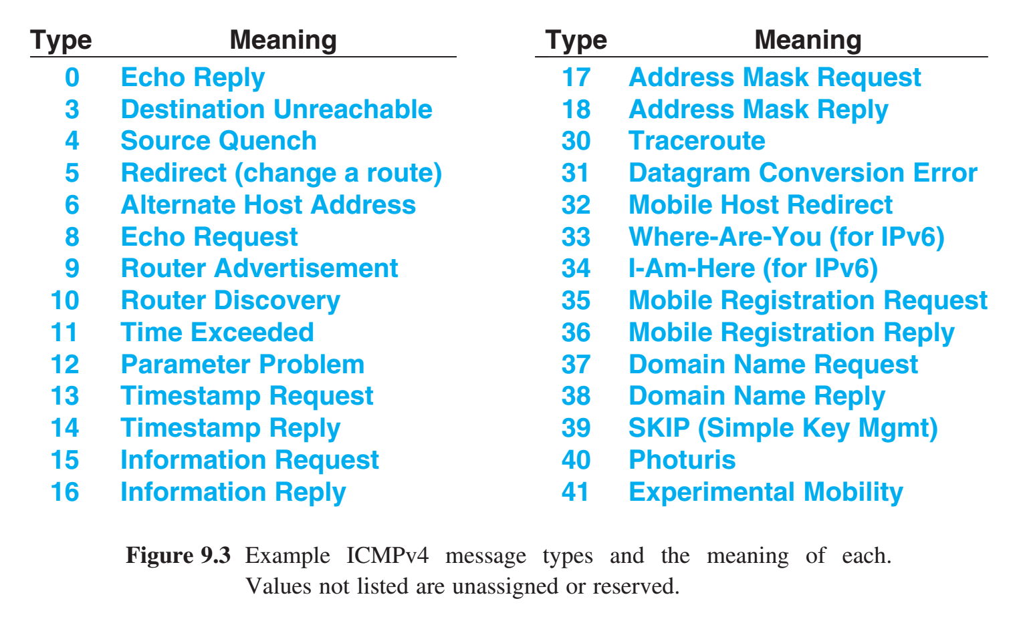
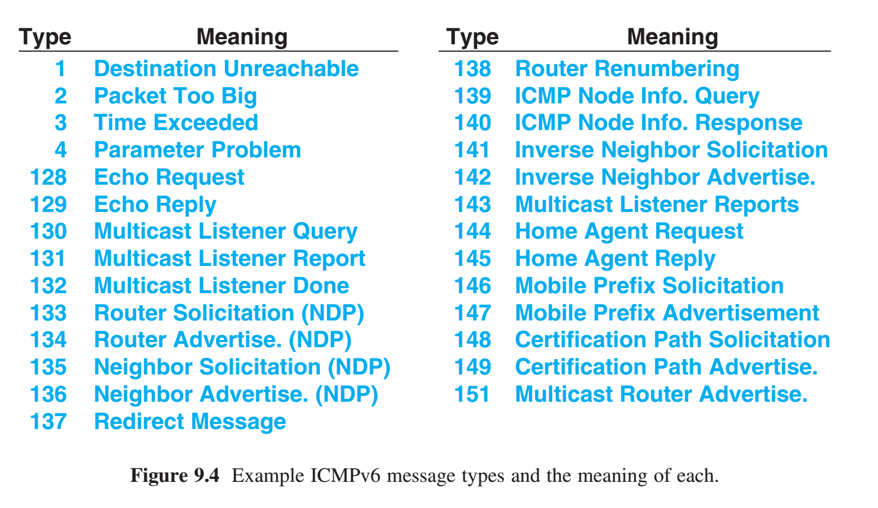
Example ICMP Message Types Used IPv4 & v6
IPv4 ICMP messages were designed to carry information rather than error messages IPv6 distinguishes between error & informational messages by dividing the type values: 1-128 error & 128 - 255 information IPv6 ICMP messages are defined for three major subsystems: Neighbor Discovery Protocol, Multicast, and IP mobility.

Slide 9
Testing Destination Reachability and Status (Ping)
The ping program verifies that major pieces of the IP transport system are working correctly. Ping is perhaps the most widely used internet diagnostic tool, for both IPv4 & v6 Ping sends an ICMP Echo Request message to a remote computer. The computer receiving an ICMP Echo Request creates an ICMP Echo Reply that is sent to the original sender. Most versions of ping also allow a user to specify the amount of data being sent in each request. Sending a large ping packet is useful for testing fragmentation and reassembly. Large packets also force IPv6 to engage in path MTU discovery. Thus, a seemingly trivial application has several uses.

Slide 10
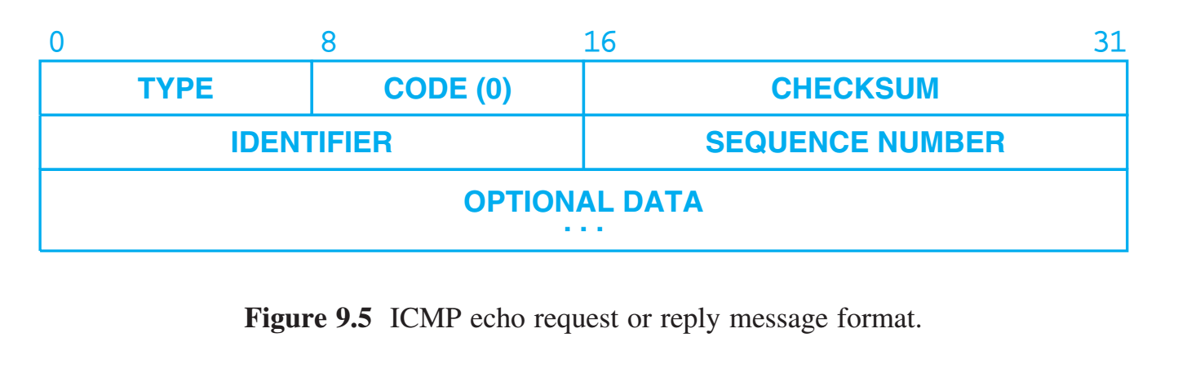
Echo Request and Reply Message Format
IPv4 & IPv6 use the same ICMP Echo Request & Reply format IPv4 TYPE is 8 in a request and 0 in a reply. IPv6 TYPE is 128 in a request and 129 in a reply. IPv4 & IPv6 CODE is zero IDENTIFIER and SEQUENCE NUMBER are used by the sender to match replies to requests. A receiving ICMP does not interpret the two fields, but does return the same values in the reply that were found in the request.
OPTIONAL DATA is a variable length field. An echo reply always returns exactly the same data as was received in the request. CHECKSUM the receiver must validate the checksum and to discard ICMP messages that have an invalid checksum. While checksum is required for both IPv4 & IPv6, IPv6 adds additional steps. The checksum used with IPv6 also covers fields from the IP base header.

Slide 11
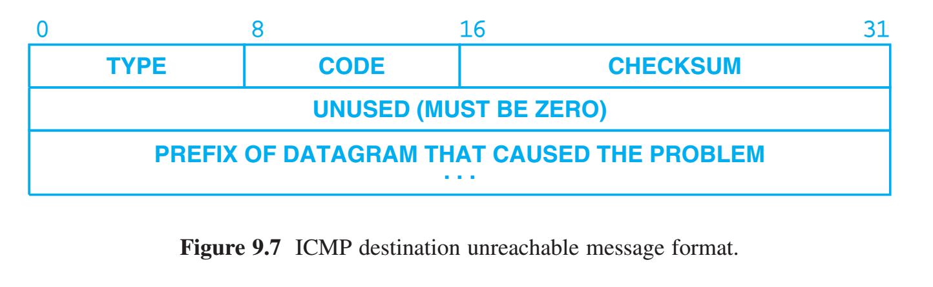
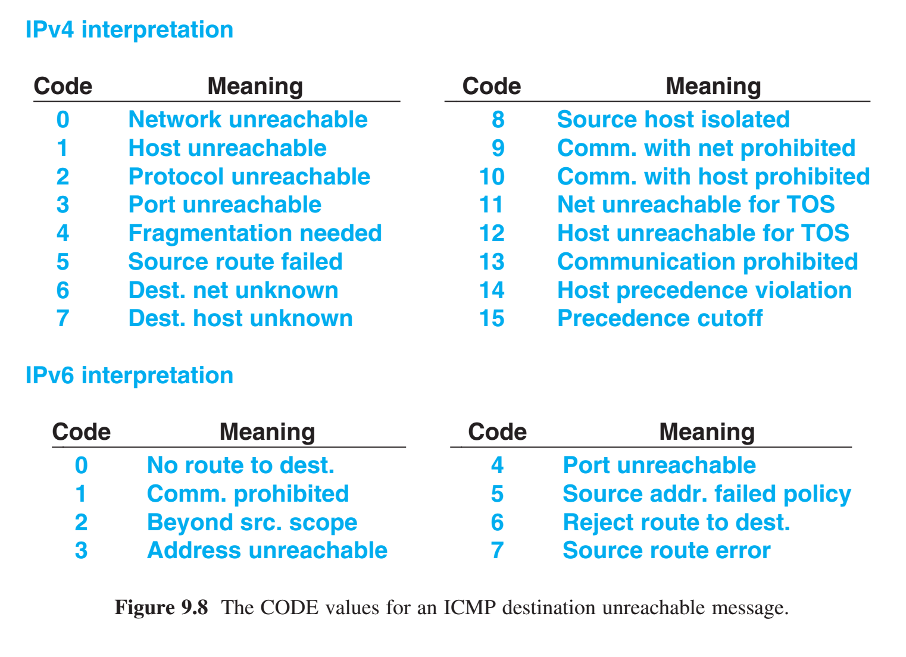
Reports of Unreachable Destinations
If a router can not forwarding or delivering a datagram, the router: 1. sends an ICMP destination unreachable message back to the source 2. drops the datagram Network unreachable errors = forwarding failed at an intermediate point host unreachable errors = delivery failed at the final hop IPv4 & IPv6 use the same format for destination unreachable messages. IPv4 sets the TYPE field to 3 IPv6 sets the TYPE field to 1 CODE field contains an integer that further describes the problem codes for IPv4 and IPv6 differ

Slide 12
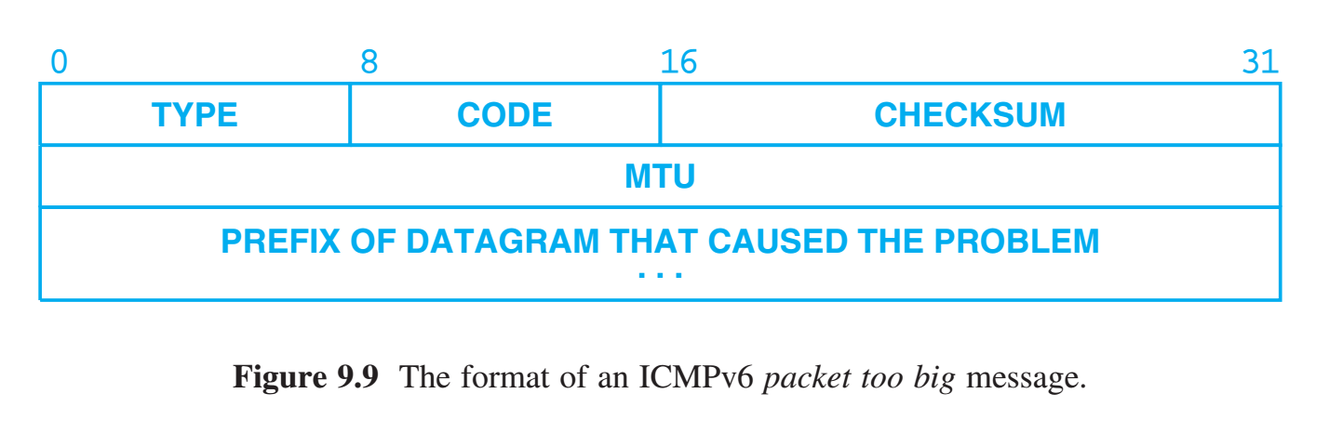
ICMP Error Reports Regarding Fragmentation
For both IPv4 & IPv6 routers report an error when a datagram is too large for a network’s maximum transmission unit (MTU).
IPv4 sends a destination unreachable message CODE field set to 4 IPv6 sends a packet too big message TYPE field set to 2. It may seem that no fragmentation reports are needed for IPv4 because a router can fragment an IPv4 datagram. But IPv4 headers include a “do not fragment” bit, in which case an error message is required.

Slide 13
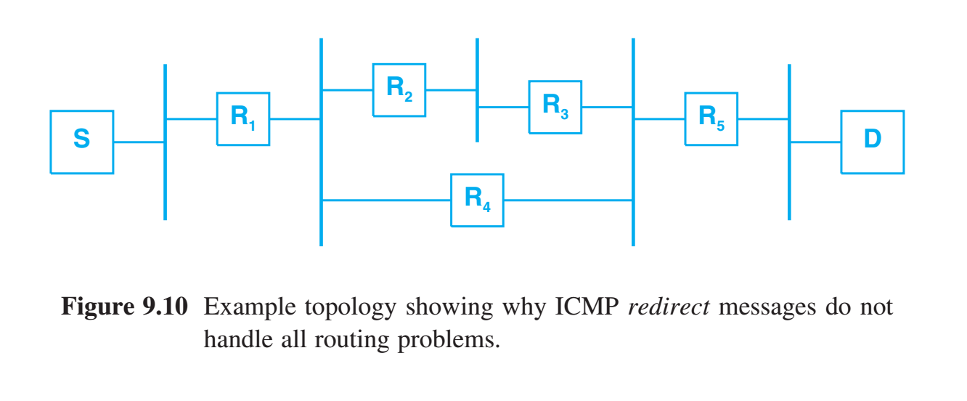
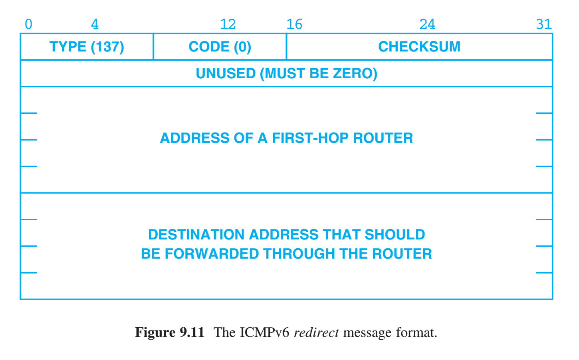
Route Change Requests from Routers
Host forwarding tables usually remain static over long periods of time.
When a router detects a host using a nonoptimal first hop, the router sends the host an ICMP redirect message that instructs the host to change its forwarding table. The router also forwards the original datagram on to its destination.
A router only sends a redirect message if the host sends a datagram along a non-preferred route. Thus, the host forwarding table remains small, but will have optimal routes for all destinations in use.

Slide 14
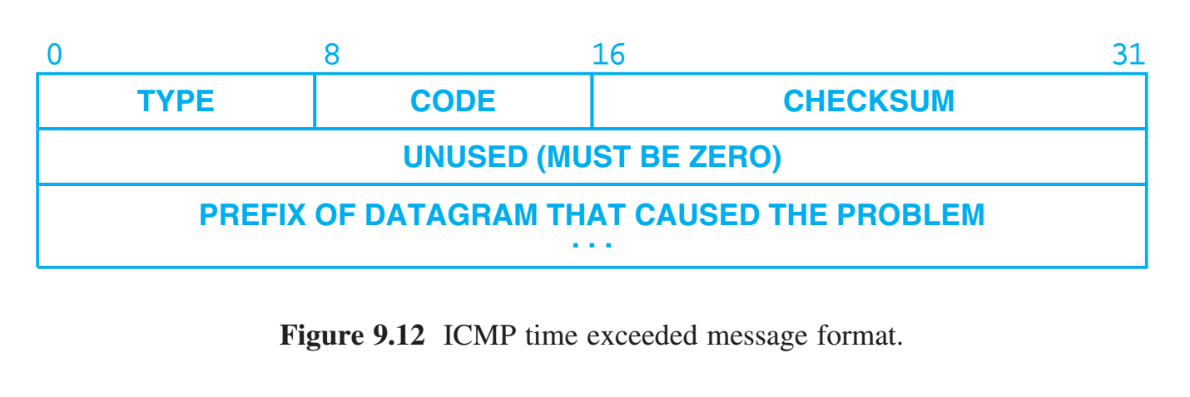
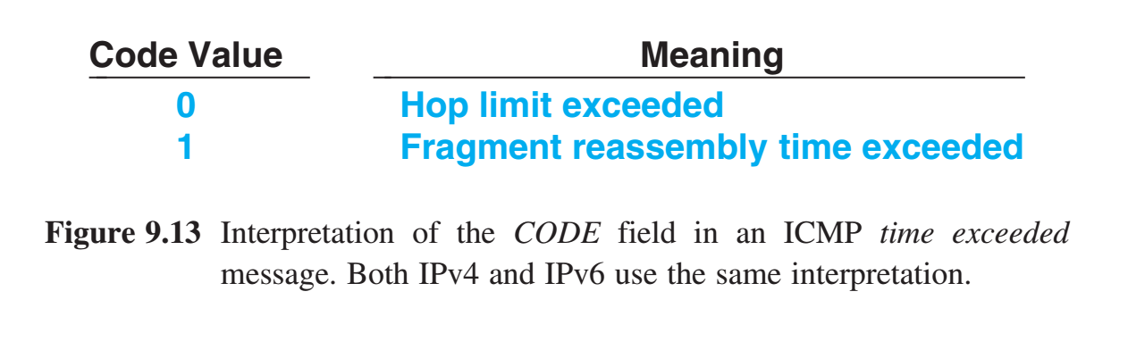
Detecting Circular or Excessively Long Routes
Forwarding errors can produce a cycle known as a routing loop Solution Hop limit - whenever a router processes a datagram it decrements the hop limit, an discards the datagram when the count reaches zero. Router then send the source an ICMP time exceeded message. IPv4 and IPv6 use the same message format IPv4 TYPE to 11 IPv6 TYPE to 3 CODE field explains the nature of the timeout being reported

Slide 15
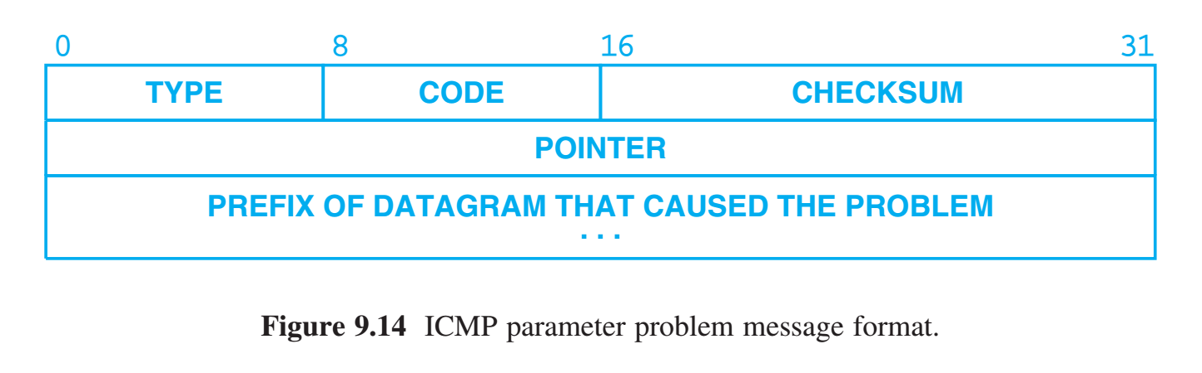
Reporting other Problems
When a router or host finds problems with a datagram not covered by previous ICMP error messages it sends a parameter problem message to the original source. CODE field to distinguish among subproblems Such messages are only sent when a problem is so severe that the datagram must be discarded.

Slide 16
Older ICMP Messages used at Startup
Originally, ICMP defined a set of messages that a host used at startup to determine its IP address, the address of a router, and the address mask used on the network. Eventually, a protocol known as DHCP was introduced that provides an IPv4 host with all the necessary information in a single exchange. ICMPv6 has returned to one of the ideas that was originally part of ICMPv4: router discovery. At startup, an IPv6 host multicasts an ICMPv6 Router Discovery message to learn about routers on the local network. There are two conceptual differences between router discovery and DHCP that make it attractive for IPv6. First, because the information is obtained directly from the router itself, there is never a third-party error. With DHCP, such errors are possible because a DHCP server must be configured with information to hand out. If a network manager fails to update the DHCP configuration after a network changes, hosts may be given out-of-date information. Second, ICMP router discovery uses a soft state technique with timers to prevent hosts from retaining a forwarding table entry after a router crashes — routers advertise their information periodically, and a host discards a route if the timer for the route expires.

Slide 17
Summary / Key Concepts
ICMP Internet Control Message Protocol Required part of IP Conceptual Layering & encapsulation Message Format Common uses Ping Reports of Unreachable Destinations ICMP Error Reports Regarding Fragmentation Route Change Requests from Routers Detecting Circular or Excessively Long Routes Reporting other Problems

