Slide 1
CSC I367 Computer Networking User Datagram Protocol (UDP)

Slide 2
Overview - User Datagram Protocol (UDP)
Using a Protocol Port as an Ultimate Destination The User Datagram Protocol UDP Message Format UDP Checksum Computation and the Pseudo-Header IPv4 UDP Pseudo-Header Format IPv6 UDP Pseudo-Header Format UDP Encapsulation and Protocol Layering Layering and the UDP Checksum Computation UDP Multiplexing, Demultiplexing, and Protocol Ports Reserved and Available UDP Port Numbers

Slide 3
Using a Protocol Port as an Ultimate Destination
To help manage the heterogeneous nature of different operating systems, each machine contains a set of abstract destination points called protocol ports. If data arrives before an application is ready to accept the data, the protocol software will hold the data the port acts as a queue, holding packets until the application extracts them.

Slide 4
The User Datagram Protocol
User Datagram Protocol (UDP) uses IP to carry messages, but adds the ability to distinguish among multiple destinations within a given host computer. - part of the transport layer - facilitates application specific communications - distinguishes among multiple applications on the same computer

Slide 5
The User Datagram Protocol
UDP comes with additional responsibilities for application designers message loss duplication delay out-of-order delivery Loss of connectivity Testing across local area networks can conceal potential failures.

Slide 6
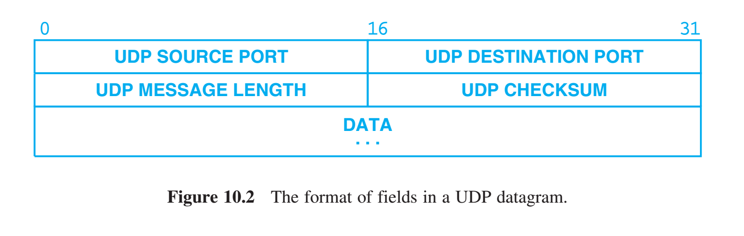
UDP Message Format
user datagram consists of two parts: header - source protocol port number (optional for one-way communication) - destination protocol port number - message length - checksum (involves info from datagram header, creating a pseudo-header) Each field is 16-bits long, which means the entire header occupies a total of only eight octets. payload - contains the data being sent.

Slide 7
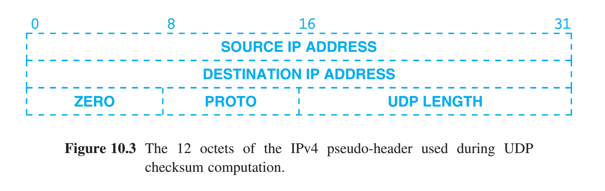
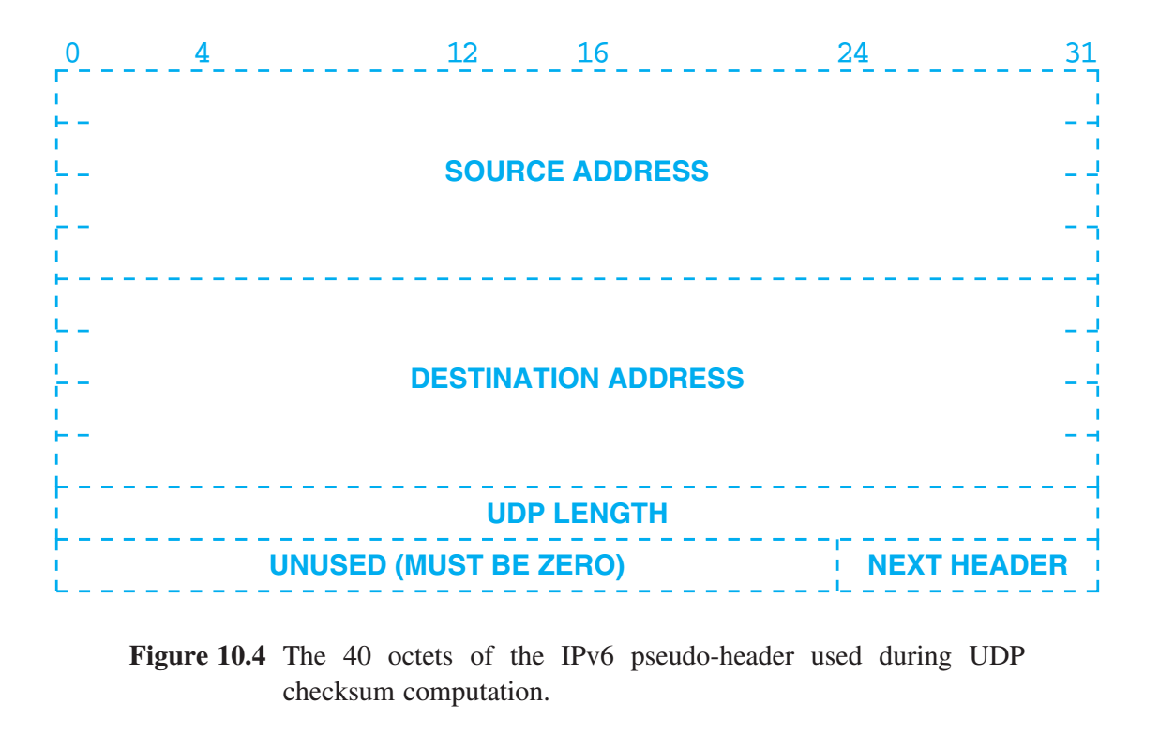
UDP Checksum Computation & the Pseudo-Header
UDP checksum involves - information is extracted from the IP header - UDP header - UDP payload Use the term pseudo-header to refer to the extra information.

Slide 8
UDP Checksum Computation & the Pseudo-Header
IPv4 SOURCE IP ADDRESS & DESTINATION IP ADDRESS PROTO contains the IPv4 protocol type code (17 for UDP), UDP LENGTH contains the length of the UDP datagram (not including the pseudo-header). To verify the checksum, the receiver must extract these fields from the IPv4 header, assemble them into the pseudo-header format, and compute the checksum.

Slide 9
UDP Checksum Computation & the Pseudo-Header
IPv6 SOURCE IP ADDRESS & DESTINATION IP ADDRESS UDP LENGTH contains the length of the UDP datagram NEXT HEADER field replaces PROTO field and the order of fields has changed.

Slide 10
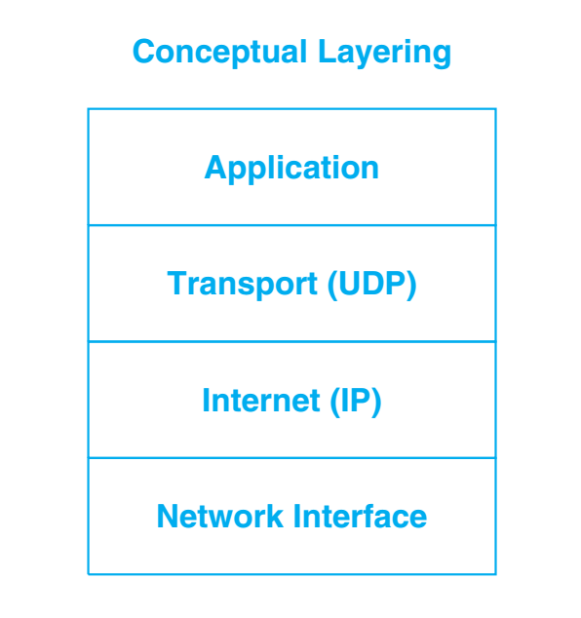
UDP Encapsulation and Protocol Layering
UDP is a transport protocol. But the use of IP addresses in the UDP header requires close interactions that challenge the clear boundaries of layered functionality. UPD messages are encapsulated in an IP datagram and IP datagrams are then encapsulated into network frames. Applications use UDP, and UDP uses IP - IP is responsible for transferring data between hosts - UDP differentiates multiple sources & destinations on one host. (multiplexing and demultiplexing when sending & receiving UDP messages)

Slide 11
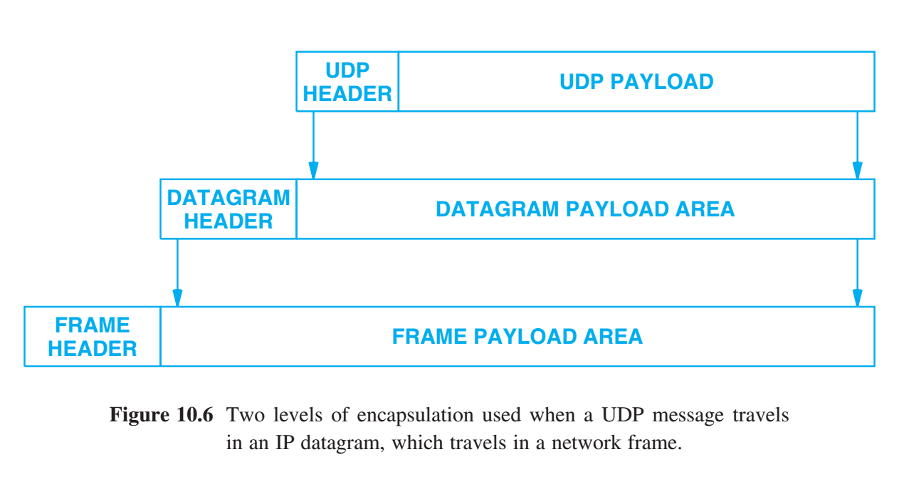
UDP Encapsulation and Protocol Layering
UDP is a transport protocol. But the use of IP addresses in the UDP header requires close interactions that challenge the clear boundaries of layered functionality. UPD messages are encapsulated in an IP datagram and IP datagrams are then encapsulated into network frames. Applications use UDP, and UDP uses IP - IP is responsible for transferring data between hosts - UDP differentiates multiple sources & destinations on one host (multiplexing and demultiplexing when sending & receiving UDP messages)

Slide 12
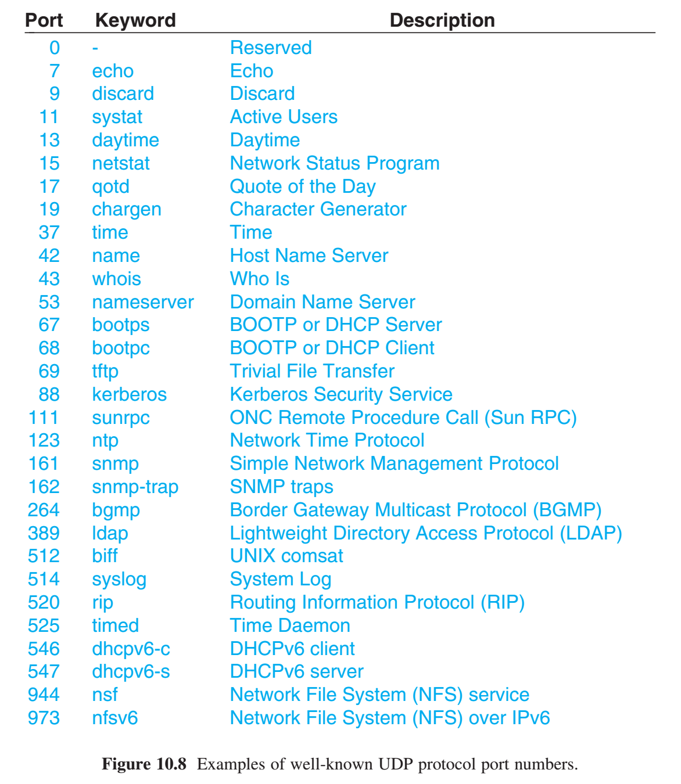
Reserved and Available UDP Port Numbers
Two fundamental approaches to port assignment. 1) Universal Assignment - involves a central authority that assigns port numbers as needed and to publish & list of all assignments. 2) Dynamic Binding - Ports are not globally known. whenever an application program needs a protocol port number, protocol software in the operating system chooses an unused number and assigns it to the application.

Slide 13
Reserved and Available UDP Port Numbers
TCP/IP involves a hybrid scheme Assigned Port Numbers Well-known port numbers assigned by the central authority begin at low values and extend upward. Unassigned Port Numbers Larger integer values are left available for dynamic assignment.

Slide 14
Summary / Key Concepts
Protocol Ports User Datagram Protocol (UDP) Part of the transport layer Message Format Checksum & Pseudo-Header UDP Encapsulation and Protocol Layering Hybrid Scheme of Reserved and Available UDP Port Numbers

