Slide 1
CSC I367 Computer Networking Reliable Stream Transport Service (TCP) - part 1

Slide 2
Transmission Control Protocol

Slide 3
TCP

Slide 4
Overview - Reliable Stream Transport Service (TCP)
The Need for Reliable Service Properties of the Reliable Delivery Service Reliability: Acknowledgement and Retransmission The Sliding Window Paradigm The Transmission Control Protocol Layering, Ports, Connections, and Endpoints Passive and Active Opens Segments, Streams, and Sequence Numbers Variable Window Size and Flow Control TCP Segment Format Out of Band Data TCP Options TCP Checksum Computation Acknowledgement, Retranission, and Timeouts Accurate Measurement of Round Trip Samples Karn’s Algorithm & Timer Backoff
Responding to High Variance in Delay Response to Congestion Fast Recovery and Other Response Modifications Explicit Feedback Mechanisms (SACK & ECN) Congestion, Trail Drop, and TCP Random Early Detection (RED) Establishing A TCP Connection Initial Sequence Numbers Closing a TCP Connection TCP Connection Reset TCP State Machine Force Data Delivery Reserved TCP Port Numbers Silly Window Syndrome and Small Packets Avoiding Silly Window Syndrome Buffer Bloat and Its Effect on Latency

Slide 5
The Need for Reliable Service
IP Problems Packets can be lost when transmission errors interfere with data or when network hardware fails Packets can be delayed when networks become overloaded Packet switching systems change routes dynamically, which means packets can be - delivered out of order - delivered with delays - duplicate deliveries Application Problems Unreliable connectionless delivery can become tedious and annoying. Programmers must incorporate error detection and recovery into each application.
Solution Networking researchers created a general purpose solution — a single reliable transfer protocol

Slide 6
Properties of TCP / Reliable Delivery Service
Stream Orientation. TCP connections, the data transfer is viewed as a stream of octets. The destination host receives exactly the same sequence of octets that was sent by the source host. Virtual Circuit Connection. Before data transfer starts, both the sending and receiving applications must agree to establish a TCP connection. TCP monitors data transfer. Buffered Transfer. TCP transfers a sequence data within distinct segments that form blocks of data that are held by a buffer or sliding window. A push mechanism enables applications to bypass sequential buffers in cases require immediate transfer in dependent of the data sequence. Unstructured Stream. The TCP/IP stream service does not provide structured data streams. Application programs using the stream service must understand stream content and agree on a stream format before they initiate a connection. Full Duplex Communication. Connections provided by the TCP/IP stream service allow concurrent transfer in both directions. Full duplex connection consists of two independent data streams flowing in opposite directions; from an application’s point of view, there is no apparent interaction between the two. TCP allows an application to terminate flow in one direction while data continues to flow in the other direction, making the connection half duplex. The advantage of a full duplex connection is that the underlying protocol software can send control information for one stream back to the source in datagrams carrying data in the opposite direction. Such piggybacking reduces network traffic.

Slide 7
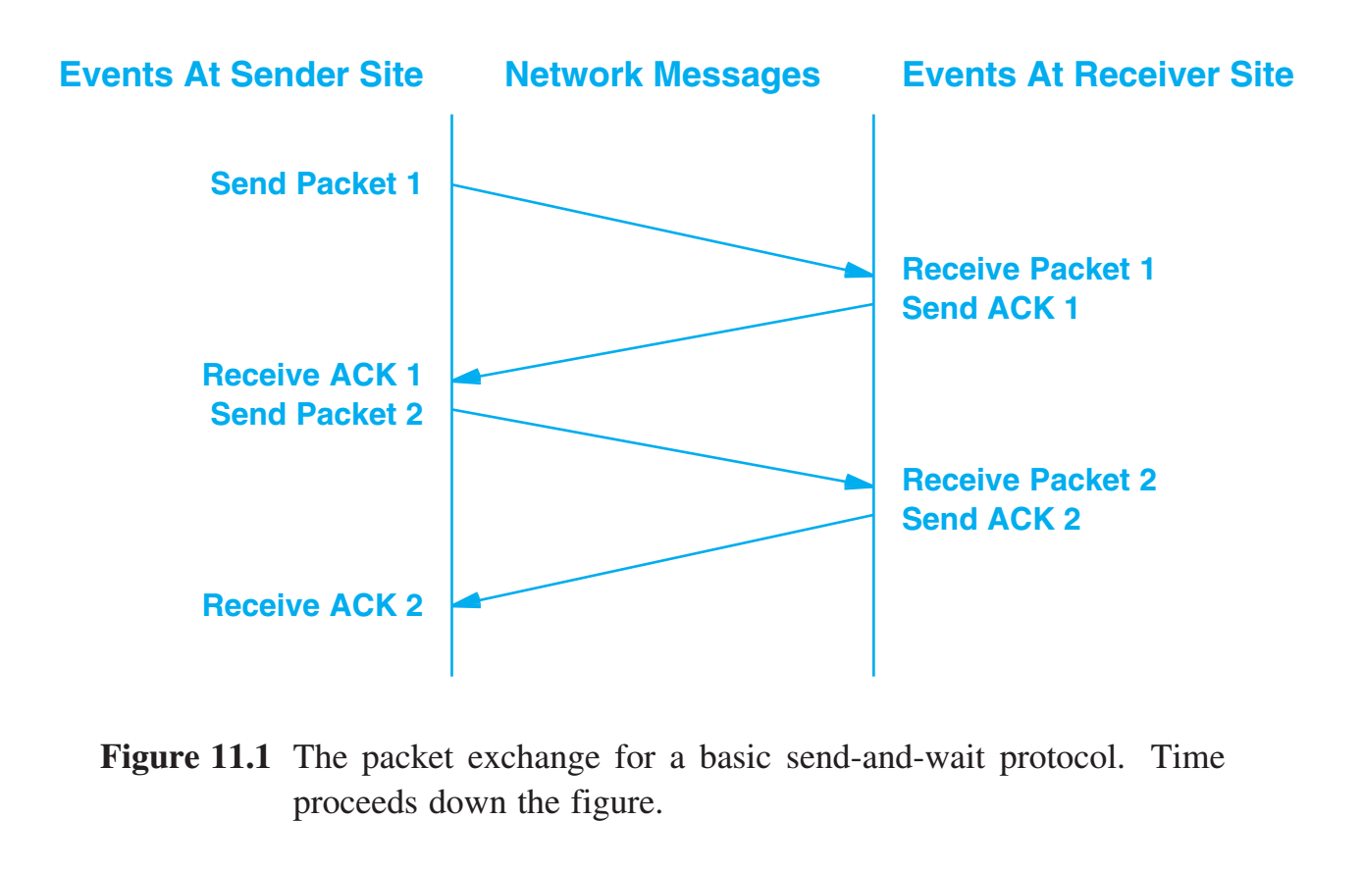
Reliability: Acknowledgement and Retransmission
Reliable protocols rely on a technique known as: positive acknowledgement with retransmission (PAR). - the recipient sends the source an acknowledgement (ACK) - a sent packet without an acknowledgement is unacknowledged The sender of a message starts a timer: If an acknowledgement arrives before the timer expires, then the sender cancels the timer & prepares to send more data. If the timer expires before an acknowledgement arrives, then the sender retransmits the packet. The simplest possible retransmission scheme waits for a given packet to be acknowledged before it sends the next packet. Known as send-and-wait, the approach can only send one packet at a time. But this wastes a substantial amount of network capacity.

Slide 8
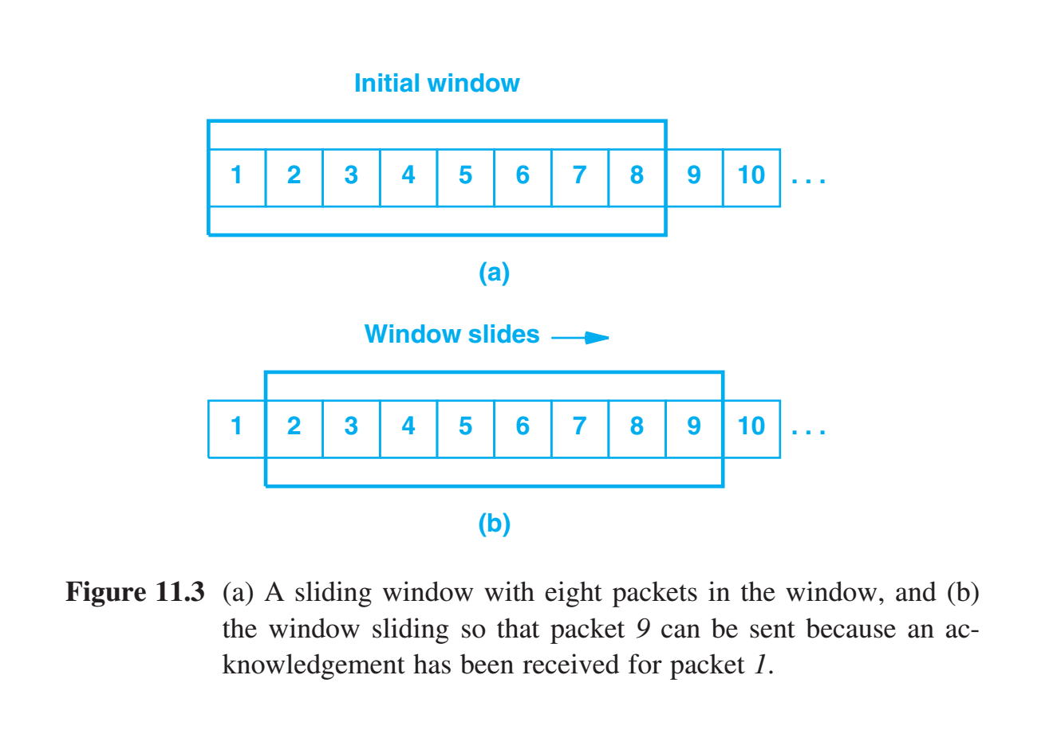
The Sliding Window Paradigm
Problem with send-and-wait approach It wastes a substantial amount of network capacity. Solution - Sliding Window - A packet is unacknowledged if it has been transmitted but no acknowledgement has been received. - The number of packets that can be unacknowledged at any given time is constrained by the window size, which is limited to a small, fixed number. - The performance of sliding window protocols depends on the window size and the speed at which the network accepts packets.
- A well-tuned sliding window protocol keeps the network completely saturated with packets, it can obtain substantially higher throughput.

Slide 9
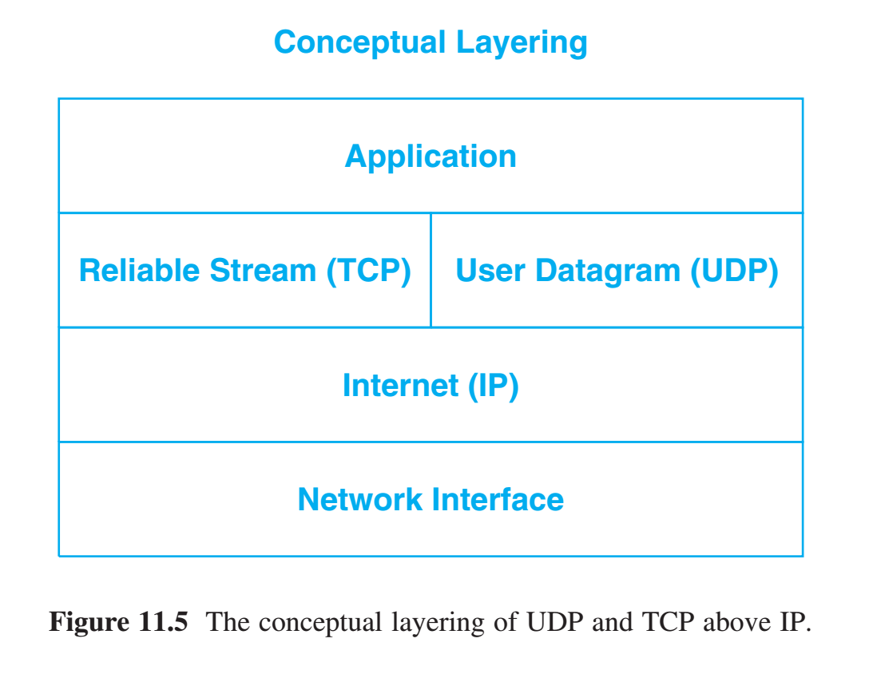
The Transmission Control Protocol
Transmission Control Protocol (TCP) is part of transport layer and provides reliable stream service. - TCP is a communication protocol, not a piece of software - TCP protocol provides a specification analogous to a blueprint - TCP software implements the specification

Slide 10
The Transmission Control Protocol
TCP specifies: - format of the data - acknowledgements that two computers exchange to achieve a reliable transfer - the procedures the computers use to ensure that the data arrives correctly Including: - how TCP software distinguishes among multiple destinations on a given machine - how communicating machines recover from errors like lost or duplicated packets. - how two computers initiate a TCP connection - how they agree when it is complete
Does not include: it does not dictate the details of the interface between an application program and TCP it does not specify the exact procedures that applications invoke to access the operations This provides flexibility for TCP implementations across different operating systems.

Slide 11
TCP Connections
Similar to User Datagram Protocol (UDP), TCP uses protocol port numbers to identify application programs. TCP ports are conceptually independent of UDP ports. TCP uses the connection, not the protocol port, as its fundamental abstraction; connections are identified by a pair of endpoints.
TCP connections are specified by a pair of endpoints that correspond with a pair of communicating applications. (18.26.0.36, 1069) and (128.10.2.3, 25)
Because TCP identifies a connection by a pair of endpoints, a given TCP port number can be shared by multiple connections on the same machine.

Slide 12
Passive and Active Opens
A TCP connection requires both endpoints to agree to participate. To do so: The application program on one end performs a passive open by contacting the local operating system and indicating that it will accept an incoming connection for a specific port number. The application program on the other end can then perform an active open by requesting that a TCP connection be established. The two TCP software modules communicate to establish and verify a connection. Once a connection has been created, application programs can begin to pass data; the TCP software modules at each end exchange messages that guarantee reliable delivery.

Slide 13
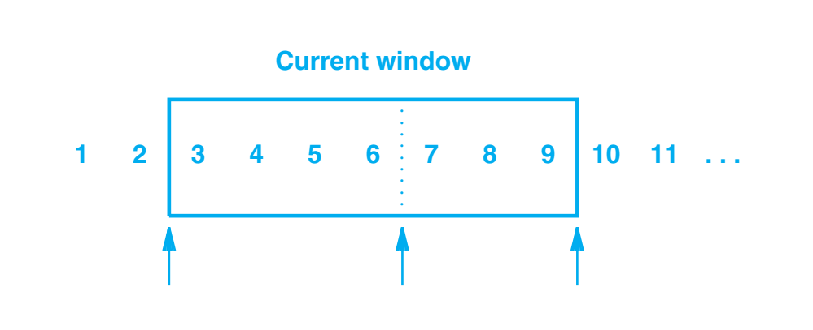
Segments, Streams, and Sequence Numbers
TCP views the data stream as a sequence of octets that it divides into segments for transmission. TCP uses a sliding window mechanism that makes it possible to send multiple segments before an acknowledgement arrives. - Octets of the data stream are numbered sequentially - The sliding window is defined by three pointers that distinguish between data segments that have been: - Send & Acknowledged - Sent & Unacknowledged - Not sent - Waiting for the window
Sent and Acknowledged
Sent and Unacknowledged
Not Sent
Waiting for the Window to move
- Receiver must maintain a similar window to recreate the stream. Both the sender and receiver have a buffer that holds segments. - Full duplex or two way transfers involved with TCP means each computer maintains two windows per connection: 1. window for the data stream being sent 2. window for the data that is received

Slide 14
Variable Window Size and Flow Control
TCP allows the window size to vary over time. Each acknowledgement contains a window advertisement that specifies how many additional octets of data the receiver is prepared to accept beyond the data being acknowledged. Variable size window provides the ability to handle flow control. Having a mechanism for flow control is essential in an environment where computers of various speeds and sizes communicate through networks and routers of various speeds and capacities.
Sent and Acknowledged
Sent and Unacknowledged
Not Sent
Waiting for the Window to move

Slide 15
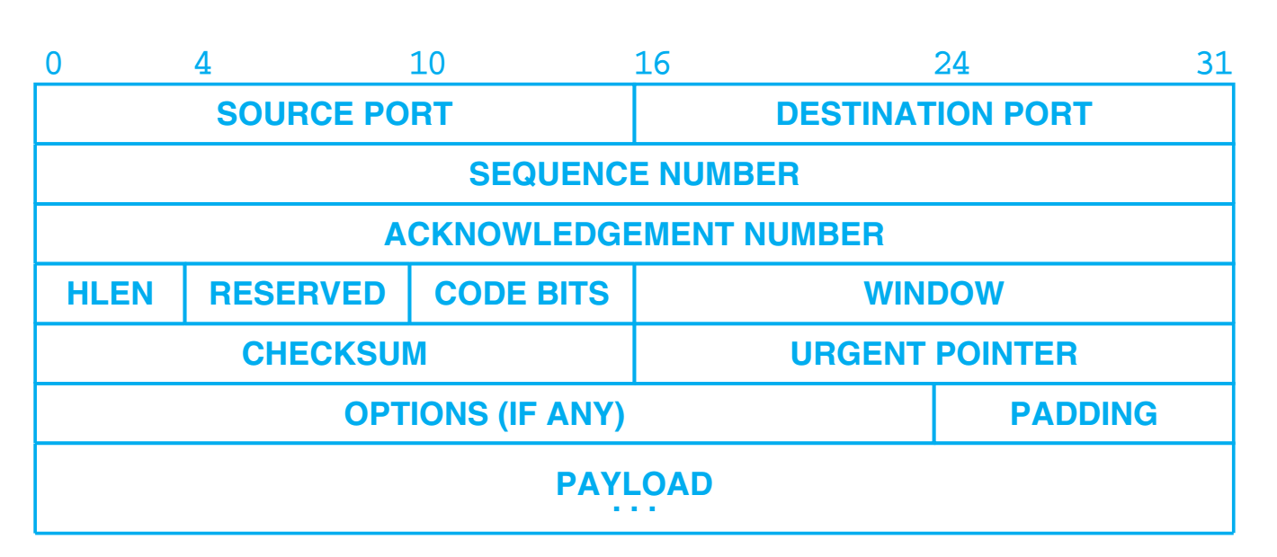
TCP Segment Format
TCP unit of transfer is called a segment, they include a header & payload
Header Fields SOURCE PORT & DESTINATION PORT - TCP Port Numbers SEQUENCE NUMBER - position in the sender’s octet stream ACKNOWLEDGEMENT NUMBER - the number of the octet that the source expects to receive next. Referring to the stream flowing in the opposite direction from the segment. HLEN - segment header length RESERVED - reserved for future use CODE BITS - provides interpretation of other fields and determines the purpose and contents of the segment. (such establishing or ending a connection)
WINDOW - specifying the sliding window buffer size URGENT POINTER - specifies data as urgent, and accommodates out-of-band signaling. The receiving application should be notified of its arrival as quickly as possible, regardless of its position in the stream.

Slide 16
TCP Segment Format
TCP unit of transfer is called a segment, they include a header & payload
Header Fields OPTIONS: maximum segment size (MSS) Both ends of TCP connection agree on the amount of data that is placed in each segment. When the segment size is small, network utilization remains low. Large segments result in large IP datagrams that might lead to fragmentation to match network MTU, which can increase the likelihood of retransmission. Window Scaling Option Expand the sliding window size. Timestamp Option Helps compute the delay on the underlying network. Includes two values: a timestamp value & an echo reply timestamp value.

Slide 17
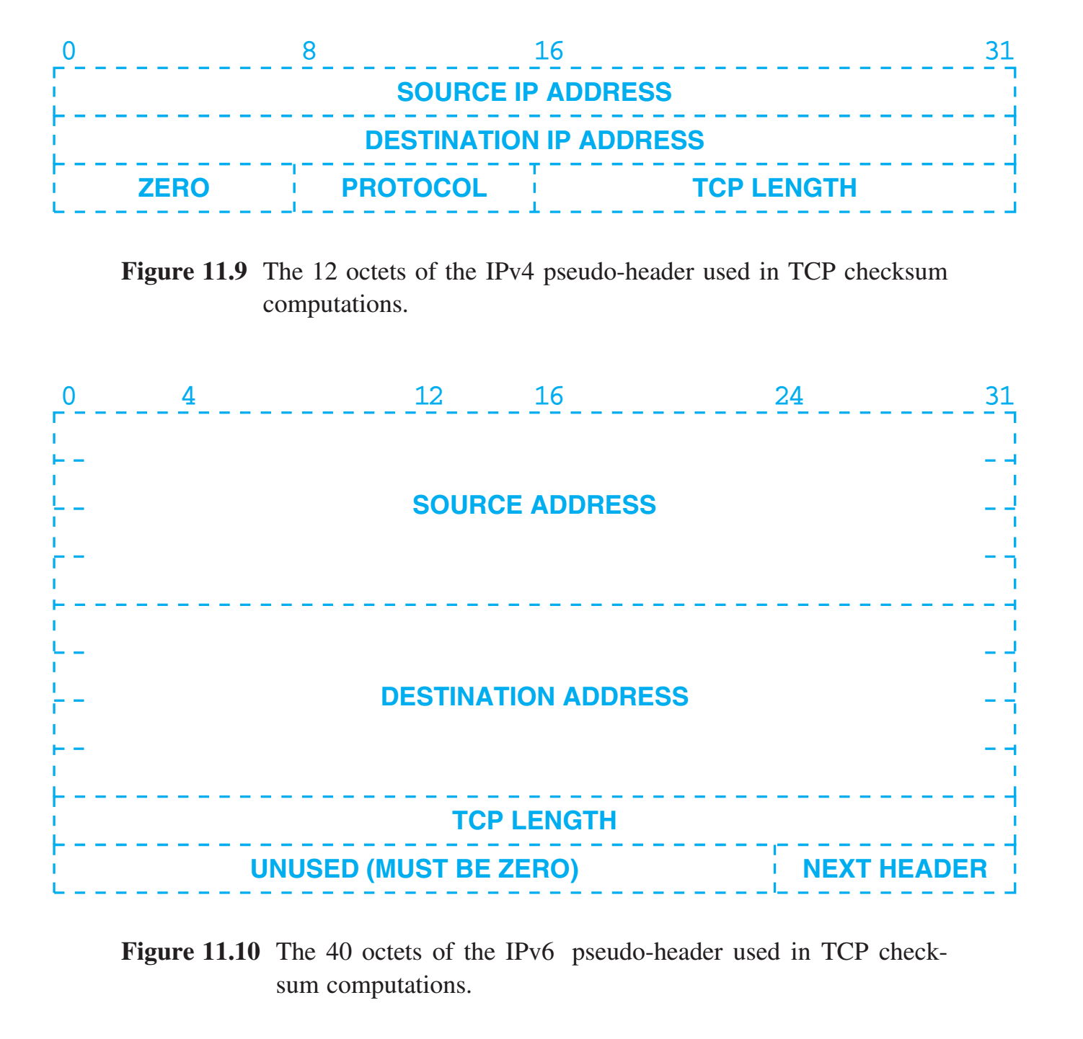
TCP Checksum Computation
The purpose of using a TCP pseudo-header is exactly the same as in UDP. It allows the receiver to verify that the segment has reached the correct endpoint, which includes both an IP address and a protocol port number. Both the source and destination IP addresses are important to TCP because it must use them to identify the connection to which the segment belongs.

Slide 18
Acknowledgement, Retransmission, and Timeouts
TCP timeout and retransmission. A segment is sent, and then TCP starts a timer. If an acknowledgement arrives before the timer expires, then the sender cancels the timer & then sends subsequent segments from the data stream. If the timer expires before an acknowledgement arrives, then the sender retransmits the segments

Slide 19
Acknowledgement, Retransmission, and Timeouts
An acknowledgement refers to a position in the stream using the stream sequence numbers. The receiver reconstructs an exact copy of the stream being sent. The TCP acknowledgement scheme is called cumulative because it reports how much of the stream has accumulated. Advantage - acknowledgements are both easy to generate and unambiguous - lost acknowledgements do not necessarily force retransmission
Disadvantage - the sender does not receive information about all successful transmissions.

Slide 20
Acknowledgement, Retransmission, and Timeouts
Problem Given the heterogeneous quality of the internet, it is impossible to know in advance how quickly acknowledgements will return.
Solution Adaptive retransmission algorithm - TCP monitors the round trip time on each connection and computes reasonable values for timeouts. As the performance of a connection changes, TCP revises its timeout value (i.e., it adapts to the change).
Challenges with Round Trip Estimates
Acknowledgement ambiguity - If retransmission is required, does the time on the acknowledgement reflect the 1st attempt or 2nd? Solution - Karn’s Algorithm - when computing the round trip estimate, ignore samples that correspond to retransmitted segments...

Slide 21
Summary / Key Concepts
TCP Connections Acknowledgements & timers Sliding Window Segment format Checksum & pseudo-header

Slide 22
CSC I367 Computer Networking Reliable Stream Transport Service (TCP) - part 2

Slide 23
Transmission Control Protocol

Slide 24
TCP

Slide 25
Overview - Reliable Stream Transport Service (TCP)
The Need for Reliable Service Properties of the Reliable Delivery Service Reliability: Acknowledgement and Retransmission The Sliding Window Paradigm The Transmission Control Protocol Layering, Ports, Connections, and Endpoints Passive and Active Opens Segments, Streams, and Sequence Numbers Variable Window Size and Flow Control TCP Segment Format Out of Band Data TCP Options TCP Checksum Computation Acknowledgement, Retranission, and Timeouts Accurate Measurement of Round Trip Samples Karn’s Algorithm & Timer Backoff
Responding to High Variance in Delay Response to Congestion Fast Recovery and Other Response Modifications Explicit Feedback Mechanisms (SACK & ECN) Congestion, Trail Drop, and TCP Random Early Detection (RED) Establishing A TCP Connection Initial Sequence Numbers Closing a TCP Connection TCP Connection Reset TCP State Machine Force Data Delivery Reserved TCP Port Numbers Silly Window Syndrome and Small Packets Avoiding Silly Window Syndrome Buffer Bloat and Its Effect on Latency

Slide 26
Response to Congestion
In addition to managing the interaction of endpoints and their delays, TCP software must also react to congestion in an internet. Congestion is a condition of severe delay caused by an overload of datagrams at one or more switching points (routers). - Each router has finite storage capacity and that datagrams compete for that storage. - Datagrams begin to be dropped if the total number of datagrams arriving at the congested router exceeds router capacity. - Endpoints do not usually know the details of where congestion has occurred or why.
Responding to delays by retransmitting datagrams can aggravate congestion. If unchecked, the increased traffic will produce increased delay, leading to increased traffic, and so on, until the network becomes useless. The condition is known as congestion collapse.

Slide 27
Response to Congestion
TCP helps avoid congestion by reducing transmission rates when congestion occurs. The TCP standard recommends using two techniques: slow-start and multiplicative decrease. In addition to remembering the receiver’s window (buffer size), TCP maintains a second limit, called the congestion window size or congestion window that it uses to restrict data flow. Reducing the congestion window reduces the traffic TCP will inject into the connection.

Slide 28
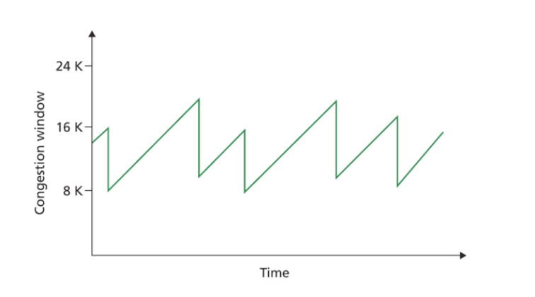
Response to Congestion
Multiplicative Decrease Congestion Avoidance: upon loss of a segment, reduce the congestion window by half (but never reduce the window to less than one segment). When transmitting segments that remain in the allowed window, backoff the retransmission timer exponentially.

Slide 29
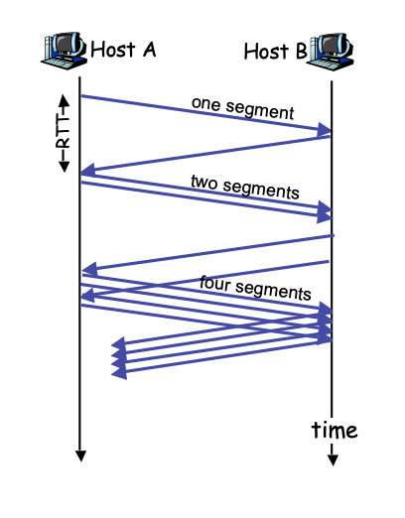
Response to Congestion
Slow-Start (Additive) Recovery: whenever starting traffic on a new connection or increasing traffic after a period of congestion, start the congestion window at the size of a single segment and increase the congestion window by one segment each time an acknowledgement arrives.

Slide 30
Explicit Feedback Mechanisms (SACK & ECN)
Most versions of TCP use implicit techniques to detect loss and congestion. That is, TCP uses timeout and duplicate ACKs to detect loss, and changes in round trip times to detect congestion. Researchers have observed that slight improvements are possible if TCP includes mechanisms that provide such information explicitly.
The Selective ACKnowledgement (SACK) The alternative to TCP’s cumulative acknowledgement mechanism is known as a selective acknowledgement mechanism. In essence, selective acknowledgements allow a receiver to specify exactly which data has been received and which is still missing. The chief advantage of selective acknowledgements arises in situations where occasional loss occurs: selective acknowledgements allow a sender to know exactly which segments to retransmit. Explicit Congestion Notification (ECN), the mechanism requires routers throughout an internet to notify TCP as congestion occurs. The mechanism is conceptually straightforward: as a TCP segment passes through the internet, routers along the path use a pair of bits in the IP header to record congestion. Thus, when a segment arrives, the receiver knows whether the segment experienced congestion at any point. Unfortunately, the sender, not the receiver, needs to learn about congestion. Therefore, the receiver uses the next ACK to inform the sender that congestion occurred. The sender then responds by reducing its congestion window.

Slide 31
Congestion, Trail Drop, RED, and TCP
Each router has finite storage capacity and that datagrams compete for that storage.
Tail-Drop Tail-Drop Policy For Routers: if a packet queue is filled when a datagram must be placed on the queue, discard the datagram. RED The answer lies in a clever scheme that avoids tail-drop whenever possible. Known as Random Early Detection, Random Early Drop, or Random Early Discard, the scheme is more frequently referred to by its acronym, RED. The general idea behind RED lies in randomization: instead of waiting until a queue fills completely, a router monitors the queue size. As the queue begins to fill, the router chooses datagrams at random to drop.

Slide 32
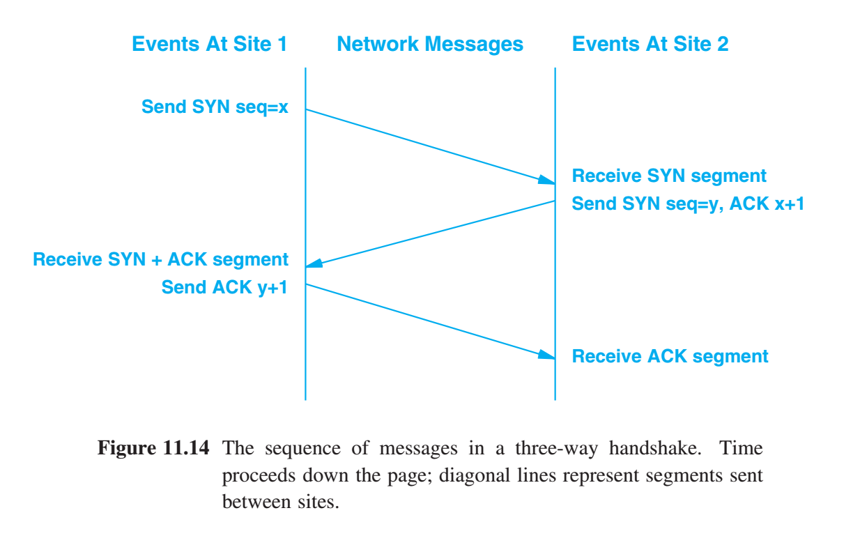
Establishing A TCP Connection
TCP uses a three-way handshake to establish a connection. 1st Message - Host A to Host B SYN bit in code field - to initiate connection 2nd Message - Host B to Host A SYN bit in code field - initiate connection ACK bit in code field - acknowledge request 3rd Message - Host A to Host B ACK bit in code field - acknowledge request
The 3rd message is key for acknowledging the two way connection. Three messages are exchanged that allow each side to agree to form a connection and know that the other side has agreed.

Slide 33
Initial Sequence Numbers
The three-way handshake accomplishes two important functions. - It guarantees that both sides are ready to transfer data (and that they know they are both ready) - It allows both sides to agree on initial sequence numbers. Sequence numbers are sent and acknowledged during the handshake.

Slide 34
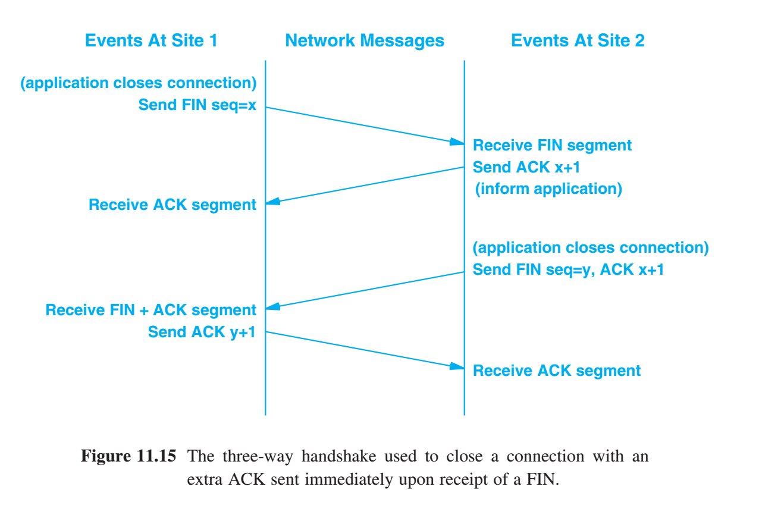
Closing a TCP Connection
TCP uses a three-way handshake to close connections. Remember that TCP connections are full duplex and that we view them as containing two independent streams, one going in each direction. 1st Message - Host A to Host B FIN bit in code field - close connection 2nd Message - Host B to Host A ACK bit in code field - acknowledge close FIN bit in code field - close connection 3rd Message - Host A to Host B ACK bit in code field - acknowledge close

Slide 35
TCP Connection Reset
TCP provides a reset facility to handle abnormal disconnections.
To reset a connection: - one side initiates termination by sending a segment with the RST (RESET) bit in the CODE field set. - the other side responds to a reset segment immediately by aborting the connection. TCP informs any local application that was using the connection. Note that a reset occurs immediately and cannot be undone. We think of it as an instantaneous abort that terminates transfer in both directions and releases resources, such as buffers.

Slide 36
Force Data Delivery - PSH
TCP provides a push operation that an application can use to force delivery of octets and bypass the stream buffer. Push operation 1. Forces the local TCP to send a segment, and include the PSH bit in the segment’s code field. 2. On the receiving end, the PSH bit requests that the segment be immediately delivered to the application.

Slide 37
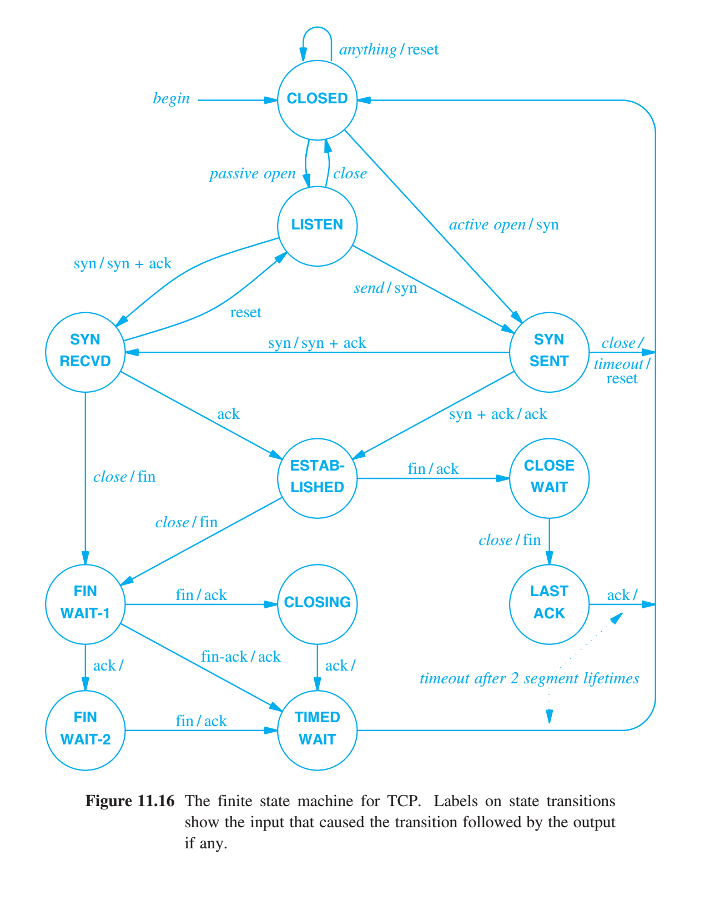
TCP State Machine
TCP can best be explained with a theoretical model called a finite state machine. TCP state machine, with circles representing states and arrows representing transitions between them. For each endpoint TCP starts in the CLOSED state. Active or Passive open to initiate a connection.
TIMED WAIT state reveals how TCP handles some of the problems incurred with unreliable delivery.

Slide 38
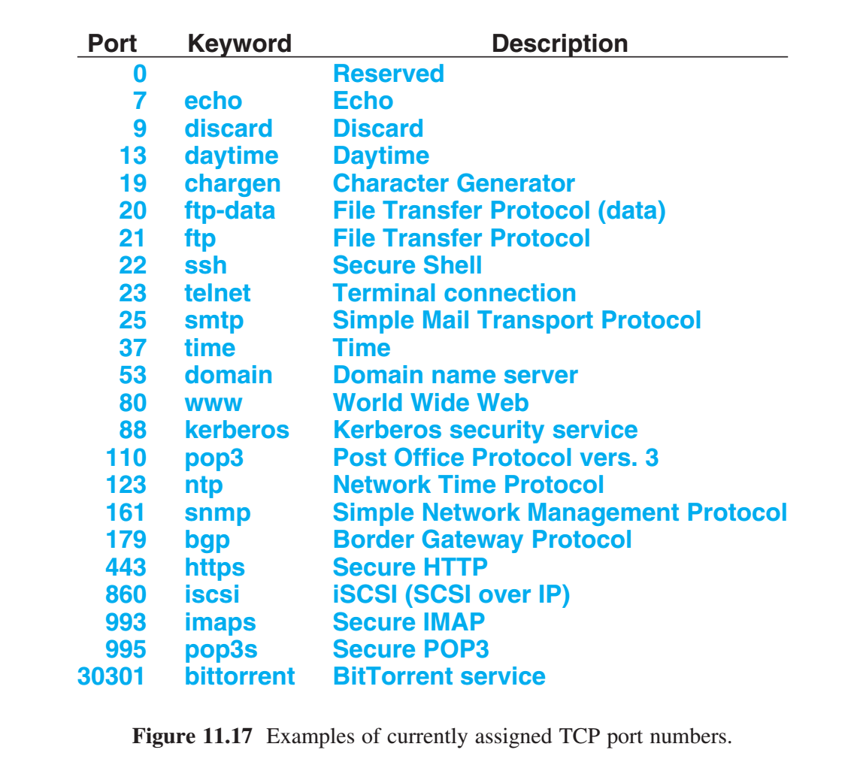
Reserved TCP Port Numbers
TCP uses a combination of statically and dynamically assigned protocol port numbers. A set of well-known ports have been assigned by a central authority for commonly invoked services (e.g., web servers and electronic mail servers). Other port numbers are available for an operating system to allocate to local applications as needed.

Slide 39
Summary / Key Concepts
Congestion Congestion window Slow-start Multiplicative Decrease Congestion Avoidance Routers Tail-drop & RED Three Way Handshake - starting connection Three Way Handshake - closing connection Resseting a TCP connection PUSH TCP Port Numbers

