Slide 1
CSC I367 Computer Networking Routing Architecture: Core, Peers, and Algorithms

Slide 2
Overview - Routing Architecture
Remember A host can forward datagrams successfully even if it only has partial forwarding information because it can rely on a router.
Overview Original Internet Architecture and Cores Beyond the Core Architecture to Peer Backbones Automatic Route Propagation and a FIB Distance-Vector (Bellman-Ford) Routing Reliability and Routing Protocols Link-State (SPF) Routing

Slide 3
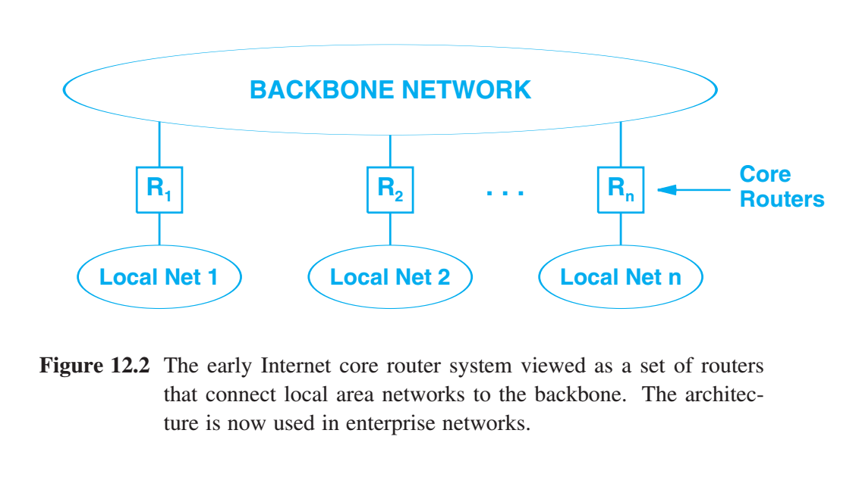
Original Internet Architecture and Cores
ARPANET Research - ARPANET served as a backbone network, connecting all sites - each site manually managed forwarding tables - with growth manual maintenance of routes was impractical - an automated mechanisms were needed

Slide 4
Original Internet Architecture and Cores
ARPANET Research Partitioned Internet routing into a two-tier system A router architecture that reflected a star-shaped topology, with a Core or central set of routers with complete info about all possible destinations. Sometimes referred to as the default-free zone. And a larger set of outlying routers that kept partial information. Advantage - permits local administrators to manage local changes in outlying routers without affecting other parts of the Internet. Disadvantage - potential for inconsistency. In the worst case, an error in an outlying router can make distant routes unreachable.

Slide 5
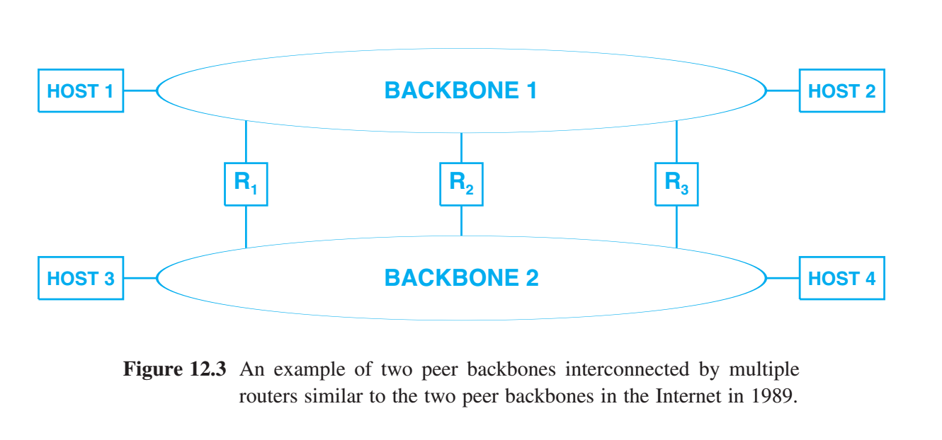

Beyond the Core Architecture to Peer Backbones
NSFNET Research - introduction to peer backbone networks or routing peers foreshadowing the current era of numerous tier-1 ISPs - NSFNET played a key transitional role in developing a routing architecture that more closely reflects the contemporary internet
Consider routes from host 3 to host 2 Three options: (a) Route the traffic from host 3, through R1 , and then across backbone 1, to host 2. (b) Forward the traffic from host 3 across backbone 2, through R2, and then across backbone 1, to host 2. (c) Forward the traffic from host 3 across backbone 2, through R3, and then to host 2. (d) Loops between backbone 2 & 1 numerous times…. Goal: to take the shortest path

Slide 6
Beyond the Core Architecture to Peer Backbones
NSFNET Research - introduction to peer backbone networks or routing peers foreshadowing the current era of numerous tier-1 ISPs - NSFNET played a key transitional role in developing a routing architecture that more closely reflects the contemporary internet
Consider routes from host 3 to host 2 Three options: (a) Route the traffic from host 3, through R1 , and then across backbone 1, to host 2. (b) Forward the traffic from host 3 across backbone 2, through R2, and then across backbone 1, to host 2. (c) Forward the traffic from host 3 across backbone 2, through R3, and then to host 2. (d) Loops between backbone 2 & 1 numerous times…. Goal: to take the shortest path

Slide 7
Beyond the Core Architecture to Peer Backbones
NSFNET Research - introduction to peer backbone networks or routing peers foreshadowing the current era of numerous tier-1 ISPs - NSFNET played a key transitional role in developing a routing architecture that more closely reflects the contemporary internet
Consider routes from host 3 to host 2 Three options: (a) Route the traffic from host 3, through R1 , and then across backbone 1, to host 2. (b) Forward the traffic from host 3 across backbone 2, through R2, and then across backbone 1, to host 2. (c) Forward the traffic from host 3 across backbone 2, through R3, and then to host 2. (d) Loops between backbone 2 & 1 numerous times…. Goal: to take the shortest path

Slide 8
Beyond the Core Architecture to Peer Backbones
NSFNET Research - introduction to peer backbone networks or routing peers foreshadowing the current era of numerous tier-1 ISPs - NSFNET played a key transitional role in developing a routing architecture that more closely reflects the contemporary internet
Consider routes from host 3 to host 2 Three options: (a) Route the traffic from host 3, through R1 , and then across backbone 1, to host 2. (b) Forward the traffic from host 3 across backbone 2, through R2, and then across backbone 1, to host 2. (c) Forward the traffic from host 3 across backbone 2, through R3, and then to host 2. (d) Loops between backbone 2 & 1 numerous times…. Goal: to take the shortest path

Slide 9
Beyond the Core Architecture to Peer Backbones
NSFNET Research - introduction to peer backbone networks or routing peers foreshadowing the current era of numerous tier-1 ISPs - NSFNET played a key transitional role in developing a routing architecture that more closely reflects the contemporary internet
Consider routes from host 3 to host 2 Three options: (a) Route the traffic from host 3, through R1 , and then across backbone 1, to host 2. (b) Forward the traffic from host 3 across backbone 2, through R2, and then across backbone 1, to host 2. (c) Forward the traffic from host 3 across backbone 2, through R3, and then to host 2. (d) Loops between backbone 2 & 1 numerous times…. Goal: to take the shortest path

Slide 10
Beyond the Core Architecture to Peer Backbones
NSFNET Research - introduction to peer backbone networks or routing peers foreshadowing the current era of numerous tier-1 ISPs - NSFNET played a key transitional role in developing a routing architecture that more closely reflects the contemporary internet
Consider routes from host 3 to host 2 Three options: (a) Route the traffic from host 3, through R1 , and then across backbone 1, to host 2. (b) Forward the traffic from host 3 across backbone 2, through R2, and then across backbone 1, to host 2. (c) Forward the traffic from host 3 across backbone 2, through R3, and then to host 2. (d) Loops between backbone 2 & 1 numerous times…. Goal: to take the shortest path

Slide 11
Beyond the Core Architecture to Peer Backbones
NSFNET Research - introduction to peer backbone networks or routing peers foreshadowing the current era of numerous tier-1 ISPs - NSFNET played a key transitional role in developing a routing architecture that more closely reflects the contemporary internet
Consider routes from host 3 to host 2 Three options: (a) Route the traffic from host 3, through R1 , and then across backbone 1, to host 2. (b) Forward the traffic from host 3 across backbone 2, through R2, and then across backbone 1, to host 2. (c) Forward the traffic from host 3 across backbone 2, through R3, and then to host 2. (d) Loops between backbone 2 & 1 numerous times…. Goal: to take the shortest path

Slide 12
Automatic Route Propagation and a FIB
Routing protocols serve two important functions (1) they compute a set of shortest paths. (2) they respond to network failures or topology changes by continually updating the routing information. Routing protocols: - operate independently from the forwarding mechanism - operate a separate process that uses IP to exchange messages with routing protocol software on other routers - learn about destinations, compute shortest paths to each destination, and pass information to other routers - does not store information directly in the router’s forwarding table - Routing software creates a Forwarding Information Base (FIB) Forwarding Information Base (FIB) - FIB may contain extra information not found in a forwarding table, such as the source of the routing information, how old the information is, and whether a manager has temporarily overridden a specific route. - FIB changes produce new router forwarding tables - between FIB & Forwarding tables: policy rules are applied - managers control which items are automatically installed in forwarding tables - policies may prevent the certain paths from being injected into the forwarding table

Slide 13
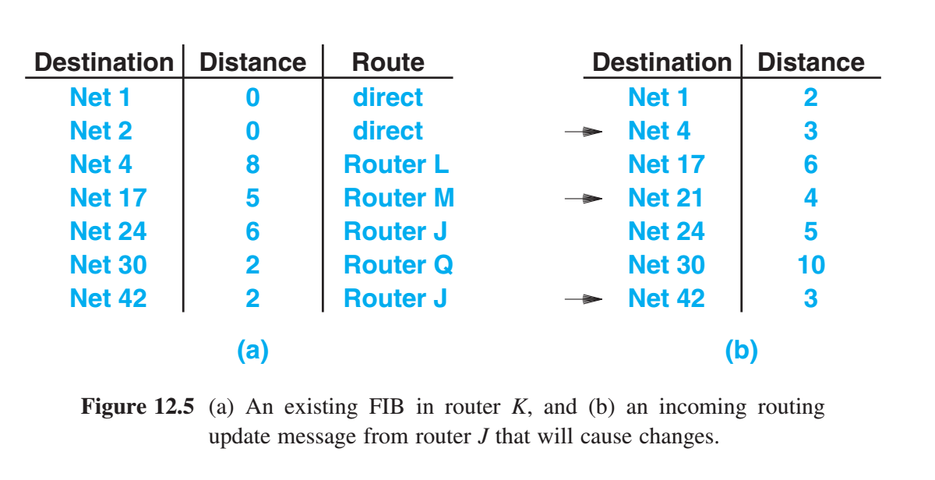
Distance-Vector (Bellman-Ford) Routing
Distance-Vector is a class of routing protocols Each router keeps a list of all known destinations in its FIB. FIB entries identify destination networks: - next-hop router used to reach the destination, - the “distance” to the network, such a number of hops - directly-connected network = zero hops - N routers to reach a destination = N hops
Advantage: In a static environment, distance-vector algorithms compute shortest paths and correctly propagate routes to all destinations. Disadvantage: When routes change rapidly, the computations may not stabilize. They don’t not scale well. - Requires the exchange of large messages, proportional to the total number of networks in an internet - Requires every router to participate.

Slide 14
Link-State (SPF) Routing
Link state, link status, or Shortest Path First (SPF) is the main alternative to distance-vector algorithms.
Each router participating in an SPF algorithm performs two tasks: - Actively test the status of each neighboring router. Two routers are considered neighbors if they attach to a common network. - Periodically broadcast link-state messages: “The link between me & router X is up” or “The link between me & router X is down.”
Once link-state messages are received: - Router uses the information to update its map of the internet. - Extracts the pair of routers mentioned in the message and makes sure that the local graph contains an edge between the two. - Status report to mark link as up or down. - With changes to the local topology graph, the link-state algorithm re-computes the shortest paths, and updates the FIB - If policies permit, FIB updates are used to change the forwarding table.

Slide 15
Summary / Key Concepts
ARPANET - one backbone Manual router management, two tiered routing, core & edges NSFNET - peer backbones Automatic Route Propagation Routing Protocols Forwarding Information Base (FIB) Distance-Vector Routing Link state, link status, or Shortest Path First (SPF)

