Slide 1
CSC I367 Computer Networking Routing Among Autonomous Systems (BGP)

Slide 2
Overview - Routing Among A.S. (BGP)
The Scope of an Routing Update Protocol Determining a Practical Limit on Group Size A Fundamental Idea: Extra Hops Autonomous System Concept Exterior Gateway Protocols and Reachability BGP Characteristics BGP Functionality and Message Types BGP Message Header BGP OPEN Message BGP UPDATE Message Compressed IPv4 Mask-Address Pairs BGP Path Attributes BGP KEEPALIVE Message Information From the Receiver’s Perspective The Key Restriction of Exterior Gateway Protocols
The Internet Routing Architecture and Registries BGP NOTIFICATION Message BGP Multiprotocol Reachable NLRI Attribute Internet Routing and Economics

Slide 3
Autonomous Systems

Slide 4
Border Gateway Protocol

Slide 5
BGP

Slide 6
The Scope of an Routing Update Protocol
Design principle for Routing Architecture: 1. No routing update protocol can scale to allow all routers in the global Internet to exchange routing information. 2. Routers must be divided into separate groups, and routing protocols designed to operate within a group. There are three reasons that routers must be divided: Traffic. No routing protocol can accommodate an arbitrary number of sites, the routing traffic becomes overwhelming. Distance-vector protocols require routers to exchange the entire set of networks Link-state protocols periodically broadcast announcements of connectivity. Indirect Communication. Routers in the global Internet cannot communicate directly. Intermediate hops are required to reach most routers. Administrative Boundaries. In the Internet, networks and routers are not all owned and managed by a single entity. Shortest paths are not always used. Large ISPs route traffic along paths that generate revenue or have lower financial cost. A routing architecture must provide control for each administrative group.

Slide 7
Determining a Practical Limit on Group Size
When determining a practical limit on group size, there are two issues: delay & overhead. Delay. The question concerns convergence time, the maximum delay until all routers are informed about a change. Overhead. A larger set of participating routers means more routing traffic. And if routing messages contain a list of possible destinations, the size of each message grows as the number of routers and networks increase. Solution Network managers follow a simple heuristic guideline: Wide Area Network has a limit of 12 routers. Local Area Network has a limit of 60 routers.

Slide 8
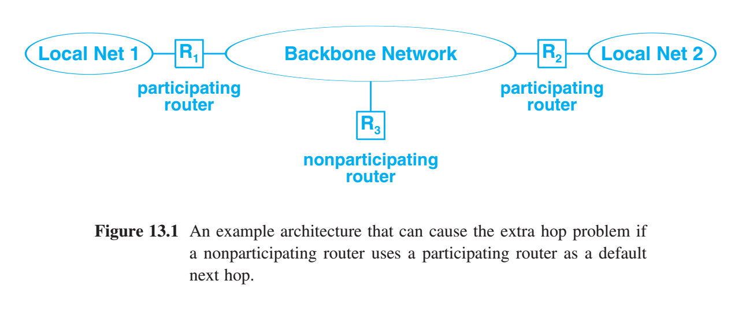
A Fundamental Idea: Extra Hops
Treating a group of routers that participate in a routing update protocol as a default delivery system can introduce an extra hop for datagram traffic. A mechanism is needed that allows nonparticipating routers to learn routes from participating routers so they can choose optimal routes.

Slide 9
Autonomous System Concept
Networks and routers owned by a given entity fall under a single administrative authority. single administrative authority - guarantees that internal routes remain consistent & viable. - chooses one or more of its routers to notify the outside world of networks within the organization - chooses one or more of its routers to learn about networks that are outside the organization.
In the context of routing, we refer to this single administrative authority as an Autonomous System (AS). AS choose their own mechanisms for discovering, propagating, validating, and checking the consistency of routes. AS summarize routing information and send the summary to neighboring AS.
AS can be an ISP, corporate or university intranet, etc… AS are defined by precise boundaries. AS are defined by distinct policies.

Slide 10
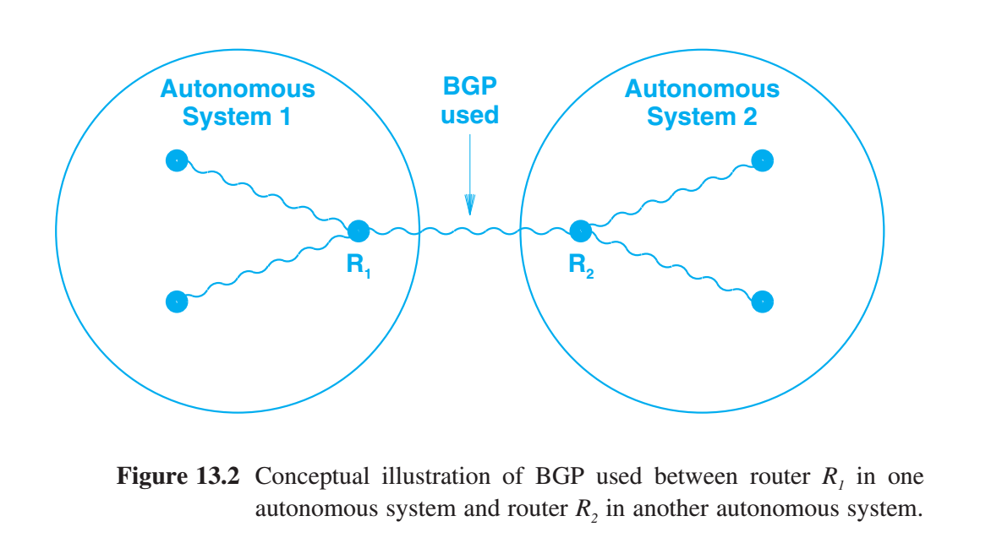
Exterior Gateway Protocols and Reachability
An autonomous system configures one or more of its routers to communicate with routers in other autonomous systems (AS). Information flows in two directions. Exterior Gateway Protocol (EGP) Passes network reachability information between two autonomous systems (AS). Border Gateway Protocol (BGP) - most common EGP (1) The router collects information about networks inside its AS and then “advertises” or passes the information out. (2) The router accepts information about networks in other AS(s) and disseminate the information inside. BGP does not use either the distance-vector algorithm or the link-state algorithm. Instead, BGP uses a modification known as a path-vector algorithm.

Slide 12
BGP Characteristics
BGP characteristics: Inter-Autonomous System Communication. Because BGP is designed as an exterior gateway protocol, its primary role is to allow one autonomous system to communicate with another. Coordination Among Multiple BGP Speakers. If an autonomous system has multiple routers each communicating with a peer in an outside autonomous system, a form of BGP known as iBGP can be used to coordinate among routers inside the system to guarantee that they all propagate consistent information. Propagation Of Reachability Information. BGP allows an autonomous system to advertise destinations that are reachable either in or through it, and to learn such information from another autonomous system. Next-Hop Paradigm. Like distance-vector routing protocols, BGP supplies next hop information for each destination. Policy Support. Unlike most distance-vector protocols BGP can implement policies that the local administrator chooses. In particular, a router running BGP can be configured to distinguish between the set of destinations reachable by computers inside its autonomous system and the set of destinations advertised to other autonomous systems.

Slide 13
BGP Characteristics
BGP characteristics (continued): Reliable Transport. BGP uses TCP for all communication. Path Information. Instead of specifying destinations that can be reached and a next hop for each, BGP uses a path-vector paradigm in which advertisements specify path information that allows a receiver to learn a series of autonomous systems along a path to the destination. Incremental Updates. To conserve network bandwidth, BGP does not pass full information in each update message. Instead, full information is exchanged once, and then successive messages carry incremental changes called deltas. Support For IPv4 and IPv6. BGP supports IPv4 classless addresses and IPv6 addresses. That is, BGP sends a prefix length along with each address. Route Aggregation. BGP conserves network bandwidth by allowing a sender to aggregate route information and send a single entry to represent multiple, related destinations (e.g., many networks owned by a single AS). Authentication. BGP allows a receiver to authenticate messages (i.e., verify the identity of a sender).

Slide 14
BGP Functionality and Message Types
BGP peers perform three basic functions: (1) Initial peer acquisition and authentication. (2) Peers establish a TCP connection and perform a message exchange that guarantees both sides have agreed to communicate. - Each side sends positive or negative reachability information. - Advertise destinations are reachable, with next hop for each - Or declare destinations are no longer reachable. (3) Ongoing verification that the peers and the network connections between them are functioning correctly.

Slide 15
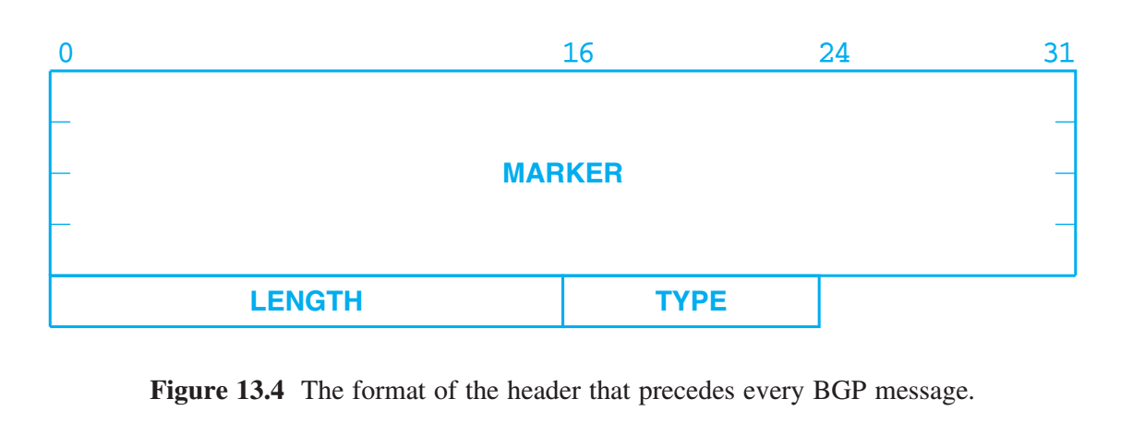
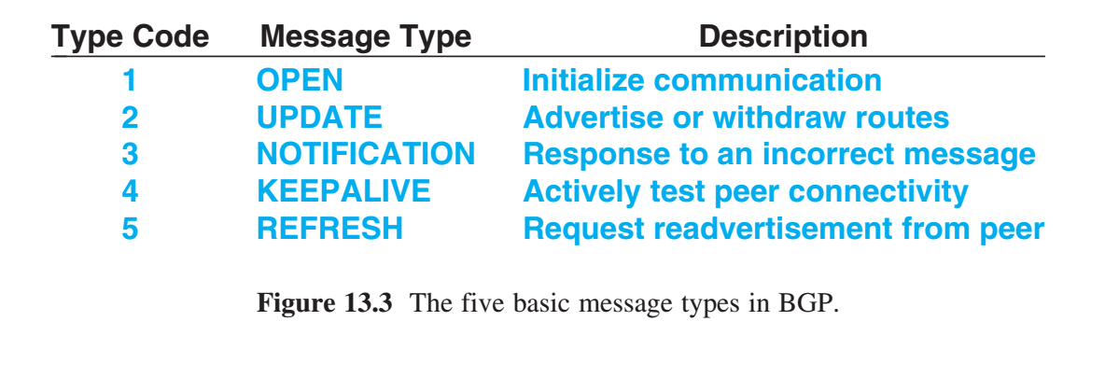
BGP Message Header
MARKER value that both sides agree to use to mark the beginning of a message. The value is used for synchronization. LENGTH specifies the total message length measured in octets. minimum 19 octets & maximum 4096 octets. TYPE contains one of the five values for the message type
To handle the three functions, BGP defines five basic message types.

Slide 16
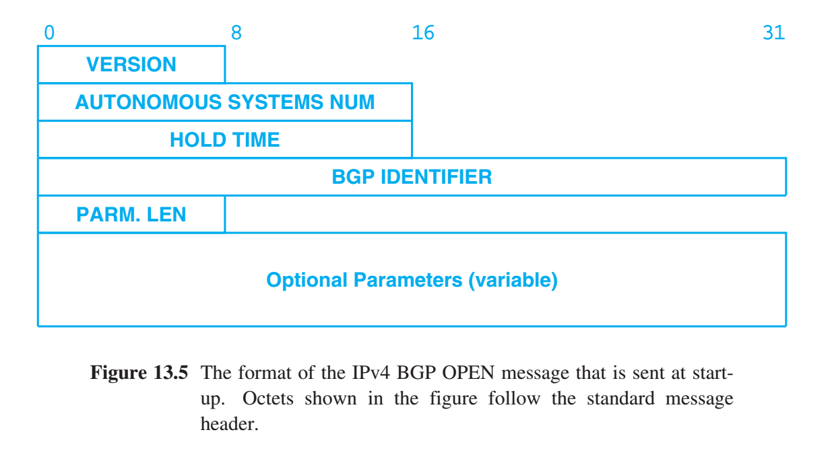
BGP OPEN Message
BGP OPEN Message HOLD TIME specify the maximum number of seconds which may elapse between the receipt of two successive messages. The timer is reset each time a message arrives; if the timer expires, the receiver assumes the sender is no longer available (and stops forwarding datagrams along routes learned from the sender).
VERSION identifies the protocol version used. AUTONOMOUS SYSTEMS NUM the autonomous system number of the sender’s system. BGP IDENTIFIER integer value that uniquely identifies the sender (IP Address). The machine must use the same identifier in communication with all peer AS. PARM. LEN optional field, specifies the length measured in octets. Optional Parameters a list of parameters. Variable size. The value is zero for no parameters.

Slide 17
BGP OPEN Message
Once two BGP peers establish a TCP connection: (1) Each AS sends OPEN message to declare: their AS number & establish operating parameters Once an OPEN message is accepted: (2) AS router responds with a KEEPALIVE message. (acknowledgement) Each peer must send an OPEN and receive a KEEPALIVE message before they can exchange routing information.

Slide 18
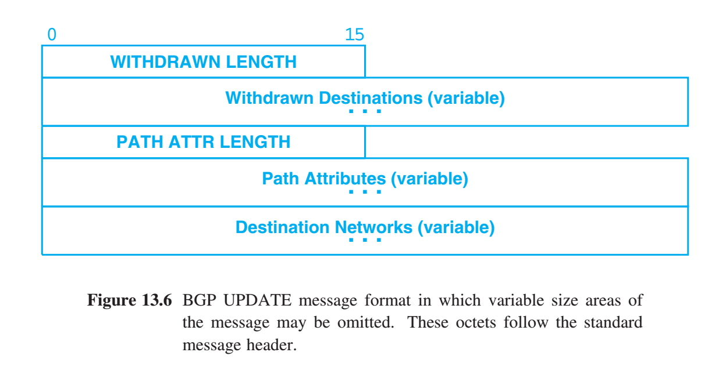
BGP UPDATE Message
Once BGP peers have: - created a TCP connection - sent OPEN messages and acknowledged them Then peers use UPDATE messages - advertise new destinations that are reachable - withdraw advertisements when destinations are unreachable.

Slide 19
BGP UPDATE Message
UPDATE messages are divided into two parts: (1) lists previously advertised destinations that are withdrawn (2) specifies new destinations being advertised - attributes & destination networks Fields labeled variable do not have a fixed size, nor do they need to be present. WITHDRAWN LENGTH specifies the size of the Withdrawn Destinations field that follows. WITHDRAWN LENGTH is zero if no destinations are being withdrawn. PATH ATTR LENGTH specifies the size of the Path Attributes that are associated with new destinations being advertised. PATH ATTR LENGTH is zero if there are no new destinations.

Slide 20
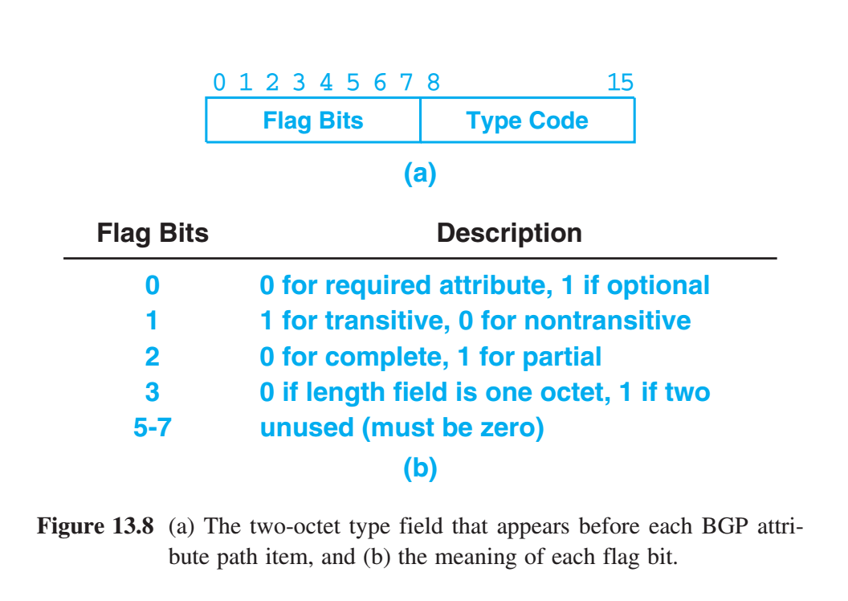
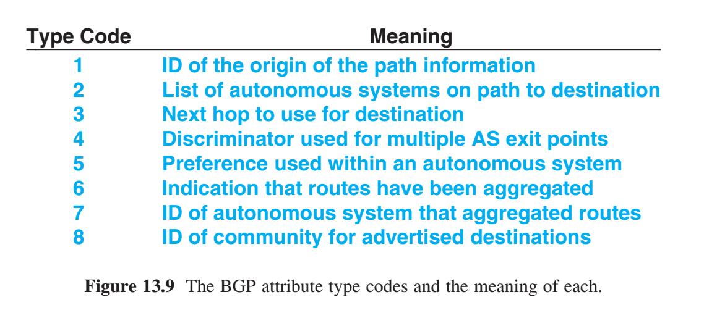
BGP Path Attributes
BGP advertises path attributes in UPDATE messages. Path attributes can specify: - a next hop for the advertised destinations - a list of autonomous systems along the path to the destinations - whether path information is from another AS or the sender’s AS. - attributes apply to all destinations advertised in the message Path attributes are important in BGP for three reasons. (1) Path info allows receiver to check for forwarding loops. (2) Path info allows receiver to implement policies. (3) Path info allows a receiver to know the source of all routes.

Slide 21
BGP KEEPALIVE Message
KEEPALIVE messages are used to test network connectivity and to verify that both peers continue to function.
KEEPALIVE message consists of the standard message header with no additional data.
There are two reasons why BGP uses KEEPALIVE messages. (1) periodic message exchange is needed because BGP uses TCP for transport, and TCP does not include a mechanism to continually test whether a connection endpoint is reachable. TCP does report an error to an application if an attempt to send data fails. (2) KEEPALIVE messages are small and conserve bandwidth compared to other messages. Many early routing protocols relied on periodic exchange of routing information to test connectivity. To avoid the inefficiency, BGP separates the functionality of route update from connectivity testing, allowing BGP to send small KEEPALIVE messages frequently and reserving larger UPDATE messages for situations when reachability information changes.

Slide 22
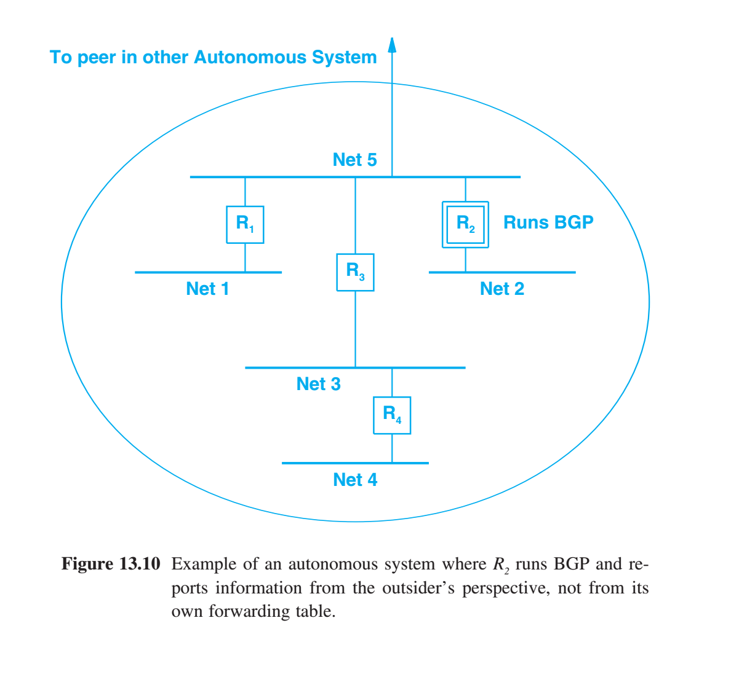
Information From the Receiver’s Perspective
Exterior Gateway Protocol (such as BGP) differs from traditional routing protocols in a significant way: Exterior protocols provide information from outsider’s perspective. We say that an exterior protocol supplies third-party routing information. There are two issues: policies and optimal routes. (1) policy issue - a router inside an autonomous system may be allowed to reach some destinations that outsiders are prohibited from reaching. (2) routing issue - a peer must advertise a next hop that is optimal from the outsider’s perspective.
If R2 lists itself as the next hop for all destinations in the autonomous system, routing will be suboptimal.

Slide 23
Information From the Receiver’s Perspective
Key Restriction of Exterior Gateway Protocols Exterior gateway protocols do not communicate or interpret distance metrics (hops, bandwidth, delay, etc). Autonomous system’s internal structure is hidden. With reachability information, a receiver can: - implement policy constraints - but cannot choose a least cost route. BGP should only advertise paths that traffic should follow.
If R2 lists itself as the next hop for all destinations in the autonomous system, routing will be suboptimal.

Slide 24
The Internet Routing Architecture and Registries
The current Internet does not have a central mechanism to validate routes and guarantee global consistency.
ISPs engage in private peering or that they enter into a peering agreement - ISPs can interconnect privately (e.g., by agreeing to lease a circuit between two routers) - ISPs can interconnect at Internet Exchange Points (IXPs), also known as Network Access Points (NAPs). - Represents routing boundaries between autonomous systems, with defined relationships - upstream (a large ISP agrees to take traffic from a smaller ISP) - downstream, (a large ISP passes traffic to a smaller ISP) - transit (an ISP agrees to accept and forward traffic to other ISPs).

Slide 25
The Internet Routing Architecture and Registries
ISPs use Routing Registries to help verify routes. Routing Registry maintain information about which ISPs own which blocks of addresses. There are many Routing Registries, --- and there is no mechanism to validate the data in a registry. Temporary routing problems occur, such as black holes, in which a given address is not reachable from all parts of the Internet. ISPs and most Routing Registries attempt to find and repair such problems quickly, but without a centralized, authoritative registry, Internet routing is not flawless.

Slide 26
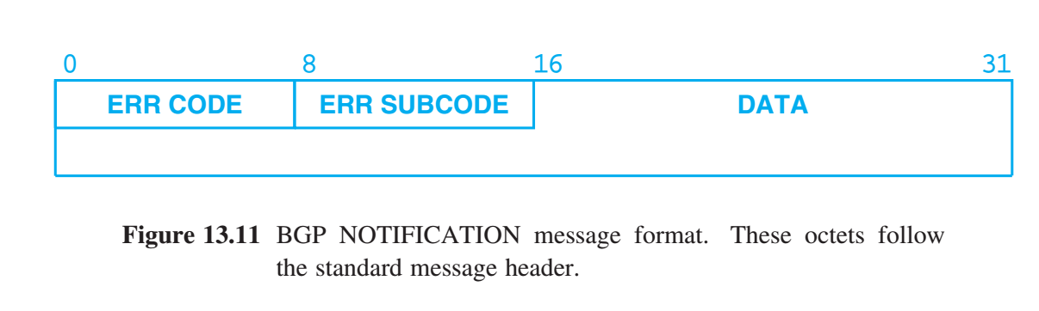
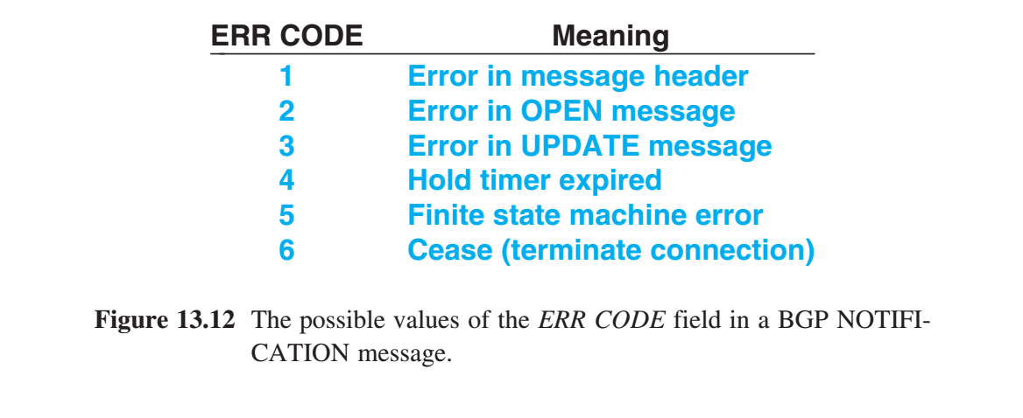
BGP NOTIFICATION Message
NOTIFICATION message type used for control or when an error occurs. Errors are permanent — once it detects a problem, BGP sends a notification message and then closes the TCP connection.

Slide 27
BGP Multiprotocol Reachable NLRI Attribute
Multiprotocol extensions were created to exchange additional types of routing information (IPv6 and MPLS). - When advertising destinations, a sender can specify a particular address family
Two key properties for the multiprotocol extensions: Optional. Multiprotocol extensions are not required Non-transitive. A router may not pass the extensions to other AS - guarantees backward compatibility - keeps Internet routing from being vulnerable to attack - older BGP will simply ignore extensions Network Layer Reachability Information (NLRI) Multiprotocol extensions are carried in BGP’s Path Attributes. Two new attribute types were created to allow a sender to specify a list of non-IPv4 destinations that are (un)reachable. - Multiprotocol Reachable NLRI (Type 14) - Multiprotocol Unreachable NLRI (Type 15)

Slide 28
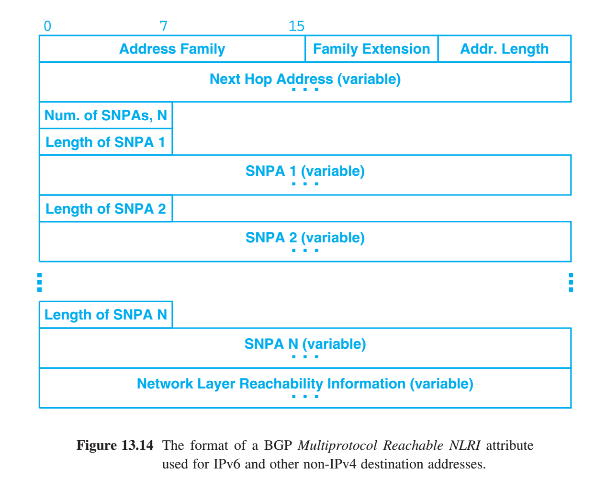
Multiprotocol Reachable NLRI Attribute
A router uses the Multiprotocol Reachable NLRI attribute to advertise reachable destinations, either within its autonomous system or destinations reachable through the autonomous system. Each destination in the attribute is called a Subnetwork Protocol Address (SNPA)
The attribute starts with fields that give the address family and address length. The attribute then specifies a next-hop address and a set of destinations (SNPA) reachable through the next hop. Each destination is preceded by a 1-octet length.

Slide 29
Internet Routing and Economics
At the center of the Internet, routing is based largely on economics rather than shortest paths. Major ISPs arrange policies, preferences, and BGP advertisements to force datagrams along routes that generate the most revenue, independent of whether the route is shortest. A pair of ISPs negotiates a business contract that specify one of three possibilities: - ISP 1 is a customer of ISP 2. - ISP 2 is a customer of ISP 1. - ISP 1 & 2 are peers. Customer relationship is defined by the flow of data. And is often representative of ISP hierarchy: tier-1,2,3 ISPs. Peer relationship Large Tier-1 ISPs often establish peer agreements, reflecting the fact that similar amounts of data will travel in each direction across their systems.
However, they also agree to monitor the data that passes across the connection. If during a given month more data passes from ISP 1 to ISP 2, the contract stipulates that ISP 2 will pay ISP 1 an amount that depends on the difference in the amount of data.

Slide 30
Summary / Key Concepts
Autonomous systems (AS) Peer AS Exterior Gateway Protocol BGP - Border Gateway Protocol Advertising reachability Routing Registries AS Policies Economic Interests While BGP was not part of the original internet architecture, it has become so widely used that it is often considered part of the TCP/IP architecture.

Slide 31
Overview - Routing within AS
Static Vs. Dynamic Interior Routes Routing Information Protocol (RIP) Slow Convergence Problem Solving the Slow Convergence Problem RIP Message Format (IPv4) Fields in A RIP Message RIP for IPv6 (RIPng) The Disadvantage of Using Hop Counts Delay Metric (HELLO) Delay Metric, Oscillation, and Route Flapping Open SPF Protocol (OSPF) OSPFv2 Message Formats (IPv4) Changes in OSPFv3 To Support IPv6 IS-IS Route Propagation Protocol Trust and Route Hijacking Gate: A Routing Gateway Daemon Artificial Metrics and Metric Transformation Routing with Partial Information

