Slide 1
CSC I367 Computer Networking Routing Within Autonomous Systems (RIP, RIPng, OSPF, IS-IS)

Slide 2
Two or more routers “within” a single autonomous system are said to be “interior” to one another.

Slide 3
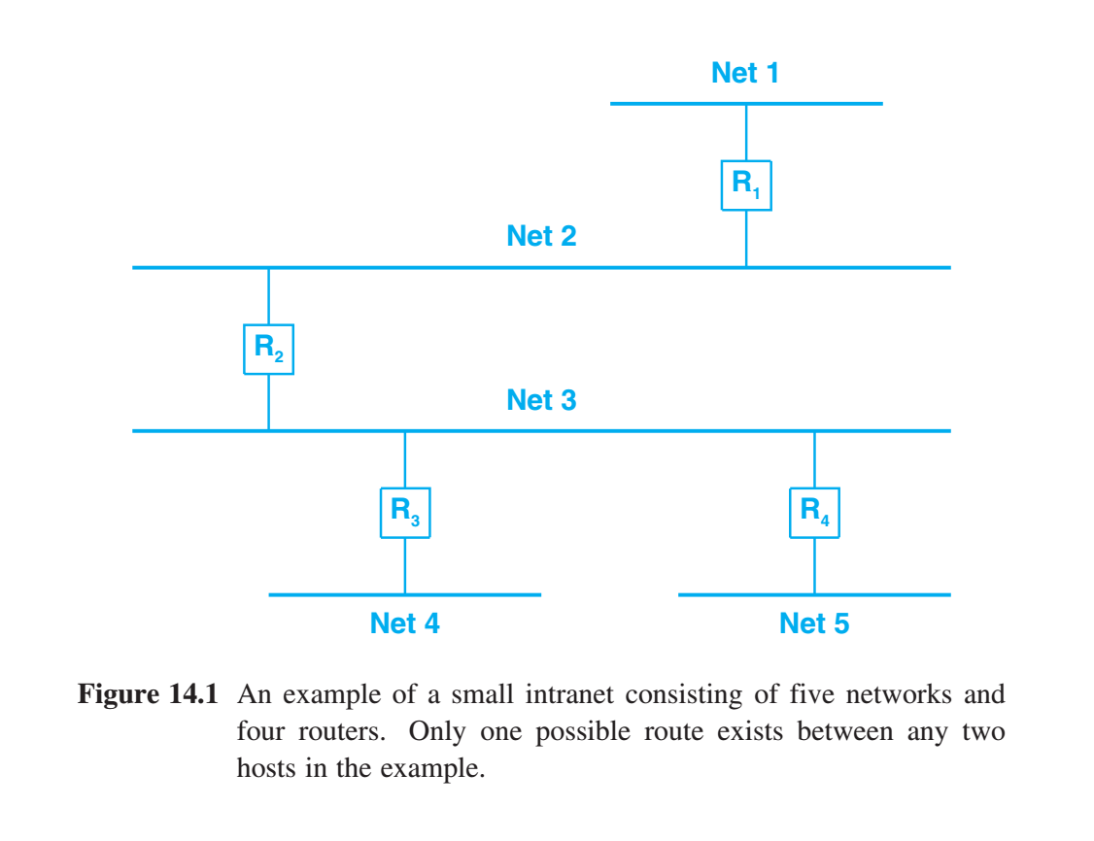
Static Vs. Dynamic Interior Routes
How can routers within a single autonomous system learn about the networks within their autonomous system? Smallest intranets can be managed manually. With a list of networks, a manager can update the forwarding tables whenever a new network is added to, or deleted from, the autonomous system. But within large, growing & dynamic AS automation is needed.

Slide 4
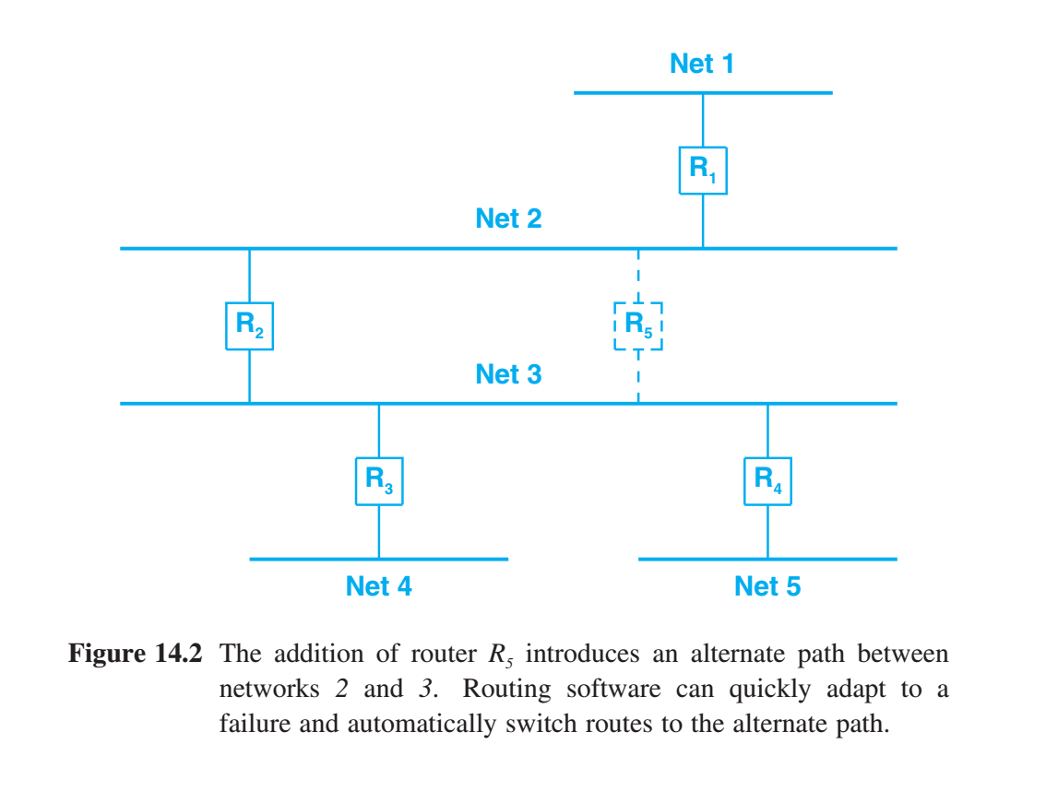
Static Vs. Dynamic Interior Routes
Routing within autonomous systems often involving primary paths. But as the availability of routers and networks, routes must be changed to send traffic along alternative paths. Automated route changes help in two ways. (1) computers can respond to failures much faster than humans. (2) humans can make small errors when entering network addresses, automated routing is less error-prone. Thus, even in small internets, an automated system is used to change routes quickly and reliably.

Slide 5
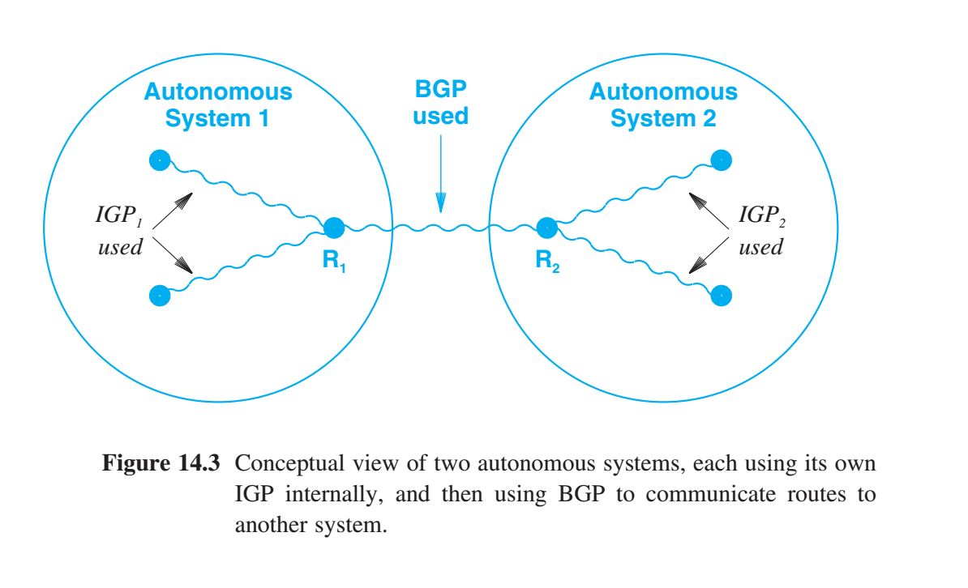
Static Vs. Dynamic Interior Routes
Interior Gateway Protocols (IGP) is a generic term for a class of routing protocols that propagate routing information “within” autonomous systems. The systems then use BGP to summarize information and communicate it to other autonomous systems. Routers that run BGP to advertise reachability usually also need to run an IGP to obtain information from within their autonomous system.

Slide 6
Static Vs. Dynamic Interior Routes
Autonomous systems are heterogeneous. Their design requirements and policy priorities reflect diverse institutional and market dynamics. Thus, there is less of a single standard for Interior Gateway Protocols than compared to Exterior Gateway Protocols. Interior Gateway Protocols (1) Routing Information Protocol (RIP & RIPng) (2) the now obsolete, HELLO protocol (3) Open SPF Protocol (OSPFv2 & OSPFv3) (4) IS-IS Route Propagation Protocol aka.. Intermediate System - Intermediate System

Slide 7
Routing Information Protocol (RIP)
The Routing Information Protocol (RIP) has remained in widespread use since early in the Internet. Based on research conducted at at Xerox Corporation’s Palo Alto Research Center (PARC), the RIP software was initially designed at the University of California at Berkeley to provide consistent routing information among machines on local networks. - RIP relies on physical network broadcast to make routing exchanges quickly - It was not originally designed to be used on large, wide area networks. - Vendors later developed versions of RIP suitable for use on WANs. RIP popularity does not arise from its technical merits alone. It is the result of Berkeley distributing routed software along with their popular 4BSD UNIX systems. Many early TCP/IP sites adopted and installed RIP without considering its limitations. Once installed and running, it became the basis for local routing, and vendors began offering products compatible with RIP.

Slide 8
Routing Information Protocol (RIP)
Distance-vector routing for local networks - RIP uses a hop count metric to measure distances. - Router is defined to be one hop from a directly connected network. - And two hops from a network that is reachable through one other router, and so on. To prevent oscillation among equal cost paths, existing routes should be retained until a new route has strictly lower cost. Two type of participants - Active participants advertise their routes to others. (only routers) - Passive participants listen to RIP messages and update their forwarding table, but do not advertise. (routers & hosts) - Both active & passive participants listen to all broadcast messages and update their forwarding tables.
RIP in active mode broadcasts a routing update message every 30 seconds. - Contains information taken from the router’s current FIB. - Contains a set of pairs, where each pair specifies an IP network address and an integer distance to that network. Disadvantages: Using hop counts to calculate shortest paths does not always produce optimal results. Thus, many RIP implementations allow managers to configure artificially high hop counts when advertising connections. Broadcasting always takes substantial bandwidth. Thus, RIP is extremely inefficient in a wide area network.

Slide 9
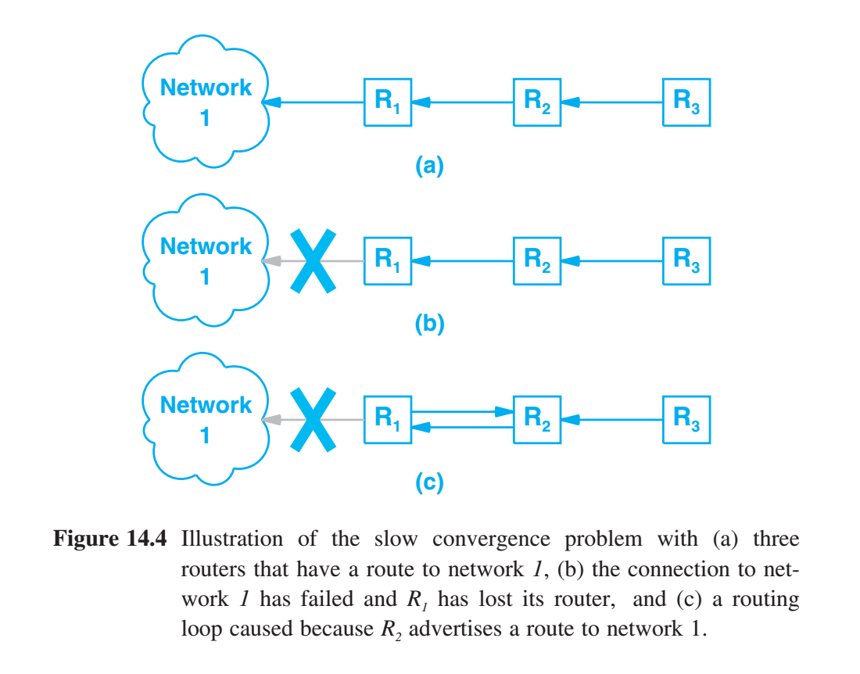
Slow Convergence Problem
Forwarding table inconsistencies and the slow convergence problem are not unique to RIP. They are fundamental problems that can occur with any distance-vector protocol in which update messages carry only pairs of destination network and distance to that network. Conventional distance-vector algorithms can form a routing loop after a failure occurs because routing information that a router sent can reach the router again.

Slide 10
Slow Convergence Problem
Slow convergence Problem in terms of Information flow - Router advertises a short route to some network - All receiving routers install that route - Router stops advertising a route - Timeout mechanism is used to considers the route unreachable - Following timeout, router finds alternative route - router propagating that information - Unfortunately, router cannot know if the alternate route depended on the route that disappeared. Thus, negative information does not always propagate quickly. In routing protocols, good news travels quickly; bad news travels slowly.

Slide 11
Solving the Slow Convergence Problem
Techniques that allows distance vector protocols, such as RIP, to solve the slow convergence problem Split Horizon Update - does not propagate information about a route back over the same interface from which the route arrived. Hold Down - participating router ignore information about a network for a fixed period of time following receipt of a message that claims the network is unreachable. RIP hold down period is 60 seconds, twice as long as a normal update period. Wait long enough to ensure that all machines receive bad news. Poison reverse - Once a connection disappears, the router advertising the connection retains the entry for several update periods, and includes an infinite cost route in its broadcasts. To make poison reverse most effective, it must be combined with triggered updates. Triggered update - router broadcasts routing information immediately after receiving bad news. The router does not wait until its next periodic broadcast. While triggered updates, poison reverse, hold down, and split horizon techniques all solve some problems, they introduce others.

Slide 12
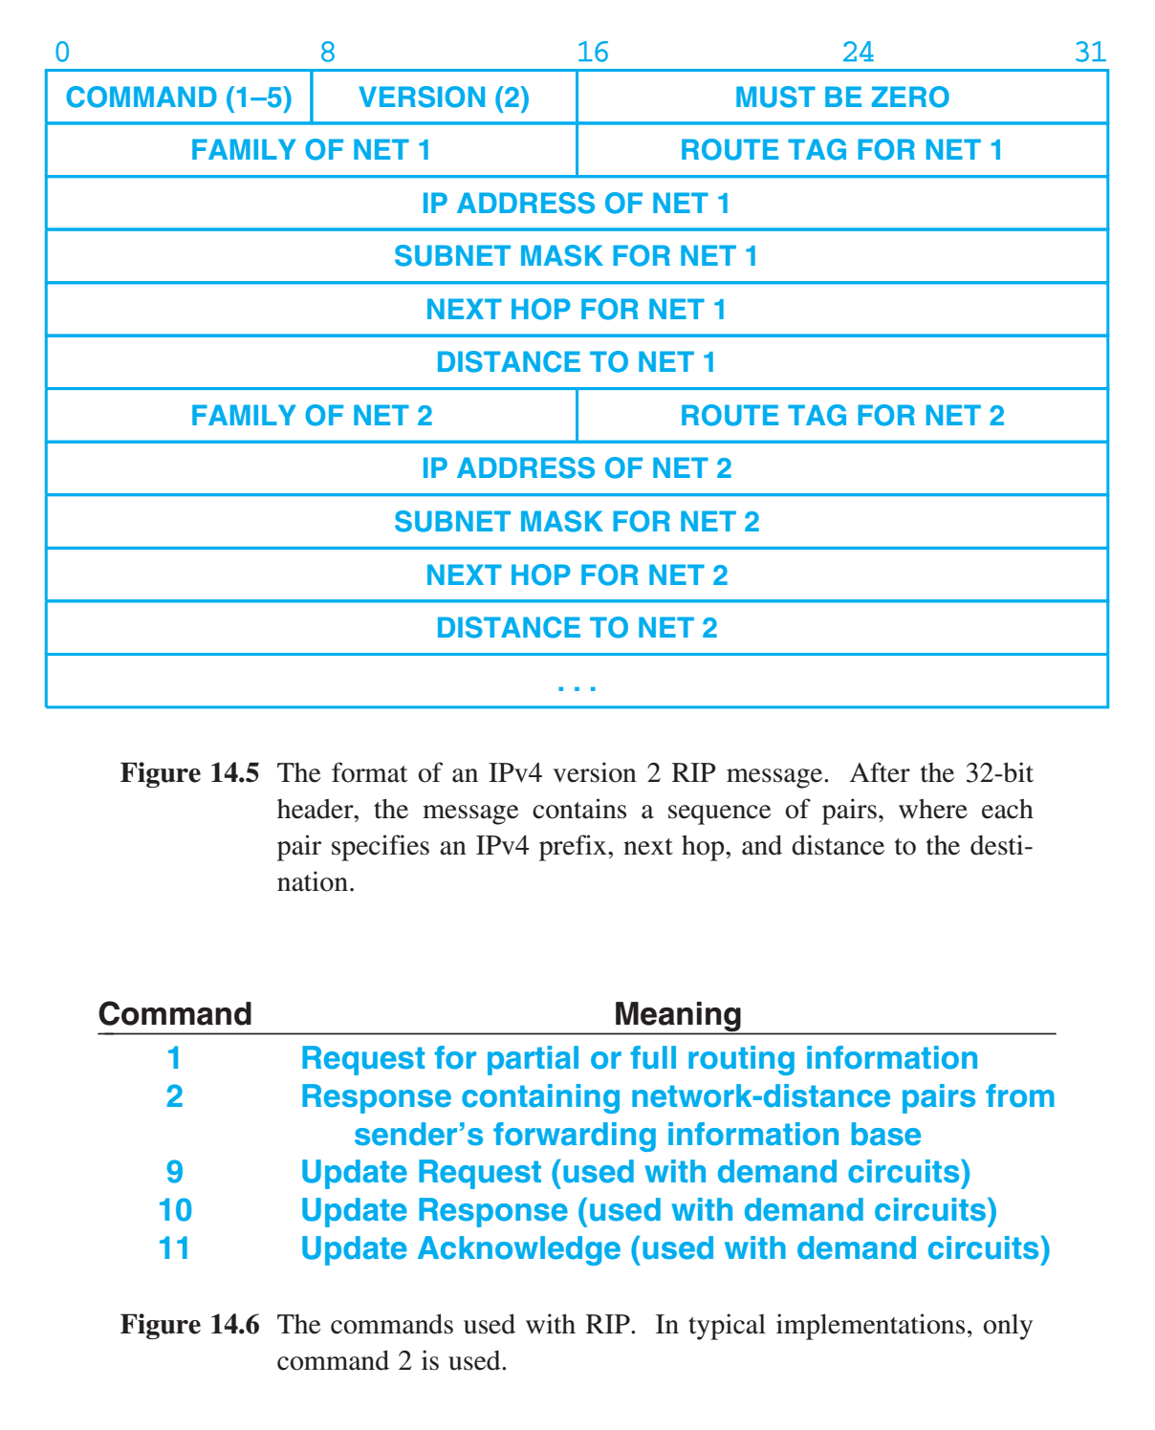
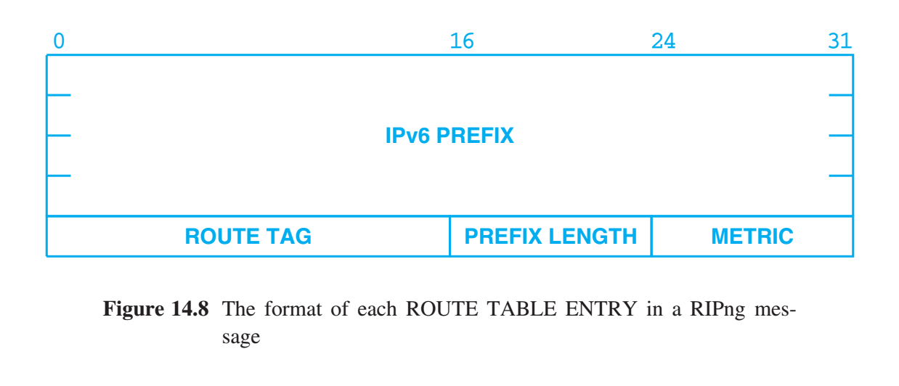
RIP & RIPng for IPv6
Routing Information Protocol - Two types messages: (1) routing information messages (2) messages used to request information. Both use the same format: - fixed header - optional list of network and distance pairs. RIP sends routing updates periodically, and it Includes commands that permit queries to be sent. RIPng - new version of RIP was created for IPv6 (RIPng = RIP next generation) - new message format - operates on a different UDP port than RIP (port 521 as opposed to port 520)

Slide 13
The Disadvantage Of Using Hop Counts
Using RIP as an interior gateway protocol restricts routing to a hop-count metric. Hop counts provide only a crude measure of network capacity or responsiveness. Hop counts does not always yield routes with least delay or highest capacity. Main Disadvantage Makes routing relatively static because routes cannot respond to changes in network load.

Slide 14
Delay Metric (HELLO)
HELLO protocol (obsolete) Instead of having routers report a hop count, however, HELLO reports an estimate of the delay to the destination. - HELLO uses the standard distance-vector approach for updates. - HELLO message carried timestamp information as well as routing information. - Routers used HELLO to synchronize their clocks. - Synchronized clocks are used to track the delay on the link between each pair of routers. - Each router can compute shortest delay paths to all destinations.

Slide 15
Delay Metric, Oscillation, and Route Flapping
Disadvantage of Delay Metric - Instability - Instability arises because delay is dynamic - Variations in delay measurements occur because - hardware clock drift - CPU load during measurement - bit delays caused by link-level synchronization Protocols that use delay implement several heuristics - they employ the hold down technique - instead of measuring accurately, the protocols round delay measurements or implement a minimum thresholds - instead of comparing individual delay measurements, they compare running averages

Slide 16
Delay Metric, Oscillation, and Route Flapping
If a routing protocol reacts quickly to slight differences in delay, it can produce a two-stage oscillation effect in which traffic switches back and forth between the alternate paths. Because delays are extremely sensitive to changes in load, protocols that use delay as a metric can easily fall into a feedback cycle. The cycle is triggered by a small external change in load. The increased traffic raises the delay, which causes the protocol to change routes. However, because a route change affects the load, it can produce an even larger change in delays, which means the protocol will again recompute routes. As a result, protocols that use delay must contain mechanisms to dampen oscillation. Otherwise route flapping will happen. Although intuition suggests that routing should use paths with lowest delay, doing so makes routing subject to oscillations known as route flapping.

Slide 17
Open SPF Protocol (OSPF)
To encourage the adoption of link-state technology, a working group of the IETF designed a interior gateway protocol that uses the link-state algorithm, known as Open Shortest Path First (OSPF). Open SPF (OSPF) - link-state approach to routing - SPF graph algorithm to compute shortest paths - scales better than a distance-vector algorithm OSPFv2 is the Current Standard - OSPF v2 was created for IPv4, and does not support IPv6 - OSPF v3 is designed for IPv6

Slide 18
Open SPF Protocol (OSPF)
OSPF Design Goals Open Standard. As the name implies, the specification is available in the published literature. Open standards without license fees encouraged many vendors to support OSPF. Type Of Service Routing. Managers can install multiple routes to a given destination, one for each priority or type of service. A router running OSPF can use both the destination address and type of service when choosing a route. Load Balancing. If a manager specifies multiple routes to a given destination at the same cost, OSPF distributes traffic over all routes equally. Hierarchical Subdivision Into Areas. To handle large intranets and limit routing overhead, OSPF allows a site to partition its networks and routers into subsets called areas. Each area is self-contained; knowledge of an area’s topology remains hidden from other areas. Thus, multiple groups within a given site can cooperate in the use of OSPF for routing even though each group retains the ability to change its internal network topology independently.

Slide 19
Open SPF Protocol (OSPF)
OSPF Design Goals (continued) Support For Authentication. OSPF allows all exchanges between routers to be authenticated. OSPF supports a variety of authentication schemes, and allows one area to choose a different scheme than another area. Arbitrary Granularity. OSPF includes support for host-specific, subnet-specific, network-specific, and default routes. Support For Multi-Access Networks. To accommodate networks such as Ethernet, OSPF extends the SPF algorithm. Normally, SPF requires each pair of routers to broadcast messages about the link between them. If K routers attach to an Ethernet, they will broadcast K 2 status messages. Instead of a graph that uses point-to-point connections, OSPF reduces broadcasts by allowing a more complex graph topology in which each node represents either a router or a network. A designated gateway (i.e., a designated router) sends link-status messages on behalf of all routers attached to the network. Multicast Delivery. To reduce the load on nonparticipating systems, OSPF uses hardware multicast capabilities, where they exist, to deliver link-status messages. OSPF sends messages via IP multicast, and allows the IP multicast mechanism to map the multicast into the underlying network; two IPv4 multicast addresses are preassigned to OSPF 224.0.0.5 for all routers and 224.0.0.6 for all nodes.

Slide 20
Open SPF Protocol (OSPF)
OSPF Design Goals (continued) Virtual Topology. A manager can create a virtual network topology. For example, a manager can configure a virtual link between two routers in the routing graph even if the physical connection between the two routers requires communication across multiple transit networks. Route Importation. OSPF can import and disseminate routing information learned from external sites (i.e., from routers that do not use OSPF). OSPF messages distinguish between information acquired from external sources and information acquired from routers interior to the site. Direct Use Of IP. Unlike RIP, OSPF messages are encapsulated directly in IP datagrams. The value 89 is used in the PROTO field (IPv4) or the NEXT HOP field (IPv6) in the header to identify the datagram is carrying OSPF.

Slide 21
OSPF Message Types
Hello Message: Periodically sent on each link to establish and test neighbor reachability. Database description message: - Used to initialize their network topology database. - one router serves as a master, and the other a slave - slave acknowledges each database description message with a response Link-status Request Message: If the network topology database are out of date: - router request updated information from a neighbor - message lists specific links for which information is needed - multiple requests can be sent for large update lists
Link-status Update Message: Routers periodically broadcast messages that specify the status of directly-connected links. Includes: - count of advertisements - list of advertisements - link-status advertisement (LSA) - values are the same as the database description message Link-status Acknowledgement Message: - acknowledgement for link-status updates

Slide 22
IS-IS Route Propagation Protocol
Intermediate System - Intermediate System (IS-IS) was developed by the Digital Equipment Corporation, and was standardized by ISO in 1992 for use in the now-defunct OSI protocols. IS-IS and OSPF are conceptually quite close; only the details differ. Both IS-IS & OSPF: - use the link-state algorithm - require participating routers to propagate link-status messages for directly-connected routers - use incoming link-status messages to build a topology database - permit status messages to be multicast if the underlying network supports multicast - Allows managers to subdivide routers into areas - use the Shortest Path First algorithm to compute shortest paths

Slide 23
IS-IS Route Propagation Protocol
Unlike OSPF, IS-IS was not originally designed for IP - IS-IS was later extended for IP (known as Integrated IS-IS or Dual IS-IS) - Unlike OSPF which had to be updated to accommodate IPv6, Dual ISIS accommodates IPv6 as yet another address family. - IS-IS does not use IP for communication - IS-IS packets are encapsulated in network frames and sent directly over the underlying network. While both OSPF & IS-IS allow managers to subdivide routers into areas the definition of an area differs. In particular, IS-IS does not require an ISP to define Area 0 to be a backbone network through which all traffic flows.
IS-IS defines a router as - Level 1 (intra-area) - only communicate with other Level 1 routers in the same area. - Level 2 (inter-area) - only communicate with Level 2 routers in other area. - Level 1-2 (both intra-area and inter-area) - connects with other two sets. While OSPF imposes a star shaped topology, IS-IS allows the center to be a set of Level 2 networks.

Slide 24
IS-IS Route Propagation Protocol
OSPF has been extended to handle special cases that arise in a large ISP. OSPF has mechanisms to deal with: - stub networks - not-so-stubby networks, - communication with other IETF protocols But IS-IS - is less “chatty” (sends fewer messages per unit time) - can handle larger areas (areas with more routers). Thus, IS-IS is considered a suitable alternative to OSPF for special cases.

Slide 25
Gate: A Routing Gateway Daemon
Single router may use: - Interior Gateway Protocol to gather routing information within its autonomous system - Exterior Gateway Protocol to advertise routes to other autonomous systems. It should be easy to construct software that combines information from the two protocols. But technical & political obstacles make doing so complex. Gate - a mechanism that provides an interface among a large set of routing protocols RIP, RIPng, BGP, HELLO, OSPF, and ICMP, ICMPv6 Gate - understands multiple protocols - both interior & exterior gateway protocols - ensure policy constraints are honored - system administrator to specify exactly which networks may and may not advertise - gated is not an IGP, but it plays an important role in routing

Slide 26
Summary / Key Concepts
Interior Gateway Protocols (IGP) Routing Information Protocol (RIP) obsolete HELLO protocol Open SPF Protocol (OSPF) IS-IS Route Propagation Protocol Gate - interface between protocols, between EGP & IGP

