Slide 1
CSCI 367 Computer Networking The Socket API

Slide 2
Overview - The Socket API
Introduction to Socket API The Socket Abstraction and Socket Operations Obtaining and Setting Socket Options How a Server Accepts TCP Connections Servers that handle Multiple Services Obtaining and Setting the Host Name Library Functions Related to Sockets Network Byte Order and Conversion Routines IP Address Manipulation Routines Accessing the Domain Name System Obtaining Information about Hosts Obtaining Information about Networks Obtaining Information about Protocols Obtaining Information about Network Services

Slide 3
Introduction to the Socket API
The Socket Application Program Interface (API) that has become a de facto standard for the Internet. 1. TCP/IP standards do not specify the exact interface that applications use; details depend on the operating system.
2. It is important to distinguish between functionality that protocols provide & functionality made available through a specific interface. Socket API, (aka Sockets) - The Socket API was built as a general mechanism to accommodate all protocols. - The type of the address, or address family, must be specified. - The generality paid off for IPv6 — instead of redesigning the socket interface, engineers merely added options for IPv6.

Slide 4
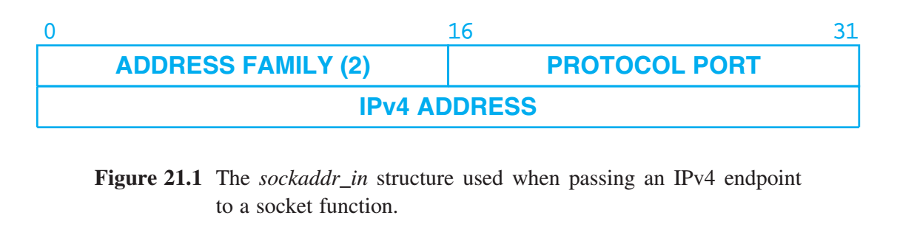
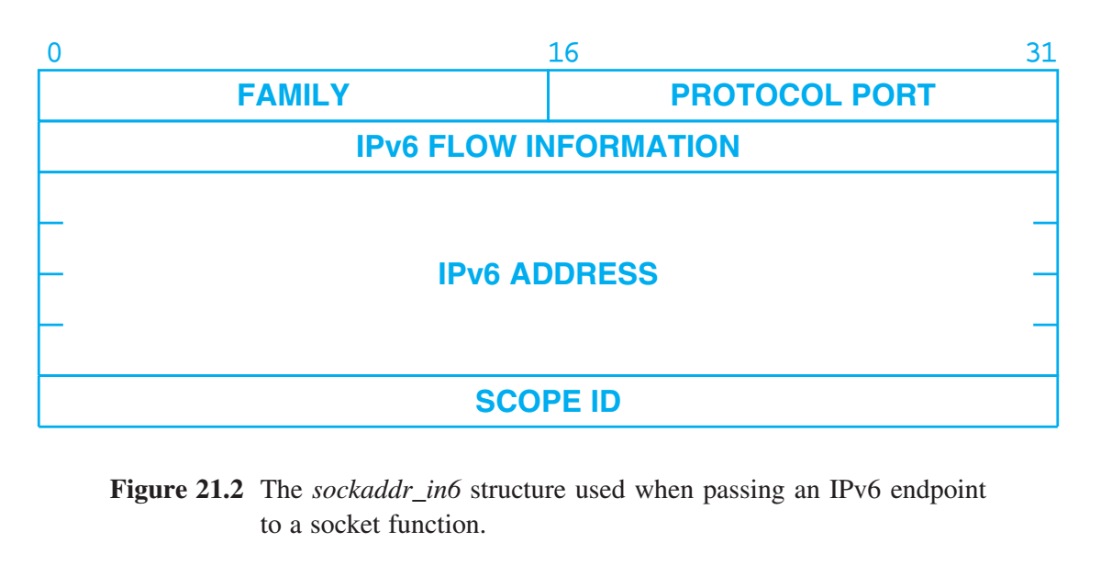
The Socket Abstraction and Socket Operations
Sockets - an operating system abstraction A mechanism that provides an application with a descriptor that can be used for network communication. Sockets are dynamic — an application program requests a socket when one is needed and releases the socket when it has finished. Like other I/O — a socket is given a descriptor just like an open file.

Slide 5
Creating A Socket
The socket function creates a socket on demand, and takes three integer arguments and returns an integer descriptor: descriptor = socket(pfam, type, protocol)
Arguments pfam specifies the protocol family (or how to interpret addresses). IPv4 (PF_INET) IPv6 (PF_INET6). type specifies the type of communication desired. SOCK_STREAM - Reliable stream delivery service SOCK_DGRAM - Connectionless datagram delivery service SOCK_RAW - Raw type that allows privileged programs to access special protocols or network interfaces.
Because a single protocol family can have multiple protocols that provide the same type of communication, the socket call has a third protocol argument that can be used to select a specific protocol; if the protocol family only contains one protocol of a given type (e.g., only TCP supplies a SOCK_STREAM service for IPv4 and IPv6), the third argument can be set to 0.

Slide 6
Socket Inheritance & Termination
A concurrent server uses socket inheritance to create a new process to handle each new client. Both old and new processes share access rights to existing descriptors. It is the responsibility of the programmer to ensure that the two processes use the shared socket meaningfully. When a process finishes using a socket it calls close. close(descriptor) Argument descriptor specifies the socket to close.

Slide 7
Specifying A Local Address
Clients don’t care about the local address they use, and allow the protocol software to fill an IP address and port number. Servers that operate at a well-known port must be able to specify the port to the system. Servers uses the bind function to establish a local address for the socket. bind(descriptor, localaddr, addrlen) Arguments descriptor the socket to be bound localaddr specifies local endpoint the socket should be bound addrlen specifies the length of the structure measured in bytes.

Slide 8
Specifying A Local Address
ADDRESS FAMILY identifies the protocol suite, and defines the layout of the remainder of the structure. - Indicate IPv4 structure - Protocol port number - IPv4 address. - Indicate IPv6 structure - Protocol port number - IPv6 flow identifier - IPv6 address - scope of an address (link-local, site-local, or global) Not all possible bindings are valid. The caller might request a local protocol port that is already in use by another program, or it might request an invalid IP address. In such cases, the bind call fails and returns an error code.

Slide 9
Connecting A Socket To A Destination Endpoint
The connect function is used to facilitate data transfer through a reliable stream socket. With connectionless service, connect simply stores the destination endpoint locally. connect(descriptor, destaddr, addrlen) Arguments descriptor is the socket to connect. destaddr argument is a socket address structure that specifies the destination address to which the socket should be bound. addrlen argument specifies the length of the destination address measured in bytes. The semantics of connect depend on the underlying protocol. Selecting the reliable stream delivery service in the PF_INET or PF_INET6 families means choosing TCP.

Slide 10
Sending Data Through A Socket
Five possible functions for transmitting data: send, sendto, sendmsg, write, and writev. Send, write, and writev only work with connected sockets because they do not allow the caller to specify a destination address. The differences between send, write, and writev are minor. send(descriptor, buffer, length, flags) Arguments descriptor is the socket descriptor buffer contains the address of the data to be sent length specifies the number of bytes to send flags controls the transmission. - out-of-band (TCP urgent data) - send message without using local forwarding table - enables network debugging software

Slide 11
Receiving Data Through A Socket
Five functions that a process can use to receive data through a socket: read, readv, recv, recvfrom, and recvmsg. The input operations recv and read can only be used when the socket is connected. recv(descriptor, buffer, length, flags) Arguments descriptor specifies a socket descriptor from which data should be received buffer specifies the address in memory into which the message should be placed length specifies the length of the buffer area flags allows the caller to control the reception.

Slide 12
Receiving Data Through A Socket
To form a reply, a UDP server uses the socket function recvfrom to obtain the sender’s IP address and protocol port number. recvfrom(descriptor, buffer, length, flags, fromaddr, fromlen) Arguments descriptor specifies a socket descriptor from which data should be received. buffer specifies the address in memory into which the message should be placed, length specifies the length of the buffer area flags allows the caller to control the reception. fromaddr sender’s endpoint information fromlen length of the endpoint information When sending a reply, a UDP server can pass the endpoint information to function sendto.

Slide 13
Obtaining Local & Remote Socket Endpoint Info
Newly created processes inherit the set of open sockets from the process that created them. new processes sometimes need to extract the remote endpoint address from an inherited socket, or determine the local endpoint address that is used for a socket. Two functions provide such information: getpeername and getsockname both handle endpoint addresses (not domain names). getpeername is used to determine the endpoint of a peer, and only works with connected sockets. getsockname returns the local endpoint associated with a socket.

Slide 14
Obtaining Local & Remote Socket Endpoint Info
getpeername is used to determine the endpoint of a peer, and only works with connected sockets. getpeername(descriptor, destaddr, addrlen) Arguments descriptor specifies the socket for which the destination endpoint is desired. destaddr is a pointer to a structure of type sockaddr that will receive the endpoint information. addrlen is a pointer to an integer that will receive the length of the endpoint structure.

Slide 15
Obtaining Local & Remote Socket Endpoint Info
getsockname returns the local endpoint associated with a socket. getsockname(descriptor, localaddr, addrlen) Arguments descriptor specifies the socket for which the local endpoint is desired. localaddr is a pointer to a structure of type sockaddr that will contain the endpoint. addrlen is a pointer to an integer that will contain the length of the endpoint structure.

Slide 16
Obtaining & Setting Socket Options
Applications need to control socket in other ways: - obtaining or setting the timeout parameters - controlling the allocation of buffer space - controlling processing of out-of-band data Rather than add new functions for each new control operation, the designers decided to build a single mechanism. The mechanism has two operations: getsockopt and setsockopt.

Slide 17
Obtaining & Setting Socket Options
Function getsockopt allows the application to request information about the socket. A caller specifies the socket, the option of interest, and a location at which to store the requested information. getsockopt(descriptor, level, optionid, optionval, length) Arguments descriptor specifies the socket for which information is needed. level identifies if the operation applies to the socket or underlying protocols. optionid specifies a single option to which the request applies. optionval gives the address of a buffer into which the system places the requested value, length gives the address of an integer into which the system places the length of the option value.

Slide 18
Obtaining & Setting Socket Options
Function setsockopt allows an application program to set a socket option using the set of values obtained with getsockopt. The caller specifies a socket for which the option should be set, the option to be changed, and a value for the option. setsockopt(descriptor, level, optionid, optionval, length) Arguments descriptor specifies the socket for which information is needed. level identifies if the operation applies to the socket or underlying protocols. optionid specifies a single option to which the request applies. optionval gives the address of a buffer into which the system places the requested value, *length integer that specifies the number of bytes in the option being passed to the system. *length is the one argument that is different from getsockopt.

Slide 19
Specifying a Queue Length for a Server
Queues are important for sequential servers, but may also be needed to handle packet bursts for concurrent servers. The listen function allows servers to prepare a socket for incoming connections. Listen puts the socket in a passive mode ready to accept connections, and contains an argument that configures the size of a queue for incoming requests. listen(descriptor, qlength) Arguments descriptor the socket that should be prepared for use by a server. qlength specifies the length of the request queue for that socket. Listen applies only to sockets that have selected reliable stream delivery service.

Slide 20
How a Server Accepts TCP Connections
Servers uses the functions: socket - to create a socket bind - bind the socket to a well-known protocol port, while the socket is not connected to specific remote destination. The remote destination must specify a wildcard, allowing the socket to receive connection requests from an arbitrary client. listen - specify a queue length for connection requests. Once a socket has been established: accept - The server waits for a connection, by calling the accept function. newsock = accept(descriptor, addr, addrlen) Arguments descriptor specifies the socket on which to wait. addr is a pointer to a structure of type sockaddr. addrlen is a pointer to an integer

Slide 21
How a Server Accepts TCP Connections
newsock = accept(descriptor, addr, addrlen) Arguments descriptor specifies the socket on which to wait. addr is a pointer to a structure of type sockaddr. addrlen is a pointer to an integer When a request arrives: - The system fills in argument addr with the endpoint information of the client that made the request. - And sets addrlen to the length of the endpoint structure. - The system creates a new socket that has its destination connected to the requesting client - returns the new socket descriptor to the caller - The original socket still has a wildcard remote destination, and it still remains open. Thus, the original server can continue to accept additional requests at the original socket.

Slide 22
Library Functions Related to Sockets
The socket API offers a large set of functions that perform useful tasks related to networking. Many of the socket library functions provide database services that allow a process to determine the names of machines and network services, protocol port numbers, and other related information.

Slide 23
Servers that handle multiple services
The socket API provides another interesting possibility for server design because it allows a single process to wait for connections on multiple sockets. The system call that makes the design possible is called select. nready = select(ndesc, indesc, outdesc, excdesc, timeout) Arguments ndesc - specifies how many descriptors should be examined (the descriptors checked are always 0 through ndesc-1). indesc - is a pointer to a bit mask that specifies the file descriptors to check for input, outdesc - is a pointer to a bit mask that specifies the file descriptors to check for output, excdesc - is a pointer to a bit mask that specifies the file descriptors to check for exception conditions. Timeout - nonzero means it is the address of an integer that specifies how long to wait for a connection before returning to the caller. A zero value for timeout forces the call to block until a descriptor becomes ready.

Slide 24
Obtaining and setting the Host Name
Although IP uses a destination address when delivering datagrams, user and application programs use a name to refer to a computer. Computer’s name is derived from the Domain Name System. The gethostname function allows an application to obtain the local computer’s name. A related function, sethostname, allows a manager to set the hostname to a given string. gethostname(name, length) Arguments name gives the address of an array of bytes where the name is to be stored length is an integer that specifies the maximum length of a name (i.e., the size of the name array). sethostname(name, length) Arguments name gives the address of an array in which a name has been stored length is an integer that gives the length of the name.

Slide 25
Network Byte Order and Conversion Routines
The socket API provides four macros that convert between the local machine byte order and the network standard byte order. From Network Byte Order to Local Host Byte Order The network to host short or ntohs function - convert a short (2-byte) integer from network byte order to the local host byte order. localshort = ntohs(netshort) The network to host long or ntohl function converts a 4-byte long from network standard byte order to local host byte order. locallong = ntohl(netlong) From Local Host Byte Order to Network Byte Order Host to network short or htons function converts 2-byte (short) integer, from local host byte order to network standard byte order. netshort = htons(localshort) The host to network long or htonl function, converts a 4-byte integer to network standard byte order. netlong = htonl(locallong)

Slide 26
IP Address Manipulation Routines
Socket library includes utility that translates address notations, between dotted decimal notation, colon-hex notation, and 32-bit IPv4 addresses, or 128-bit IPv6 addresses. For instance: Inet_aton function translates dotted decimal format to a 32-bit IPv4 address in network byte order. error_code = inet_aton(string, address) Arguments string gives the address of an ASCII string that contains the IPv4 address expressed in dotted decimal format address is a pointer to a 32-bit integer into which the binary value is placed. inet_ntoa function performs the inverse of inet_aton by mapping a 32-bit IPv4 address to an ASCII string in dotted decimal format. str = inet_ntoa(internetaddr) Argument internetaddr is a 32-bit IPv4 address in network byte order, and str is the address of the resulting ASCII version.

Slide 27
Accessing the Domain Name System
Five library functions constitute the interface to the Domain Name System (DNS). Using these functions creates a client-server relationship with a DNS server. res_init - program calls res_init before calling other functions. The call takes no arguments. Res_init stores the name of a domain name server in global structure res, making the system ready to contact the server res_mkquery - forms a domain name query and places the query in a buffer in memory. res_send - once a program has formed a query, it calls res_send to send it to a name server and obtain a response. dn_expand - expands a compressed domain name into a full ASCII version. dn_comp - compresses a full domain name

Slide 28
Accessing the Domain Name System
res_mkquery function forms a domain name query and places the query in a buffer in memory. res_mkquery(op, dname, class, type, data, datalen, newrr, buffer, buflen) Arguments (The first seven arguments correspond directly to the fields of a domain name query) op specifies the requested operation dname gives the address of a character array that contains a domain name class is an integer that gives the class of the query type is an integer that gives the type of the query data gives the address of an array of data to be included in the query datalen is an integer that gives the length of the data newrr is unused in current implementation buffer the address of an area into which the query should be placed buflen integer length of the buffer area

Slide 29
Accessing the Domain Name System
Once a program has formed a query, it calls res_send to send it to a name server and obtain a response. res_send(buffer, buflen, answer, anslen) Arguments buffer is a pointer to memory that holds the message to be sent (application called function res_mkquery to form the message). buflen is an integer that specifies the length. answer gives the address in memory into which a response should be written, anslen specifies the length of the answer area.

Slide 30
Accessing the Domain Name System
Function dn_expand expands a compressed domain name into a full ASCII version. dn_expand(msg, eom, compressed, full, fullen) Arguments msg gives the address of a domain name message that contains the name to be expanded eom specifying the end-of-message limit beyond which the expansion cannot go. compressed is a pointer to the first byte of the compressed name. full is a pointer to an array into which the expanded name should be written fullen is an integer that specifies the length of the array.

Slide 31
Accessing the Domain Name System
Function dn_comp compresses a full domain name by comparing suffixes to a list of previously used suffixes and eliminating the longest possible suffix. dn_comp(full, compressed, cmprlen, prevptrs, lastptr) Arguments full gives the address of a full domain name. compressed points to an array of bytes that will hold the compressed name cmprlen specifying the length of the array prevptrs is the address of an array of pointers to previously compressed suffixes in the current message lastptr pointing to the end of the array. dn_comp can also be used to translate a domain name from ASCII to the internal form without compression (i.e., without removing suffixes). To do so, a process invokes dn_comp with the prevptrs argument set to NULL (i.e., zero).

Slide 32
Obtaining Information about Hosts
Functions exist that allow an application to retrieve information about a host using either its domain name or its IP address. Functions make the application a client of the DNS, by sending a request to a DNS server and wait for a response. Following functions take a domain name or address and return a pointer to a structure of information for the specified host. gethostbyname function takes a domain name and returns a pointer to a structure of information for the specified host. gethostbyaddr function take a host address and returns a pointer to a structure of information for the specified host. The value returned points to a structure that contains: - official host name - list of aliases that have been registered for the host - the host address type (i.e., IPv4, IPv6, or some other type) - the length of an address - a list of one or more addresses for the host. Functions sethostent, gethostent, and endhostent provide sequential access to the host database — an application can open the database, extract entries sequentially, and then close the database

Slide 33
Obtaining Information about Hosts
ptr = gethostbyname(namestr) Arguments namestr is a pointer to a character string that contains a domain name for the host. The value returned points to a structure that contains: - official host name - list of aliases that have been registered for the host - the host address type (i.e., IPv4, IPv6, or some other type) - the length of an address - a list of one or more addresses for the host.

Slide 34
Obtaining Information about Hosts
ptr = gethostbyaddr(addr, len, type) Arguments addr is a pointer to a sequence of bytes that contain a host address len is an integer that gives the length of the address type is an integer that specifies the type of the address (IPv4 or IPv6 address). The value returned points to a structure that contains: - official host name - list of aliases that have been registered for the host - the host address type (i.e., IPv4, IPv6, or some other type) - the length of an address - a list of one or more addresses for the host.

Slide 35
Obtaining Information about Networks
The socket library also includes functions that allow an application to access a database of networks. Function getnetbyname obtains and formats the contents of an entry from the database given the domain name of a network. ptr = getnetbyname(name) Argument name is a pointer to a string that contains the name of the network for which information is desired. The value returned is a pointer to a structure that contains: - the official name of the network - list of registered aliases - an integer address type (i.e., IPv4, IPv6, or some other type), - the address prefix used with the network (i.e., the network portion of an IP address with the host portion set to zero).

Slide 36
Obtaining Information about Protocols
Five library functions provide access to the database of protocols available on a machine. Each protocol has an official name, registered aliases, and an official protocol number. ptr = getprotobyname(name) Allows a caller to obtain information about a protocol given its name. ptr = getprotobynumber(number) Allows a process to search for protocol information using the protocol number as a key. Additional Functions getprotoent - provide sequential access to the protocol database setprotoent - provide sequential access to the protocol database endprotoent - provide sequential access to the protocol database

Slide 37
Obtaining Information about Network Services
Some UDP and TCP protocol port numbers are reserved for well-known services. For instance, TCP port 37 is reserved for the time protocol Five library functions exist that obtain information about services and the protocol ports they use. getservbyname - maps a named service onto a port number getservbyport - obtain an entry from the services database using the port number setservent - access the services database sequentially getservent - access the services database sequentially endservent - access the services database sequentially Entries in the services database include: - service name - time - protocol - protocol port number

Slide 38
Obtaining Information about Network Services
ptr = getservbyname(name, proto) maps a named service onto a port number Arguments name specifies the address of a string that contains the name of the desired service, proto is a string that gives the name of the protocol with which the service is to be used (TCP, or UDP) ptr = getservbyport(port, proto) obtain an entry from the services database given the port number Arguments port is the integer protocol port number assigned to the service proto specifies the protocol for which the service is desired

Slide 39
Summary / Key Concepts
Introduction to Socket API The Socket Abstraction and Socket Operations Obtaining and Setting Socket Options How a Server Accepts TCP Connections Servers that handle Multiple Services Obtaining and Setting the Host Name Library Functions Related to Sockets Network Byte Order and Conversion Routines IP Address Manipulation Routines Accessing the Domain Name System Obtaining Information about Hosts Obtaining Information about Networks Obtaining Information about Protocols Obtaining Information about Network Services

