Slide 1
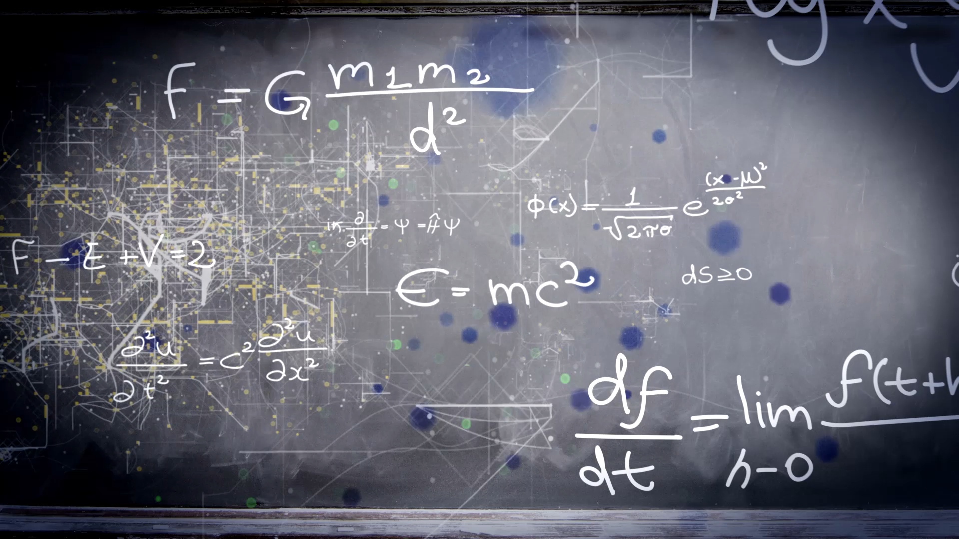
(1.2) Coulomb’s Law
Dustin Roten, Ph.D.
Wilkes Community College
Spring 2025

Slide 2
1.2 Coulomb’s Law Topics
1.2.1 A Brief History of Coulomb’s Law
1.2.2 Coulomb’s Law
1.2.3 Units of Charge
1.2.4 Using Coulomb’s Law
Example #1
Example #2

Slide 3
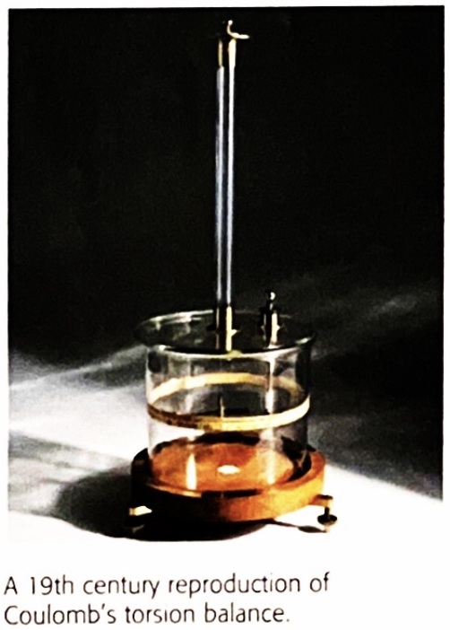
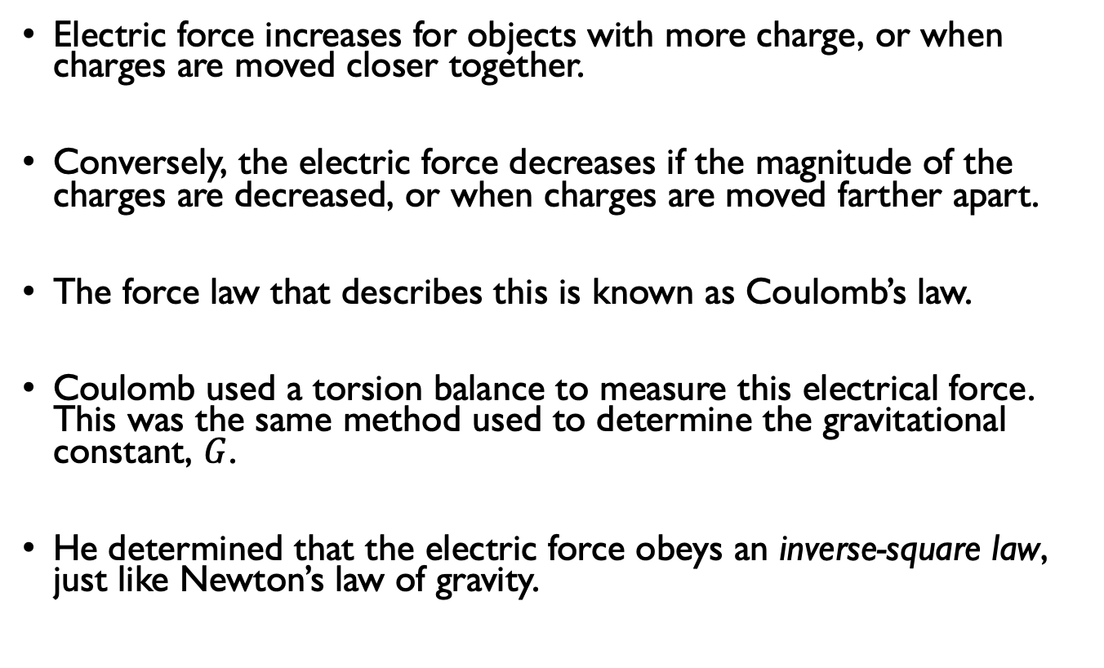
1.2.1 A Brief History of Coulomb’s Law
Electric force increases for objects with more charge, or when charges are moved closer together.
Conversely, the electric force decreases if the magnitude of the charges are decreased, or when charges are moved farther apart.
The force law that describes this is known as Coulomb’s law.
Coulomb used a torsion balance to measure this electrical force. This was the same method used to determine the gravitational constant, $G$.
He determined that the electric force obeys an inverse-square law, just like Newton’s law of gravity.

Slide 4
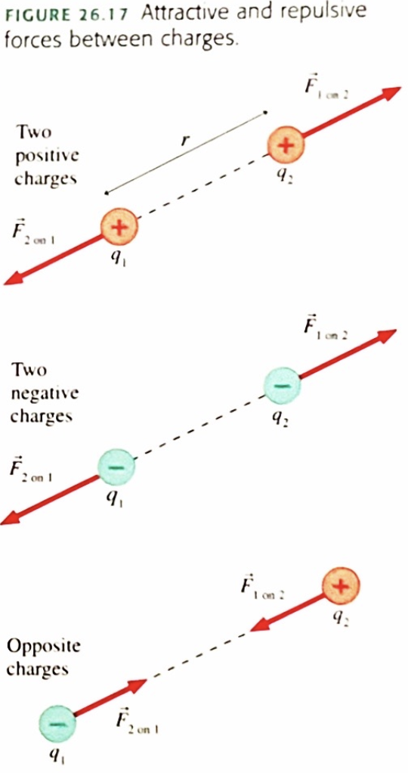
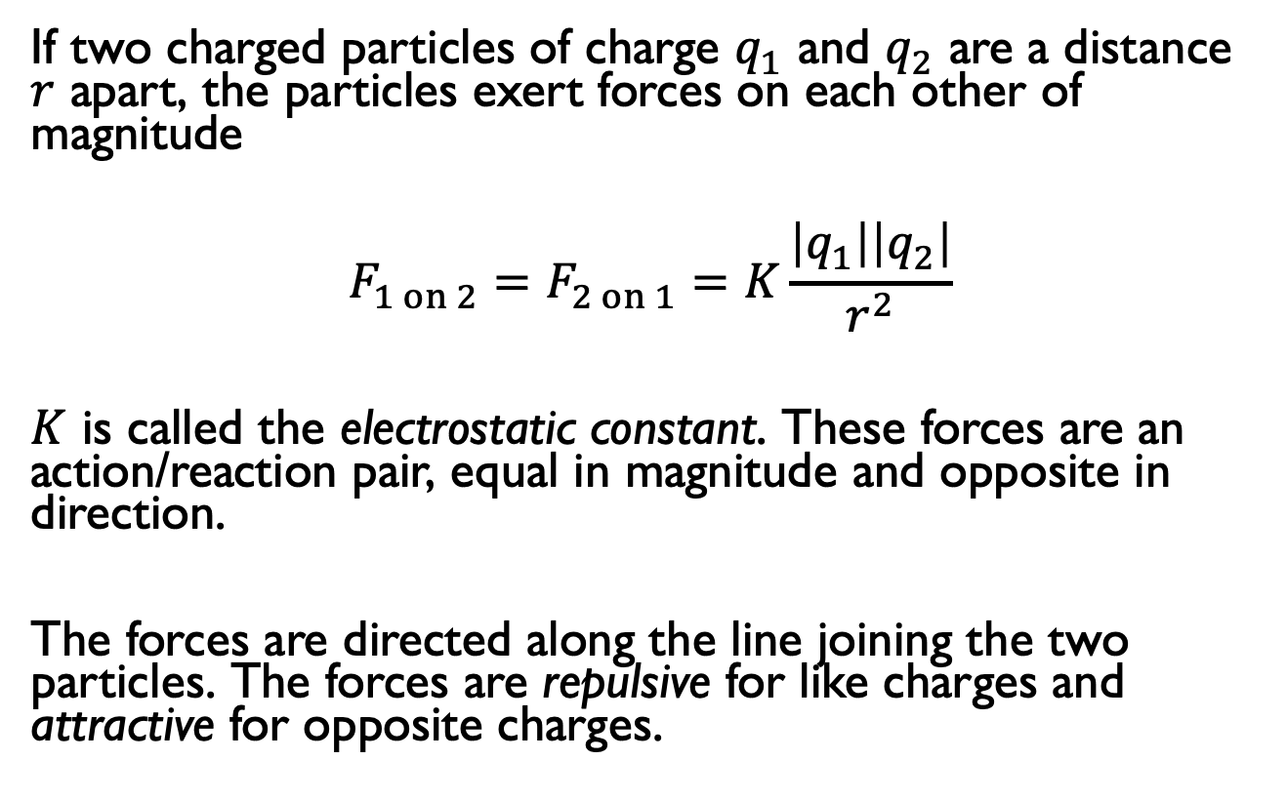
1.2.2 Coulomb’s Law
If two charged particles of charge $q_{1}$ and $q_{2}$ are a distance $r$ apart, the particles exert forces on each other of magnitude
$$F_{1 on 2}=F_{2 on 1}=K\frac{\left|q_{1}\right|\left|q_{2}\right|}{r^{2}}$$
$K$ is called the electrostatic constant. These forces are an action/reaction pair, equal in magnitude and opposite in direction.
The forces are directed along the line joining the two particles. The forces are repulsive for like charges and attractive for opposite charges.

Slide 5
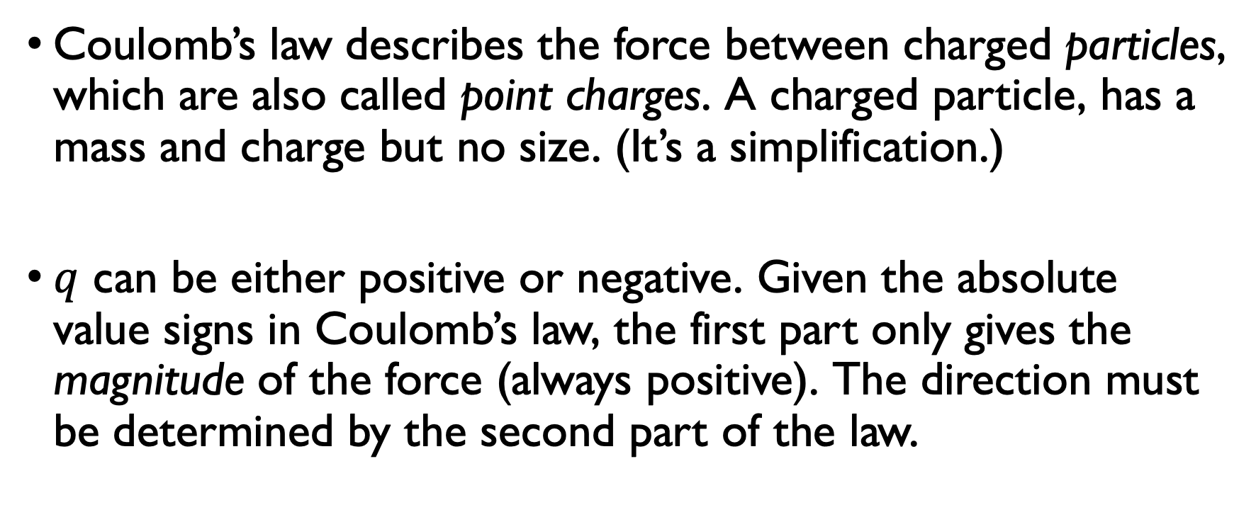
1.2.2 Coulomb’s Law
Coulomb’s law describes the force between charged particles, which are also called point charges. A charged particle, has a mass and charge but no size. (It’s a simplification.)
$q$ can be either positive or negative. Given the absolute value signs in Coulomb’s law, the first part only gives the magnitude of the force (always positive). The direction must be determined by the second part of the law.

Slide 6
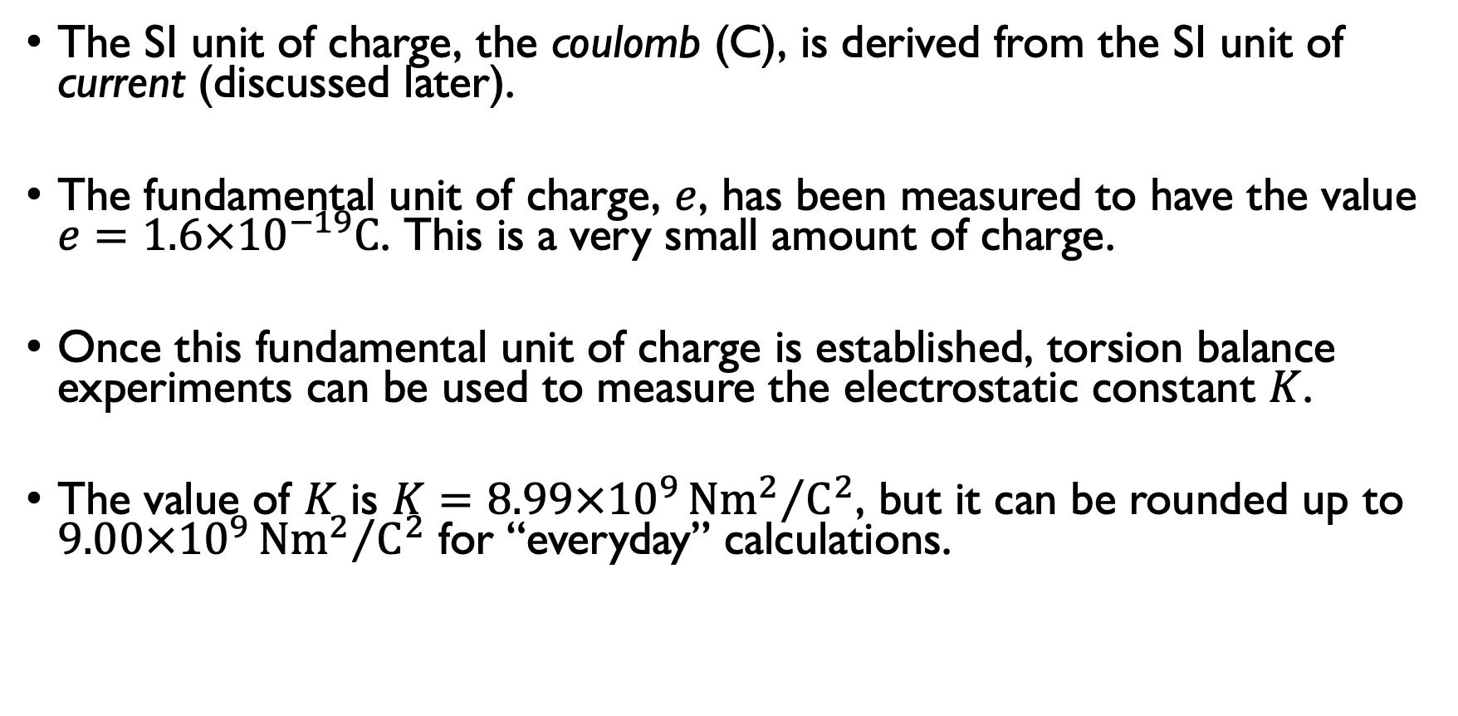
1.2.3 Units of Charge
The SI unit of charge, the coulomb (C), is derived from the SI unit of current (discussed later).
The fundamental unit of charge, $e$, has been measured to have the value $e=1.6×{10}^{−19}C$. This is a very small amount of charge.
Once this fundamental unit of charge is established, torsion balance experiments can be used to measure the electrostatic constant $K$.
The value of $K$ is $K=8.99×{10}^{9}{Nm^{2}}/{C^{2}}$, but it can be rounded up to $9.00×{10}^{9}{Nm^{2}}/{C^{2}}$ for “everyday” calculations.

Slide 7
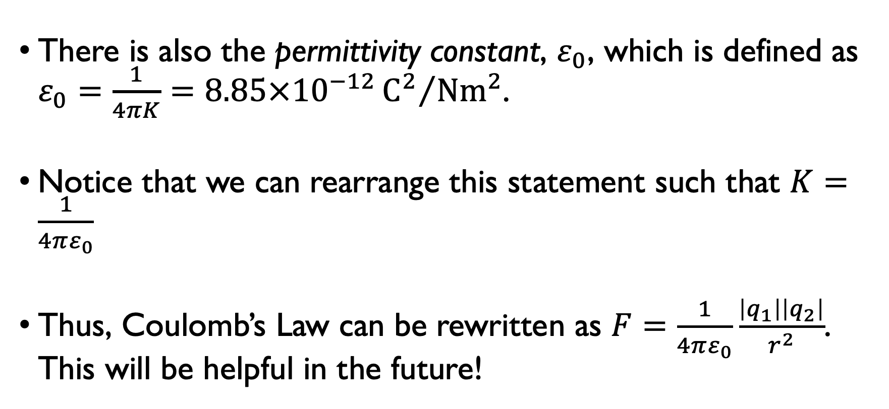
1.2.3 Units of Charge
There is also the permittivity constant, $ε_{0}$, which is defined as $ε_{0}=\frac{1}{4πK}=8.85×{10}^{−12}{C^{2}}/{Nm^{2}}$.
Notice that we can rearrange this statement such that $K=\frac{1}{4πε_{0}}$
Thus, Coulomb’s Law can be rewritten as $F=\frac{1}{4πε_{0}}\frac{\left|q_{1}\right|\left|q_{2}\right|}{r^{2}}$. This will be helpful in the future!

Slide 8
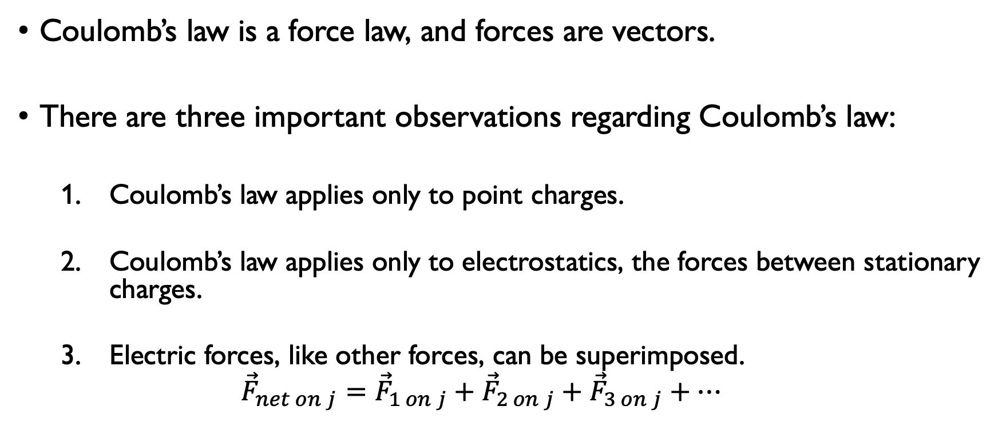
1.2.4 Using Coulomb’s Law
Coulomb’s law is a force law, and forces are vectors.
There are three important observations regarding Coulomb’s law:
Coulomb’s law applies only to point charges.
Coulomb’s law applies only to electrostatics, the forces between stationary charges.
Electric forces, like other forces, can be superimposed.
$${\vec{F}}_{net on j}={\vec{F}}_{1 on j}+{\vec{F}}_{2 on j}+{\vec{F}}_{3 on j}+…$$

Slide 9
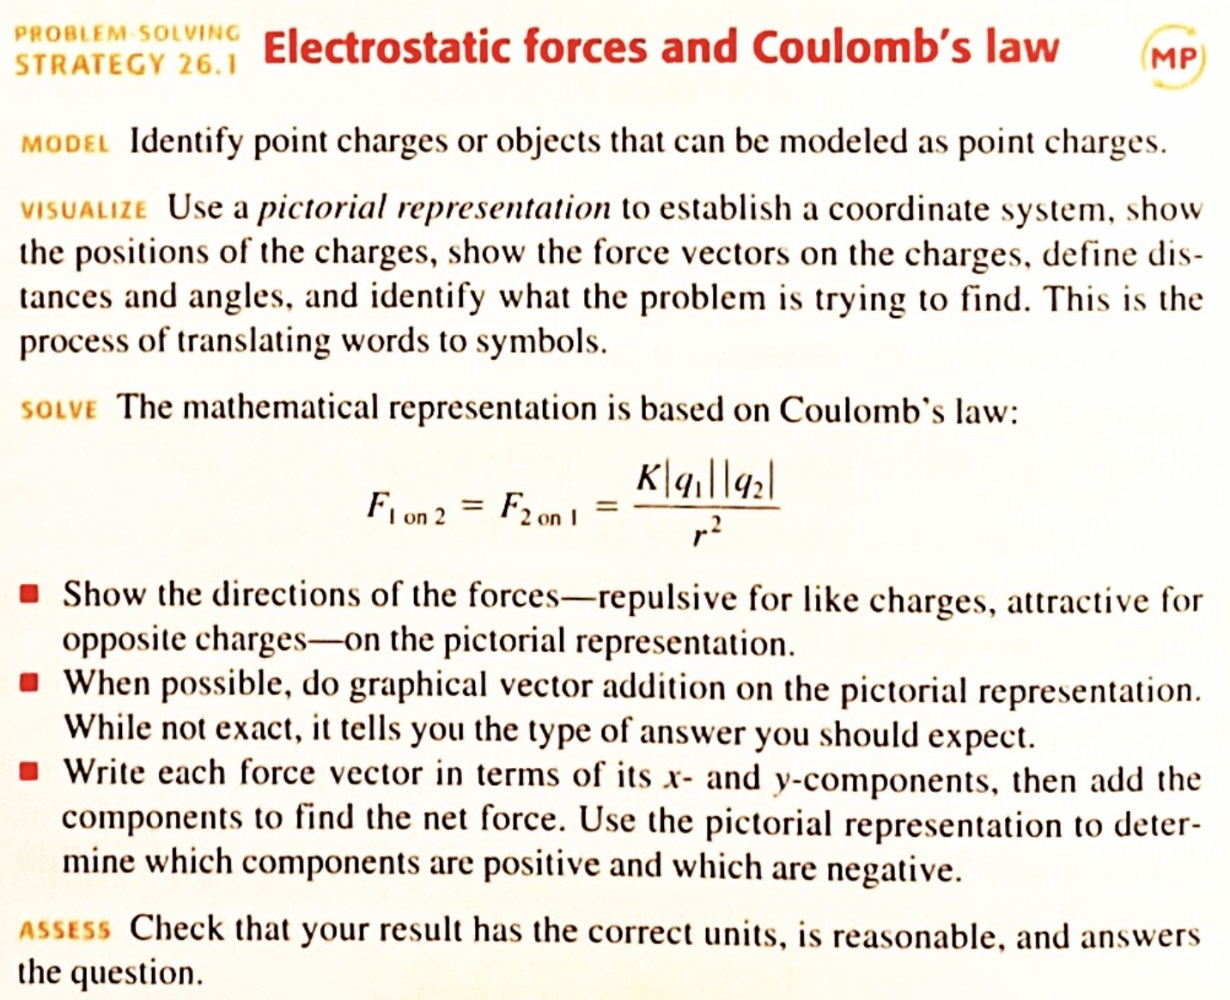
1.2.4 Using Coulomb’s Law

Slide 10
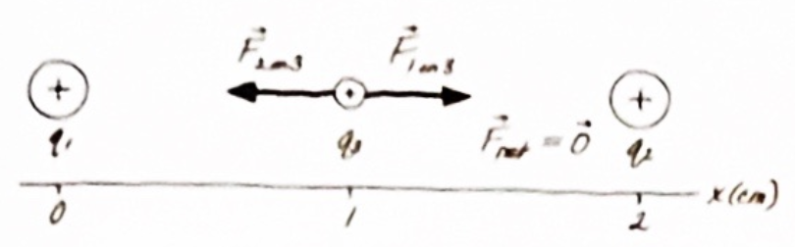

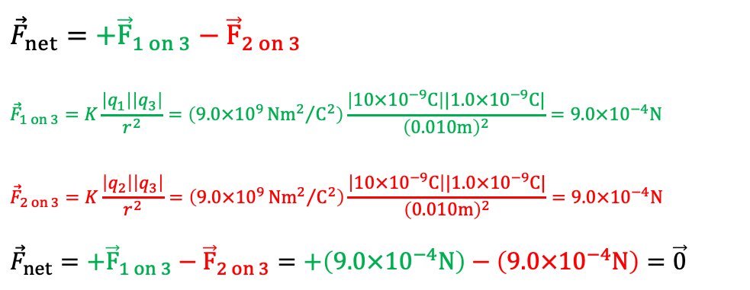
Example #1
Two $+10nC$ charged particles are $2.0cm$ apart on the x-axis. What is the net force on a $+1.0nC$ particle placed halfway between them?
$${\vec{F}}_{net}=+{\vec{F}}_{1 on 3}−{\vec{F}}_{2 on 3}$$
$${\vec{F}}_{1 on 3}=K\frac{\left|q_{1}\right|\left|q_{3}\right|}{r^{2}}=\left(9.0×{10}^{9}{Nm^{2}}/{C^{2}}\right)\frac{\left|10×{10}^{−9}C\right||1.0×{10}^{−9}C|}{{\left(0.010m\right)}^{2}}=9.0×{10}^{−4}N$$
$${\vec{F}}_{2 on 3}=K\frac{\left|q_{2}\right|\left|q_{3}\right|}{r^{2}}=\left(9.0×{10}^{9}{Nm^{2}}/{C^{2}}\right)\frac{\left|10×{10}^{−9}C\right||1.0×{10}^{−9}C|}{{\left(0.010m\right)}^{2}}=9.0×{10}^{−4}N$$
$${\vec{F}}_{net}=+{\vec{F}}_{1 on 3}−{\vec{F}}_{2 on 3}=+\left(9.0×{10}^{−4}N\right)−\left(9.0×{10}^{−4}N\right)=\vec{0}$$
Notice that the geometry of the problem causes the two large charges to apply equal forces to the smaller one (same distance apart). Additionally, the geometry causes them to be in opposing directions, cancelling them out.

Slide 11
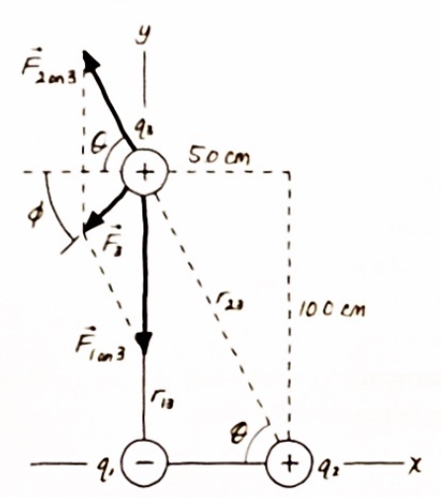
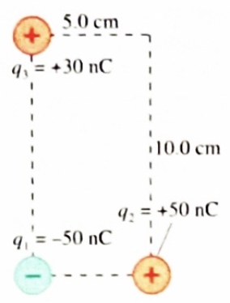
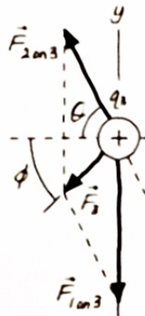


Example #2
Three charged particles with $q_{1}=−50nC$, $q_{2}=+50nC$, and $q_{3}=+30nC$ are placed on the corners of a $5.0cm ×10.0cm$ rectangle. What is the net force on charge $q_{3}$?
Some notes:
$${\vec{F}}_{3}={\vec{F}}_{1 on 3}+{\vec{F}}_{2 on 3}$$
Notice how the components of these vectors make up ${\vec{F}}_{3}$.
There are also two angles that must be considered: $θ$ and $φ$.

Slide 12
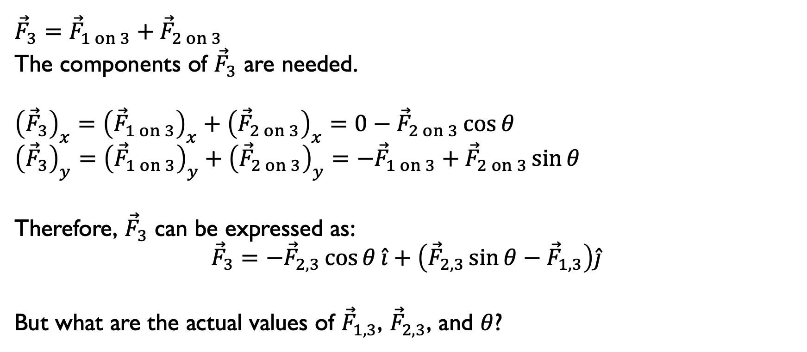
Example #2
$${\vec{F}}_{3}={\vec{F}}_{1 on 3}+{\vec{F}}_{2 on 3}$$
The components of ${\vec{F}}_{3}$ are needed.
$${\left({\vec{F}}_{3}\right)}_{x}={\left({\vec{F}}_{1 on 3}\right)}_{x}+{\left({\vec{F}}_{2 on 3}\right)}_{x}=0−{\vec{F}}_{2 on 3}\cos{θ}$$
$${\left({\vec{F}}_{3}\right)}_{y}={\left({\vec{F}}_{1 on 3}\right)}_{y}+{\left({\vec{F}}_{2 on 3}\right)}_{y}=−{\vec{F}}_{1 on 3}+{\vec{F}}_{2 on 3}\sin{θ}$$
Therefore, ${\vec{F}}_{3}$ can be expressed as:
$${\vec{F}}_{3}=−{\vec{F}}_{2,3}\cos{θ}\hat{i}+\left({\vec{F}}_{2,3}\sin{θ}−{\vec{F}}_{1,3}\right)\hat{j}$$
But what are the actual values of ${\vec{F}}_{1,3}$, ${\vec{F}}_{2,3}$, and $θ$?

Slide 13
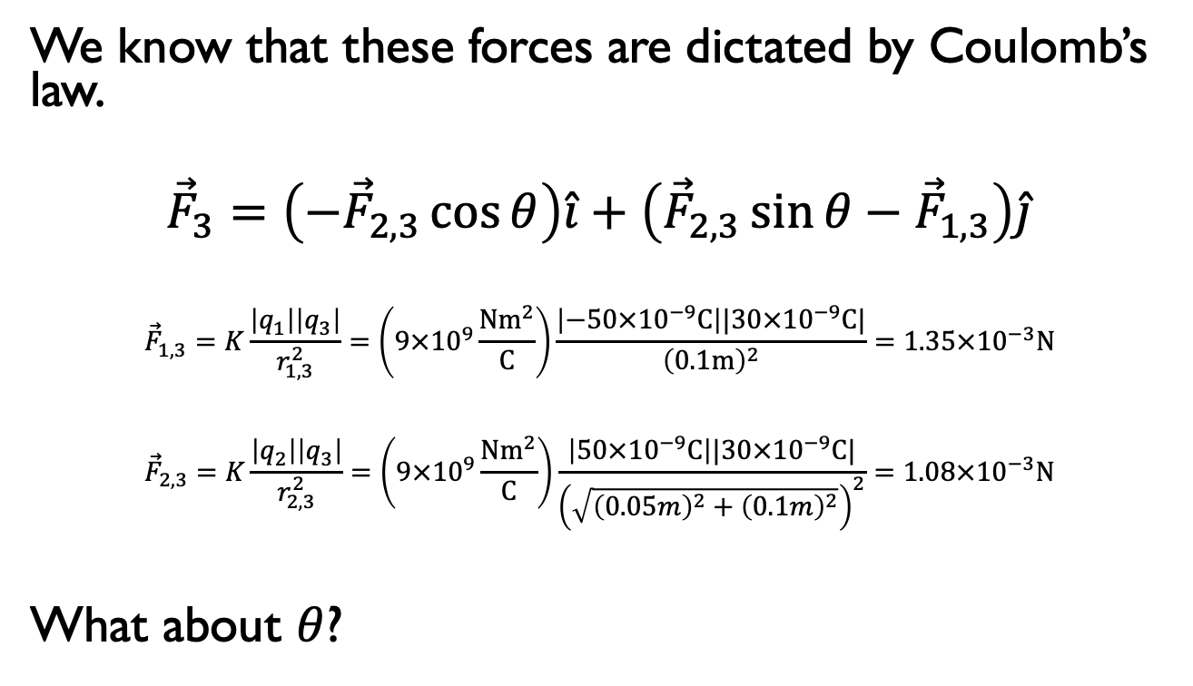
Example #2
We know that these forces are dictated by Coulomb’s law.
$${\vec{F}}_{3}=\left(−{\vec{F}}_{2,3}\cos{θ}\right)\hat{i}+\left({\vec{F}}_{2,3}\sin{θ}−{\vec{F}}_{1,3}\right)\hat{j}$$
$${\vec{F}}_{1,3}=K\frac{\left|q_{1}\right|\left|q_{3}\right|}{r_{1,3}^{2}}=\left(9×{10}^{9}\frac{Nm^{2}}{C}\right)\frac{\left|−50×{10}^{−9}C\right||30×{10}^{−9}C|}{{\left(0.1m\right)}^{2}}=1.35×{10}^{−3}N$$
$${\vec{F}}_{2,3}=K\frac{\left|q_{2}\right|\left|q_{3}\right|}{r_{2,3}^{2}}=\left(9×{10}^{9}\frac{Nm^{2}}{C}\right)\frac{\left|50×{10}^{−9}C\right||30×{10}^{−9}C|}{{\left(\sqrt{{\left(0.05m\right)}^{2}+{\left(0.1m\right)}^{2}}\right)}^{2}}=1.08×{10}^{−3}N$$
What about $θ$?

Slide 14
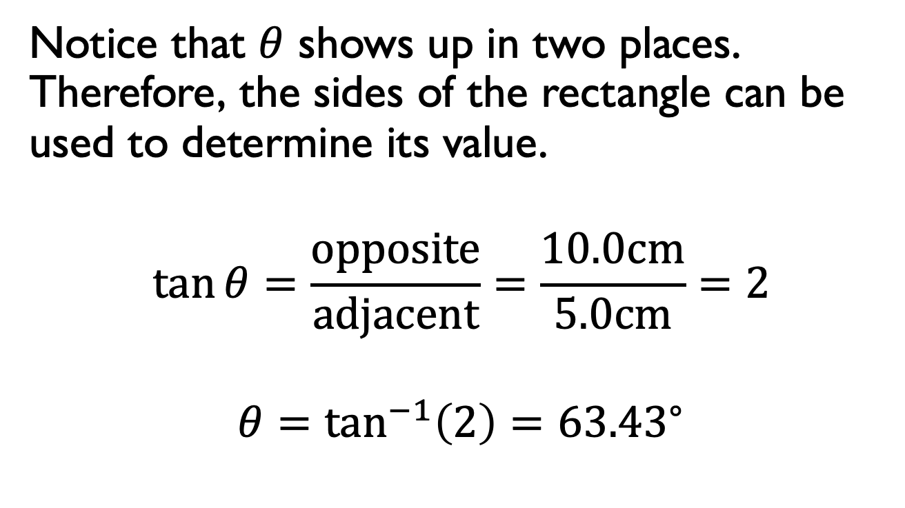
Example #2
Notice that $θ$ shows up in two places. Therefore, the sides of the rectangle can be used to determine its value.
$$\tan{θ}=\frac{opposite}{adjacent}=\frac{10.0cm}{5.0cm}=2$$
$$θ=\tan^{−1}\left(2\right)={63.43}^{∘}$$

Slide 15
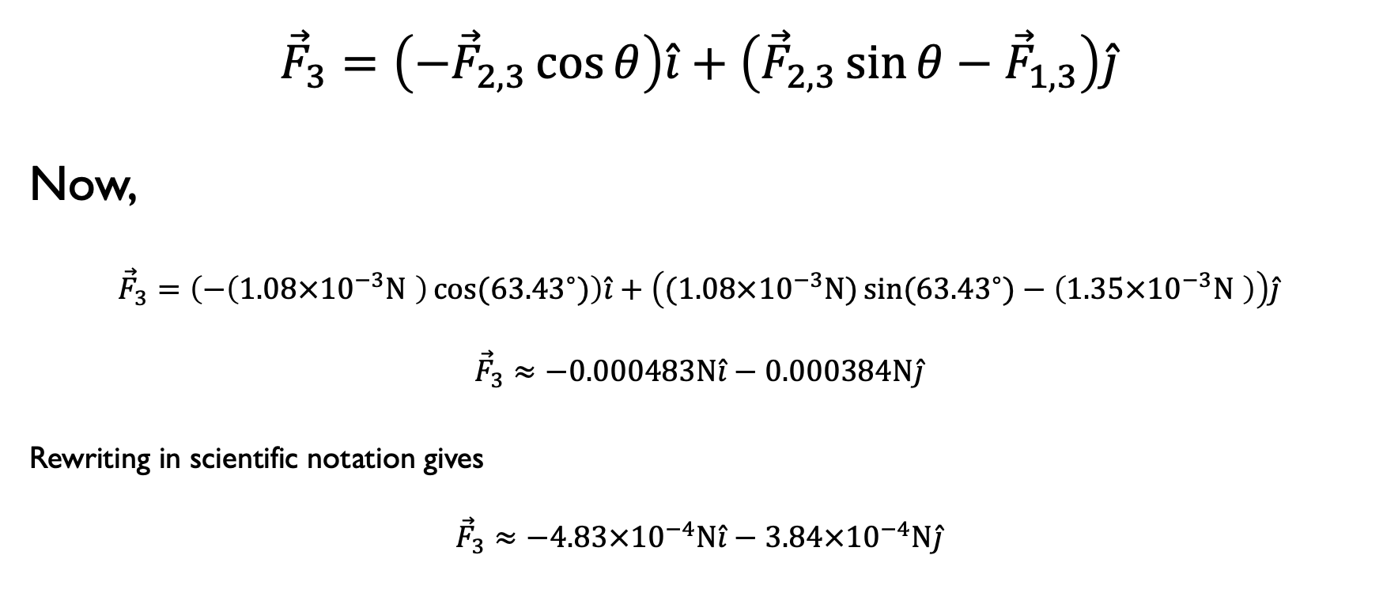
Example #2
$${\vec{F}}_{3}=\left(−{\vec{F}}_{2,3}\cos{θ}\right)\hat{i}+\left({\vec{F}}_{2,3}\sin{θ}−{\vec{F}}_{1,3}\right)\hat{j}$$
Now,
$${\vec{F}}_{3}=\left(−\left(1.08×{10}^{−3}N \right)\cos{({63.43}^{∘})}\right)\hat{i}+\left((1.08×{10}^{−3}N\text{)}\sin{({63.43}^{∘})}−\left(1.35×{10}^{−3}N \right)\right)\hat{j}$$
$${\vec{F}}_{3}≈−0.000483N\hat{i}−0.000384N\hat{j}$$
Rewriting in scientific notation gives
$${\vec{F}}_{3}≈−4.83×{10}^{−4}N\hat{i}−3.84×{10}^{−4}N\hat{j}$$

Slide 16
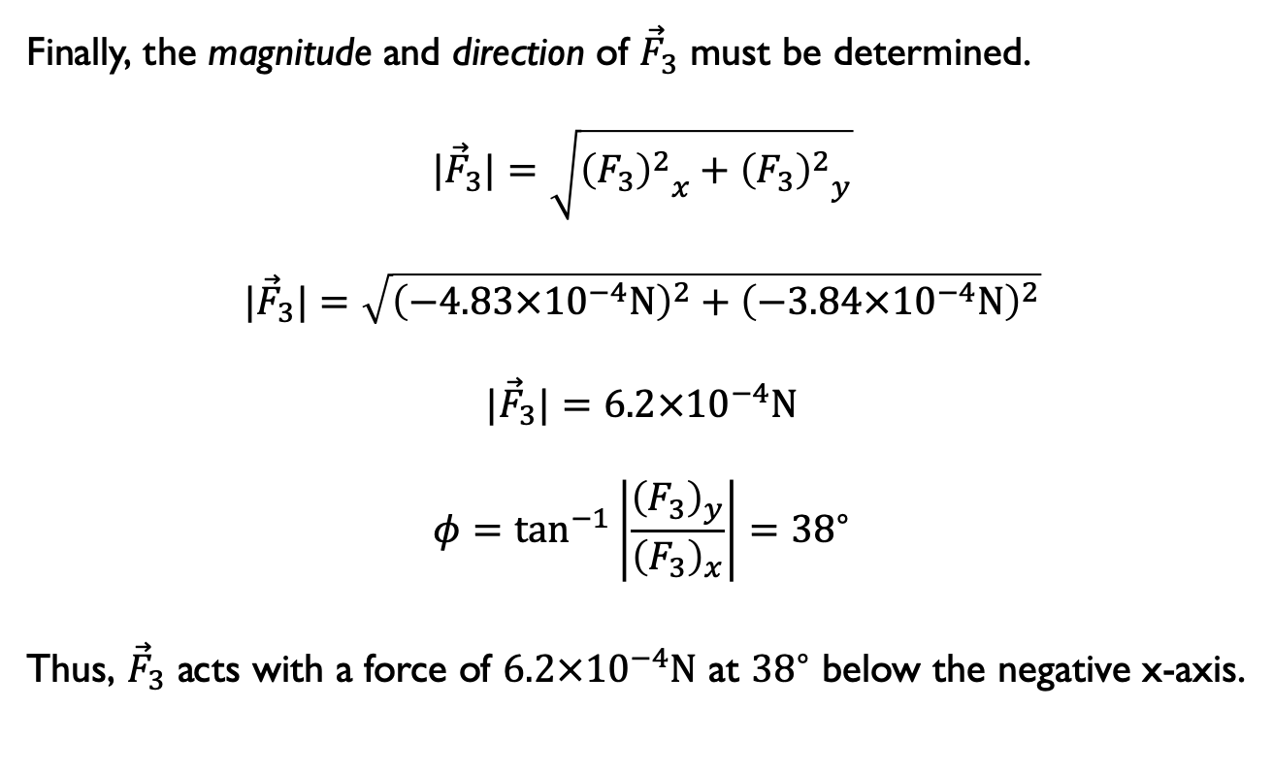
Example #2
Finally, the magnitude and direction of ${\vec{F}}_{3}$ must be determined.
$${|\vec{F}}_{3}|=\sqrt{{{\left(F_{3}\right)}^{2}}_{x}+{{\left(F_{3}\right)}^{2}}_{y}}$$
$${|\vec{F}}_{3}|=\sqrt{{\left(−4.83×{10}^{−4}N\right)}^{2}+{\left(−3.84×{10}^{−4}N\right)}^{2}}$$
$${|\vec{F}}_{3}|=6.2×{10}^{−4}N$$
$$φ=\tan^{−1}\left|\frac{{\left(F_{3}\right)}_{y}}{{\left(F_{3}\right)}_{x}}\right|={38}^{∘}$$
Thus, ${\vec{F}}_{3}$ acts with a force of $6.2×{10}^{−4}N$ at ${38}^{∘}$ below the negative x-axis.

