Slide 1
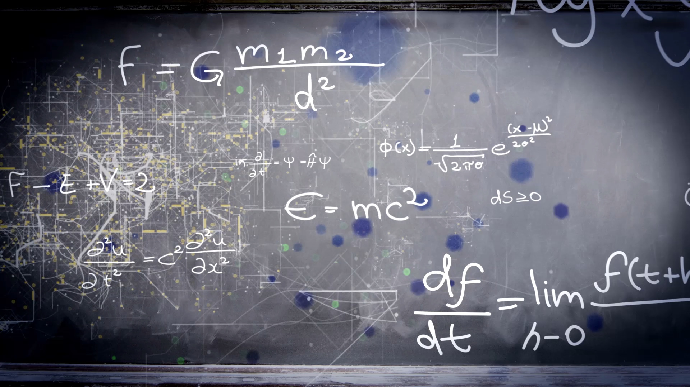
(1.3) The Field Model
Dustin Roten, Ph.D.
Wilkes Community College
Spring 2025

Slide 2
1.3 The Field Model Topics
1.3.1 The Need for a Field Model
1.3.2 The Concept of a Field
1.3.3 The Electric Field
1.3.4 Unit Vector Notation
Example #1

Slide 3
1.3.1 The Need for a Field Model
Electric and magnetic forces, like gravity, are long-range forces.
No contact is required for one charged particle to exert a force on another charged particle.
How do long range forces work anyway?

Slide 4
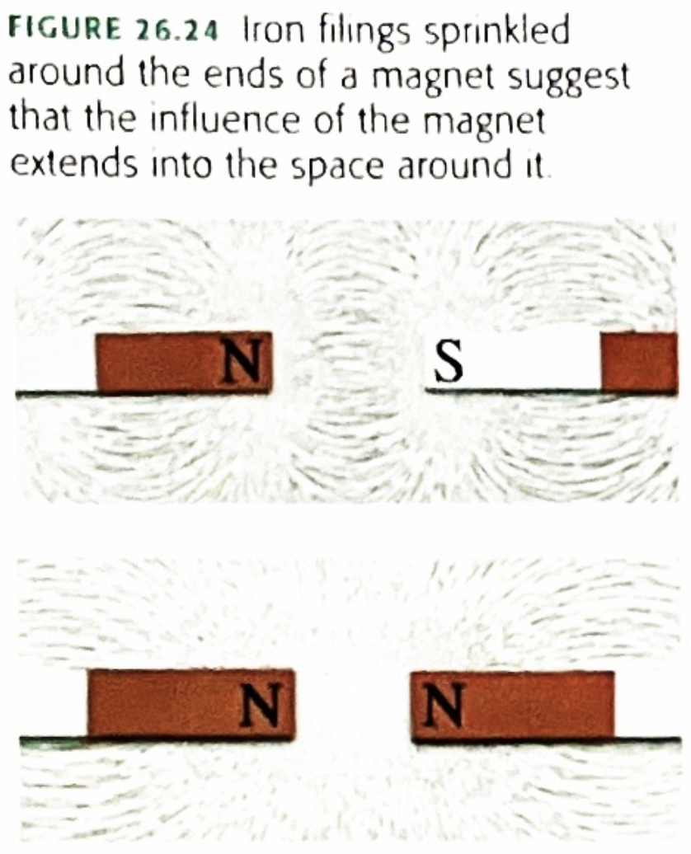
1.3.2 The Concept of a Field
Michael Faraday sprinkled iron filings over a magnet, revealing a spatial pattern.
The pattern’s regularity and curved lines suggested that the space itself around the magnetic is filled with some kind of magnetic influence.
This “space alteration” is the mechanism by which the long-range force is exerted.

Slide 5
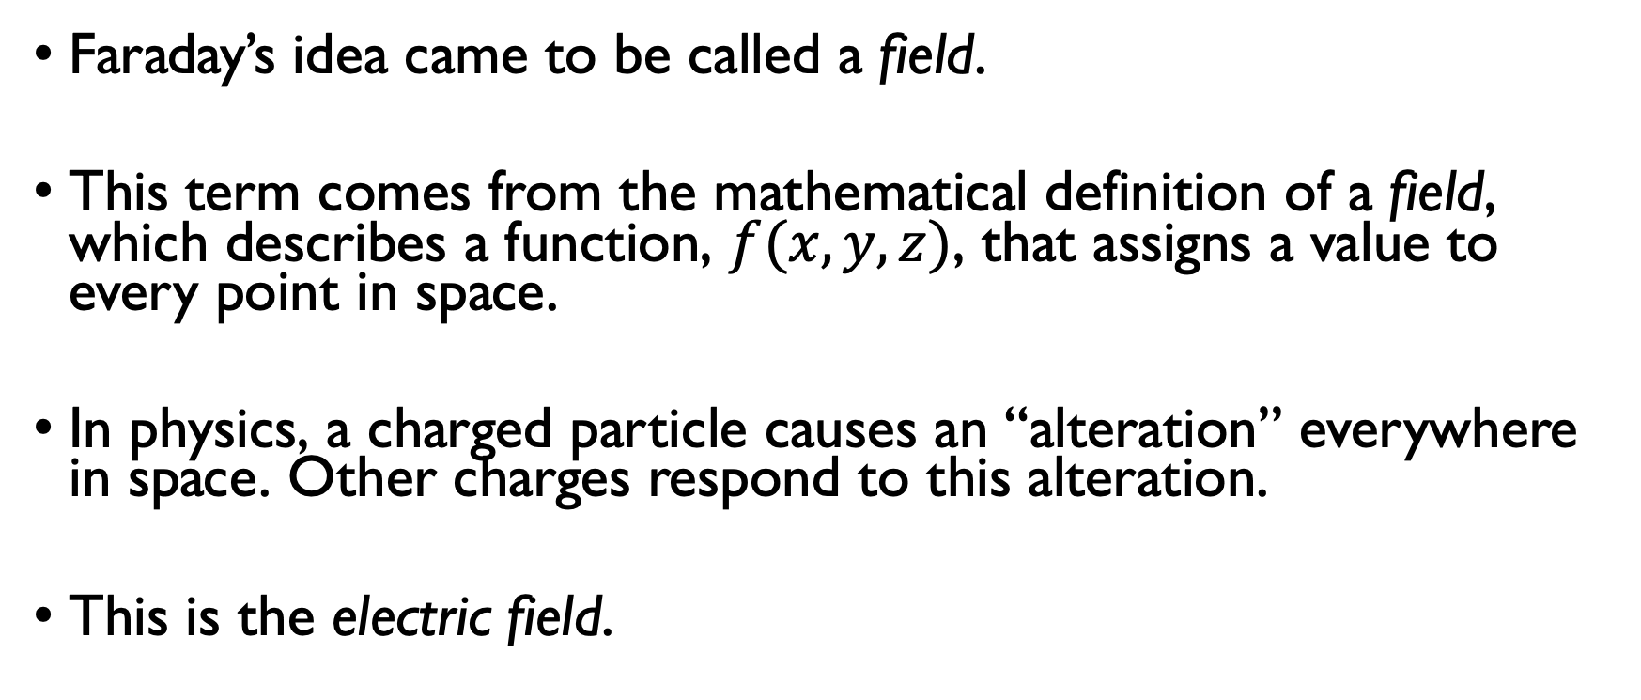
1.3.2 Concept of a Field
Faraday’s idea came to be called a field.
This term comes from the mathematical definition of a field, which describes a function, $f(x,y,z)$, that assigns a value to every point in space.
In physics, a charged particle causes an “alteration” everywhere in space. Other charges respond to this alteration.
This is the electric field.

Slide 6
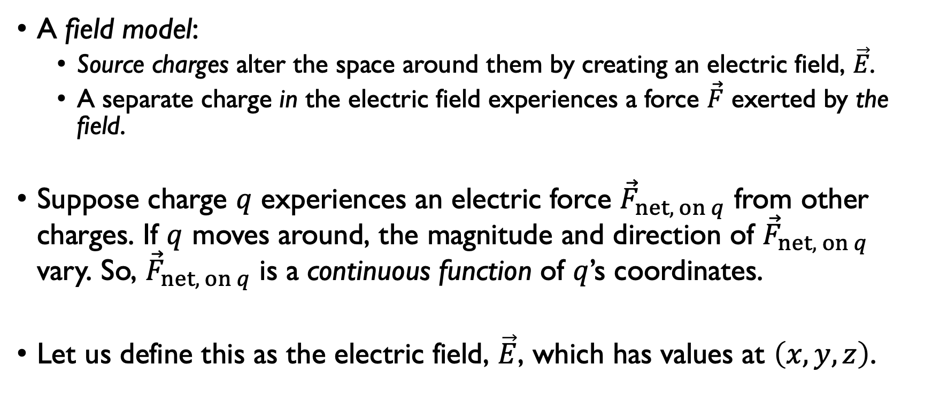
1.3.3 The Electric Field
A field model:
Source charges alter the space around them by creating an electric field, $\vec{E}$.
A separate charge in the electric field experiences a force $\vec{F}$ exerted by the field.
Suppose charge $q$ experiences an electric force ${\vec{F}}_{net, on q}$ from other charges. If $q$ moves around, the magnitude and direction of ${\vec{F}}_{net, on q}$ vary. So, ${\vec{F}}_{net, on q}$ is a continuous function of $q$’s coordinates.
Let us define this as the electric field, $\vec{E}$, which has values at $\left(x,y,z\right)$.

Slide 7
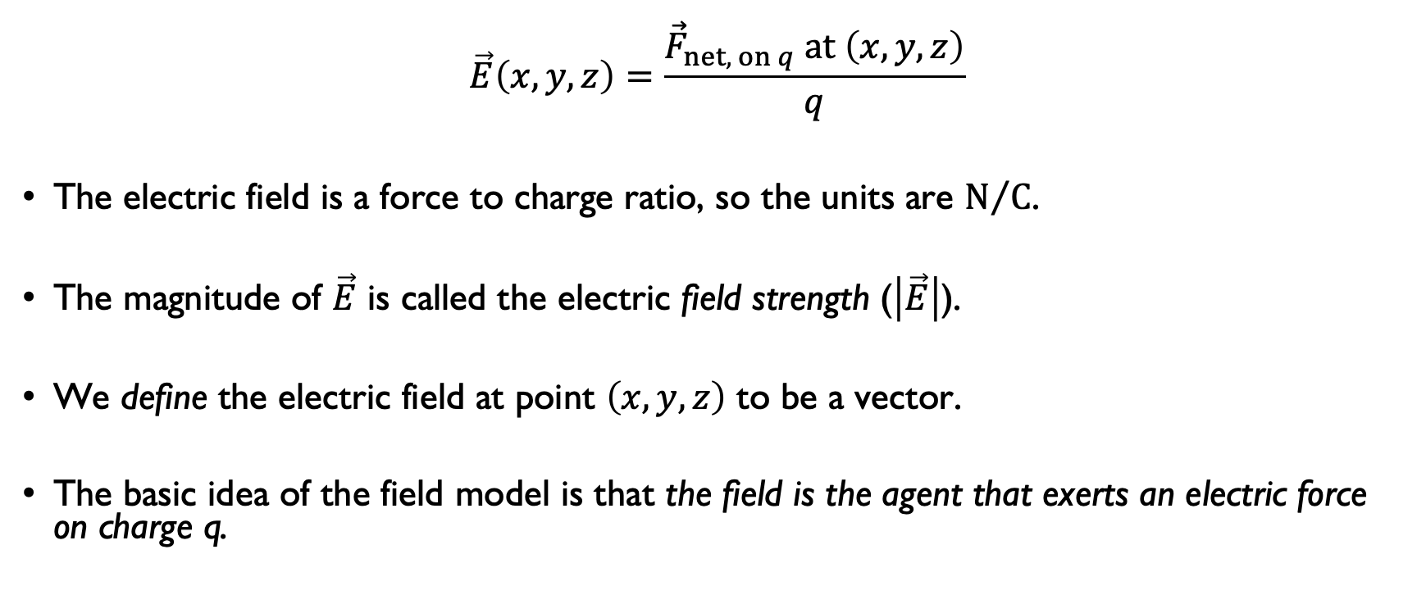
1.3.3 The Electric Field
$$\vec{E}\left(x,y,z\right)=\frac{{\vec{F}}_{net, on q} at \left(x,y,z\right)}{q}$$
The electric field is a force to charge ratio, so the units are $N/C$.
The magnitude of $\vec{E}$ is called the electric field strength ($\left|\vec{E}\right|$).
We define the electric field at point $\left(x,y,z\right)$ to be a vector.
The basic idea of the field model is that the field is the agent that exerts an electric force on charge q.

Slide 8
1.3.3 The Electric Field
There are three important ideas about the field:
The electric field is a vector field.
If q is positive, the electric field vector points in the same direction as the force on the charge.
The electric field is independent of the charge q. The charge q is only a charge used to probe the electric field.
What does #3 even mean!?

Slide 9
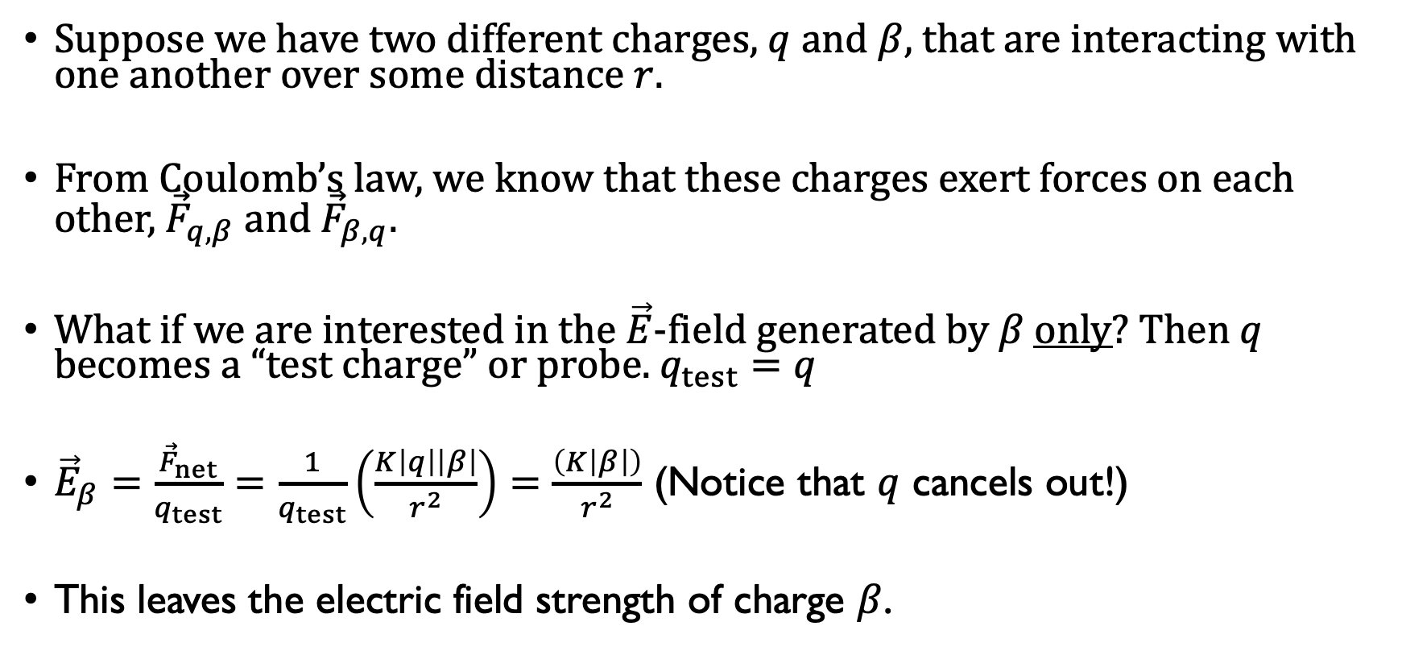
1.3.3 The Electric Field
Suppose we have two different charges, $q$ and $β$, that are interacting with one another over some distance $r$.
From Coulomb’s law, we know that these charges exert forces on each other, ${\vec{F}}_{q,β}$ and ${\vec{F}}_{β,q}$.
What if we are interested in the $\vec{E}$-field generated by $β$ only? Then $q$ becomes a “test charge” or probe. $q_{test}=q$
${\vec{E}}_{β}=\frac{{\vec{F}}_{net}}{q_{test}}=\frac{1}{q_{test}}\left(\frac{K\left|q\right|\left|β\right|}{r^{2}}\right)=\frac{\left(K\left|β\right|\right)}{r^{2}}$ (Notice that $q$ cancels out!)
This leaves the electric field strength of charge $β$.

Slide 10
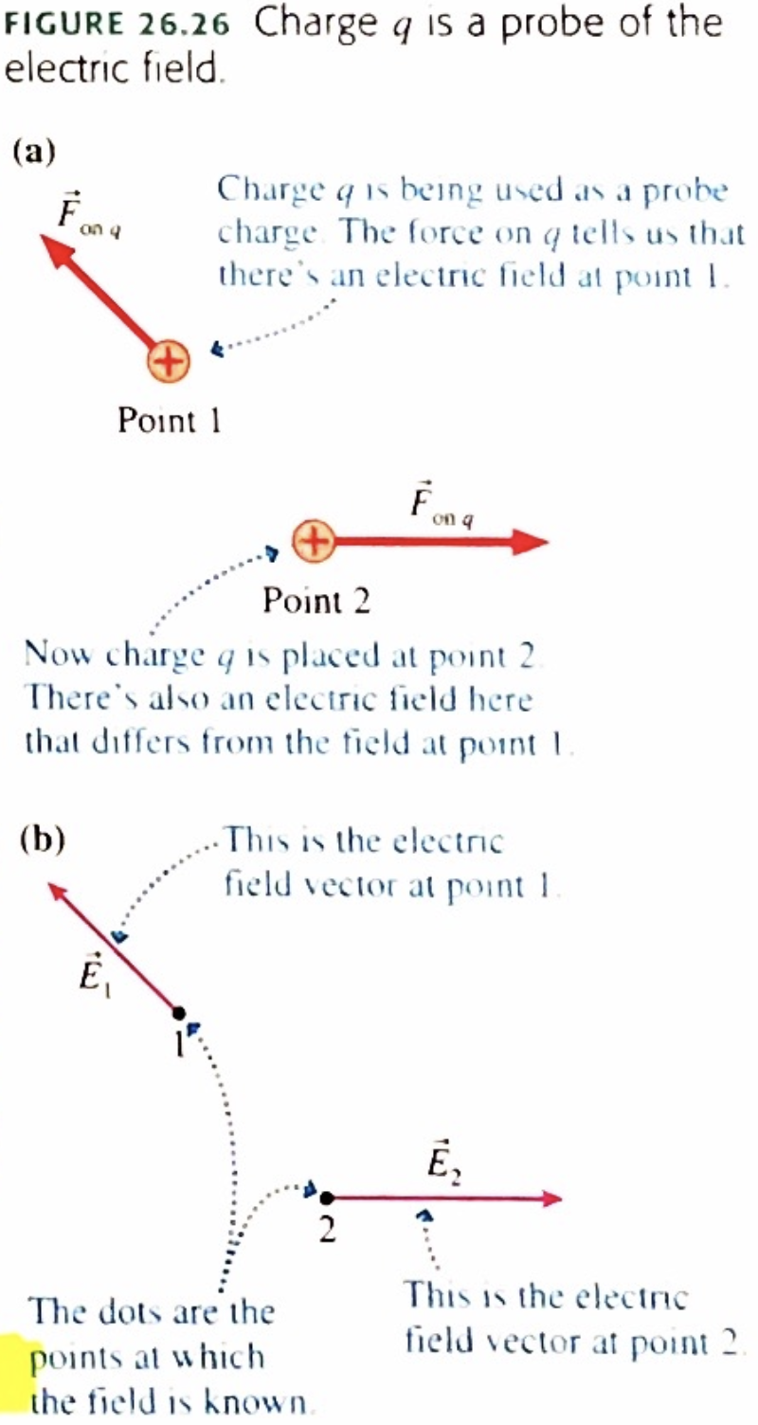
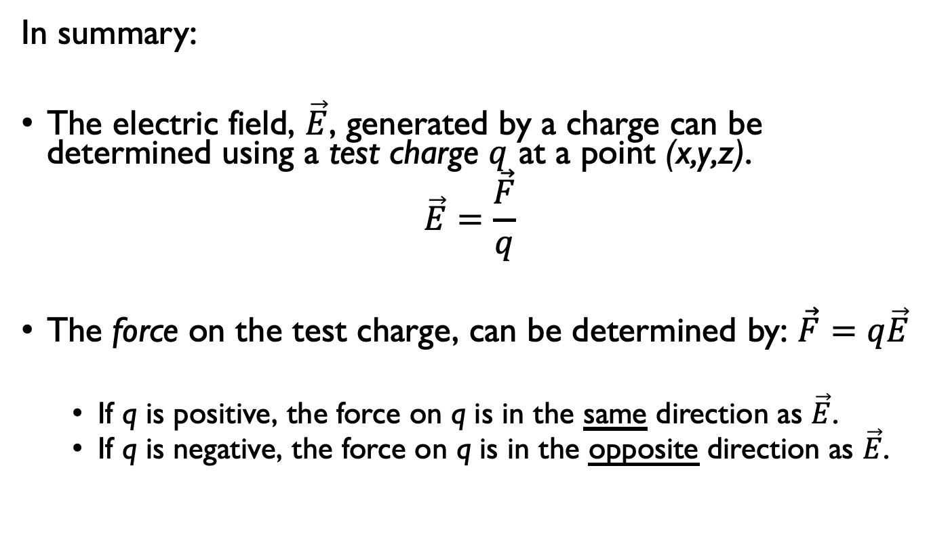
1.3.3 The Electric Field
In summary:
The electric field, $\vec{E}$, generated by a charge can be determined using a test charge $q$ at a point (x,y,z).
$$\vec{E}=\frac{\vec{F}}{q}$$
The force on the test charge, can be determined by: $\vec{F}=q\vec{E}$
If q is positive, the force on q is in the same direction as $\vec{E}$.
If q is negative, the force on q is in the opposite direction as $\vec{E}$.

Slide 11
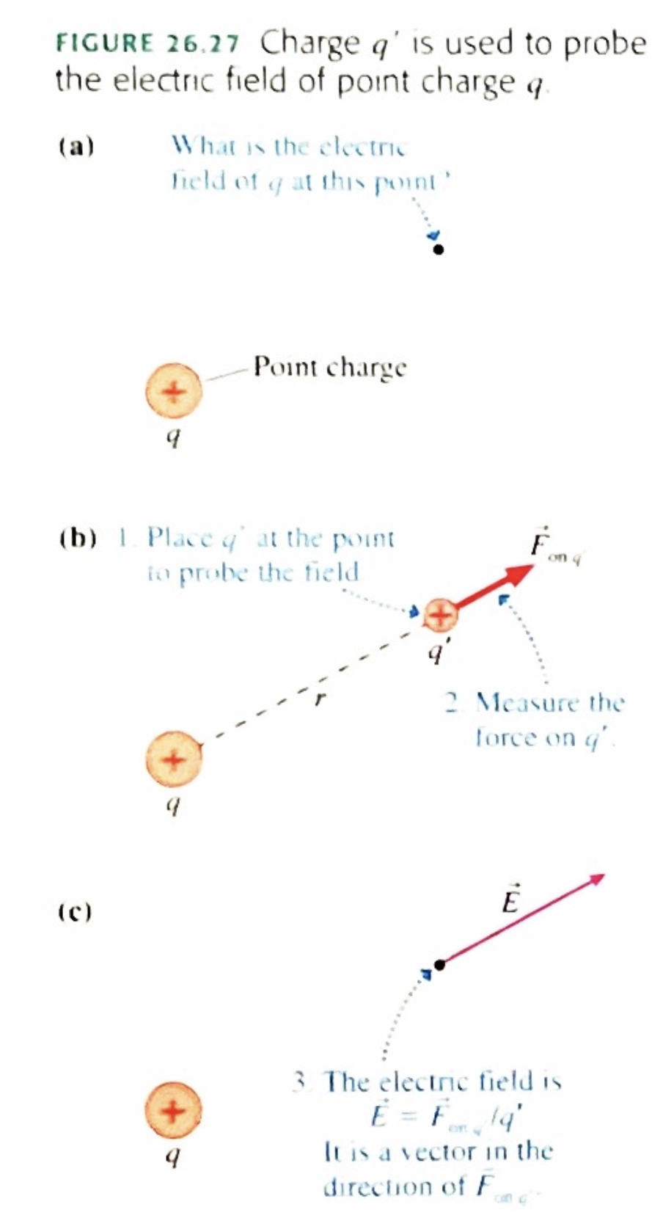
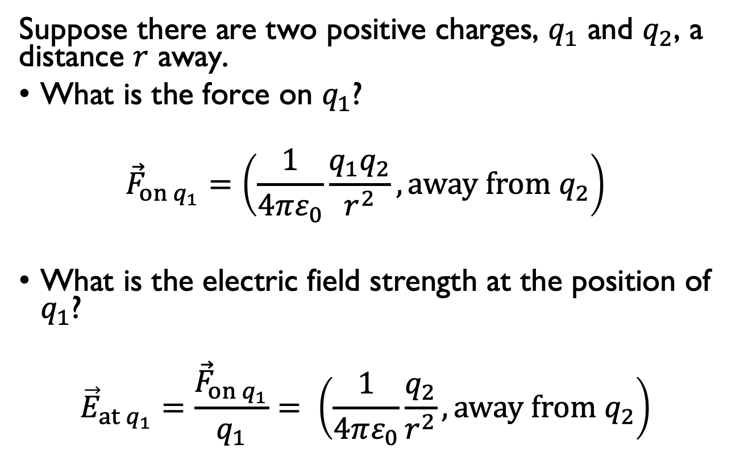
1.3.3 The Electric Field
Suppose there are two positive charges, $q_{1}$ and $q_{2}$, a distance $r$ away.
What is the force on $q_{1}$?
$${\vec{F}}_{on q_{1}}=\left(\frac{1}{4πε_{0}}\frac{q_{1}q_{2}}{r^{2}}, away from q_{2}\right)$$
What is the electric field strength at the position of $q_{1}$?
$${\vec{E}}_{at q_{1}}=\frac{{\vec{F}}_{on q_{1}}}{q_{1}}= \left(\frac{1}{4πε_{0}}\frac{q_{2}}{r^{2}}, away from q_{2}\right)$$

Slide 12
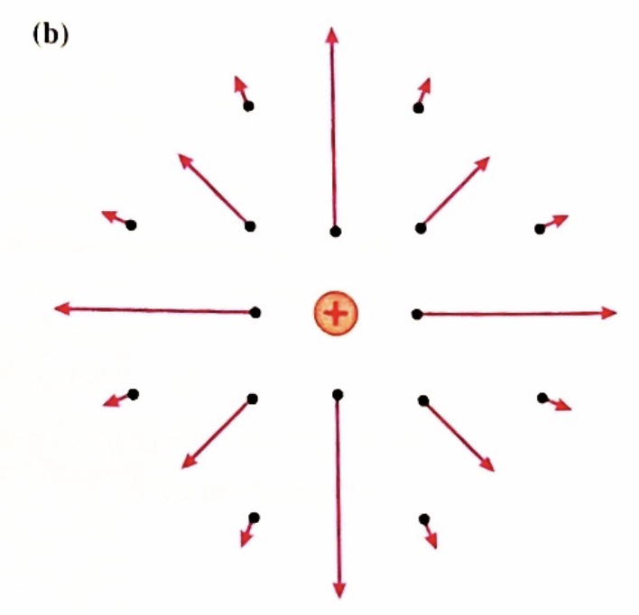
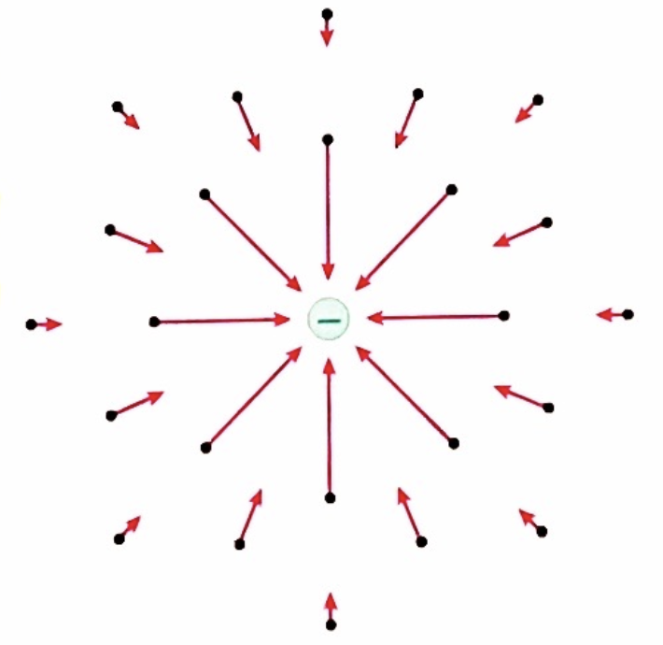
1.3.3 The Electric Field
If we calculate the field at enough points, we can draw a field diagram. Notice that the field vectors all point straight away from the charge. Also, the vectors quickly decrease in length due to the inverse-square dependence on r.

Slide 13
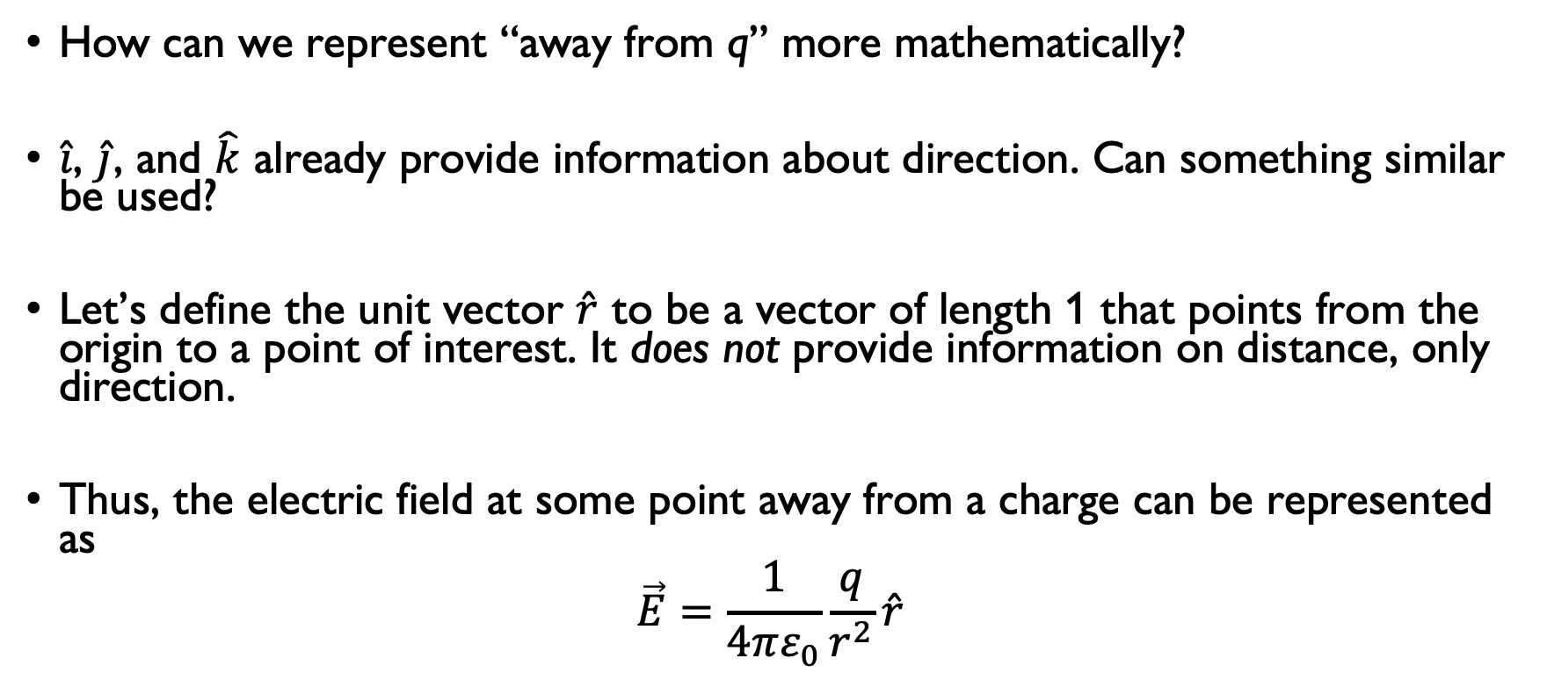
1.3.4 Unit Vector Notation
How can we represent “away from q” more mathematically?
$\hat{i}$, $\hat{j}$, and $\hat{k}$ already provide information about direction. Can something similar be used?
Let’s define the unit vector $\hat{r}$ to be a vector of length 1 that points from the origin to a point of interest. It does not provide information on distance, only direction.
Thus, the electric field at some point away from a charge can be represented as
$$\vec{E}=\frac{1}{4πε_{0}}\frac{q}{r^{2}}\hat{r}$$

Slide 14
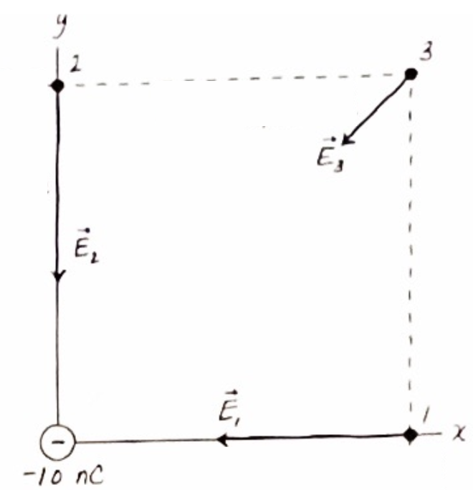
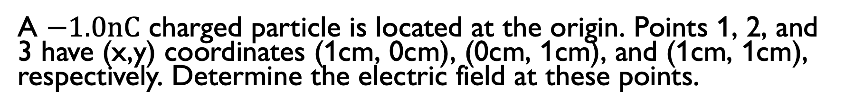
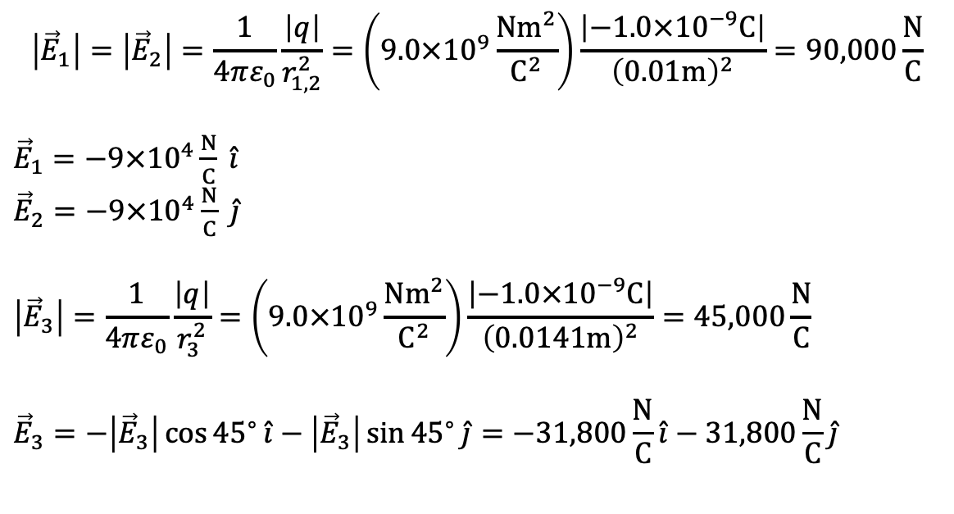
Example #1
A $−1.0nC$ charged particle is located at the origin. Points 1, 2, and 3 have (x,y) coordinates (1cm, 0cm), (0cm, 1cm), and (1cm, 1cm), respectively. Determine the electric field at these points.
$$\left|{\vec{E}}_{1}\right|=\left|{\vec{E}}_{2}\right|=\frac{1}{4πε_{0}}\frac{\left|q\right|}{r_{1,2}^{2}}=\left(9.0×{10}^{9}\frac{Nm^{2}}{C^{2}}\right)\frac{\left|−1.0×{10}^{−9}C\right|}{{\left(0.01m\right)}^{2}}=90,000\frac{N}{C}$$
${\vec{E}}_{1}=−9×{10}^{4}\frac{N}{C} \hat{i}$
${\vec{E}}_{2}=−9×{10}^{4}\frac{N}{C} \hat{j}$
$$\left|{\vec{E}}_{3}\right|=\frac{1}{4πε_{0}}\frac{\left|q\right|}{r_{3}^{2}}=\left(9.0×{10}^{9}\frac{Nm^{2}}{C^{2}}\right)\frac{\left|−1.0×{10}^{−9}C\right|}{{\left(0.0141m\right)}^{2}}=45,000\frac{N}{C}$$
$${\vec{E}}_{3}=−\left|{\vec{E}}_{3}\right|\cos{{45}^{∘}}\hat{i}−\left|{\vec{E}}_{3}\right|\sin{{45}^{∘}}\hat{j}=−31,800\frac{N}{C}\hat{i}−31,800\frac{N}{C}\hat{j}$$

