Slide 1
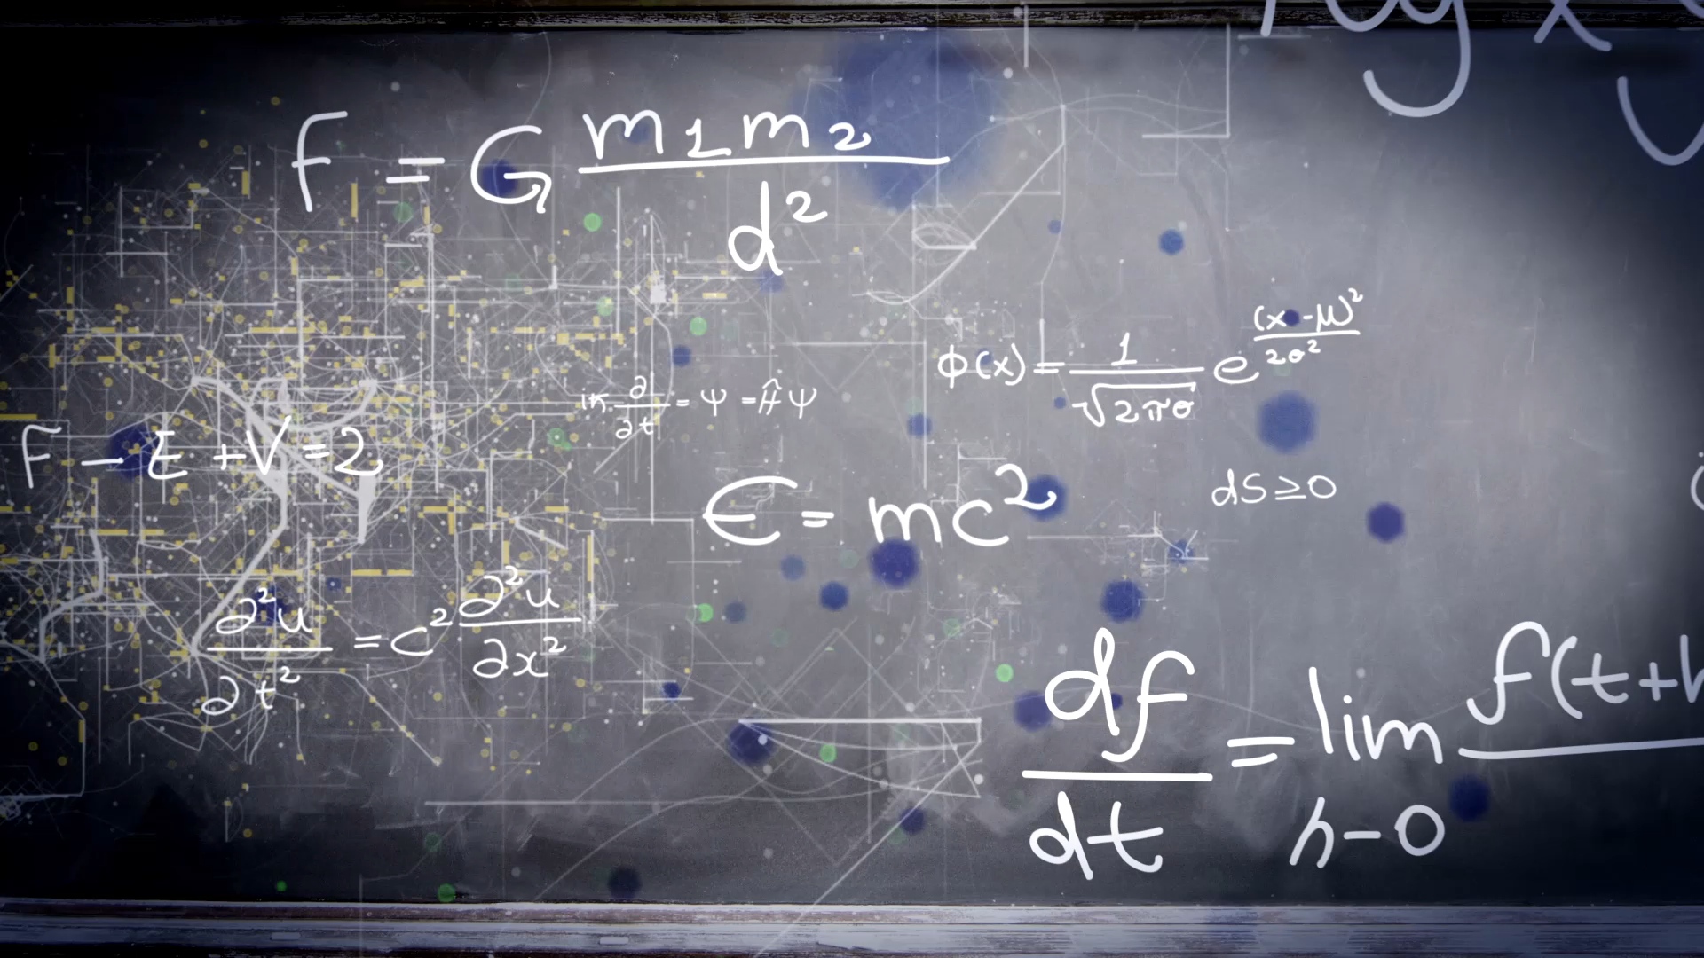
(1.1) Charges, Conductors, and Insulators
Dustin Roten, Ph.D.
Wilkes Community College
Spring 2025

Slide 2
1.1 Charges, Conductors, and Insulators Topics
1.1.1 Charge
1.1.2 Atoms and Electricity
1.1.3 Ions
1.1.4 Charge Conservation
1.1.5 Insulators and Conductors
1.1.6 Charging
1.1.7 Discharging
1.1.8 Polarization
1.1.9 Charging by Induction

Slide 3
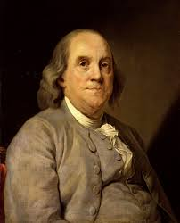
1.1.1 Charge
The modern names for the two types of charge are positive charge and negative charge.
Benjamin Franklin established the convention that a glass rod that has been rubbed with silk is positively charged.
Any charged object that attracts a charged glass rod is negatively charged.
Thus, a plastic rod rubbed with wool is negative.

Slide 4
1.1.1 Charge
It wasn’t until many years later, with the discovery of electrons and protons, that electrons were found to be attracted to the charged glass rod while protons were repelled.
By convention, electrons have a negative charge, and protons have a positive charge.
This could have been oppositely defined! (In hindsight, it would have been better if Franklin made the opposite choice.)

Slide 5
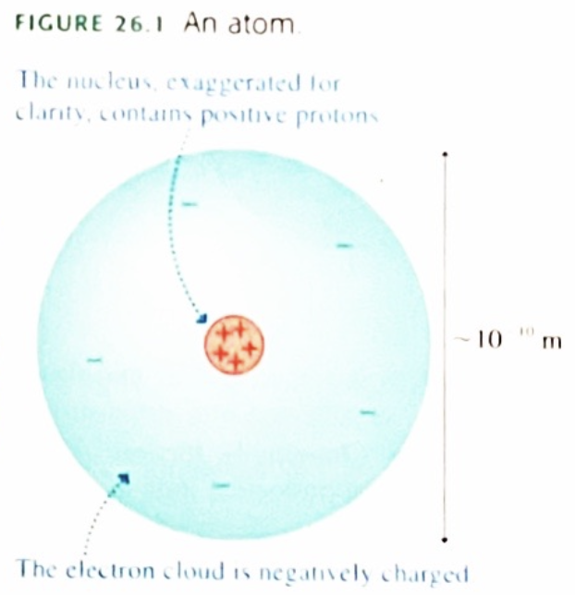
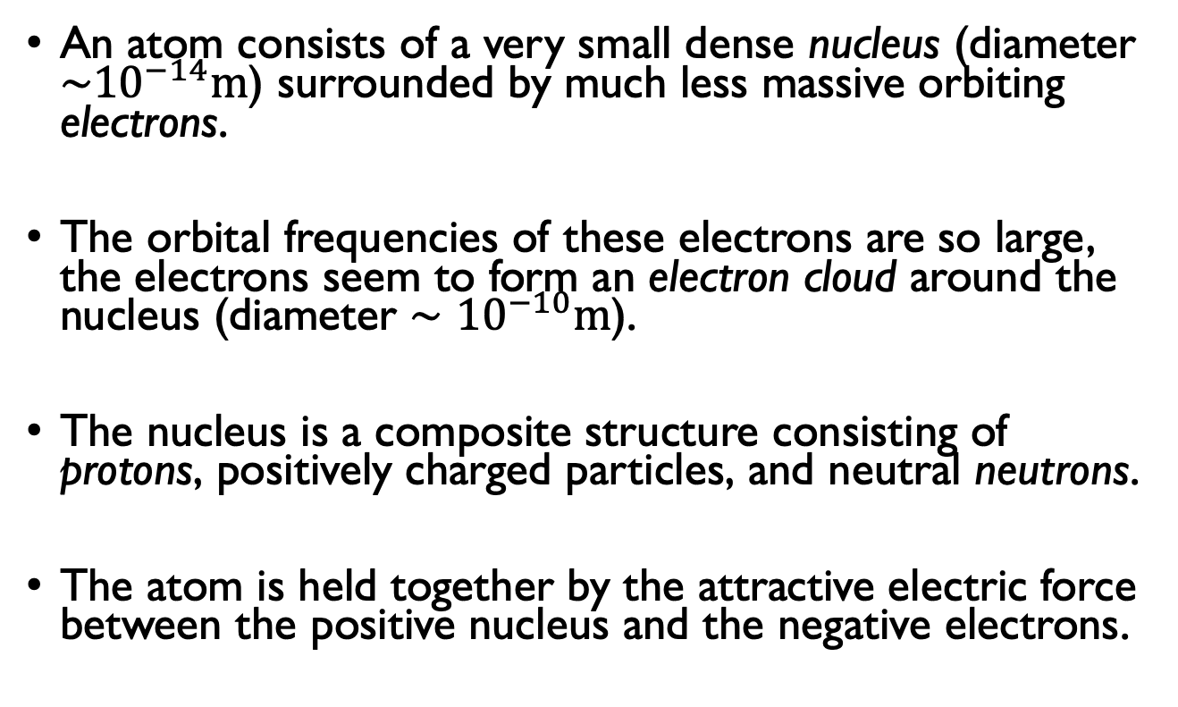
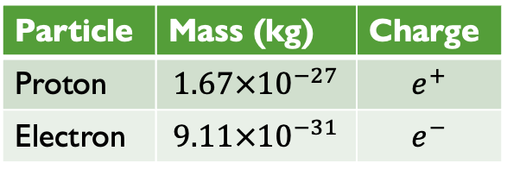
1.1.2 Atoms and Electricity
An atom consists of a very small dense nucleus (diameter $\sim {10}^{−14}m$) surrounded by much less massive orbiting electrons.
The orbital frequencies of these electrons are so large, the electrons seem to form an electron cloud around the nucleus (diameter $∼{10}^{−10}m$).
The nucleus is a composite structure consisting of protons, positively charged particles, and neutral neutrons.
The atom is held together by the attractive electric force between the positive nucleus and the negative electrons.
Particle | Mass (kg) | Charge
Proton | $$1.67×{10}^{−27}$$ | $$e^{+}$$
Electron | $$9.11×{10}^{−31}$$ | $$e^{−}$$

Slide 6
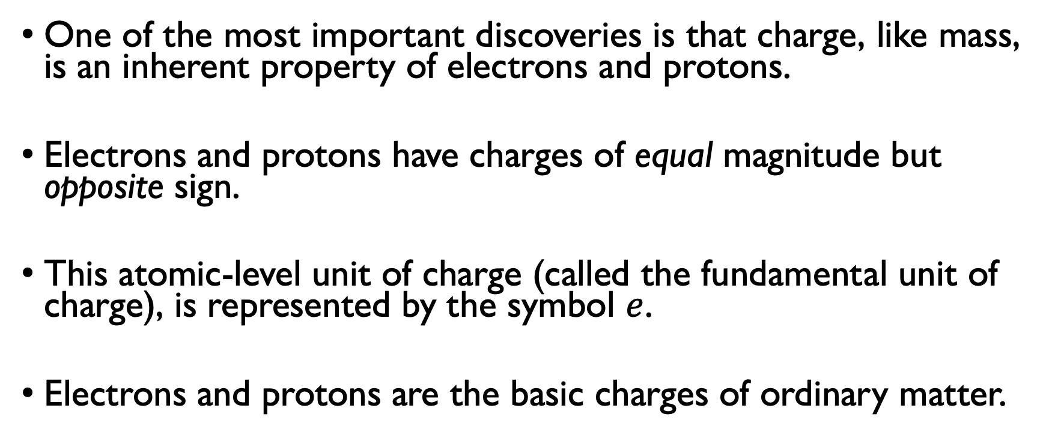
1.1.2 Atoms and Electricity
One of the most important discoveries is that charge, like mass, is an inherent property of electrons and protons.
Electrons and protons have charges of equal magnitude but opposite sign.
This atomic-level unit of charge (called the fundamental unit of charge), is represented by the symbol $e$.
Electrons and protons are the basic charges of ordinary matter.

Slide 7
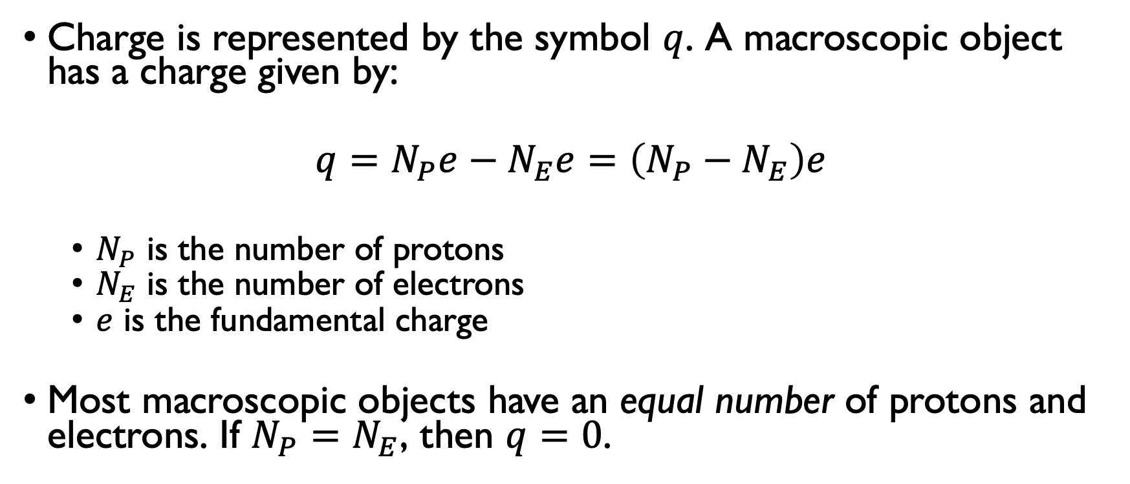
1.1.2 Atoms and Electricity
Charge is represented by the symbol $q$. A macroscopic object has a charge given by:
$$q=N_{P}e−N_{E}e=\left(N_{P}−N_{E}\right)e$$
$N_{P}$ is the number of protons
$N_{E}$ is the number of electrons
$e$ is the fundamental charge
Most macroscopic objects have an equal number of protons and electrons. If $N_{P}=N_{E}$, then $q=0$.

Slide 8
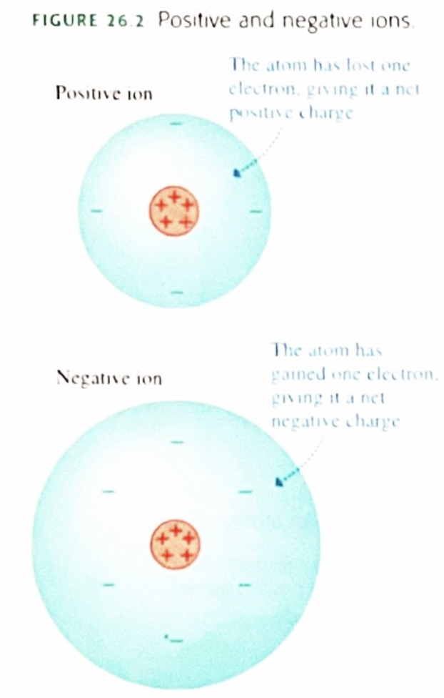
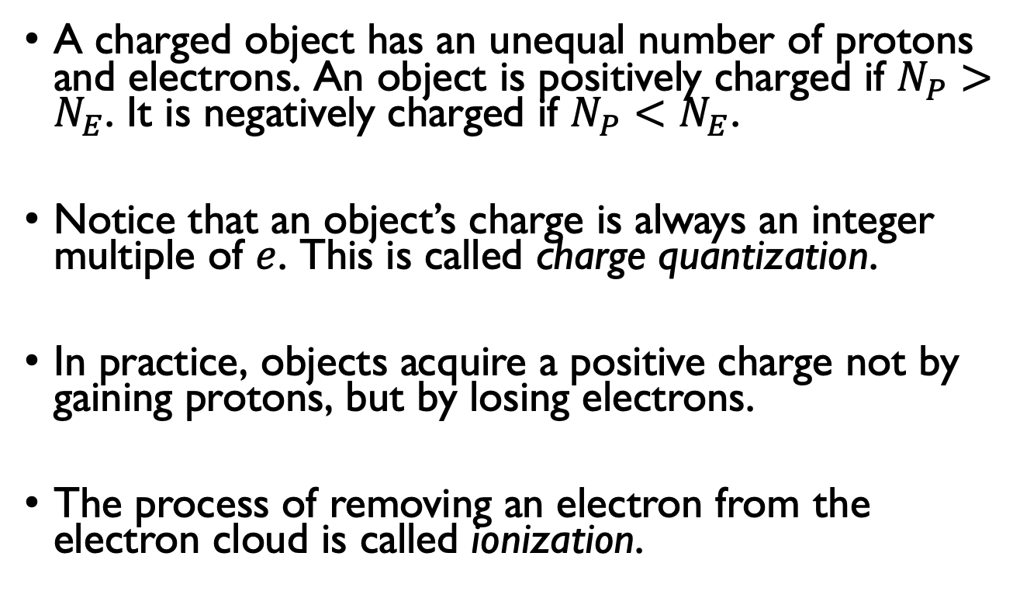
1.1.3 Ions
A charged object has an unequal number of protons and electrons. An object is positively charged if $N_{P}>N_{E}$. It is negatively charged if $N_{P}<N_{E}$.
Notice that an object’s charge is always an integer multiple of $e$. This is called charge quantization.
In practice, objects acquire a positive charge not by gaining protons, but by losing electrons.
The process of removing an electron from the electron cloud is called ionization.

Slide 9
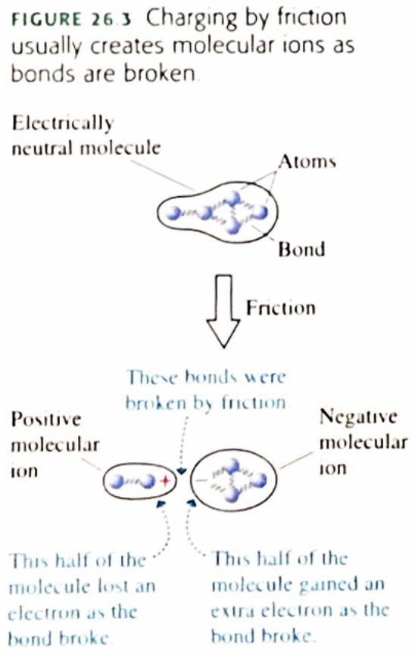
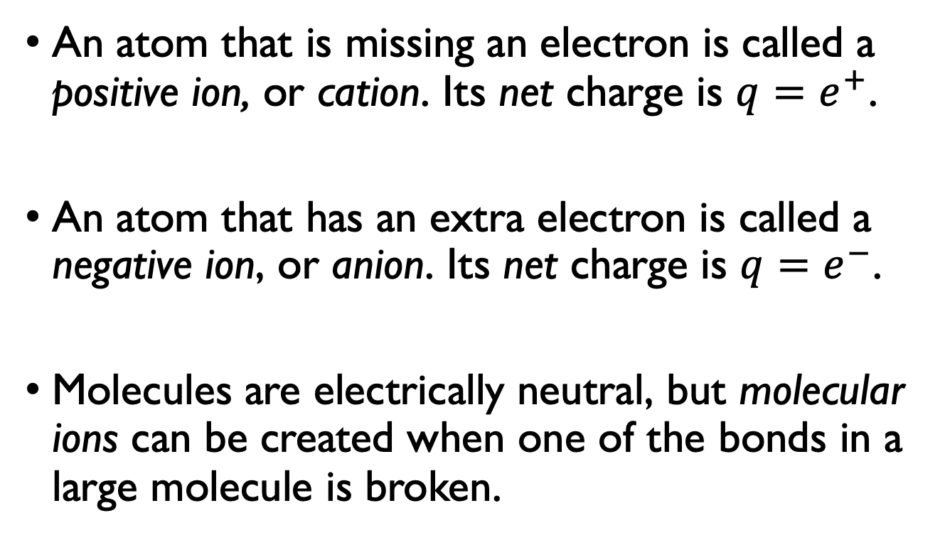
1.1.3 Ions
An atom that is missing an electron is called a positive ion, or cation. Its net charge is $q=e^{+}$.
An atom that has an extra electron is called a negative ion, or anion. Its net charge is $q=e^{−}$.
Molecules are electrically neutral, but molecular ions can be created when one of the bonds in a large molecule is broken.

Slide 10
1.1.4 Charge Conservation
One of the important discoveries about charge is the law of conservation of charge:
Charge is neither created nor destroyed. It can only be transferred from one object to another as electrons and ions move about.
The total amount of charge remains constant.

Slide 11
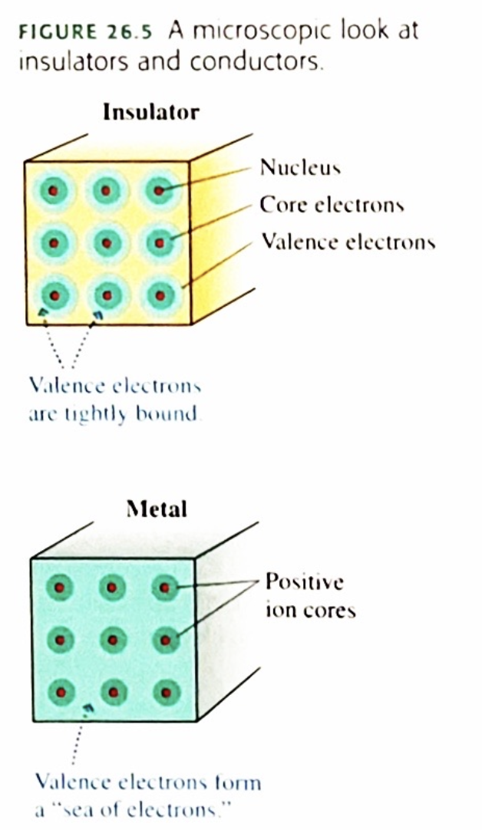
1.1.5 Insulators and Conductors
Conductors and insulators can be charged by friction.
Rubbing a glass/plastic rod with silk/wool will transfer electrons from/to the rod. (Triboelectric effect)
Charging an insulator by friction leaves patches of molecular ions on the surface, but these patches are immobile.
In metals, the outer electrons are only weakly bound to the nuclei. Thus, electrons in a metal are highly mobile. These electrons are charge carriers.

Slide 12
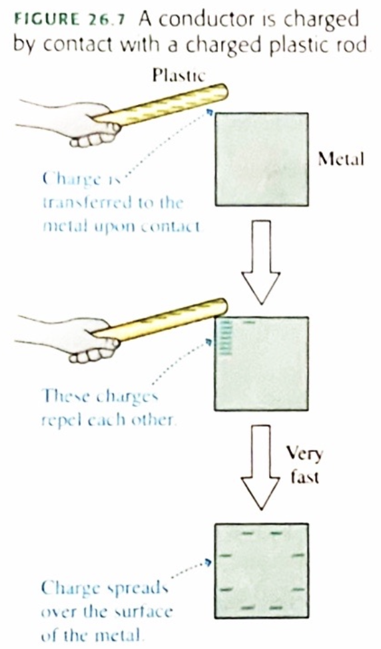
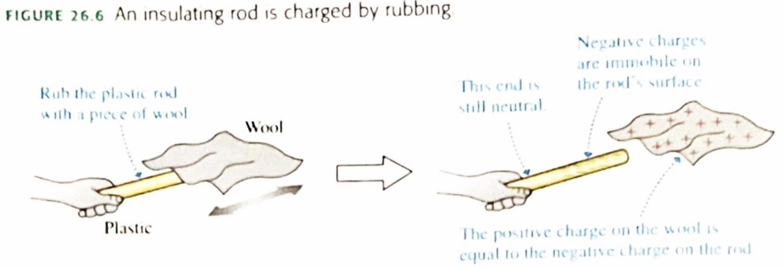
1.1.6 Charging
Once charges are situated across an isolated conductor, they are in static equilibrium. There is not net force on any charge. This is called electrostatic equilibrium.
In an isolated conductor, any excess charge is located on the surface of the conductor.

Slide 13
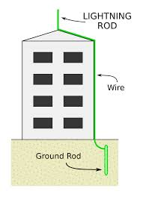
1.1.7 Discharging
Two conductors in contact “share” the charge that was originally on just one of them.
Moist air is a poor conductor, but charged objects in air slowly lose their charge as they share charges with the air.
Any object that is connected to the earth by a conductor is said to be grounded. A grounded object shares any excess charge with Earth, leading to the discharge of the object.
Grounding prevents the build-up of charge on an object.
https://en.wikipedia.org/wiki/Lightning_rod

Slide 14
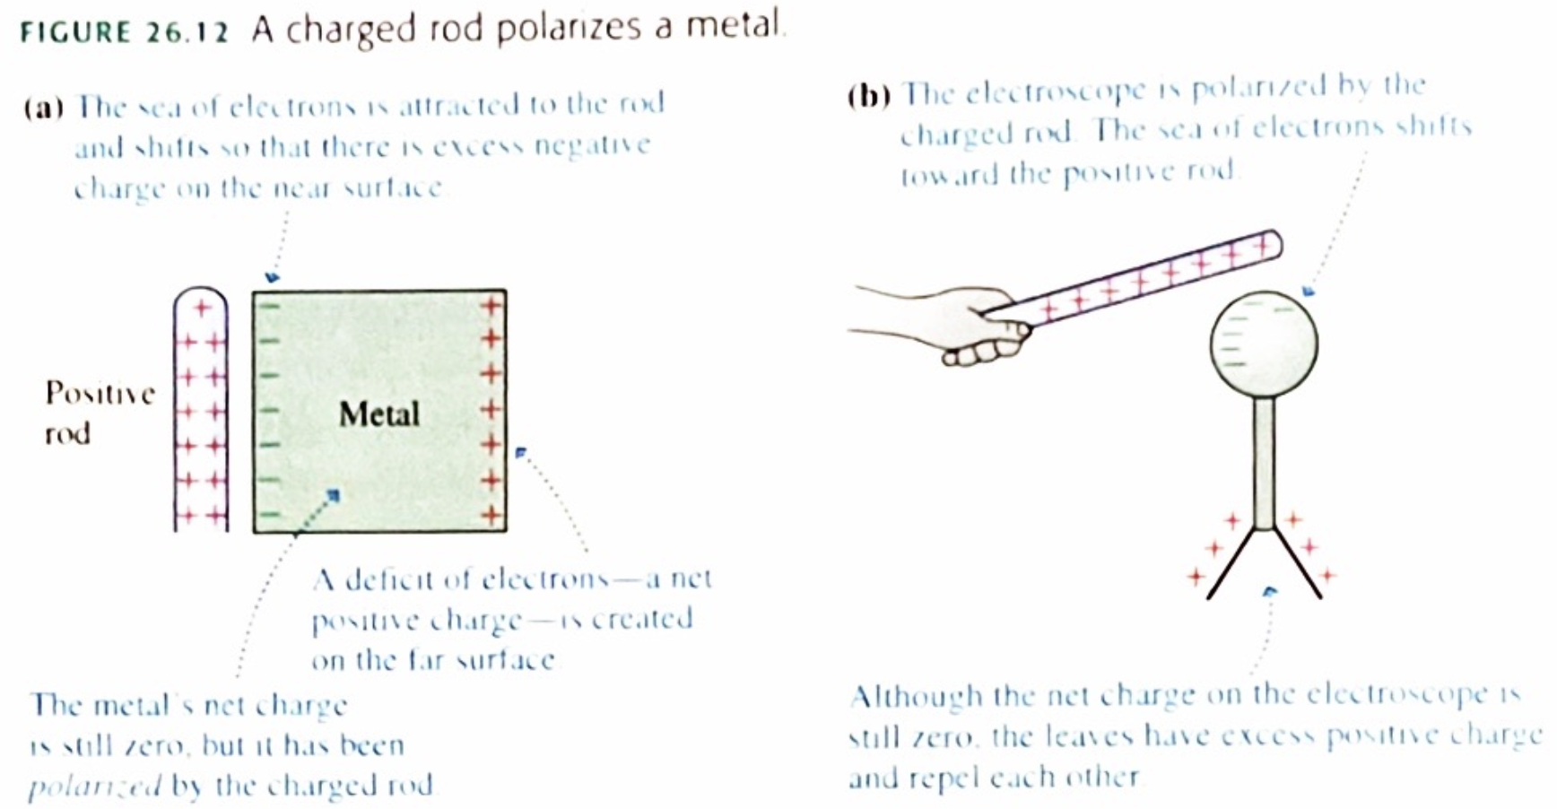
1.1.8 Polarization
Charge polarization is a slight separation of the positive and negative charges in a neutral object.
A charged rod brought near a metal object will attract the “sea of electrons”, leaving fewer electrons (net positive charge) elsewhere.

Slide 15
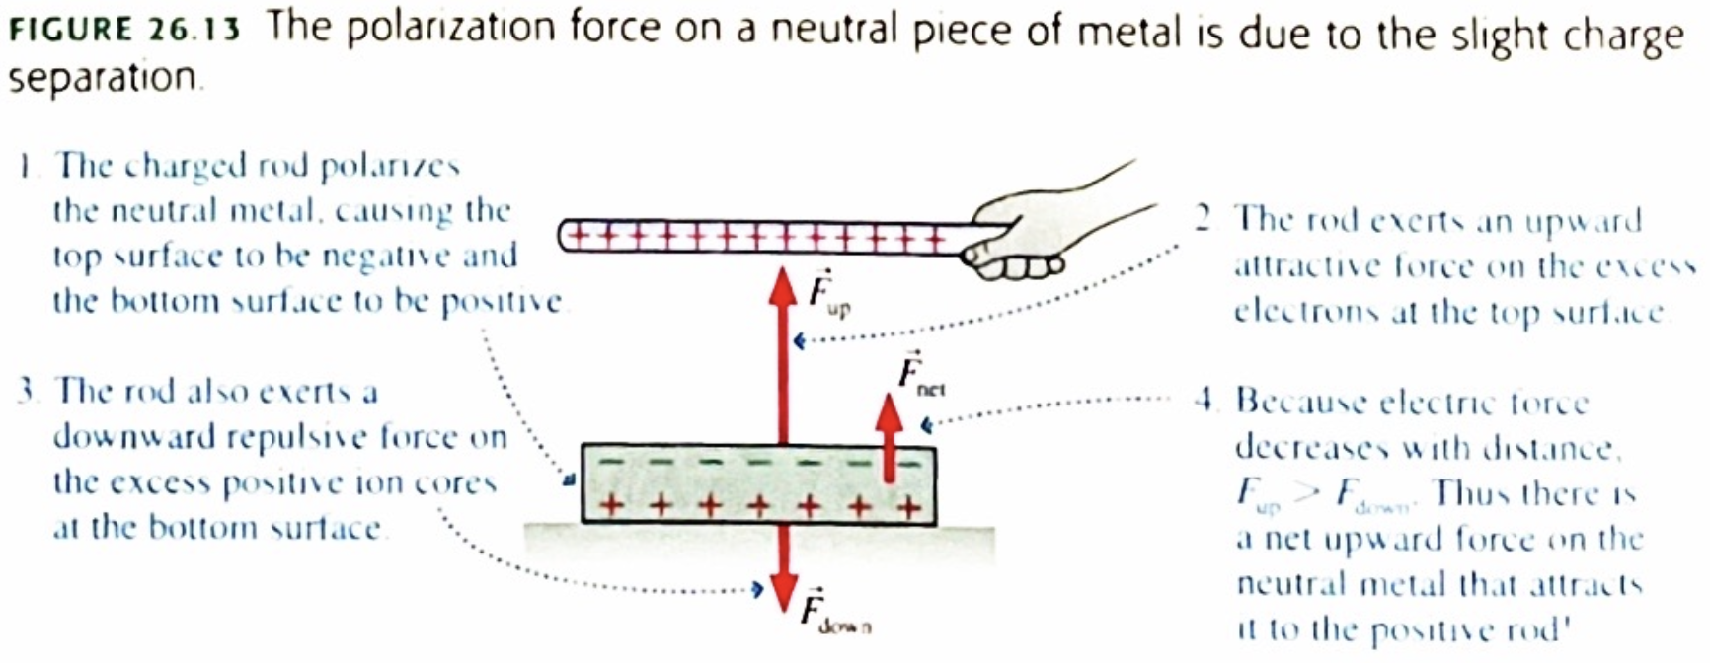
1.1.8 Polarization
The net force toward the charged rod is called a polarization force.
The polarization force arises because the charges in the metal are separated, not because the rod and metal are oppositely charged.
Since the electrons are closer to the charged rod, they will exert a stronger force than the repulsion experienced by the positive charges.

Slide 16
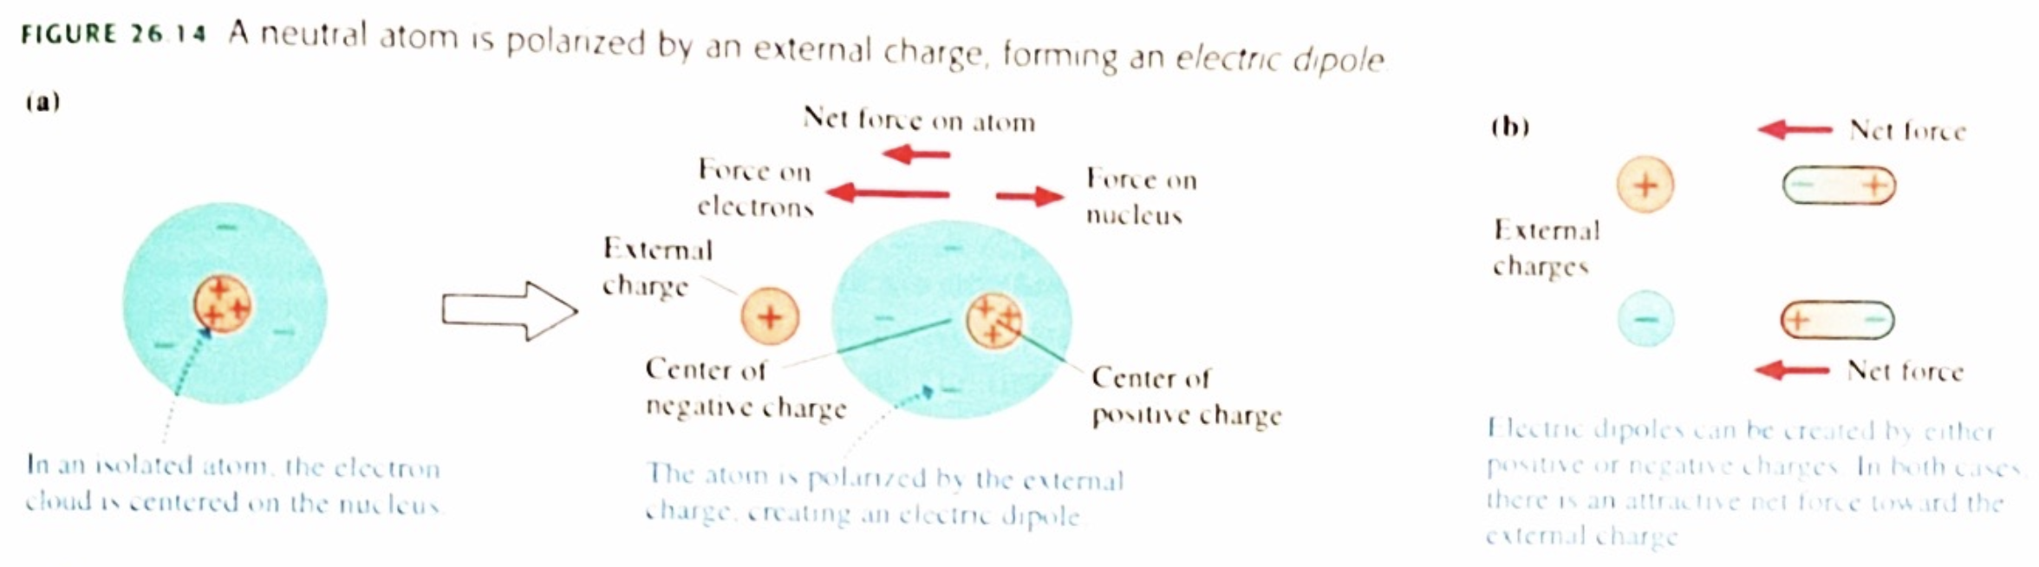
1.1.8 Polarization
Two opposite charges with a slight separation between them form a dipole.
A dipole is created when an external, charged object is brought near a neutral object like an atom. The electrons move closer to the external object while the positive nucleus is repelled. This creates a “lopsided” dipole.

Slide 17
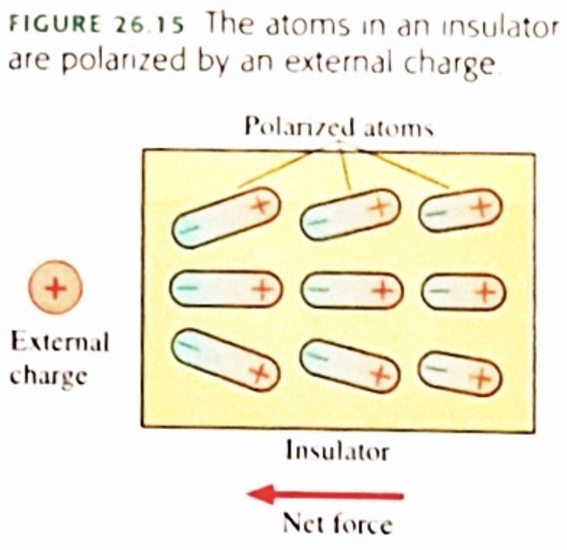
1.1.8 Polarization
An insulator has no sea of electrons to shift if an external charge is brought close. Instead, all the individual atoms in the insulator become polarized.
The polarization force acting on each atom produces a net polarization force toward the external charge.

Slide 18
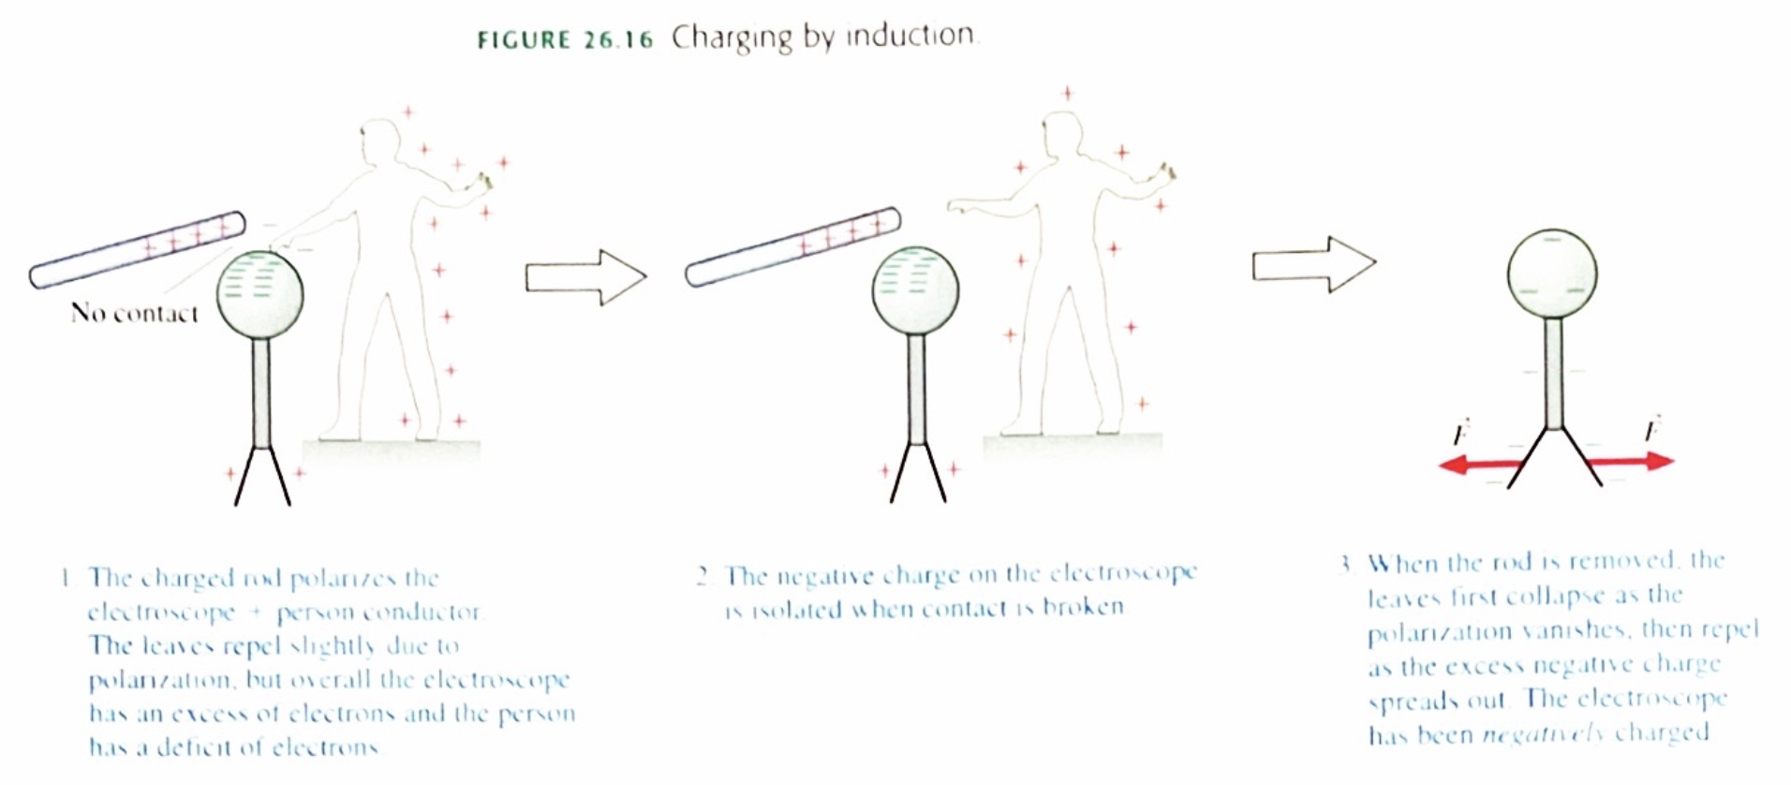
1.1.9 Charging by Induction
An object can be charged by induction if a distant object separates charges, and the negative (or positive) charges are then isolated.
Consider the example below. The electroscope + human system is polarized, some electrons from the human move to the electroscope. leaving a net negative charge on the top of the electroscope.
When the human breaks the connection, the electroscope now has a net negative charge, and the electrons redistribute themselves.

