Slide 1
COVID-19 Business Response Hackathon
Abstract Thinking
Pay@Ease
Author
Nguyen Huu Phuc Trinh
Andy Lin

Slide 2
PROBLEMS
01
SOLUTION
02
TABLE OF CONTENTS
OPERATION
03
TECHNOLOGY
04
What hardships are everyone facing during this time?
Introduction of our Application and how can it can help all parties to combat problems.
How the application operate with step by step explanation.
In depth about the technologies we used for our application.

Slide 3
01
PROBLEMS
You can enter here the subtitle if you need it

Slide 4
DEMAND
OPERATE
EXPENSIVE CREDIT
SAFETY
SERVICES
Demands for services had been decreasing due to social distance. Businesses are struggling to have customers.
Applying all safety methods to prevent the spread of the virus is a hard task. Not all Businesses know how to do so.
Businesses have to pay an expensive amount for using credit, Visa or Mastercard which give them more pressure during this time.
BUSINESSES
Nowadays, safety is the top priority of most customers. They are always concern about safety whenever using any service.
Some services have not prepared for this pandemic so they cannot serve the customers as they wanted.
CUSTOMERS

Slide 5
02
PAY@EASE – A SOLUTION

Slide 6
WHAT IS IT
CASHLESS & ENSURE DISTANCING
EASY LOADING BALANCE
A system that generate and use QR Code as a main method of payment.
Allows users to load their account with any available method, e.g Credit, Debit, Visa, etc…
COMMISSION-FREE OF CREDIT CHARGE
By using Pay@Ease, merchants or any other services will not be charged commission like Credit or Visa.

Slide 7
OUTCOMES
SAFETY
SUPPORT COD
(Cash On Delivery)
DEMAND & SUPPLY
Businesses can deliver goods to the customers and they will scan the bill once they received their desired items.
Businesses can now reach more customers by ensuring their safety and convenience. Customers are also able to reach more services.
LESS EXPENSIVE
Both staffs and customers do not need to use Cash and pay from distance since the payment method does not require tap or handling of objects
Services do not need to pay an average of 1.5% for every purchases they have.

Slide 8
03
HOW IT OPERATE

Slide 9
ON SPOT PAYMENT
1. Generate Bill
(QR Code)
2.
Display Bill to Customer
3.
Customers scan QR and Pay
4.
Fast and Easily Verify Payment

Slide 10
COD (Cash On Delivery) PAYMENT *except there won’t be cash involve*
1. Customers call and order from businesses
2.
Businesses prepare order and Generate Bill
(QR Code)
3.
Deliver order for customer to check.
4.
Display Bill after Customer checked and happy with order.
5.
Customer make payment
6.
DONE

Slide 11
MAINTENANCE & PRICING
 | NORMAL | PREMIUM | GOLDEN
NUMBER OF BILLS | 0 - 1000 | 1001 - 10000 | Unlimited
MAXIMUM EXPENSE | $0.05 / Bill | $0.01 / Bill
PRICE | $50 / month | $100 / month | $200 / month

Slide 12
04
Pay@Ease Technology

Slide 13





COMPONENTS
WEBSITE PACK
WEBSERVER
Database
iOS Swift

Slide 14
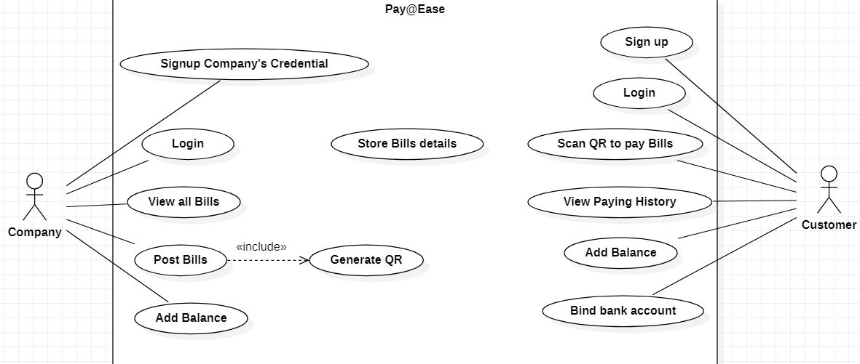
Use Case Diagram

Slide 15
THE END THANK YOU

