Slide 1
Operating Systems (Homework 1)
Multi-threaded programming
These lecture materials are modified from the lecture notes
written by A. Silberschatz, P. Galvin and G. Gagne.
Spring, 2018

Slide 2
Outline
1. Objectives
2. How to write a program ?
3. First program
4. Second program
5. Schedule

Slide 3
Objectives
Writing two multi-threaded programs using the following functions;
pthread_create
pthread_join
pthread_exit

Slide 4
How to write a program ?
POSIX thread programming (1)
Thread creation
1> Prototype
#include <pthread.h>
int pthread_create( pthread_t* tid, pthread_attr_t *attr, (void *) f, void *arg);
Roles
Creates a new thread and runs the thread routine f with an input argument of arg
When pthread_create returns, argument tid contains the ID of the newly created thread

Slide 5
POSIX thread programming (2)
Terminating the threads
Prototype
#include <pthread.h>
int pthread_exit(void *thread_return);
Roles
Terminating the thread with a return value of thread_return that will be transferred to pthread_join

Slide 6
POSIX thread programming (2)
Reaping terminated threads
Prototype
#include <pthread.h>
int pthread_join(pthread_t tid, void *thread_return);
Roles
pthread_join function blocks until thread tid terminates
It is similar to wait function but can only wait for a specific thread to terminate

Slide 7
S/W architecture
main thread
call pthread_create()
peer thread
call pthread_join()
pthread_exit()
pthread_join() returns

Slide 8
First program
Finding the highest value
5 3 4 -------------
6 7 2 -------------
1 9 8 -------------
--------------------
--------------------
--------------------
--------------------
--------------------
--------------------

Slide 9
Requirements
10개 thread 생성
Nine threads to check each of the 3 X 3 subgrids and returns the highest value to the tenth thread (selection thread)
Tenth thread (selection thread) selects one highest value from them (9 values)
Assumption
No same number
반드시 보고서에 10개의 쓰레드가 제대로 동작함을 기술할 것
모든 thread 는 가장 높은 수를 parent thread에게 return 함

Slide 10
Requirements
file로 숫자를 입력받을 것
1 2 3 4 5 6 7 9 8
10 11 12 13 14 15 16 17 18
20 21 22 23 24 25 26 27 28
---------------------------------
input.txt
---------------------------------
---------------------------------
---------------------------------
---------------------------------
---------------------------------

Slide 11
실행 예>
highest input.txt
Highest number: 100
실행화일명

Slide 12
How to pass parameters to threads ?
int pthread_create( pthread_t* tid, pthread_attr_t *attr, (void *) f, void *arg);

Slide 13
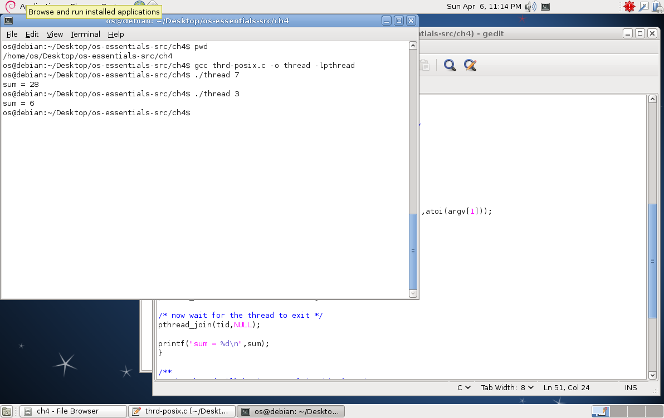
http://people.westminstercollege.edu/faculty/ggagne/osc/vm/index.html

Slide 14
Second program
Finding the lowest value
1. The global array is shared by each thread
2. The programming project requires passing parameters to each of the sorting threads
Starting index, Ending index
7, 12,19,3,18,4,2,6,15,8
7,12,19
3,18,4
2,6,15,8
7
3
2
2

Slide 15
Requirements
The merging thread must wait until three sorting threads calculate their results
Use a spin lock (busy looping) mechanism

Slide 16
Input.txt
프로그램 실행 결과
Lowest: 2
7 12 19 3 18 4 2 6 15 8

Slide 17
Schedule
데드라인
데드라인: 4월 19일 오후 23:59
실제로는 4월 18일 오후 23:59 임
이후에는 어떤 경우에도 안 받으니, 하루 전에 미리 제출할 것을 권유함
What to submit ?
보고서
별도 평가 예정이니, 자세히 쓸 것
source file, 출력 image

