Slide 1
Amazing Black box
Introduction to Heap (a basic data structure)
Dustin Xu

Slide 2
Cruel Trump
A Warmup Task for You

Slide 3
Cruel Trump
It is 2021, the year when Trump ends his presidency. Assume you are a HR in his company. Trump has an interesting habit: When he is unhappy, he will ask you to fire the employee with the highest salary as soon as possible. Also, there will be new employees. So you’d better to design an employee list to keep track of everyone’s salary.
To sum up, this list should be able to:
1. Add a new employee with his/her salary
2. Delete the employee with the highest salary

Slide 4
Cruel Trump
Yes! Excel!
Sounds Exciting!
That is Heap!
We are going to learn about how to insert a new value and delete the maximum value in Microsoft Excel today~~
But I have an amazing black box to achieve this requirement, which is much more exciting than Excel!

Slide 5
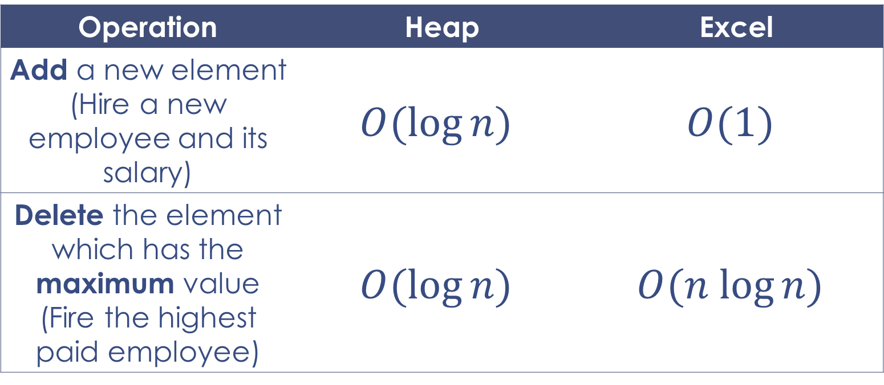
Heap vs Excel in time complexity
Operation | Heap | Excel
Add a new element (Hire a new employee and its salary) | $$O(log⁡n)$$ | $$O(1)$$
Delete the element which has the maximum value (Fire the highest paid employee) | $$O(log⁡n)$$ | $$O(n log⁡n)$$

Slide 6
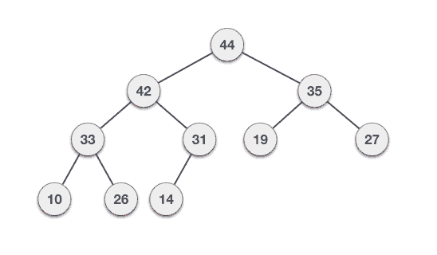
Heap
Any special feature?
Heap is a binary tree.
Heap is not a good-looking tree (Maybe).
A heap may look like this~~

Slide 7
Heap—Add a new element

Slide 8
Heap—Delete the maximum element

Slide 9
Meitan—the Second Hometown of ZJU
A Dangerous Task for You

Slide 10
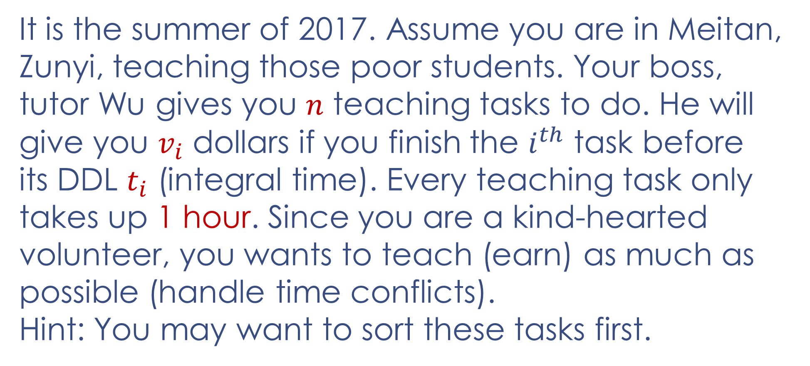
Meitan—the Second Hometown of ZJU
It is the summer of 2017. Assume you are in Meitan, Zunyi, teaching those poor students. Your boss, tutor Wu gives you $n$ teaching tasks to do. He will give you $v_{i}$ dollars if you finish the $i^{th}$ task before its DDL $t_{i}$ (integral time). Every teaching task only takes up 1 hour. Since you are a kind-hearted volunteer, you wants to teach (earn) as much as possible (handle time conflicts).
Hint: You may want to sort these tasks first.

Slide 11
Thank you!

