Slide 1
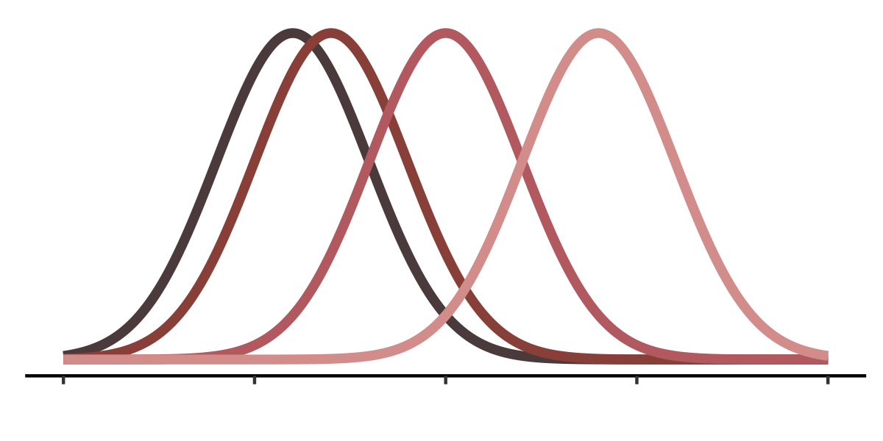








$$f\left(u_{1}\right)$$
$$f\left(u_{2}\right)$$
$$f\left(u_{3}\right)$$
$$f\left(u_{4}\right)$$
$$u_{2}$$
$$u_{3}$$
$$u_{1}$$
$$u_{4}$$

Slide 2
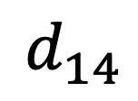

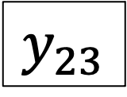

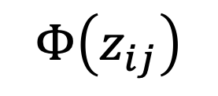
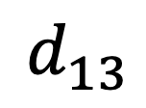

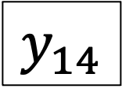

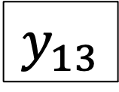
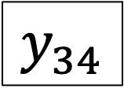
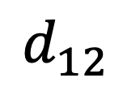
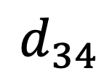

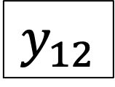
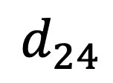
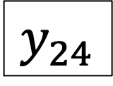

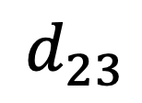

$$σ^{2}$$
$$σ^{2}$$
$$σ^{2}$$
$$U_{1}$$
$$U_{2}$$
$$U_{3}$$
$$U_{4}$$
$$d_{12}$$
$$d_{13}$$
$$d_{14}$$
$$d_{23}$$
$$d_{24}$$
$$d_{34}$$
$$Φ\left(z_{ij}\right)$$
$$y_{12}$$
$$y_{13}$$
$$y_{14}$$
$$y_{23}$$
$$y_{24}$$
$$y_{34}$$

