Slide 1

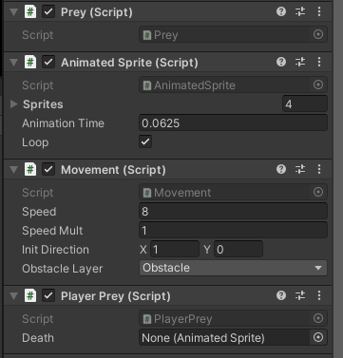
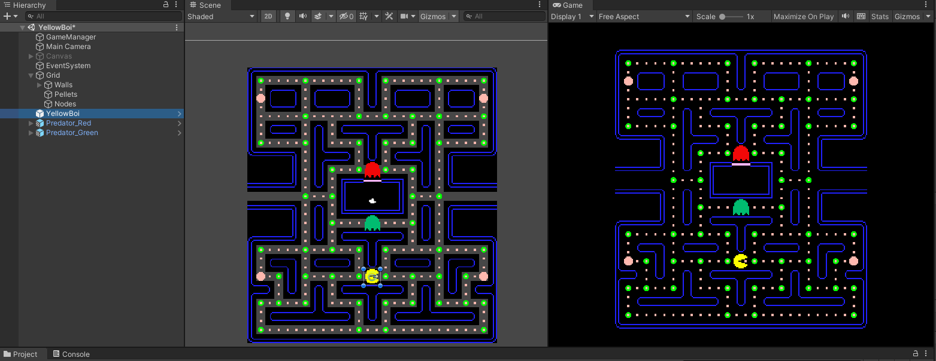

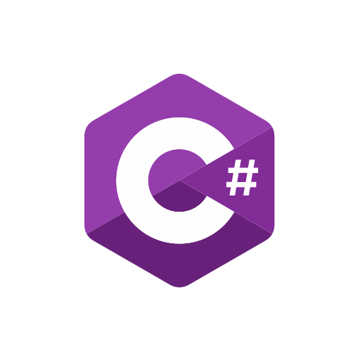
Yellow Boi Unity
Dominic London
Dr. Sam Siewert
PROJECT OVERVIEW
Unity
The Unity Game engine allows for the creation of games to be much easier using by allowing for you to easily to attach scripts to individual objects such as UI elements or sprites
HOW IT WORKS
The basic of this project is pacman with a slight alteration instead of controlling the pacman you are controlling the ghosts to catch pacman which is controlled by an AI agent. One is using reactive AI implementation and the other is using the A* project package
The A* project makes use of a node grid system an calculating the best path to a determined point or destination
The Intended purpose of this project was to construct a fun and educational game about AI and machine learning using a pacman clone as the game of choice.
The constraints of the project included:
The builds of the game to be able to run on Windows, Linux, and Mac
  Make use of the keyboard for gameplay
  Yellow boi (pacman) and the predators (ghosts) are constrained by the walls
  The objectives of the project included:
Create a 2D sprite game using Unity
Use a node-based grid system to allow for AI elements of navigation
Allow for seamless pausing of the game to access the option menu.
Citation:
PacMan Asset and Structure:
Zigurous.com
A* Project Package:
https://arongranberg.com/astar/
AI structure
The primary structure for the AI both in the reactive and the pathfinding use a node-based grid system both to tell the best path using A* but also just for general movement. With Reactive AI when a ghost/predator is close to yellow boi the AI will make it choose the path farthest from the immediate ghosts at each intersection node. The A* pathfinding using the node of each grid to find a particular point on the grid based on the difficulty of the level and using the Seeker script in the package will layout a path for the AI to follow.
PROJECT OUTLOOK
When the game is completed built and new levels and features are completed in the final version individuals will be able to upload their own AI or machine learning script using the C# programming language.
CSCI / Computer Science Senior Capstone Project

