Slide 1

Disegnophone
By Robert Venezia

Slide 2

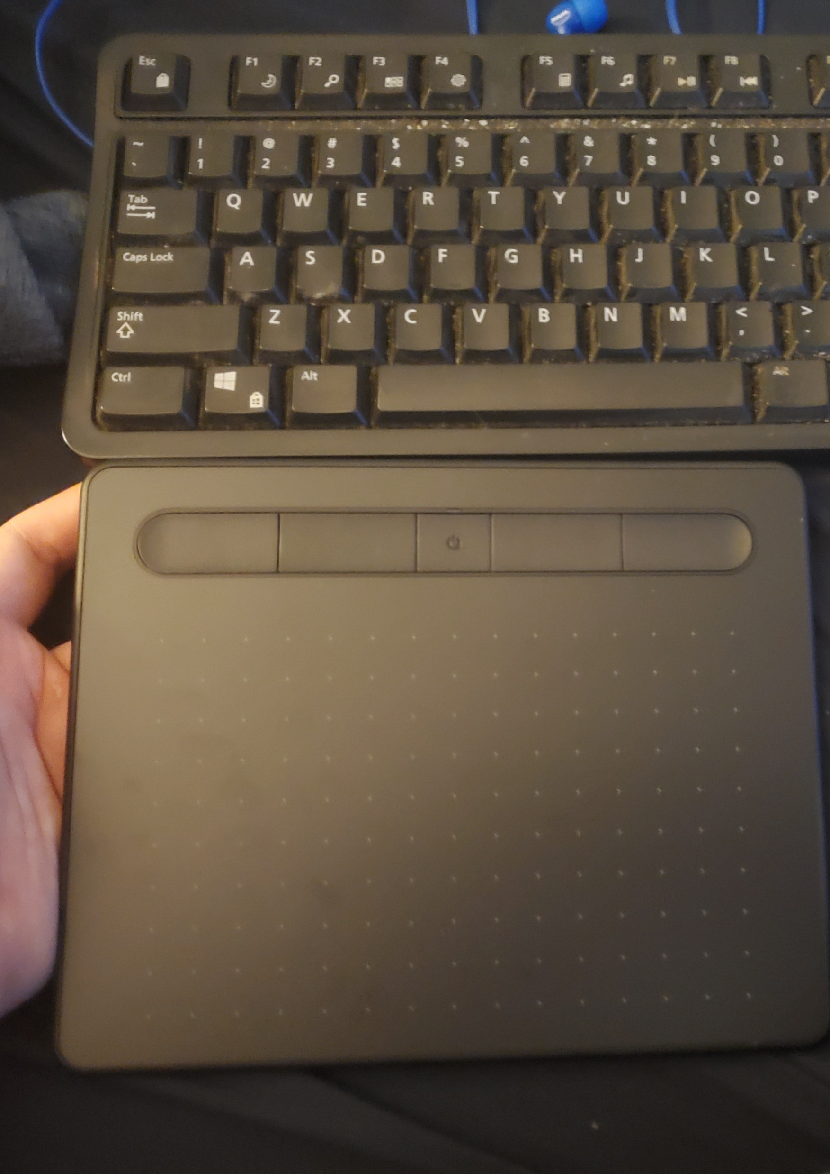
Concept
Started from the idea of a piano- where you move left to right to determine pitch
Main apparatus is a drawing tablet, which has 2 axes, unlike the piano’s single axis; as well as several buttons. (Pictured on right for scale)
Addition of knobs/switches/buttons to add complexity (various ideas for what these could add, nothing in stone yet)

Slide 3
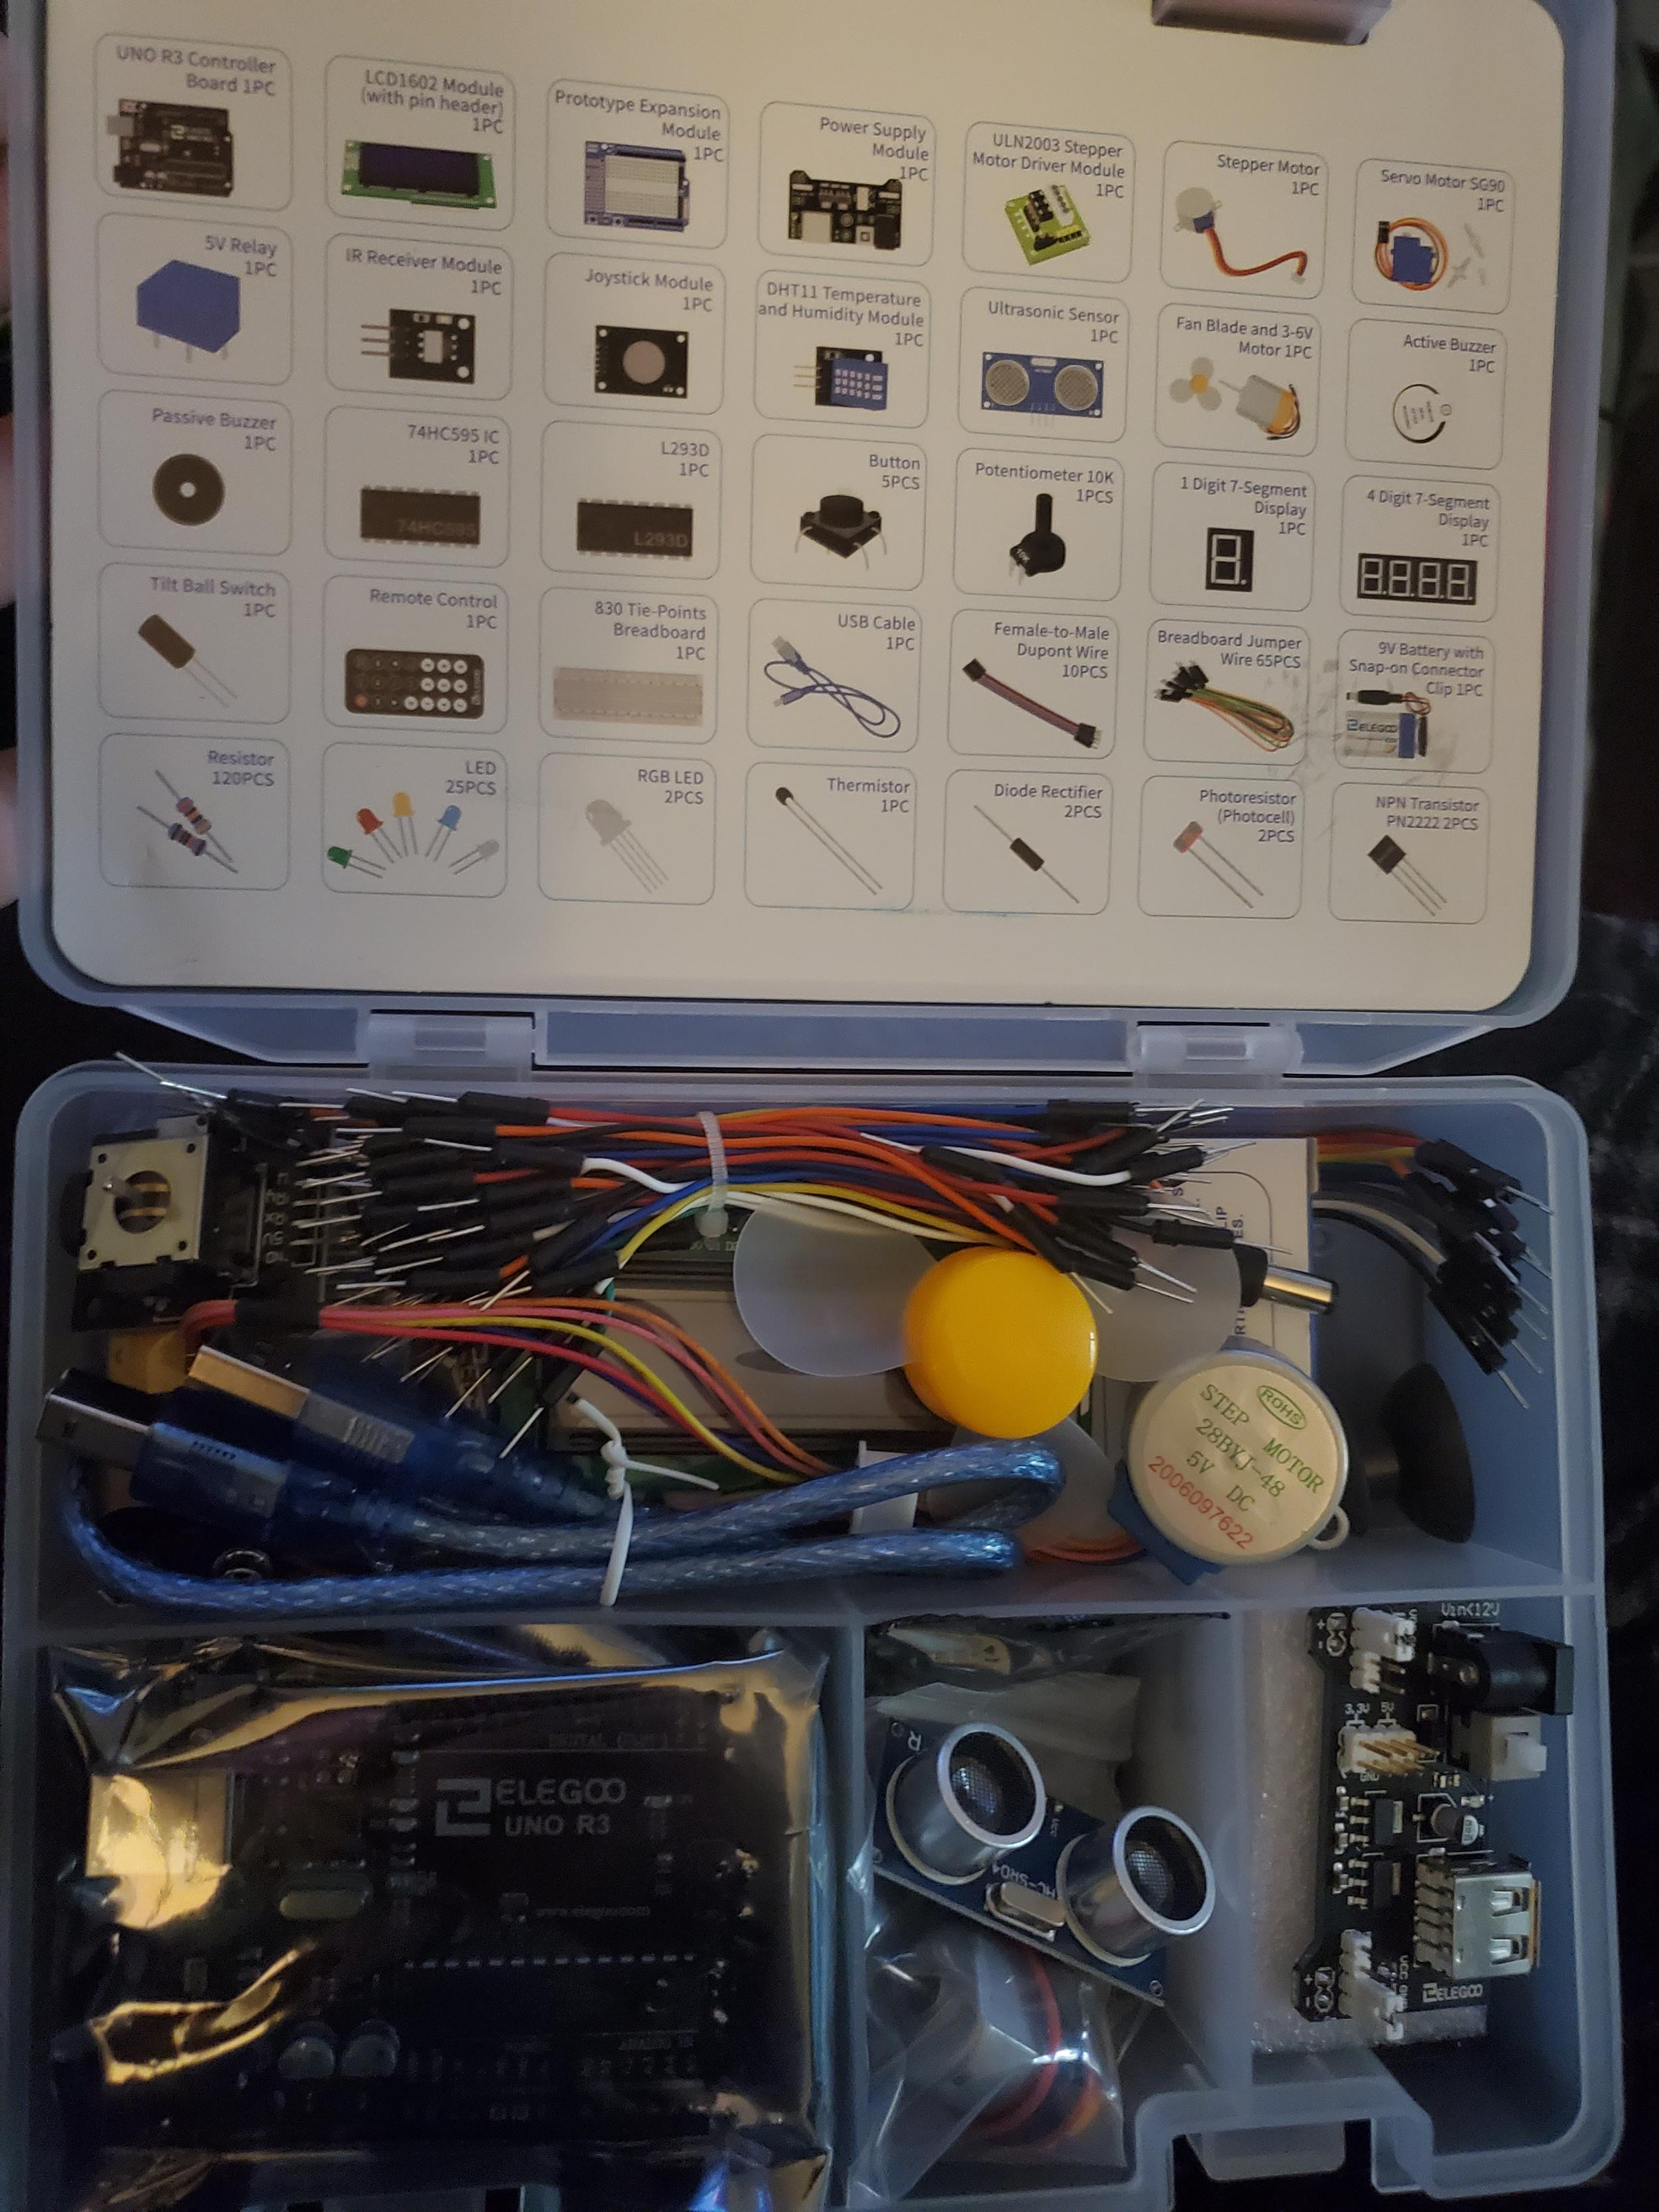
Hardware
The drawing tablet pictured on the previous slide
Arduino UNO and various sensors (knobs, buttons, switches). Starter kit pictured to the right; more may be needed before completion.

Slide 4
Musical Expression
The Disegnophone will have a complex mapping, making use of the drawing pad itself and the various sensors hooked up via Arduino.
This should allow a high level of musical expression, capable of creating a wide range of different sounds.

Slide 5
Technical Description

Slide 6
Connecting the Components
I will be using Arduino and Max to connect the Drawing Tablet and various sensors.
Sound will be triggered via pressing on the drawing pad. This will hopefully support multi-touch to have multiple tones playing at once.
Other knobs/buttons will alter settings, changing the texture of the sound, though only pressing on the drawing pad actually triggers sound to play.

Slide 7
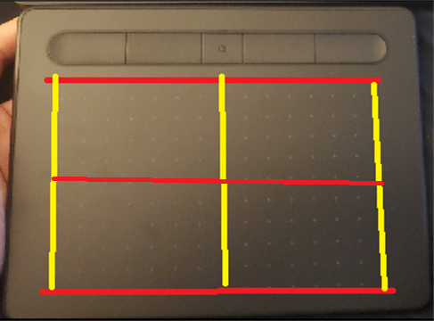
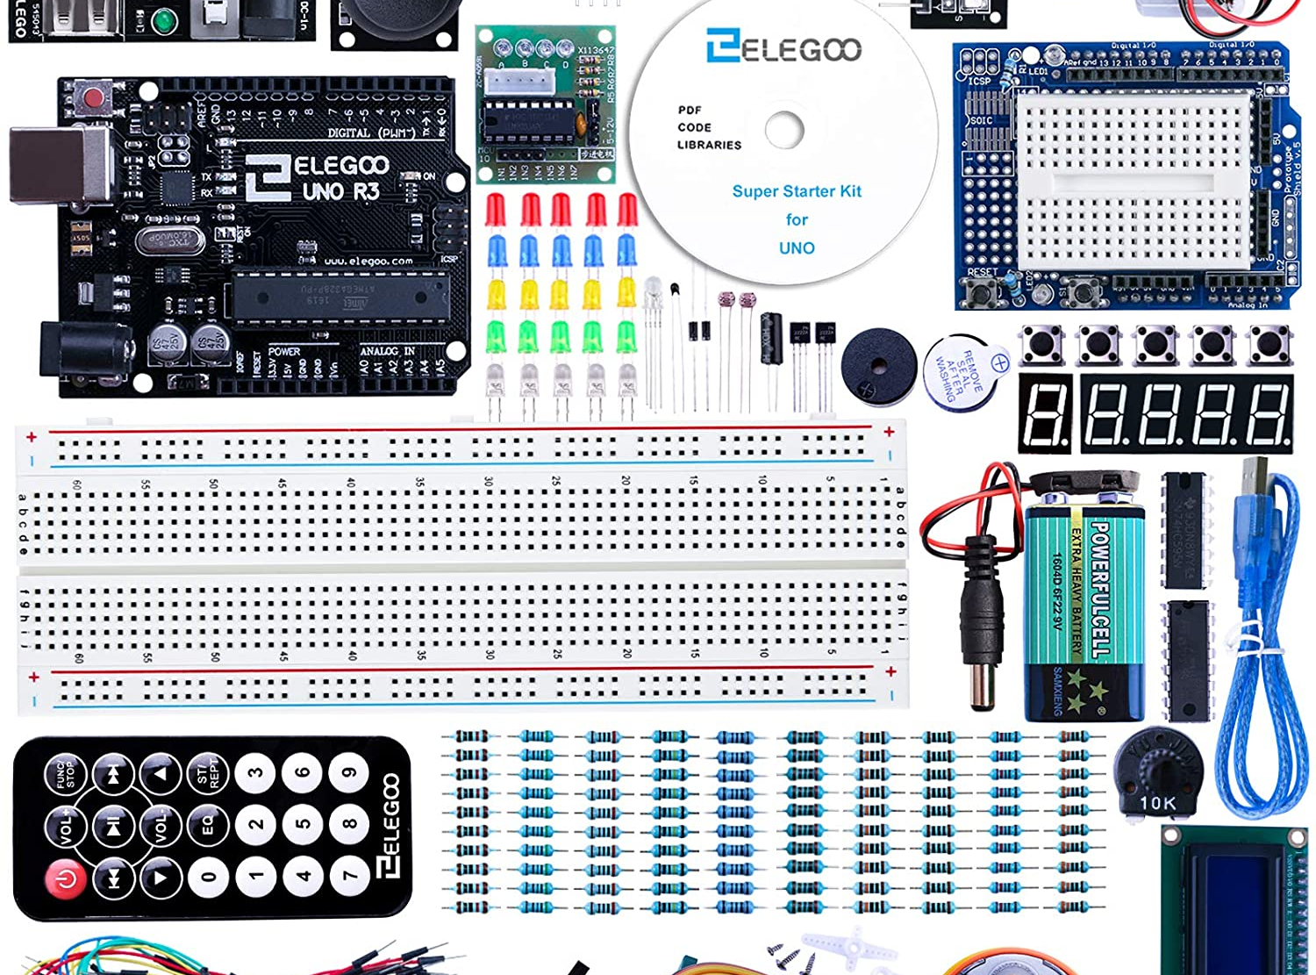
Mapping
Drawing Tablet: Horizontal axis maps to pitch, pressure maps to volume. Vertical axis likely also maps to pitch, though may map more strongly (large pitch changes), and/or map to other effects on the sound as well.
Knobs/buttons will control various aspects of the sound, which I am not entirely settled on. This will certainly allow for drastically changing the sound, depending on how you ‘tune’ it.

Slide 8
Plan of Action
I will get Max soon and begin playing with it and the tablet to see what I can do; get an idea for the type of sound I want, and what I will need as far as knobs/buttons for additional mappings. Hopefully, I will have it mostly functional by Thanksgiving. Time permitting, I hope to be able to build a case for the Disegnophone, such that the knobs and buttons from the Arduino are affixed to the face of the case, probably requiring soldering.

