Slide 1
COVID-19 Risk Calculator
Washington University, St. Louis
Data Analytics Bootcamp – Final Project
By: Michael Becker, Leo Huang, Aukje Rijpkema, Joseph Yi

Slide 2
Project Scope
Probability/Risk Calculator of being impacted by COVID-19 based on ML
By: Geographical location, Population Density, Measurements taken
Severity of being impacted by COVID-19 based on ML
By: Personal Health Input (age, gender, lifestyle, underlying conditions)
City/State Comparison Finder based on ML
User input: City or State
Model compares China vs US (states and/or provinces)
Plot 2 charts side-by-side with projected trajectory
Summary Page
Evolving US heatmap, Rat-race barchart (states), Profile information (bottom)

Slide 3
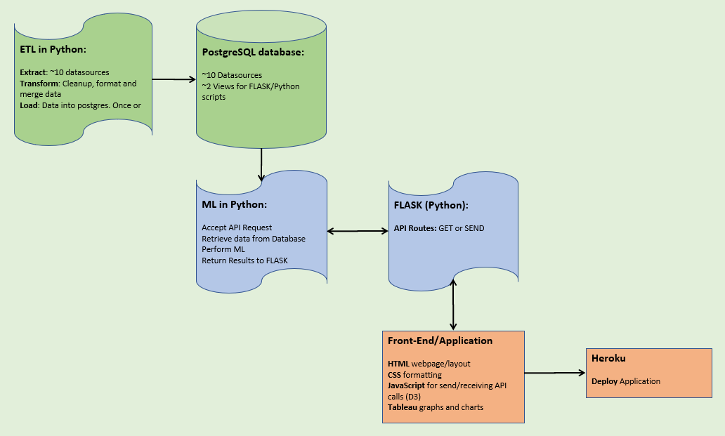
Architecture

Slide 4



Roles
 | Mike | Joe | Leo | Aukje
Database/ETL | X |  |  | X
ML | X | X | X
FLASK_API |  |  | X | X
Frontend |  | X
Tableau | X
Heroku |  |  | X | X

