Slide 1

Tutorial – refleksja i adnotacje
Zaawansowane programowanie obiektowe
dr hab. Szymon Grabowski
dr inż. Wojciech Bieniecki
wbieniec@kis.p.lodz.pl
http://wbieniec.kis.p.lodz.pl

Slide 2
Reflection
Reflection (...) refers to the ability to observe and/or manipulate the inner workings of the environment programmatically.
Reflection in Java is possible thanks to late dynamic binding.
Class loading occurs when the class is first referenced.
2

Slide 3
How the Class object works
Every class loaded into the JVM has a Class object
Corresponds to a .class file
The ClassLoader is responsible for finding and loading the class into the JVM
At object instantiation…
The JVM checks to see if the class is already loaded into the virtual machine
Locates and loads the class if necessary
Once loaded, the JVM uses the loaded class to instantiate an instance
3

Slide 4
Reflection – what can I do with it?
Load a class
Determine if it is a class or interface
Determine its superclass and implemented interfaces
Instantiate a new instance of a class
Determine class and instance methods
Invoke class and instance methods
Determine and possibly manipulate fields
Determine the modifiers for fields, methods, classes, and interfaces
...
4

Slide 5
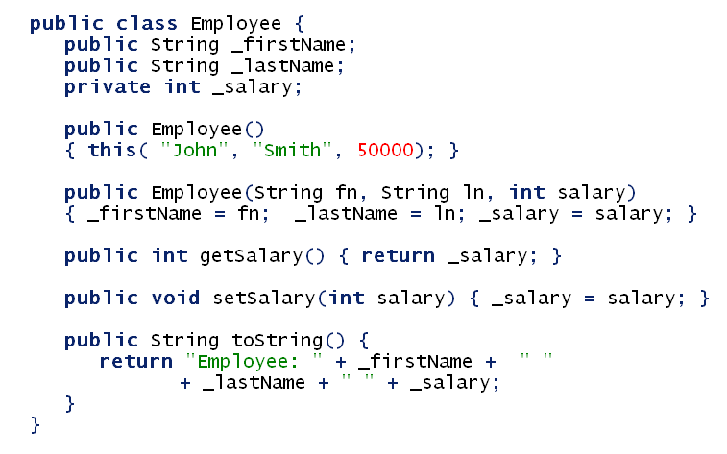
A very simple class
5

Slide 6
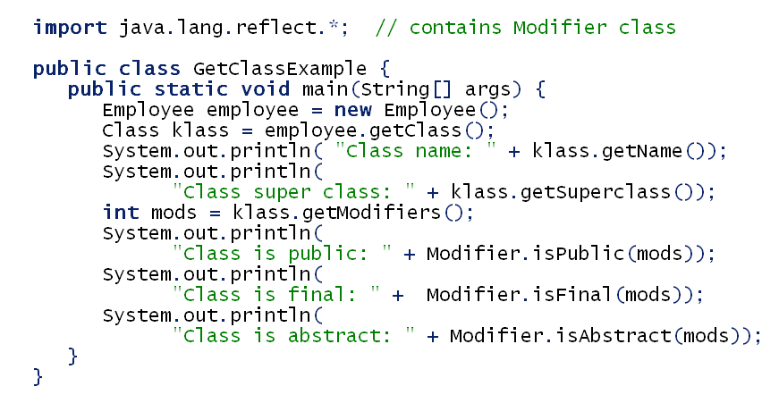
Looking into Employee’s internals
Class name: Employee Class super class: class java.lang.Object Class is public: true Class is final: false Class is abstract: false
Output
6

Slide 7
There are 3 ways to get hold of a class object
Calling getClass on an instance (we used it in the example).
2. Getting it directly from a class name:
Class klass = Employee.class;
3. Creating a Class object from a string:
Class klass = Class.forName("javax.swing.JButton"); ...
System.out.println("Class name: " + klass.getName()); ... System.out.println("Class super class: " + klass.getSuperclass());
7

Slide 8
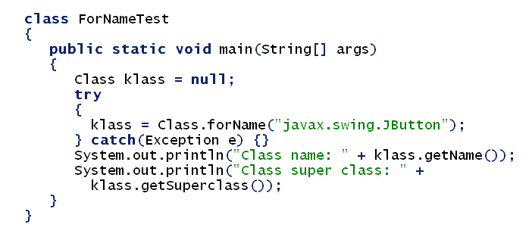
Creating a Class object from a string
About forName: you need to supply the full, complete with the package, name of the class.
8

Slide 9
Do smth with a Class object
Make a new instance of the “hold” class: newInstance() method.
public static void main(String[] args) throws ClassNotFoundException, InstantiationException, IllegalAccessException {
Class klass = Class.forName(args[0]); Object theNewObject = klass.newInstance();
System.out.println("Just made: " + theNewObject); }
Run with Employee argument (remember about the package name, if not the same); you will see:
Just made: Employee: John Smith 50000
9

Slide 10
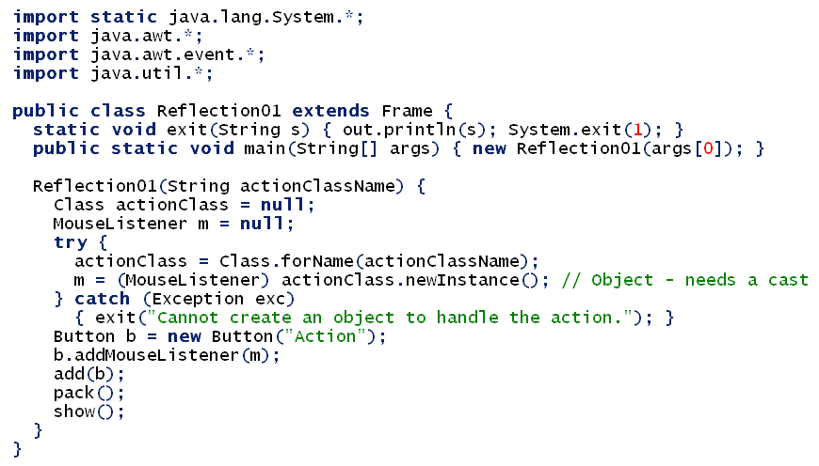
Delaying the way an action is handling until the run-time
10

Slide 11
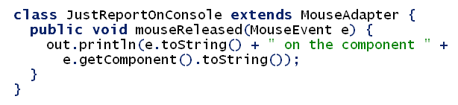
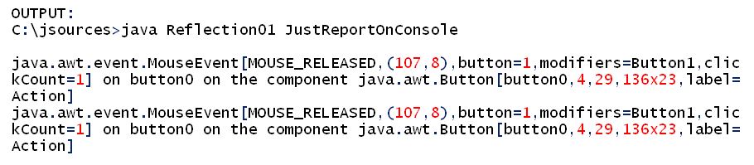
Delaying the way an action is handling until the run-time
11

Slide 12
Reflection can simplify code. A factory design pattern example
Without reflection
12

Slide 13
A factory design pattern example
With reflection
13

Slide 14
Reflecting arrays
In Java, arrays are objects.
Like all objects, they have classes.
If you have an array, you can get the class of that array using the standard getClass method, just as with any other object.
However, getting the class without an existing instance works differently than for other types of objects. ☹
Even after you have an array class, there’s not much you can do with it directly – the constructor access provided
by reflection for normal classes doesn’t work for arrays,
and arrays don’t have any accessible fields.
(Only the base java.lang.Object methods are defined
for array objects.)
14

Slide 15
Reflecting arrays
The special handling of arrays uses a collection
of static methods provided by the
java.lang.reflect.Array class.
The methods in this class let you create new arrays,
get the length of an array object,
and read and write indexed values of an array object.
Next slide:
a useful method for effectively resizing an existing array.
It uses reflection to create a new array of the same type,
then copies all the data across from the old array
before returning the new array.
15

Slide 16
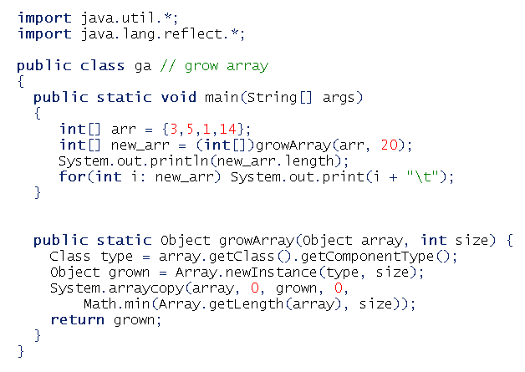

Reflecting arrays
16

Slide 17
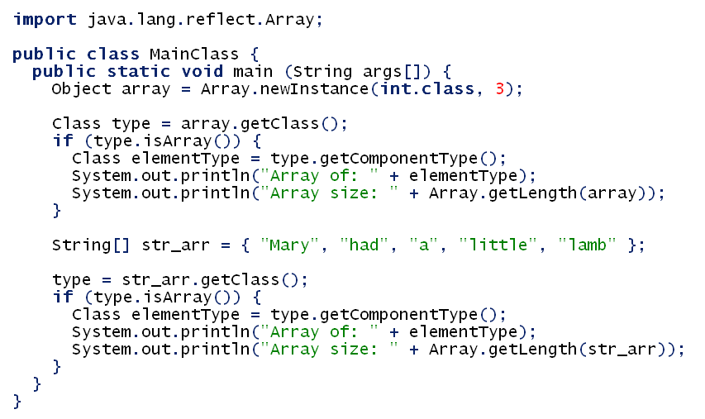
More on reflecting arrays
17

Slide 18
Annotations
Annotations provide data about a program that is not part of the program itself. They have no direct effect on the operation of the code they annotate.
Annotations have a number of uses, among them:
Information for the compiler — Annotations can be used by the compiler to detect errors or suppress warnings.
Compiler-time and deployment-time processing — Software tools can process annotation information to generate code, XML files, and so forth.
Runtime processing — Some annotations are available to be examined at runtime.
Annotations can be applied to a program's declarations of classes, fields, methods, and other program elements.

Slide 19
Declaring annotations
The annotation may be defined on its own line, and may include elements with named or unnamed values:
@Author(
name = "Benjamin Franklin",
date = "3/27/2003"
)
class MyClass() { }
@SuppressWarnings(value = "unchecked")
void myMethod() { }
If there is just one element named "value," then the name may be omitted
@SuppressWarnings("unchecked")
void myMethod() { }
if an annotation has no elements, the parentheses may be omitted
@Override
void mySuperMethod() { }

Slide 20
Documentation and annotations
Many annotations replace what would otherwise have been comments in code.
Suppose that a software group has traditionally begun the body of every class with comments providing important information:
public class Generation3List extends Generation2List {
// Author: John Doe
// Date: 10/17/2011
// Current revision: 6
// Last modified: 10/21/2011
// By: Jane Doe
// Reviewers: Alice, Bill, Cindy
// class code goes here
}
To add this same metadata with an annotation, you must first define the annotation type.
@interface ClassPreamble {
String author();
String date();
int currentRevision() default 1;
String lastModified() default "N/A";
String lastModifiedBy() default "N/A";
String[] reviewers(); // Note use of array
}

Slide 21
Documentation and annotations
The annotation type definition looks somewhat like an interface definition where the keyword interface is preceded by the @ character (@ = "AT" as in Annotation Type).
Annotation types are, in fact, a form of interface.
The body of the annotation definition above contains annotation type element declarations, which look a lot like methods. Note that they may define optional default values.
Once the annotation type has been defined, you can use annotations of that type
@ClassPreamble (
author = "John Doe",
date = "10/17/2011",
currentRevision = 6,
lastModified = "10/21/2011",
lastModifiedBy = "Jane Doe",
reviewers = {"Alice", "Bob", "Cindy"} // Note array notation
)
public class Generation3List extends Generation2List {
// class code goes here
}

Slide 22
Annotations with javadoc
To make the information in @ClassPreamble appear in Javadoc generated documentation, you must annotate the @ClassPreamble definition itself with the @Documented annotation
import java.lang.annotation.*;
// import this to use @Documented
@Documented
@interface ClassPreamble {
// Annotation element definitions
}

Slide 23
Annotations and the compiler
There are three annotation types that are predefined by the language specification itself: @Deprecated, @Override, and @SuppressWarnings.
@Deprecated annotation indicates that the marked element is deprecated and should no longer be used.
The compiler generates a warning whenever a program uses a method, class, or field with the @Deprecated annotation.
When an element is deprecated, it should also be documented using the Javadoc @deprecated tag, as shown in the following example.
note that the Javadoc tag starts with a lowercase "d" and the annotation starts with an uppercase "D".
// Javadoc comment follows
/**
* @deprecated
* explanation of why it was deprecated
*/
@Deprecated
static void deprecatedMethod() { } }

Slide 24
Annotations and the compiler
@Override annotation informs the compiler that the element is meant to override an element declared in a superclass
// mark method as a superclass method
// that has been overridden
@Override
int overriddenMethod() { }
While it's not required to use this annotation when overriding a method, it helps to prevent errors.
If a method marked with @Override fails to correctly override a method in one of its superclasses, the compiler generates an error

Slide 25
Annotations and the compiler
annotation tells the compiler to suppress specific warnings that it would otherwise generate. In the example below, a deprecated method is used and the compiler would normally generate a warning. In this case, however, the annotation causes the warning to be suppressed.
// use a deprecated method and tell
// compiler not to generate a warning
@SuppressWarnings("deprecation")
void useDeprecatedMethod() {
objectOne.deprecatedMethod(); //deprecation warning - suppressed
}
Every compiler warning belongs to a category. The Java Language Specification lists two categories: "deprecation" and "unchecked."
The "unchecked" warning can occur when interfacing with legacy code written before the advent of generics.
To suppress more than one category of warnings, use the following syntax:
@SuppressWarnings({"unchecked", "deprecation"})

Slide 26
Annotation Processing
The more advanced uses of annotations include writing an annotation processor that can read a Java program and take actions based on its annotations.
To make annotation information available at runtime, the annotation type itself must be annotated with @Retention(RetentionPolicy.RUNTIME), as follows:
import java.lang.annotation.*;
@Retention(RetentionPolicy.RUNTIME)
@interface AnnotationForRuntime {
// Elements that give information
// for runtime processing
}

Slide 27
@Retention annotation
The retention annotation indicates where and how long annotations with this type are to be retained. There are three values:
RetentionPolicy.SOURCE – Annotations with this type will be by retained only at the source level and will be ignored by the compiler
RetentionPolicy.CLASS – Annotations with this type will be by retained by the compiler at compile time, but will be ignored by the VM
RetentionPolicy.RUNTIME – Annotations with this type will be retained by the VM so they can be read only at run-time

Slide 28
@Retention annotation
@Retention(RetentionPolicy.RUNTIME)
public @interface Test_Retention
{
String doTestRetention();
}
In this example, the Retention(RetentionPolicy.RUNTIME) annotation indicates that your Test_Retention annotation is to be retained by the VM so that it can be read reflectively at run-time.

Slide 29
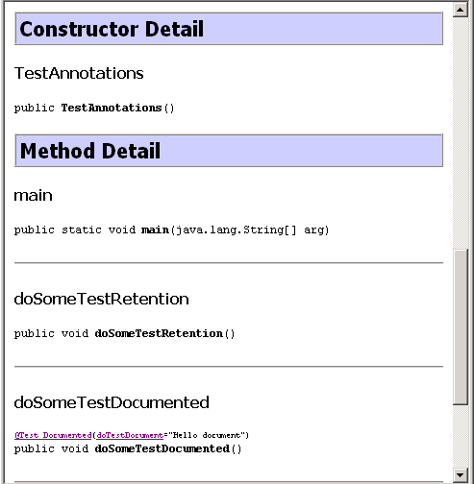
@Retention + @Documented
@Documented
public @interface Test_Documented {
String doTestDocument();
}
public class TestAnnotations {
public static void main(String arg[]) {
new TestAnnotations().doSomeTestRetention();
new TestAnnotations().doSomeTestDocumented(); }
@Test_Retention (doTestRetention="Hello retention test")
public void doSomeTestRetention() {
System.out.printf("Testing annotation 'Retention'");
}
@Test_Documented(doTestDocument="Hello document")
public void doSomeTestDocumented() {
System.out.printf("Testing annotation 'Documented'");
}
}

Slide 30
@Inherited Annotation
It indicates that the annotated class with this type is automatically inherited.
If you define an annotation with the @Inherited tag, then annotate a class with your annotation, and finally extend the class in a subclass, all properties of the parent class will be inherited into its subclass.
@Inherited
public @interface myParentObject {
boolean isInherited() default true;
String doSomething() default "Do what?";
}
@myParentObject
public Class myChildObject {
}
you do not have to define the interface methods inside the implementing class. These are automatically inherited because of using the @Inherited tag.
Also you don’t have to remeber about equals(), hashCode(), toString() and annotationType() methods

