Slide 1

Zaawansowane programowanie obiektowe Lecture 4 (concurrent programming)
Szymon Grabowski sgrabow@kis.p.lodz.pl
Łódź, 2023

Slide 2
Processes and threads
Processes are tasks that a given OS runs (in parallel).
A process has a self-contained execution environment: a complete, private set of basic run-time resources; in particular, each process has its own memory space.
Threads are “sub-processes” that run concurrently within a single process.
Java provides language-level and library support for threads — independent sequences of execution within the same program that share the same code and data address space. Each thread has its own runtime stack to make method calls and store local variables.
Most stuff in this lecture based on http://www.cs.stir.ac.uk/courses/31V4/lectures/
But see also
http://www.cs.usfca.edu/~parrt/doc/java/Threads-notes.pdf

Slide 3
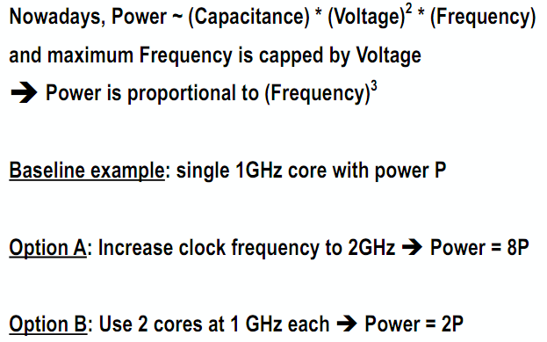
Parallelism saves power
Simplified analysis:
http://www.cs.rice.edu/~vsarkar/PDF/comp322-s15-lec1-slides-v1.pdf

Slide 4
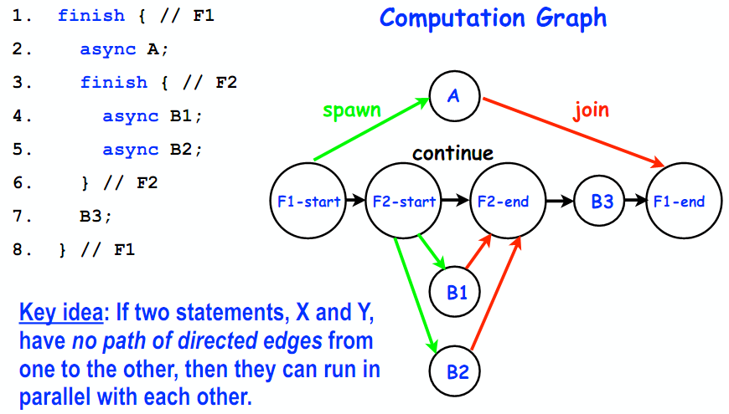
Computation graph [ https://wiki.rice.edu/confluence/download/attachments/4435861/comp322-s15-lec2-slides-v1.pdf ]

Slide 5
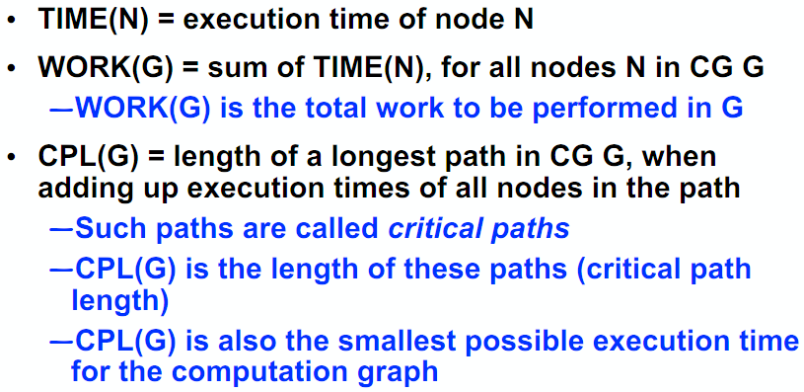
Complexity measures for computation graphs [ https://wiki.rice.edu/confluence/download/attachments/4435861/comp322-s15-lec2-slides-v1.pdf ]

Slide 6
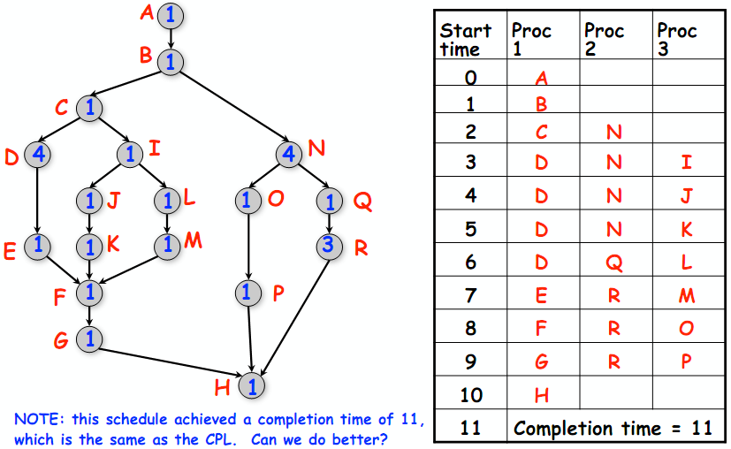
Scheduling, fixed # of processors (example) [ https://wiki.rice.edu/confluence/display/PARPROG/COMP322 , lecture 3 ]

Slide 7
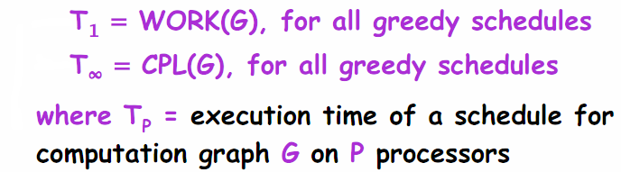
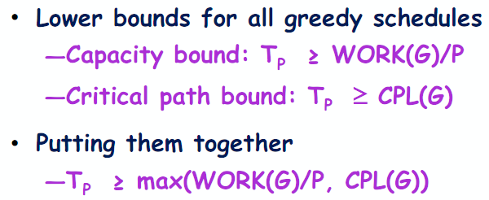
Greedy schedule [ https://wiki.rice.edu/confluence/display/PARPROG/COMP322 , lecture 3 ]
Def.: A greedy schedule never forces a processor to be idle when at least one node is ready for execution.

Slide 8
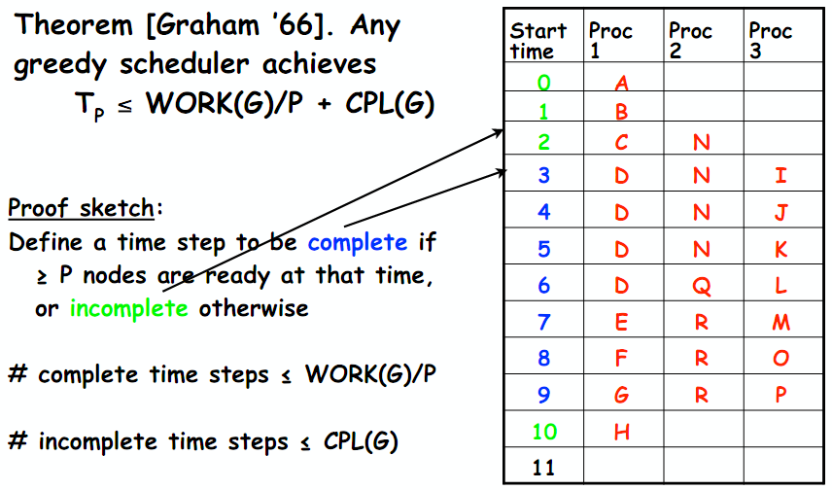
Upper bound for greedy schedules [ https://wiki.rice.edu/confluence/display/PARPROG/COMP322 , lecture 3 ]
Conclusion: Any greedy scheduler achieves T_{p} at most twice longer than the optimal time!

Slide 9
Using threads – examples
Server applications can handle multiple clients by launching a thread to deal with each client.
Long computations or high-latency disk and network operations can be handled in the background without disturbing foreground computations or screen updates.
Time measurement (via a timer) can be done in a separate thread.
Editing a source code while compiling
(the previous version of) the code at the same time.

Slide 10
Using threads – examples, cont’d
App: web browser.
[ http://www.cs.fiu.edu/~weiss/cop3338_f00/lectures/Threads/threads.pdf ]
Separate thread downloads each image on a page (could be one thread per image).
Separate thread displays HTML.
Separate thread allows typing or pressing the stop button.
Makes browser look more responsive.
Why threads
simpler programs (hm…)
high degree of control
(possibly) faster execution
making use of multiple cores/CPUs.

Slide 11
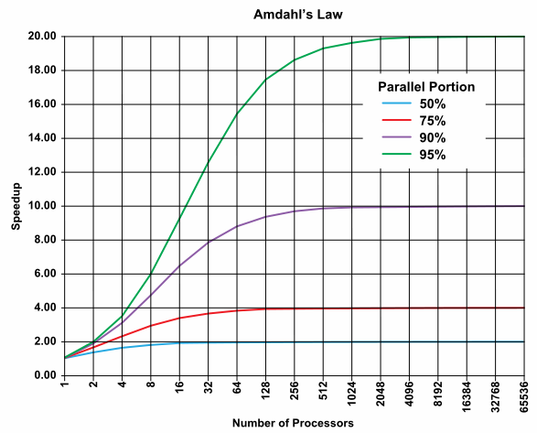
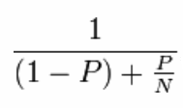
Beware of Amdahl’s law! [ http://en.wikipedia.org/wiki/Amdahl's_law ]
Max speedup:
P – parallel component S – serial component (= 1 – P) N – no of processors

Slide 12

Various concurrency models
threads and locks,
functional programming (pure functions, no mutable state),
actors,
communicating sequential processes,
data parallelism (e.g., SIMD),
…

Slide 13
Concurrency and parallelism
A concurrent program has multiple logical threads of control. These threads may or may not run in parallel.
A parallel program (usually) runs faster than a sequential program by executing different parts of the computation simultaneously (in parallel).
It may or may not have more than one logical thread of control.
We can also say that
concurrency is an aspect of the problem domain
(your program needs to handle multiple simultaneous, or near-simultaneous, events).
Parallelism, by contrast, is an aspect of the solution domain
(you want to make your program faster by processing different
portions of the problem in parallel).
Based on [P. Butcher, Seven Concurrency Models in Seven Weeks], chap. 1

Slide 14
Threads in the VM
VM has threads in background
VM alive as long as a “legitimate thread” still around (illegitimate threads are “daemons”)
GUI programs will start separate thread to handle events once frame is visible

Slide 15
Spawning a thread (step-by-step)
1. Create your class, making it implement Runnable
class Animation implements Runnable { … }
2. Define a method in your class with the signature:
public void run() { // this method will be called // when the thread starts up
…
// when this exits, thread dies }
3. Create an instance of your class: Animation a = new Animation();
4. Create a new thread attached to your new instance: Thread t = new Thread(a);
5. Start the thread attached to your object: t.start();

Slide 16
Simplest example
class BlahBlah implements Runnable {
String str;
public BlahBlah(String s) { str = s; }
public void run() {
while (true) { System.out.print(str); } }
}
class BlahBlahTest {
public static void main(String[] args) {
BlahBlah j = new BlahBlah("Oi! ");
BlahBlah k = new BlahBlah("Yo! ");
Thread t = new Thread(j);
Thread u = new Thread(k);
t.start();
u.start();
}
}
Output:
Oi! Oi! Oi! Oi! Oi! Oi! Oi! Oi! Oi! Oi! Oi! Oi! Oi! Oi! Oi! Oi!
Oi! Oi! Oi! Oi! Oi! Oi! Oi! Oi! Oi! Oi! Oi! Oi! Oi! Oi! Oi! Yo!
Yo! Yo! Yo! Yo! Yo! Yo! Yo! Yo! Yo! Yo! Yo! Yo! Yo! Yo! Yo! Yo!
Yo! Yo! Yo! Yo! Yo! Yo! Yo! Yo! Yo! Yo! Yo! Yo! Yo! Yo! Yo! Yo!
Yo! Yo! Oi! Oi! Oi! Oi! Oi! Oi! Oi! Oi! Oi! Oi! Oi! Oi! Oi! Oi!
Oi! Oi! Oi! Oi! Oi! Oi! Oi! Oi! Oi! Oi! Oi! Oi! Oi! Oi! Oi! Oi!
Oi! Oi! Oi! Oi! Oi! Yo! Yo! Yo! Yo! Yo! Yo! Yo! Yo!

Slide 17
Improving the output...
class BlahBlah implements Runnable {
String str;
public BlahBlah(String s) { str = s; }
public void run() {
while (true) {
System.out.print(str);
try { Thread.sleep(1); }
catch( InterruptedException e ) {}
}
}
}
....
Output:
Oi! Yo! Oi! Yo! Oi! Oi! Yo! Oi! Yo! Oi! Yo! Yo! Oi! Yo! Oi! Yo! Oi! Yo! Oi! Yo!
Oi! Yo! Oi! Oi! Yo! Oi! Yo! Yo! Oi! Yo! Oi! Yo! Oi! Yo! Oi! Yo! Oi! Yo! Oi! Yo!
Oi! Oi! Yo! Oi! Yo! Yo! Oi! Yo! Oi! Yo! Oi! Yo! Oi! Yo! Oi! Yo! Oi! Oi! Yo! Oi!
Yo! Oi! Yo! Yo! Oi! Yo! Oi! Yo! Oi! Yo! Oi! Yo! Oi! Yo! Oi! Oi! Yo! Oi! Yo! Yo!

Slide 18
Spawning a thread, another way (1/2)
// Create your class extending Thread
import java.awt.*;
class Timer extends Thread {
Label t1;
Timer(Label l){ t1 = l; }
// Redefine method run():
public void run() {
int time = 0;
while (true) {
try { this.sleep(500); } catch(InterruptedException exc){ return; }
time++;
t1.setText(String.valueOf(time));
}
}
}

Slide 19
Spawning a thread, another way (2/2)
// create an object of your class
public class Timer1 { public static void main(String[] args) {
Frame f = new Frame("Threads");
Label l = new Label("00000");
l.setFont(new Font("Dialog", Font.BOLD, 44));
f.add(l, "North");
f.setSize(300,200);
f.show();
// send the start() message to your object
Timer tm = new Timer(l); // here we create object
tm.start(); // here we launch a thread
// counting half-secs
}
}

Slide 20
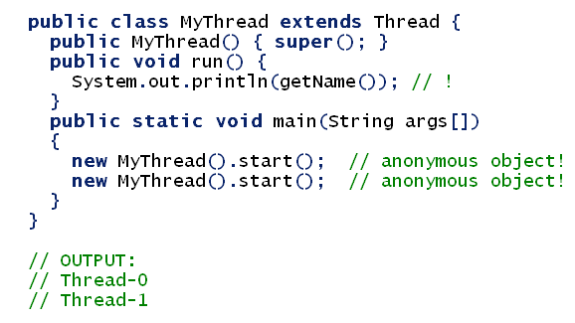
We can name a thread, and get its name
Analogously: setName(String name)

Slide 21
States of a thread
A thread may be in one of the following states:
New: the Thread object has been created using new, but start() has not yet been called for it.
Runnable: It is able to run, but currently some other thread is being executed.
Running: it is currently running, i.e. executing instructions on the computer.
Blocked: The thread cannot proceed until something happens. For example, it might have called sleep() (or it might have called wait() – elaborated later). Or is blocking on I/O.
Terminated (dead): The run() method has terminated. Cannot be “revitalized”. That is, you can’t restart it by calling start() again (i.e. no effect).
Some authors don’t distinguish between Runnable and Running.

Slide 22
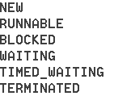
States of a thread, cont’d [ http://www.jguru.com/faq/view.jsp?EID=1253344 ]
We can find out some information about the state of a thread at any time, e.g.: if (ball.isAlive()) { ... }
The method isAlive() returns true if the thread is running, runnable or blocked, and returns false if it is new or dead.
// t – some thread Thread.State e = t.getState(); // returns an enum System.out.println(e.name()); // prints the current state of t Thread.State[] ts = e.values(); for(int i = 0; i < ts.length; i++) { System.out.println(ts[i]); }

Slide 23
Thread lifecycle [ http://horstmann.com/corejava/cj7v2ch1.pdf ]
Light-shaded methods (suspend, resume, stop) –deprecated!

Slide 24
Scheduling
Parallel thread execution on a single CPU core is an illusion, of course. At a time, only one thread is running.
How does the system decide which thread runs? That is the job of the scheduler.
We cannot make any assumptions about how the scheduler works, as different strategies are used in different operating systems, or different versions of the Java Virtual Machine.
A thread executes only when it is in state running.
Invoking start() does NOT cause a thread to run (it merely becomes runnable, and must wait for the scheduler to give it a turn).

Slide 25
Daemon threads
t.setDeamon(true); // set t as a daemon // This method must be called before the thread is started.
Daemons are threads that are constantly running (once created), and typically perform some services. (like the garbage collection thread).
When only daemon threads remain, the VM exits.
Daemon example: a timer thread that sends regular “time ticks” to other threads.

Slide 26
Method sleep(long time_in_millis) is very useful
Static method (invoke: Thread.sleep(...); ).
Current thread gives up the processor for at least the time specified.
Time in millisec.
No guarantee that you get processor back.
Must catch InterruptedException (an exception that sleep throws when another thread interrupts the current thread while sleep is active).
Also a form sleep(long millis, int nanos) exists.

Slide 27
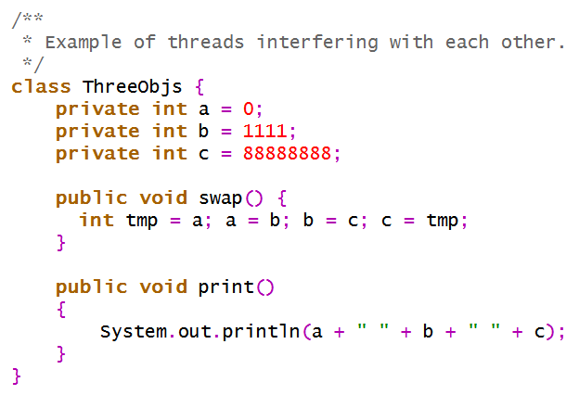
Houston, we got a problem! [ http://www.cs.fiu.edu/~weiss/cop3338_f00/lectures/Threads/NoSync.java ]
An example showing that threads may disturb each other.

Slide 28
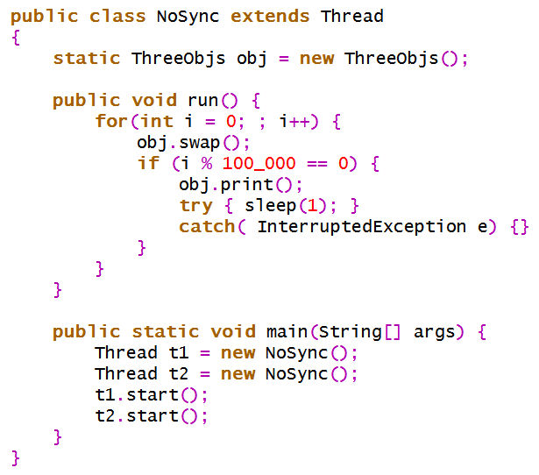
NoSync.java, cont’d
Output (smth like that...):
88888888 0 1111
88888888 0 1111
88888888 88888888 88888888
88888888 88888888 88888888
88888888 88888888 88888888
…
Or sometimes, e.g.:
88888888 0 1111
88888888 0 1111
0 0 0
0 0 0
…

Slide 29
Shared data, problem gradation
Two threads access the same object, but only read data: no problem.
Two threads access the same object, but only one of them changes data: no good, as the object may be temporarily in a bad state.
Example [ http://www.cs.fiu.edu/~weiss/cop3338_f00/lectures/Threads/threads.pdf ] : class TwoObjs { private int a = 15; private int b = 37; public int sum() { return a + b; } // should always be 52 public void swap() { int tmp = a; a = b; b = tmp; } } // assume time-slice in swap() ends after a=b; // the other thread calls sum()... ☹
Two threads access the same object, and both change the object: fatal (we’ve just seen it, NoSync.java).

Slide 30
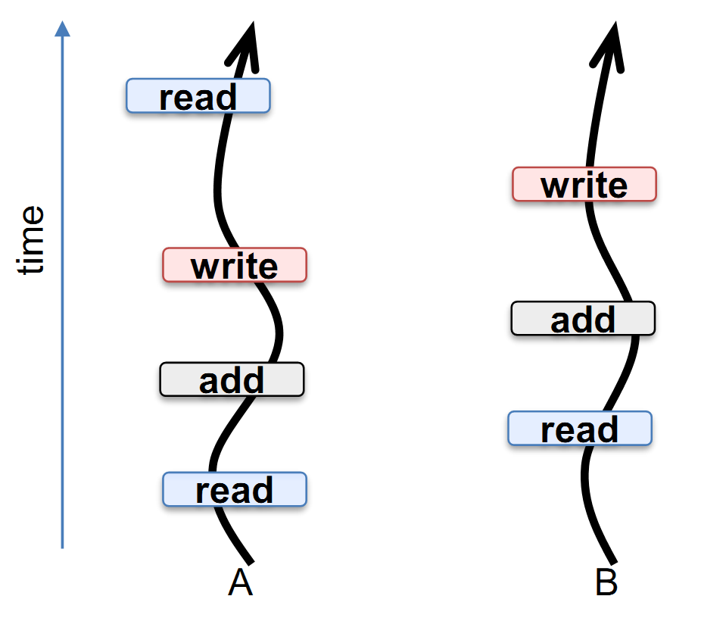
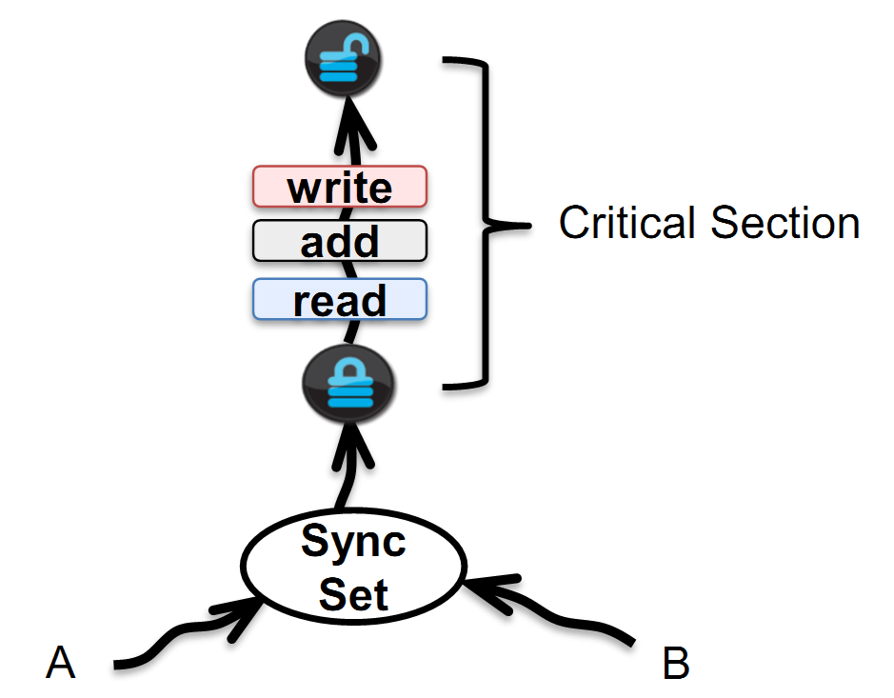
Even ++ is non-atomic!
problem (the add op on variable n may be even n++)
solution
https://fis.uni-bamberg.de/bitstream/uniba/53739/3/fisba53739.pdf

Slide 31
Thread interference, another example
Suppose we have two threads: one sets new dates (setDate), the other periodically reads dates (getDate).
Suppose now we have the date set to March, 31. One thread makes the call: theDate.setDate("April", 1);
Let the month be set first. And just now the pre-emptive scheduler decides (after only executing the first line in setDate) that this thread’s time-slot is over and that another thread is to be run.
Say this other different thread makes the call String current = theDate.getDate();
What will be the value of current?
"April, 31". ☹
Happens very rarely? If so, THAT’S EVEN WORSE. Testing multi-threading programs is (very) hard.

Slide 32
Some terms in concurrent programming
Mutual Exclusion – one must be certain that concurrent processes have mutual exclusive access to shared data.
Race Condition – one must avoid situations in which the relative speed of various processes affect the outcome.
Deadlock & Starvation – one must avoid situations in which processes are placed in a locked condition indefinitely.

Slide 33
How to stop threads from interfering with each other
Threads may well need to communicate information to each other.
• The simplest way of achieving this is to allow several threads to access the same stored information. This leads to the idea of shared variables.
• In the date example, there was one shared variable: the date object.
• We had a typical problem of what happens if threads try to share variables: one thread tries to update a shared variable at the same time that another thread is reading it.
This can lead to inconsistent information being read.

Slide 34
Critical regions
• A solution: critical regions (critical sections) in our program.
• All access to shared variables takes place within these critical regions, and Java uses monitors to control access to the critical regions.
For example, the setDate and getDate methods might form a critical region.
• Java provides mechanisms so that we can be confident that only one thread can be executing (whether currently suspended by the scheduler or not) within a critical region at any one time.
• If a second thread wishes to access to the critical region, it needs to be blocked until the first thread has left.
• This is mutual exclusion, i.e. threads have mutually exclusive access to the shared variables.

Slide 35
Keyword synchronized
We achieve all this in Java through synchronized methods. Our Date class would be the same as before except for the word synchronized being inserted in the relevant method headers:

Slide 36
Synchronizing a block
Sometimes no need to synchronize the entire method.
Just need to synchronize a “critical section” – few lines of code that should be viewed as an “atomic” single operation.
Use a synchronized block then: synchronized( anyobject ) { ... }
As long as a given thread is inside a synchronized method or a synchronized block, any other thread attempting to invoke this or another method of the synchronized object must wait until the first thread leaves the synchronized method (block).

Slide 37
Version #1 and #2 are equivalent
public class C1 { // Version #1 synchronized public void f1() { ... } synchronized static void f2() { ... } }
public class C1 { // Version #2 public void f1() { synchronized(this) { ... } } static void f2() { synchronized(C1.class) { ... } } }
synchronized in method header is just a convenience. Synchronized is NOT inherited.

Slide 38
Synchronization
Synchronization
prevents a thread from observing an object in an inconsistent state,
ensures that each thread entering a
synchronized method or block sees the effects of all previous modifications that were guarded by the same lock.
When multiple threads share mutable data, each thread that reads or writes the data must perform synchronization.

Slide 39
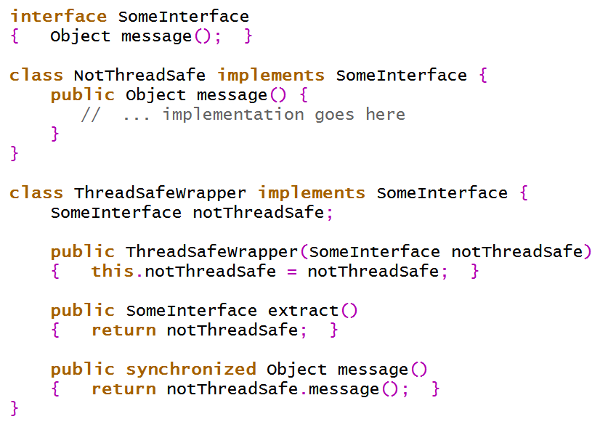
Synchronization wrappers. Example
Based on [A. Holub, Taming Java Threads, 2000]

Slide 40
Synchronization wrappers, cont’d
When thread safety isn’t an issue, you can just declare and use objects of class NotThreadSafe.
When you need a thread-safe version, just wrap it:
SomeInterface object = new NotThreadSafe();
// ...
object = new ThreadSafeWrapper(object); // object is now thread-safe
When you don’t need thread-safe access any more, unwrap it:
object = ((ThreadSafeWrapper)object).extract();

Slide 41
Synchronization is (often) not enough
Interacting Threads – Producer/Consumer
• In the setDate/getDate example, we do not care how often a date, once set, is accessed using getDate.
• But sometimes where we need to add the condition that the information must be read exactly once.
• This is known as the producer/consumer problem.
• A Producer produces items. A Consumer consumes items. E.g., Author / Writer example in [Barteczko’04]: Author creates stories, Writer “catches” them and prints (sends to the screen).

Slide 42
Producer / Consumer, cont’d
• We must ensure that all items produced by Producer are consumed by Consumer, and that Consumer does not consume the same item twice.
Hence:
– if Producer is faster than Consumer, then Producer must wait for the item to be consumed, and
– if Consumer is faster than Producer, then Consumer must wait until the next item has been produced.

Slide 43
Solution?
1. Use a buffer (queue)?
In one thread, Producer produces items which it puts in the buffer, in the other thread, Consumer takes items from the buffer and “consumes” them.
The Buffer encapsulates the shared variable, and is the critical region.
Producer and Consumer access the shared variable (which stores the items) through synchronized give and take methods from the Buffer class.
Gives mutual exclusion (because the methods are synchronized).
OK?

Slide 44
Solution? (cont’d)
WRONG. ☹ As well as mutual exclusion, we need to ensure that an item can only be put in an empty buffer, and removed from a full buffer.
We are going to use wait() and notify() from class Thread
When a thread invokes wait(), it is put in state blocked and loses the lock.
The effect of notify() is to wake up a thread which has executed a call of wait() in this object. If there is no waiting thread, then the call has no effect.
When a thread is woken up, it becomes runnable. (But it is run again only when the scheduler decides.)

Slide 45
wait()
wait() must always occur within a try/catch block: try { wait(); } catch (InterruptedException e) { System.err.println("Exception"); }
Now, let’s present all the needed classes...
Many of them... Producer, Consumer, Buffer and ProduceConsume.

Slide 46
Producer (produces items and puts them in a buffer)

Slide 47
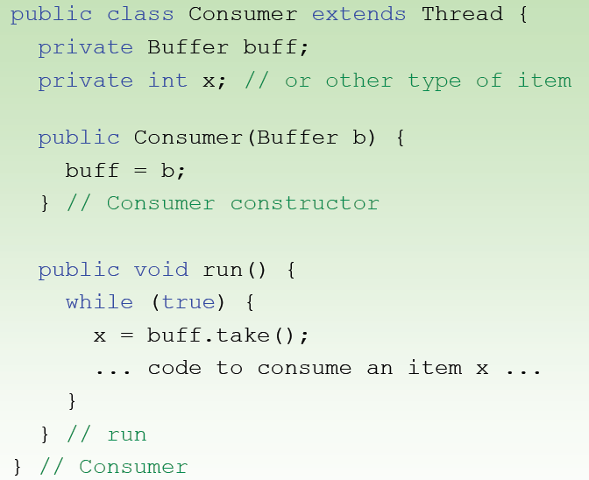
Consumer (takes items from a buffer)

Slide 48
in a try/catch block, remember!
Buffer (critical region; only one thread may be executing one of its methods at any one time)

Slide 49
Putting it all together

Slide 50
Producer / Consumer – extension
We could have several Producer and Consumer objects running in parallel in separate threads
– When a thread calls wait(), the thread is blocked.
– Several threads can be blocked at any one time.
• When a call of notify() is executed, one of the blocked threads is reactivated, i.e. put in state Runnable.
• For our example to work, a Producer needs to notify a Consumer, and a Consumer needs to notify a Producer...
– …but it’s possible for a Producer to notify another Producer (or a Consumer to notify another Consumer).
• To get around this problem, there is a method notifyAll(). This can be used in place of notify(), and it wakes up all threads waiting on this object (i.e. sets them all to be runnable).

Slide 51
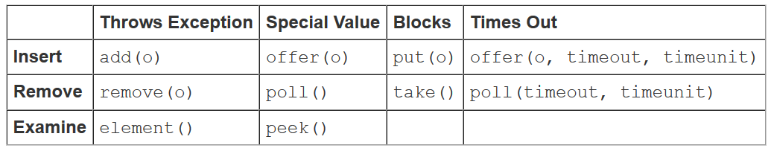
Simpler: use a queue implementing java.util.concurrent.BlockingQueue<E>
BlockingQueue methods:
Blocking methods: put (if the producer cannot add an item to the queue, as it is full), take (when the consumer cannot take an item since the queue is empty).
http://tutorials.jenkov.com/java-util-concurrent/blockingqueue.html

Slide 52
Recommended BlockingQueue implementations
SynchronousQueue: does not have any internal capacity!
You cannot insert an element (using any method) unless another thread is trying to remove it.
ArrayBlockingQueue: backed by an array, its capacity is set in the constructor(s).

Slide 53
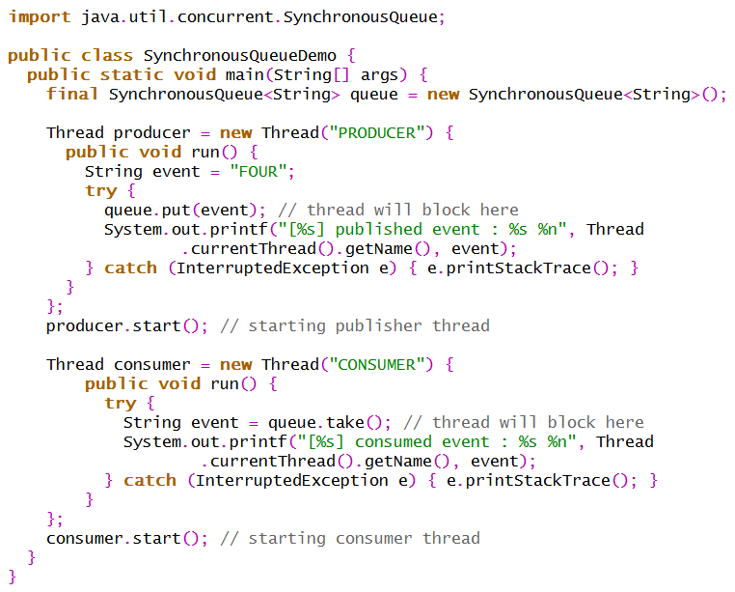
SynchronousQueue demo (Producer/Consumer)
https://javarevisited.blogspot.com/2014/06/synchronousqueue-example-in-java.html
[CONSUMER] consumed event : FOUR
[PRODUCER] published event : FOUR

Slide 54
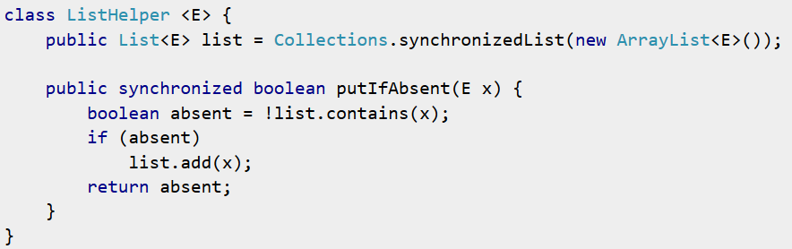
Careful with locking!
What’s wrong with this code? We have synchronized keyword…
Yet, the list is unlocked when contains returns, and then locked again when add is called. Something else could add the same element between the two.
That’s because the method putIfAbsent synchronizes on a wrong lock. this, i.e. object of ListHelper, gives no guarantee that another thread won’t modify the list while putIfAbsent is executing.
http://stackoverflow.com/questions/17533263/why-is-this-code-not-thread-safe-even-when-using-a-synchronized-method

Slide 55
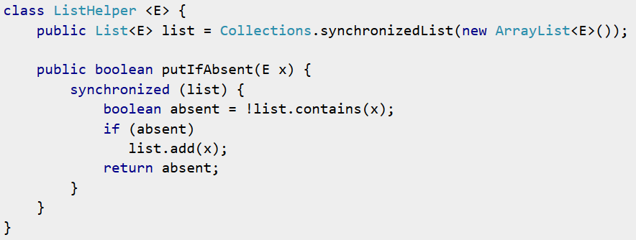
Fixed version
Alternatively: make list private (then no other objects can access it). Then also Collections.synchronizedList is not needed, as you’re providing all necessary synchronization in your own code.

Slide 56
Atomic operations
Assignments to variables of primitive types except for long and double are atomic.
Remember: only assignments! Statements like x += y or even x++ are NOT guaranteed to be atomic, even for the int type.
If you need atomicity in such a case, use synchronization or a special atomic type from the java.util.concurrent.atomic package.

Slide 57
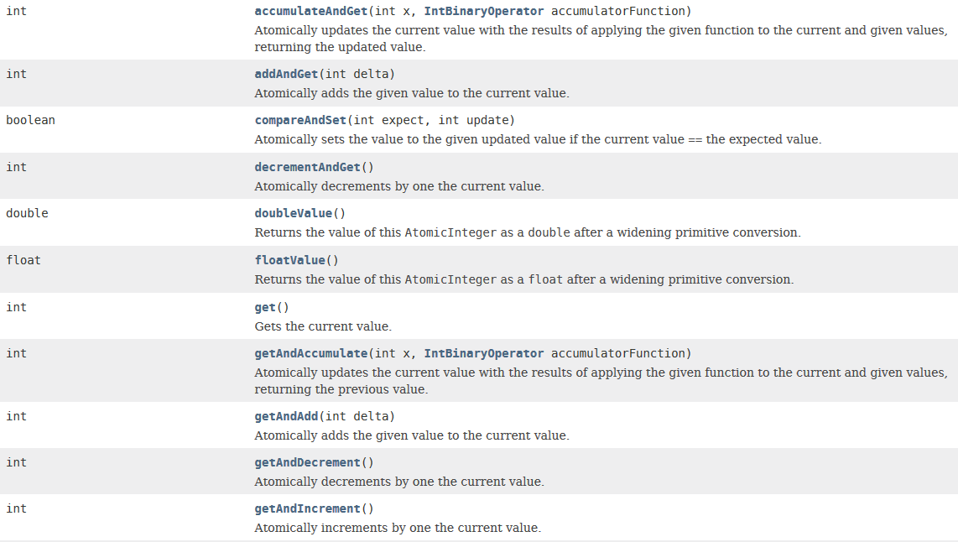
java.util.concurrent.atomic.AtomicInteger (extends Number implements Serializable)
. . .

Slide 58
Guarded blocks [ http://docs.oracle.com/javase/tutorial/essential/concurrency/guardmeth.html ]
Suppose, for example, that guardedJoy() is a method that must not proceed until a shared variable joy has been set by another thread.
Do you like the following piece of code?
public void guardedJoy() {
while(!joy) { } // empty loop System.out.println("Joy has been achieved!"); }
This is bad. CPU cycles are wasted.

Slide 59
Guarded blocks, cont’d [ http://docs.oracle.com/javase/tutorial/essential/concurrency/guardmeth.html ]
// this is a correct way
public synchronized guardedJoy() { // This guard only loops once for each special event, // which may not be the event we're waiting for. while(!joy) { try { wait(); } catch (InterruptedException e) { } } System.out.println("Joy and efficiency have been achieved!"); }
We expect that some other thread will eventually invoke smth like this: public synchronized notifyJoy() { joy = true; notifyAll(); }
Note this kind of solution was used for the producer / consumer problem.

Slide 60
Thread.join()
Thread.join() method waits until the thread on which it is called terminates (dies).
I.e., t.join() causes the current thread to pause execution until t’s thread terminates.
Overloads of join allow the programmer to specify a waiting period. However, as with sleep, join is dependent on the OS for timing, so you should not assume that join will wait exactly as long as you specify.

Slide 61
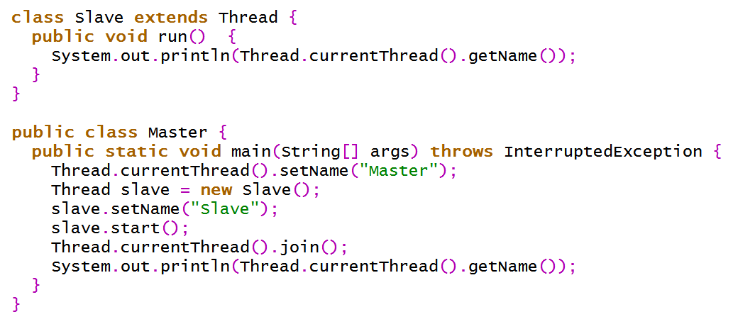
Join question. What’s the result of the following program?
Answer: prints "Slave" and hangs (blocks infinitely on the Thread.currentThread().join() line).

Slide 62
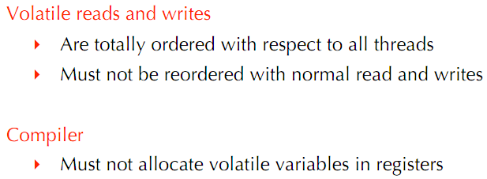
Volatile fields
Fields can be declared with a keyword volatile.
Every read of a volatile variable will be read from main memory, and not from a register or the CPU cache, and that every write to a volatile variable will be written to main memory, and not just to the CPU cache.
http://www.lst.inf.ethz.ch/teaching/lectures/hs12/2800/slides/2012_11_26Jmm.pdf

Slide 63
Since Java 5 the keyword volatile means more
If Thread A writes to a volatile variable and Thread B subsequently reads the same volatile variable, then all variables visible to Thread A before writing the volatile variable, will also be visible to Thread B after it has read the volatile variable. In other words: not only the volatile variable, but also all other variables changed by Thread A before writing to the volatile variable are flushed to main memory.
The reading and writing instructions of volatile variables cannot be reordered by the JVM (the JVM may reorder instructions for performance reasons as long as the JVM detects no change in program behavior from the reordering).
Instructions before and after can be reordered, but the volatile read or write cannot be mixed with these instructions.
Whatever instructions follow a read or write of a volatile variable are guaranteed to happen after the read or write.
http://tutorials.jenkov.com/java-concurrency/volatile.html

Slide 64
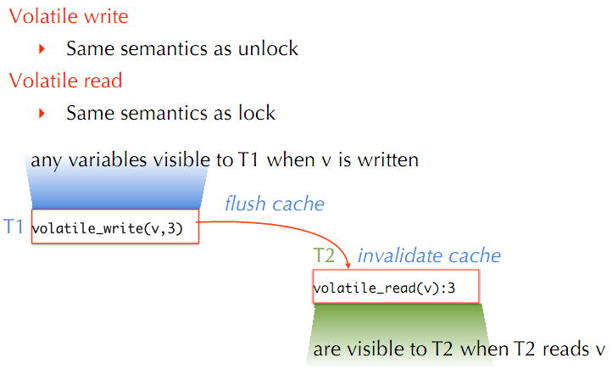
Java Memory Model (JMM) semantics

Slide 65
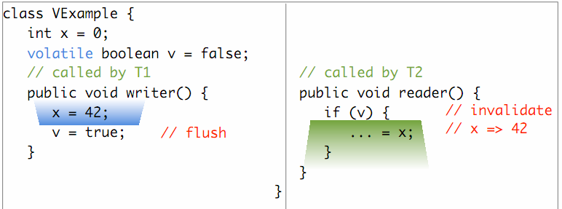
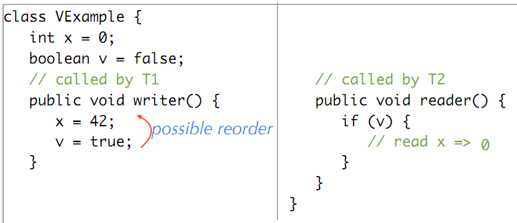
volatile example
Below: without volatile

Slide 66
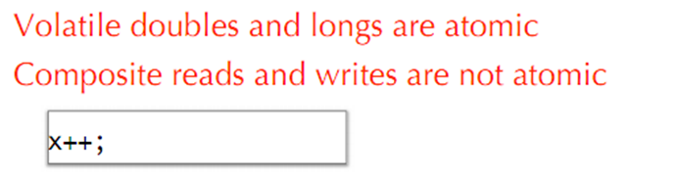
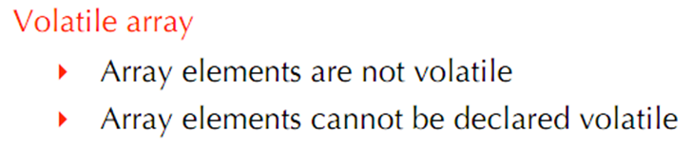
More on volatiles
AtomicIntegerArray or AtomicLongArray, or AtomicReferenceArray
AtomicIntegerArray implements an int array whose slots can be accessed with volatile semantics, via get()/set(). Calling arr.set(x, y) from one thread will then guarantee that another thread calling arr.get(x) will read the value y.

Slide 67
StringBuffer, StringBuilder
Scenario: you want to modify a string. You know already StringBuffer and StringBuilder. No difference between them?
If the (mutable) string will be shared between threads,
then use the StringBuffer class:
• you’re sure that the string is updated correctly,
• ...but the methods may execute slower.
If the (mutable) string will NOT be shared between threads,
use the StringBuilder class:
• no overhead of synchronization → faster.

Slide 68
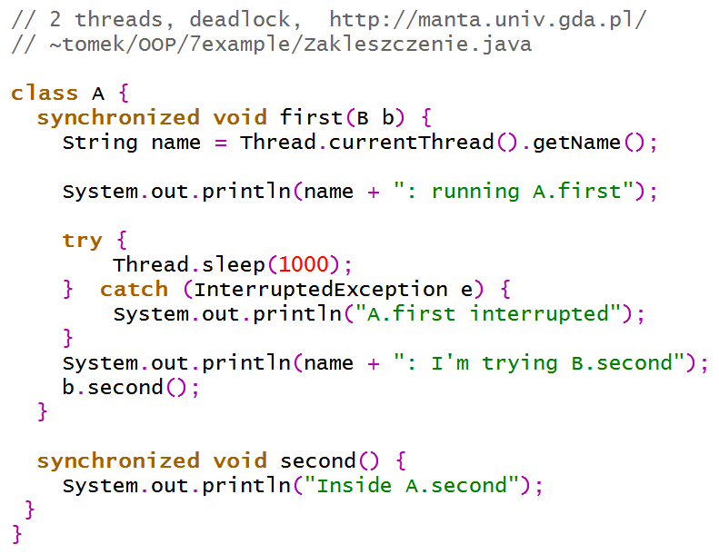
Deadlock example (1/3)

Slide 69
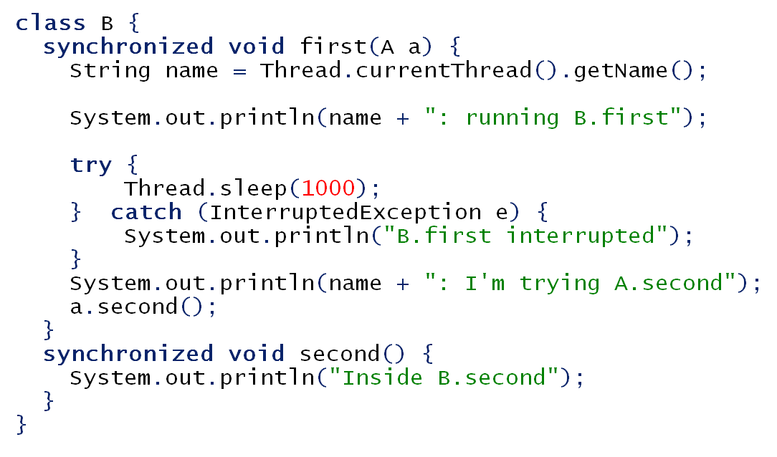
Deadlock example (2/3)

Slide 70
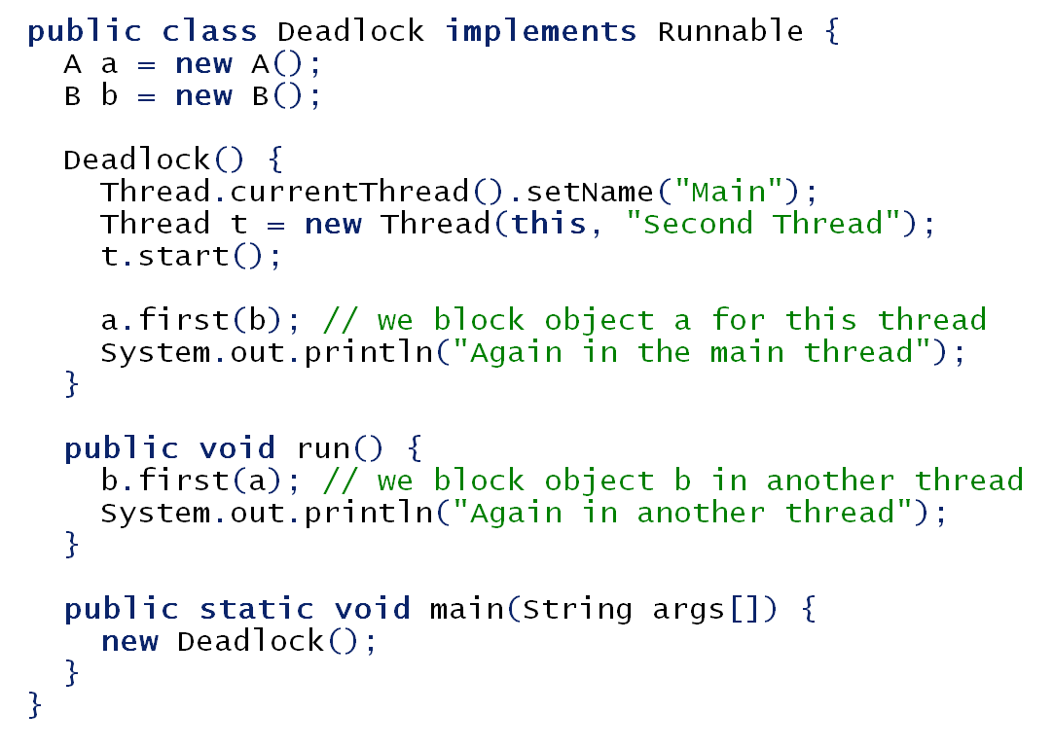
Deadlock example (3/3)

Slide 71
java.util.concurrent (since Java 1.5)
It is hard to write multi-threaded apps… …especially if the number of threads is large (SCALED concurrency!).
The package java.util.concurrent introduced many useful classes, for
separation of threads and tasks,
thread pools handled by executors,
effective locks,
blocking queues,
concurrent collections,
atomic types,
and more.

Slide 72
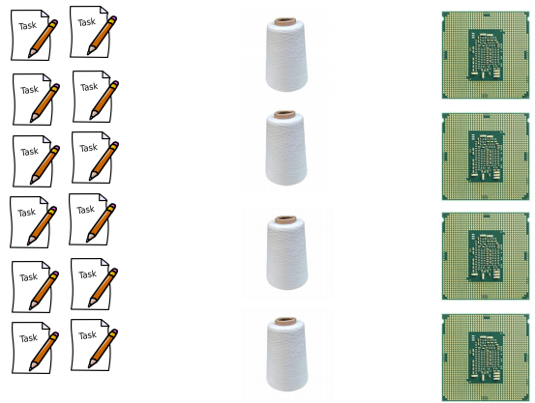
Separate tasks from threads
A task is something to do.
A thread is a unit of processing (smth physical, not conceptual), a technical detail…
public interface Executor {
void execute(Runnable r);
}
Implementations of interface Executor should create and run threads. They will follow some general strategy (e.g., max number of threads in a pool can be specified).
Often there are (much) more tasks than threads which run them.
The picture from: Thomas Dybdahl Ahle, Practical Concurrent and Parallel Programming 5, 2019.

Slide 73
Executors class
We don’t have to create our own Executor classes (i.e. classes implementing the interface Executor). Instead, we can made use of ready-made executors, produced by static factory methods from Executors (they create objects implementing ExecutorService).
Executors.newSingleThreadExecutor() runs the given tasks one by one (one thread at a time); unlike the otherwise equivalent newFixedThreadPool(1) the returned executor is guaranteed not to be reconfigurable to use additional threads
Executors.newFixedThreadPool(…) given thread pool size (if more tasks, they’ll wait in a queue)
Executors.newCachedThreadPool() dynamic (=variable-size) thread pool; will reuse previously constructed threads when available

Slide 74
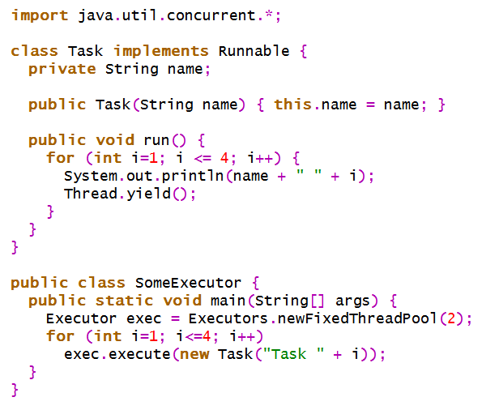

Executors in action, example [ http://edu.pjwstk.edu.pl/wyklady/zap/scb/W8/W8.htm ]

Slide 75
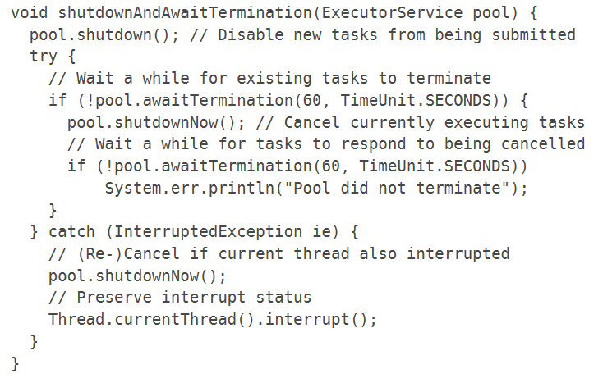
ExecutorService (which extends Executor)
shutdown() method (in ExecutorService interface) – the object will reject new tasks (but won’t close the currently run ones)
https://docs.oracle.com/en/java/javase/16/docs/api/java.base/java/util/concurrent/ExecutorService.html

Slide 76
Callable tasks
Sometimes we wish to deal with tasks returning values (or possibly throwing exceptions, when needed).
public interface Callable<V> { V call() throws Exception }
Something like Runnable, but with two major differences:
returns a value,
may throw a (checked) exception.

Slide 77
Future<V> [ http://download.oracle.com/javase/6/docs/api/java/util/concurrent/Future.html ]
A Future represents the result of an asynchronous call (computation).
There are methods to check if the computation is complete (isDone()), to wait until it is complete (get(long timeout, TimeUnit unit)), to get its result (get()).
Method cancel is also provided (won’t work once the computation was completed).

Slide 78
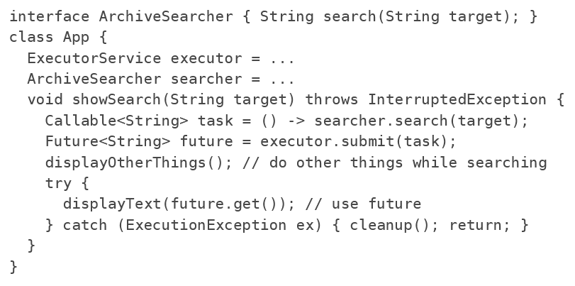
Future example [ https://docs.oracle.com/en/java/javase/16/docs/api/java.base/java/util/concurrent/Future.html ]
(The following classes are all made-up.)
The FutureTask class is an impl. of Future that implements Runnable, and so may be executed by an Executor. For ex., the submit construction could be replaced by: FutureTask<String> future = new FutureTask<>(task); executor.execute(future);

Slide 79
Problem with Future (solution from Java 8) [ http://www.deadcoderising.com/java8-writing-asynchronous-code-with-completablefuture/ ]
The method get(…) in Future is blocking. This doesn’t fit nicely asynchronous computation.
public class CompletableFuture<T>
extends Object
implements Future<T>, CompletionStage<T>
Simplest example:
CompletableFuture.supplyAsync(this::sendMsg);
supplyAsync takes a Supplier containing the code we want to execute asynchronously — in our case the sendMsg method.

Slide 80
CompletableFuture, cont’d
Now let’s add a callback where we notify about how the sending of the message went:
CompletableFuture.supplyAsync(this::sendMsg)
.thenAccept(this::notify);
In this way, we say what should happen when an async computation is done without waiting around for the result.
thenAccept is one of many ways to add a callback. It takes a Consumer (e.g., notify) which handles the result of the preceding comput. when done.
CompletableFuture.supplyAsync(this::failingMsg)
.exceptionally(ex -> new Result(Status.FAILED))
.thenAccept(this::notify);
exceptionally gives a chance to recover by taking an alternative function to be called if preceding calculation fails with an exception.

Slide 81
Task features [ http://edu.pjwstk.edu.pl/wyklady/zap/scb/W8/W8.htm ]
must allow for async execution in a separate thread – i.e., must be Runnable,
must be separable from its thread (separation of concerns) – executors handle that,
its results must be available (return value, info if / what exception was thrown, info if the task was cancelled during execution or removed from the queue before its execution start) – i.e., must be Future, its code must be Callable,
there must be a way to cancel / break it (not ‘touching’ a thread directly) – i.e., must be Future.

Slide 82
FutureTask [ http://edu.pjwstk.edu.pl/wyklady/zap/scb/W8/W8.htm ]
So, a task is an object implementing the interfaces Runnable and Future, and its code is in the method call() of a class implementing the interface Callable.
FutureTask class is provided, to wrap a Callable or Runnable object. It has methods get(), get(…), cancel(…), done(…), set(…) and more.
FutureTask implements Runnable. Because of that it can be submitted to an Executor for execution.

Slide 83
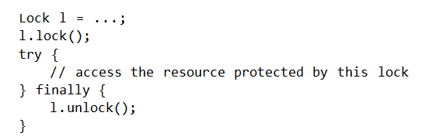
Lock interface [ http://download.oracle.com/javase/6/docs/api/java/util/concurrent/locks/Lock.html ]
3 classes in java.util.concurrent.locks to implement Lock interface: ReentrantLock, ReentrantReadWriteLock.ReadLock, ReentrantReadWriteLock.WriteLock.
Common idiom:

Slide 84
Why (a class implementing) Lock is better than synchronized?
more readable code,
(possibly) more effective in highly concurrent cases,
may be passed to methods / constructors,
may be locked / unlocked in different methods (but by the same thread) – impossible with synchronized;
tryLock() method – if another thread is in the critical region, our thread may do smth else instead of blocking;
tryLock(long, TimeUnit) – to attempt the lock with timeout.

Slide 85
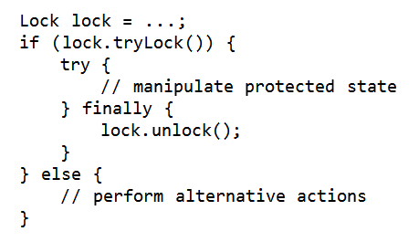
tryLock() example [ https://docs.oracle.com/javase/8/docs/api/java/util/concurrent/locks/Lock.html ]
boolean tryLock():
acquires the lock only if it is free at the time of invocation (and returns true)

Slide 86
CyclicBarrier
CyclicBarrier class is a barrier (=synchronization mechanism) that all threads must wait at, until n threads reach it, before any of the threads can continue.
Create a cyclic barrier:
CyclicBarrier barrier = new CyclicBarrier(3);
or
CyclicBarrier barrier = new CyclicBarrier(3, r);
// r is a Runnable (action) executed after // the last (of 3) thread arrives
How a thread waits at a CyclicBarrier:
barrier.await();
or: barrier.await(5, TimeUnit.SECONDS);
See example: http://tutorials.jenkov.com/java-util-concurrent/cyclicbarrier.html

Slide 87
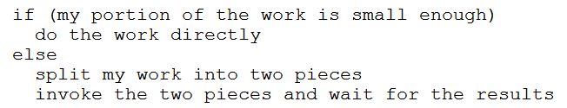
Fork/Join framework
The fork/join framework is an implementation of the ExecutorService interface that helps us take advantage of multiple processors. It is designed for work that can be broken into smaller pieces recursively.
Work-stealing idea: worker threads that run out of things to do can steal tasks from other threads that are still busy.
http://docs.oracle.com/javase/tutorial/essential/concurrency/forkjoin.html

Slide 88
4 main Fork/Join classes (from java.util.concurrent)
ForkJoinPool: we create exactly one of these to run
all your fork-join tasks in the whole program
RecursiveTask<V>: we run a subclass of this in a pool
and have it return a result
RecursiveAction: just like RecursiveTask
except it does not return a result
ForkJoinTask<V>: superclass of RecursiveTask<V> and RecursiveAction,
fork and join are methods defined in this class.
We won’t use this class directly, but it is the class with most of the useful javadoc documentation
http://homes.cs.washington.edu/~djg/teachingMaterials/grossmanSPAC_forkJoinFramework.html

Slide 89
Basic syntax
RecursiveTask<V> has an abstract method V compute(), which is often not called directly (in a concrete class extending RecursiveTask<V>), but is called by method fork().
After our ForkJoinTask subclass (i.e., a subclass of RecursiveTask<V> or RecursiveAction) is ready, we create the object that represents all the work to be done and pass it to the invoke() method of a ForkJoinPool instance.

Slide 90
Basic syntax, cont’d
The idea is that our compute method can create other
RecursiveTask objects and have the pool run them in parallel.
First we create another object. Then we call its fork method.
That actually starts parallel computation – fork itself
returns quickly, but more computation is now going on.
When you need the answer, you call the join method on
the object you called fork on.
The join method will get you the answer from compute()
that was figured out by fork.
If it is not ready yet, then join will block
(i.e., not return) until it is ready.
So the point is to call fork “early” and call join “late”,
doing other useful work in-between.
http://homes.cs.washington.edu/~djg/teachingMaterials/grossmanSPAC_forkJoinFramework.html

Slide 91
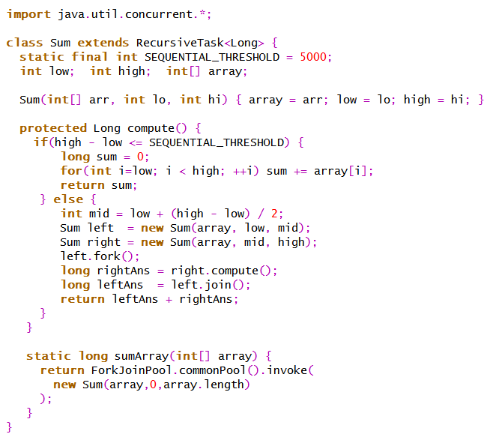
Simple example
http://homes.cs.washington.edu/~djg/teachingMaterials/grossmanSPAC_forkJoinFramework.html

Slide 92
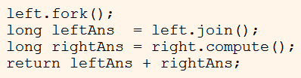
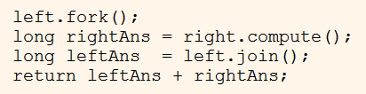
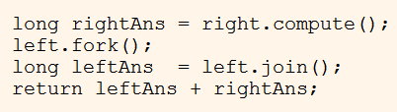
Remember that calling join blocks until the answer is ready!
So, which of the following 3 code orders is correct?
no parallelism! since each step would completely compute the left before starting to compute the right
correct!
no parallelism! since each step would completely compute the right before starting to compute the left

Slide 93
Structured concurrency API (Java 19+, preview)
StructuredTaskScope supports cases where a task splits into several concurrent subtasks, to be executed in their own threads, and where the subtasks must complete before the main task continues.
Response handle() throws ExecutionException, InterruptedException {
try (var scope = new StructuredTaskScope.ShutdownOnFailure()) {
Future<String> user = scope.fork(() -> findUser());
Future<Integer> order = scope.fork(() -> fetchOrder());
scope.join(); // Join both forks
scope.throwIfFailed(); // ... and propagate errors
// Here, both forks have succeeded, so compose their results
return new Response(user.resultNow(), order.resultNow());
}
}

Slide 94

Dining philosophers

Slide 95
Other static methods from Thread
static Thread currentThread() –
returns the object representing the currently running thread
static int enumerate(Thread[] threadArray) –
copies into the specified array every active thread in the current thread’s thread group and its subgroups. Returns the number of threads put into the array
static int activeCount() –
returns the number of active threads in the
current thread’s thread group
J. Bloch, Effective Java, item 73: (…) thread groups are obsolete. (…) If you design a class that deals with logical groups of threads, you should probably use thread pool executors.

Slide 96
Thread priorities
A thread priority is an int from Thread.MIN_PRIORITY (currently 1) to Thread.MAX_PRIORITY (currently 10).
Higher priority – accessing the CPU more often.
Methods from class Thread():
void setPriority(int pr); int getPriority();

