Slide 1
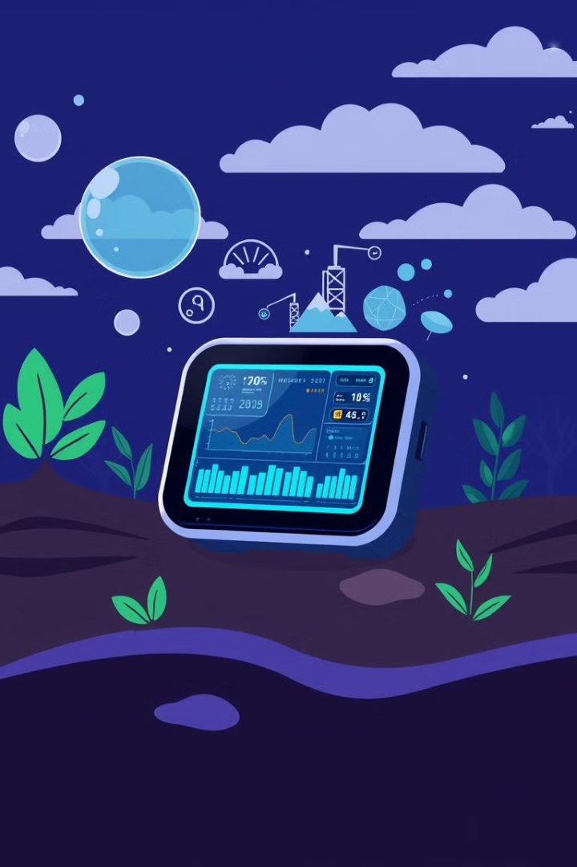
IoT-Based Environmental Monitoring with Linux Local Web Server
This presentation explores the development and implementation of a robust IoT-based environmental monitoring system utilizing a local Linux web server for data storage and visualization.
DP
by Datt Panchal

Slide 2
Overview: Real-Time Monitoring and Local Data Storage
Objective
Features
Real-time monitoring of environmental conditions such as temperature, humidity, air quality, and other relevant parameters.
Secure local data storage, eliminating reliance on external cloud services, and ensuring data privacy and reliability.

Slide 3
Architecture: A Connected System
Sensors
1
Environmental sensors gather data on various parameters, providing real-time insights.
2
ESP8266
The microcontroller gathers data from sensors, processes it, and transmits it to the server.
Server
3
The local server receives data from the microcontroller, stores it in the database, and serves web pages for visualization.
4
Database
A dedicated database stores all collected sensor data for analysis and retrieval.
Visualization
5
Web pages display real-time and historical data, providing user-friendly access to environmental information.

Slide 4
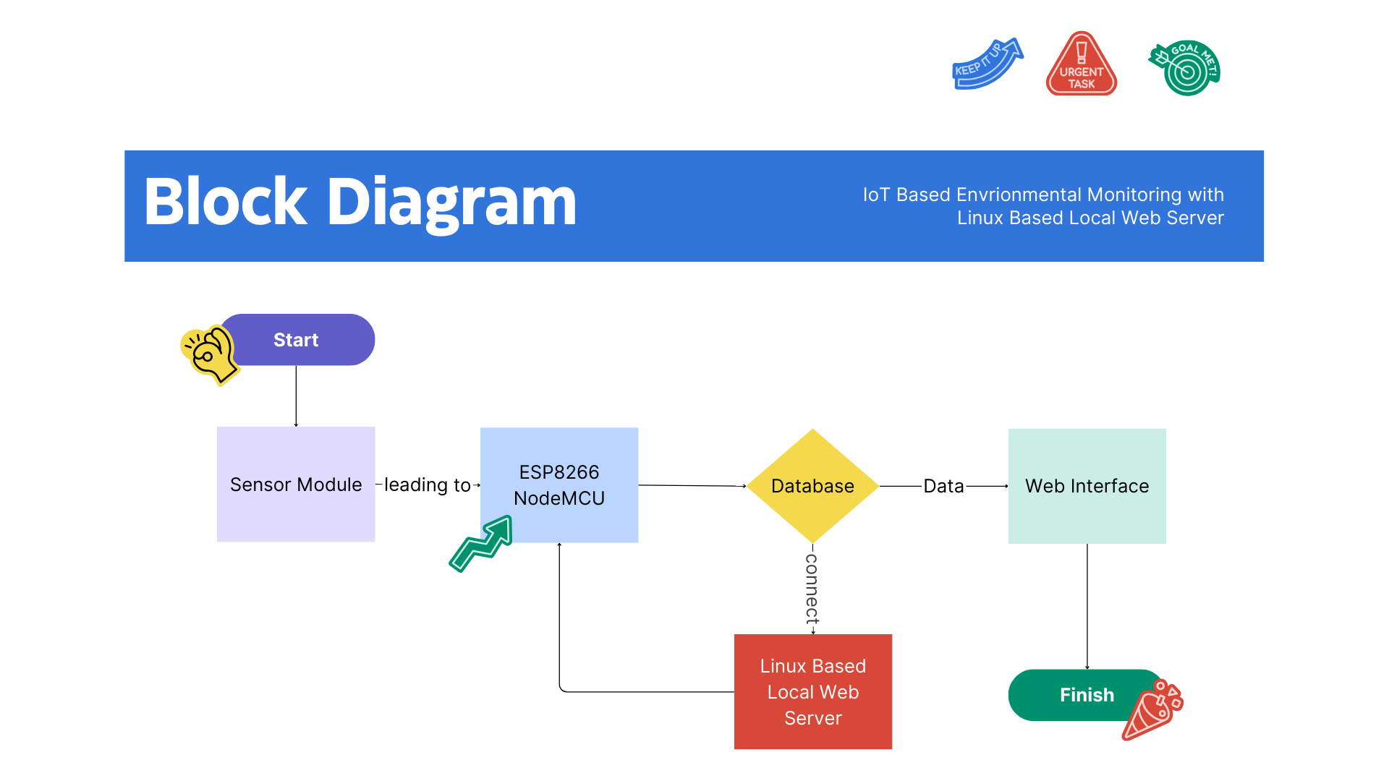

Slide 5
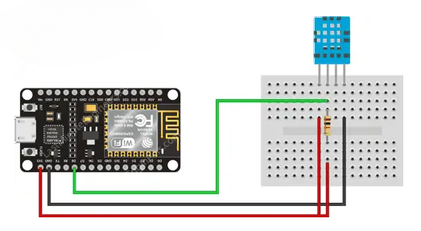
Circuit Diagram

Slide 6



Sensor Integration: Expanding Capabilities
Temperature
Measure ambient temperature to monitor heat levels and identify potential anomalies.
Humidity
Monitor humidity levels to track moisture content and assess potential risks or favorable conditions.

Slide 7

Setup: Apache2 and MySQL Database Integration
Apache2
MySQL
The web server is installed and configured to serve web pages and handle data requests.
The database is installed, configured, and tested to ensure secure and efficient data storage and retrieval.

Slide 8
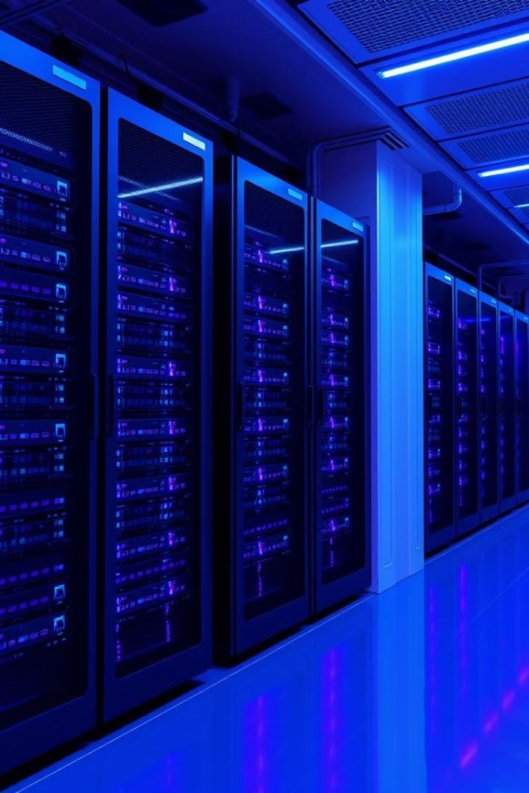
MySQL Database
Creation
Data Insertion
The dedicated database is created to store and manage environmental data effectively.
Testing data insertion ensures the database's functionality and ability to handle incoming sensor readings.
Retrieval
Testing data retrieval verifies the ability to access and retrieve stored data for visualization and analysis.

Slide 9
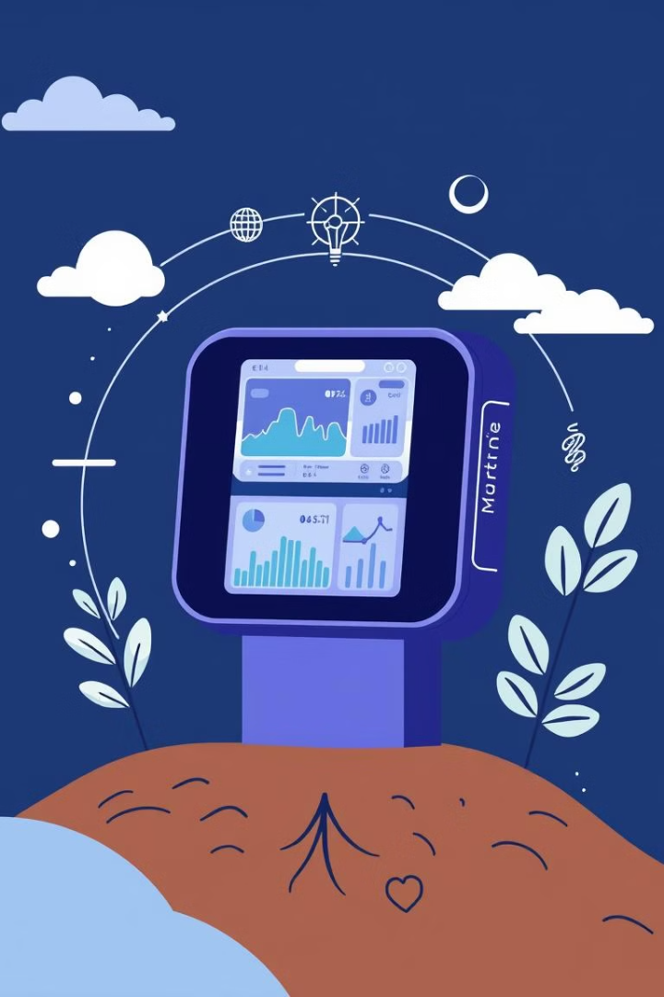



Interaction: Data Flow and Presentation
Data Transmission
Data Storage
Sensors send data to the server via PHP, ensuring efficient data exchange and processing.
The server receives data, stores it in the database, and prepares data for web visualization.
Web Display
Data is presented on a responsive HTML table for user-friendly access and real-time insights.

Slide 10
Thank you

