Slide 1

Theme : Intelligent Post-Lock Down Management System For Public Transportation
IBM Hack Challenge 2020
IBM
Team Name : Immutable Coders

Slide 2

Problems Faced due to Covid-19 Pandemic
Post-Lockdown, it will be risky to allow the public transportation without proper mechanism to maintain the social distancing, especially the frequency of buses, trains and metros shall be managed properly to utilize the capacity with social distancing criteria. The transport authorities must integrate to maintain the system properly. People need to be aware about the effects of Covid-19 and take necessary precautions while travelling. Moreover, they must be aware about the recent guidelines generated by the Govt. Of India.

Slide 3
Proposed Solution
During this pandemic the major risk for the spread can be through the use of public transports:
So our Solution focuses on avoiding the over-occupancy of public transport / bus stations / railway stations.
Our idea is to schedule the timing of passenger's arrival on the basis of their ticket class , for instance we can have a nominal gap in the arrival time of passengers of the 3.Ac, 2.AC and sleeper class resulting in the reduction in the crowd at the stations .
All valid ticket holders will have to pass through the check in procedures on our app where they will have to submit ticket number and Adhaar Card / or any other document valid by Government of India/state which will subsequently generate QR-CODE on user's phones that is valid for some time after verifying the Adhaar Number using Adhaar API .
Further , There will be two designated spaces/waiting areas where the passengers will report according to odd or even number based upon the last digit of your ticket number.
The scanning of QR-CODE will avoid the direct contact of authorities at stations and will eliminate TT or Bus Conductor avoiding direct contact. The said QR_CODE will allow your entry into the waiting areas before boarding. Reporting pattern will be allotted at the time of check in.

Slide 4
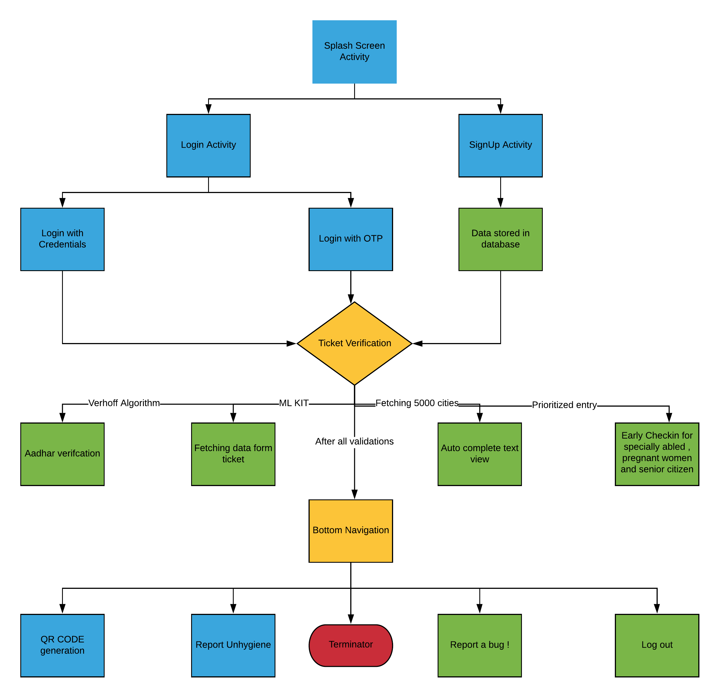
Application Flow Chart

Slide 5
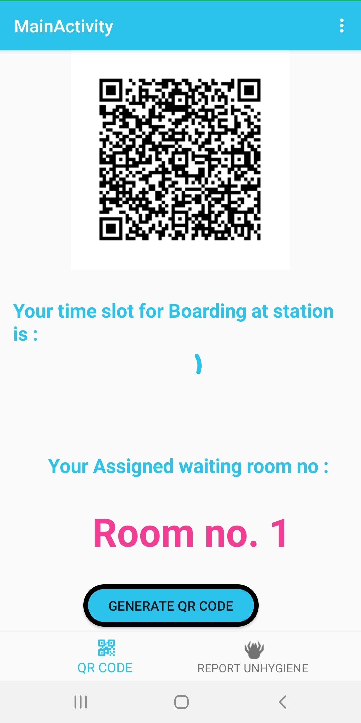
Advantages
1. Generation of QR Code
Checking/Scanning of ticket through QRCode to avoid physical contact between people. Firstly, user shall be asked to upload an image of his confirmed ticket for travel, then using ml kit, the app will fetch extract necessary details and a QR-code will be generated, which shall be scanned at the railway station at the time of boarding. The app aims at maintaining social distancing principle for the safety of passengers, which is the most important thing to be taken care of so that passengers feel safe during their travel. QRCode scanning shall avoid physical contact between people as the physical validation of all the tickets might put their life to risk.

Slide 6
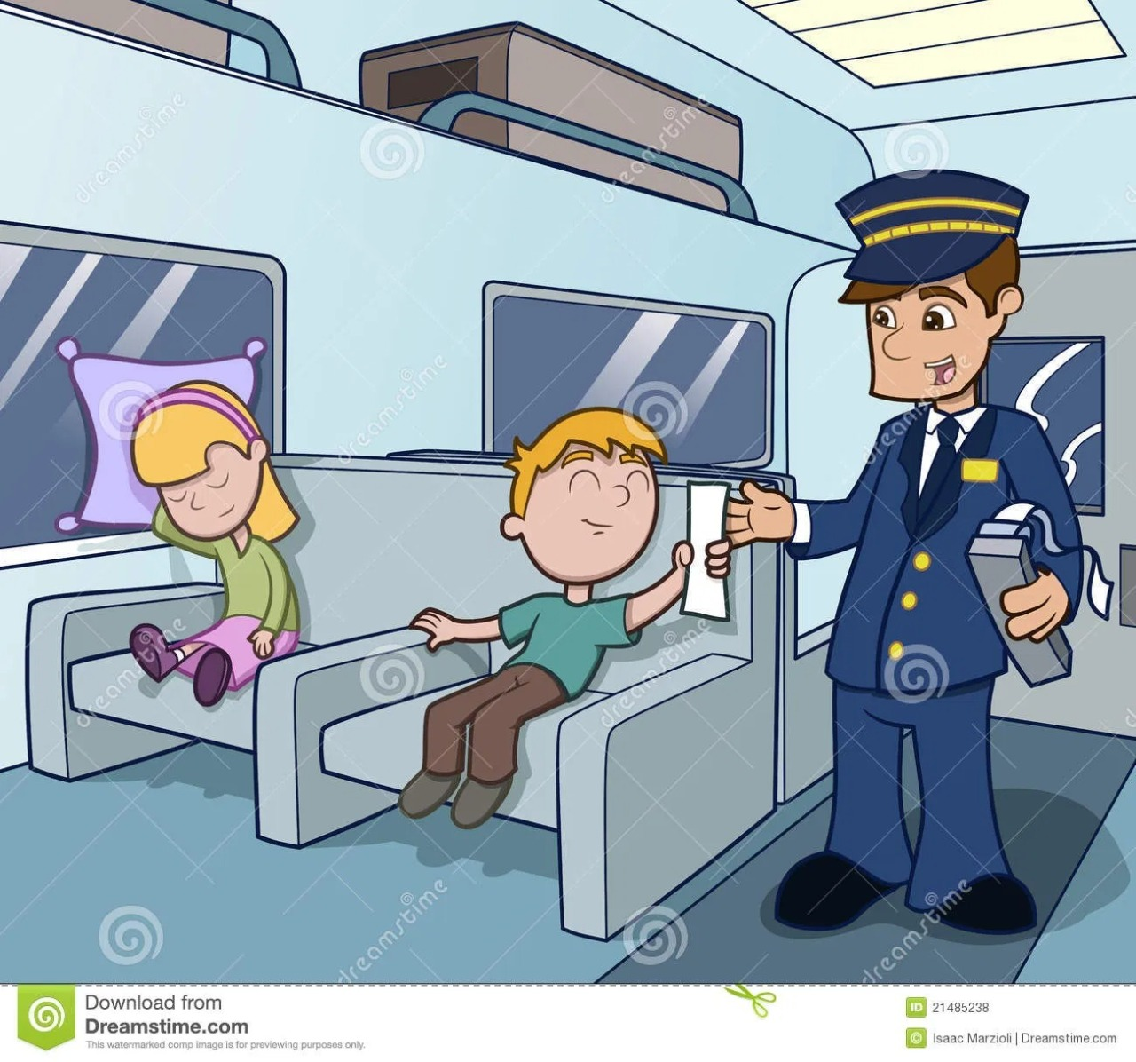
2. Generation of QR Code
No checking of tickets inside train. The application is intended to provide all validations required. This will avoid ticket collector (TT) to manually go and check the tickets of all passengers as the user's will have already been verified at the time of boarding.
3. Used for All Public Transport Methods
The app can further be extended to operate for buses and metros operating in the Country. With a bit modification in code, the same idea can be implemented in case of metros and buses to ensure safe travel.

Slide 7
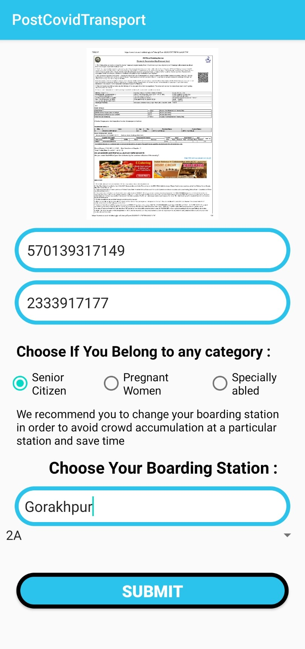
4. Fetching Data Using ML
The application enables the user to upload the reserved ticket of travel and recognizes the ticket number and verifies other credentials using text recognition facility provided by ML kit. The text is fetched using onDeviceTextRecognition() method provided by ml.
5. Special Priorities
Special provision is there for senior citizens and women passengers. They are given priority and are provided the earliest time slot for their convenience because the elderly require special care.

Slide 8
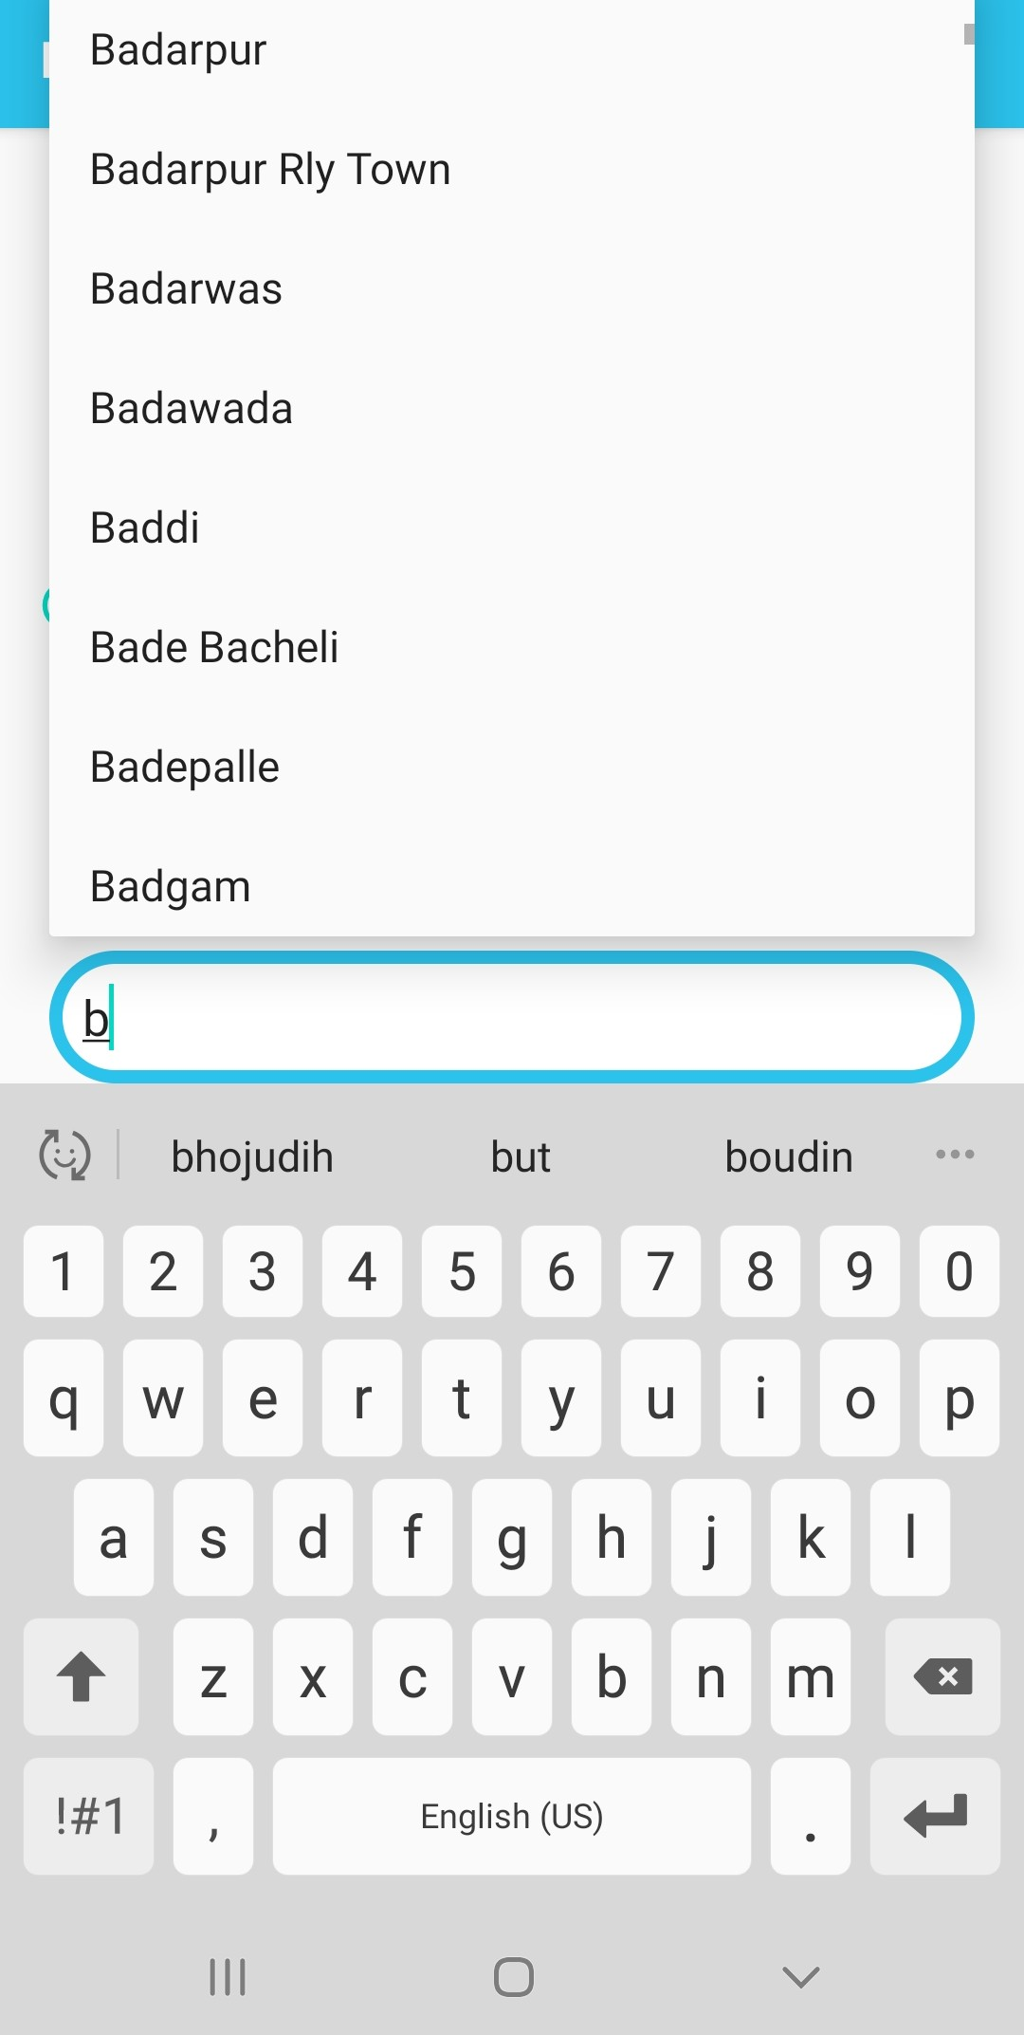
6. Allotment of Waiting Rooms At Station Premises
Proper waiting rooms will be allotted to the user based on Odd-even algorithm. The passengers can wait for their turn to board the train in waiting rooms if they have reached the railway station before their allotted time and the rooms shall be sanitized from time to time by the railway authorities.
7. Changing Boarding Station
Facility provided to change the boarding station as per the convenience of user. Passenger is given an option of changing the boarding station as per his convenience and also to avoid crowd accumulation at a particular station.

Slide 9
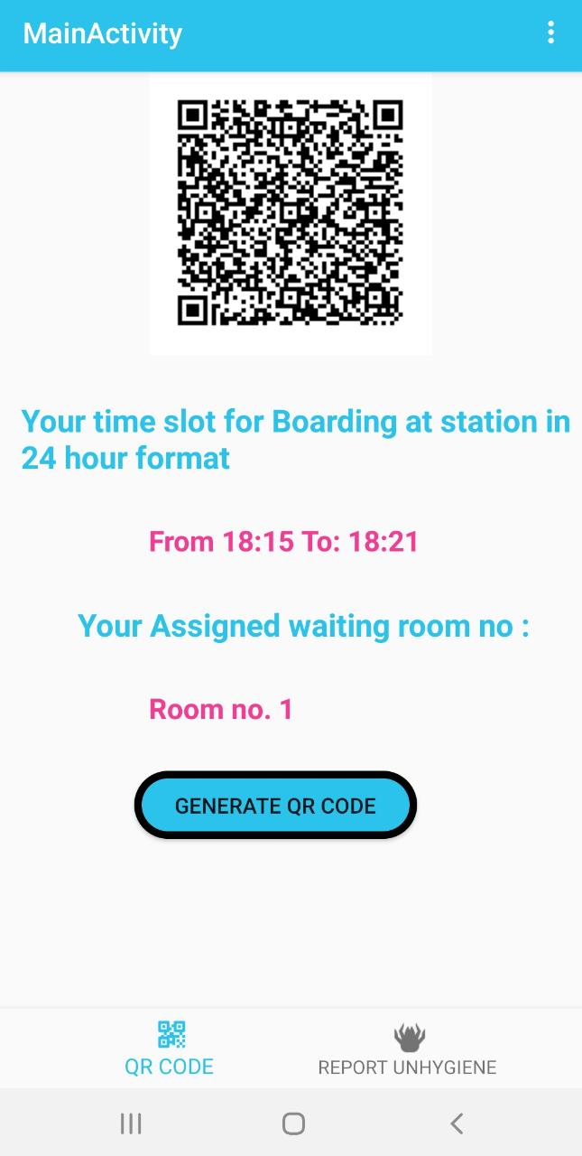
8. Proper Time Management
Proper Time Slots are provided to passengers for boarding the train based upon the class in which they are going to travel. The arrival and departure timings of trains are fetched from live api and the time slots are allotted to users. Even the user can get the train timings for all the stations that are included in train's stoppage.

Slide 10
Features
The application is intended to be used in Railway station for the safe transportation of people who want to travel to other cities. No checking of tickets inside train.
The application is intended to provide all validations required. This will avoid ticket collector (TT) to manually go and check the tickets of all passengers as the user's will have already been verified at the time of boarding.
The app can further be extended to operate for buses and metros operating in the Country. With a little bit modification in code, the same idea can be implemented in case of metros and buses to ensure safe travel.
The application designed by us supports minimum API Level: 26, i. e android version 8 & above. Therefore the number of users targeted by the application is around 85% of the mobile devices running on android operating system.

Slide 11
Future Scope
The application can further be extended to operate for buses and metros as well operating in the Country. With a little bit modification in code like ( fetching particular details from ticket uploaded using Firebase's ondeviceTextRecognition() method, fetching cities at which buses operate etc) , the same idea can be implemented in case of metros and buses to ensure safe travel.
Firebase's Face recognition can be later used to identify.
Artificial Intelligence based Chat bot using IBM services can be incorporated to provide resolve petty issues and doubts of the passengers.
The application can be later developed for IOS Users as well

Slide 12
Conclusion
At last , We Thank IBM for given us an opportunity to showcase our skills in the IBM Hack-Challenge 2020. It has been a great experience to make an Android Application for Post-Lockdown Transport System Management.The Online Bootcamps were very informative and we got to learn about Node-Red and other IBM Technologies. The Courses provided were also very informative and helped us earn badges.

Slide 13

Thank You.
IBM
Immutable Coders
8557024411
immutablecoders@gmail.com

