Slide 1
Knowledge Transfer Workshop
Overview
09/09/2024

Slide 2
Agenda
Architecture
Data Source
Data Flow & Layers
      Source to Raw DLT / Source to Raw
      Raw to Standardised (includes ODA)
      Standardised to Conformed (includes BED)
      Conformed to DW (Dim -> Bridge -> Fact)
Metadata Usage and Task Overlap
Metadata Tables (Config & Audit)
Load Schedules
Orchestration
Reconciliation
Pull Requests & Release Pipelines
Catalogs and Squads

Slide 3
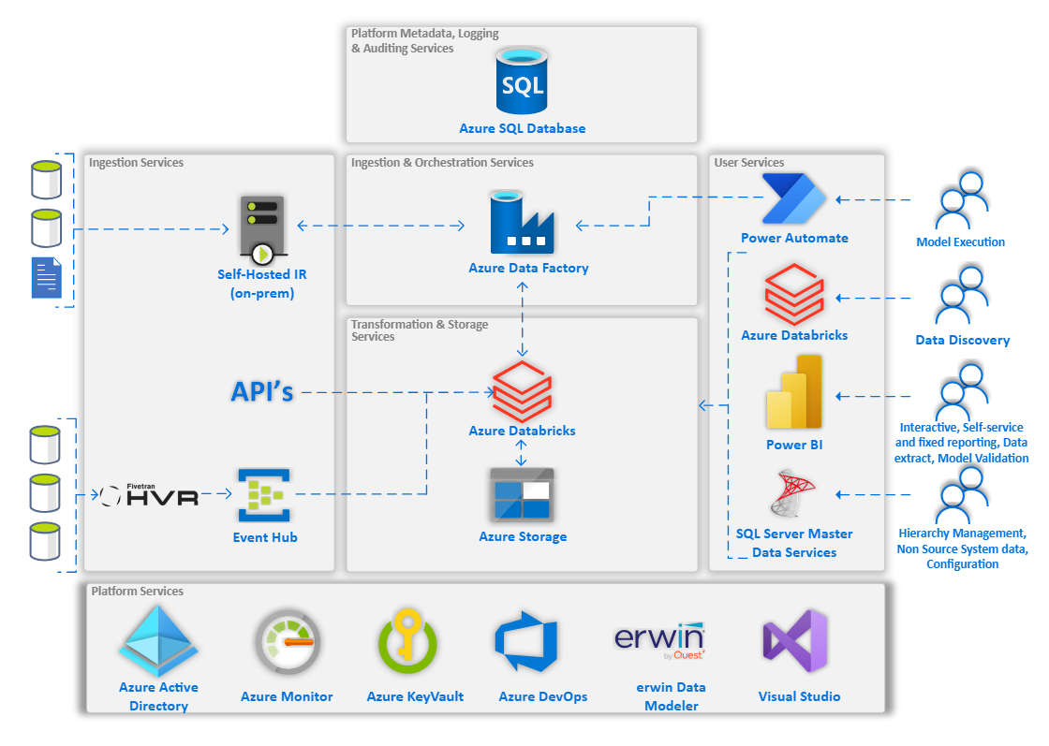
Architecture

Slide 4
Data Sources
Source Name | Source Platform | Frequency | Subject Area
Subscribe | Database (HVR) | Twice a day | London Inwards Policy
Elgar | Database (HVR) | Twice a day | Outwards Policy
RI (Split & Spreadsheet) | Flat Files | Adhoc | Re-Insurance
FX (Oanda API & Files) | API & Flat Files | Daily & Adhoc | Exchange Rate
MDS | Database | Daily | Master Data Service
Bordereaux (Intrali & Viper) | Database | Daily | Bordereaux
Overseas | Database | Daily | Inwards Policy (OVerseas)

Slide 5
Data Flow
Subscribe
Intralli
CDC
Elgar
Exchange Rate
Raw
Conformed
DW
(Dimension, Bridge, Fact and Reporting)
Standardised
RI Split & Excel
Table
View
Overseas
MDS
Ingestion (ADF + ADB + ADLS)
  Full data extraction
  Full data extraction
  Data extraction based on Batch Effective Date
  Data extraction based on Batch Effective Date
  Each time, raw table gets truncated & loaded
  History maintenance via SCD Type 2
  History maintenance via SCD Type 2
  History maintenance via SCD Type 2
  CDC is not yet implemented
  Soft Deletion of deleted records
  Soft Deletion of deleted records
  Inactivation of deleted records
  1:1 column level mapping, no change in PK
  1:1 column level mapping, no change in PK
  High level data transformation (eg unpivot)
  Business specific transformation, PK is not same

Slide 6
Source To Raw DLT (CDC using HVR)
HVR Hub
Views
Supported Platform
Scheduler
Hive DLT
Catalog 1
HVR Jobs
Event Hub
HVR Agent
Logs & Reuter Files
Unit Catalog DLT
Catalog N
For more information, please refer to excel document - CDC_Details.xlsx

Slide 7
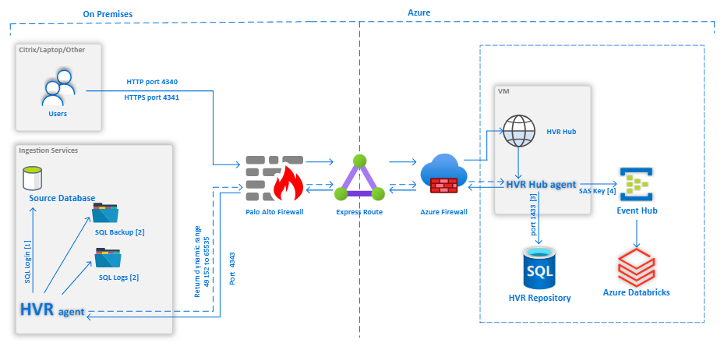
Source To Raw DLT (CDC using HVR)

Slide 8






Source To Raw (Non HVR)
ADLS
SQLDB (Metadata)
  Looks for active Batch in SQLDB
  Truncate the table in raw
  Loads the data in delta table
  Update the object date availability for raw tables
  Calls the procedure usp_get_object_connectionStringDetails
  Update the log tables
  This procedure generates a where_clause

Slide 9
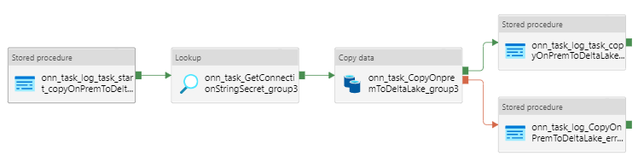
Source To Non HVR Raw
Summary:
“onn_task_GetConnectionStringSecret_grou” Activity – calls SQLDB procedure, usp_get_object_connectionStringDetails that helps generates a connection string in order to connect to the on premises source. It also updates where clause to “Full_Refresh”
“onn_task_CopyOnpremmToDeltaLake_group3” Activity – Establishes connecting using connecting string, truncates the target table and loads data in raw table
“onn_task_log_task_copyOnPremToDeltaLakeend_group” Activity – calls SQLDB procedure, usp_log_sql_task_end which further calls procedure, usp_mark_dates_loaded. This activity thus helps to update tbl_object_dates_availability to mark a batch_task_id for an object (raw) as loaded

Slide 10
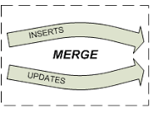

Raw To Standardised
ADLS
SQLDB (Metadata)
  Looks for active Batch in SQLDB
  Fetches data based on entries in object dates availability
  Loads the data in delta table
  Update the object date availability for standardised tables
  Calls notebook load_scd2withdelete_dbdt_dbdt
  This helps to filter only for new data from Raw
  Update the log tables
  Update the log tables
  Apply the merge statement - insert, update & soft delete

Slide 11
Incremental Filter – Raw & Standardised
Batch Task Id | Input Object | Output Object | Input DateTime From | Input DateTime To | Output DateTime From | Output DateTime To
1001 | dbo.PolMain | Raw.dbo_PolMain | 2000-01-01 00:00:01.000 | 2022-04-29 09:09:34.500 | 2000-01-01 00:00:01.000 | 2022-04-29 09:09:34.500
1002 | Raw.dbo_PolMain | Std.dbo_PolMain | 2000-01-01 00:00:01.000 | 2022-04-29 09:09:34.500 | 2000-01-01 00:00:01.000 | 2022-05-09 16:19:31.043
2001 | dbo.PolMain | Raw.dbo_PolMain | 2022-04-29 09:09:34.500 | 2022-05-10 15:10:04.987 | 2022-04-29 09:09:34.500 | 2022-05-10 15:10:04.987
2002 | Raw.dbo_PolMain | Std.dbo_PolMain | 2022-04-29 09:09:34.500 | 2022-05-10 15:10:04.987 | 2022-05-12 08:40:01.282 | 2022-05-12 08:40:01.282
To understand the oda population of conformed, please refer to the excel document - Example-Object_Dates_Availability.xlsx

Slide 12
Raw To Standardised (Merge)
Sr. | Scenario | Outcome | Description
1 | A new record comes from Raw table that does not exist in standardised Eg: HBK = 1, HV = 1, LCT = D1 | Record gets inserted as new and active record in standardised Eg: HBK = HBK1, HV = HV1, VF = D1, VT = NULL, DT = NULL | New record get inserted
2 | A record (existing in Standardised) comes from Raw with some updates Eg: HBK = 1, HV = 2, LCT = D2 | Existing active record marked as inactive Record gets inserted as new and active record in standardised Eg: HBK = HBK1, HV = HV1, VF = D1, VT = D2, NULL, DT = NULL HBK = HBK1, HV = 2, VF = D2, VT = NULL, DT = NULL | Existing record closed, updated record inserted
3 | A record (existing in Standardised) comes from Raw with no updates Eg: HBK = 1, HV = 2, LCT = D3 | No change in Standardised table Eg: HBK = HBK1, HV = HV1, VF = D1, VT = D2, NULL, DT = NULL HBK = HBK1, HV = HV2, VF = D2, VT = NULL, DT = NULL | No impact on existing dataset
4 | A record (existing in Standardised) doesn’t appear in Raw | Existing Record gets updated with DTS in standardised Eg: HBK = HBK1, HV = HV1, VF = D1, VT = D2, NULL, DT = NULL HBK = HBK1, HV = HV2, VF = D2, VT = NULL, DT = D4 | Existing active record marked as deleted
5 | Same record (mentioned step 4) re-appears in Raw Eg: HBK = 1, HV = 2, LCT = D5 | Existing active record marked as inactive Record gets inserted as new and active record in standardised Eg: HBK = HBK1, HV = HV1, VF = D1, VT = D2, NULL, DT = NULL HBK = HBK1, HV = HV2, VF = D2, VT = D5, DT = D4 HBK = HBK1, HV = HV2, VF = D5, VT = NULL, DT = NULL | Existing active record marked as inactive, new active record inserted

Slide 13

Standardised To Conformed
ADLS
SQLDB (Metadata)
  Looks for active Batch and BED in SQLDB
Fetches data based on entries in object dates availability
  Apply the merge statement - insert, update & soft delete
  Loads the data in delta table
  Update the object date availability for conformed tables
  Calls custom notebook for individual entity
  This helps to filter only for new data from standardised
  Merge joins are done on Partition Key and HBK
  Update the log tables
  Update the log tables
  Custom SQL helps to fetch data as per target structure
  BED filter is applied in custom SQL Notebook
  NULLs are assigned to respective DEFAULT values

Slide 14
Standardised To Conformed (Merge)
Sr. | Scenario | Outcome | Description
1 | A new record comes from Standardised table Eg: HBK = 1, HV = 1, VFT = D1, VTT = NULL, DT = NULL | Record gets inserted as new and active record in conformed Eg: HBK = 1, HV = 1, VFT = D1, VTT = NULL, DT = NULL | New record get inserted
2 | A record (existing conformed) comes from standardised with some updates as active Eg: HBK = 1, HV = 2, VFT = D2, VTT = NULL, DT = NULL | Existing active record marked as inactive Record gets inserted as new and active record in conformed Eg: HBK = 1, HV = 1, VFT = D1, VTT = D2, NULL, DT = NULL HBK = 1, HV = 2, VFT = D2, VTT = NULL, DT = NULL | Existing record closed, updated record inserted as active
3 | A record (existing in conformed as active) comes from standardised with some updates as well as lakeDeletedTimestamp Eg: HBK = 1, HV = 3, VFT = D3, VTT = NULL, DT = D3 | Existing active record marked as inactive Record gets inserted as deleted and active record in conformed Eg: HBK = 1, HV = 1, VFT = D1, VTT = D2, NULL, DT = NULL HBK = 1, HV = 2, VFT = D2, VTT = D3, DT = NULL HBK = 1, HV = 3, VFT = D3, VTT = NULL, DT = D3 | Existing record closed, updated record inserted as deleted
4 | A record (existing in conformed as deleted) comes from standardised with some updates as well as lakeDeletedTimestamp Eg: HBK = 1, HV = 4, VFT = D4, VTT = NULL, DT = D4 | Existing active record marked as inactive Record gets inserted as deleted and active record in conformed Eg: HBK = 1, HV = 1, VFT = D1, VTT = D2, NULL, DT = NULL HBK = 1, HV = 2, VFT = D2, VTT = D3, DT = NULL HBK = 1, HV = 3, VFT = D3, VTT = D4, DT = D3 HBK = 1, HV = 4, VFT = D4, VTT = NULL, DT = D4 | Existing record closed, updated record inserted as deleted
5 | A record (existing in conformed as deleted) comes from standardised with some update and as active Eg: HBK = 1, HV = 5, VFT = D5, VTT = NULL, DT = NULL | Existing active record marked as inactive Record gets inserted as new and active record in conformed Eg: HBK = 1, HV = 1, VFT = D1, VTT = D2, NULL, DT = NULL HBK = 1, HV = 2, VFT = D2, VTT = D3, DT = NULL HBK = 1, HV = 3, VFT = D3, VTT = D4, DT = D3 HBK = 1, HV = 4, VFT = D4, VTT = D5, DT = D4 HBK = 1, HV = 5, VFT = D5, VTT = NULL, DT = NULL | Existing record closed, updated record inserted as active

Slide 15
Standardised To Conformed (Merge)
Sr. | Scenario | Outcome | Description
6 | A record (existing in conformed as active) comes from standardised with no change and as active Eg: HBK = 1, HV = 5, VFT = D5, VTT = NULL, DT = NULL | No change in conformed table Eg: HBK = 1, HV = 1, VFT = D1, VTT = D2, NULL, DT = NULL HBK = 1, HV = 2, VFT = D2, VTT = D3, DT = NULL HBK = 1, HV = 3, VFT = D3, VTT = D4, DT = D3 HBK = 1, HV = 4, VFT = D4, VTT = D5, DT = D4 HBK = 1, HV = 5, VFT = D5, VTT = NULL, DT = NULL | No impact on existing dataset
7 | A record (existing in conformed as active) comes from standardised with no change but with some lakeDeletedTimestamp Eg: HBK = 1, HV = 5, VFT = D5, VTT = NULL, DT = D7 | Existing active record marked as inactive Record gets inserted as deleted and active record Eg: HBK = 1, HV = 1, VFT = D1, VTT = D2, NULL, DT = NULL HBK = 1, HV = 2, VFT = D2, VTT = D3, DT = NULL HBK = 1, HV = 3, VFT = D3, VTT = D4, DT = D3 HBK = 1, HV = 4, VFT = D4, VTT = D5, DT = D4 HBK = 1, HV = 5, VFT = D5, VTT = NULL, DT = D7 | Existing record closed, updated record inserted as deleted
8 | A record (existing in conformed as deleted) comes from standardised with no change but with some lakeDeletedTimestamp Eg: HBK = 1, HV = 5, VFT = D8, VTT = NULL, DT = D8 | No change in conformed table Eg: HBK = 1, HV = 1, VFT = D1, VTT = D2, NULL, DT = NULL HBK = 1, HV = 2, VFT = D2, VTT = D3, DT = NULL HBK = 1, HV = 3, VFT = D3, VTT = D4, DT = D3 HBK = 1, HV = 4, VFT = D4, VTT = D5, DT = D4 HBK = 1, HV = 5, VFT = D5, VTT = NULL, DT = D7 | No impact on existing dataset
9 | A record (existing in conformed as deleted) comes from standardised with no change and as active Eg: HBK = 1, HV = 5, VFT = D9, VTT = NULL, DT = NULL | Existing active record marked as inactive Record gets inserted as active record in conformed Eg: HBK = 1, HV = 1, VFT = D1, VTT = D2, NULL, DT = NULL HBK = 1, HV = 2, VFT = D2, VTT = D3, DT = NULL HBK = 1, HV = 3, VFT = D3, VTT = D4, DT = D3 HBK = 1, HV = 4, VFT = D4, VTT = D5, DT = D4 HBK = 1, HV = 5, VFT = D5, VTT = D9, DT = D7 HBK = 1, HV = 5, VFT = D9, VTT = NULL, DT = NULL | Existing record closed, updated record inserted as active

Slide 16
Incremental Filter – Conformed
Apply BED at individual table
Join & Apply object dates availability
Merge into Target
A
Conformed Table
B
C
When we fetch the data from multiple standardised tables, filter of BED is applied on each table. Thus, the data gets restricted in the custom SQL
Based on the source phase dates availability populated for tables A, B & C in standardised layer. A where_clause is generated on partition column taking min & max date of data loaded across three tables.
The source data gets filtered based on where_clause post which it gets inserted, updated or soft deleted in target conformed table

Slide 17
Conformed to DW
ADLS
SQLDB (Metadata)
  Looks for active Batch and BED in SQLDB
Fetches data based on entries in object dates availability
  Apply the merge statement - insert, update & soft delete
  Loads the data in delta table
  Update the object date availability for conformed tables
  Calls custom notebook for individual entity
  This helps to filter only for new data from conformed
  Append Contra and Deletes in Fact
  Update the log tables
  Update the log tables
  Custom SQL helps to fetch data as per target structure
  BED filter is applied in custom SQL Notebook
  NULLs are assigned to respective DEFAULT values

Slide 18
Metadata usage and task overlap​
​ | Raw​ | Standardised​ | Conformed Table​ | Conformed View​ | Dimension/Fact Table​
Description​ | Source specific physical table in databricks holding latest extract from source​ | Source specific physical table in databricks holding all type 2 historical data​ | Source specific physical table in databricks holding all type 2historical data that has been conformed across multiple standardised tables​ | View sitting over source specificconformed tables –should be identicalstructure to warehousestaging table andwarehouse external view​ | ​
Modelled in ERWIN​ | Yes​ | Yes​ | Yes​ | No | Yes​
Creates HBK​ | No​ | Yes | Yes​ | No​ | Yes​
Metadata Object defined (table/view)​ | Yes​ | Yes​ | Yes​ | Yes​ | No​
Metadata Object definition defined (columns)​ | Yes​ | Yes​ | Yes​ | No​ | No​
Metadata Object Primary Key | No​ | Yes​ | Yes​ | No​ | No​
Metadata column to column level mapping​ | Yes​ | Yes​ | No​ | No​ | No​
Metadata type 2 columns defined​ | No | Yes​ | Yes​ | No | No​
Metadata task​ | Yes​ | Yes​ | Yes​ | No​ | Yes​

Slide 19
Metadata Tables (config)
Schema | Table Name | Description
Config | Phase | Phases across which data is being stored eg: Raw, Standardised, Conformed, Dwh (Dim, Bridge &Fact) and Reporting
Config | Source | Sources from which data is being fetched into insights
Config | Schedule | Timing at which various source gets executed across multiple phases
Config | Entity
Config | Schedule_Phase_Entity_Map | Entities that gets loaded when a schedule is triggered across multiple phases
Config | Databricks_Workspace | Databricks workspaces details such as URL, workspace name, resource id and keyvault reference
Config | Databricks_Cluster | Clusters associated with individual catalog workspace
Config | Databricks_Cluster_Schedule | Clusters associated with individual schedules when it gets triggered
Config | Activity | All the notebooks present in insihgts with location at which it is present
Config | Task
Config | Task_Type
Config | Task_Object_Map
Config | Object
Config | Object_Definition
Config | Object_To_Object_Map
Config | Source_Phase_Treshold

Slide 20
Metadata Tables (audit)
Schema | Table Name | Description
Audit | Batch
Audit | Batch_Task
Audit | Error_Log
Audit | Object_Dates_Availability
Audit | Source_Phase_Dates_Availability

Slide 21
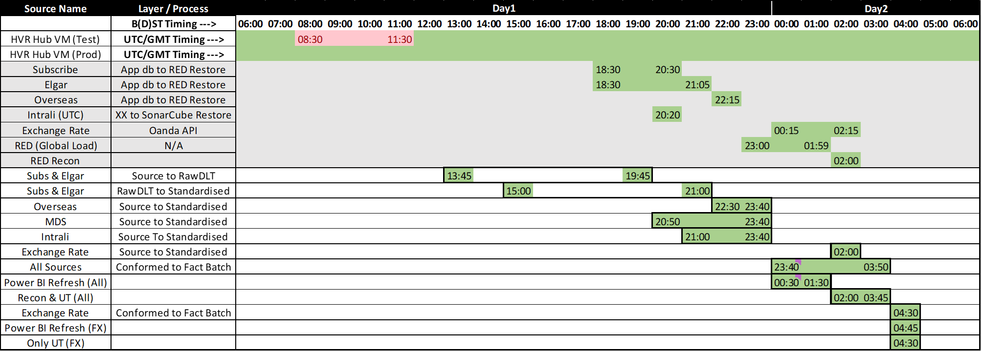
Load Schedules

Slide 22
Orchestration Overview
orch_napp_napp_master
orch_napp_napp_task
orch_napp_napp_process_cube_and_recon
orch_napp_napp_powerbi_refresh
Orch_napp_napp_ut_execution
Orch_napp_napp_reporting
orch_red_dp_recon
orch_napp_napp_send_notifications

Slide 23
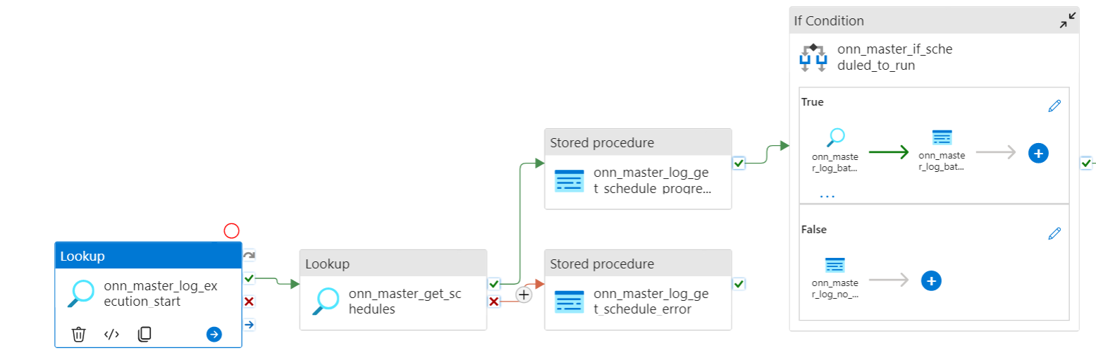
orch_napp_napp_master
Step | Activity Name | Description
1 | Lookup - onn_master_log_execution_start | Executes audit.usp_log_adf_pipeline_execution_start Populates audit table [audit].[tbl_log_adf_pipeline_execution] Contains adf execution details - execution id, run id, start end time, status, batch id
2 | Lookup - onn_master_get_schedules | Executes config.usp_get_schedule_reference Checks at a particular time, what all schedules are active (when the master pipeline is triggered) For a particular adf_pipeline_schedule_group, if adf_pipeline_schedule_group=schedule_priority, those schedule ids will run in parallel, others will run post their completion tbl_schedule is joined with tbl_batch to check if a batch is running for a schedule priority lower to the ones we would like to start It returns 3 values -->schedule_reference, schedule_to_run, batch_is_running If a batch is still running for a schedule priority lower to the ones we want to start, schedule reference will have value 'Batch is running', schedule to run will have value 0 and batch_is_running will have value 1 For a batch to start, schedule to run should be 1 and batch is running should be 0, i.e., no batch for the lower priority should be in running state

Slide 24
orch_napp_napp_master
Step | Activity Name | Description
3 | Stored Proc - onn_master_log_get_schedule_progress | Executes audit.usp_log_adf_pipeline_progress Inserts the value for pipeline_activity_duration(ss) column in log tbl audit.tbl_log_adf_pipeline_progress
4 | Stored Proc - onn_master_log_get_schedule_error | Executes audit.usp_log_error in case onn_master_get_schedules fails
5 | If Condition - onn_master_if_scheduled_to_run | This checks if we have any schedule that can be triggered
5 (a) | Stored proc - onn_master_log_batch_start_progress | If the above condition is True Executes audit.usp_batch_start by taking schedule reference as input Populates table audit.tbl_batch and audit.tbl_batch_task
5 (b) | Stored Proc - onn_master_log_batch_start_progress | On Success of Activity (5a) Executes [audit].[usp_log_adf_pipeline_progress]
5 (c) | Set Variable | On Success of Activity (5a) Stores the output of audit.usp_batch_start stored proc
5 (d) | Stored Proc - onn_master_log_batch_start_error | On Failure of Activity (5a) Executes [audit].[usp_log_error] Populates [audit].[tbl_error_log]
5 (e) | Stored Proc - onn_master_log_no_schedule_to_run | If the above condition is False Executes [audit].[usp_log_adf_pipeline_progress] Populates pipeline progress message as no schedule to run

Slide 25
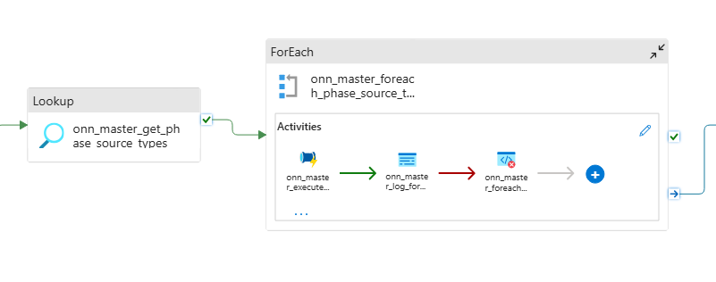

orch_napp_napp_master
Step | Activity Name | Description
6 | Lookup - onn_master_get_phase_source_types | Executes [config].[usp_get_phase_sourcetype_taskpriority] batch_id This gives the phase_id, source_type_id, source_type_name, source_type_priority, task_priority, phase_priority, phase_name for a particular batch Next activity will loop through the result set of the stored proc
9 | ForEach - onn_master_foreach_phase_source_type | This takes the above result set and checks the phase name, by default it executes napp_napp_task

Slide 26
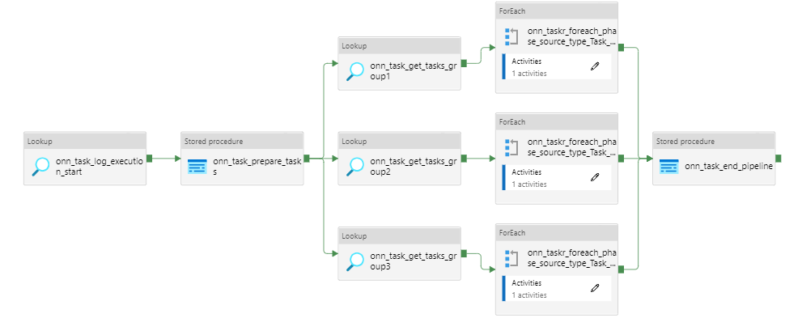
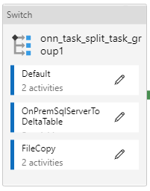
orch_napp_napp_task
Step | Activity Name | Description
8 | Stored Proc - on_task_prepare_task | Entry in source phase dates availability
9 | Lookup – onn_task_get_task_group | Divides tasks into group of max 30 across three groups (overall 90)
10 | For Each – onn_tasks_foreach_phase_source_type_task | Gets input from previous activity based on that performs either execution of notebook of copy activity

Slide 27
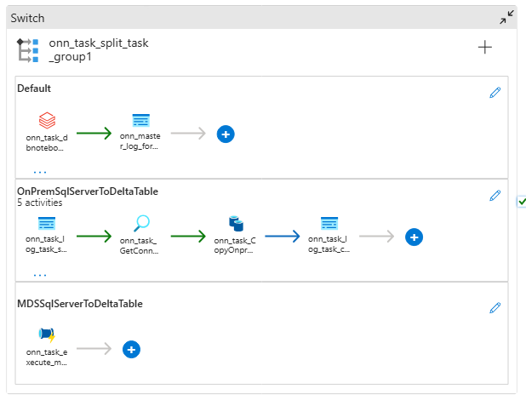
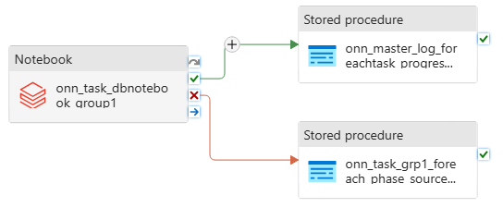
orch_napp_napp_task
Step | Activity Name | Description
1 | Notebook - onn_task_dbnotebook_group | Calls custom notebook for individual entities The notebook has set of commands that gets executed only when flag (generated by using history of transaction performed on delta table) dependentTableIsUpdated = true i.e. if none of source table are update the commands won’t get executed The notebook further calls procedure, usp_mark_dates_loaded. This activity thus helps to update tbl_object_dates_availability to mark a batch_task_id for an object (conformed) as loaded

Slide 28
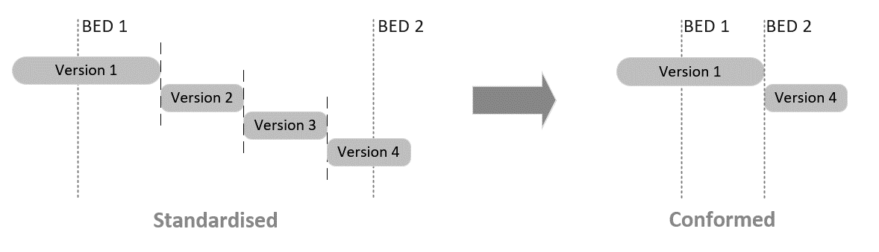
Standardised To Conformed (BED)
The essence of the BED approach can be captured as follows:
Incremental loads will be conducted in batches during which a clearly-defined window of data will be processed to Conformed. There can be multiple such batches processed per day. Each batch has an associated “Batch Effective Date”, which is the latest time considered during processing of that batch
Within a batch, if the same source record is updated multiple times, only the latest version of that record will be processed to Conformed
All records created/updated/deleted in Conformed as a result of the batch will receive ValidFrom / ValidTo timestamps equal to the BED of that batch

Slide 29
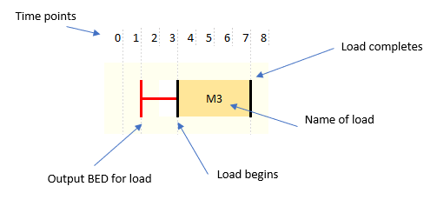
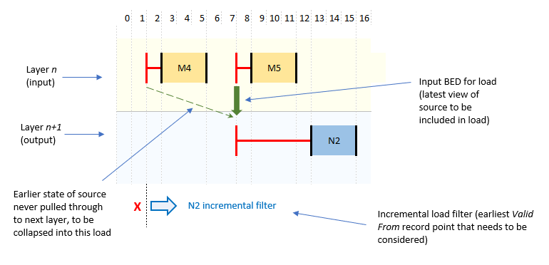
BED - Explanation of Diagram Notation
Specific notation is used in the following scenario diagrams to illustrate important aspects of the incremental loads
Basic Notation
Notation for Loading between Layers

Slide 30
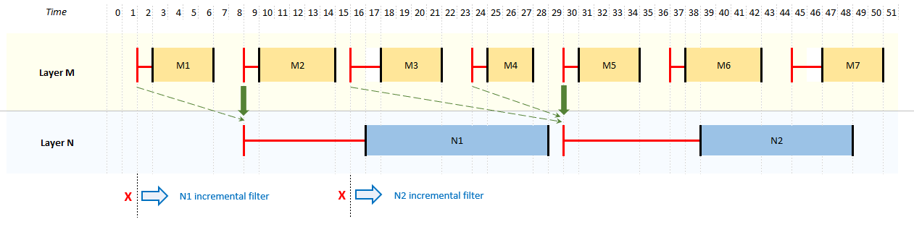
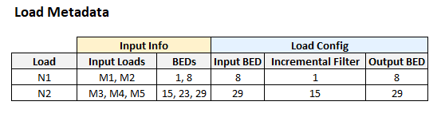
BED - Single Source Load, Scenario 1
Output layer loaded using latest available consistent data from input layer

Slide 31
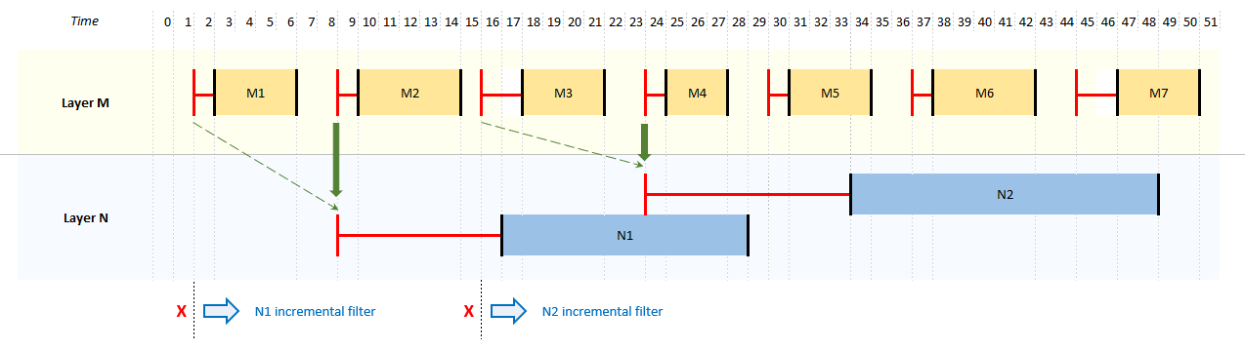
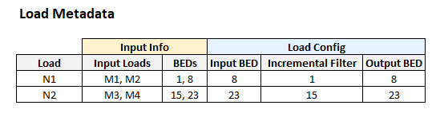
BED - Single Source Load, Scenario 2
Output layer loaded using latest available consistent data from input layer
NOTES
BED for load N2 overlaps within execution window of load N1, but this poses no problem in practice (the loads themselves do not run in parallel)

Slide 32
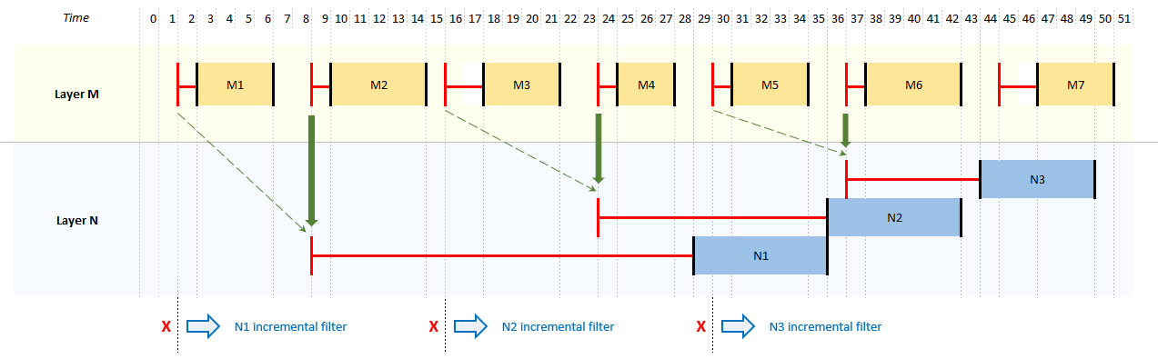
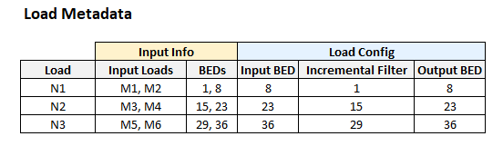
BED - Single Source Load, Scenario 3
Output layer loaded using historical slices of data following a period without loads, to catch-up in small chunks rather than lumping all change into a small window
NOTES
Load N1 could have potentially pulled data from source loads M1, M2, M3 and M4 all together, as these had all completed prior to start of N1. However to avoid to large a quantum of change in a single layer N load, Input BED is chosen such that N1 only targets M1 and M2.

Slide 33
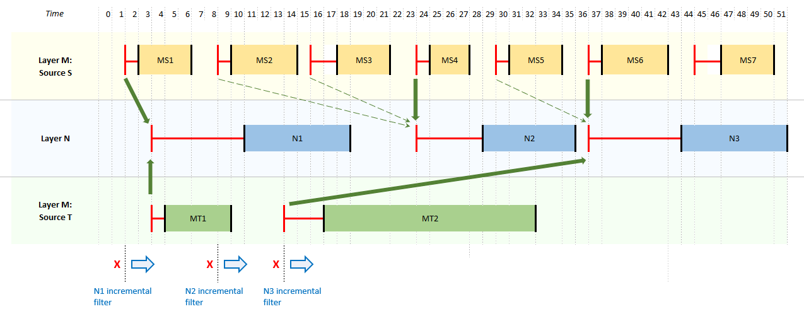
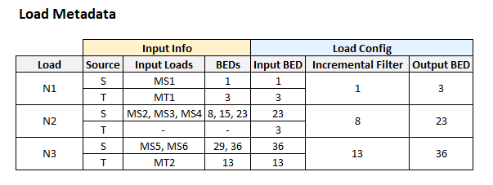
BED - Multiple Source Load, Scenario 1
Output layer loaded using latest available consistent data from input layer
NOTES
Source T has not updated in-between higher-layer loads N1 and N2, so its Input BED is unchanged.
Incremental filter is now the minimum of the BEDs across all source loads in scope

Slide 34
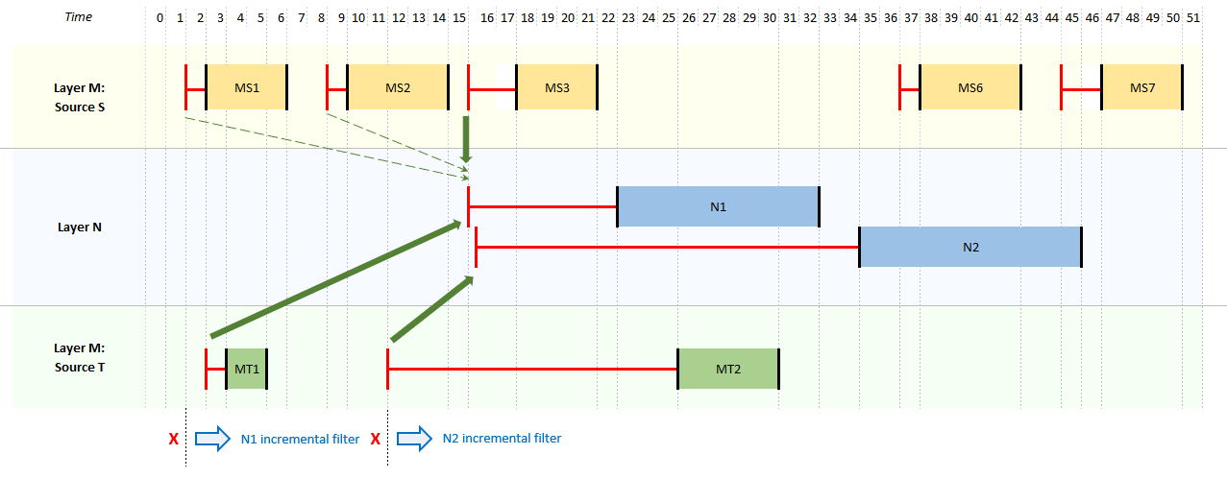
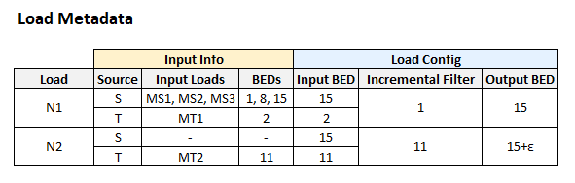
BED - Multiple Source Load, Scenario 2
Output layer loaded using latest available consistent data from input layer
NOTES
Load MT2 has been significantly delayed (e.g. could be a catch-up run at the lower layer) and so runs with a BED earlier than the latest BED already used in the higher layer i.e. in effect it changes history.
As source S has not updated in the meantime, normal rules would therefore have this pulled into the next layer in load N2 with a BED that’s already been used by load N1, but the same BED can never be used twice (would cause Type 2 merge problems/lost data). So instead a small increment is added to the BED of N2 to differentiate.

Slide 35
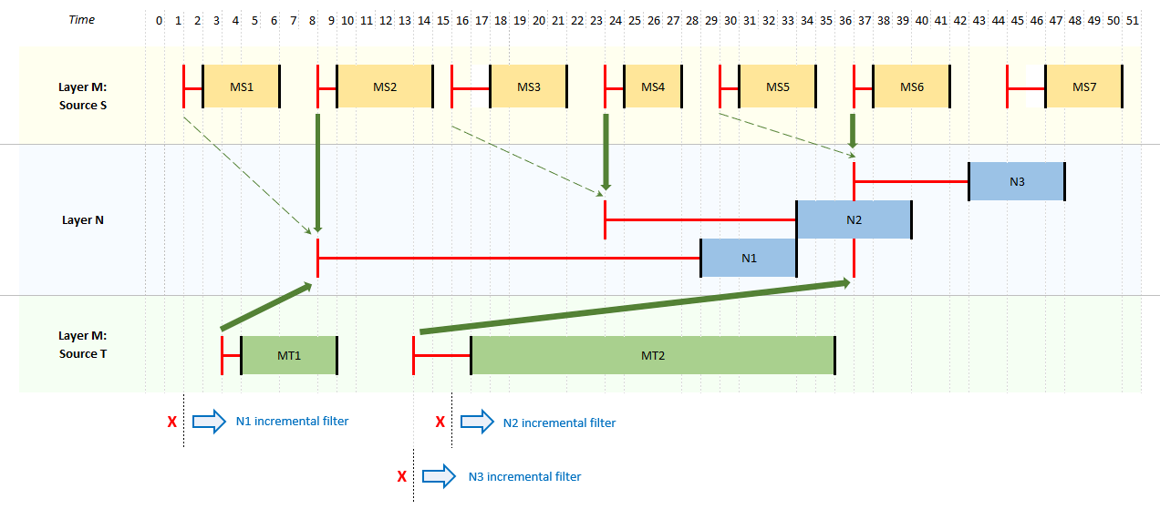
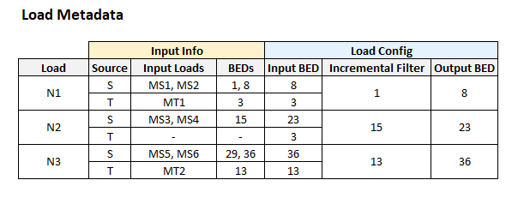
BED - Multiple Source Load, Scenario 3
Output layer loaded using historical slices of data following a period without loads, to catch-up in chunks rather than lumping all change into a small window
NOTES
Load N1 could have potentially pulled data from source loads M1, M2, M3 and M4 all together, as these had all completed prior to start of N1. However to avoid to large a quantum of change in a single layer N load, Input BED/From and To are chosen such that N1 only targets M1 and M2.
Source T has not updated in between higher-layer loads N1 and N2, so its Input BED is unchanged.

Slide 36
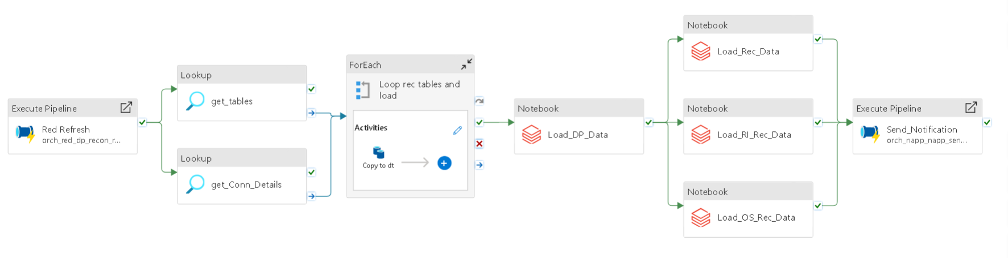
Reconciliations
RECON.orch_recon_refresh
Load data from RED into RED_DP_RECON schema via SP
orch_red_dp_recon_task
Truncate table and move the data from RED into DP using ADF
01_00_DP_objects
Load data from DP into REC schema via Synapse views
03_Load_<Phase>_Rec_Data
Transform the data from both RED as well as DP and move it to external location
rec.usp_get_notification
Send the email notification in tabular format

Slide 37
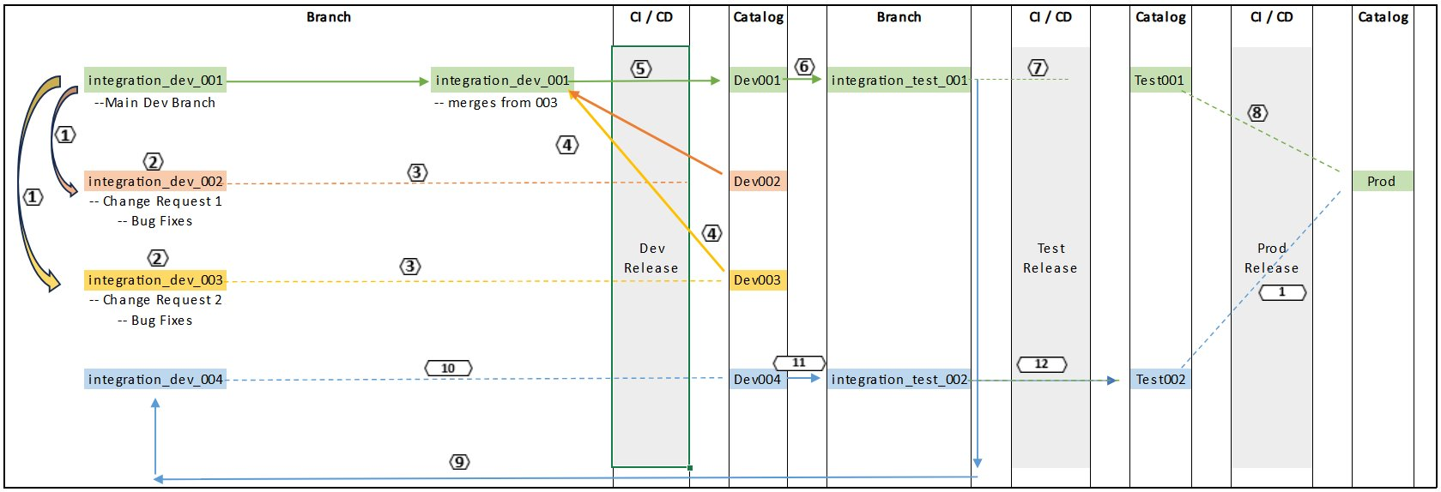
Catalogs and Squads
Please refer to below Visio for better understanding of Catalogs and squads - Approach-Squad_Development&Release.vsdx

Slide 38
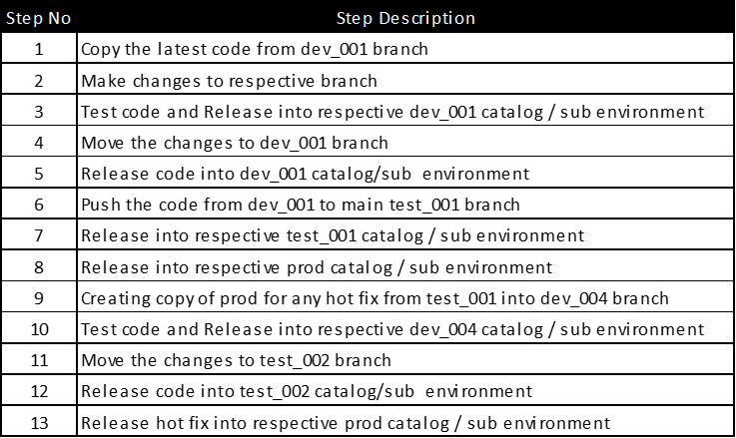
Catalogs and Squads

Slide 39
Important Links
Legacy-RED&GraftToCloud.xlsx
Approach-Squad_Development&Release.vsdx
Approach-CI_CD_Overview.docx
Approach-Handling_Deleted_Attributes.xlsx
Approach-Data_Filtering.xlsx
Approach-NULL_Handling_Defaults.xlsx
Approach-BED_Specific_Fact_Load.xlsx
Approach-Build and Data Load

Slide 40
Thank You

