Slide 2

Objectives of next few minutes
Quick recap of what we have done in Nifi
Nifi best features
Future Areas of improvements

Slide 3



Event Ingestion
H
HDFS file system
FICO
Events
Events
Events
Azure Storage Queue
Apache NiFi
Hadoop
Event Collection
Event Processing
VCAP
Data Storage
HDD
Stream Processing

Slide 4
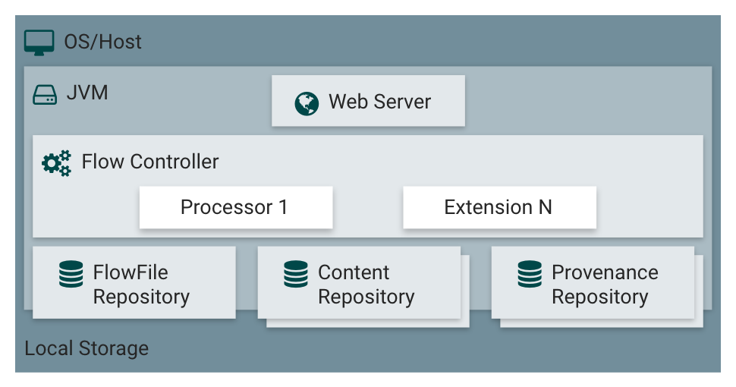
Nifi Architecture

Slide 5
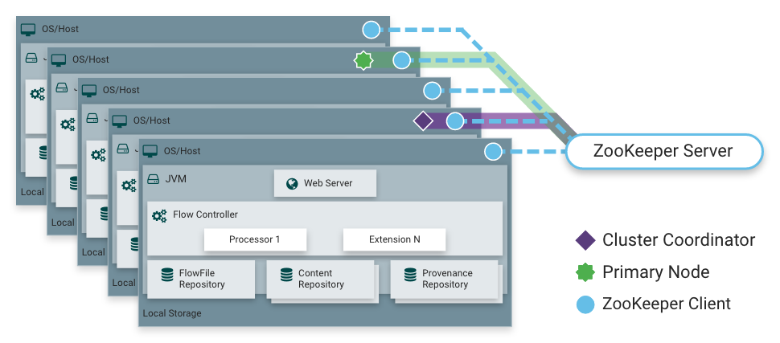
Nifi Cluster

Slide 6
Nifi Best features
Visual Command and Control
Data source and destination agnostic
Changes are fine-grained and isolated to the affected components
Real time data handling
Flow Templates
Secure transfer
Scale-out (Clustering)
Scale-up & down
Highly Configurable
Bulletin
Data Recovery
Error Handling
Provenance Events
Scheduling

Slide 7
Nifi Challenges &
Future Areas of Improvements
Json approach is complex
Absence of source code control, ( registry could solve )
Manual Deployment, complex and Long deployment hours
No Join or aggregation or complex Etl features

Slide 8
Q & A’s
Thank You

