Slide 2

Platform
Process
Chitransh Srivastava
02/Jun/2022

Slide 3
Agenda
Introduction to Data Flow
Metadata Usage and Task Overlap
High Level Orchestration
Source to Raw
      Processing
      Orchestration
      Data
      Reconciliation
Raw to Standardised
      Processing
      Orchestration
      Data
      Merge
      Reconciliation
Standardised to Conformed
      Processing
      Orchestration
      BED
      Data
      Merge
      Reconciliation
Conformed to Staging
      Processing
      Orchestration
      Data
      Reconciliation
Staging to DW
      Processing
      Orchestration
      Data
      Reconciliation

Slide 4
Introduction
Subscribe
CDC
Raw
Standardised
Conformed
Ext
Staging
DW (Fact/Dim)
Table
View
MDS
Ingestion (ADF + ADB + ADLS)
DW (ADF + Synapse)
  Full data extraction
  Full data extraction
  Data extraction based on Batch Effective Date
  Incremental data extraction
  Data extraction based on Batch Effective Date
  Each time, raw table gets truncated & loaded
  History maintenance via SCD Type 2
  History maintenance via SCD Type 2
  History maintenance via SCD Type 2
  History maintenance via SCD Type 2
  CDC is not yet implemented
  Soft Deletion of deleted records
  Soft Deletion of deleted records
  Soft Deletion of deleted records
  Inactivation of deleted records
  1:1 column level mapping, no change in PK
  1:1 column level mapping, no change in PK
  High level data transformation
  1:1 column level mapping
  Business specific transformation, PK is not same

Slide 5
Metadata usage and task overlap​
​ | Raw​ | Standardised​ | Conformed Table​ | Conformed View​ | Incremental Parquet​ | External Table​ | Staging Table​ | Dimension/Fact Table​
Description​ | Source specific physical table in databricks holding latest extract from source​ | Source specific physical table in databricks holding all type 2 historical data​ | Source specific physical table in databricks holding all type 2historical data that has been conformed across multiple standardised tables​ | View sitting over source specificconformed tables –should be identicalstructure to warehousestaging table andwarehouse external view​ | Temporary parquet files​ | Transient object over the parquet file directory for the table​ | Full history and effectively a copy of the conformed view contents, but within synapse​ | ​
Modelled in ERWIN​ | Yes​ | Yes​ | Yes​ | No | No​ | No​ | Yes​ | Yes​
Creates HBK​ | No​ | Yes | Yes​ | No​ | No​ | No​ | No​ | Yes​
Metadata Object defined (table/view)​ | Yes​ | Yes​ | Yes​ | Yes​ | No​ | No​ | Yes​ | No​
Metadata Object definition defined (columns)​ | Yes​ | Yes​ | Yes​ | No​ | No​ | No​ | Yes​ | No​
Metadata Object Primary Key | No​ | Yes​ | Yes​ | No​ | No​ | No​ | No​ | No​
Metadata column to column level mapping​ | Yes​ | Yes​ | No​ | No​ | No​ | No​ | No​ | No​
Metadata type 2 columns defined​ | No | Yes​ | Yes​ | No | No​ |  |  | No​
Metadata task​ | Yes​ | Yes​ | Yes​ | No​ | Yes​ |  |  | Yes​

Slide 6
Source To Raw (Data)
Where Clause while fetching data from source (Day 1):
Full Refresh
Sample Data in raw (Day 1):
Day 1 | lakeCreatedDate | lakeCreatedBatchID | PolId | UnitPsu | Nt
 | 20220610 | 366 | A09857AAA | CAN | UPDATED N0101 OK KIT BUT NOT TEH BEST OPW. QUOTED MONTHS AGO - VERY
Object Date Availability population for raw table (Day 1):

Slide 7
Source To Raw (Data)
Where Clause while fetching data from source- (Day 2):
Full Refresh
Sample Data in raw (Day 2):
Day 2 | lakeCreatedDate | lakeCreatedBatchID | PolId | UnitPsu | Nt
 | 20220610 | 369 | A09857AAA | CAN | UPDATED 2 UPDATED N0101 OK KIT BUT NOT TEH BEST OPW. QUOTED MONTHS AGO - VERY
Object Date Availability population for raw table (Day 2):

Slide 8
Source To Raw (Reconciliation)
As CDC is yet to be implemented, full extract of data is taken from source that gets ingested in the platform. In near future, only modified records will make it to data platform via CDC. Basic data standardization (such as trim, upper, etc.) gets applied on identified attributes.
Reconciliation:
All the reconciliation code is in progress and will be available on databricks notebook – Src_Raw_Reconciliation
Record count validation between corresponding source and raw table
Incremental Load:
Even for the incremental load, processing approach remains the same

Slide 9
Raw To Standardised (Data)
Where Clause while fetching data from raw (Day 1):
((lakeCreatedDate = 20220530) OR (lakeCreatedDate >= 20220531 AND lakeCreatedDate < 20220610) OR (lakeCreatedDate = 20220610)) AND ((lakeCreatedTimeStamp > CAST('2022-05-30 19:12:58.233' AS TIMESTAMP)) AND (lakeCreatedTimeStamp <= CAST('2022-06-10 11:44:10.660' AS TIMESTAMP)))
Sample Data in standardised (Day 1):
Object Date Availability population for standardised table (Day 1):

Slide 10
Raw To Standardised (Data)
Where Clause while fetching data from raw (Day 2):
((lakeCreatedDate = 20220610)) AND ((lakeCreatedTimeStamp > CAST('2022-06-10 11:44:10.660' AS TIMESTAMP)) AND (lakeCreatedTimeStamp <= CAST('2022-06-10 16:20:42.203' AS TIMESTAMP)))
Sample Data in standardised (Day 2):
Object Date Availability population for standardised table (Day 2):

Slide 11
Raw To Standardised (Merge)
Incremental Load:
Sr. | Scenario | Outcome | Description
1 | A new record comes from Raw table that does not exist in standardised Eg: HBK = 1, HV = 1, LCT = D1 | Record gets inserted as new and active record in standardised Eg: HBK = 1, HV = 1, VFT = D1, VTT = NULL, DT = NULL | New record get inserted
2 | A record (existing in Standardised) comes from Raw with some updates Eg: HBK = 1, HV = 2, LCT = D2 | Existing active record marked as inactive Record gets inserted as new and active record in standardised Eg: HBK = 1, HV = 1, VFT = D1, VTT = D2, NULL, DT = NULL HBK = 1, HV = 2, VFT = D2, VTT = NULL, DT = NULL | Existing record closed, updated record inserted
3 | A record (existing in Standardised) comes from Raw with no updates Eg: HBK = 1, HV = 2, LCT = D3 | No change in Standardised table Eg: HBK = 1, HV = 1, VFT = D1, VTT = D2, NULL, DT = NULL HBK = 1, HV = 2, VFT = D2, VTT = NULL, DT = NULL | No impact on existing dataset
4 | A record (existing in Standardised) doesn’t appear in Raw | Existing Record gets updated with DTS in standardised Eg: HBK = 1, HV = 1, VFT = D1, VTT = D2, NULL, DT = NULL HBK = 1, HV = 2, VFT = D2, VTT = NULL, DT = D4 | Existing active record marked as deleted
5 | Same record (mentioned step 4) re-appears in Raw Eg: HBK = 1, HV = 2, LCT = D5 | Existing active record marked as inactive Record gets inserted as new and active record in standardised Eg: HBK = 1, HV = 1, VFT = D1, VTT = D2, NULL, DT = NULL HBK = 1, HV = 2, VFT = D2, VTT = D5, DT = D4 HBK = 1, HV = 2, VFT = D5, VTT = NULL, DT = NULL | Existing active record marked as inactive, new active record inserted

Slide 12
Raw To Standardised (Reconciliation)
Soft Deletion - In case, there is a record that existed in Raw table in previous run but not in current run, “lakeDeletedTimestamp” gets populated for those records in Standardised table. However, these records acts as active records in standardized unless and until there is re-occurrence in Raw table.
Reconciliation:
All the reconciliation code is available on databricks notebook - Raw_Stand_Conf_Reconciliation. We have option to perform validation of either in specific table or entire table present in a database.
Record count comparison between corresponding raw and active records of standardised table (lakeIsActive = true)
Duplication on PK/Grain i.e. HashedBusinessKey for active as well as inactive records
Delta (newly inserted as well as updated records) between subsequent runs

Slide 13
Standardised To Conformed (Processing)
Apply BED at individual table
Join & Apply object dates availability
Merge into Target
A
Conformed Table
B
C
When we fetch the data from multiple standardised tables, filter of BED is applied on each table. Thus, the data gets restricted in the custom SQL
Based on the object dates availability populated for tables A, B & C in standardised layer. A where_clause is generated on partition column taking min & max date of data loaded across three tables.
The source data gets filtered based on where_clause post which it gets inserted, updated or soft deleted in target conformed table

Slide 14
Standardised To Conformed (Data)
Where Clause while fetching data from standardised (Day 1):
((lakeLastUpdateDate = 20220531) OR (lakeLastUpdateDate >= 20220601 AND lakeLastUpdateDate < 20220610) OR (lakeLastUpdateDate = 20220610)) AND ((lakeLastUpdateTimeStamp > CAST('2022-05-31 18:17:46.092' AS TIMESTAMP)) AND (lakeLastUpdateTimeStamp <= CAST('2022-06-10 14:28:14.268' AS TIMESTAMP)))
Sample Data in conformed (Day 1):
Object Date Availability population for conformed table (Day 1):

Slide 15
Standardised To Conformed (Data)
Where Clause while fetching data from raw (Day 2):
((lakeLastUpdateDate = 20220610)) AND ((lakeLastUpdateTimeStamp > CAST('2022-06-10 14:28:14.268' AS TIMESTAMP)) AND (lakeLastUpdateTimeStamp <= CAST('2022-06-10 17:57:09.472' AS TIMESTAMP)))
Sample Data in standardised (Day 2):
Object Date Availability population for standardised table (Day 2):

Slide 16
Standardised To Conformed (Merge)
Incremental Load:
Sr. | Scenario | Outcome | Description
1 | A new record comes from Standardised table Eg: HBK = 1, HV = 1, VFT = D1, VTT = NULL, DT = NULL | Record gets inserted as new and active record in conformed Eg: HBK = 1, HV = 1, VFT = D1, VTT = NULL, DT = NULL | New record get inserted
2 | A record (existing conformed) comes from standardised with some updates as active Eg: HBK = 1, HV = 2, VFT = D2, VTT = NULL, DT = NULL | Existing active record marked as inactive Record gets inserted as new and active record in conformed Eg: HBK = 1, HV = 1, VFT = D1, VTT = D2, NULL, DT = NULL HBK = 1, HV = 2, VFT = D2, VTT = NULL, DT = NULL | Existing record closed, updated record inserted as active
3 | A record (existing in conformed as active) comes from standardised with some updates as well as lakeDeletedTimestamp Eg: HBK = 1, HV = 3, VFT = D3, VTT = NULL, DT = D3 | Existing active record marked as inactive Record gets inserted as deleted and active record in conformed Eg: HBK = 1, HV = 1, VFT = D1, VTT = D2, NULL, DT = NULL HBK = 1, HV = 2, VFT = D2, VTT = D3, DT = NULL HBK = 1, HV = 3, VFT = D3, VTT = NULL, DT = D3 | Existing record closed, updated record inserted as deleted
4 | A record (existing in conformed as deleted) comes from standardised with some updates as well as lakeDeletedTimestamp Eg: HBK = 1, HV = 4, VFT = D4, VTT = NULL, DT = D4 | Existing active record marked as inactive Record gets inserted as deleted and active record in conformed Eg: HBK = 1, HV = 1, VFT = D1, VTT = D2, NULL, DT = NULL HBK = 1, HV = 2, VFT = D2, VTT = D3, DT = NULL HBK = 1, HV = 3, VFT = D3, VTT = D4, DT = D3 HBK = 1, HV = 4, VFT = D4, VTT = NULL, DT = D4 | Existing record closed, updated record inserted as deleted
5 | A record (existing in conformed as deleted) comes from standardised with some update and as active Eg: HBK = 1, HV = 5, VFT = D5, VTT = NULL, DT = NULL | Existing active record marked as inactive Record gets inserted as new and active record in conformed Eg: HBK = 1, HV = 1, VFT = D1, VTT = D2, NULL, DT = NULL HBK = 1, HV = 2, VFT = D2, VTT = D3, DT = NULL HBK = 1, HV = 3, VFT = D3, VTT = D4, DT = D3 HBK = 1, HV = 4, VFT = D4, VTT = D5, DT = D4 HBK = 1, HV = 5, VFT = D5, VTT = NULL, DT = NULL | Existing record closed, updated record inserted as active

Slide 17
Standardised To Conformed (Merge)
Sr. | Scenario | Outcome | Description
6 | A record (existing in conformed as active) comes from standardised with no change and as active Eg: HBK = 1, HV = 5, VFT = D5, VTT = NULL, DT = NULL | No change in conformed table Eg: HBK = 1, HV = 1, VFT = D1, VTT = D2, NULL, DT = NULL HBK = 1, HV = 2, VFT = D2, VTT = D3, DT = NULL HBK = 1, HV = 3, VFT = D3, VTT = D4, DT = D3 HBK = 1, HV = 4, VFT = D4, VTT = D5, DT = D4 HBK = 1, HV = 5, VFT = D5, VTT = NULL, DT = NULL | No impact on existing dataset
7 | A record (existing in conformed as active) comes from standardised with no change but with some lakeDeletedTimestamp Eg: HBK = 1, HV = 5, VFT = D5, VTT = NULL, DT = D7 | Existing active record marked as inactive Record gets inserted as deleted and active record Eg: HBK = 1, HV = 1, VFT = D1, VTT = D2, NULL, DT = NULL HBK = 1, HV = 2, VFT = D2, VTT = D3, DT = NULL HBK = 1, HV = 3, VFT = D3, VTT = D4, DT = D3 HBK = 1, HV = 4, VFT = D4, VTT = D5, DT = D4 HBK = 1, HV = 5, VFT = D5, VTT = NULL, DT = D7 | Existing record closed, updated record inserted as deleted
8 | A record (existing in conformed as deleted) comes from standardised with no change but with some lakeDeletedTimestamp Eg: HBK = 1, HV = 5, VFT = D8, VTT = NULL, DT = D8 | No change in conformed table Eg: HBK = 1, HV = 1, VFT = D1, VTT = D2, NULL, DT = NULL HBK = 1, HV = 2, VFT = D2, VTT = D3, DT = NULL HBK = 1, HV = 3, VFT = D3, VTT = D4, DT = D3 HBK = 1, HV = 4, VFT = D4, VTT = D5, DT = D4 HBK = 1, HV = 5, VFT = D5, VTT = NULL, DT = D7 | No impact on existing dataset
9 | A record (existing in conformed as deleted) comes from standardised with no change and as active Eg: HBK = 1, HV = 5, VFT = D9, VTT = NULL, DT = NULL | Existing active record marked as inactive Record gets inserted as active record in conformed Eg: HBK = 1, HV = 1, VFT = D1, VTT = D2, NULL, DT = NULL HBK = 1, HV = 2, VFT = D2, VTT = D3, DT = NULL HBK = 1, HV = 3, VFT = D3, VTT = D4, DT = D3 HBK = 1, HV = 4, VFT = D4, VTT = D5, DT = D4 HBK = 1, HV = 5, VFT = D5, VTT = D9, DT = D7 HBK = 1, HV = 5, VFT = D9, VTT = NULL, DT = NULL | Existing record closed, updated record inserted as active

Slide 18
Standardised To Conformed (Reconciliation)
Data is extracted from Standardised table in batches as per the Batch Effective Date using azure databricks for transformation logics. It helps us to load the data “as is” for a particular timestamp, however, we can only load BED sequentially. As we have concept of soft deletion of record happening in Standardised table the SCD logic needs to include “lakeDeletedTimestamp” for handling the updates.
Reconciliation:
All the reconciliation code is available on databricks notebook - Raw_Stand_Conf_Reconciliation. We have option to perform validation of either in specific table or entire table present in a database
Duplication on PK/Grain i.e. HashedBusinessKey for active as well as inactive records
Delta (newly inserted as well as updated records) between subsequent runs
NULL check validation on the columns ensuring default values are assigned to the columns

Slide 19
Conformed To Staging (Data)
Where Clause while fetching data from standardised (Day 1):
lakeValidFromTimestamp = BED OR lakeDeletedTimeStamp = BED OR lakeValidToTimestamp = BED
((lakeLastUpdateDate = 20220531) OR (lakeLastUpdateDate >= 20220601 AND lakeLastUpdateDate < 20220610) OR (lakeLastUpdateDate = 20220610)) AND ((lakeLastUpdateTimeStamp > CAST('2022-05-31 16:00:00.000' AS TIMESTAMP)) AND (lakeLastUpdateTimeStamp <= CAST('2022-06-10 14:30:00.000' AS TIMESTAMP)))
Sample Data in conformed (Day 1):
Object Date Availability population for conformed table (Day 1):

Slide 20
Conformed To Staging (Data)
Where Clause while fetching data from raw (Day 2):
lakeValidFromTimestamp = BED OR lakeDeletedTimeStamp = BED OR lakeValidToTimestamp = BED
((lakeLastUpdateDate = 20220610)) AND ((lakeLastUpdateTimeStamp > CAST('2022-06-10 14:30:00.000' AS TIMESTAMP)) AND (lakeLastUpdateTimeStamp <= CAST('2022-06-10 18:00:00.000' AS TIMESTAMP)))
Sample Data in standardised (Day 2):
Object Date Availability population for standardised table (Day 2):

Slide 21
Conformed To Staging (Reconciliation)
Data moves from ADLS (parquet) to synapse (table) using concept of “External Tables”. These external tables are used to load the data in staging using MERGE statement for each combination of HashedBusinessKey & LakeValidFromTimestamp and in synapse stored procedures.
Reconciliation:
All the reconciliation code is available on databricks notebook - Conf_Stg_DW_Reconciliation.
Record Count validation across conformed and staging tables
Duplication on PK/Grain i.e. HashedBusinessKey for active as well as inactive records
NULL check validation on the columns ensuring default values are assigned to the columns

Slide 22
Staging To DW (Data)
Where Clause while fetching data from staging (Day 1):
lakeValidFromTimestamp = BED OR lakeDeletedTimeStamp = BED
Sample Data in DW (Day 1):
Object Date Availability population for DW table (Day 1):
No record in object_date_availability for dwh tables

Slide 23
Staging To DW (Reconciliation)
This layer hold the fact, dimension and bridge tables of the warehouse. It includes addition of surrogate keys along with business specific transformations. Data gets loaded using Batch Effective Date in the DW tables and can’t be loaded for same Batch Effective Date twice.
One major change here is that, the records marked as deleted are treated as active records till staging layer but in DW layer those records gets updated and are treated as inactive.
Reconciliation:
All the reconciliation code is in progress and will be available on databricks notebook - Conf_Stg_DW_Reconciliation.
Record Count validation across staging and dw tables
Duplication on PK/Grain i.e. HashedBusinessKey for active as well as inactive records
NULL check validation on the columns ensuring default values are assigned to the columns

Slide 24

Thank You

Slide 25
Chitransh Srivastava
exlservice.com
Title Senior Consultant - C1
Global headquarters
Chitransh.srivastava@exlservice.com
M: +91-7829114323
320 Park Ave, 29th floor
New York, NY 10022
T: +1(212) 277-7100
F: +1(212) 277-7111
United States | United Kingdom | Australia
Bulgaria | Colombia | Czech Republic
India | Philippines | Romania | South Africa
© 2021 ExlService Holdings, Inc. All rights reserved. For more information go to www.exlservice.com/legal-disclaimer

Slide 26
Appendix

Slide 27
Legends
In upcoming slides, we might find some keywords related to audit columns on data platform which are used to explain the type 2 functionality across layers:
HBK – HashedBusinessKey (Grain/PK of tables across layer)
HV – HashedValue (Combination of all non-key columns used which tracking Insert & Update DMLs in merge function)
LCT – LakeCreatedTimestamp (Identifies the creation date and time of a record)
VFT – LakeValidFromTimestamp (Track the date and time from which record was active in the table)
VTT – LakeValidToTimestamp (Track the date and time on which record became inactive in the table)
DT – LakeDeletedTimestamp (Track the date and time on which record was marked as deleted in the table)
BED – BatchEffectiveDate (Timestamp for which the data gets loaded into conformed layer and onwards)

Slide 28
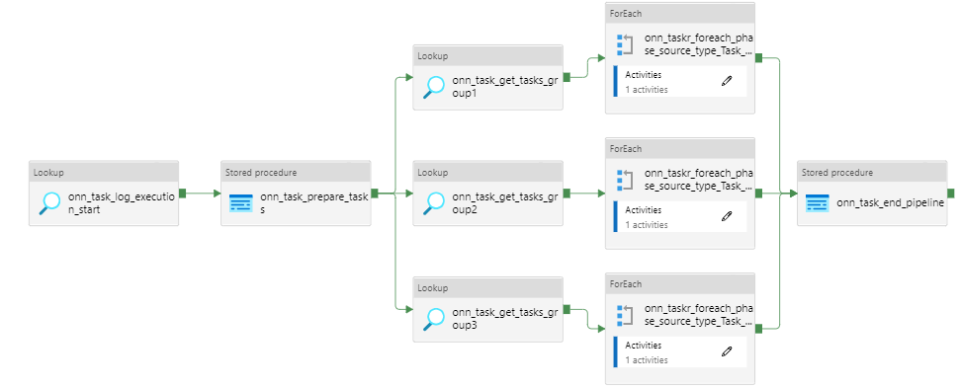
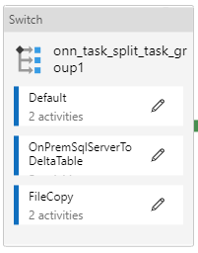
High Level Orchestration
Summary:
“onn_task_prepare_tasks” Activity – calls SQLDB procedure, usp_prepare_tasks that identifies that tasks that needs to be loaded
“on_task_get_tasks” Activity – calls SQLDB procedure, and usp_get_tasks and identifies the new data that needs to be loaded as per object_dates_availability table from metadata
As we can see, the pipeline creates three parallel branches so that multiple entities can be processed at once at once. Threshold for each branches is 20 i.e. At any instance maximum 60 (20*3) tasks can be in progress

Slide 29





Source To Raw (Processing)
On - Prem
(Subscribe)
ADLS
SQLDB (Metadata)
  Looks for active Batch in SQLDB
  Truncate the table in raw
  Loads the data in delta table
  Update the object date availability for raw tables
  Calls the procedure usp_get_object_connectionStringDetails
  Update the log tables
  This procedure generates a where_clause

Slide 30
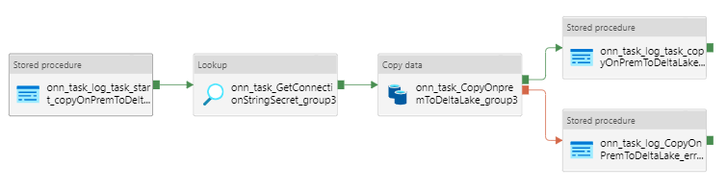
Source To Raw (Orchestration)
Summary:
“onn_task_GetConnectionStringSecret_group3” Activity – calls SQLDB procedure, usp_get_object_connectionStringDetails that helps generates a connection string in order to connect to the on premises source. It also updates where clause to “Full_Refresh”
“onn_task_CopyOnpremmToDeltaLake_group3” Activity – Establishes connecting using connecting string, truncates the target table and loads data in raw table
“onn_task_log_task_copyOnPremToDeltaLakeend_group1” Activity – calls SQLDB procedure, usp_log_sql_task_end which further calls procedure, usp_mark_dates_loaded. This activity thus helps to update tbl_object_dates_availability to mark a batch_task_id for an object (raw) as loaded

Slide 31

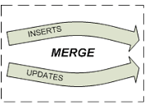
Raw To Standardised (Processing)
ADLS
SQLDB (Metadata)
  Looks for active Batch in SQLDB
  Fetches data based on entries in object dates availability
  Loads the data in delta table
  Update the object date availability for standardised tables
  Calls notebook load_scd2withdelete_dbdt_dbdt
  This helps to filter only for new data from Raw
  Update the log tables
  Update the log tables
  Apply the merge statement - insert, update & soft delete

Slide 32
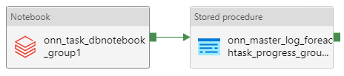
Raw To Standardised (Orchestration)
Summary:
“onn_task_dbnotebook_group1” Activity – calls generic notebook, load_scd2withdelete_dbdt_dbdt that uses object date availability to create a where_clause. This where_clause gets applied as data gets loaded from standardised to conformed
The generic notebook further calls procedure, usp_mark_dates_loaded. This activity thus helps to update tbl_object_dates_availability to mark a batch_task_id for an object (standardised) as loaded

Slide 33

Standardised To Conformed (Processing)
ADLS
SQLDB (Metadata)
  Looks for active Batch and BED in SQLDB
Fetches data based on entries in object dates availability
  Apply the merge statement - insert, update & soft delete
  Loads the data in delta table
  Update the object date availability for conformed tables
  Calls custom notebook for individual entity
  This helps to filter only for new data from standardised
  Merge joins are done on Partition Key and HBK
  Update the log tables
  Update the log tables
  Custom SQL helps to fetch data as per target structure
  BED filter is applied in custom SQL Notebook
  NULLs are assigned to respective DEFAULT values

Slide 34
Standardised To Conformed (Orchestration)
Summary:
“onn_task_dbnotebook_group1” Activity – calls custom notebook for individual entity that uses object date availability to create a where_clause. This where_clause gets applied as data gets loaded from standardised to conformed
The notebook has set of commands that gets executed only when flag (generated by using history of transaction performed on delta table) dependentTableIsUpdated = true i.e. if none of source table are update the commands won’t get executed
The notebook further calls procedure, usp_mark_dates_loaded. This activity thus helps to update tbl_object_dates_availability to mark a batch_task_id for an object (conformed) as loaded

Slide 35
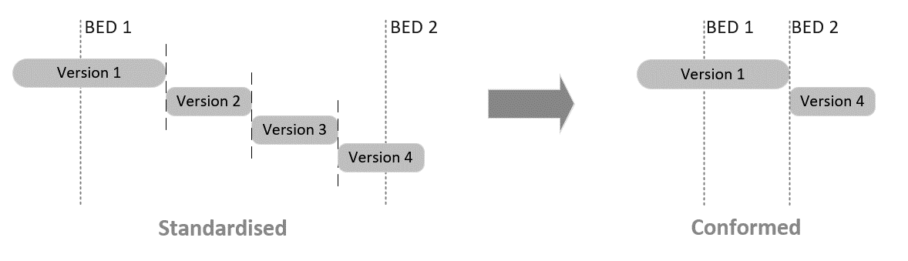
Standardised To Conformed (BED)
The essence of the BED approach can be captured as follows:
Incremental loads will be conducted in batches during which a clearly-defined window of data will be processed to Conformed. There can be multiple such batches processed per day. Each batch has an associated “Batch Effective Date”, which is the latest time considered during processing of that batch
Within a batch, if the same source record is updated multiple times, only the latest version of that record will be processed to Conformed
All records created/updated/deleted in Conformed as a result of the batch will receive ValidFrom / ValidTo timestamps equal to the BED of that batch

Slide 36

Conformed To Staging (Processing)
SQLDB (Metadata)
  Looks for active Batch and BED in SQLDB
  Fetches data based on BED condition
  Apply the merge statement – insert and update
  Update the object date availability for staging tables
  Calls the notebook load_bed_dbdt_sqdw
  Overwrites the data into (external table) parquet location
  Merge logic is based on HBK and VFT
  Update the log tables
  Update the log tables
  Moves the data from external to Staging table
  Addition of dwh audit columns

Slide 37
Conformed To Staging (Orchestration)
Summary:
“onn_task_dbnotebook_group1” Activity – calls generic notebook, load_bed_dbdt_sqdw which suffices two objective, mentioned below:
  Overwrite the data from conformed delta table to (external table) parquet location based on BED i.e move only data satisfying the condition: lakeValidFromTimestamp = BED OR lakeDeletedTimeStamp = BED OR lakeValidToTimestamp = BED
  Execute the stored procedure in synapse to load data from external table to corresponding staging table. Additional dwh audit columns (dwhCreatedTimestamp, dwhLastUpdateTimestamp, dwhCreatedBatchID and dwhLastUpdatedBatchID) are created.

Slide 38
Staging To DW (Processing)
SQLDB (Metadata)
  Looks for active Batch and BED in SQLDB
  BED is provided as parameter to stored procedure
  Update the log tables
  Calls the stored procedures in synapse
  Apply the merge statement – insert and update
  Fetches data based on BED criteria from staging
  Creation of new dwh audit columns (e.g. HBK/HV/ID)
  Update the log tables

Slide 39
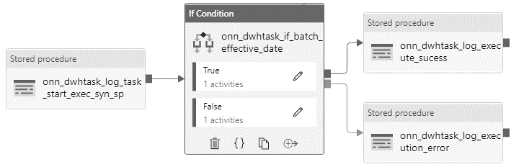
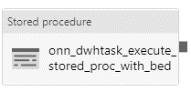
Staging To DW (Orchestration)
Summary:
“onn_dwtask_execute_Stored_procedure_with_bed” calls the stored procedure that helps us to load data in DW tables i.e. Fact/Dim/Bridge
The procedure fetches only those record that has been either updated or deleted in the current batch based on BED
The records marked as deleted in staging table are present as inactive record in DW tables

