Slide 1
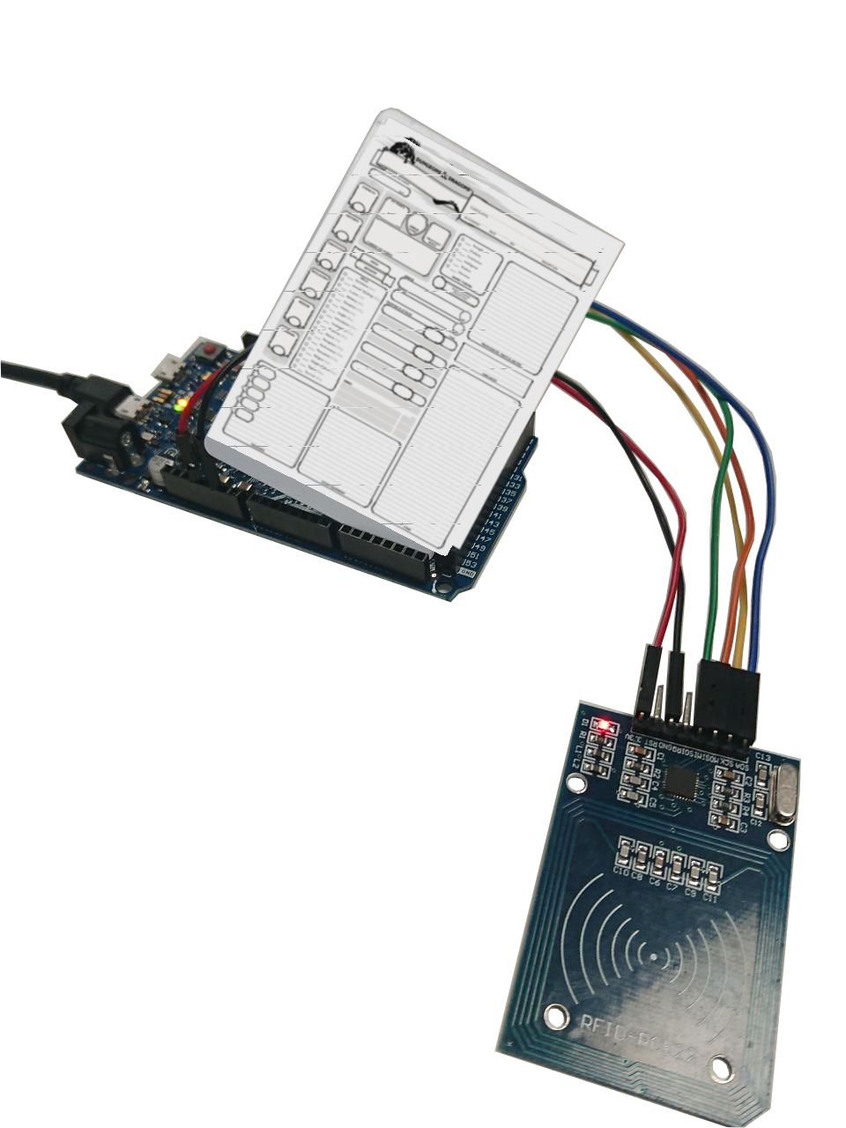
Character Card
Duur Alblas V1C IPASS 2019
https://github.com/DuurAlblas/IPassDnD
-library for rfid readers
(RC522 implemented)
-library for rfid cards
(MIFARE 1K MF1S503yX implemented)
-Support DnD Sheets can be expanded with support for other games using character sheets

