Slide 1
Arvenne Cycles: Q3 2025 investor update
Prepared for Northbeam Ventures and the board · 10 October 2025 · Confidential

Slide 2
Q3 at a glance
Net revenue Q3: €2.81M (-20% vs Q2, summer closure in August)
Bikes delivered in Q3: 932
Barge 2 launched on 15 September; up to 140 km with the Range Extender
Active dealers at 30 September: 27
Headcount at 30 September: 81

Slide 3
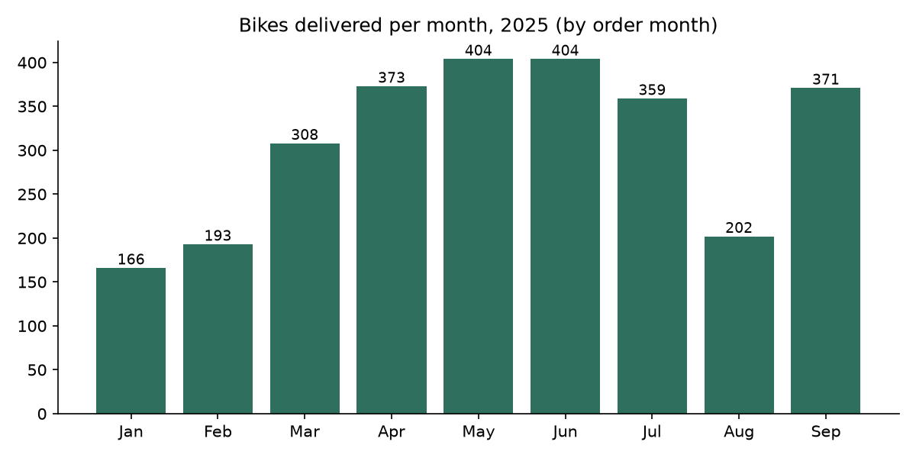
Volumes

Slide 4
Risks we are managing
Battery quality: abnormal connector claims on one Voltaris lot (VL-2507-B); inspection campaign under way, costs to be recovered from the supplier
Supply: lot VL-2508-C arrived 23 days late; penalty claimed under the supply agreement
Product transition: first-generation Barge reached end of sale on 30 September

Slide 5
Cash
Cash at 30 September: €6.2M
Average monthly net burn Q3: €0.28M
No new debt in Q3

Slide 6
Next quarter
Utrecht distribution hub opens in November
Barge 2 ramp-up on Line B
2026 price list to the board in December

