Slide 1


SMART INDIA HACKATHON 2026
NIYAMLENS
Evidence-grade packaged commodity inspection
Problem Statement ID – SIH26034
Problem Statement Title – Software System to check compliance of Packaged Commodities under Legal Metrology (Packaged Commodities) Rules, 2011 by scanning products, images and labels.
Theme – Agriculture, FoodTech & Rural Development
PS Category – Software
Team ID – College allocation pending
Team Name – NiyamLens
Notes:
State the exact problem statement and team identity. Introduce NiyamLens as an evidence-grade inspection assistant, not an autonomous enforcement system.

Slide 2
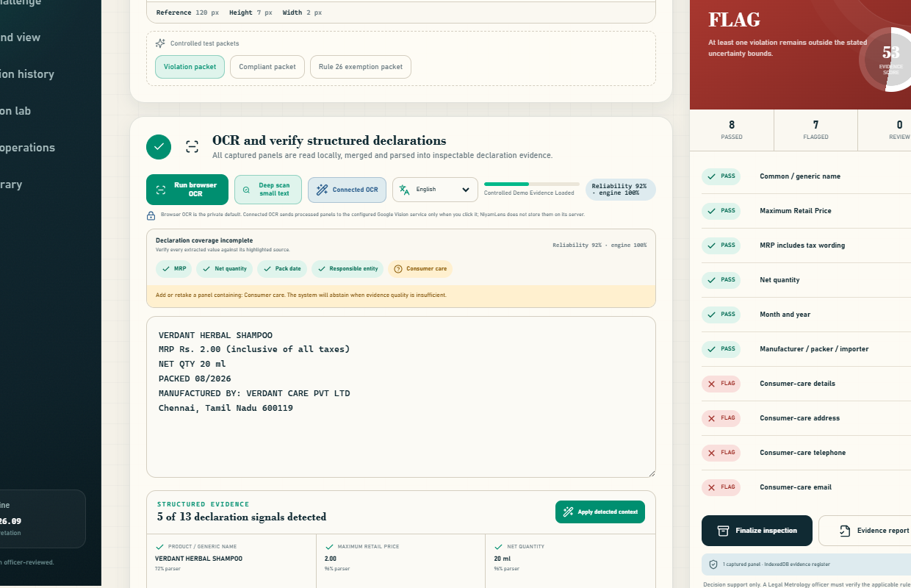
NIYAMLENS
NiyamLens
Proposed Solution / Approach
From image to defensible evidence
Guided capture: Front, back, side and declaration panels; quality checks and original SHA-256.
Hybrid OCR: Three-pass local scan, seven-pass deep scan and an explicit connected-OCR option.
Rules-as-code: Rule 6 declarations, Rule 7 Table-I typography and Rule 26 exemptions.
Safe verdict: PASS, FLAG, REVIEW or EXEMPT with source regions, uncertainty and officer audit.
WORKING PROTOTYPE: OCR + STRUCTURED EVIDENCE + RULE VERDICT
OCR proposes evidence. Rules and officers decide.
01
02
03
04
Unseen-packet test
Area-tier uncertainty
Rule 26 carve-outs
Auditable abstention
Decision support only; Legal Metrology officer verification remains explicit.
@SIH Idea submission- Template
2
Notes:
Explain why this is not an OCR wrapper. Show the real prototype screen, then walk through guided evidence, hybrid OCR, deterministic rules and calibrated abstention.

Slide 3
TECHNICAL APPROACH
TECHNICAL APPROACH
NiyamLens
01
02
03
04
05
06
CAPTURE
RECOGNIZE
STRUCTURE
MEASURE
EVALUATE
SEAL
4 panels
quality + hash
local / deep /
connected OCR
MRP • quantity •
date • entity
homography +
scale uncertainty
versioned Rule
6 / 7 / 26
audit chain +
evidence report
ZONE 1 — BROWSER PWA
ZONE 2 — TRUST + RULE LAYER
ZONE 3 — OPTIONAL SERVICE
React 18 + Vite
SHA-256 evidence integrity
Explicit connected-OCR action
Canvas rectification
IndexedDB local register
Vercel serverless function
Tesseract.js bundled OCR
Deterministic versioned matrix
Google Vision key stays server-side
Installable offline service worker
Rule outcome + officer disposition
Core flow remains complete offline
COMPONENTS / TECHNOLOGY STACK
React 18 • Vite • Canvas API • Tesseract.js • Web Crypto • IndexedDB • Playwright • Vercel
3
@SIH Idea submission- Template
3
@SIH Idea submission- Template
Notes:
Present the system as a six-stage evidence pipeline. Keep capture, OCR and legal evaluation separate. Emphasize that cloud OCR is optional and explicit, while the core inspection path remains local-first.

Slide 4
FEASIBILITY AND VIABILITY
FEASIBILITY AND VIABILITY
NiyamLens
Feasibility
Viability
Practical Implementation
31 implemented capabilities
PWA + bundled OCR
Random-packet Blind Challenge
54/54 automated tests pass
Local IndexedDB evidence
Vercel-ready release candidate
Production build + browser QA pass
No cloud required for core flow
Field/legal approvals remain visible
POTENTIAL CHALLENGES AND RISKS
STRATEGIES FOR OVERCOMING CHALLENGES
01
Small, curved or glared text can reduce OCR recall.
01
Quality gates, retake guidance, deep tiles and optional connected OCR.
02
Panel-area or scale error can flip a font-size result.
02
Homography, same-panel calibration and uncertainty → REVIEW.
03
Exemptions and amendments can change applicability.
03
Versioned rule pack, Rule 26 carve-outs and legal approval register.
04
Inspection evidence may be offline or sensitive.
04
Local-first OCR/storage, consent and encrypted evidence transfer.
05
Automation could create a false accusation.
05
Missing view ≠ violation; preserve source, supervisor reason and audit.
4
@SIH Idea submission- Template
4
@SIH Idea submission- Template
Notes:
Lead with what already works, then show the explicit boundaries. Each major risk has a built safeguard. Do not describe the ten-photo OCR pilot as field accuracy or claim regulatory approval.

Slide 5
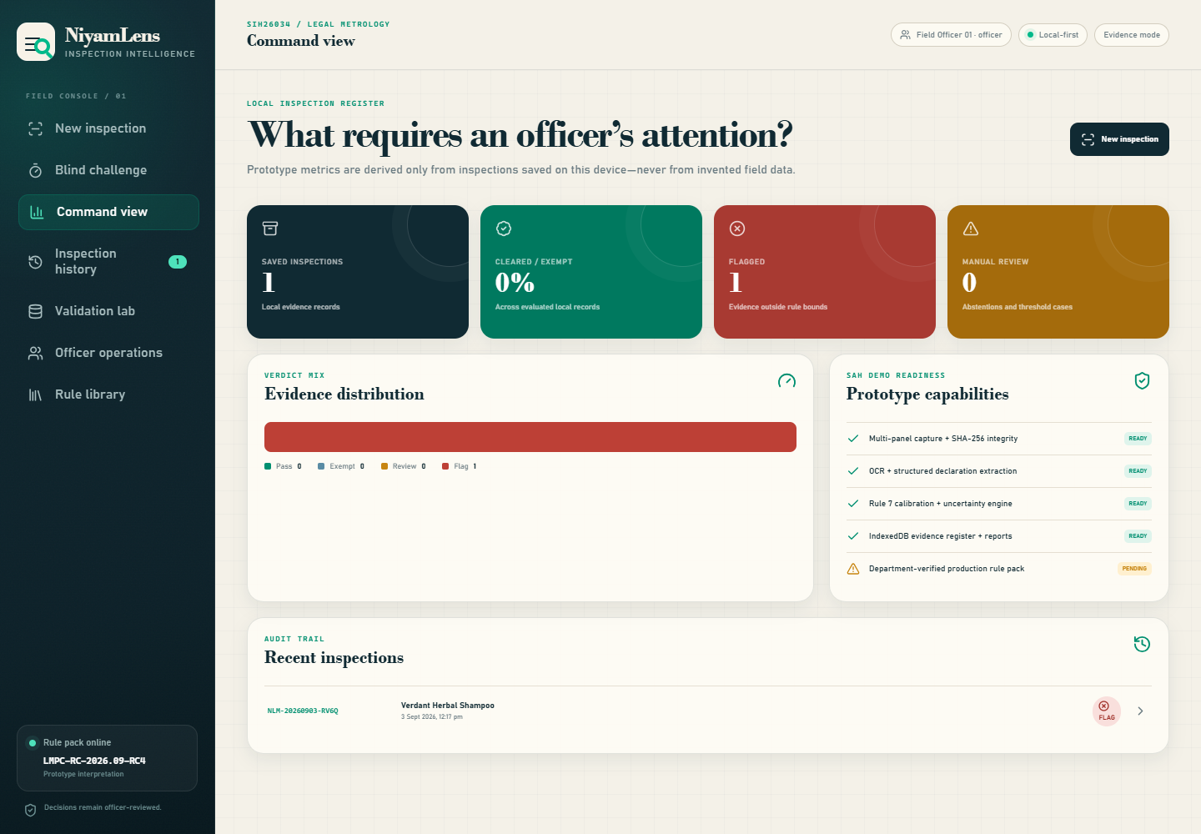
IMPACT AND BENEFITS
NiyamLens
01
INSPECTOR
02
SUPERVISOR
Faster triage
Reviewable decisions
Guided capture, grounded fields and a one-click evidence packet.
Reason-required disposition with the automated result preserved.
03
CONSUMER / BUSINESS
04
DEPARTMENT
Explainable findings
Operational visibility
Shows what is missing, uncertain, exempt or outside the current scope.
Local register, status dashboard and labelled validation workflow.
One record links image, declaration, geometry, rule and human disposition.
Social
Fairer, transparent inspection
Economic
Less repetitive manual collation
Operational
Auditable evidence at scale
Governance
Human authority stays explicit
From “trust the dashboard” to “inspect the source, rule, measurement and audit trail.”
@SIH Idea submission- Template
5
Notes:
Connect each user group to a concrete artifact already visible in the prototype. Avoid unmeasured percentage claims. The primary benefit is safer, explainable and auditable triage.

Slide 6
RESEARCH AND REFERENCES
RESEARCH AND REFERENCES
NiyamLens
54 / 54
17
61.1%
67.5%
93.7%
AUTOMATED TESTS PASS
REAL PHOTOS • 10 PRODUCTS
STANDARD TOKEN RECALL
DEEP-SCAN TOKEN RECALL
PRECOMPUTED CLOUD BASELINE
Same expected tokens • no manual corrections • reliability and engine confidence are not accuracy
OFFICIAL / PRIMARY SOURCES
BEFORE ENFORCEMENT USE
01
Legal Metrology (Packaged Commodities) Rules, 2011 + amendments — Department of Consumer Affairs
Freeze a 250+ package, package-level test split with dual review.
01
02
Current Legal Metrology Acts & Rules index — Department of Consumer Affairs
02
Obtain amendment-complete Legal Metrology approval for each rule profile.
03
Packaged Commodities FAQ — Department of Consumer Affairs
04
Open product-image data and API — Open Food Facts
03
Laboratory-validate phone, marker and curved-panel measurement error.
05
Document text detection and request format — Google Cloud Vision
04
Add departmental SSO, shared storage, retention and audit anchoring.
06
Prototype, test reports and architecture — NiyamLens repository
WIN CONDITION: survive the judge’s unseen packet—honestly.
Pilot measurements show progress; they are not a field-accuracy or enforcement claim.
6
@SIH Idea submission- Template
6
@SIH Idea submission- Template
Notes:
Close with measured evidence and primary sources. Standard local token recall is 61.1%; deep scan is 67.5% on the same 17 declaration-panel photos from ten products. The 93.7% number is a precomputed cloud baseline, not live NiyamLens accuracy.

