Slide 1

Automatic Image Caption Generation Using CNN-RNN Architecture
B Tech 7th Semester Project
on
Under the Guidance of:
Mrs. Gitimoni Talukdar
Assistant Professor
Department of Computer Science,
The Assam Royal Global University,
Guwahati
Presented by:
Divyanshu Singh(172025017)
Duwesh Kumar(172025018)
Bachelor of Technology (7th sem)
Department of Computer Science,
The Assam Royal Global University,
Guwahati

Slide 2
PRESENTATION OUTLINE
1)INTRODUCTION
2)MOTIVATION
3)PROBLEM STATEMENT
4)LITERATURE REVIEW
5)METHODOLOGY
6)MODEL ARCHITECTURE
7)RESULTS
8)SCREENSHOTS
9)CONCLUSION
10)REFERENCES

Slide 3
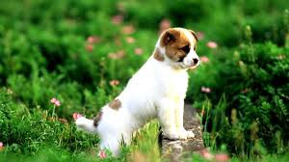
Introduction
Image captioning is basically describing the contents of an image.
What do you see in the below picture?
Well some of you might say “A white dog in a grassy area”, some may say “White dog with brown spots” and yet some others might say “A dog on grass and some pink flowers”.

Slide 4
MOTIVATION
We must first understand how important this problem is to real world scenarios. Let’s see few applications where a solution to this problem can be very useful.
Self driving cars
Aid to the blind
CCTV cameras
Automatic Captioning

Slide 5
PROBLEM STATEMENT
The goal of automatic image captioning is to generate description for a given input image.
Two key challenges were:
Feature extraction.
Generating syntactically and semantically correct sentences.

Slide 6
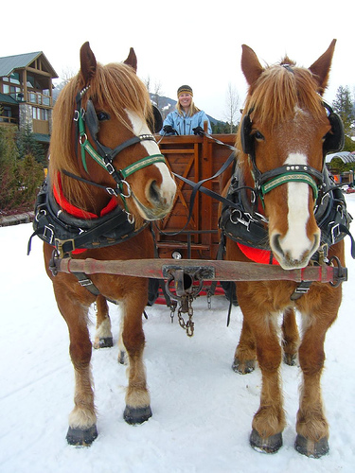
Simple Image Captioning Model
Two horses pull a carriage driven by a woman over snow covered ground.
Image Captioning Model

Slide 7
Literature Review
Artificial Neural Network (ANN) is an efficient computing system whose central theme is borrowed from the analogy of biological neural networks. ANNs are also named as “artificial neural systems,” or “parallel distributed processing systems,” or “connectionist systems”. ANN acquires a large collection of units that are interconnected in some pattern to allow communication between the units. These units, also referred to as nodes or neurons, are simple processors which operate in parallel [1].

Slide 8
Convolutional neural network are specialized deep neural networks which can process the data that has input shape like a 2D matrix and CNN is very useful in working with images. CNN is basically used for image classifications and identifying if an image is a bird, a plane or superman, etc. It scans images from left to right and top to bottom to pull out important features from the image and combines the feature to classify images. It can handle the images that have been translated, rotated, scaled and changes in perspective[2].

Slide 9
RNN came into existence, which solved this issue with the help of a Hidden Layer. The main and most important feature of RNN is Hidden state, which remembers some information about a sequence. RNN have a “memory” which remembers all information about what has been calculated. It uses the same parameters for each input as it performs the same task on all the inputs or hidden layers to produce the output. They’re especially useful with sequential data because each neuron or unit can use its internal memory to maintain information about the previous input. This reduces the complexity of parameters, unlike other neural networks. Also, this concept includes a huge number of possibilities. RNNs are designed to recognize data sequential characteristics and use patterns to predict the next likely scenario. RNNs are used in deep learning and in the development of models that simulate the activity of neurons in the human brain. They are especially powerful in use cases in which context is critical to predicting an outcome and are distinct from other types of artificial neural networks because they usefeedback loops to process a sequence of data that informs the final output, which can also be a sequence of data. The core reason that recurrent nets are more exciting is that they allow us to operate over sequences of vectors: Sequences in the input, the output, or in the most general case both [3].

Slide 10
The Long Short-Term Memory Networks. Long Short-Term Memory networks – usually just called “LSTMs” – are a special kind of RNN, capable of learning long- term dependencies. LSTMs are explicitly designed to avoid the long-term dependency problem. Remembering information for long periods of time is practically their default behavior, not something they struggle to learn. In order to add new information, RNN transforms the existing information completely by applying a function. Because of this, the entire information is modified; on the whole, i.e. there is no consideration for ‘important’ information and ‘not so important’ information.
LSTMs on the other hand, make small modifications to the information by multiplications and additions. With LSTMs, the information flows through a mechanism known as cell states. This way, LSTMs can selectively remember or forget things. The information at a particular cell state has three different dependencies [4].

Slide 11
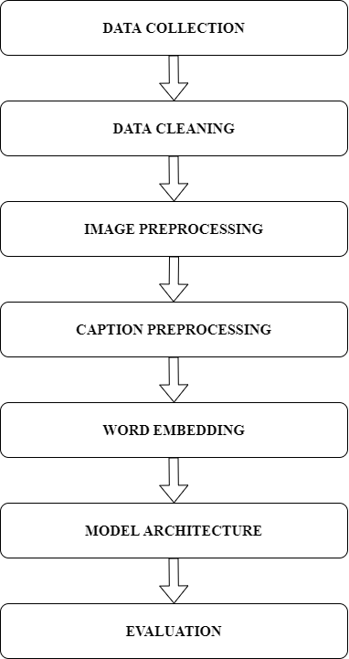
METHODOLOGY

Slide 12
Data Collection
There are many open source datasets available for this problem,like Flicker_8k(containing 8k images).
The dataset contains 8000 images each with 5 captions.
The dataset is divided in three splits: train set, validation set and test set.
The train set contains 6000 images, the validation set contains 1000 images and the test set contains 1000 images.

Slide 13
Data Cleaning
When we deal with text, we generally perform some basic cleaning like lower casing all the words.
Removing special tokens (like '%' , '$' ,'#' ,etc.).
Eliminating words which contains number (like 'hey199', etc).

Slide 14
Image Preprocessing
Images are nothing but input (X) to our model.As you may already know that any input to a model must be given in the form of a vector.
We need to convert every image into a fixed sized vector which can then be fed as input to the neural network.For this purpose,we opt for transfer learning by using the Inception-V3 Model.
This model was trained on Imagenet dataset to perform image classification on 1000 different classes of images.

Slide 15
Caption Preprocessing
We must note that captions are something that we want to predict. So during the training period, captions will be target variable(Y) that the model is learning to predict.
But the prediction of the entire caption,given the image does not happen at once.We will predict the caption word by word.Thus,we need to encode each word into a fixed size vector.

Slide 16
Word Embedding
Word Embeddings are the texts converted into numbers and there may be different numerical representations of the same text.
A vector representation of a word may be a one-hot encoded vector where 1 stands for the position where the word exists and 0 everywhere else.
We will map every word (index) to a 200-long vector and for this purpose, we will use a pre- trained GLOVE Model.

Slide 17
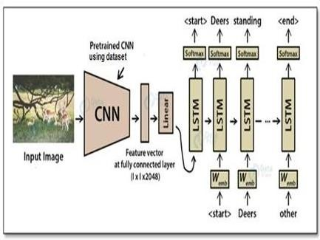
The CNN-LSTM Architecture

Slide 18
Encoder-CNN
Now, we’re using the CNN as a feature extractor that compresses the huge amount of extraction contained in the original image into a smaller representation. This CNN is often called the encoder because it encodes the content of the image into a smaller feature vector. Then we can process this feature vector and use it as an initial input to the following RNN.

Slide 19
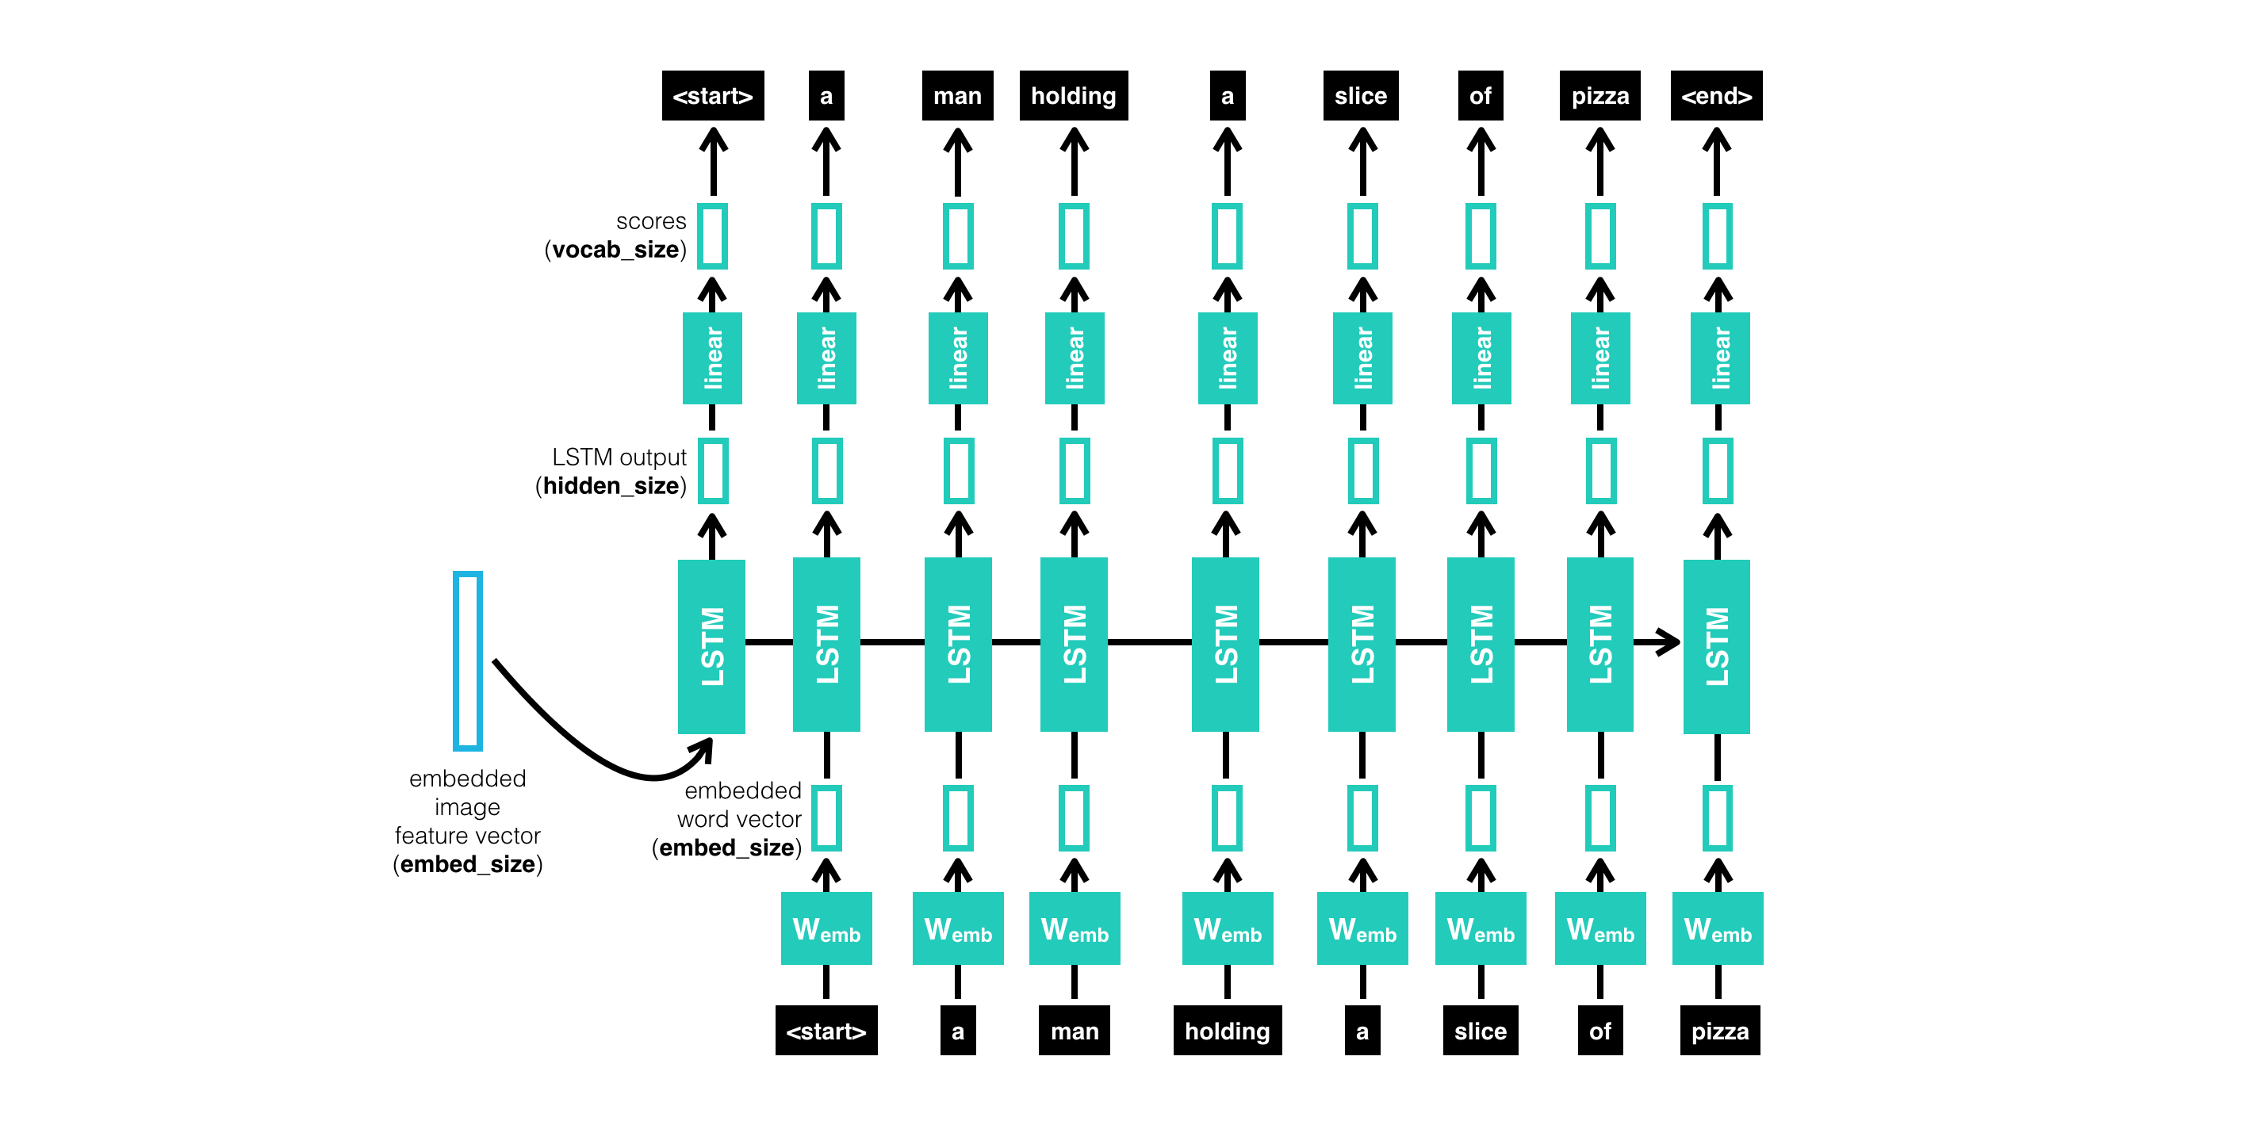
Decoder-RNN
The job of the RNN is to decode the process vector and turn it into a sequence of words. Thus, this portion of the network is often called a decoder.

Slide 20
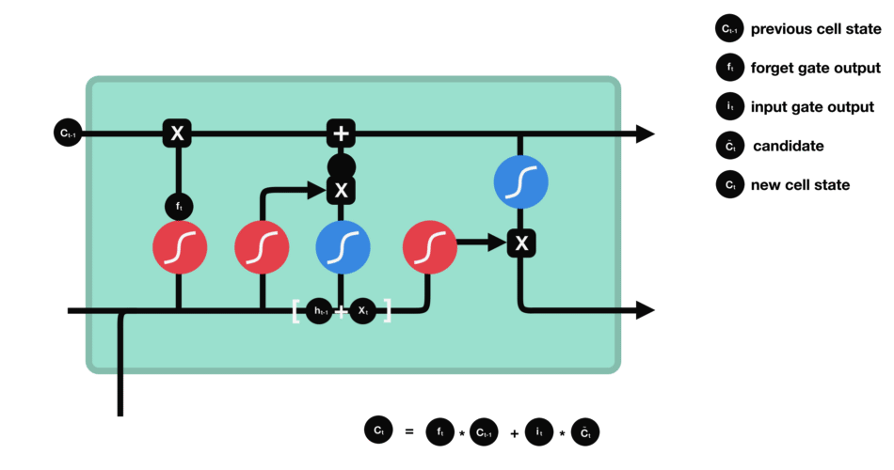
LSTM CELL STRUCTURE

Slide 21
Evaluation of Generated Caption
For text evaluation we have a metric called a BLEU Score. BLEU stands for Bilingual Evaluation Understudy which is a score for comparing a candidate text to the reference text to check out the generated caption’s quality.
BLEU-SCORE EVALUATION
BLEU-1 | 0.569691
BLEU-2 | 0.277107
BLEU-3 | 0.182869
BLEU-4 | 0.080318

Slide 22
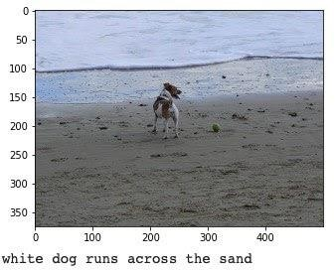
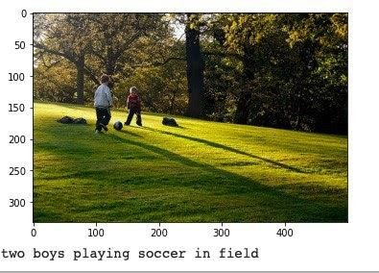
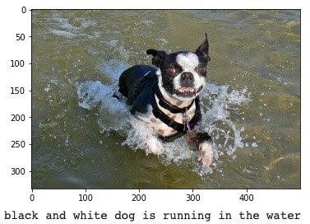
Result and Discussion
 | Generated Caption White dog runs across the sand. Human provided caption A dog is standing on the beach.
 | Generated Caption Two boys playing soccer in field. Human provided caption Two children are playing soccer in the park.
 | Generated Caption Black and white dog is running in the water. Human provided caption The dog is running in the water.

Slide 23
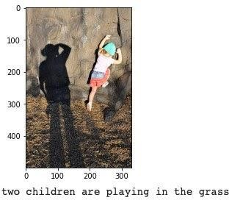
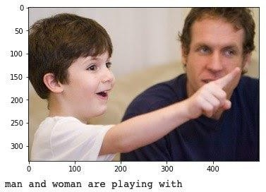
 | Generated Caption Two children are playing in the grass Human provided caption A girl is trying to climb the hill.
 | Generated Caption Man and woman are playing with Human provided caption A boy is showing something to the man.

Slide 24


SCREENSHOTS

Slide 25
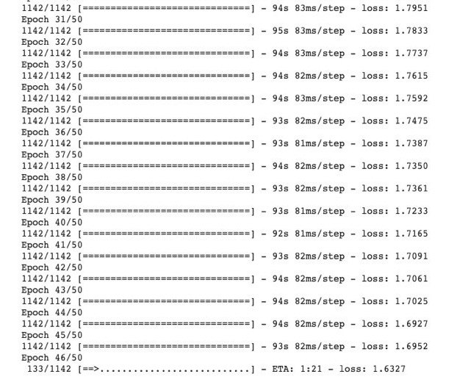

Slide 26
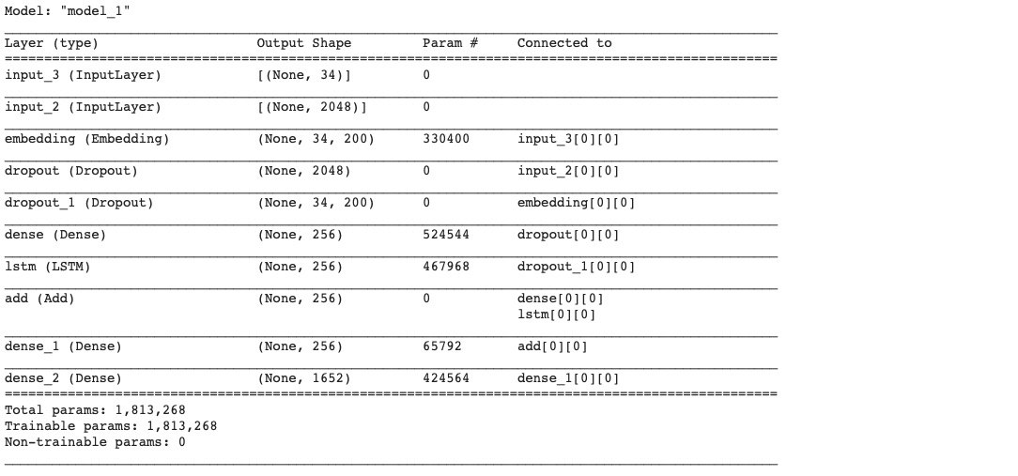

Slide 27
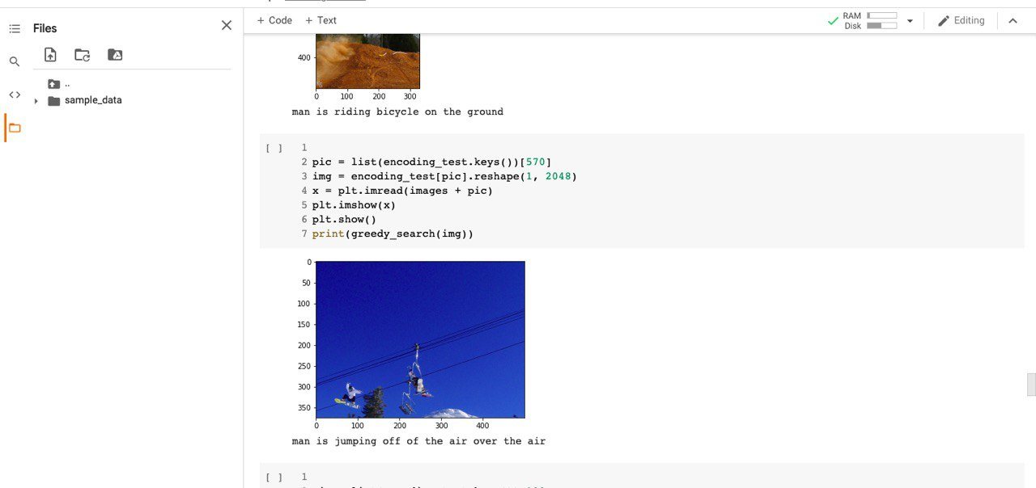

Slide 28
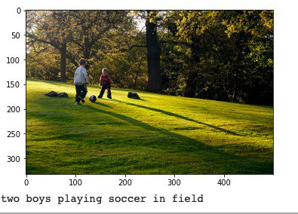
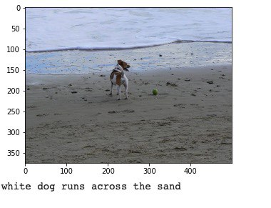

Slide 29
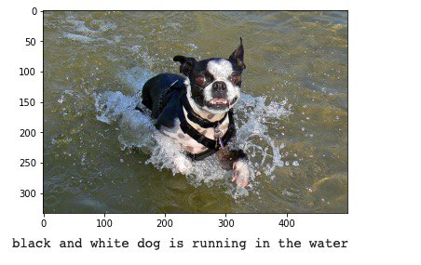
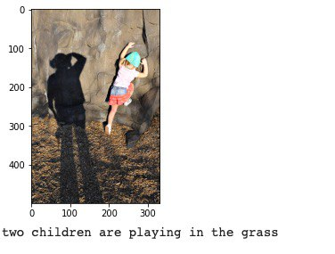

Slide 30
Conclusion
In the proposed work, a hybrid-model for Image caption generation is proposed using Inception- V3 model with pre-trained weights for feature extraction and a Recurrent neural network that is the LSTM model for sentence generation.
The work is based on extracting the features from the image and generating the meaningful caption for the given input image.
Furthermore, The model’s accuracy can be boosted by deploying it on a larger dataset so that the words in the vocabulary of the model increase significantly. The use of relatively newer architecture, like ResNet and GoogleNet can also increase the accuracy in the classification task thus reducing the error rate in the language generation.
Apart from that the use of bidirectional LSTM network and Gated Recurrent Unit may help in improving the accuracy of the model.

Slide 31
References
[1] Sebastain, S. (2016). Performance evaluation by artificial neural network using WEKA. International Research Journal of Engineering and Technology, 3(3), 1459-1464
[2] Krizhevsky, A., Sutskever, I., & Hinton, G. E. (2017). Imagenet classification with deep convolutional neural networks. Communications of the ACM, 60(6),84-90.
[3] Xu, K., Wang, H., & Tang, P. (2017, July). Image captioning with deep LSTM based on sequential residual. In 2017 IEEE International Conference on Multimedia and Expo(ICME) (pp. 361-366). IEEE.
[4] Schmidhuber, J., & Hochreiter, S. (1997). Long short-term memory. Neural Comput, 9(8),1735-1780.
[5] Gers, F. A., Schraudolph, N. N., & Schmidhuber, J. (2002). Learning precise timing with LSTM recurrent networks. Journal of machine learning research, 3(Aug),115-143.

Slide 32
[6] Deng, J., Dong, W., Socher, R., Li, L. J., Li, K., & Fei-Fei, L. (2009, June). Imagenet: A large-scale hierarchical image database. In 2009 IEEE conference on computer vision and pattern recognition (pp. 248-255).Ieee.
[7] Karpathy, A., & Fei-Fei, L. (2015). Deep visual-semantic alignments for generating image descriptions. In Proceedings of the IEEE conference on computer vision and pattern recognition (pp.3128-3137).

Slide 33
DEMO

Slide 34
THANKYOU

