Slide 1
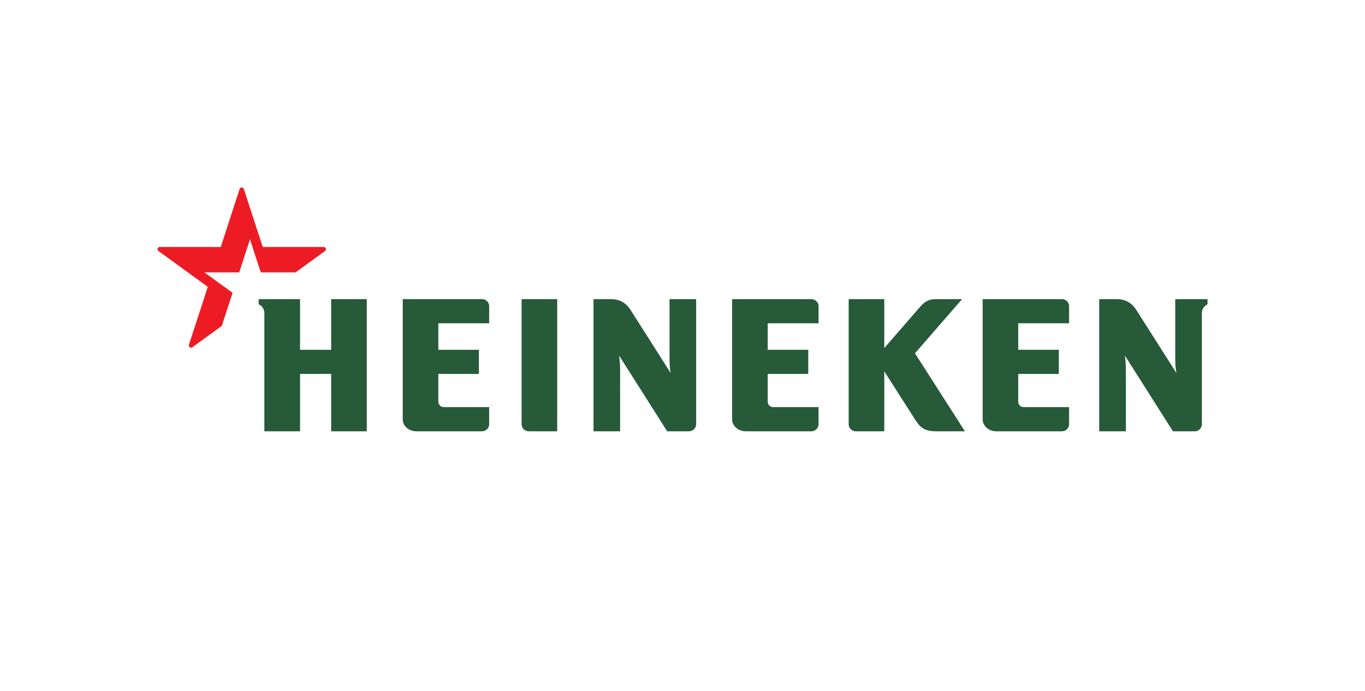
AIO_369
A robust approach for empowering beer business analysis
Trần Duy Tuấn
Mai Trung Kiên
Nguyễn Đại Anh Tuấn

Slide 2



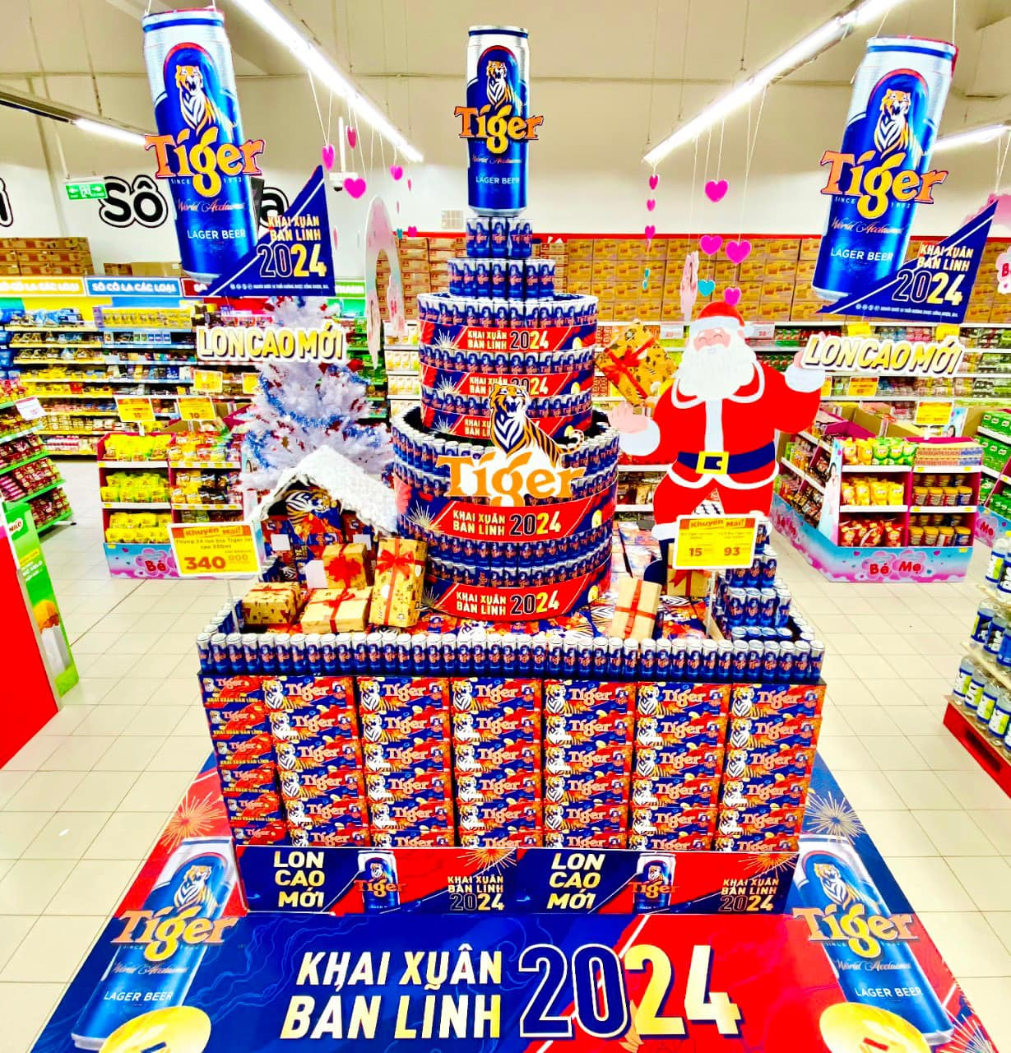
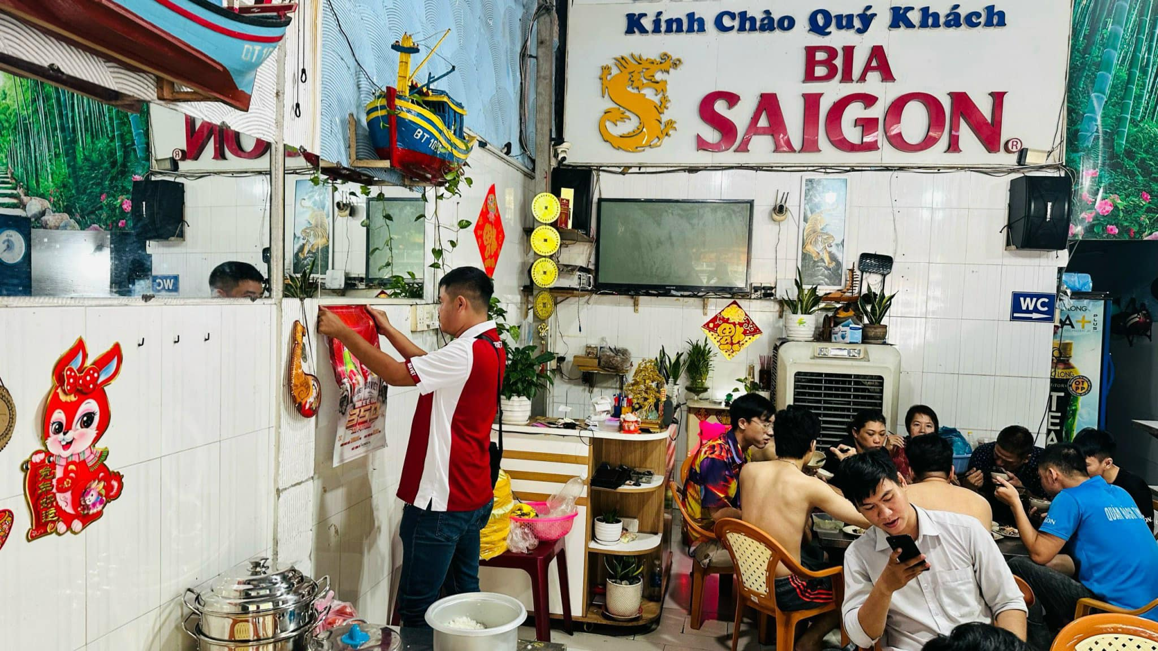

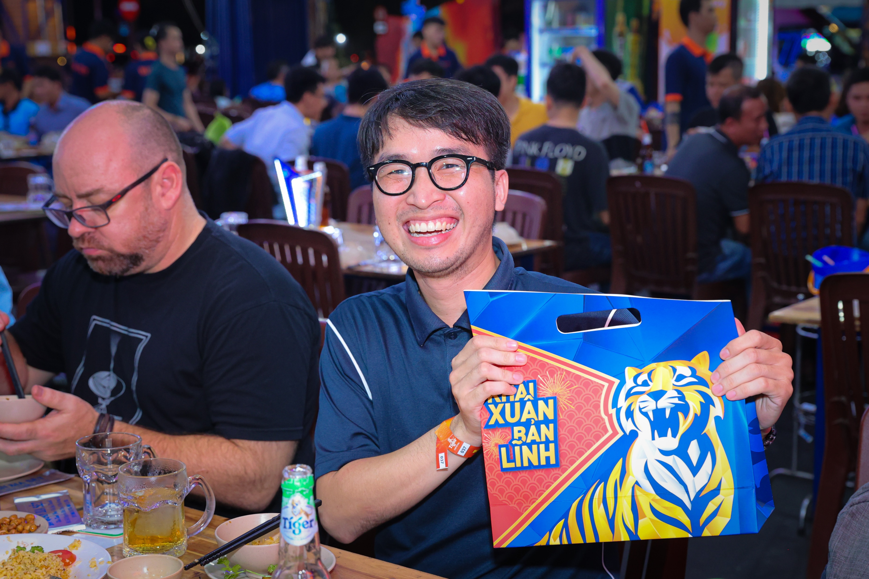
1. Motivation
Traditional method
Our approach
We use AI model for all analysis tasks.

Slide 3
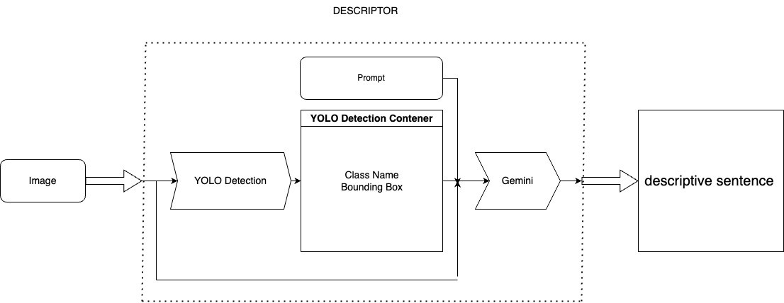
2. Our approach
YOLOv10 and Gemini are the backbone of our method. The Figure 1 outlines our process where an image is inputted into a system, YOLO detects objects and their bounding boxes, and this information is passed to Gemini. Gemini then analyzes the context, emotions, and actions to generate a descriptive sentence summarizing the image.
Figure 1. The pipeline for our proposed method

Slide 4
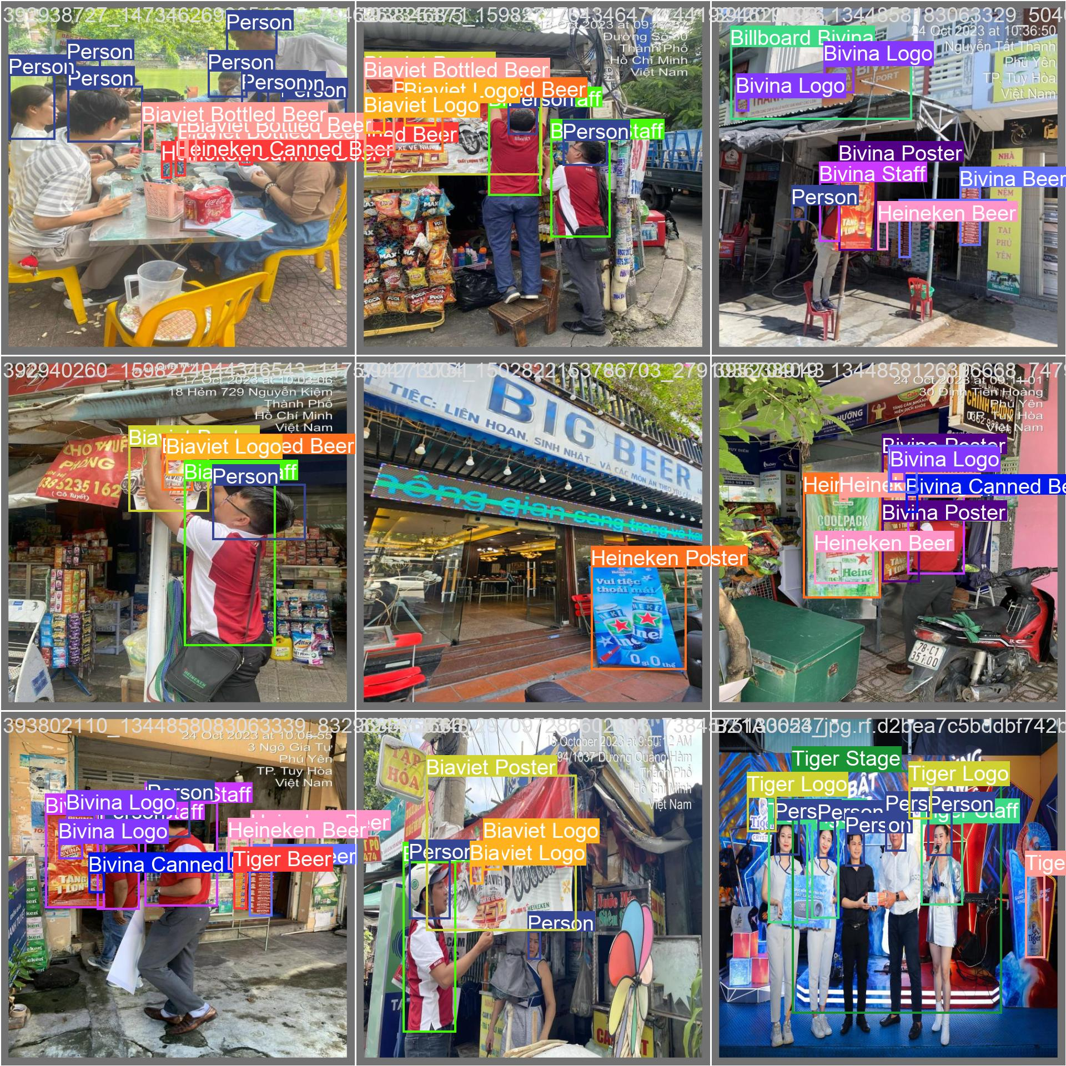
2. Our approach
To train YOLOv10, we conduct label on beer carpet, human face, brand staff, beer can, beer bottle, billboard, poster, brand logo
Figure 2. Result of pretrained YOLOv10 for detecting object

Slide 5
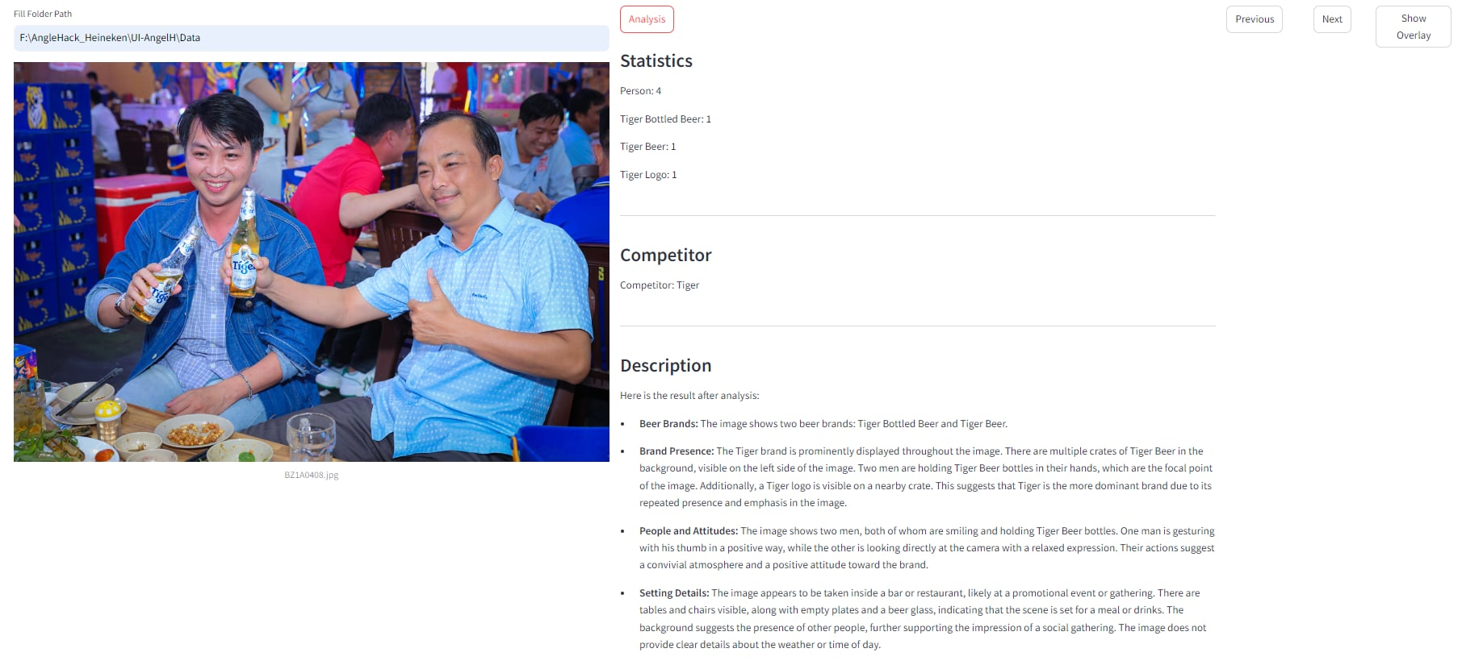
2. Our approach
We create a user-friendly app for use
Figure 3. UI for our approach

Slide 6
3. Result
Our approach solve almost the provided challenges, include:
Business Challenge 2: Advertising Material Detection
Business Challenge 3: Event Success Evaluation
Business Challenge 4: Monitoring Marketing Staff
Business Challenge 5: Evaluating Store Presence
- Context Identification
- Identifying Competitors' Logos

Slide 7
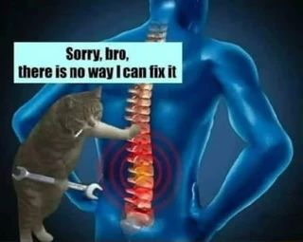
4. Our difficulty
During our work, we face several challenges:
1. Imbalanced labels in the training dataset.
2. The need for a suitable LLM model to enhance the task of context review.
3. Significant time spent configuring effective prompts for high performance.
4. Lack of ergonomic chairs, which cannot be adjusted properly, affecting our comfort and spine health. D:

Slide 8



5. Our future
No need for the arrival of brand staff
Beer Staffs
Use 1 VQA model for all tasks: object detecting, context reviews and context analysis

Slide 9
Thank you for listening
We are AIO_369

