Slide 1



Statistics for biological data
Contingency tables & significance tests for categorical variables
Aya Elwazir
Teaching assistant of medical genetics, FOMSCU
PhD student, University of Sheffield

Slide 2
A look at the data!
Categorical
Continuous
Categorical
Case No. | Treatment | Troponin | Abdominal problems
1 | Aspirin | 0.032 | Yes
2 | Aspirin | 0.045 | Yes
3 | Aspirin | 0.028 | No
4 | Placebo | 0.018 | Yes
5 | Placebo | 0.030 | No
6 | Placebo | 0.021 | No
Is daily aspirin use associated with higher frequency of abdominal problems?
H₀
Daily aspirin use is associated with lower OR not associated with frequency of abdominal problems
H₁
Daily aspirin use is associated with higher frequency of abdominal problems

Slide 3
Two by two table
Is daily aspirin use associated with higher frequency of abdominal problems?
 |  | Abdominal problems
 |  | Yes | No
Treatment | Aspirin
 | Placebo
Frequency distribution of two categorical variables simultaneously
Allows us to assess if there is a relationship between the two variables

Slide 4
Two by two table
 |  | Abdominal problems
 |  | Yes | No
Treatment | Aspirin | 2 | 1
 | Placebo | 1 | 2
Case No. | Treatment | Abdominal problems
1 | Aspirin | Yes
2 | Aspirin | Yes
3 | Aspirin | No
4 | Placebo | Yes
5 | Placebo | No
6 | Placebo | No
Count
‘frequency’

Slide 5
Two by two table
 |  | Abdominal problems
 |  | Yes | No
Treatment | Aspirin | 2 | 1
 | Placebo | 1 | 2
Total
3
3
Total | 3 | 3 | 6
Total

Slide 6
Two by two table
 |  | Abdominal problems
 |  | Yes | No
Treatment | Aspirin | 2 (0.67) | 1 (0.33)
 | Placebo | 1 (0.33) | 2 (0.67)
Total
3
3
Total | 3 | 3 | 6
Total
Proportion

Slide 7
Two by two table
 |  | Abdominal problems
 |  | Yes | No
Treatment | Aspirin | 2 (67%) | 1 (33%)
 | Placebo | 1 (33%) | 2 (67%)
Total
3
3
Total | 3 | 3 | 6
Total
Proportion
Percentage

Slide 8

Two by two table
 |  | Abdominal problems
 |  | Yes | No
Treatment | Aspirin | 2 (67%) | 1 (33%)
 | Placebo | 1 (33%) | 2 (67%)
P value
?
Is daily aspirin use associated with higher frequency of abdominal problems?

Slide 9
Hypothesis Testing for categorical variables
Chi square
test
Fisher Exact
test
chisq.test()
fisher.test()

Slide 10
Chi square test
Compares distribution of two categorical variables in a contingency table to see if they are related
Measures difference between what is actually observed in the data and what would be expected if there was truly no relationship between the variables
Row total x Column total
E=
Overall total

Slide 11
Chi square test
Observed
 |  | Abdominal problems |  | Total
 |  | Yes | No
Treatment | Aspirin | 43 | 17 | 60
 | Placebo | 22 | 35 | 57
Total |  | 65 | 52 | 117
R total x C total
E=
Overall total
Expected
 |  | Abdominal problems
 |  | Yes | No
Treatment | Aspirin | 33.3 | 26.7
 | Placebo | 31.7 | 25.3

Slide 12

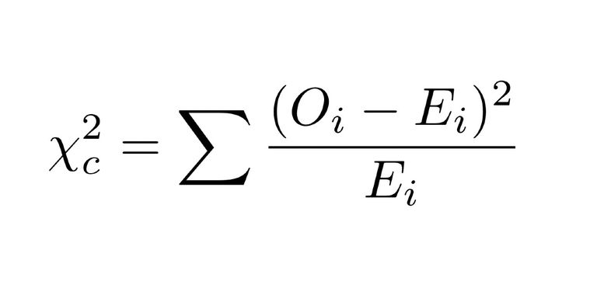

Chi square test
Observed
 |  | Abdominal problems |  | Total
 |  | Yes | No
Treatment | Aspirin | 43 | 17 | 60
 | Placebo | 22 | 35 | 57
Total |  | 65 | 52 | 117
R total x C total
E=
Overall total
X²= 12.95
P= 0.00032
Accept or reject?
H₀
Daily aspirin use is associated with lower OR not associated with frequency of abdominal problems

Slide 13
Fisher Exact test
Used instead of Chi square when >20% of cells have expected values < 5
Or any cell has a count< 1
Expected
 |  | Abdominal problems
 |  | Yes | No
Treatment | Aspirin | 4.3 | 16.7
 | Placebo | 11.7 | 3.6

Slide 14
A look at the data again!
Categorical
Continuous
Categorical
Case No. | Treatment | Troponin | Abdominal problems
1 | Aspirin | 0.032 | Yes
2 | Aspirin | 0.045 | Yes
3 | Aspirin | 0.028 | No
4 | Placebo | 0.018 | Yes
5 | Placebo | 0.030 | No
6 | Placebo | 0.021 | No
Is daily aspirin use associated with lower troponin levels?
Significance tests for continuous variables

Slide 15

Statistics for biological data
Course Objectives
Introduction to statistics
1. Contingency tables & testing for categorial variables
2. Normality testing & Descriptive statistics
3. Testing for continuous variables
Lots of practice!

