Slide 1



Statistics for biological data
Normality testing & descriptive statistics
Aya Elwazir
Teaching assistant of medical genetics, FOMSCU
PhD student, University of Sheffield

Slide 2
Descriptive statistics
SD
Range
Mean
Median
Mode
Variance
SD
Interquartile
range

Slide 3
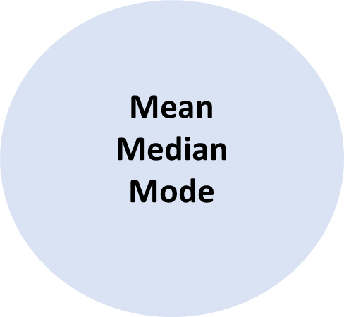
Descriptive statistics: measures of central tendency
Mean
average
(sum/number)
mean(x)
2 4 8 3 3
Mean = 2+4+8+3+3 / 5
= 20/5
= 4

Slide 4

Descriptive statistics: measures of central tendency
Median
Number in the middle
median(x)
2 4 8 3 3
Re-arrange
(ascending order)
2 3 3 4 8
In case number of data is even
2 3 3 4 8 9
Average 3+4 /2 = 3.5

Slide 5
Descriptive statistics: measures of central tendency
Mode
Most repeated
number
2 4 8 3 3
Mode= 3

Slide 6
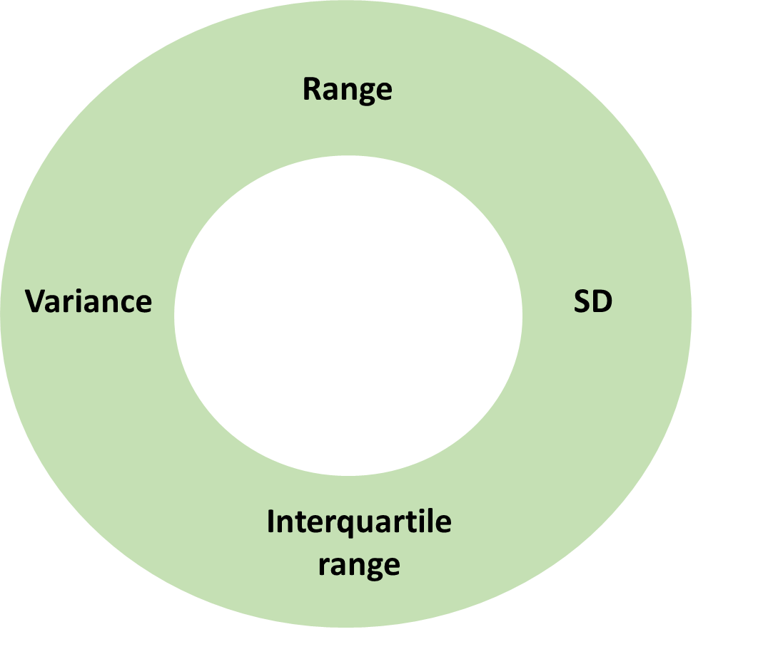
Descriptive statistics: measures of dispersion
Range
Maximum - Minimum
range(x)
2 4 8 3 3
Re-arrange
(ascending order)
2 3 3 4 8
min
max
Range= max – min
= 8 – 2
= 6

Slide 7
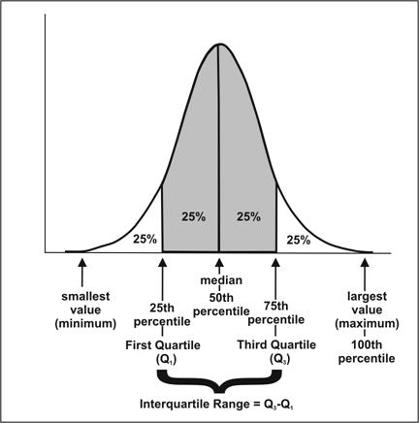
Descriptive statistics: measures of dispersion
Interquartile
range (IQR)
middle 50% of the data

Slide 8
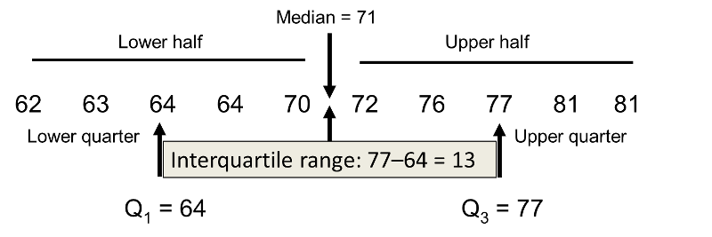
Descriptive statistics: measures of dispersion
Interquartile
range (IQR)
middle 50% of the data
IQR(x)
Q3 minus Q1
quantile(x,0.25)
Q1
quantile(x,0.75)
Q3
Q1- Q3
IQR = Q1-Q3
64-77

Slide 9
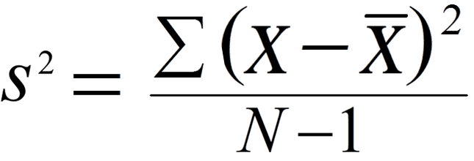
Descriptive statistics: measures of dispersion
Variance & Standard deviation
how much the data differs from the mean value
(difference of each data value from the mean)
V
SD
var(x)
sd(x)
Sum of
Value
Sample size
Mean

Slide 10
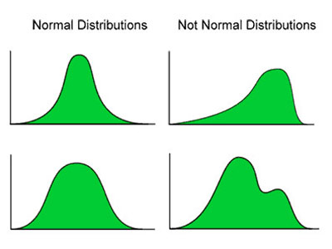
Choice of descriptive statistics
Continuous data
Normally distributed
NOT normally distributed
Mean ± SD
Median (IQR)

Slide 11
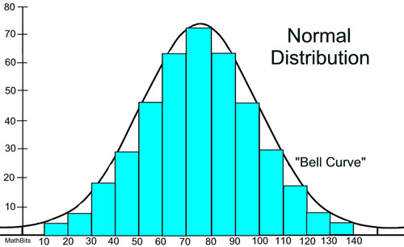
Normal distribution
Mean
Median
Mode

Slide 12
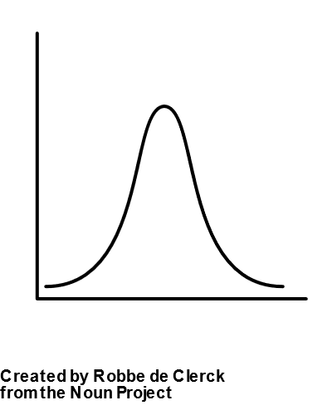
Normal distribution
Shorter than average
=
Taller than average
Number of people
Shortest
people
Average height
Tallest people

Slide 13
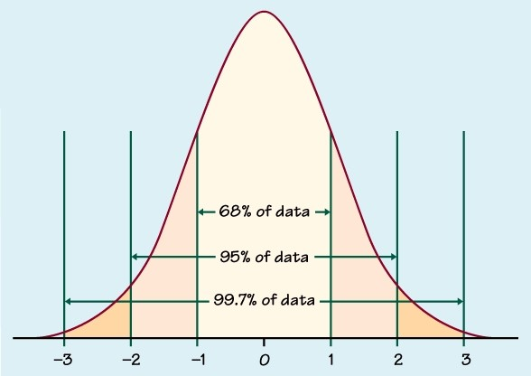
Normal distribution
Mean ± SD
Height: 170±10
1SD
68% of the population have heights between
160 and 180
SD

Slide 14
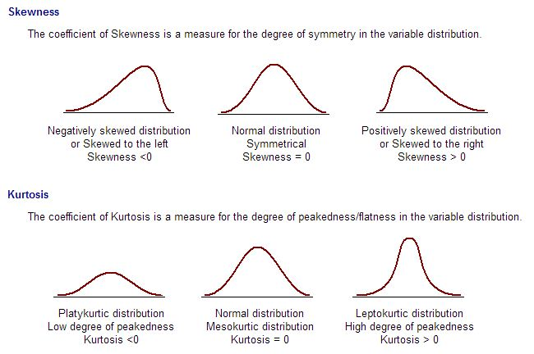
Skewness/kurtosis

Slide 15
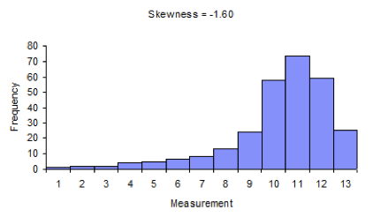
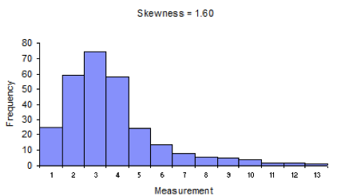
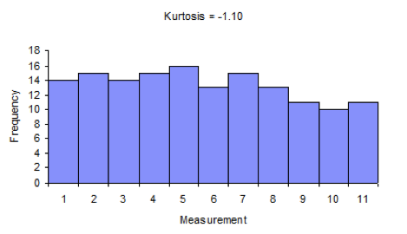
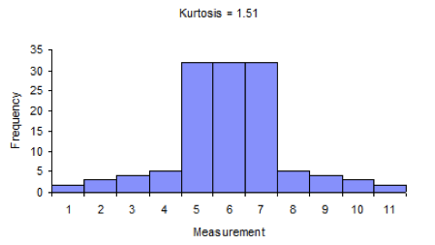
Skewness/kurtosis

Slide 16
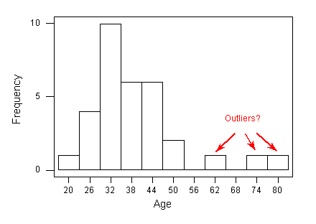
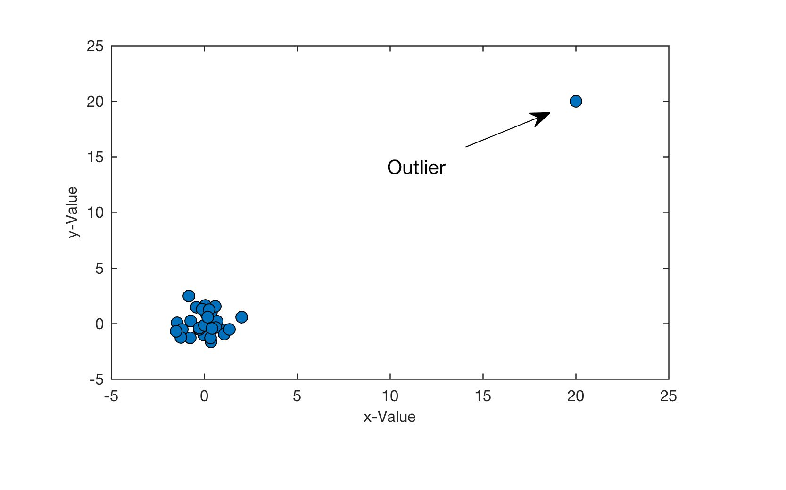
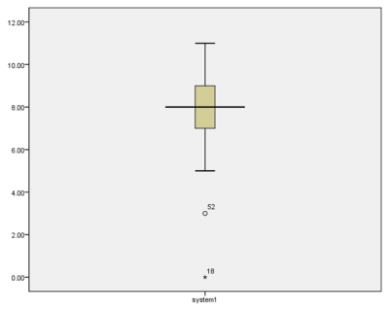
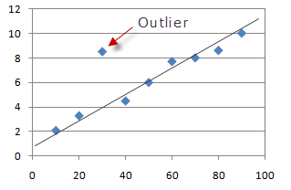
Outliers
An observation that is distant from other observations
Makes the data skewed (NOT normally distributed)

Slide 17
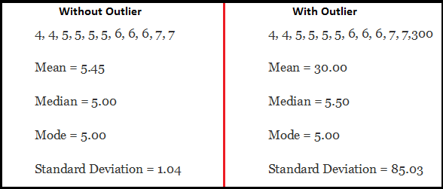
Outliers

Slide 18
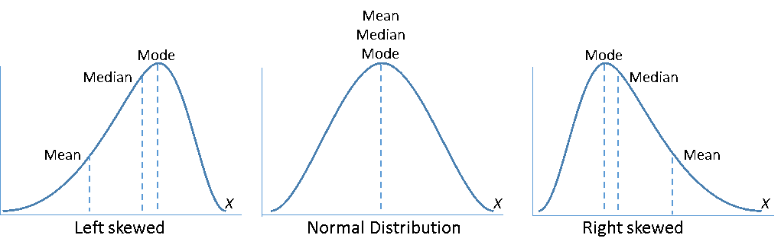
Effect of Skewness on mean and median
Median (IQR)
Mean ± SD
Median (IQR)
Small effect on median
Huge effect on mean

Slide 19
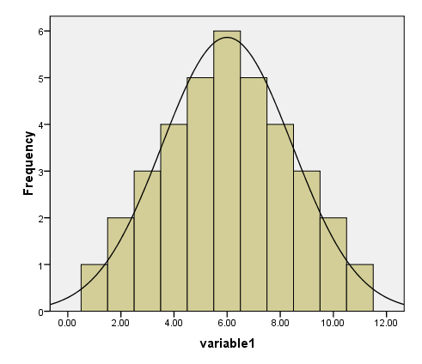
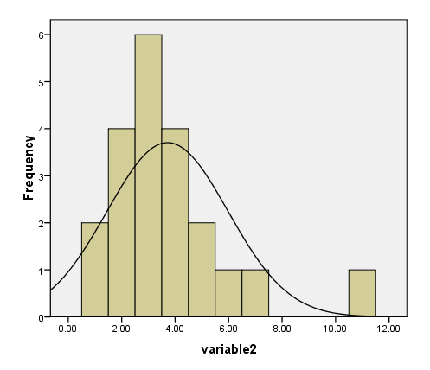
Testing for normality
Histogram
Normal
Not Normal

Slide 20
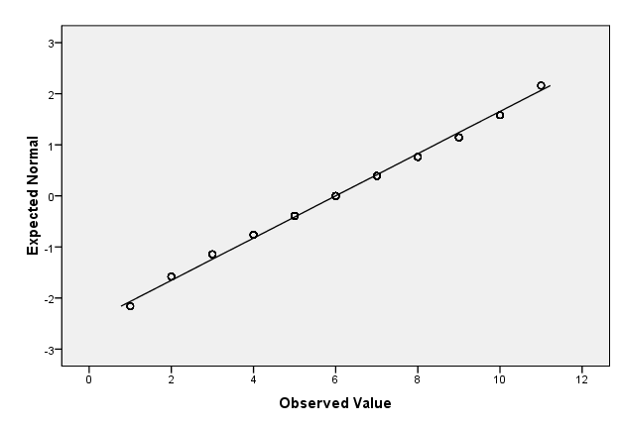
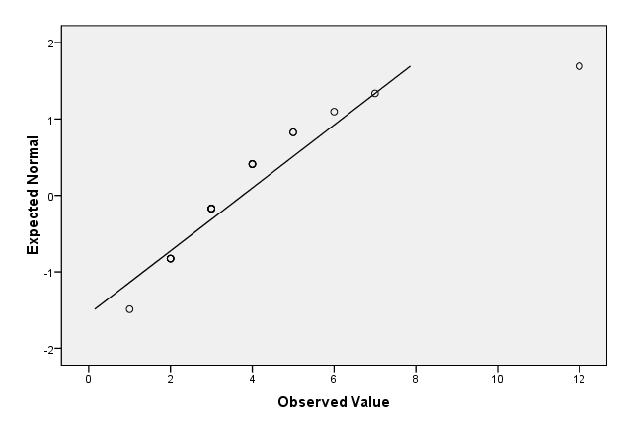
Testing for normality
Q-Q plot
Normal
Not Normal

Slide 21
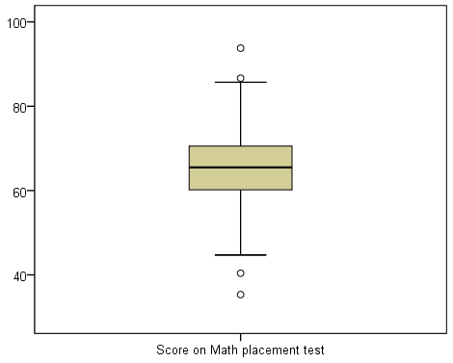
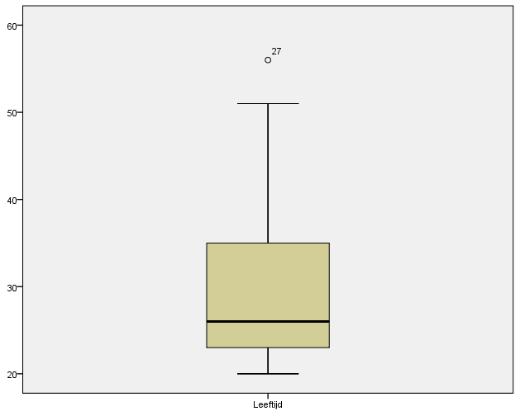
Testing for normality
Box plot
Normal
Not Normal

Slide 22
Testing for normality
Significance tests
Shapiro-Wilk W
Test
Anderson-Darling
Test
Kolmogorov-Smirnov Test
shapiro.test(x)
ad.test(x)
ks.test(x)
Compares data to a normal distribution
Is there a significant difference between the data and the normal distribution?
Significant → Not Normal
Not significant → Normal

Slide 23
Summary
Continuous variables
Test for normality
Select descriptive statistic
Plots
Significance tests
Normal
Not Normal
Histogram
Q-Q plot
Boxplot
Shapiro-Wilk W
Anderson-Darling
Kolmogorov-Smirnov
Mean ± SD
Median (IQR)

Slide 24

Statistics for biological data
Course Objectives
Introduction to statistics
1. Contingency tables & testing for categorial variables
2. Normality testing & Descriptive statistics
3. Testing for continuous variables
Lots of practice!

