Slide 1
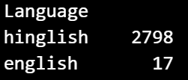
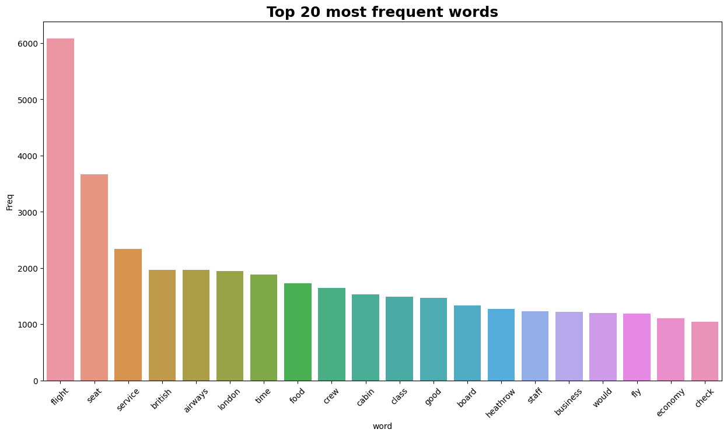
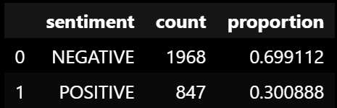
Insight Summaries
Total reviews about flights are in English
There are 1968 negative feedbacks, accounting for 69.9% of the response rate. There are 847 positive feedbacks, accounting for 30.1% of the response rate
‘seat, service, time, food, crew, cabin, economy,…’ is most frequent words of customers feedbacks

