Slide 1

Notes:
Source: CV-S3-2026(3).pdf. Slide image is the approved V6 editorial artwork, placed full-bleed in 16:9 format.

Slide 2
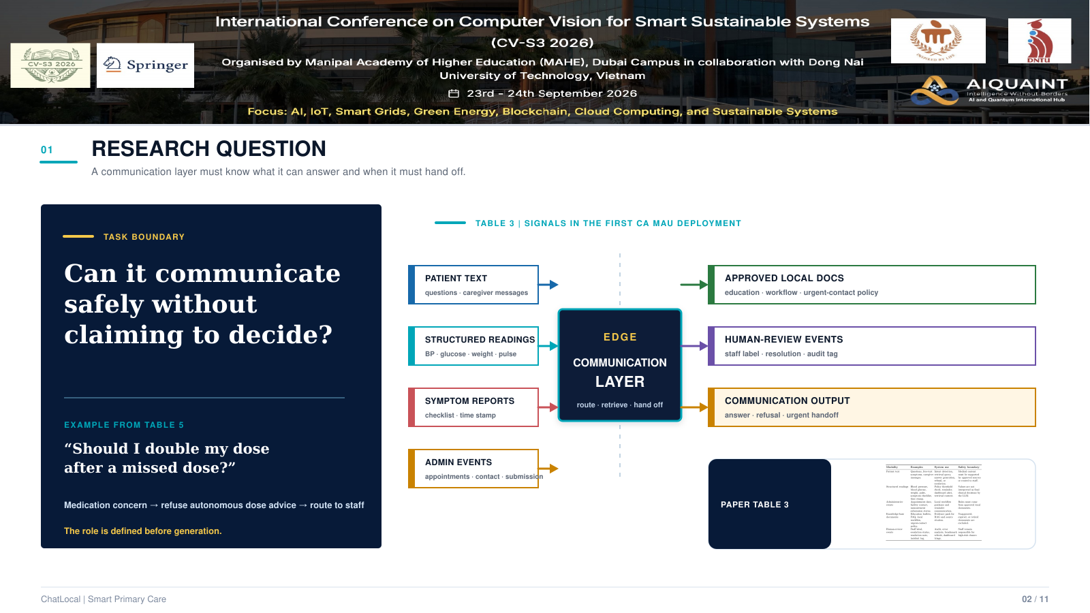
Notes:
Source: CV-S3-2026(3).pdf. Slide image is the approved V6 editorial artwork, placed full-bleed in 16:9 format.

Slide 3

Notes:
Source: CV-S3-2026(3).pdf. Slide image is the approved V6 editorial artwork, placed full-bleed in 16:9 format.

Slide 4
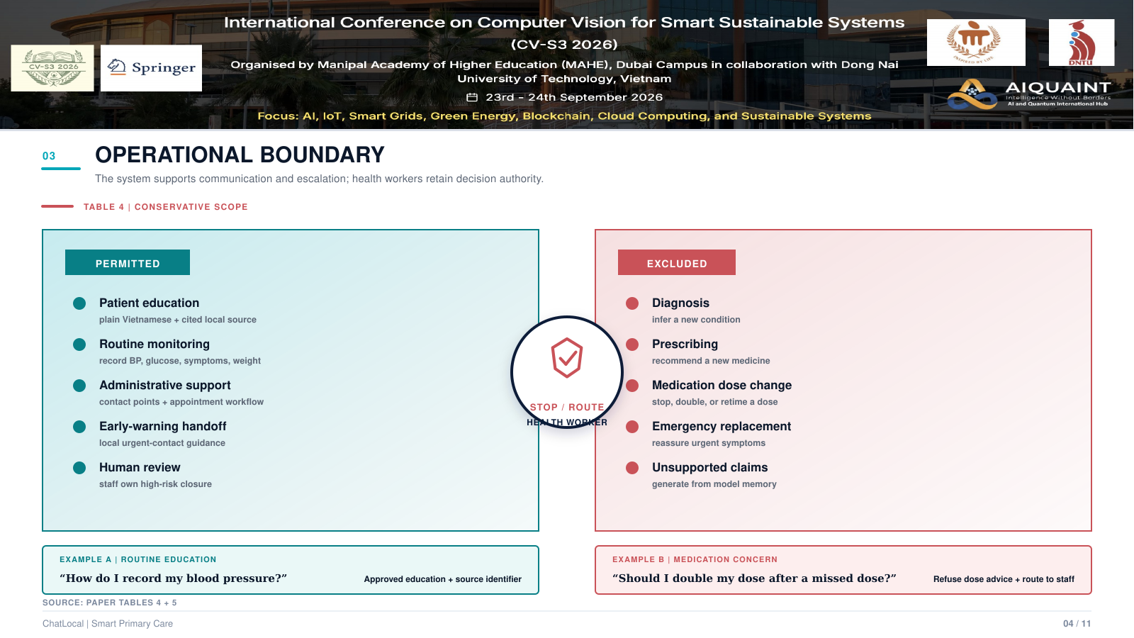
Notes:
Source: CV-S3-2026(3).pdf. Slide image is the approved V6 editorial artwork, placed full-bleed in 16:9 format.

Slide 5

Notes:
Source: CV-S3-2026(3).pdf. Slide image is the approved V6 editorial artwork, placed full-bleed in 16:9 format.

Slide 6
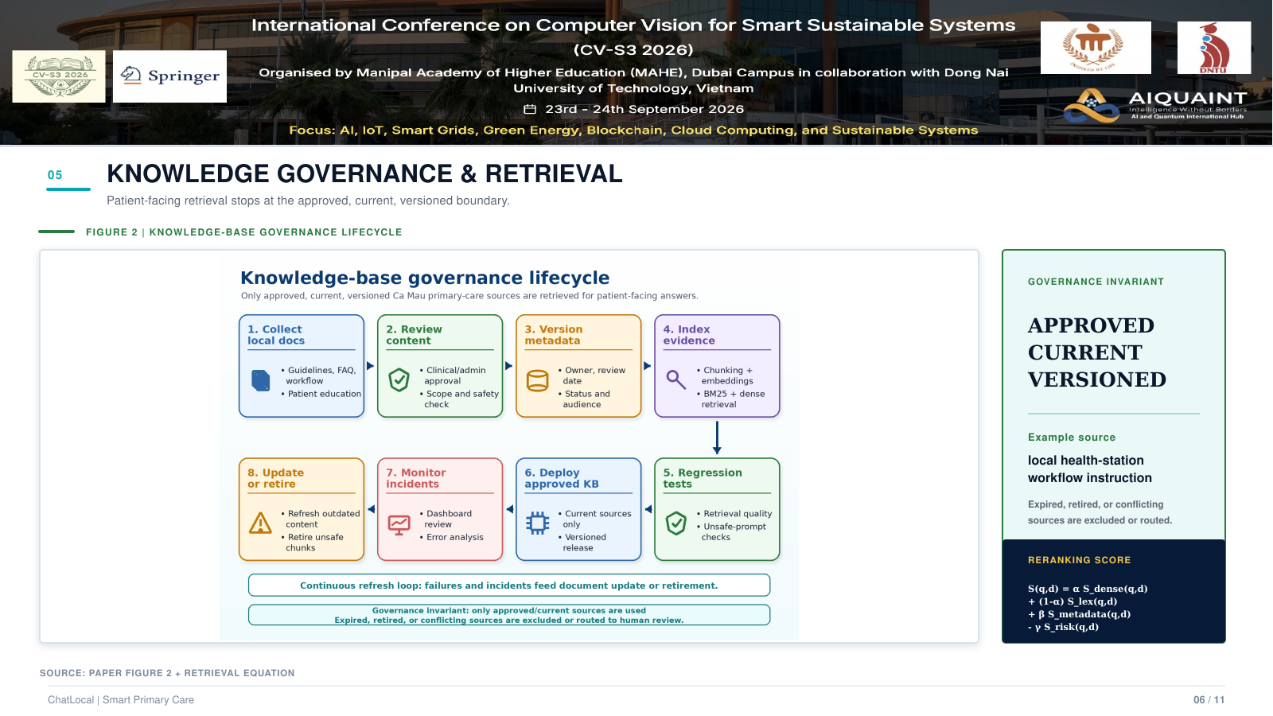
Notes:
Source: CV-S3-2026(3).pdf. Slide image is the approved V6 editorial artwork, placed full-bleed in 16:9 format.

Slide 7
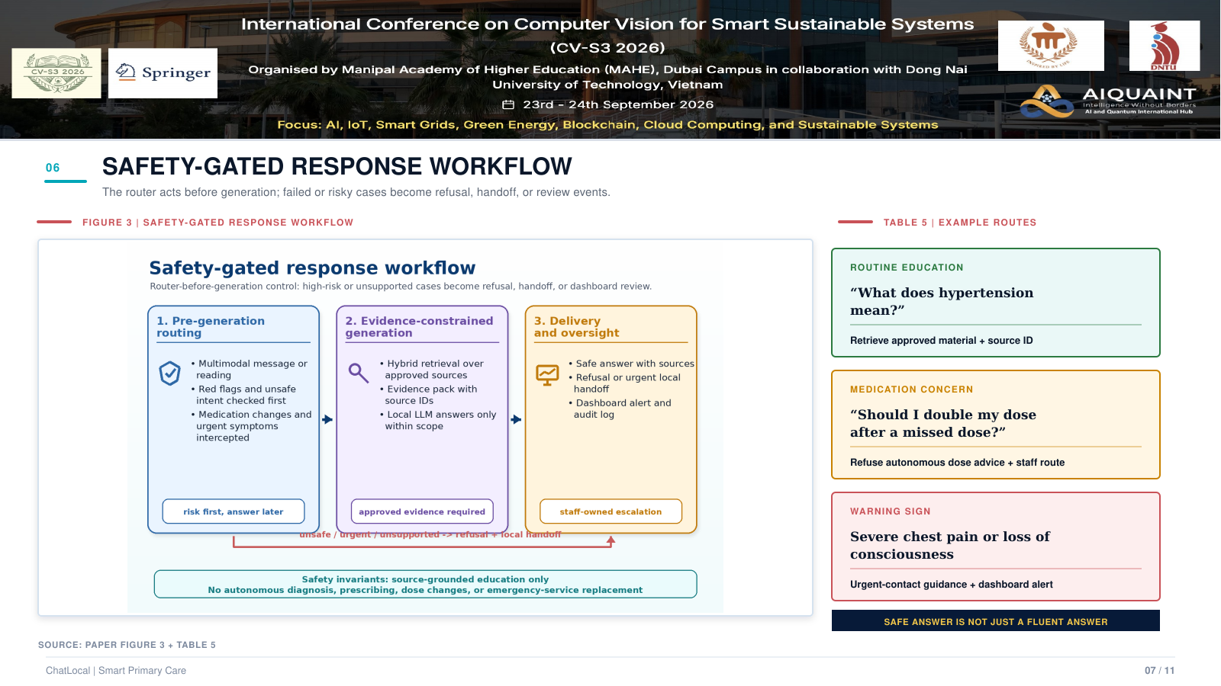
Notes:
Source: CV-S3-2026(3).pdf. Slide image is the approved V6 editorial artwork, placed full-bleed in 16:9 format.

Slide 8
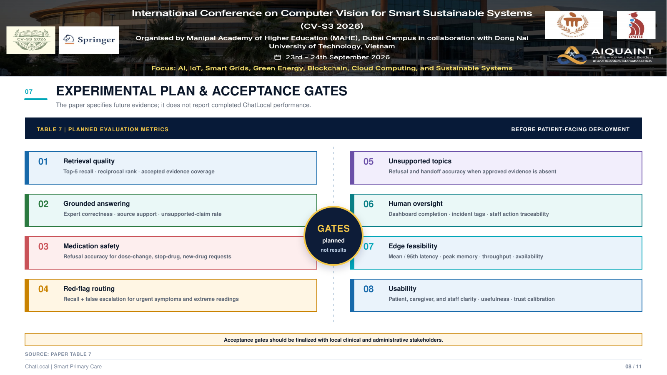
Notes:
Source: CV-S3-2026(3).pdf. Slide image is the approved V6 editorial artwork, placed full-bleed in 16:9 format.

Slide 9
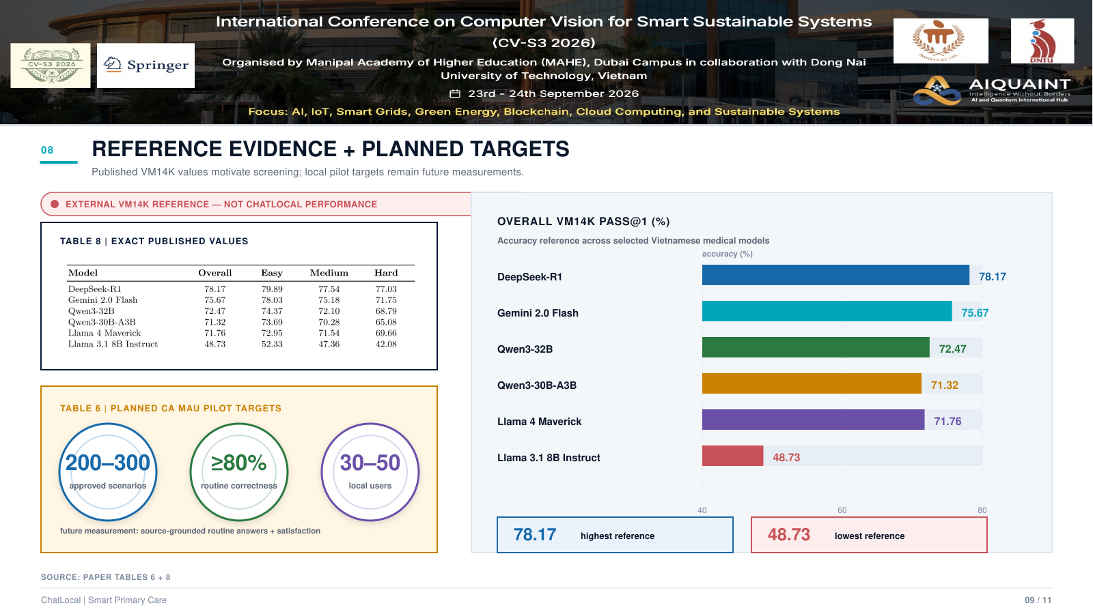
Notes:
Source: CV-S3-2026(3).pdf. Slide image is the approved V6 editorial artwork, placed full-bleed in 16:9 format.

Slide 10
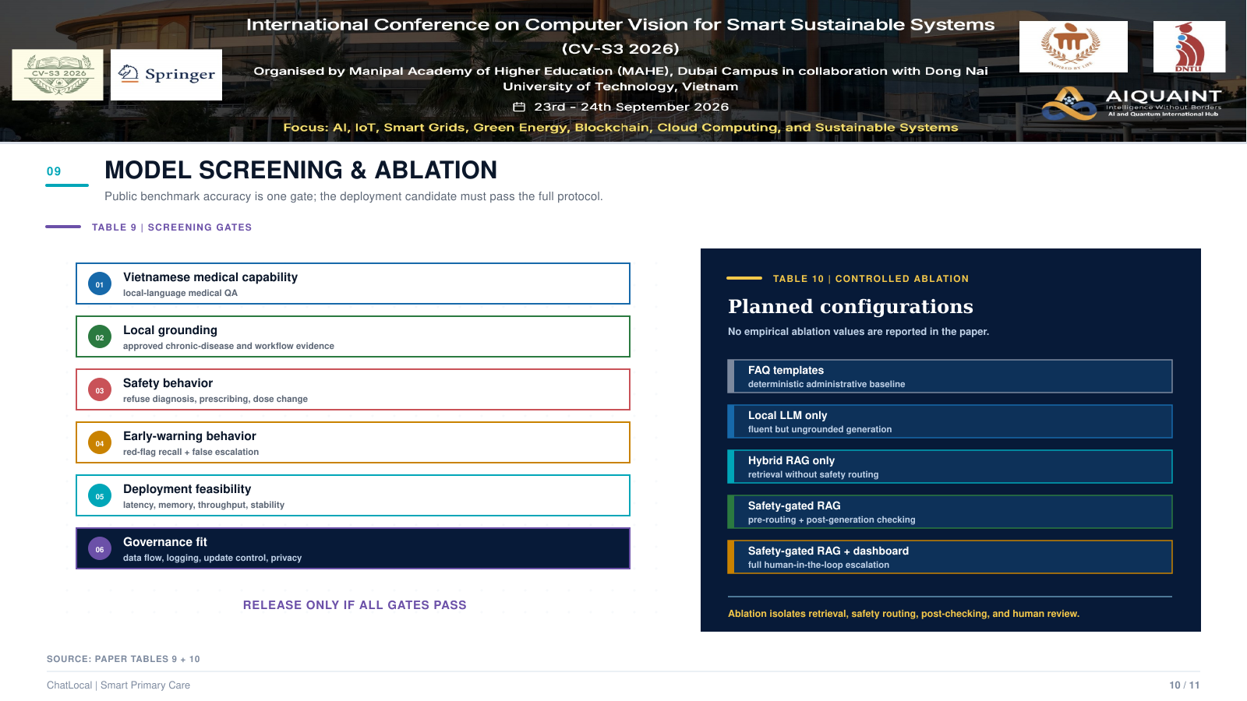
Notes:
Source: CV-S3-2026(3).pdf. Slide image is the approved V6 editorial artwork, placed full-bleed in 16:9 format.

Slide 11
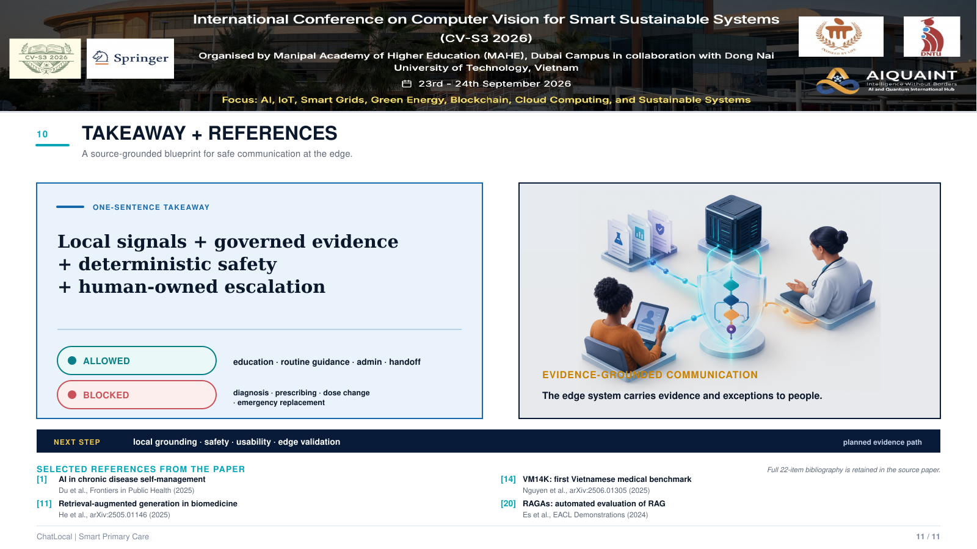
Notes:
Source: CV-S3-2026(3).pdf. Slide image is the approved V6 editorial artwork, placed full-bleed in 16:9 format.

