Slide 1



Twitter
Client
Group 3
Notes:
<a href="https://www.freepik.com/free-photos-vectors/business">Business vector created by pikisuperstar - www.freepik.com</a>

Slide 2


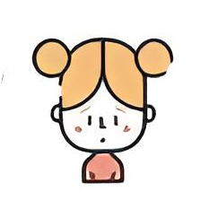

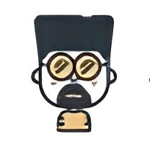

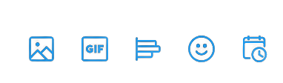
Home
Nguyen Thi
Quynh Anh
Vu Yen Linh
Nguyen Thi
Khanh Huyen
Le Tran
Khuong Duy
Vi Van Hieu
Group 3

Slide 3

Table of content
Trending in Mobile Application
#No1. Introduction
70k Tweets
#No2. Architecture
50k Tweets
#No3. Activities
46k Tweets
#No4. Optimization
37k Tweets
#No5. Demo
22K Tweets
#No6. Conclusion
10.7K Tweets
Notes:
slidesppt.net
‹#›

Slide 4
Introduction

Slide 5

# NO1. INTRODUCTION
Overview
Twitter is an open social network that people use to converse with each other.
People are using it to share their news, updates and follow their favourite celebrities.
2. About mobile app
Users are able to read, post, retweet and share different types of content from their phone.
Twitter users can discover the latest happenings anywhere from their mobile device.

Slide 6
Architecture

Slide 7
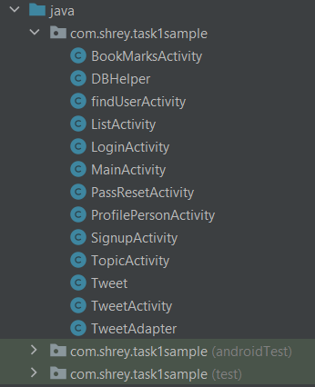
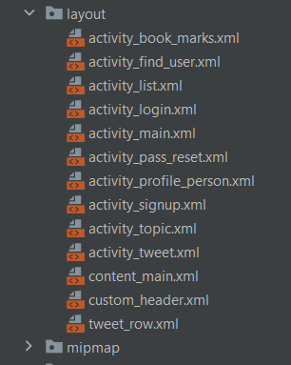
Main Components
Base Activity, Single Fragment Activity
Res (layout design)

Slide 8
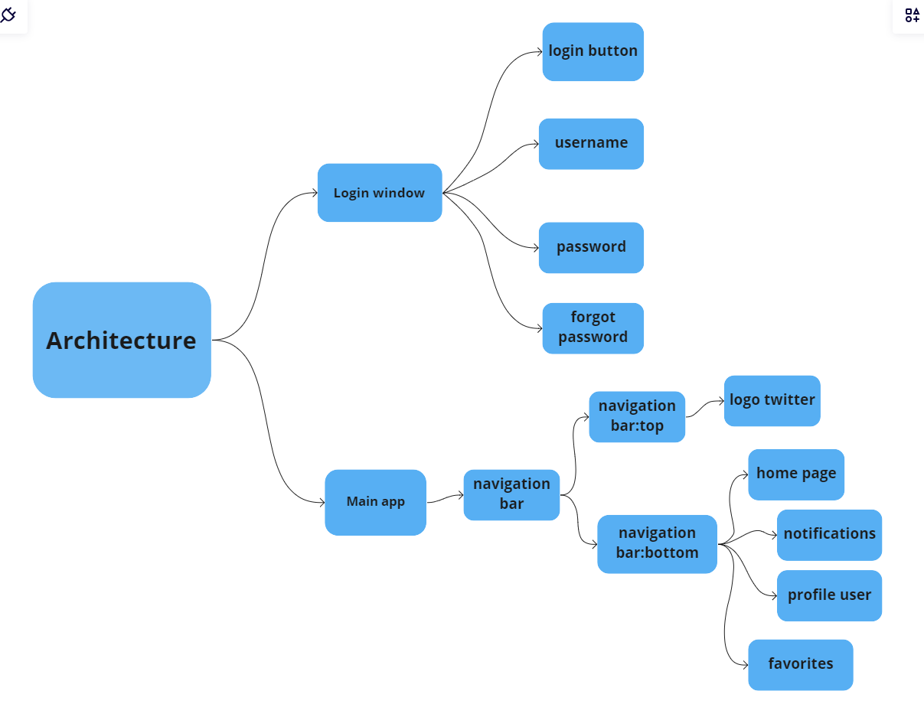
# NO2. ARCHITECTURE
Notes:
<a href="https://www.freepik.com/free-photos-vectors/background">Background vector created by freepik - www.freepik.com</a>

Slide 9
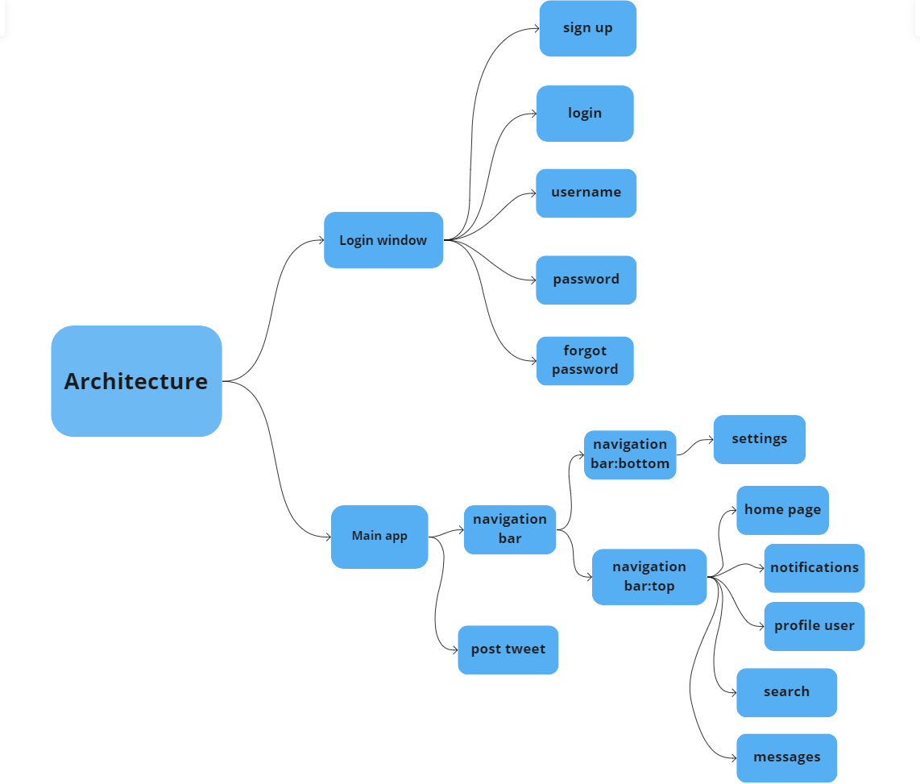

After
Additional function :
+Login window
-Sign up
+Main app
-post tweet
-navbar: settings,search,messages

Slide 10
Activities

Slide 11
Main Activities & Fragments
- Sign up Activity & Login Activity
- Pass Reset Activity
- Tweet Activity
- Lists Activity
- Login Activity & Login Fragment : Start app
- Lists Activity :
Profile
List
Topics
Bookmarks
Notes:
slidesppt.net
‹#›

Slide 12
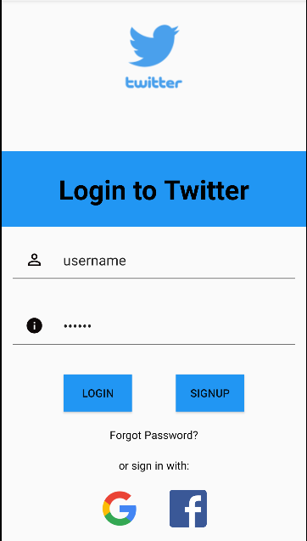
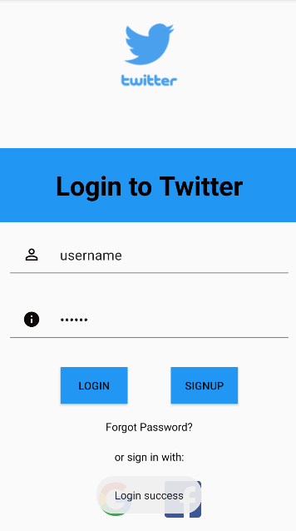
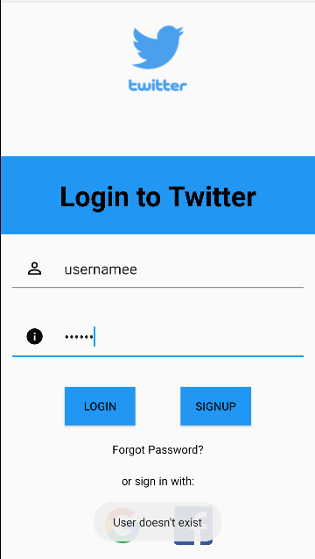
# NO3. ACTIVITIES
Login activity
Notes:
<a href="https://www.freepik.com/free-photos-vectors/background">Background vector created by freepik - www.freepik.com</a>

Slide 13
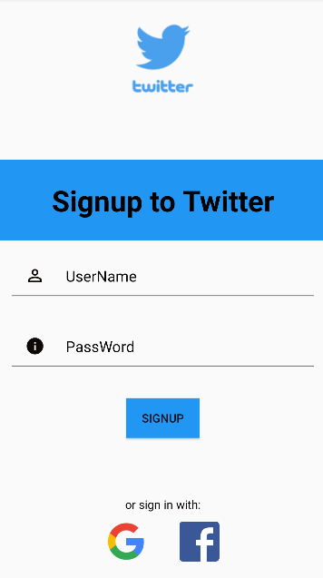
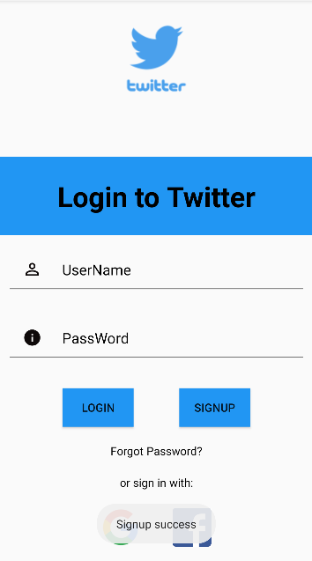
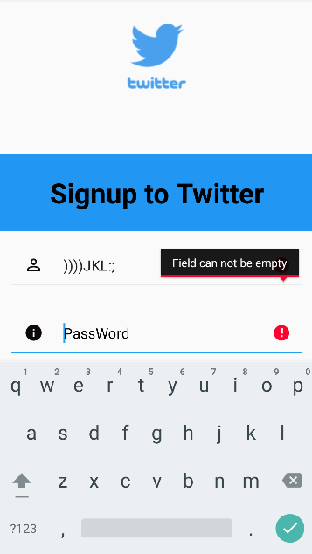
Sign up activity

Slide 14
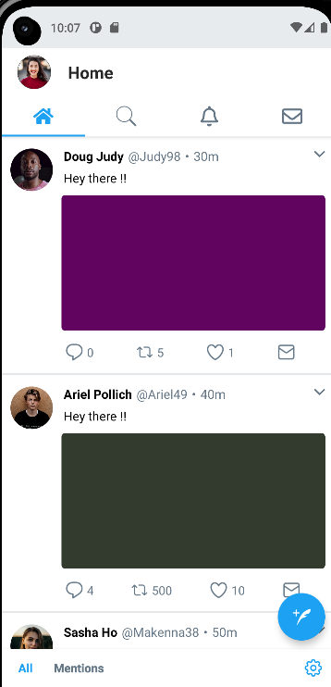
Start App
Read Tweets
Comment, Retweet, Likes, Inbox
Home activity
Notes:
slidesppt.net
‹#›

Slide 15
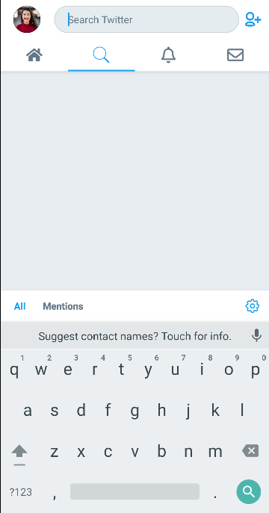
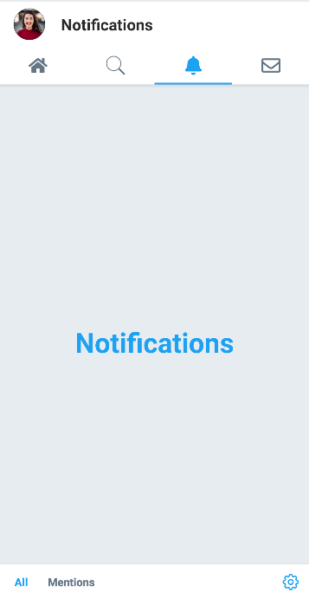
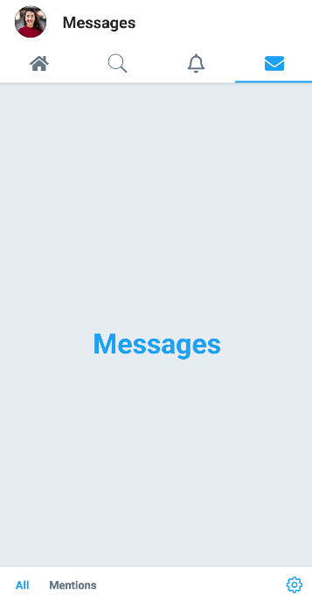
Search
Notif
Message
Notes:
slidesppt.net
‹#›

Slide 16
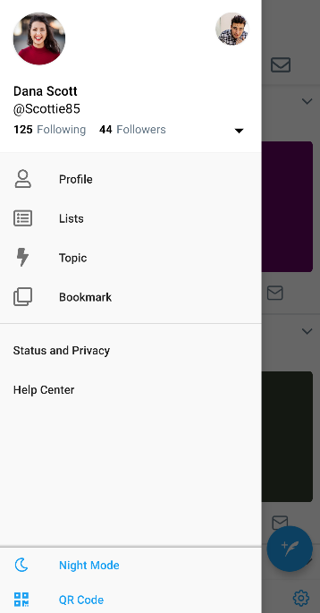
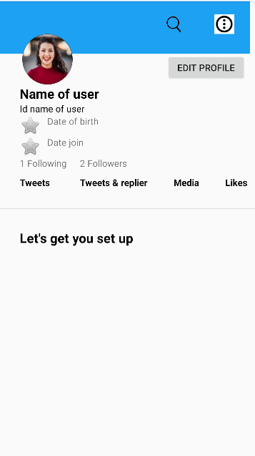
Profile

Slide 17
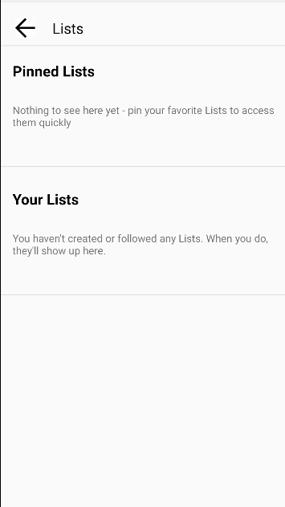
Lists

Slide 18
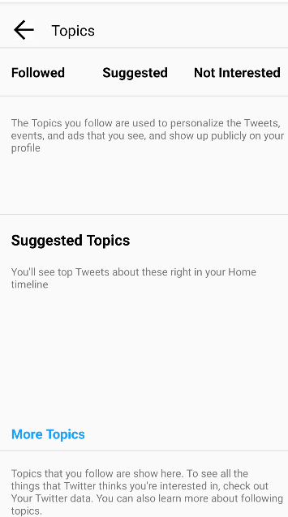
Topics

Slide 19
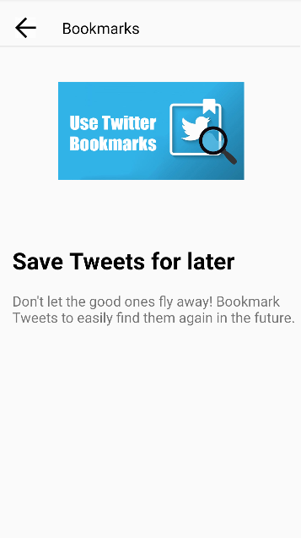
Bookmarks

Slide 20
Optimization

Slide 21
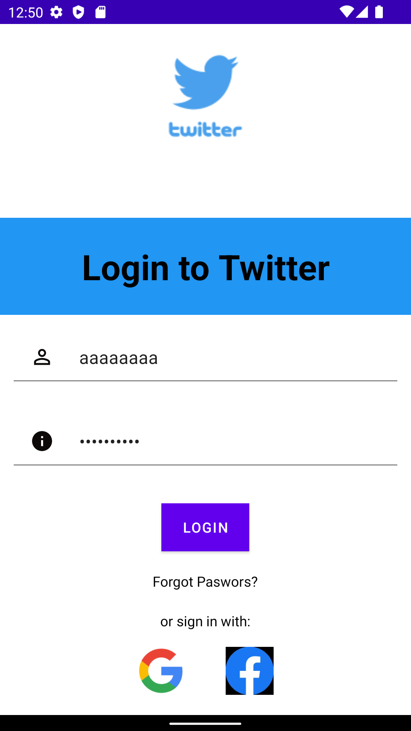
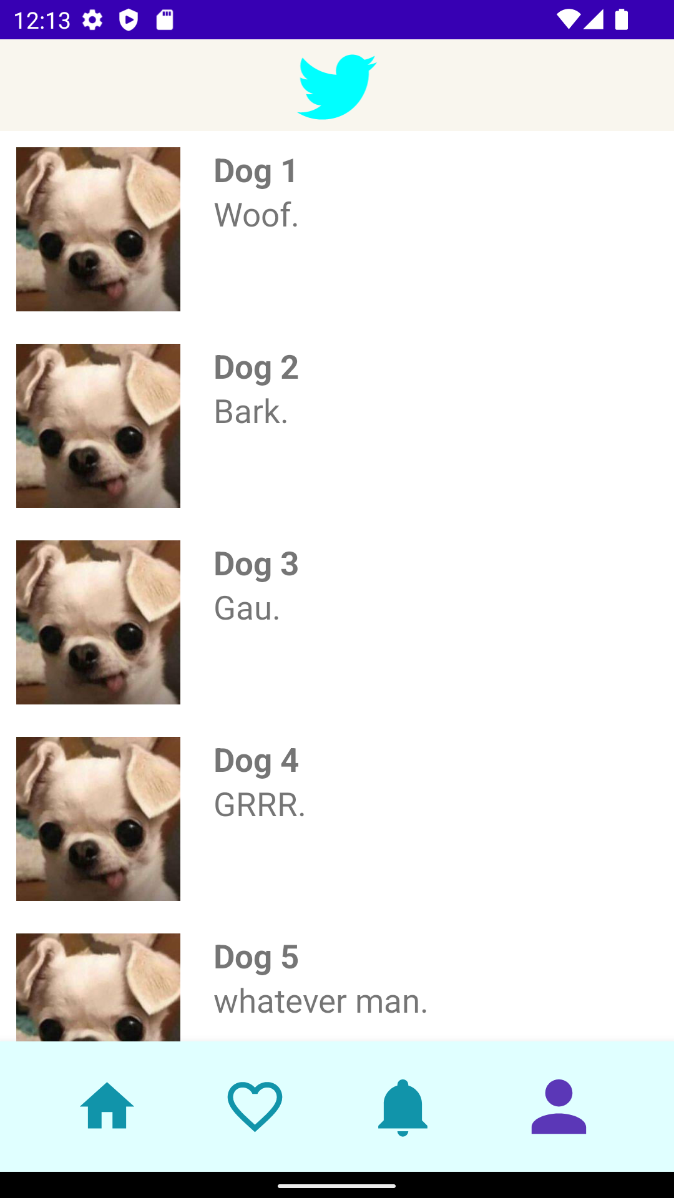
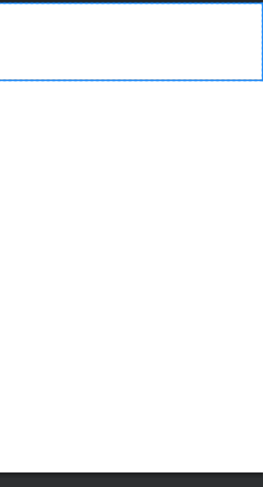
Before

Slide 22
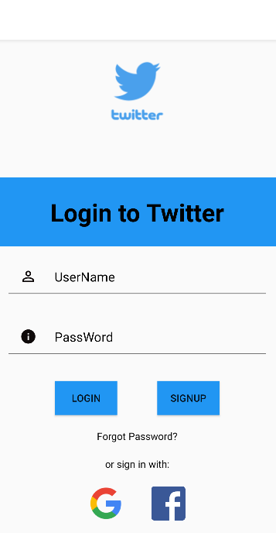
Before
After
Notes:
slidesppt.net
‹#›

Slide 23
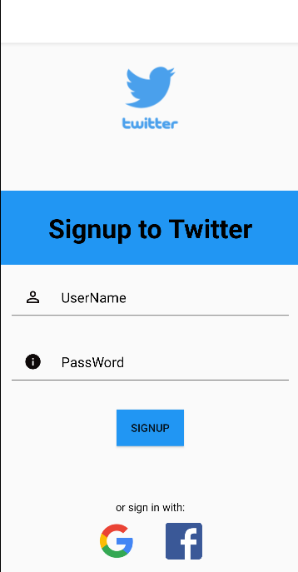
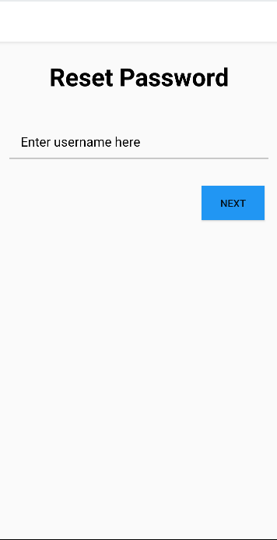
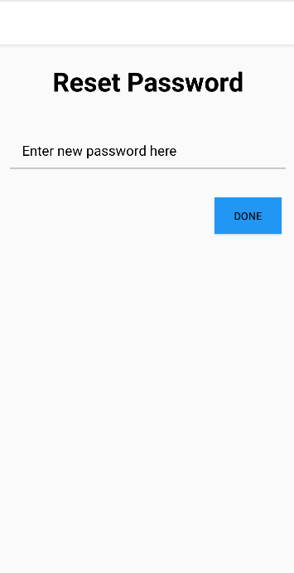
After
Notes:
slidesppt.net
‹#›

Slide 24
Before
After
Notes:
slidesppt.net
‹#›

Slide 25
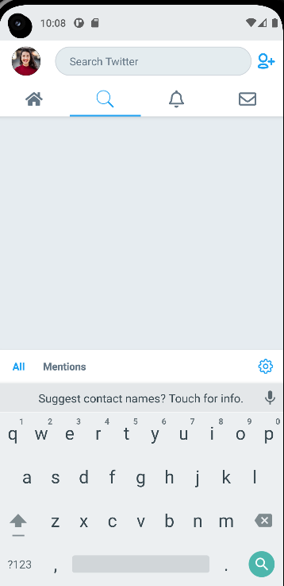

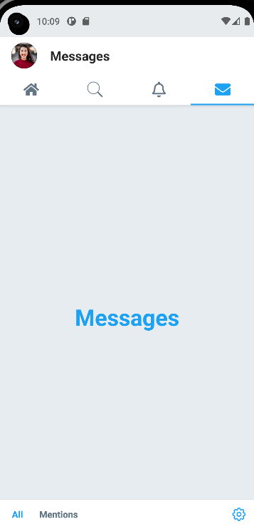
After
Notes:
slidesppt.net
‹#›

Slide 26
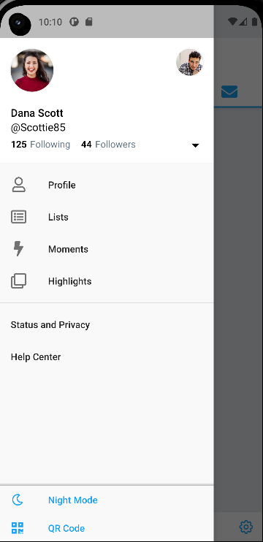
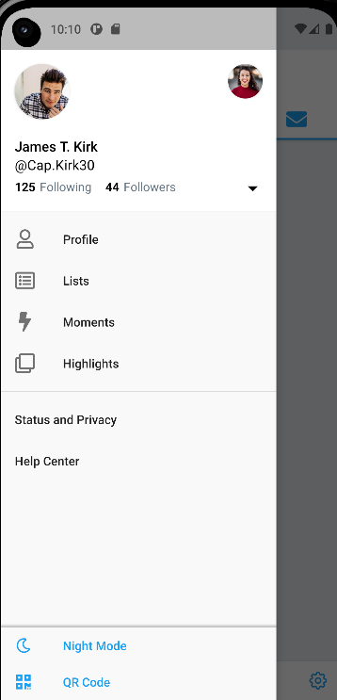
After
Notes:
slidesppt.net
‹#›

Slide 27
# NO5. OPTIMIZATION
Product/Service must be useful and fill a need
$41.09 Billion
Useful
Simple and easy to use
Useable
Desirable
UI design elements that engage and excite users
Valuable
Findable
Accessible
Information need to be findable and easy to navigate
Ensure everyone can navigate a site effectively and digest its content
Credible
Trustworthy products/services
Figure. User Experience Honeycomb
Notes:
slidesppt.net
‹#›

Slide 28
Demo

Slide 29
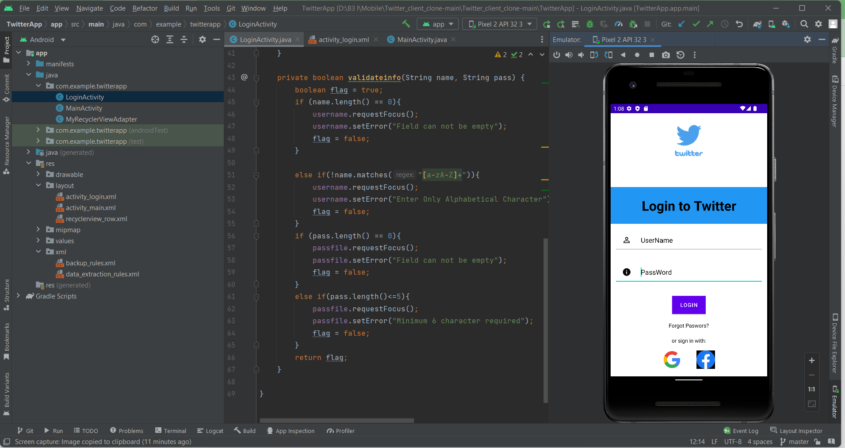
# NO5. DEMO
Notes:
<a href="https://www.freepik.com/free-photos-vectors/menu">Menu vector created by freepik - www.freepik.com</a>

Slide 30
Conclusion

Slide 31
# NO6. CONCLUSION
01
What have we done?
02
What we have not done yet?
Login page:
Login Interface
Singin function
Username/Password Input
Username/Password Validation
Forgot password functionality
Main page:
Top/Bot navigation
Display tweets, reactions
Display user profiles
Create posts
Login page:
Firebase authentication
Main page:
Retweet
Comment
Follow, unfollow
Notes:
<a href="https://www.freepik.com/free-photos-vectors/business">Business vector created by pikisuperstar - www.freepik.com</a>

Slide 32
# NO6. CONCLUSION
03
Possible future development
Age limitation for account
Edit user profile
API connection
Notes:
<a href="https://www.freepik.com/free-photos-vectors/business">Business vector created by pikisuperstar - www.freepik.com</a>

Slide 33

Home
Thank you, do you have any questions?
Everyone can reply. Please do not resell.
TWEET

