Slide 1



Twitter
Client
Group 3
Notes:
<a href="https://www.freepik.com/free-photos-vectors/business">Business vector created by pikisuperstar - www.freepik.com</a>

Slide 2
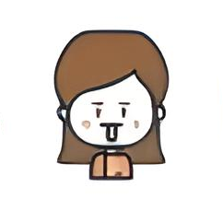
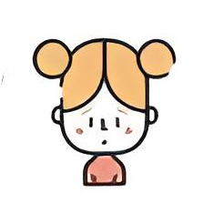
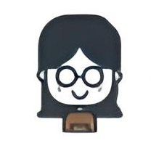

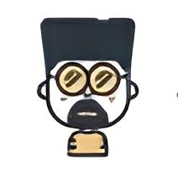
Team Work
Nguyen Thi Quynh Anh
Nguyen Thi Khanh Huyen
Vu Yen Linh
Le Tran Khuong Duy
Vi Van Hieu
Notes:
<a href="https://www.freepik.com/free-photos-vectors/business">Business vector created by pikisuperstar - www.freepik.com</a>

Slide 3

Content of tables
Group 3
Tweets
5
Following
1000
Followers
82.523.966
Trends For You
# No1. Introduction
# No2. Architecture
# No3. Activities
# No4. Demo
# No5. Conclusion

Slide 4

# NO1. INTRODUCTION
Overview
Twitter is an open social network that people use to converse with each other in short messages, known as tweets. People are using it to share their news, updates and follow their favourite celebrities.
2. About mobile app
Users are able to read, post, retweet and share different types of content straight from their phone. Twitter users can also discover the latest happenings anywhere from their mobile device.

Slide 5
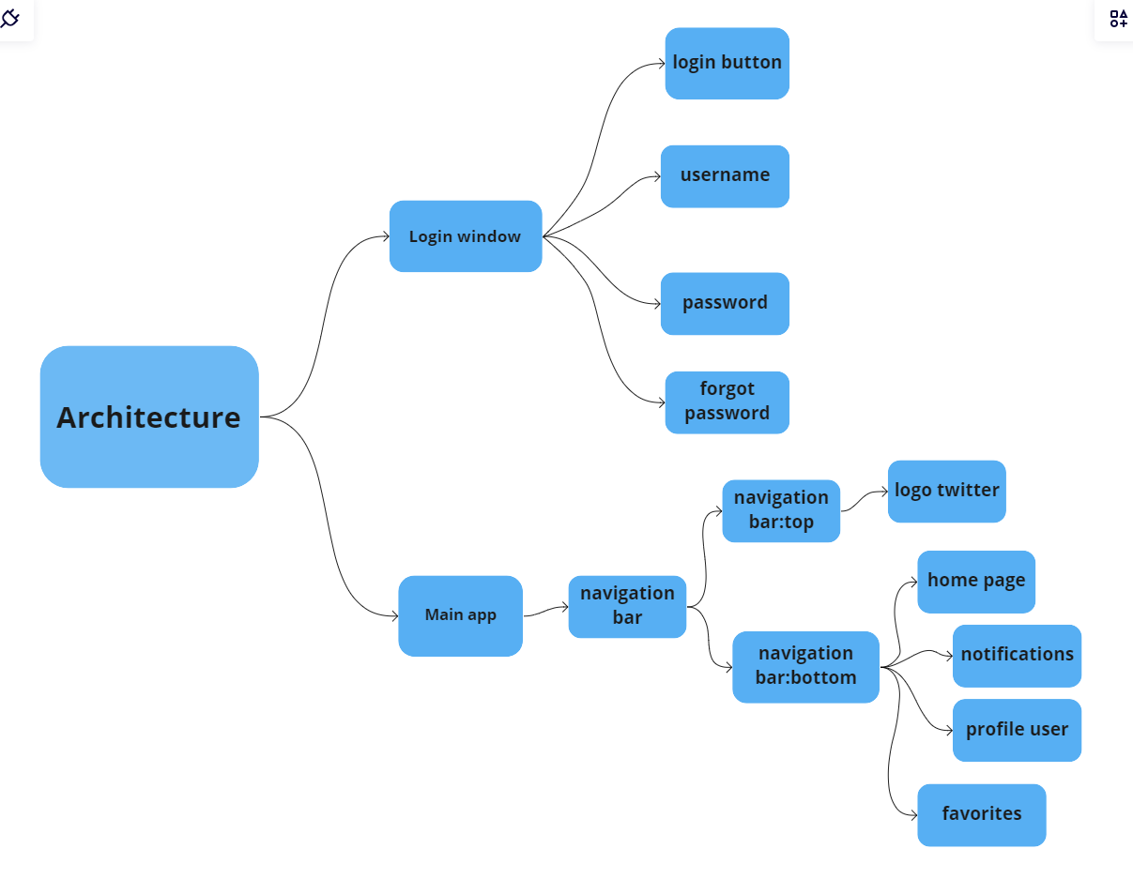
# NO2. ARCHITECTURE
Notes:
<a href="https://www.freepik.com/free-photos-vectors/background">Background vector created by freepik - www.freepik.com</a>

Slide 6
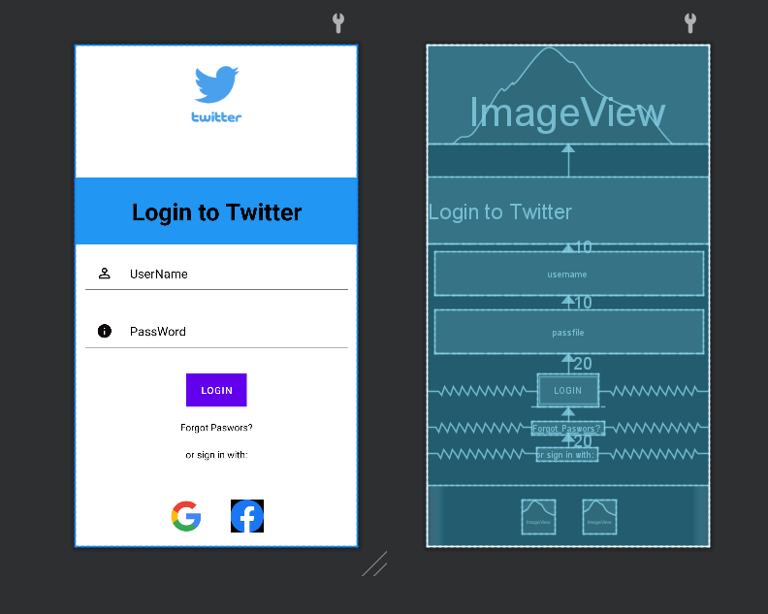
# NO2. ARCHITECTURE
Notes:
<a href="https://www.freepik.com/free-photos-vectors/background">Background vector created by freepik - www.freepik.com</a>

Slide 7
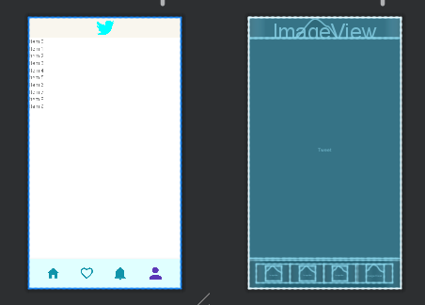
# NO2. ARCHITECTURE
Notes:
<a href="https://www.freepik.com/free-photos-vectors/background">Background vector created by freepik - www.freepik.com</a>

Slide 8
# NO2. ARCHITECTURE
Notes:
<a href="https://www.freepik.com/free-photos-vectors/background">Background vector created by freepik - www.freepik.com</a>

Slide 9
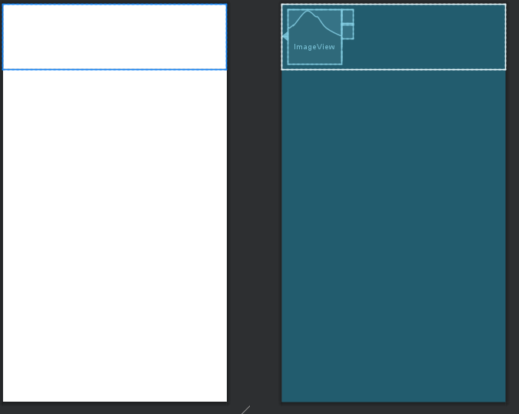
# NO2. ARCHITECTURE
Notes:
<a href="https://www.freepik.com/free-photos-vectors/background">Background vector created by freepik - www.freepik.com</a>

Slide 10
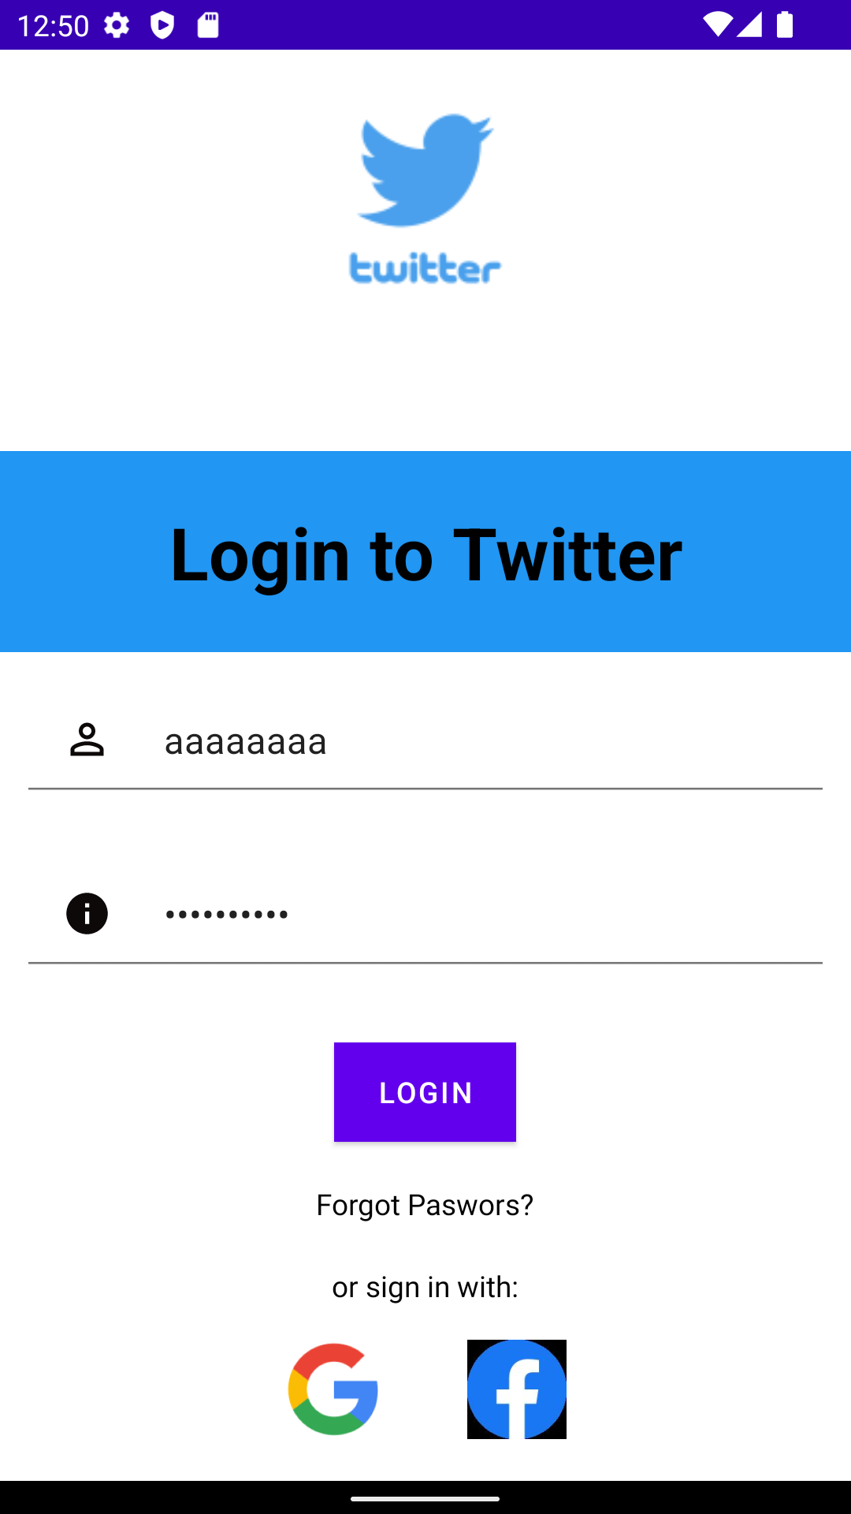
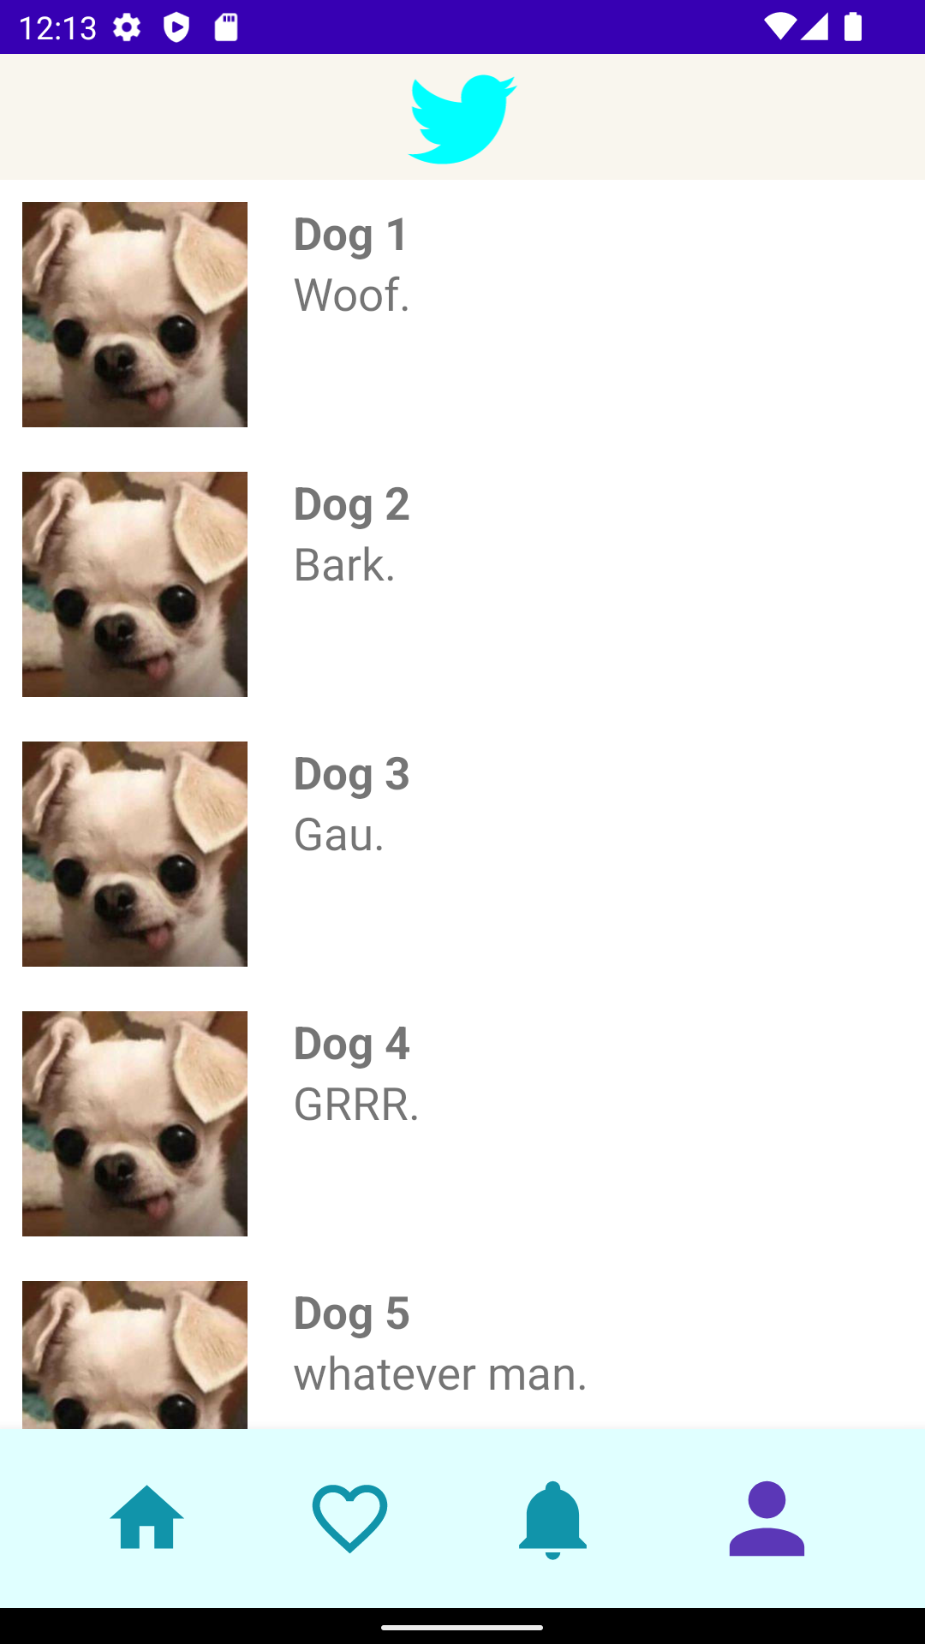
# NO3. ACTIVITIES
Currently 2
main screens
Notes:
<a href="https://www.freepik.com/free-photos-vectors/background">Background vector created by freepik - www.freepik.com</a>

Slide 11
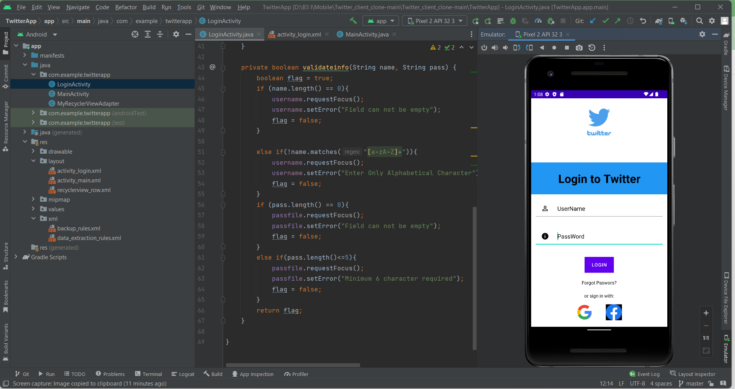
# NO4. DEMO
Notes:
<a href="https://www.freepik.com/free-photos-vectors/menu">Menu vector created by freepik - www.freepik.com</a>

Slide 12
# NO5. CONCLUSION
01
What have we done?
02
What we have not done yet?
Login screen:
Login Interface
Username/Password Input
Username/Password Validation
Login button with activity
Main screen:
Top/Bot navigation
Login screen:
Singin function
Forgot passwords function
Login by Facebook/Google account
Main screen:
Post, retweet, share contents
Comment, like
Display user profile
Follow, unfollow
Notes:
<a href="https://www.freepik.com/free-photos-vectors/business">Business vector created by pikisuperstar - www.freepik.com</a>

Slide 13
# NO5. CONCLUSION
03
Possible future development
Age limitation for account
Edit user profile
API connection
Notes:
<a href="https://www.freepik.com/free-photos-vectors/business">Business vector created by pikisuperstar - www.freepik.com</a>

Slide 14
THANK YOU

Slide 15
THANK YOU
ANY QUESTIONS?

