Slide 1

Library Management System
GROUP 6
Contributors
Van Duy Nguyen
Van Nhat Le
Ngoc Thinh Le
Hana Aga

Slide 2
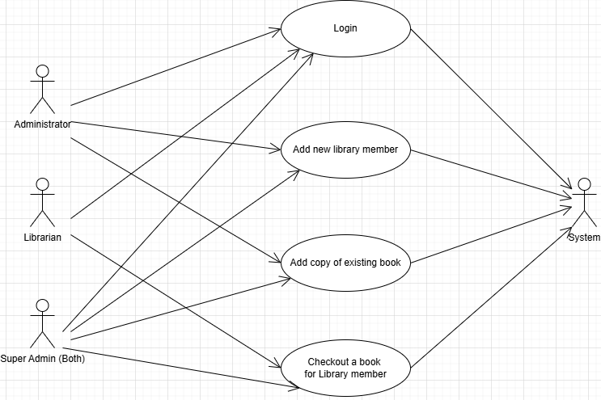
Library System ---------- Use Case Diagram

Slide 3
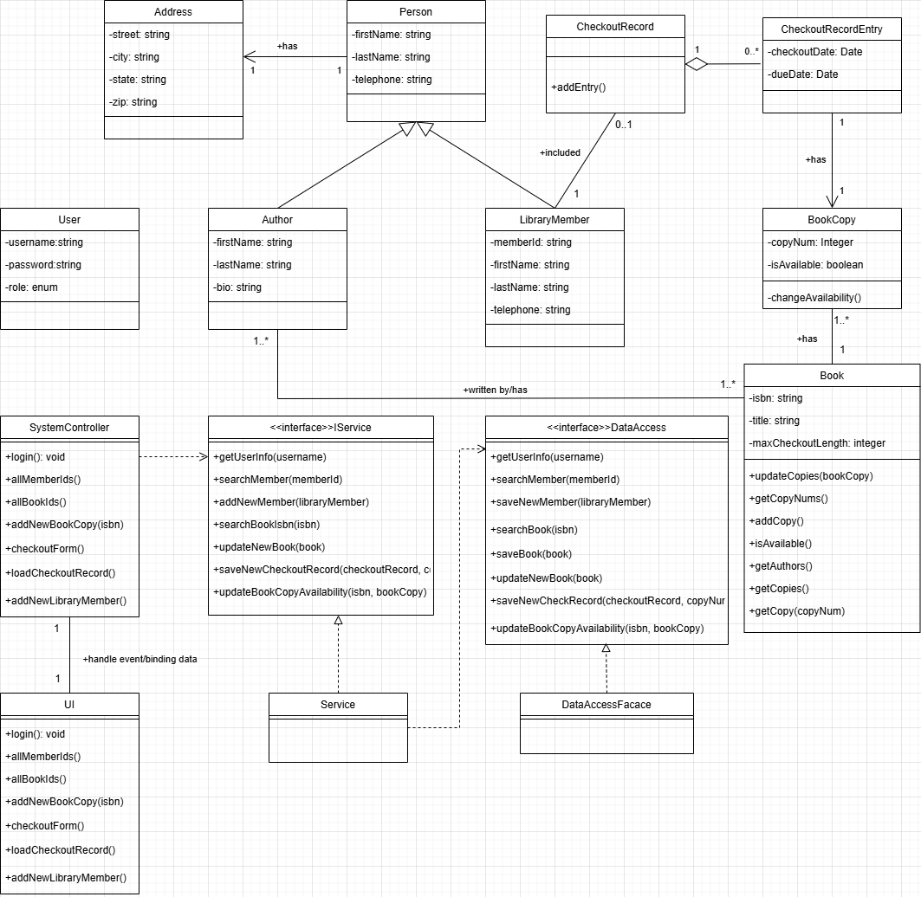
Library System ---------- Class Diagram

Slide 4
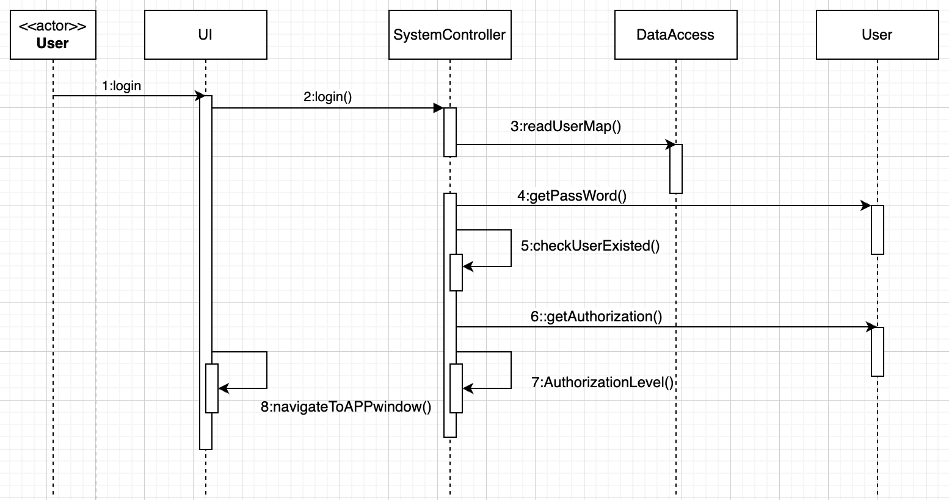
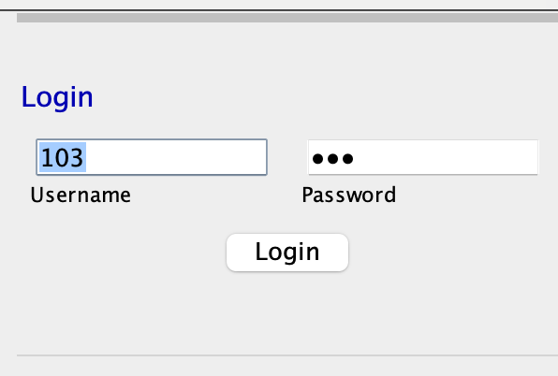
Login – Sequence Diagram

Slide 5
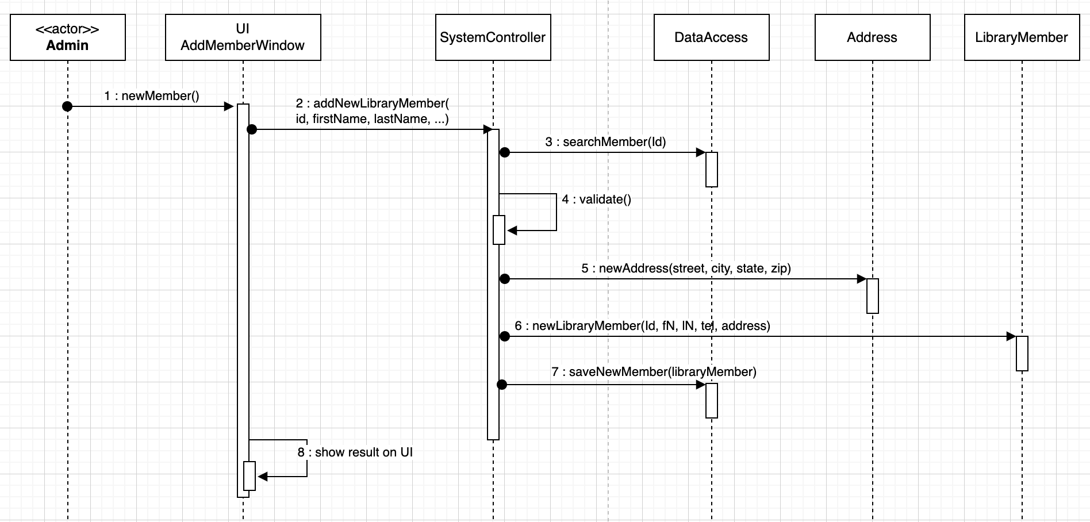
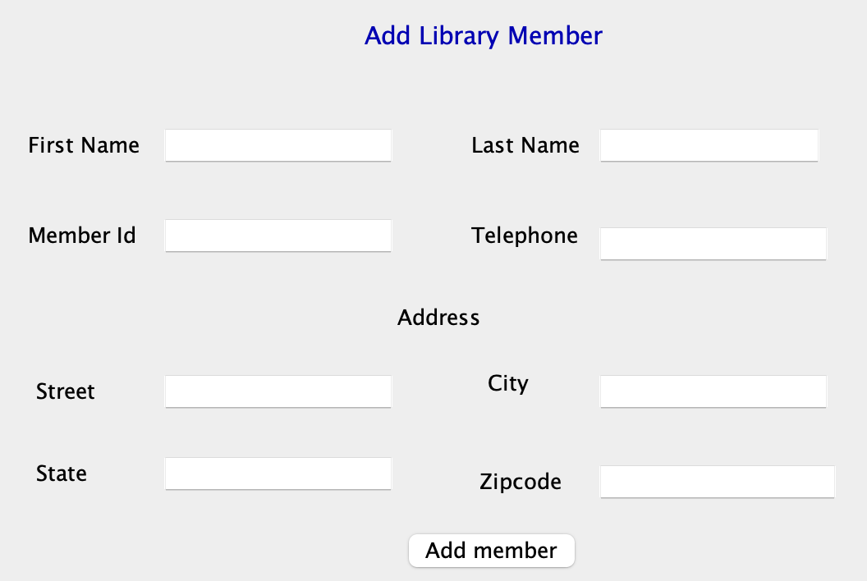
Add New Member – Sequence Diagram

Slide 6
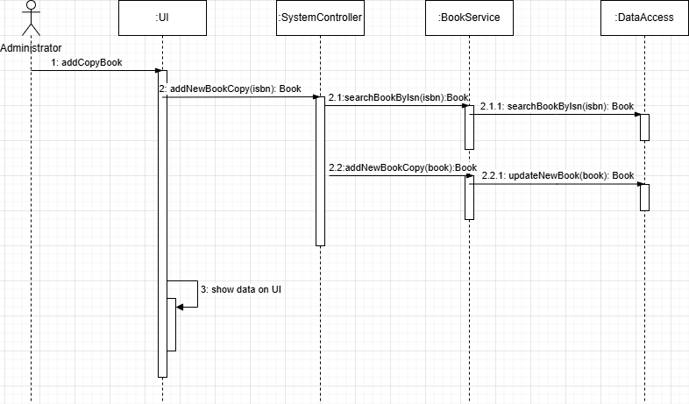
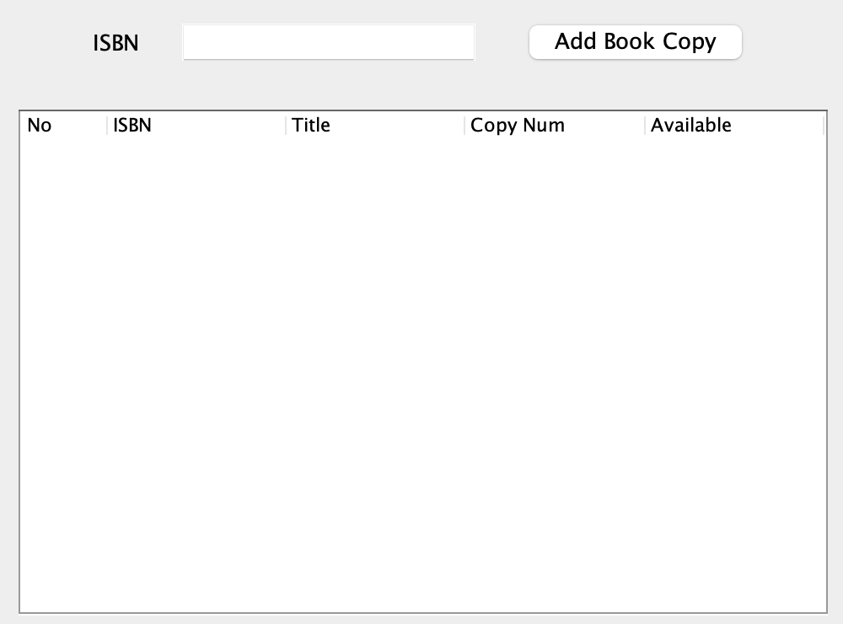
Add Book Copy – Sequence Diagram

Slide 7
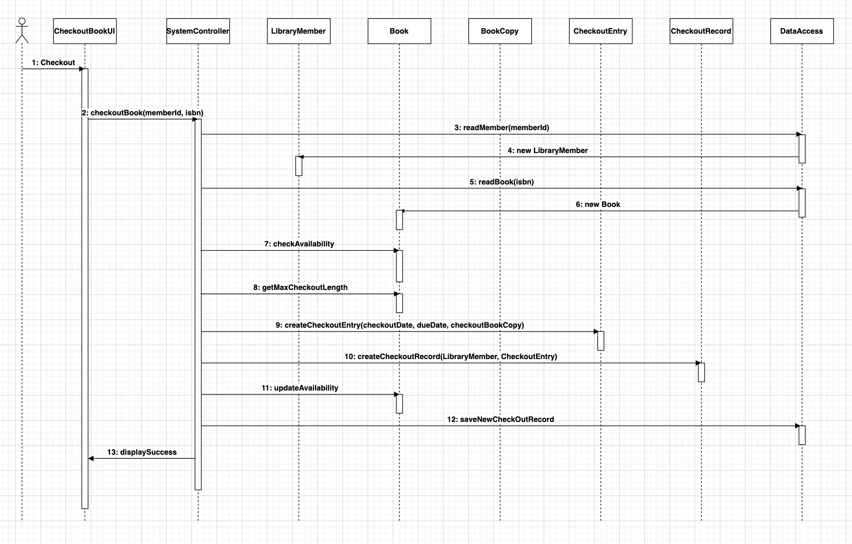
Checkout Book – Sequence Diagram

Slide 8
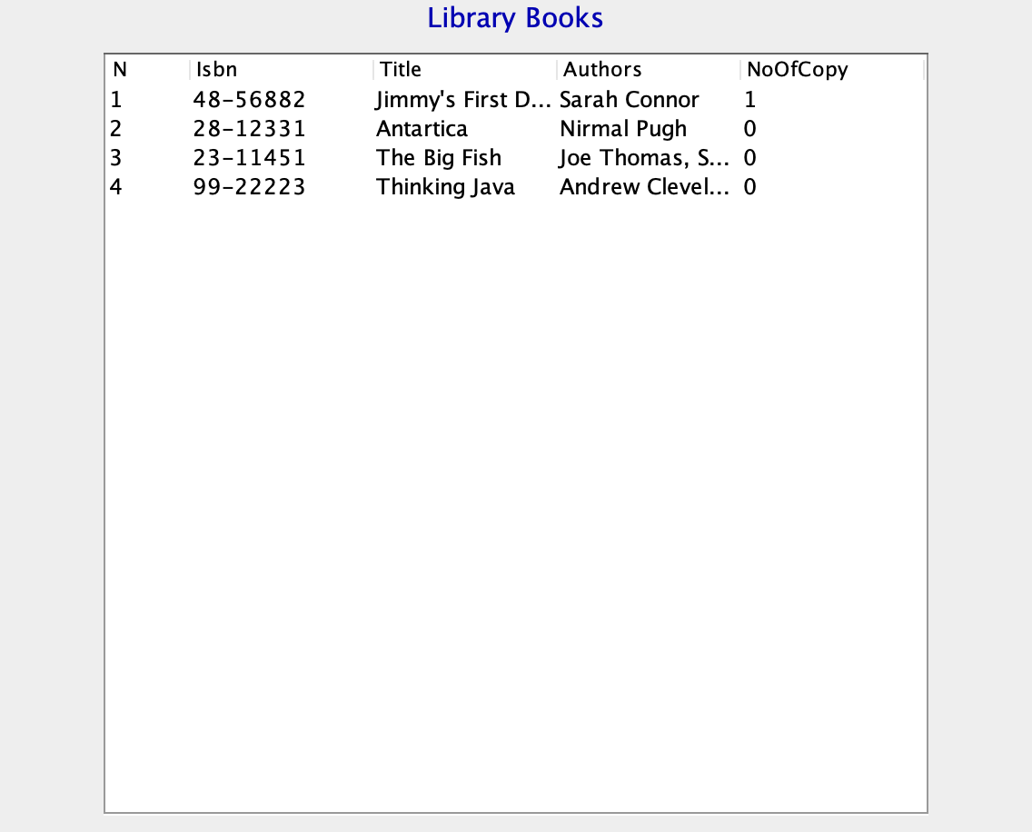
Extra feature - Load All Books

Slide 9


