Slide 1
DSP305x FINAL PROJECT REPORT

Slide 2
Content
Business Understanding
Data Understanding
Exploratory Data Analysis
Data preprocessing
Solution approach
Modelling and Evaluation

Slide 3
Business Understanding

Slide 4
Business Understanding
Problem : The client wants you to help food centers with demand forecasting for upcoming weeks so that these centers will plan the stock of raw materials accordingly.This is a regression problem with the input is the information related to order and the output is the number of orders
Goal : Provide insights for client that will help them to plan the stock of raw materials
Objective : Forecast precisely the number or orders in the next coming week
Criteria for a successful outcome : Precision of algorithm and the amount of useful insights

Slide 5
Data Understanding

Slide 6
Data Understanding
There are four datasets and two of them are train set and test set while the rest of datasets are center and meal info
Train set has 9 fields and 423611 rows : 7 numeric cols and 2 one hot cols
Test set has the same fields as train set but without num_orders and 32573 rows
Fulfilment_center_info has 5 fields and 77 rows : 4 numeric and 1 categorical cols
meal_info has 3 fields and 51 rows : 1 numeric and 2 categorical cols

Slide 7
Data Understanding
The input features of train set : checkout_price,base_price,week and so on
The input features of meal set : category,meal_id
The input features of center set : center_id , cuisine, operation area ,center_type
The output of the problem : num_orders

Slide 8
Exploratory Data Analysis

Slide 9
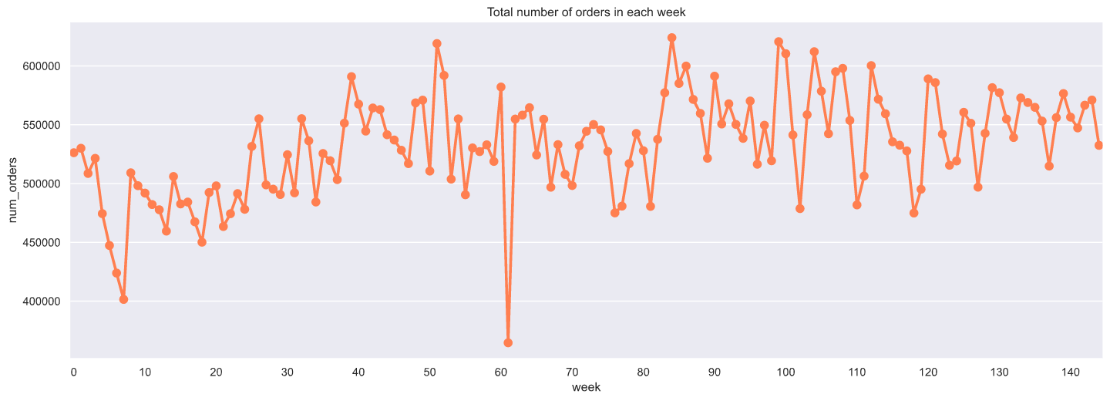
Total Order
Looking at the chart, the total order in each week seems to indicate that weeks in the last quarter of the year have the highest orders during the whole year.
Week 18 and 61 witnessed a dramatic dump in the number of orders

Slide 10
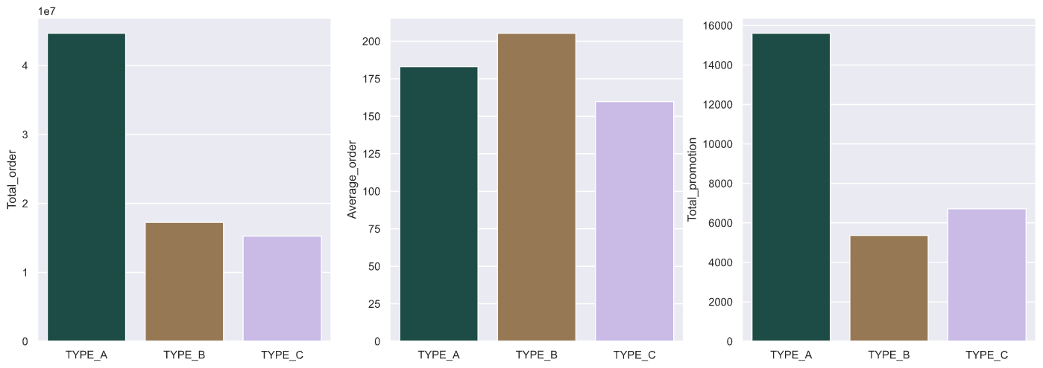
Business analysis
Center A achieved the largest number of bills at 244023
This is due to the fact that center A has more centers than B and C
Due to the stats from Total_homepage_featured we can denote that homepage_featured stimulates customers to order more in each bill. As a result, total_order of B is bigger than that of C

Slide 11
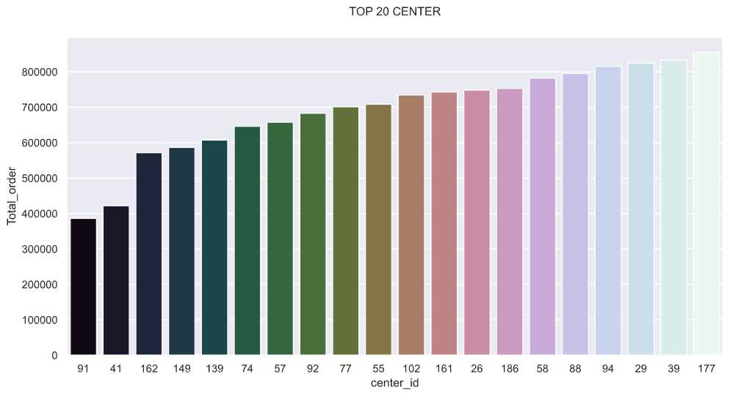
Business analysis
In 20 centers, center A got 7 and center B only owned 1 while center C accounted for the highest number of centers at 12
This is due to the fact that center A has more centers than B and C
This indicator could somehow prove that center C operates efficiently than others

Slide 12
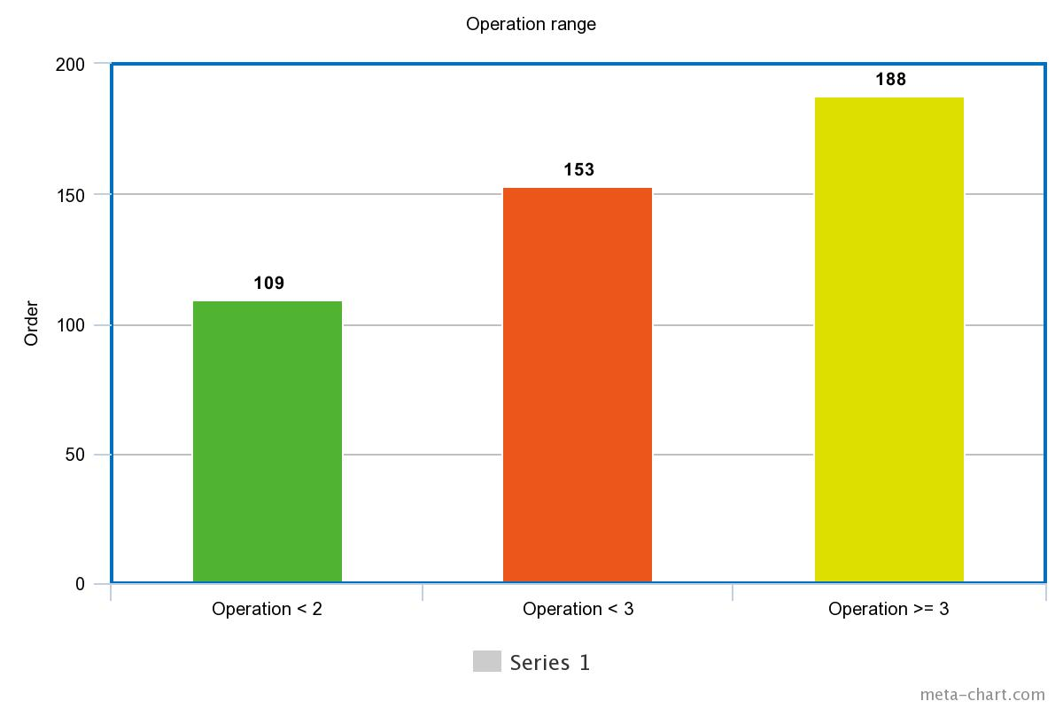
Strategy analysis
HomePage featuring : The average order when having featuring was higher than having none at 96 orders.Thus, food featuring is effective for business
Promotion : The average order when having promotion was higher than having none at 98 orders. As a result, promotion is efficient for stimulating customers to order more
Operation area : As we can see, the number of avg order increases as the operation area increases so that this factor is also effective for business

Slide 13
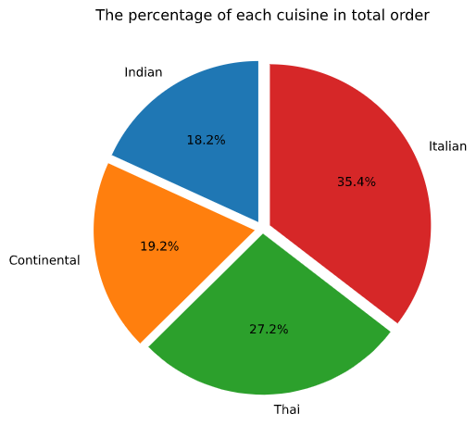
Cuisine
Italian food was the most popular among other cuisines with the highest total order and average order in each bill

Slide 14
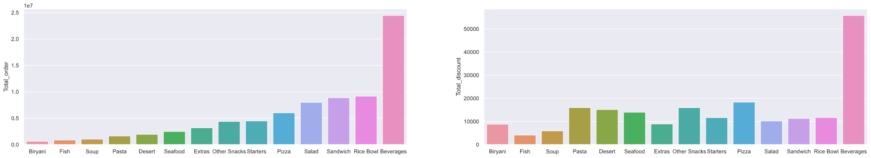
Category
Beverages were predominantly the most favorite category of meal for customers but Rice Bowl seemed to get higher orders in each bill
Simultaneously,Beverages accounted for the highest number of promotion

Slide 15
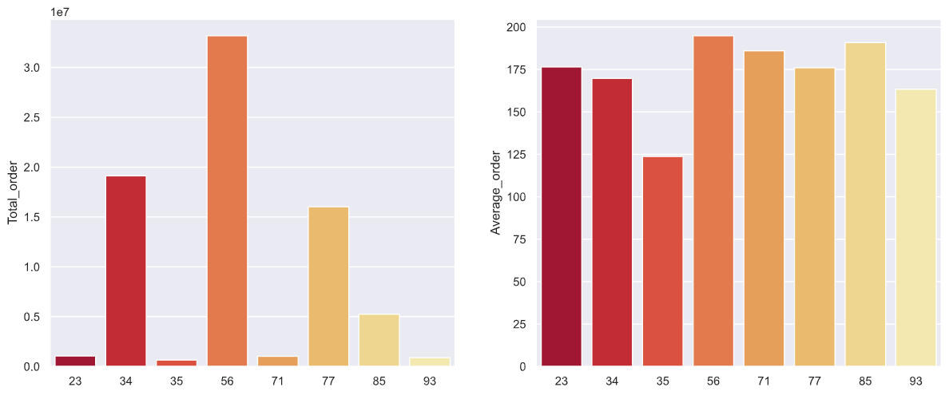
Region
Region 56 seems to consume the highest amount of food in all 8 regions with highest total order and average order at 33177147 and 195 orders

Slide 16
Data preprocessing

Slide 17
Data preprocessing
Looking at the summary statistics, the difference between the mean and median value of num_orders is quite large,thus there might be some outliers
Remove outliers and Na values out of dataset
One hot encoding and label encoding for categorical features
Generating new features for dataset such as : Quarter,discount percentage,binary classification
Applying standardization for training features and log transformation for label features( because it has left-skewed distribution)
After transformation , dataset has 228 training features with 1 ground truth feature which includes 7 numeric, 13 categorical and the rest of features are one hot features
Notes:
plot xem distribution
log trans

Slide 18
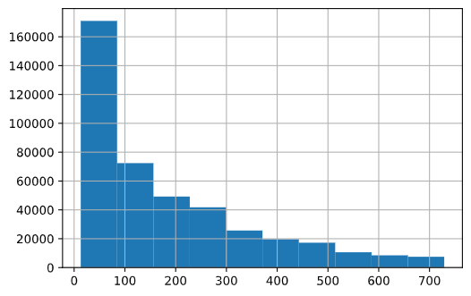
Distribution
Only the output feature has the left-skewed distribution so that log transformation is applied to make it become more balanced

Slide 19
Solution approach

Slide 20
Solution Approach
In this project,I will use two popular algorithms which are LightGBM and XGboosting to implement forecasting and then compare to each other for selecting SOTA
LightGBM : this is a tree-based algorithm like CART but unlike traditional tree-based algorithm,it uses leaf-wise(best-first) for growing instead of level-wise(depth-first).Leaf-wise totally outperforms the traditional one due to its smart operation,which only choose node with max delta loss to split.As a result,this algorithm will make the model converge faster and more efficient.
XGboosting : extreme gradient boosting helps to accelerate the convergence of the objective function,thus simultaneously boost the speed of ensemble algorithm and so does the accuracy
Notes:
dung GD

Slide 21
Modelling and evaluation

Slide 22
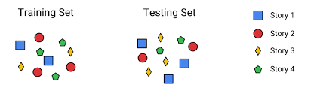
Data splitting
The datasets have already splitted train and test set so that we only need to split train set into train and validation set with validation size equals to 0.2 for tuning

Slide 23
Evaluation measurement
Metrics for evaluation : R2 and RMSE
R2 score : how well the regression model fits the observed data.For example, a r-squared of 60% reveals that 60% of the data fit the regression model
RMSE : similar to mse using residuals to compute but at this metrics,square root is used to compute the standard deviation of residuals

Slide 24
Experiment
Parameters for tuning in each algorithm :
LightGBM : boosting_type,objective,max_depth,num_leaves,feature_fraction,min_data_in_leaf,metrics
XGboosting : max_depth,learning_rate,objective,eval_metrics
Feature selection : Using ANOVA to take the best 150 out of 229 features
Notes:
them table

Slide 25
Experiment
LightGBM
max_depth | learning rate | num leaves | feature fraction | min data in leaf | bagging fraction | r2_val
9 | 0.5 | 60 | 0.8 | 100 | 0.3 | 0.784
7 | 0.6 | 65 | 0.5 | 70 | 0.4 | 0.782
10 | 0.4 | 80 | 0.6 | 80 | 0.8 | 0.783
12 | 0.7 | 120 | 0.5 | 64 | 0.6 | 0.781
8 | 0.6 | 110 | 0.5 | 80 | 0.5 | 0.783

Slide 26
Experiment
XGBoosting
max_depth | learning rate | eta | gamma | max_delta_step | r2_val
8 | 0.6 | 0.3 | 0.1 | 1 | 0.8
9 | 0.4 | 0.5 | 0.5 | 2 | 0.792
10 | 0.5 | 0.8 | 0.9 | 2 | 0.796
11 | 0.7 | 0.9 | 1 | 1 | 0.797

Slide 27
Evaluation result before improvement
LightGBM :
+ R2_validation : 0.733
+ RMSE_validation : 0.65
Xgboosting :
+ R2_validation : 0.75
+ RMSE_validation : 0.6

Slide 28
Evaluation result after improvement
LightGBM :
+ R2_validation : 0.784
+ RMSE_validation : 0.508
+ RMSE_test : 0.572
Xgboosting :
+ R2_validation : 0.8
+ RMSE_validation : 0.502
+ RMSE_test : 0.566

Slide 29
Conclusion
XGboosting has higher accuracy in the test set than LightGBM after fine-tuning for both algorithms.
As a result,XGBoosting will be chosen for this regression problem

