Slide 1
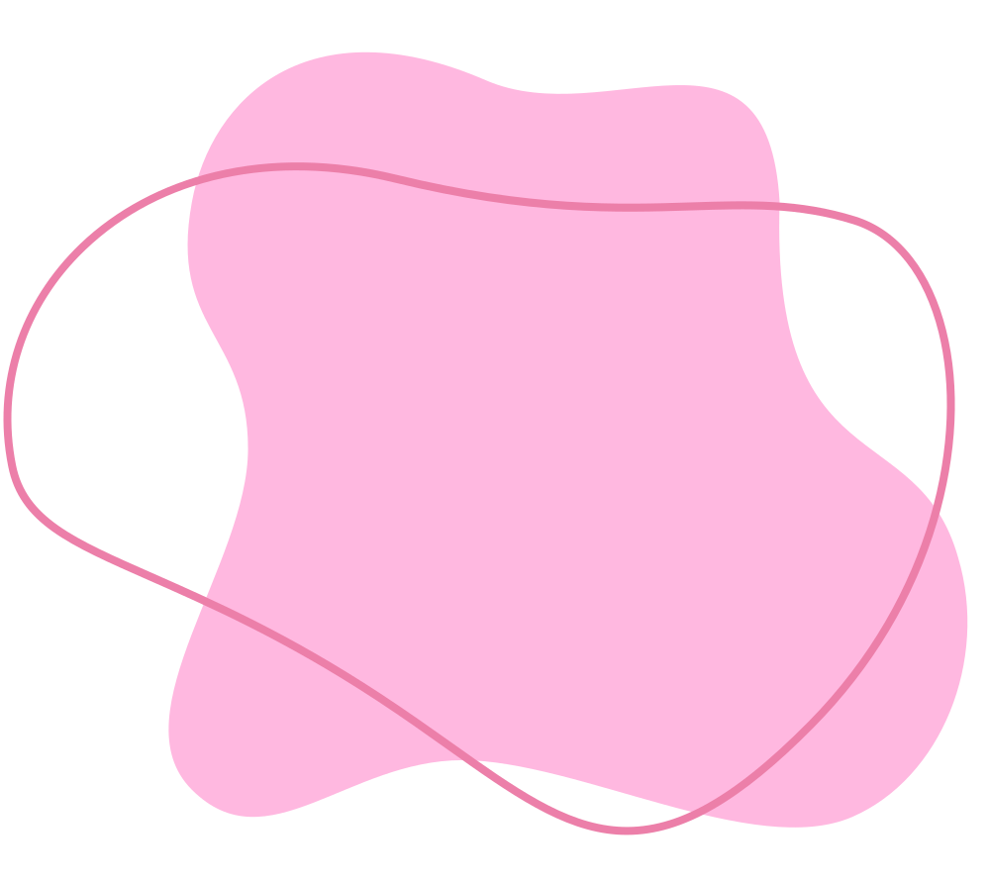





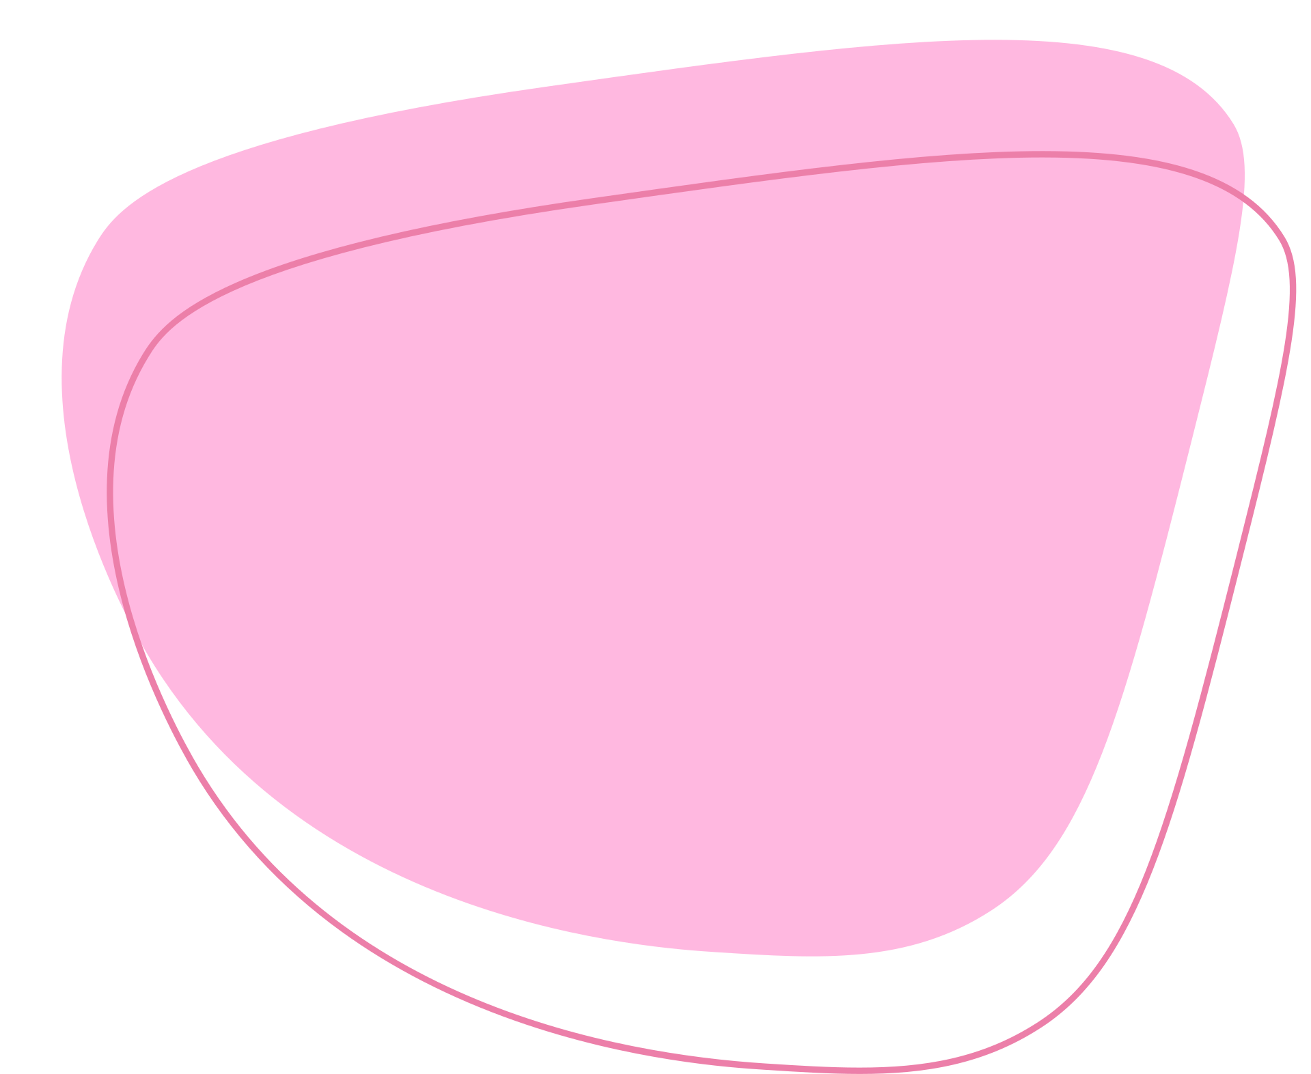
AI FASHION ASSISTANT
prepared by Duygu Gücüyetmez

Slide 2




PROJECT GOALS
Giving a place for the users where they can see different brands clothes pieces. They can scan a product item and find smilar products.
They can track the stock or discount of products so they can buy the product in their desired price and before it out of stock.
A place where they can share their outfit style and see other people’s outfit sharings. So they can get inspiration. If they like a product they can just scan the product image and found outfits that build with this product or similar .

Slide 3
Technologies
Frontend:
The user interface of this project designed with React and styled with CSS.
Backend:
The backend developed with node.js. It manages data exchange between frontend and database with the help of routes.
Database:
It’s maded with MySQL.
AI:
1. NSFW
2. MediaPipe Pose
3. CLIP with the help of FAISS embedding search engine
Zara API by Apify

Slide 4
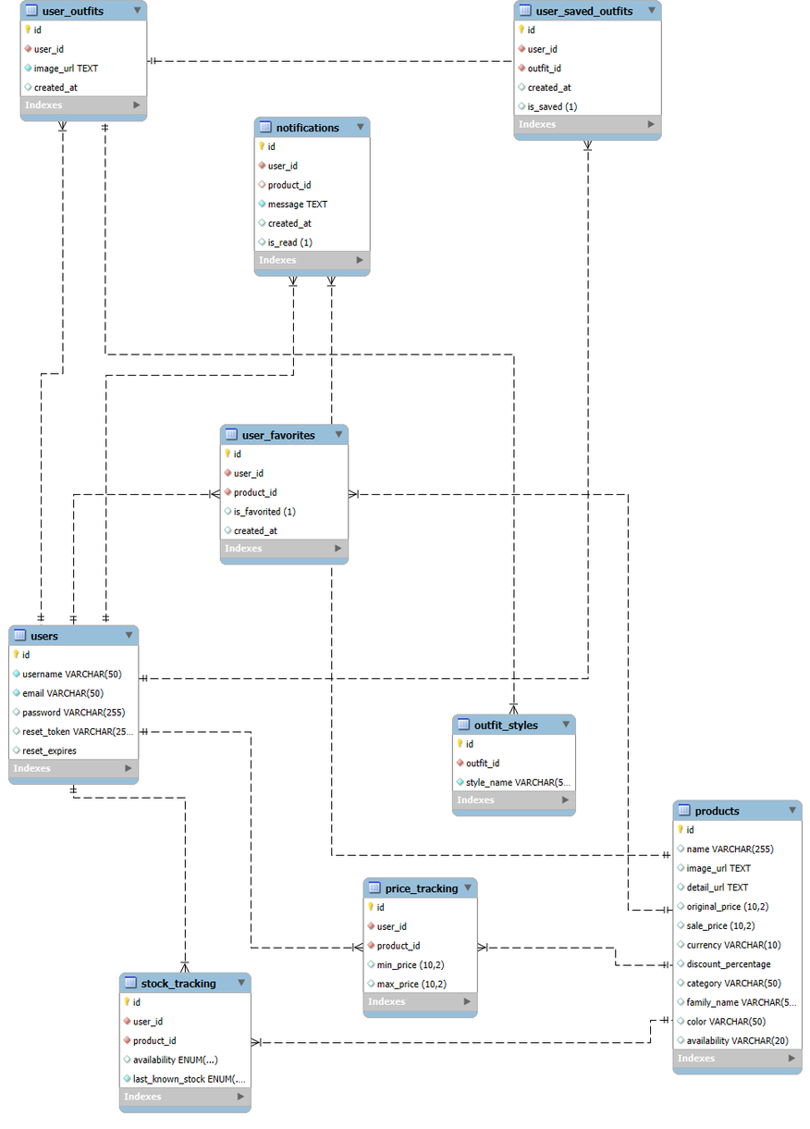
ER
DIAGRAM

Slide 5
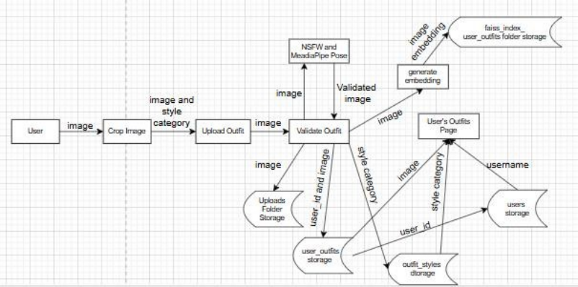
DFD OF UPLOADİNG AN OUTFİT

Slide 6
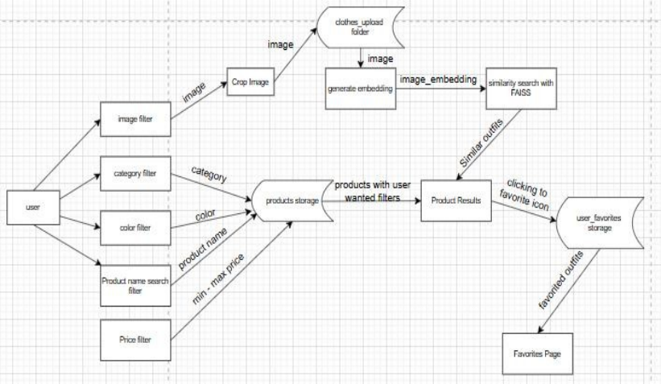
DFD OF USING FILTERS AND ADDING INTO FAVORITES IN FIND CLOTHES PAGE

Slide 7

THANK YOU

